Slide 1
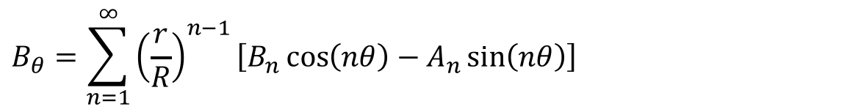






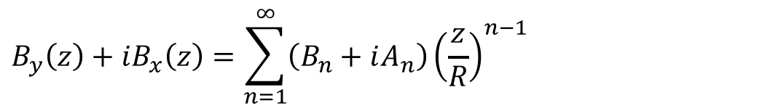

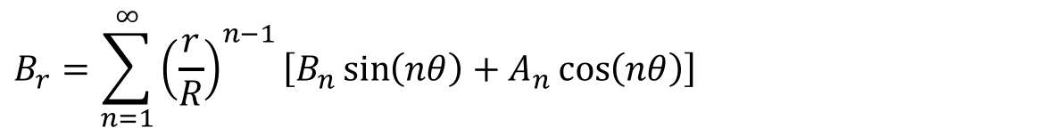
In synchrotrons / transfer lines the B field as seen from the beam is usually expressed as a series of multipoles
$$y$$
$$B_{r}=\sum_{n=1}^{∞}{{\left(\frac{r}{R}\right)}^{n−1}\left[B_{n}\sin\left(nθ\right)+A_{n}\cos\left(nθ\right)\right]}$$
$$B_{θ}$$
$$B_{r}$$
$$r$$
$$B_{θ}=\sum_{n=1}^{∞}{{\left(\frac{r}{R}\right)}^{n−1}\left[B_{n}\cos\left(nθ\right)−A_{n}\sin\left(nθ\right)\right]}$$
$$θ$$
$$x$$
$$B_{y}\left(z\right)+iB_{x}\left(z\right)=\sum_{n=1}^{∞}{\left(B_{n}+iA_{n}\right){\left(\frac{z}{R}\right)}^{n−1}}$$
$$z=x+iy=re^{iθ}$$

Slide 2
Usually, for optics calculation, the field or multipole component is given, together with the (magnetic) length; these are a few definitions from MAD-X
Dipole
bend angle α [rad] & length L [m]
k₀ [1/m] & length L [m] obsolete
k₀ = B / (Bρ) B = B₁
Quadrupole
quadrupole coefficient k₁ [1/m²] × length L [m]
k₁ = (dB_{y}/dx) / (Bρ)
G = dB_{y}/dx = B₂/R
Sextupole
sextupole coefficient k₂ [1/m³] × length L [m]
k₂ = (d²B_{y}/dx²) / (Bρ)
(d²B_{y}/dx²)/2! = B₃/R²
Notes:
In a lattice code, usually magnetic elements are described as a uniform dipole / quadrupole / sextupole (or other) field times a magnetic length. The product of the 2D field (or gradient) times the length is the integrated strength.
In many cases, the quadrupoles and sextupoles can be considered as thin lenses, so basically only the integrated strengths matters.
MAD-X normalizes the coefficients by dividing by the beam rigidity Bρ. The length definitions for an SBEND (sector bending magnet) and an RBEND (rectangular bending magnet) can be found in the MAD-X documentation.
For quadrupole, sextupole and higher order magnets, to avoid ambiguity it is good to quote the pole tip field, or the field at the reference radius. The pole tip field is
quadrupole: B_{pole} = G*r = B₂*(r/R)
sextupole: B_{pole} = B₃ *(r/R)²
where r is the radius at the pole tip, and R the reference radius for the harmonics. In a dipole, B_{pole} = B, since the field is uniform.
Note: for MAD-X, B₀ is a dipole, B₁ is a quadrupole, B₂ is a sextupole, etc.

Slide 3
BEAM, PARTICLE=ELECTRON,PC=3.0;
DEGREE:=PI/180.0;
QF: QUADRUPOLE,L=0.5,K1=0.2;
QD: QUADRUPOLE,L=1.0,K1=-0.2;
B: SBEND,L=1.0,ANGLE=15.0*DEGREE;
(Bρ) = 10⁹/c*PC = 10^9/299792485*3.0 = 10.01 Tm
dipole (SBEND)
B = |ANGLE|/L*(Bρ) = (15*pi/180)/1.0*10.01 = 2.62 T
quadrupole
G = |K1|*(Bρ) = 0.2*10.01 = 2.00 T/m
Notes:
The BEAM command has several possible entries. In this case, PC is specified, which is the particle momentum times the speed of light, in GeV. The CHARGE is not specified, so the program assumes the default of 1 proton charge. Then the beam rigidity can be computed as
BRHO = PC / ( |CHARGE| * c * 1.e-9)
For an SBEND, the declared length is the arc length of the reference orbit, so the dipole magnetic field is computed as shown; by the way, 2.62 T is rather an uncommon value for the field.
For an RBEND, some trigonometry is needed as (normally) the length is taken along a straight line joining the entry and exit point, so in that case
B = 2/L*sin(|ANGLE|/2)*(Bρ).
The gradient of a quadrupole per se does not mean much: what matters is gradient and aperture. In this case, for example, if we had a 100 mm bore diameter, then we would have 0.1 T ( = 2.0*0.050) as B_{pole}. This is relatively low also for resistive magnets, so maybe the possibility of getting the same integrated field with a shorter though stronger magnet could be envisaged.

Slide 4
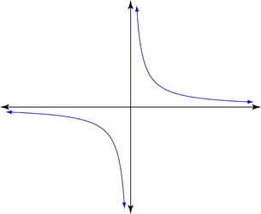



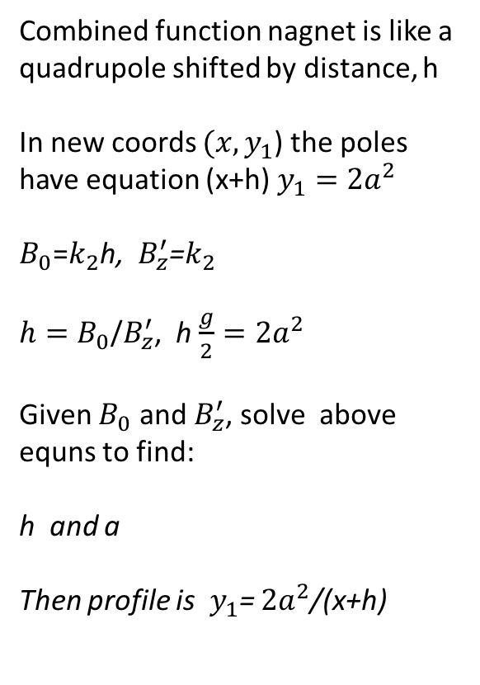
Combined function nagnet is like a quadrupole shifted by distance, h
In new coords $(x,y_{1}$) the poles have equation (x+h) $y_{1}=$ $2a^{2}$
$B_{0}$=$k_{2}$h, $B_{z}^{′}$=$k_{2}$
$h=B_{0}$/$B_{z}^{′}$, h $\frac{g}{2}=2a^{2}$
Given $B_{0}$ and $B_{z}^{′}$, solve above equns to find:
h and a
Then profile is${ y}_{1}$= $2a^{2}$/(x+h)
Poles of a quadrupole are a rectangular hyperbola $xy=2a^{2}$
$$B_{y}\left(x=0\right)=0$$
${ B}_{y}\left(x\right)=$ $k_{2}x$
On the poletip: $B_{t}$=$k_{2}$a
y
$$y_{1}$$
$$xy=2a^{2}$$
a
x
h
g/2
To Calculate Pole Profile of CF Magnet

Slide 5
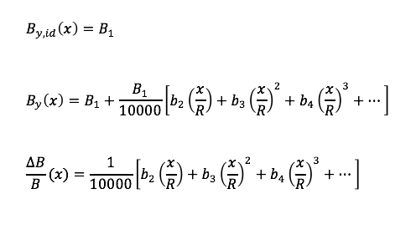
Definition of field error coefficients

Slide 6

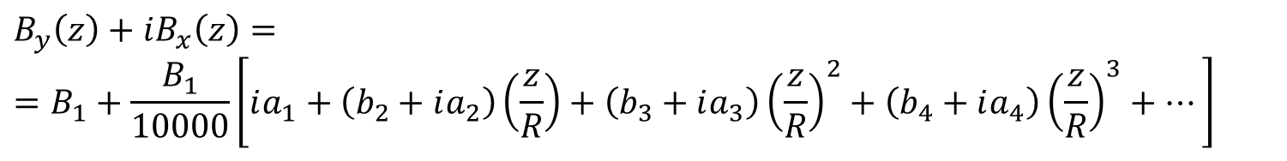
The harmonic decomposition is very handy to describe the field quality, that is, deviations of the actual B vs. the ideal one
(normal) dipole
$${\vec{B}}_{id}\left(x,y\right)=B_{1}\vec{j}$$
$$B_{y}\left(z\right)+iB_{x}\left(z\right)==B_{1}+\frac{B_{1}}{10000}\left[ia_{1}+\left(b_{2}+ia_{2}\right)\left(\frac{z}{R}\right)+\left(b_{3}+ia_{3}\right){\left(\frac{z}{R}\right)}^{2}+\left(b_{4}+ia_{4}\right){\left(\frac{z}{R}\right)}^{3}+…\right]$$
$$b_{2}=10000\frac{B_{2}}{B_{1}} b_{3}=10000\frac{B_{3}}{B_{1}} a_{1}=10000\frac{A_{1}}{B_{1}} a_{2}=10000\frac{A_{2}}{B_{1}} …$$
Notes:
The simulated or measured field is often decomposed in multipole coefficients. Again, this decomposition holds in 2D, or in 3D for the integrated field along the longitudinal direction, and it is valid up to a radius within which no current or magnetic material is present. As before, R is a reference radius. A typical value for R is 2/3 of the physical aperture radius. This is often referred to as the good field region (GFR).
Taking for example a dipole, in the ideal case only one term – B₁ – is present in the series. In reality, all other terms are present, though most often only the lower order ones give a somehow significant contribution to the field. It is customary to express these unwanted components (errors) normalized to the fundamental (or main) component, and multiplied by 10000. Usually the upper case letters B_{n}, A_{n} are used for the not normalized coefficients – measured in Tesla – while the lower case letters b_{n}, a_{n} are reserved for the normalized terms, expressed in units of 10⁻⁴.
The b_{n}, a_{n} terms are typically a few units for well designed and well built dipoles and quadrupoles. Higher values are usually found (and accepted) for sextupoles and correctors, whose strength is anyway much smaller than the accompanying bending and focusing magnets in the lattice.
Note: some terms can also come from a misalignment of the magnet, for example for a dipole the a₁ (skew dipole, or horizontal dipole) term is connected to a roll angle misalignment.

Slide 7
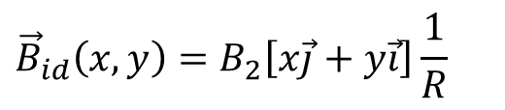
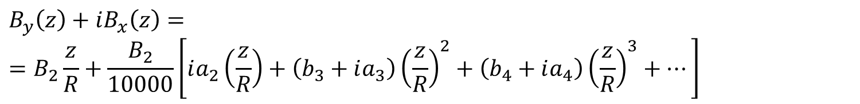
The same expression can be written for a quadrupole
(normal) quadrupole
$${\vec{B}}_{id}\left(x,y\right)=B_{2}\left[x\vec{j}+y\vec{i}\right]\frac{1}{R}$$
$$B_{y}\left(z\right)+iB_{x}\left(z\right)==B_{2}\frac{z}{R}+\frac{B_{2}}{10000}\left[ia_{2}\left(\frac{z}{R}\right)+\left(b_{3}+ia_{3}\right){\left(\frac{z}{R}\right)}^{2}+\left(b_{4}+ia_{4}\right){\left(\frac{z}{R}\right)}^{3}+…\right]$$
$$b_{3}=10000\frac{B_{3}}{B_{2}} b_{4}=10000\frac{B_{4}}{B_{2}} a_{2}=10000\frac{A_{2}}{B_{2}} …$$
Notes:
For a quadrupole, the relative multipole errors are a₂, b₃, a₃, b₄, a₄, etc., and they are obtained by normalizing the upper case coefficients by B₂.
Usually no dipole errors (b₁, a₁) are considered in a quadrupole, as these correspond to a transverse shift of the magnetic centre (axis in 3D); in that case, the harmonic decomposition is re-expressed taking as the centre of the circle the point where there is no field (no integrated field in 3D).
Note: also for a quadrupole, some multipole errors can come from a misalignment of the magnet, for example a roll angle gives rise to an a₂ (skew quadrupole) term.

