Slide 1
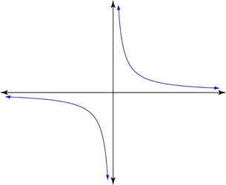



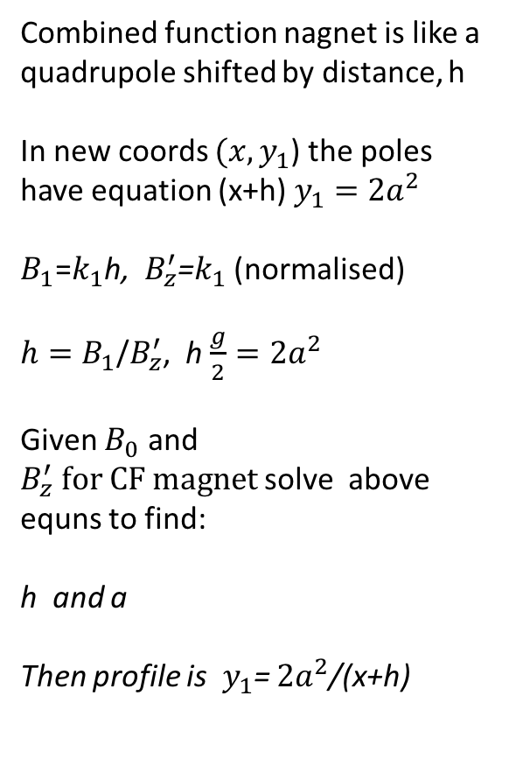
Combined function nagnet is like a quadrupole shifted by distance, h
In new coords $(x,y_{1}$) the poles have equation (x+h) $y_{1}=$ $2a^{2}$
$B_{1}$=$k_{1}$h, $B_{z}^{′}$=$k_{1}$ (normalised)
$h=B_{1}$/$B_{z}^{′}$, h $\frac{g}{2}=2a^{2}$
Given $B_{0}$ and $B_{z}^{′} for CF magnet$solve above equns to find:
h and a
Then profile is${ y}_{1}$= $2a^{2}$/(x+h)
Poles of a quadrupole are a rectangular hyperbola $xy=2a^{2}$
(normalised) :
$$B_{y}\left(x=0\right)=0$$
${ B}_{y}\left(x\right)=$ $k_{1}x$
On the poletip: $B_{t}$=$k_{1}$a
y
$$y_{1}$$
$$xy=2a^{2}$$
a
x
h
g/2
To Calculate Pole Profile of CF Magnet

Slide 2
BEAM, PARTICLE=ELECTRON,PC=3.0;
DEGREE:=PI/180.0;
QF: QUADRUPOLE,L=0.5,K1=0.2;
QD: QUADRUPOLE,L=1.0,K1=-0.2;
B: SBEND,L=1.0,ANGLE=15.0*DEGREE;
(Bρ) = 10⁹/c*PC = 10^9/299792485*3.0 = 10.01 Tm
dipole (SBEND)
B = |ANGLE|/L*(Bρ) = (15*pi/180)/1.0*10.01 = 2.62 T
quadrupole
G = |K1|*(Bρ) = 0.2*10.01 = 2.00 T/m
Notes:
The BEAM command has several possible entries. In this case, PC is specified, which is the particle momentum times the speed of light, in GeV. The CHARGE is not specified, so the program assumes the default of 1 proton charge. Then the beam rigidity can be computed as
BRHO = PC / ( |CHARGE| * c * 1.e-9)
For an SBEND, the declared length is the arc length of the reference orbit, so the dipole magnetic field is computed as shown; by the way, 2.62 T is rather an uncommon value for the field.
For an RBEND, some trigonometry is needed as (normally) the length is taken along a straight line joining the entry and exit point, so in that case
B = 2/L*sin(|ANGLE|/2)*(Bρ).
The gradient of a quadrupole per se does not mean much: what matters is gradient and aperture. In this case, for example, if we had a 100 mm bore diameter, then we would have 0.1 T ( = 2.0*0.050) as B_{pole}. This is relatively low also for resistive magnets, so maybe the possibility of getting the same integrated field with a shorter though stronger magnet could be envisaged.

Slide 3
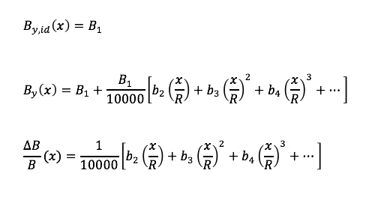
Definition of field error coefficients

