Slide 1
Report of the HL-LHC WP4 (Crab Cavities):
SPS Cryo-module Engineering Review
Reviewers:
Pierre Bosland, Philippe Lebrun, Vittorio Parma, Leonardo Ristori, and Akira Yamamoto (Chair)
The review held at CERN, 10 – 11 Nov. 2015

Slide 2
Boundary Conditions
The installation of Crab Cavities (CC) is planned during Long Shutdown 3 (LS3), scheduled for beginning 2024-25.
Due to lack of experience of CC performance in hadron machines, a beam test of CCs is planned in the SPS before LS2 (by end of 2018) where one or more Cryomodules and as many different types of CC as possible will be installed in the SPS beam and tested for performance.
A significant effort towards the SPS tests have resulted in a detailed design of the cryomodules for the double quarter wave (DQW) and the RF dipole (RFD).

Slide 3
General plans
Courtesy: R. Calaga, O.Capatina
  2 cryomodules for SPS tests - test 1 CM in 2018, the 2nd after LS2
    1 CM w/ 2 identical cavities (type «vertical» - DQW)
    1 CM w/ 2 identical cavities (type «horizontal» - RFD)
  2 cryomodules pre-series for LHC (one of each type)
  16 cryomodules for installation in LHC (8 of each type) + spares
      post C&S review:
        - all 32 dressed cavities to be produced
        - only 8 CMs foreseen for installation in LS3 with subsequent cryomodules in the following technical stops
        - this also allows schedule mitigation and flexibility to accommodate for crossing plane changes
today
2015
2016
2017
2018
2019
2020
2021
2022
2023
2024
2025
2026
YETS
EYETS
YETS
Run 2
LS2
Run 3
LS3
Run 4
SPS test prototype
LHC series production
preparation
tests
Fabrication & tests
Preparation & Installation
LHC pre-series

Slide 4

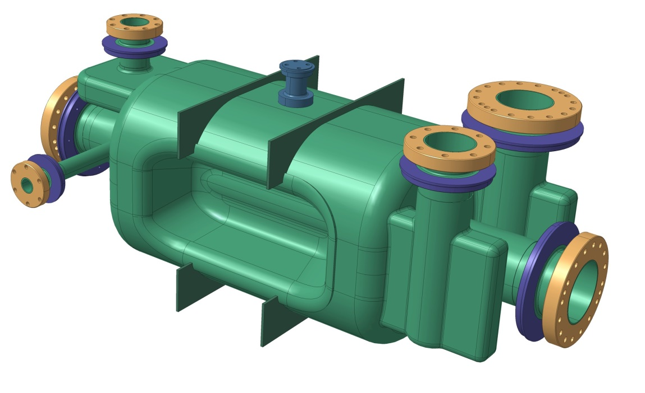
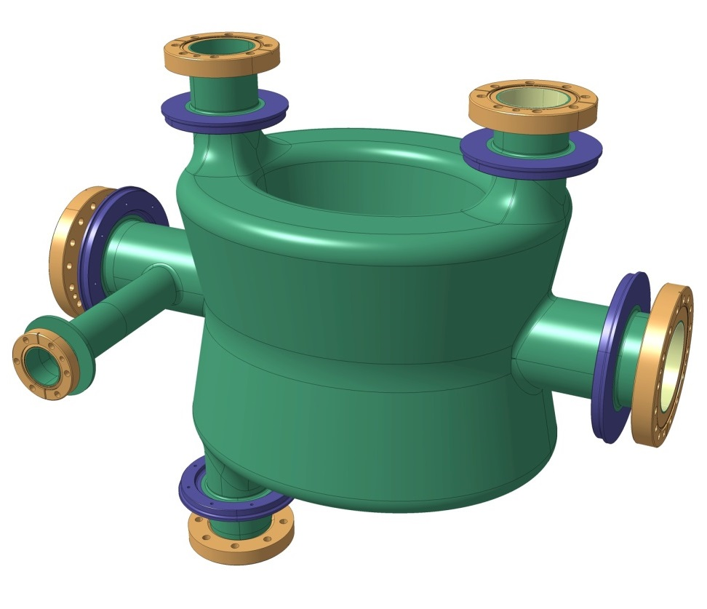
Courtesy: R. Calaga, O.Capatina
SM18 Area
Cavity cold testing, clean room facilities & cryomodule qualification
SPS Test Prototype Module before LS2
CMS
LHC Point 5 (horizontal)
4 cavities / IP side/ beam
to be installed during LS3
ATLAS
LHC Point 1 (vertical)
4 cavities / IP side/ beam
to be installed during LS3

Slide 5
General Charges to the Review
This review is charged to comprehensively review and address any outstanding issues related to the
  SPS cryomodules components design:
    vacuum vessel, thermal and magnetic shielding, thermal insulation, cryogenic distribution, internal support structure, RF internal lines, alignment adjustment and monitoring; as well as
  Physical and functional interfaces:
    to the RF cavities and helium vessels, cryogenic and vacuum systems.
  Some important elements of the cryomodule are being prototyped to understand the performance of the design choices (He-vessel, tuner etc..).
The maturity of the technical status of the cryomodule and its readiness towards an installation in the technical stop of 2017-18 should be assessed

Slide 6
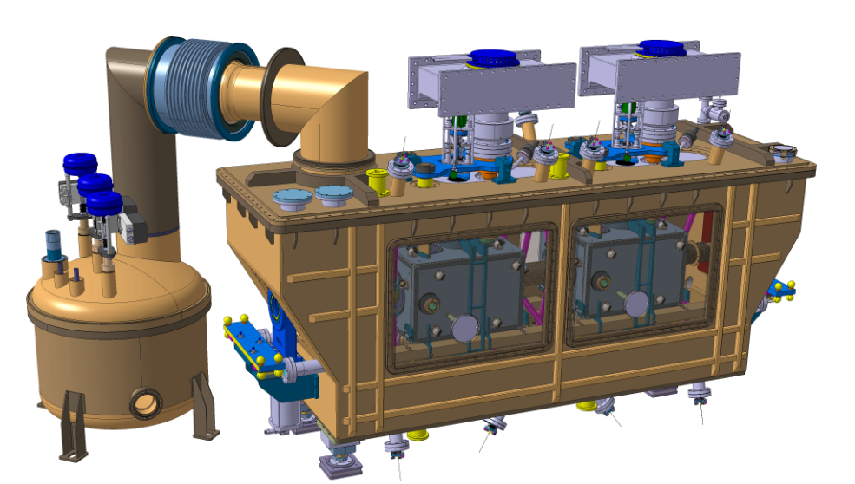
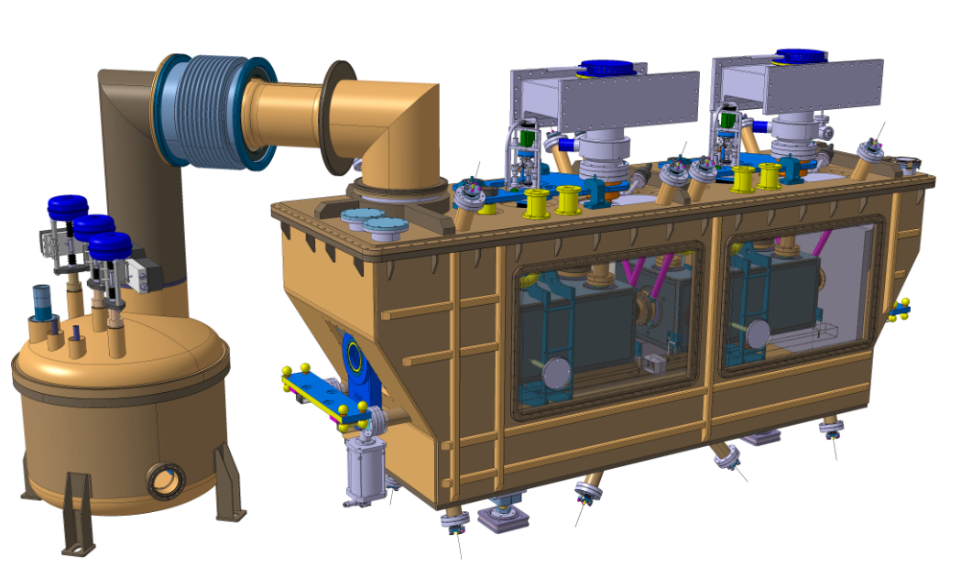
SPS Cryomodule: with 2 identical cavities installed
Courtesy: R. Calaga, O.Capatina
Vertical Crabbing
Double Quarter Wave
(ATLAS)
Horizontal Crabbing
RF Dipole
(CMS)
Notes:
Design per SPS, lo stesso concetto da tenere per LHC. DQW: vertical kick

Slide 7
Specific Charges
Specific questions to be addressed by the review:
Does the design meet all the functional requirements of such a cryomodule?
Have all important issues been covered by the project team ?
Have all the design aspects been studied sufficiently in detail in preparation for manufacturing? Are-there particular area where extra design effort is needed?
Are there risks associated with the design that could or must be removed or mitigated at this stage?
Is the proposed schedule related to SPS tests realistic?
Are the general plans and criteria for cryomodule development past the SPS application and into the HL-LHC period (post-2024) correctly defined? Is there any particular area that should be studied in more detail at this stage

Slide 8
Reports given, 10 Nov. (1)
a1 | Introduction and overview of the CM | Ofelia CAPATINA et al.
a2 | He vessel design, prototyping and tests | Carlo ZANONI
a3 | Cold magnetic-shielding & Proposal for … | Niklas TEMPLETON
a4 | Tuning system | Kurt ARTOOS
a5 | HOM couplers | Marco GARLASCHE
a6 | Fundamental power coupler and RF … | Eric MONTESINOS
a7 | Support system of the dressed cavity | Thomas JONES
a8 | Alignment and position monitoring system | Mateusz SOSIN

Slide 9
Reports given, 10 Nov. (2/2)
p1 | Cryogenics and cryolines | Krzysztof BRODZINSKI
p2 | Thermal and outer magnetic shields | Niklas TEMPLETON
P3 | Thermal budget and heat loads | Federico CARRA
p4 | Vacuum vessel | Norbert KUDER et al.
p5 | Cryostating | Pierre MINGINETTE
p6 | Integration in SM18 bunker tests | Alick MACPHERSON
p7 | Integration in SPS | Giovanna VANDONI

Slide 10
Reports given in addition, 11 Nov.
A1 | Requirements/Goal for CC system at LHC Requirement/Goal for CC test at SPS Min. Success Criteria for CC test at SPS | Rama Calaga
A2 | General Plan (schedule) to reach the SPS Test | Ofelia CAPATINA et al.

Slide 11
Executive Summary (1/2)
The review team wishes to thank all the participants for their well-prepared oral reports and comprehensive documents received soon after the review meeting. We have been impressed with the crab cavity (CC) and cryomodule (CCCM) team activities for their engineering design work and for the SPS test preparation.
We congratulate the team on the progress and current design achieved, and recognize the excellent work.
The engineering design presented is sound and the current design concept should be kept.
  We have understood that the idea to accommodate two complementary CC designs of Double Quarter Wave (DQW) and RF Dipole (RFD) into those CCCMs so as to provide common interfaces to RF power and cryogenic system layout in the accelerator tunnel.

Slide 12
Executive Summary (2/2)
On the other hand, we are concerned with that the general plan/schedule is very challenging to realize the SPS beam test within the LHC Run-2 period before the end of 2018.
Installation of a new dedicated cryogenic system for the SPS test planned in the technical stop of 2016-17 (and CM in a year later) would be the most critical issue, and this must be well managed.
We recommend the basic CCCM design to be kept as achieved, and encourage to establish the preparation plan to be robust enough to ensure that the SPS test stay to be supported, and recommend to provide backup plans with the minimum goal to be clear enough to demonstrate the viability.

Slide 13
Recommendations (1/6)
Charge 1: Does the design meet all the functional requirements of such a cryomodules?
Clarify “the minimum functional requirement/goal” for the SPS CC test to be prepared in case of difficulties to be met in the course to the SPS test.

Slide 14
Documents given to the review team responding to its requests
“Functional Specifications of the LHC Prototype Crab Cavity System” P. Baudrenghien et al., CERN-ACC-NOTE-2013-003, Feb., 2013
“Compact Crab Cavity Cryomodule” K. Srtoos et a., CERN-ACC-2015-0130, Oct. 2015.
“Conceptual specification: Crab Cavities”, LHC-EQCOD-ES-xxxx, Draft.
“Dressed bulk niobium radio-frequency crab cavities”, LHC-ACFDC-ES-0001, June 2014.
“Conceptual specification: SPS Crab cavity validation run installation”, LHC-EQCOD-EX-xxxx, Draft June 2014.
“Crab cavities prototype cryomodule, a proposal for compliance with CERN safety requirements”, EDMS No. 1494776, August 2015.
All information is online available:
https://indico.cern.ch/event/435319/

Slide 15
Recommendations (2/6)
Charge 2: Have all the important issues been covered by the project team?
A decision on the implantation/location of the refrigerator cold box (at ground level or in tunnel) needs to be urgently taken.
The critical components such as FPCs and tuners shall be individually reviewed in timely manner, if they have not already been done.

Slide 16
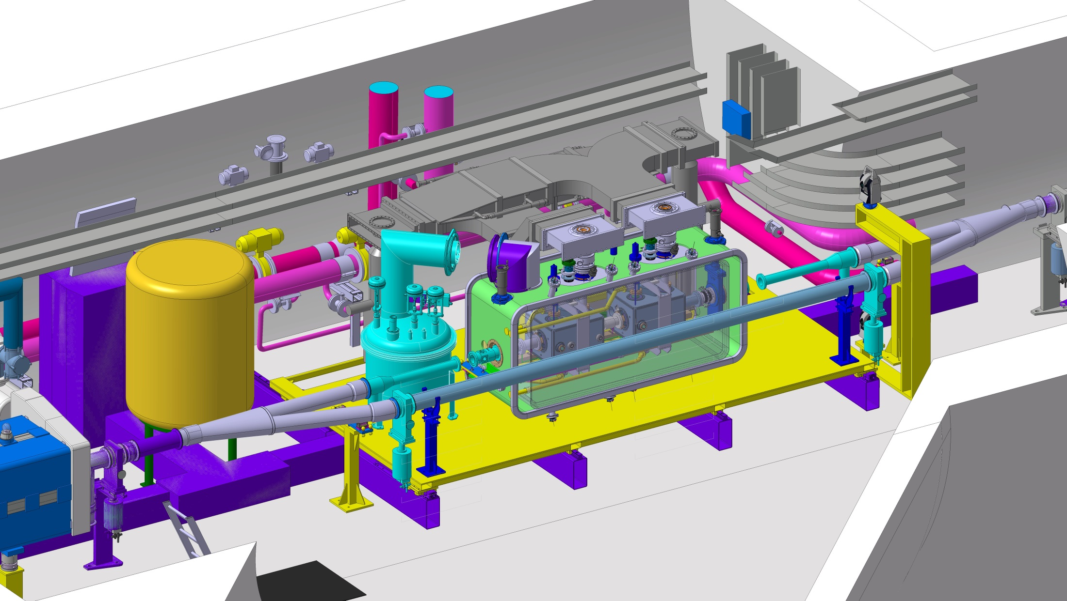
Courtesy: R. Calaga, O.Capatina
SPS: operation
this is illustration only as the location recently changed and integration in the new location is underway – see Giovanna’s talk this after-noon

Slide 17
Recommendations (3/6)
Charge 3: Have all the design aspects been studied sufficiently in detail in preparation for manufacturing? Are there particular area where extra design effort is needed?
The system integration workflow, including efficient tooling, fixtures, and intermediate tests must be studied in greater detail, especially with regard to preventing contamination of the CC and degrading its performance.
Cryogenic-safety and the extreme failure-mode analyses should be performed, considering the specific SPS test environment to be well prepared.,

Slide 18
Recommendations (4/6)
Charge 4: Are there risks associate with the design that could or must be removed or mitigated at this stage?
We advise the project team to consider reinforcing the stiffness of the supporting system while, at the same time, limiting forces on the FPCs.

Slide 19
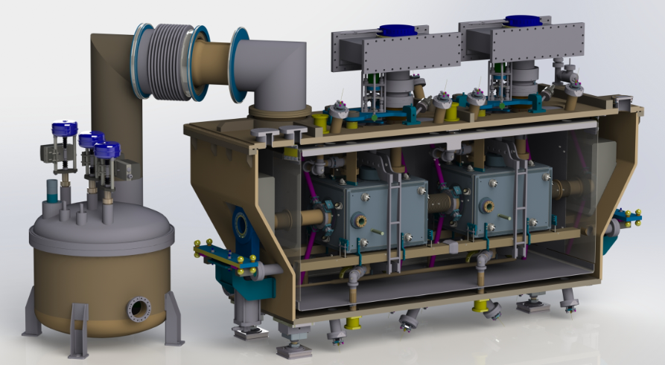
Cryomodule Assembly
Courtesy: R. Calaga, O.Capatina
  SPS crab cavity cryomodules components design :
  vacuum vessel, thermal and magnetic shielding, thermal insulation, cryogenic distribution, internal support structure, RF internal lines, alignment adjustment and monitoring;
  the physical and functional interfaces to the: RF cavities, HOM couplers and helium vessel, cryogenic and vacuum systems.

Slide 20
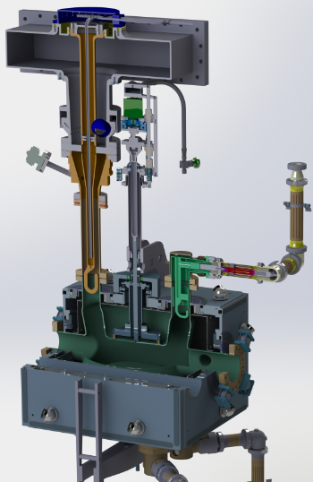
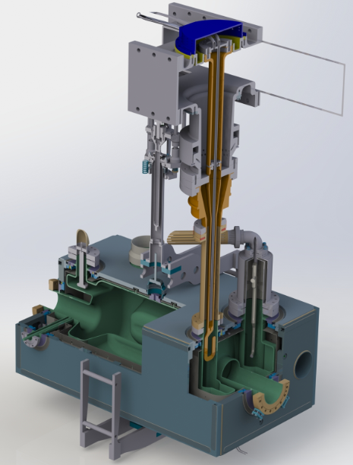
Dressed Cavities
Courtesy: R. Calaga, O.Capatina
Vertocal Crossing
Double Quarter Wave
(ATLAS)
Horizontal Crabbing
RF Dipole
(CMS)

Slide 21
Recommendations (5/6)
Charge 5: Is the proposed schedule related to SPS tests realistic?
Take fast action, such as ordering cryogenic refrigerator, as well as
  tracking closely the milestones of the project schedule and working out mitigation paths in case these milestones are not met.
Prepare for various scenarios, at least to reach the minimum requirements for the SPS test.

Slide 22
General plans
Courtesy: R. Calaga, O.Capatina
  2 cryomodules for SPS tests - test 1 CM in 2018, the 2nd after LS2
    1 CM w/ 2 identical cavities (type «vertical» - DQW)
    1 CM w/ 2 identical cavities (type «horizontal» - RFD)
  2 cryomodules pre-series for LHC (one of each type)
  16 cryomodules for installation in LHC (8 of each type) + spares
      post C&S review:
        - all 32 dressed cavities to be produced
        - only 8 CMs foreseen for installation in LS3 with subsequent cryomodules in the following technical stops
        - this also allows schedule mitigation and flexibility to accommodate for crossing plane changes
Cryogenics installation required,
→ Challenging
CM installation required,
today
2015
2016
2017
2018
2019
2020
2021
2022
2023
2024
2025
2026
YETS
EYETS
YETS
Run 2
LS2
Run 3
LS3
Run 4
SPS test prototype
LHC series production
preparation
tests
Fabrication & tests
Preparation & Installation
LHC pre-series

Slide 23
Recommendations (6/6)
Charge 6: Are the general plans and criteria for cryomodule development past the SPS application and into the HL-LHC period (post-2024) correctly defined? Is there any particular area that should be studied in more detail at this stage?
Provide clear documents for the general plan, at least for the goal of the CC-CM test at SPS with various scenarios including the minimum requirement to be achieved. Further scope for the HL-LHC period shall be re-visited after certain progress in the SPS test preparation.

Slide 24
Test Program Summary (discussed in the 2nd day)
Provided by R. Calaga,
In-situ cryomodule testing in out-of-beam position
RF commissioning with low-intensity beam, 1-12 bunches
    Establish proper RF parameters (operating frequency, amplitude, and phase)
    Verify that CCs are transparent (cavity counter-phasing and detuning)
High intensity single bunch up to 4x72 trains
    Impact on cavity performance (including transient behavior), impedance, stability & machine protection as a function of beam current; interlocks
    Verify cavity stability over many hours (relevant for LHC physics fill)
Long-term behavior of coasting beams in the SPS with 1-bunch
    Study the effects of cavity drifts, emittance growth, non-linear effects such as RF multipoles

Slide 25
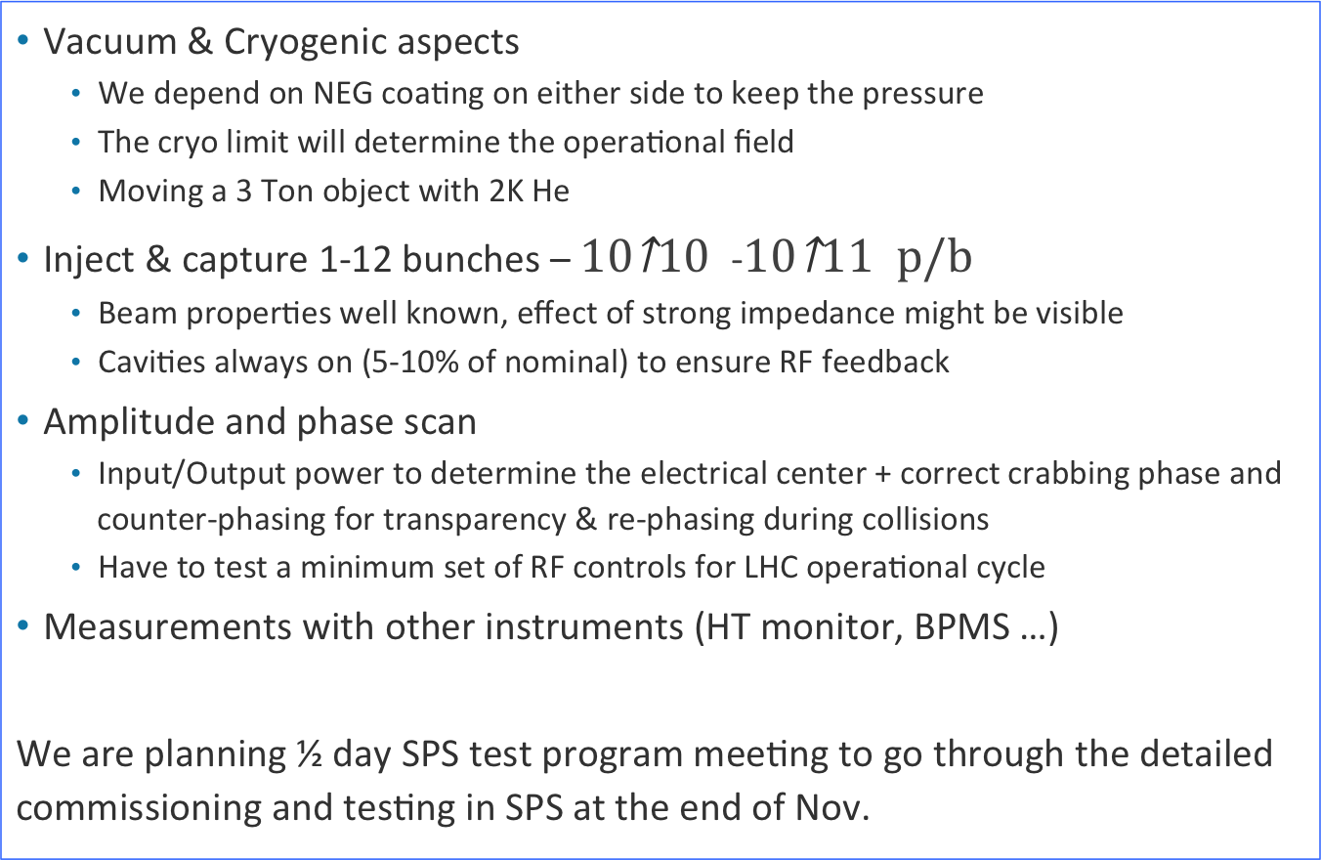
Minimum Test Program (discussed in the 2nd day)
Provided by R. Calaga,
Vacuum & Cryogenic aspects
    We depend on NEG coating on either side to keep the pressure
    The cryo limit will determine the operational field
    Moving a 3 Ton object with 2K He
Inject & capture 1-12 bunches – -
    Beam properties well known, effect of strong impedance might be visible
    Cavities always on (5-10% of nominal) to ensure RF feedback
Amplitude and phase scan
    Input/Output power to determine the electrical center + correct crabbing phase and counter-phasing for transparency & re-phasing during collisions
    Have to test a minimum set of RF controls for LHC operational cycle
Measurements with other instruments (HT monitor, BPMS …)
We are planning ½ day SPS test program meeting to go through the detailed commissioning and testing in SPS at the end of Nov.

Slide 26
Summary
Primary recommendations:
  Keep the current CM design w/ common interfaces to the associate system,
  Establish the general preparation and test plan to be robust and reliable in schedule,
    Specially for the cryogenics system installation in 2016- 2017 (short technical stop), and for workflow of the CM assembly with keeping cleanness and performance.
  Prepare for backup plans with the minimal goal to be reliable achieved.

Slide 27
Aknowledgments
We would thank all CC-CM team members for their much effort for design to reach this stage and for the review to have been successfully made.

