Slide 1
Beam Screen and Cold Bore Temperatures
V. Baglin
32nd HL-LHC TC
03-12-2015

Slide 2
Outline
LHC cases
HL-LHC cases with ”high” temperature beam screen
Conclusions

Slide 3
1. LHC Cases

Slide 4
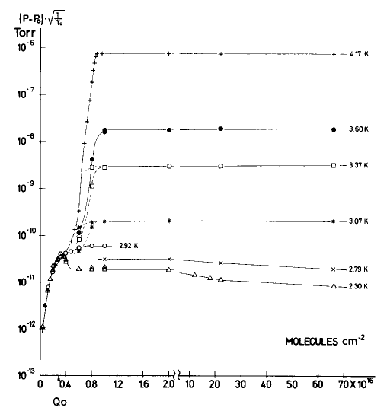
LHC arc & IT: case 1
Cold bore (CB) operates at 1.9 K
Beam screen (BS) operates in the 5-20 K window
H₂ adsorption isotherm on stainless steel
During machine operation, the gas load, induced by the interaction of the beam with the vacuum chamber wall, increase with time
This gas load, can be as large as 10 10¹⁵ H₂/cm²
As a result, the gas condense on the surface with a given vapour pressure
On the CB, the H₂ vapour pressure is negligible:
  < 10⁻¹⁹ mbar
  the vapour pressure of the other gases in even much lower
On the BS, the H₂ vapour pressure increase with operation time …..
….. and can be much larger than 10⁻⁶ mbar when more than one monolayer are condensed !
10⁻⁶
4.2 K
2.3 K
10⁻¹²
Operation time
A monolayer
C. Benvenuti, R. Calder, G. Passardi
J.Vac.Sci. 13(6), Nov/Dec 1976, 1172-1182

Slide 5
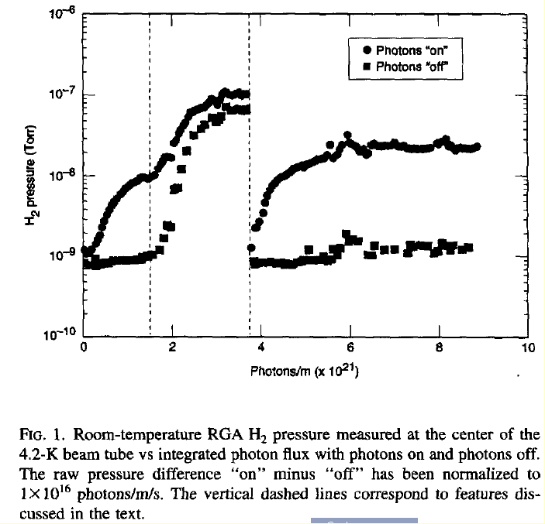
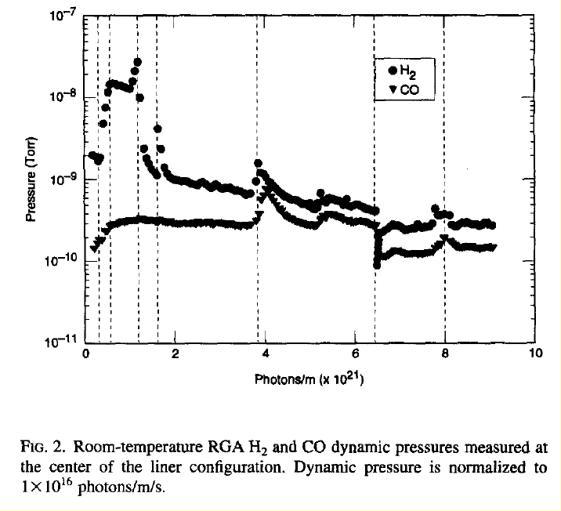
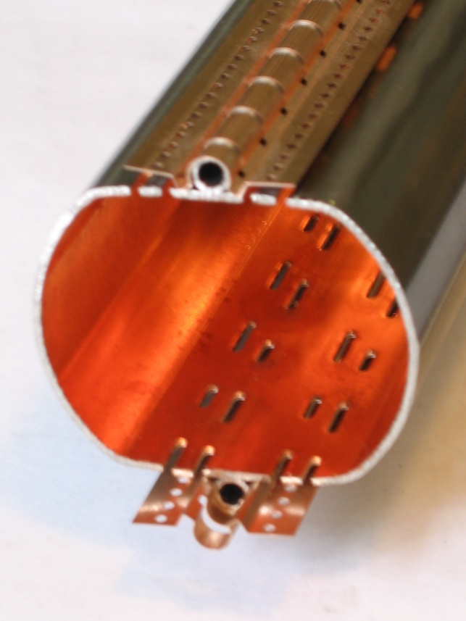
LHC arc & IT: solution to the H₂ vapour pressure issue
A perforated beam screen as demonstrated by SSC studies in 1994
No perforations
With perforations
10⁻⁷
10⁻⁹
V.V. Anashin et al. J. Vac.Sci.Technol. A. 12(5) , Sep/Oct 194
The beam screen holes defines the pumping speed
The 1.9 K cold bore temperature provide the capacity (infinite)

Slide 6
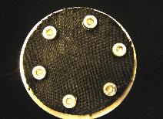
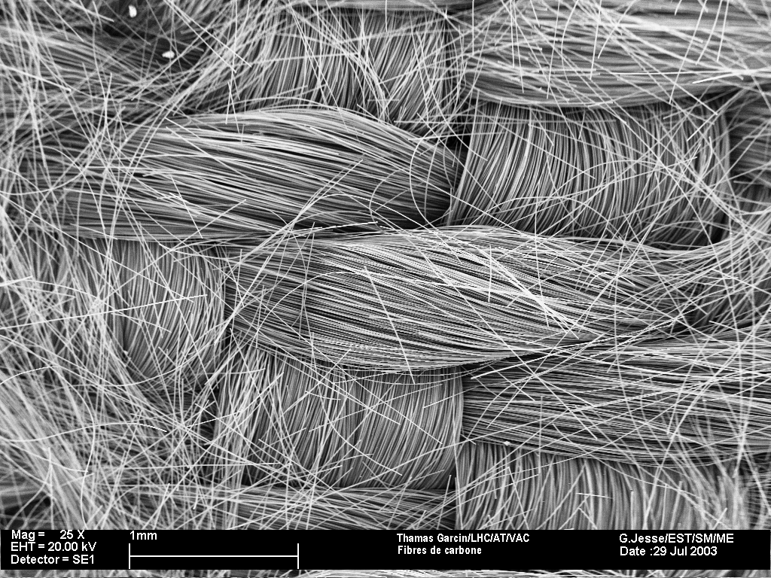
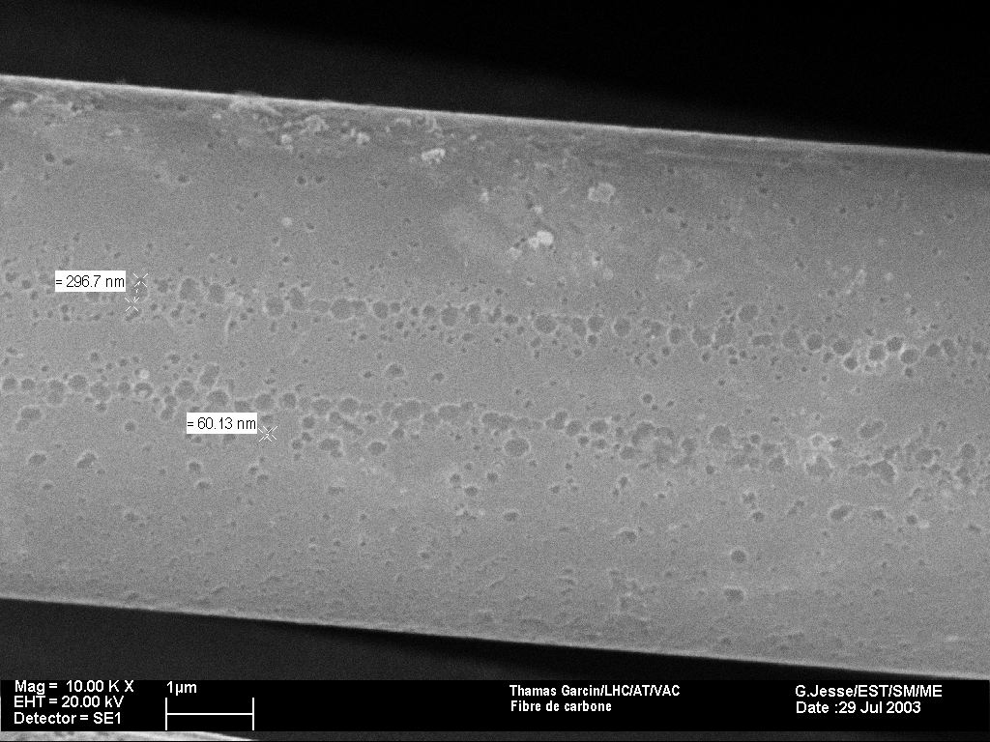
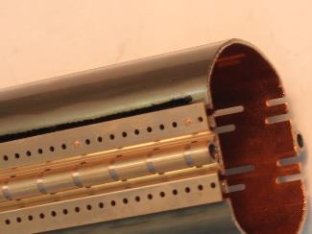
LHC SAM: case 2
Cold bore (CB) operates at 4.5 K
Beam screen (BS) operates in the 5-20 K window
  During gas load production, H₂ accumulates on the CB reaching the 4.5 K saturated vapour pressure of 2 10⁻⁵ mbar
  the CB does not provide enough pumping capacity anymore
  a cryosorber is needed: a woven carbon fiber was selected during LHC design
X 25
X 10 000
V. Anashin et al. Vacuum 75 (2004) 293-299
Required performances (for installation of 200 cm²/m):
  Operates from 5 to 20 K
  Capacity larger than 10¹⁸ H₂/cm²
  Capture coefficient larger than 15 %

Slide 7
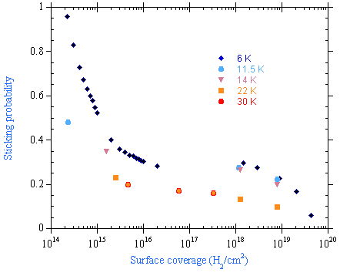
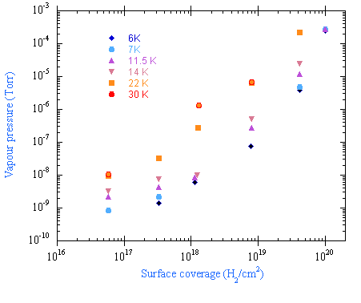
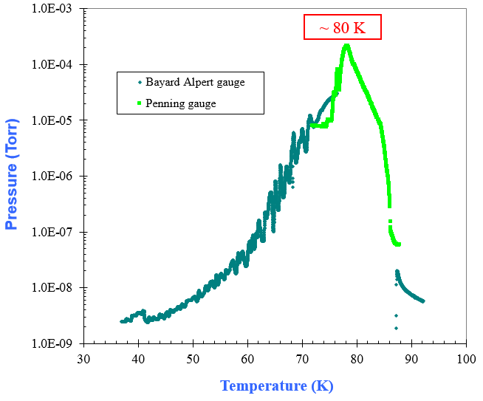
Carbon fiber cryosorbers
Sticking probability at 10¹⁸ H₂/cm² :
  15 % at 22 K
  > 15 % below 22 K
Capacity at 10⁻⁸ mbar :
  10¹⁸ H₂/cm² at 6 K
  10¹⁷ H₂/cm² at 30 K
Capacity
Sticking prob.
Principle of operation
The cryosorbers installed onto the back of the BS provide the required capacity and pumping speed for H_{2.} They are located in cryoelements operating with 4.5 K cold bores
The cryosorbers installed in D2, D3, D4, Q4, Q5 and Q6 of the LSS require a regeneration during the shutdown for removing the H₂
During normal operation of the LHC machine, a regeneration is not foreseen
The cryosorber is regenerated at ~ 80 K
While regenerating, the beam is OFF and the BS should be warmed up to more than 80 K and the CB held at more than 20 K (emptying cold mass)
While the H₂ is liberated from the cryosorbers, it is pumped by an external pumping system.
V. Baglin et al. EPAC’04, Luzern 2004.

Slide 8
2. HL-LHC Cases with
“High” Temperature Beam Screen

Slide 9
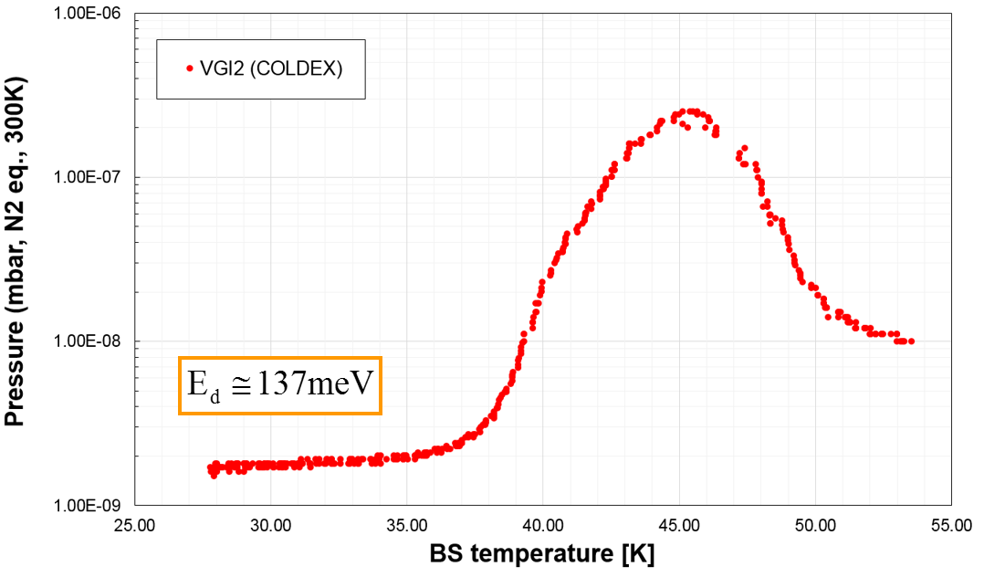
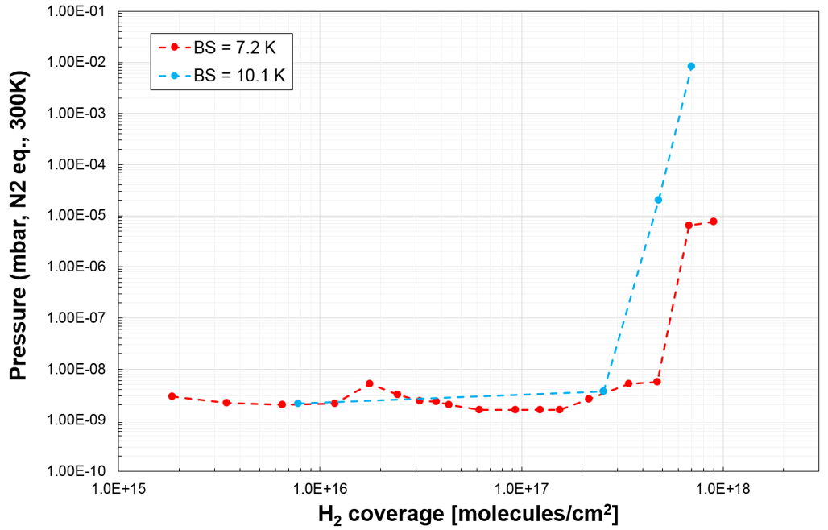
HL-LHC: case 1
Cold bore (CB) operates at 1.9 K
Beam screen (BS) operates in the 40-60 K range
The perforated beam screen together with the 1.9 K cold bore provides the H₂ pumping speed and capacity
Particularity of a-C coated beam screen:
40 K
50 K
Physisorbed / condensed H₂ is released from 400 nm thick a-C coating in the 40-50 K temperature range !
➔ The temperature window 40-60 K is not appropriated
➔ TBC in the coming year(s) if 50–70 K is an alternative
R. Salemme
H₂ adsorption isotherm
a-C coating is a cryosorber !
At 10 K:
  capacity ~ 100 Cu
  but less than the LHC cryosorber
Increasing T
Characterisation with different gases and temperatures to be continued in 2016 and later

Slide 10
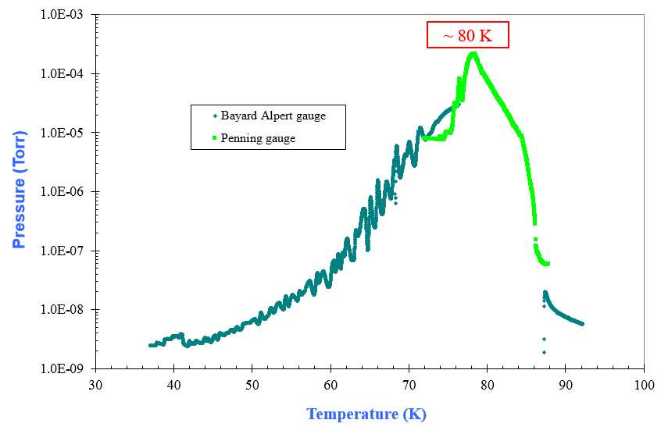
HL-LHC: case 2
Cold bore (CB) operates at 4.5 K
Beam screen (BS) operates in the 40-60 K range
A cryosorber is needed with a perforated beam screen to provide the H₂ pumping speed and capacity
LHC cryosorber:
  H₂ is not pumped above 40 K
  Regeneration above 80 K
No cryosorber is evidenced above 5-20-30 K working temperature

Slide 11
3. Conclusions

Slide 12
Conclusions
Perforation on the beam screen provides pumping speed
Operating the cold bore at 1.9 K provides H₂ capacity
A cold bore operating at 4.5 K do not provides H₂ capacity: a cryosorber is needed
Actual (known) cryosorber can operate in the range 5-20 K but cannot operate above ~ 40 K
Finding a cryosorber operating above 40 K is one of the main challenge for the FCC study !
Evidencing such a cryosorber in the HL-LHC time frame seems unrealistic

Slide 13
Thank you for your attention

Slide 15
Reserve slides

Slide 16
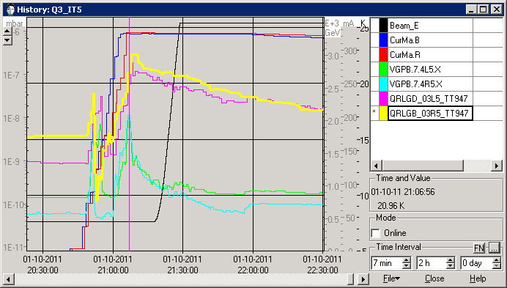
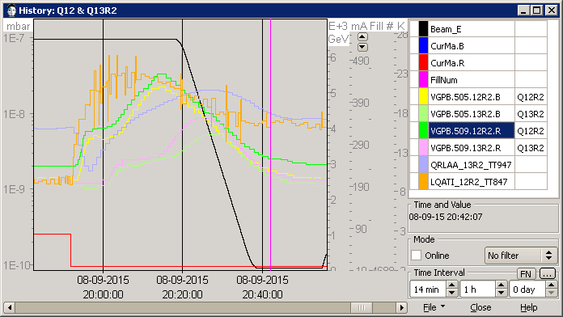
LHC : Examples of temperature transients
Cold bore (CB) operates at 1.9 K
Beam screen (BS) operates in the 5-20 K but with excursion outside the temperature window
During beam injection:
  T => 22 K
    ➔ P ~ 10⁻⁸ mbar
Fill 2177, 1st October 2011
During end of fill:
  T => 22 K
    ➔ P ~ 3 10⁻⁸ mbar
Fill 4332, 8th September 2015

