Slide 1
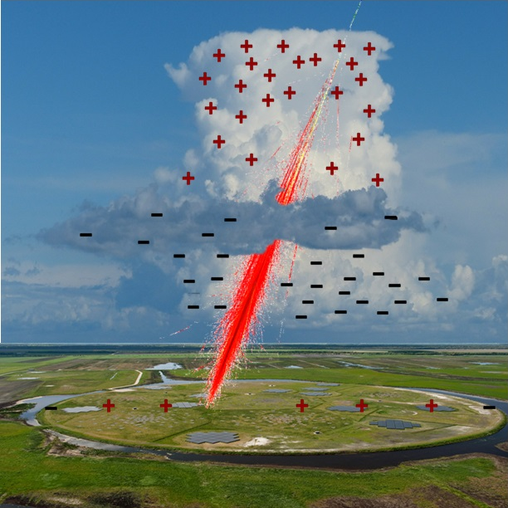
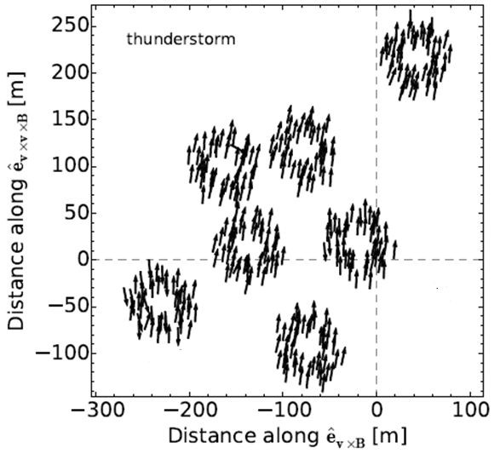
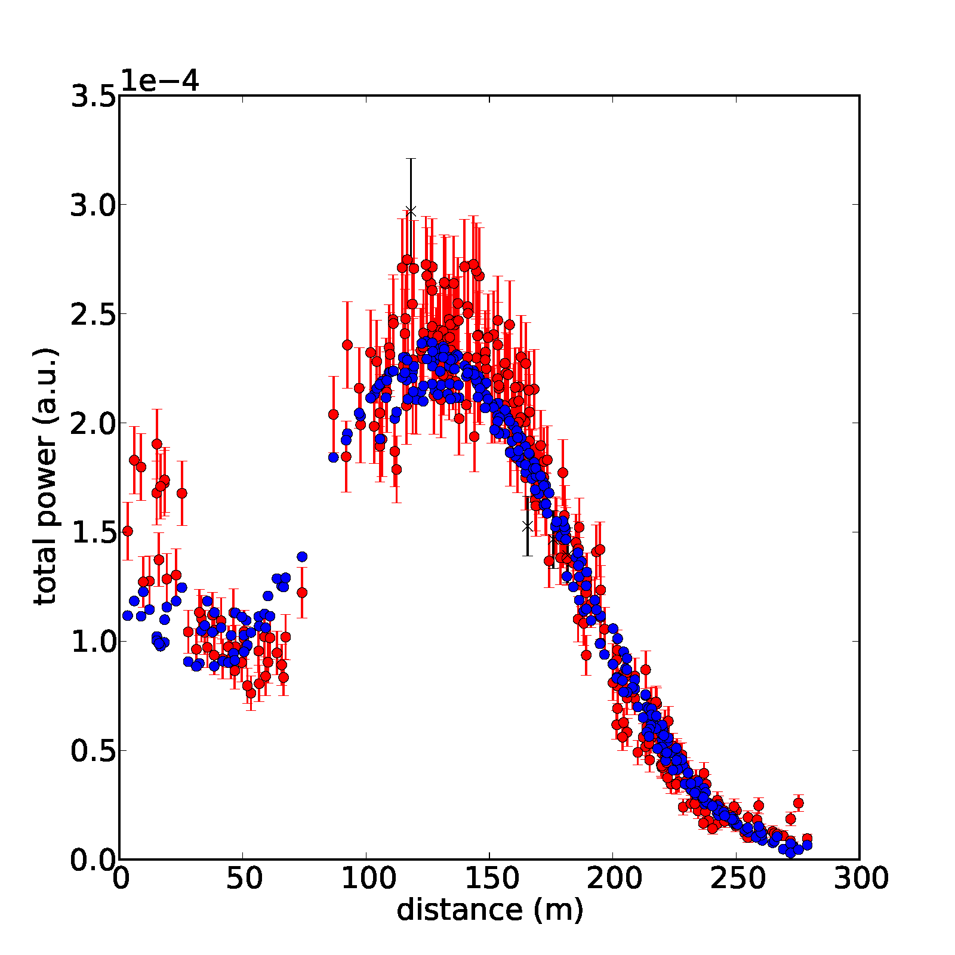
Circular polarization of radio emission from air showers in thundercloud conditions
T. N. G. Trinh
(LOFAR-CR)
$$h$$
$${\vec{E}}_{⊥above}$$
$$h_{above}$$
$${\vec{E}}_{⊥below}$$
E_{a}
$${\vec{E}}_{⊥above}$$
$$h_{below}$$
$${\vec{E}}_{⊥below}$$
E_{b}
$$\vec{v}$$
0
$$E_{⊥}$$

Slide 2





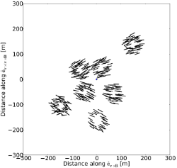
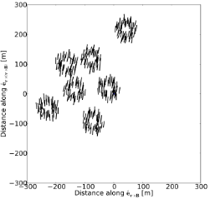
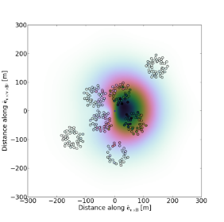
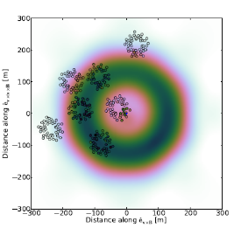
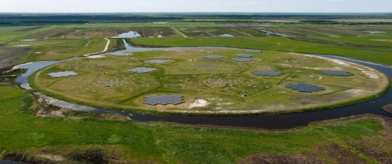
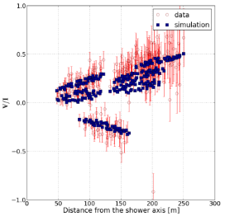
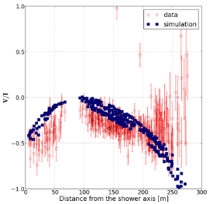
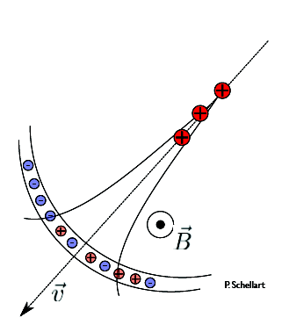
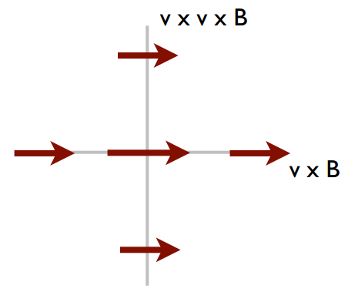
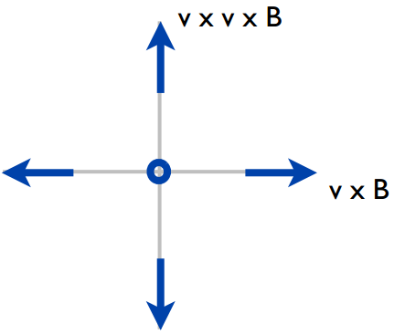
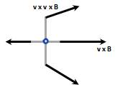

Circular polarization of radio emission from air showers in thundercloud conditions
T. N. G. Trinh, O. Scholten, A. Bonardi, S. Buitink, A. Corstanje, U. Ebert, J. E. Enriquez,
H. Falcke, J.R. Hörandel, Q. D. Hasankiadeh, P. Mitra, K. Mulrey, A. Nelles, S. Thoudam, J. P. Rachen, L. Rossetto, C. Rutjes, P. Schellart, S. ter Veen, T. Winchen
Introduction
Fair-weather events vs. thunderstorm events
Atmospheric electric fields play an important role in lightning initiation and propagration but it is very diffuct to measure them.
LINEAR POLARIZATION FOOTPRINT (Stokes Q and V)
h
STRUCTURE OF ELECTRIC FIELDS
Similar to charge accumulation of thunderclouds
h_{U} to h_{L}: field strength E_{U}, directed downward.
h_{L} to ground: field strength E_{L} = kE_{U}, directed upward.
Fair-weather
h
h_{u}
h_{u}
h_{L}
h_{L}
Thunderstorm
E
E
Linear polarization angle: 2 φ =atan(U/Q)
Fair-weather event: mainly along v x B direction with small radial deviation because of the contribution from charge excess
Thunderstorm event: mainly along the direction of the net force
It was discoverd that radio emission from cosmic-ray-induced air showers can be used to determine electric fields ^{[1]}.
LOFAR
Radio antenna array consisted of 48 stations in Northern Europe
Six central stations in Exloo
Low Band Antennas: 10 – 90 MHz
High Band Antennas: 110 – 240 MHz
INTENSITY FOOTPRINT (Stokes I)
Fair-weather
Thunderstorm
Fair-weather event: bean-shaped ^{[2]}
Thunderstorm event: ring-like structure ^{[1]}
Radio mechanism
CIRCULAR POLARIZATION (Stokes V)
Fair-weather condition
Fair-weather
Thunderstorm
Two main contributions:
Transverse current polarized along the force
Charge excess polarized radially
$$\vec{J}$$
+
=
Effects of atmospheric electric fields
F_{E}
$${\vec{E}=\vec{E}}_{//}+{\vec{E}}_{⊥}$$
Fair-weather event: small circular polarization near the core, due to charge-excess
Thunderstorm event: large circular polarization near the core, due to change in transverse current
Charge excess component
Amplitude: little effect
Polarization: slightly more radial
Transverse-current component:
Amplitude: large effect
Polarization: changing to the direction of the net force
- Intensity pattern is sensitive to h_{below} and k
- Observe large circular polarization in thunderstorm events, related to the change of E-fields.
- Combining intensity and polarization allows to determine detailed E-fields
Conclusion
Thunderstorm condition Stokes parameters
$$\begin{matrix}I=\frac{1}{n}\sum_{0}^{n−1}{{{\left|ε\right|}^{2}}_{i,\vec{v}×\vec{B}}+{{\left|ε\right|}^{2}}_{i,\vec{v}×\vec{v}×\vec{B}}} \\ Q=\frac{1}{n}\sum_{0}^{n−1}{{{\left|ε\right|}^{2}}_{i,\vec{v}×\vec{B}}−{{\left|ε\right|}^{2}}_{i,\vec{v}×\vec{v}×\vec{B}}} \\ U+iV= \frac{2}{n}\sum_{0}^{n−1}{\left(ε_{i,\vec{v}×\vec{B}}{ε^{∗}}_{i,\vec{v}×\vec{v}×\vec{B}}\right)}\end{matrix}$$
v x v x B
v x v x B
v x v x B
References:
[1] P. Schellart et al., Phys. Rev. Lett. 114, 165001 (2015).
[2] S. Buitink et al., Phys. Rev. D 90, 082003 (2014).
+
=
v x B
v x B
v x B
E-mail: t.n.g.trinh@rug.nl

