Slide 1
GÉANT
status and plans
Vincenzo Capone
LHCOPN-LHCONE meeting – Taipei (TW)
13-14 March 2016

Slide 2

Who is GÉANT?
In 2014 DANTE and TERENA joined forces to become GÉANT Association
Created Europe's leading collaboration on e-infrastructure and services for R&E
Build upon > 20 years of experience in R&E networking
~100 staff in two locations: Cambridge & Amsterdam
Owned by:
  36 National Members (European NRENs)
  1 Representative Member (NORDUnet) on behalf of 5 Nordic NRENs
  Associate members: commercial organisations, multi-national research infrastructures and projects
More than just a network
One Ethos: Networks. Services. People.
Notes:
No longer stands for one project or organisation, but stands for the entire community collaboration

Slide 3
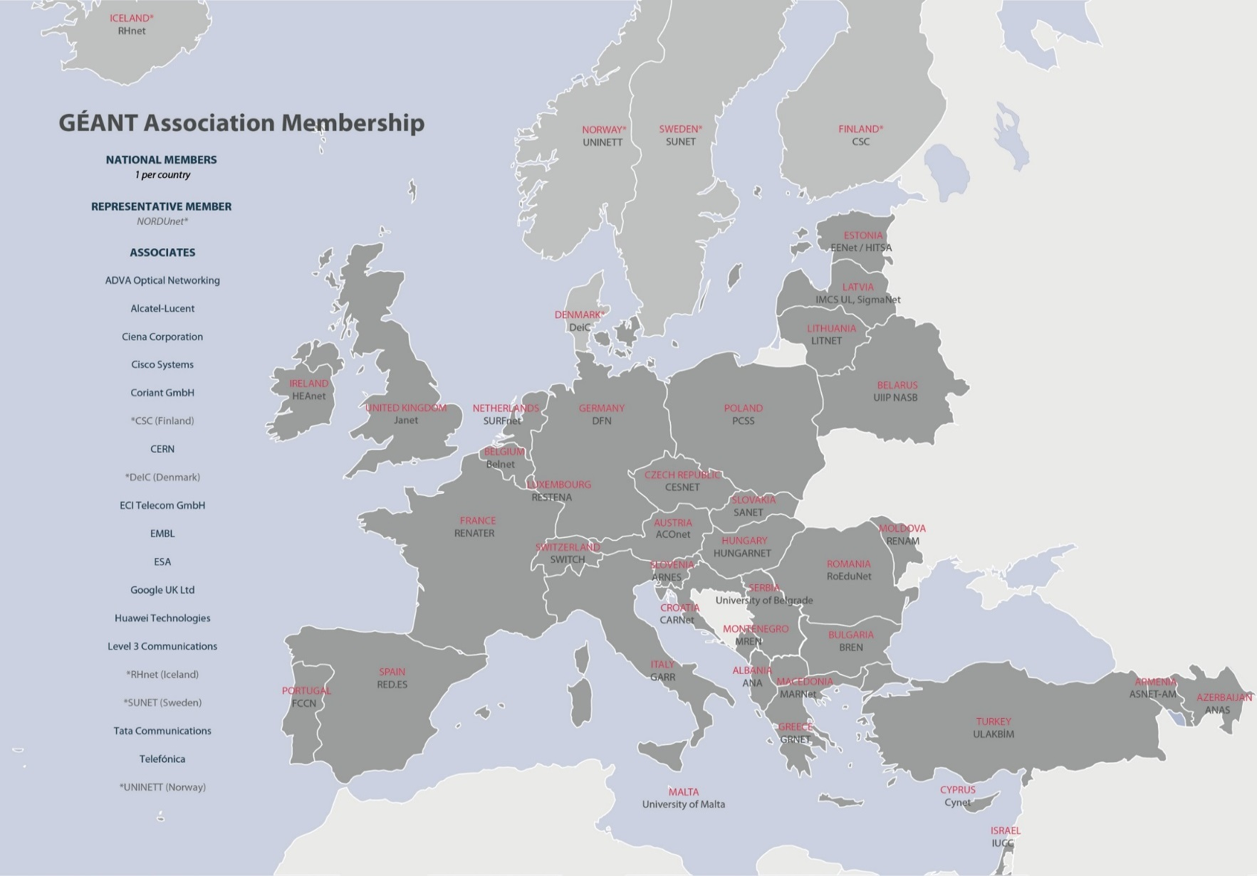
Current members
Notes:
Association representatives meet 3 x per year at the GÉANT Association Assembly = main decision making body.

Slide 4






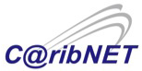
GÉANT - Networks
Manages research & education networking projects
Procures, builds and operates large-scale, advanced international high-speed networks
  GÉANT (Europe)
  EUMEDCONNECT (Mediterranean)
  AfricaConnect (Africa)
  CAREN (Central Asia)
  EAPConnect (Eastern Partnership Countries)
Supports and assists other regional projects
  ORIENTplus (Europe-China collaboration)
  TEIN*CC (Asia-Pacific)
  RedCLARA (Latin America)
  CKLN (Caribbean)
Notes:
GÉANT manages research and education networking projects in partnership with the European Commission (EC), our European NREN members, global NRENs and other partners.
At the core of these projects is to interconnect national research and education networking (NREN) organisations in different regions, through the procurement, building and operation of large-scale, advanced international high-speed networks. Some of the projects also include development and delivery of services above the network, and research into networking technologies.
GÉ​ANT currently manages networking projects serving Europe (GÉANT Project), the Eastern Partnership countries (EaPConnect), the Mediterranean (EUMEDCONNECT3), Central Asia (CAREN2) and Africa (AfricaConnect2). We also participate in the Fed4FIRE testbed 'future internet' project and support GLIF, the Global Lambda Integrated Facility​. ​ An overview of these projects is shown below, with further information available on the respective project websites.

Slide 5
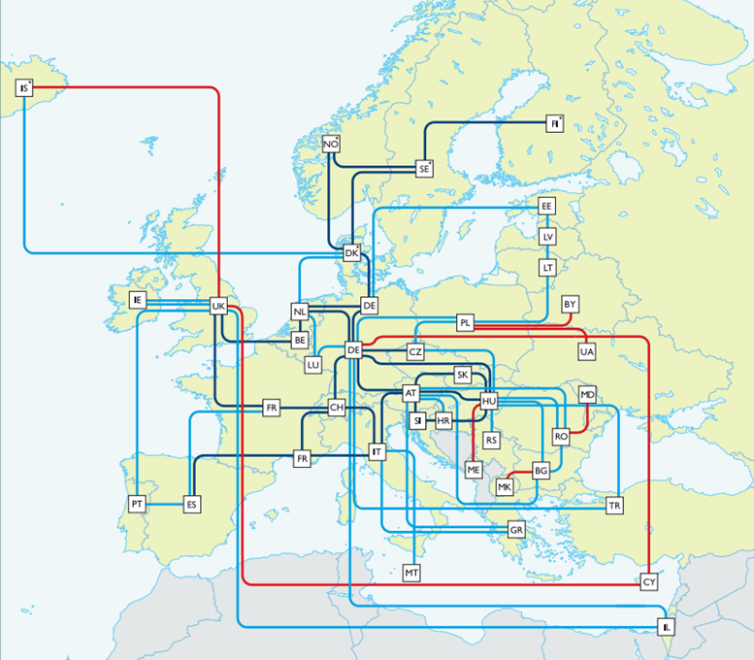
The GÉANT Pan-European Network infrastructure
Widely diversified footprint
  Serves 50M users
  10,000 institutions
  40 European countries
Operates at speeds up to 500Gbps
50,000km network infrastructure on 44 routes
~2,000 terabytes of data transferred across network per day
100% average monthly IP service availability
Notes:
The GÉANT network is the largest and most advanced R&E network in the world, connecting over 50 million users at 10,000 institutions across Europe and supporting all scientific disciplines
The network operates at speeds of up to 500Gbps and reaches over 100 national networks worldwide.
The network and associated services are co-funded by the European Commission through the GÉANT project
The project coordinator is the GÉANT organisation on behalf of Europe’s NRENs.
Responsibility for the network is allocated to the individual NREN organisations for supporting and maintaining their respective national networks, while GÉANT also maintains and operates the connecting backbone network on a pan-European basis.
Over 1000 terabytes of data is transferred via the GÉANT IP backbone every day.
12,000km of dark fibre on 18 routes
28 European POPs

Slide 6
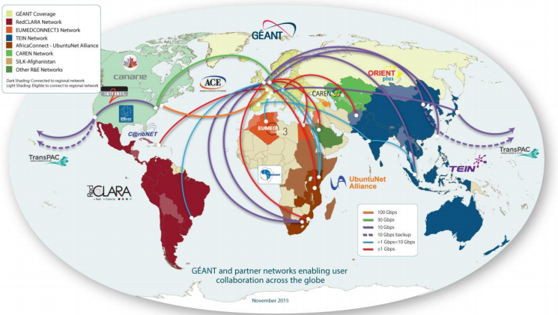
Global connectivity
GÉANT network is connected to all continents
Interconnecting >100 countries globally
Notes:
In addition to its pan-European reach, the GÉANT network has extensive links to networks in other world regions including North America, Latin America, the Caribbean, North Africa and the Middle East, Southern and Eastern Africa, the Eastern Partnership, Central Asia and the Asia-Pacific Region.
Work is also on-going to connect to Western and Central Africa.
Latin America - RedCLARA is regional R&E Network for Latin America:
connects 13 Latin American NRENs
Interconnects with GÉANT at 5Gbps (London – Brazil)
Work ongoing to procur submarine fibre between London and ??

Slide 7
GÉANT – Asia-Pacific connectivity
TEIN*CC
  10G Singapore-London
  2.5G (update to 10G in a few weeks) Mumbai-Madrid (Mumbai-Singapore already upgraded to 10G)
ORIENT+
  10G Beijing-London (10 years China-EU agreement)
SINET5 (Japan)
  2x10G Tokyo-London (low-latency land route – funded by NII)
  10G backup route via North America
TIFR (India)
  10G peering via CERNLight
NKN (India)
  2x10G expected in 2016

Slide 8
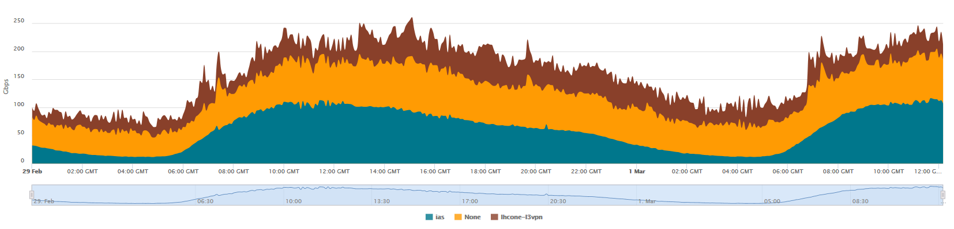
Traffic facts
1.9 Pbytes of unique data per day (including weekends in the averaging) without considering lambdas
693 Pbytes of unique data (inbound counting only) switched per year
Peak of over 300Gbps on busy days, average of 180Gbps
LHCONE traffic accounts for slightly less than 1/3 of the overall IP average traffic, with a similar amount on IAS and slightly higher on the Global R&E table

Slide 9


Services
Connectivity & network management
  Standard IP, up to multiple 100Gbps
  MD-VPNs (L2 and L3)
  Point-to-point circuits
  Wavelengths 10 -100Gbps
  Open Exchange for global & commercial collaborations 1, 10, 100Gbps
  Networking Testbeds
  International and Commercial Peerings
  Firewall on-demand
End to end Performance
  perfSONAR – Real-time, multi-domain performance monitoring
  eduPERT – Performance troubleshooting
Trust, Identity and Security
  eduGAIN – Secure access, single sign-on
  Eduroam – ​Seamless Wi-Fi access for research and education around the world​
One Stop Shop
  Consultancy
  International co-ordination
  Bespoke solutions
Summer 2016:
Cloud services –GÉANT as community broker
Notes:
On top pf the physical infrastructure we provide a range of accompanying services
Available to all users who are connected o an NREN

Slide 10

Support for International Users
Dedicated User Support Team
  to ensure users gain full benefit from the GÉANT infrastructure and services
Single point-of-contact
  for international collaborations and organisations
Providing a one-stop-shop
  to analyse, implement and manage international networking needs
Policy and technical consultancy
  for public and commercial organisations wishing to connect to GÉANT
User’s voice within GÉANT
  International User Advisor Committee, NREN feedback, Surveys, Conferences, Focus Groups….

Slide 11
The One-stop-shop concept
Work closely with Users, NRENs, other e-Infrastructures and GÉANT subject experts
Discuss and understand user requirements
Develop a consolidated and consistent solution for all involved sites:
technical/administrative/financial/contractual
Ensure seamless service implementation and operation through full project lifecycle management
Respect for the NRENs administrative boundaries→ GÉANT connects networks, not end-sites

Slide 12
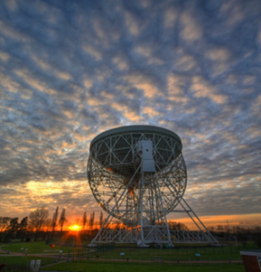


User we work with
High-Energy Physics and Astronomy
Earth Sciences and Observations
Future Internet Projects
Life Sciences
Social Sciences, Arts and Humanities
E-Infrastructures
Notes:
Via the GÉANT User Support Function, GÉANT actively engages with a broad range of user communities s

Slide 13
GÉANT – Asia-Pacific scientific collaborations
A few examples

Slide 14
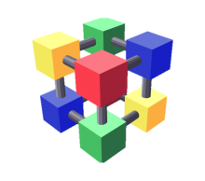

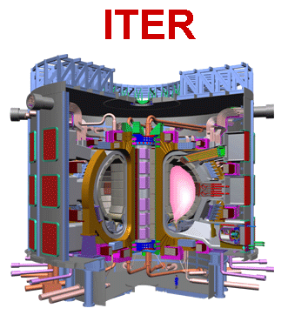
Physics community
Connectivity to WLCG sites for LHC and BELLE II
~15 WLCG sites in the Asia-Pacific area + KEK (BELLE 2 T0)
Increasing support to the LHCONE connectivity
ITER
  HELIOS (Rokkasho - JP) supercomputing facility
  10G circuit to GÉANT/RENATER (Cadarache)
    migrated on the new 100G PAR-NY

Slide 15

EUMETSAT is the European operational satellite agency for monitoring weather, climate and the environment.
Operate a system of meteorological satellites that observe the atmosphere and ocean and land surfaces – 24 hours a day, 365 days a year.
This data is supplied to the National Meteorological Services of the organisation's Member and Cooperating States in Europe, as well as other users worldwide (USA, Korea, Africa).
EUMETCast Terrestrial data distribution using IP multicast from EUMETSAT HQ in Germany
  Europe - using GÉANT and the NRENs networks (30+ countries)
  United States – using GEANT & Internet2
  ASIA – using GÉANT , TEIN, KOREN (Korea), AARnet (Australia)
      Preparing to work with China (CSTnet) and India

Slide 16
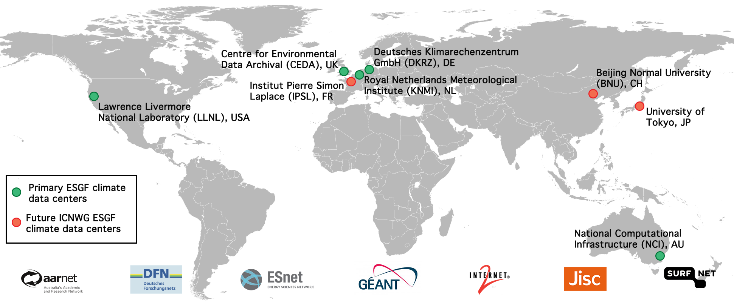
International network for Climate Science

Slide 17
Future Internet projects
SmartFIRE, Fed4FIRE
Interconnecting network testbeds for advanced research
New protocol and technology for wired and wireless networking
Collaboration with KOREN and KREONET
  Point-to-point L2 connections between Europe and Korean institutions

Slide 18
JAXA-ESOC joint mission control
JAXA (Japanese Space Agency) and ESOC (European Space Agency Control Centre) to provide mutual backup to for mission control
ESOC’s BepiColombo (Mars landing) and JAXA’s Hayabusa2 (asteroid exploration) missions
  Replaced existing expensive commercial ISDN connections
QoS parameters specified in terms of loss, RTT, throughput to support VOIP and mission control applications
Two paths (using GÉANT point to point service):
  West: Europe-US-Japan
  East: Europe-China-Japan

Slide 19













InfiniCortex
Use of InfiniBand on the WAN
A “Galaxy of Supercomputers” scattered across the world
Successful demos:
  Supercomputing Frontiers (March ‘15)
  TNC15
  ISC 2015 (June ‘15)
  SC15
The SC15 demo has used some newly deployed GÉANT international links
  100G Paris-NY (30G from Poznan to SC)
  TEIN London-Singapore direct 10G
GÉANT will host some InfiniBand equipment in the London PoP for a Europan InfiniCortex infrastructure

Slide 20


TNC16 – Building the Internet of People
12-16 June 2016
Prague, Czech Republic
Register online until 3 June, also for the (free!) extra events!
Call for Participation, round 2 is open:
Submit posters and lightning talks!
Deadline: 15 April, midnight CEST
http://tnc16.geant.org

Slide 21
Questions?
Vincenzo.capone@geant.org

