Slide 1
LHCONE Reachability Measurement
Michael O’Connor moc@es.net
Network Engineering
Energy Sciences Network
Lawrence Berkeley National Lab
LHCOPN-LHCONE Meeting
Taipei Taiwan
March 13, 2016

Slide 2
Introduction LHCONE
The LHC Open Network Environment VRF Overlay Network is intended to be built on shared network infrastructure.
100Gbps technologies have reduced bandwidth costs making virtual network overlays cheap, quick and scalable, expect this paradigm to grow.
The reduced cost, increased speed and the community centric governance models of overlay networks greatly enhance the Globally Distributed Compute Model relied on by international scientific collaborations.
LHCONE will evolve, connecting is to join in shaping that evolution.
LHCONE is not like other Internet uplinks, planning and care are essential for a smooth integration.
Notes:
LHCONE Introduction
Distinguish from OPN
Describe virtual network architecture

Slide 3
LHCONE Global Expansion
LHCONE expansion is driving the incorporation of continental transit service to bridge gaps in the existing full mesh BGP architecture.
On the general Internet, no single provider – no matter how big – connects to all subscribers or to all of the global content.
To connect it all together (to give all subscribers access to all content), providers must spend money and connect their networks together.
What options and approaches are available in the research and education networking space to maintain full connectivity among all LHCONE participating institutions?
The challenge is to provide transit services in a zero cost peering framework

Slide 4
Brief History of LHCONE Routing Architecture
The early LHCONE implementation was a full BGP mesh
North America
  CANET, ESnet, Internet2
Europe
  GEANT, NORDUnet, CERN
Transit paths were well established along standard provider customer relationships and funding models.
Recently GEANT and Internet2 have begun
providing LHCONE transit service.
In general, LHCONE NSPs will consider providing transit on a case by case basis
Notes:
Small network
Full Mesh of participating networks Europe and North America

Slide 5
Full Mesh LHCONE BGP Routing
Established point to point or multipoint BGP peering
Today the principle LHCONE NSPs form a full BGP Mesh, establishing a fully connected network.
CANET
NORDU
NET
ESnet
GEANT
Internet2 hosted multipoint BGP exchanges could be considered a form of transit concentrated within in a POP.
I2
GEANT provides LHCONE transit for the RNP network in Brasil
In general, LHCONE NSPs will consider providing transit on a case by case basis

Slide 6
Connecting to Asia
KREONET Hypothetical Example
Example:
If ASGC joins LHCONE by connecting to CANET, ESnet and I2 on the US west coast in Seattle WA
CANET
NORDU
NET
ASGC
ESnet
GEANT
I2
What options exist for GEANT, NORDUnet and ASGC to exchange routes?

Slide 7
Connecting to Asia
KREONET Hypothetical Example
Example:
If ASGC joins LHCONE by connecting to CANET, ESnet and I2 on the US west coast in Seattle WA
CANET
NORD
ASGC
ESnet
GEANT
Maintain Full Mesh by:
ASGC establishing a point of presence at an exchange where GEANT and NORDUnet are located, or vice versa.
I2

Slide 8
Connecting to Asia
ASGC Hypothetical Example
Dedicated transcontinental circuits are no longer required.
Transit service also provides alternate paths to CANET and ESnet.
CANET
NORD
ASGC
ESnet
GEANT
I2
Use a Transit NSP:
Hypothetically, I2Transit service fills in the gaps left in the partial mesh by exporting the full routing table to ASGC.

Slide 9
Connecting to Asia
How will this scale?
CANET
NORD
TEIN
KREO
NET
ESnet
ASGC
GEANT
TWAREN
ARnet
I2
Clearly an Asian regional transit service similar to that provided by GEANT in Europe would simplify LHCONE expansion into Asia.

Slide 10
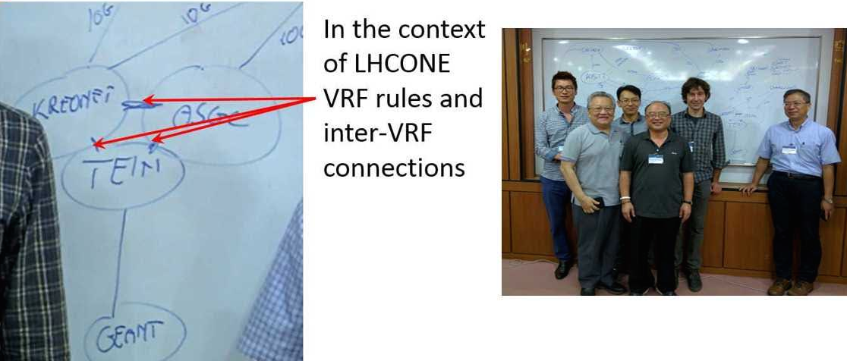
Asian Transit Agreement
TEIN, ASGC, KREOnet
TEIN, ASGC & KREOnet have agreed to implement LHCONE VRFs and to interconnect them in Hong-Kong where they will transit LHCONE globally.

Slide 11
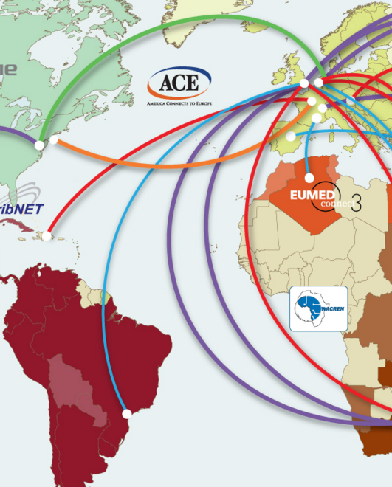
Brazil via GEANT
When RNP (Brazil) peered with the GEANT LHCONE VRF the LHCONE path from ESnet to RNP Crossed the Atlantic twice.
Path:
New York, London, Sao Paulo
ESnet and RNP peered directly in WIX to improve path efficiency by ~60ms
LHCONE paths should be compared with the General Internet Path
Notes:
*B:aofa-cr5# show router 111 route-table ipv4 200.17.30.0
===============================================================================
Route Table (Service: 111)
===============================================================================
Dest Prefix[Flags] Type Proto Age Pref
Next Hop[Interface Name] Metric
-------------------------------------------------------------------------------
200.17.30.0/24 Remote BGP VPN 02h32m47s 170
134.55.200.147 (tunneled) 0
-------------------------------------------------------------------------------
No. of Routes: 1
Flags: n = Number of times nexthop is repeated
B = BGP backup route available
L = LFA nexthop available
S = Sticky ECMP requested
===============================================================================
*B:aofa-cr5# show router 111 bgp route 200.17.30.0/24
===============================================================================
BGP Router ID:134.55.200.132 AS:293 Local AS:293
===============================================================================
Legend -
Status codes : u - used, s - suppressed, h - history, d - decayed, * - valid
Origin codes : i - IGP, e - EGP, ? - incomplete, > - best, b - backup
===============================================================================
BGP IPv4 Routes
===============================================================================
Flag Network LocalPref MED
Nexthop Path-Id Label
As-Path
-------------------------------------------------------------------------------
*i 200.17.30.0/24 None 1527
198.124.80.10 None -
20965 1916 28571
-------------------------------------------------------------------------------
Routes : 1
===============================================================================
*B:aofa-cr5#
GEANT(20965) RNP(1916) USAO-PAULO(28571)
ESnet LHCONE peers with RNP in Wash.
Email 8/30/15 from wej
Some notes:
LHC related institutions: HEPGrid is CMS, CBPF is LHCb, SPRACE is CMS, and SAMPA is ALICE.
RNP is the national R&E networking organization, IP is its IP network.
RNP backbone comprises 27 Points of Presence (PoPs), which are located in universities. In S\xc3\xa3o Paulo, RNP PoP is at USP Computer Center
.
So, RNP serves both as a backbone and as a connector network.
ANSP is a regional R&E network serving the state of S\xc3\xa3o Paulo, is a completely separate network, it does not use or depend on RNP backb
one.
[Think CENIC vs. Internet2. -wej]
PTTA: Verizon Terremarks "NAP do Brasil" in So Paulo is the open exchange point operated by ANSP. ANSP and RNP exchange traffic at PTTA and th
e connection to RedCLARA is at PTTA. (PTTA is an acyronym for "academic traffic exchange point").
[Like AmPath in Verizon Terremark\xe2\x80\x99s "NAP of America" in Miami. -wej]
Redecomep is a network aggregator for sites in Rio de Janeiro (CBPF, HEPGrid UERJ).
SouthernLight is the term used in the context of the GLIF project to characterize the South American distributed GOLE (GLIF Open Lightpath Exc
hange point) in which RNP and ANSP are the main actors.
[Not currently related to LHCONE, but a potential partner in the LHCONE P2P testing. wej
CRAZY ROUTE
Bill,
I noticed that we are using a GEANT route from their London router, so to arrive in Brazil we take a couple trips across the Atlantic.
The RTT is 263ms.
A:aofa-cr5# ping router 111 152.84.101.1
PING 152.84.101.1 56 data bytes
64 bytes from 152.84.101.1: icmp_seq=1 ttl=248 time=263ms.
64 bytes from 152.84.101.1: icmp_seq=2 ttl=248 time=263ms.
64 bytes from 152.84.101.1: icmp_seq=3 ttl=248 time=263ms.
A:aofa-cr5# traceroute router 111 152.84.101.0
traceroute to 152.84.101.0, 30 hops max, 40 byte packets
1 62.40.126.151 (62.40.126.151) 70.5 ms 70.7 ms 70.5 ms
2 62.40.126.150 (62.40.126.150) 73.6 ms 86.9 ms 73.4 ms
3 62.40.126.174 (62.40.126.174) 255 ms 255 ms 255 ms
4 rj-sp-nau.bkb.rnp.br (200.143.252.70) 263 ms
4 0.0.0.0 * *
5 0.0.0.0 * * *
6 0.0.0.0 * * *
7 0.0.0.0 * * *
8 200.20.97.158 (200.20.97.158) 263 ms 263 ms 264 ms
9 10.1.1.2 (10.1.1.2) 267 ms
Today March 8, 2016
*B:aofa-cr5# ping router 111 152.84.101.1
PING 152.84.101.1 56 data bytes
64 bytes from 152.84.101.1: icmp_seq=2 ttl=247 time=206ms.
64 bytes from 152.84.101.1: icmp_seq=3 ttl=247 time=206ms.
64 bytes from 152.84.101.1: icmp_seq=4 ttl=247 time=206ms.
64 bytes from 152.84.101.1: icmp_seq=5 ttl=247 time=206ms.
Request timed out. icmp_seq=1.
---- 152.84.101.1 PING Statistics ----
5 packets transmitted, 4 packets received, 20.00% packet loss
round-trip min = 206ms, avg = 206ms, max = 206ms, stddev = 0.088ms
*B:aofa-cr5# traceroute router 111 152.84.101.1
traceroute to 152.84.101.1, 30 hops max, 40 byte packets
1 esnet-lhc1-wix-rnp.es.net (198.124.80.157) 5.93 ms 5.94 ms 5.92 ms
2 rnp-lhc1-wix-esnet.es.net (198.124.80.158) 218 ms
2 0.0.0.0 *
2 rnp-lhc1-wix-esnet.es.net (198.124.80.158) 227 ms
3 0.0.0.0 * * *
4 0.0.0.0 *
4 sp2-rj-oi.bkb.rnp.br (200.143.253.222) 207 ms 206 ms
5 0.0.0.0 * * *
6 0.0.0.0 * * *
7 200.20.97.158 (200.20.97.158) 207 ms 207 ms
7 0.0.0.0 *
8 10.1.1.2 (10.1.1.2) 207 ms
8 0.0.0.0 *
8 10.1.1.2 (10.1.1.2) 207 ms

Slide 12
The Need for Measurement
Goal – To ensure that every LHCONE site is reachable by every other LHCONE site across the LHCONE network.
Global expansion of the LHCONE network has strained the full mesh architecture between NSPs.
To maintain full reachability, LHCONE now requires some NSPs to provide transit to other NSPs.
These transit arrangements are being arranged on a case by case basis, there may be gaps.
As a high performance network, routing path efficiency will need to be maintained between NSPs.
Notes:
LHCONE growth into Asia and the Americas may result in LHCONE reachability issues due to the aforementioned routing policies.
Measurement will be required to maintain 100% reachability for all LHCONE connected sites.

Slide 13
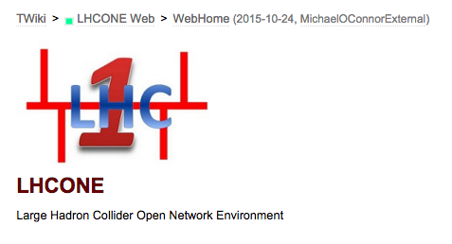
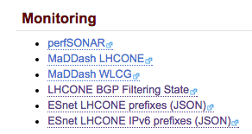
Maintaining LHCONE Reachability
Through Measurement
twiki.cern.ch/twiki/bin/view/LHCONE/WebHome
A new report containing LHCONE BGP Ipv4 and Ipv6 route prefixes.
JSON format facilitates automated route table comparisons.
Proposal:
Define an LHCONE route table reporting format.
Principle NSPs will share LHCONE route tables.
Table comparison will yield an LHCONE reachability metric, identifying isolated prefixes.

Slide 14
Summary
LHCONE success is driving expansion and that is a good thing.
To manage growth, the community needs to develop:
    Strategies for maintaining LHCONE reachability.
    Policies for mitigating the exploitation risk of zero cost transit services.
What are the transit policies of the principle LHCONE NSPs?
Are existing transit policies sufficient to support global expansion?
What technical approaches and tools are required to maintain a fully connected LHCONE network?

Slide 15
Thank You
Michael O’Connor moc@es.net
Network Engineering
Energy Sciences Network
Lawrence Berkeley National Lab
LHCOPN-LHCONE Meeting
Taipei Taiwan
March 13, 2016

