Slide 1
LHCONE Operations Update
Michael O’Connor moc@es.net
Network Engineering
Energy Sciences Network
Lawrence Berkeley National Lab
LHCOPN-LHCONE Meeting
Taipei Taiwan
March 13, 2016

Slide 2
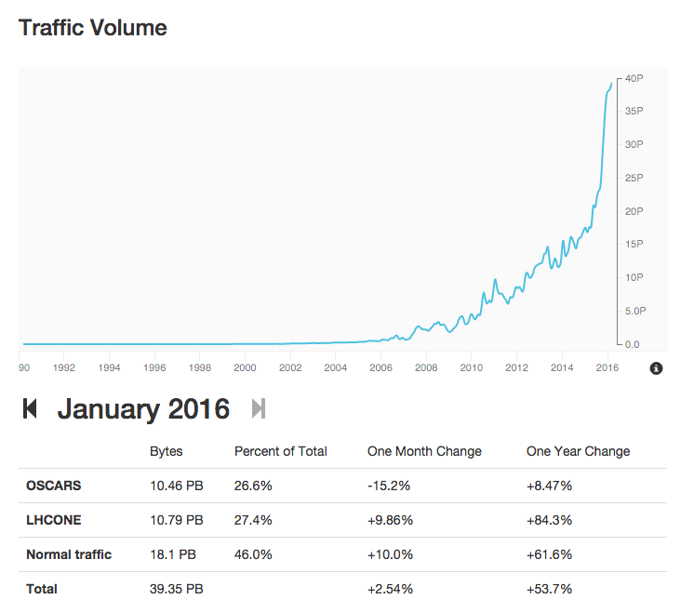
ESnet Traffic Volumes
LHCONE represents more than 27% of ESnet accepted traffic

Slide 3
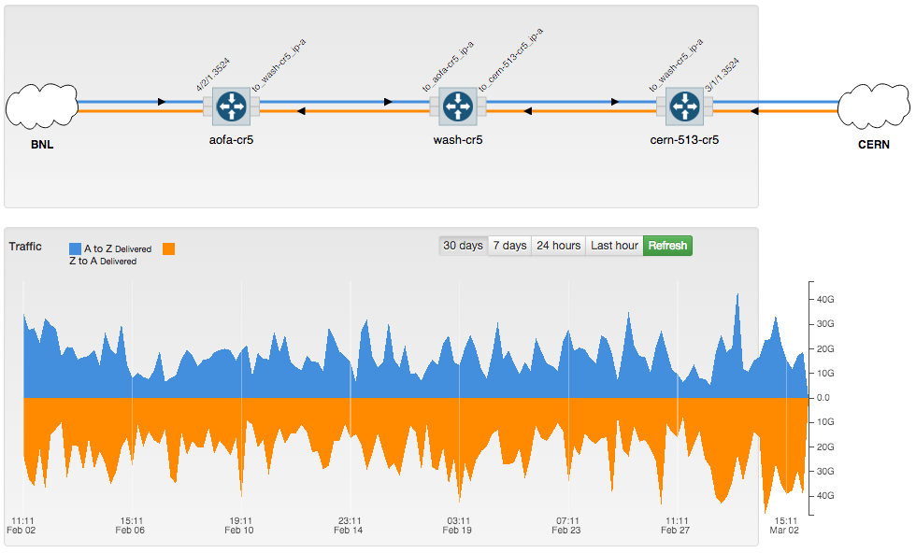
LHCOPN US ATLAS Tier1 BNL
Last 30 Days

Slide 4
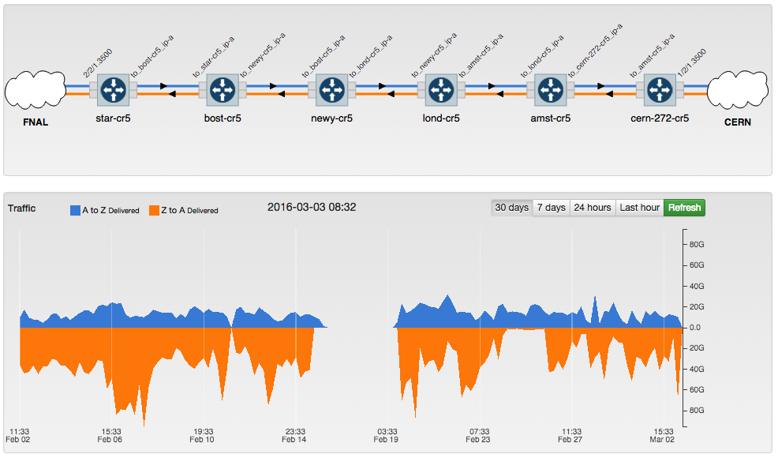
LHCOPN US CMS Tier1 Fermilab
Last 30 Days
Why is there a large gap in this data?

Slide 5
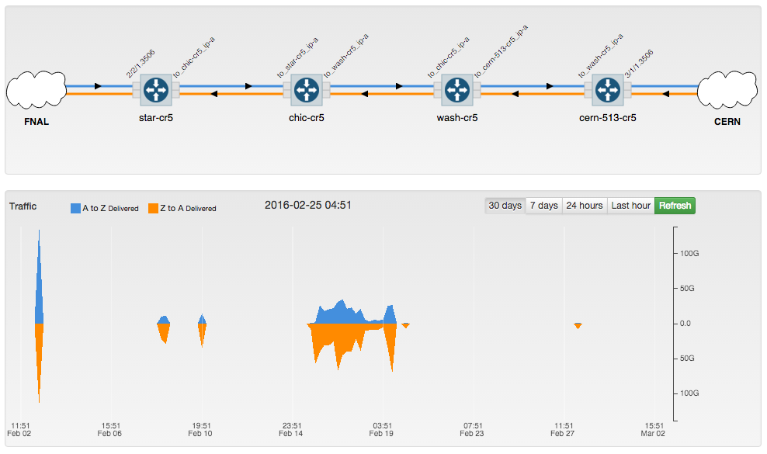
LHCOPN US CMS Tier1 Fermilab
Last 30 Days
Fermilab shifted their traffic to their secondary during a period of TA link instability in Feb.

Slide 6
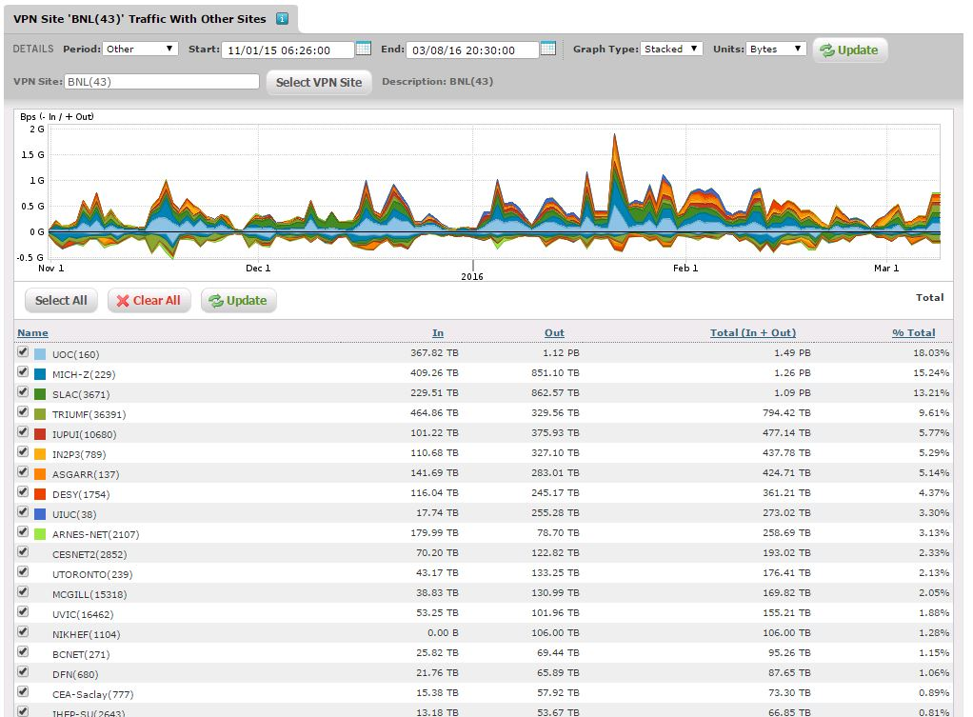
LHCONE BNL Top Sites
By Octets Transferred

Slide 7
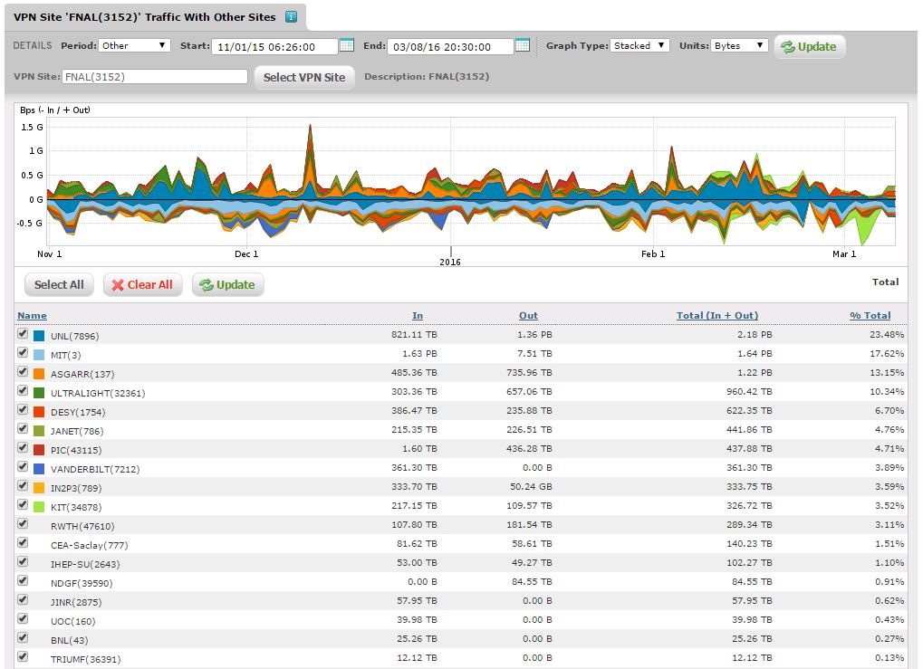
LHCONE Fermilab Top Sites
By Octets Transferred

Slide 8
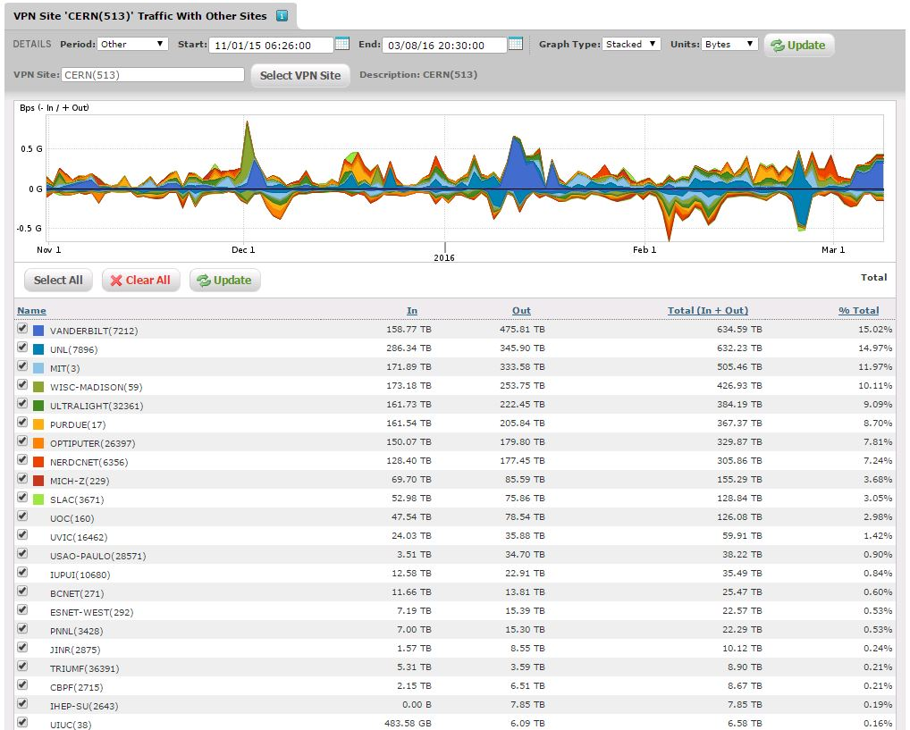
LHCONE ESnet/CERN Top Sites
By Octets Transferred
CERN also connects to GEANT/LHCONE.
Not represented here.

Slide 9
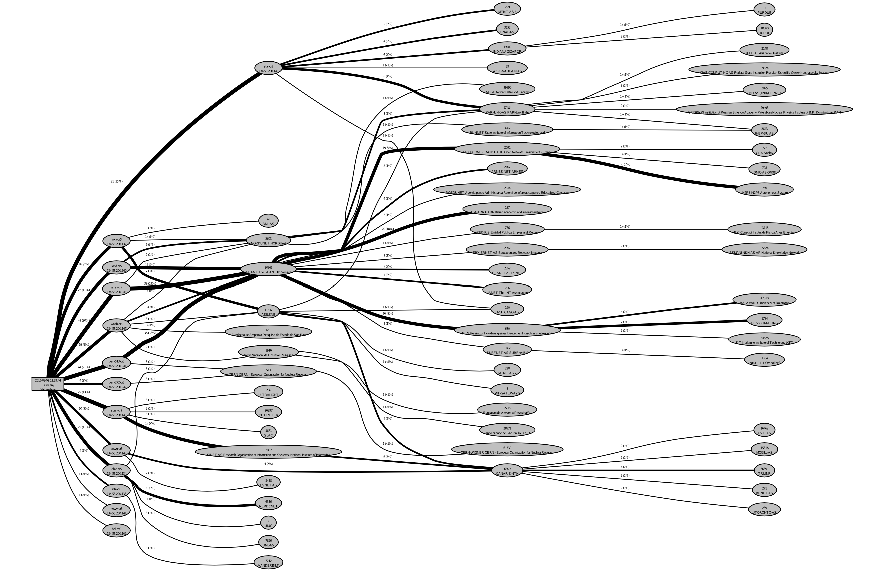
ESnet LHCONE Reachability Graph
Routing Layer
A routed view of the LHCONE network from the perspective of ESnet
https://twiki.cern.ch/twiki/pub/LHCONE/LhcOneVRF/LHCONE-RoutingVis.svg
Notes:
https://twiki.cern.ch/twiki/pub/LHCONE/LhcOneVRF/LHCONE-RoutingVis.svg

Slide 10
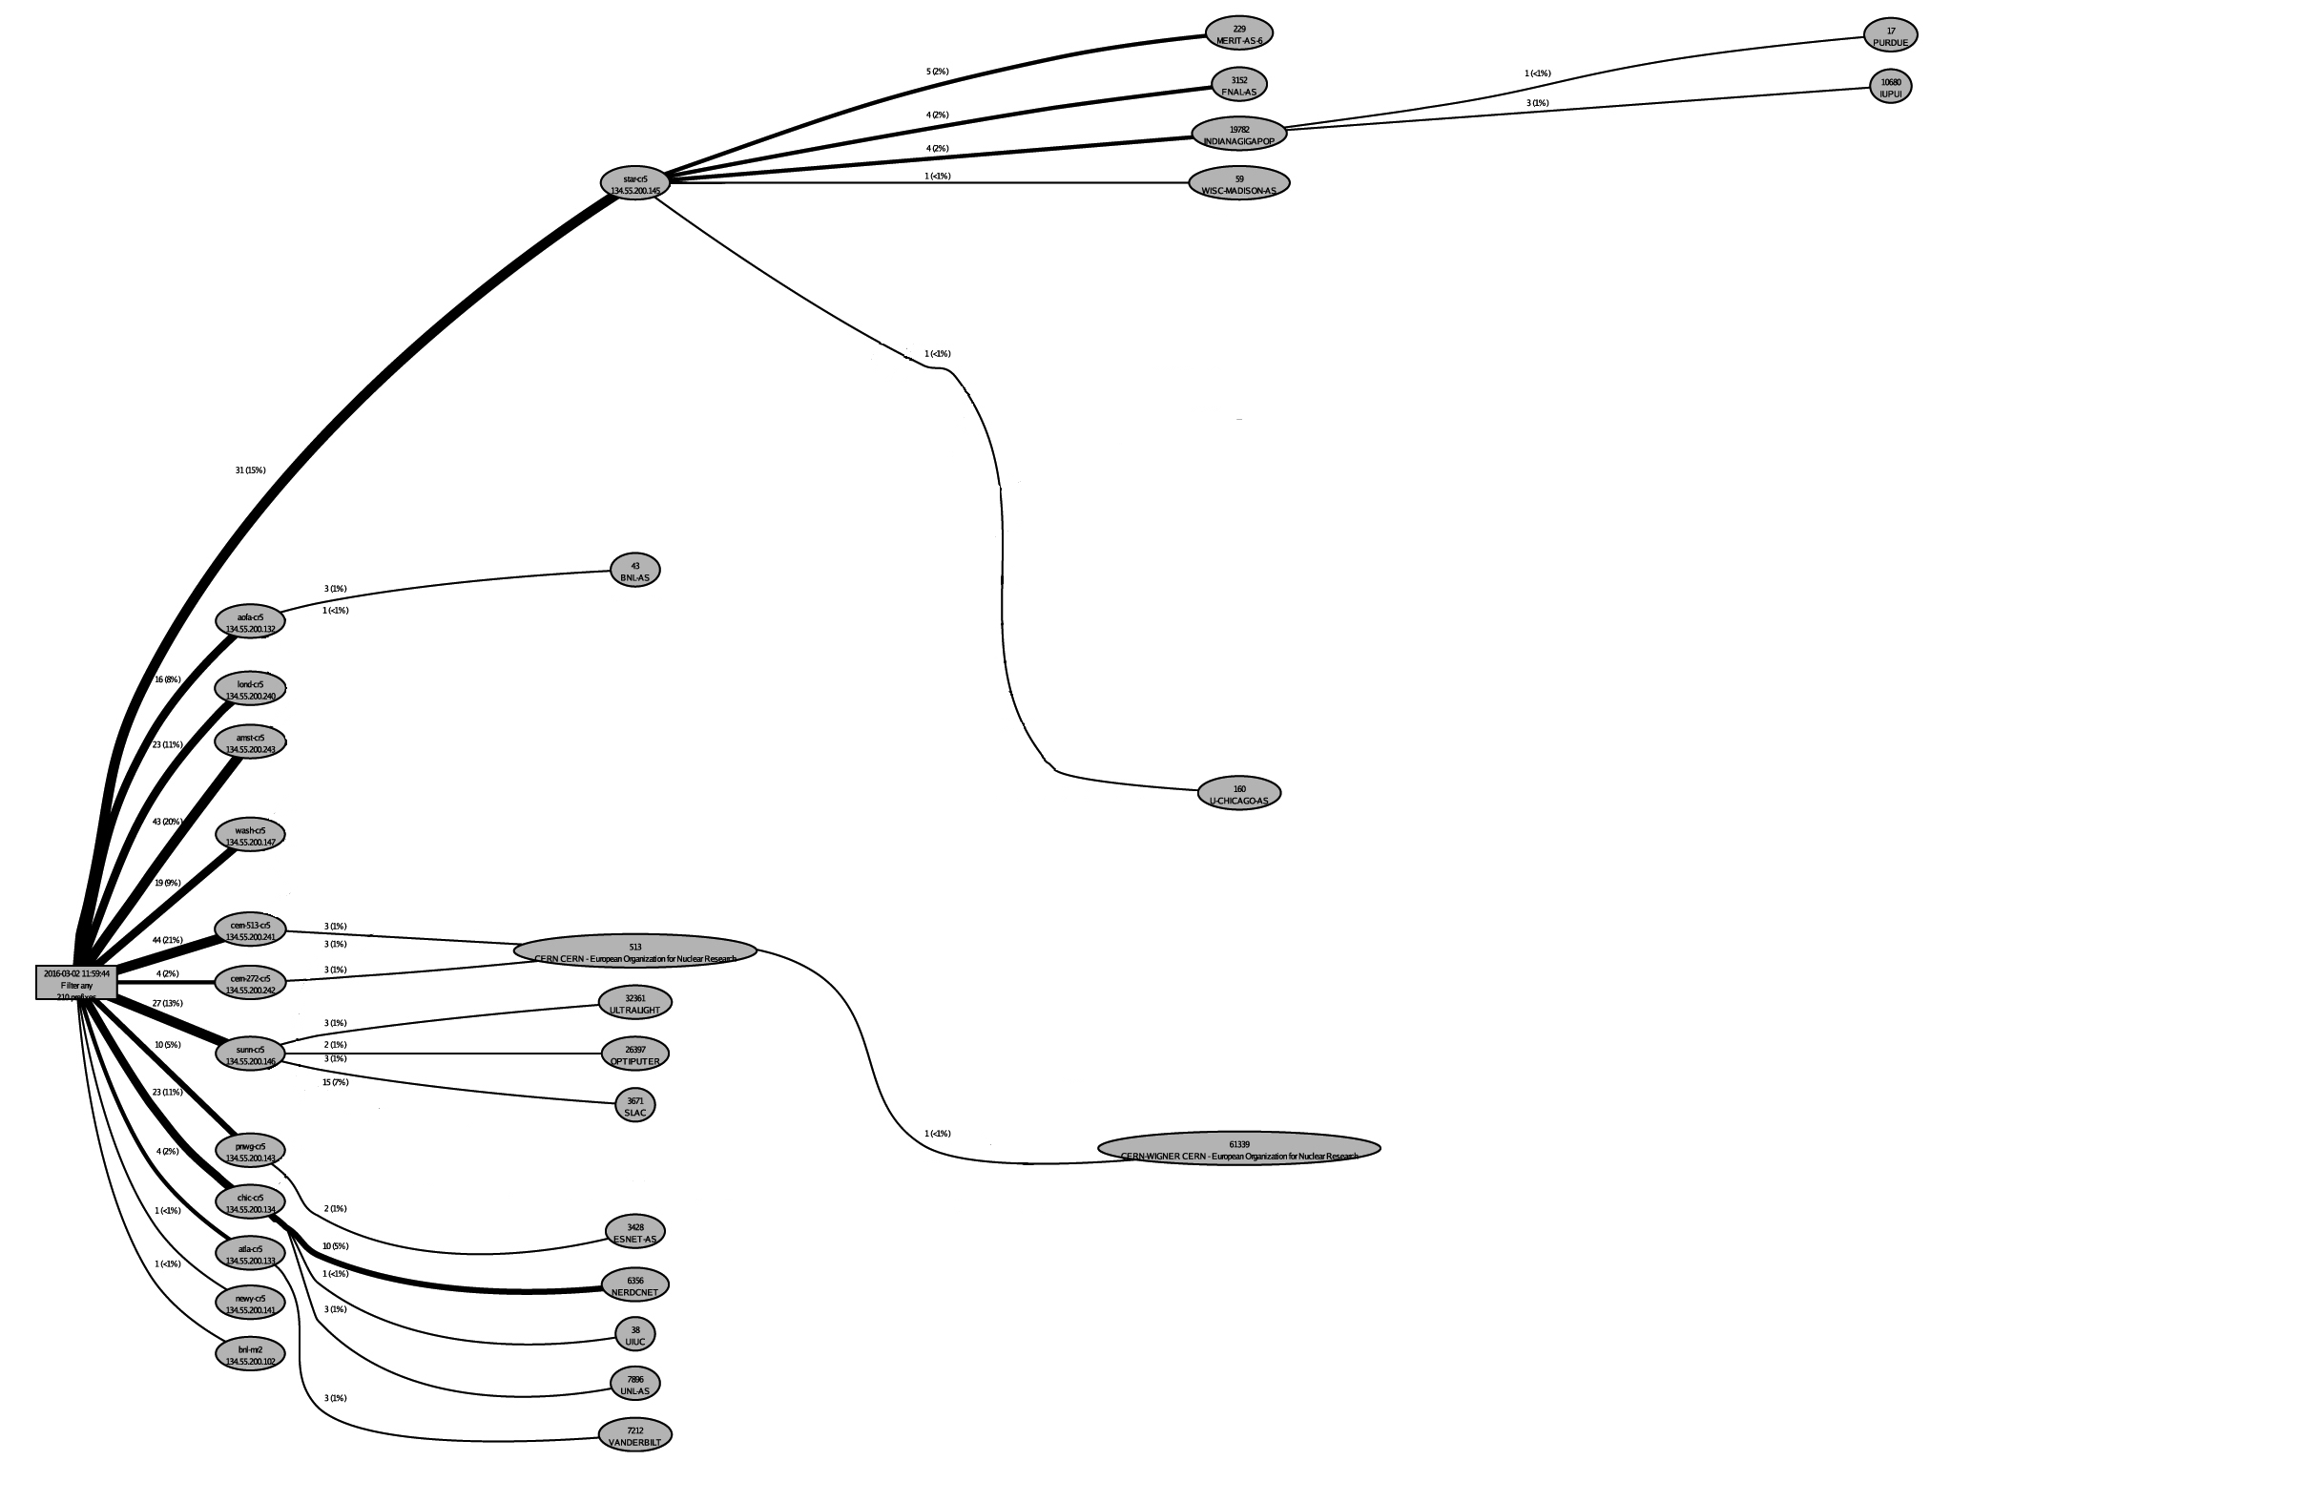
ESnet LHCONE Site Routes
Exported to Peers
When an LHCONE NSP BGP peers with ESnet, these are the sites that we advertise to them.

Slide 11
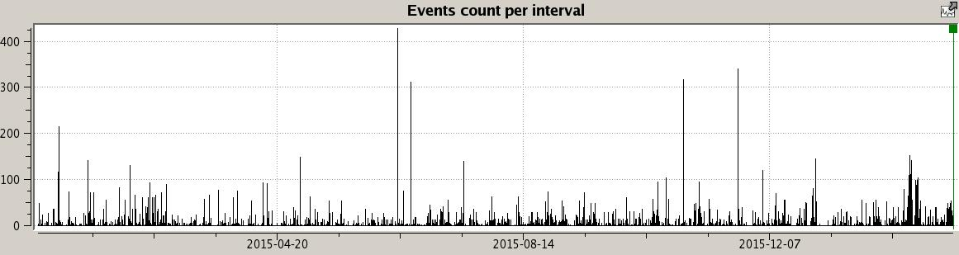
ESnet LHCONE BGP Events
Past 14 Months
BGP Events:
Routes added
Routes withdrawn
Neighbor State Transitions

Slide 12
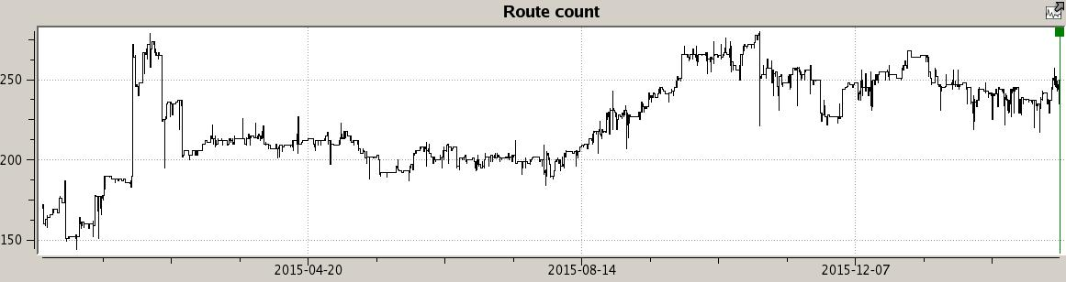
ESnet LHCONE BGP Table Size
Past 14 Months
BGP Table size has varied between 150 to 275 routes received on all peers

Slide 13
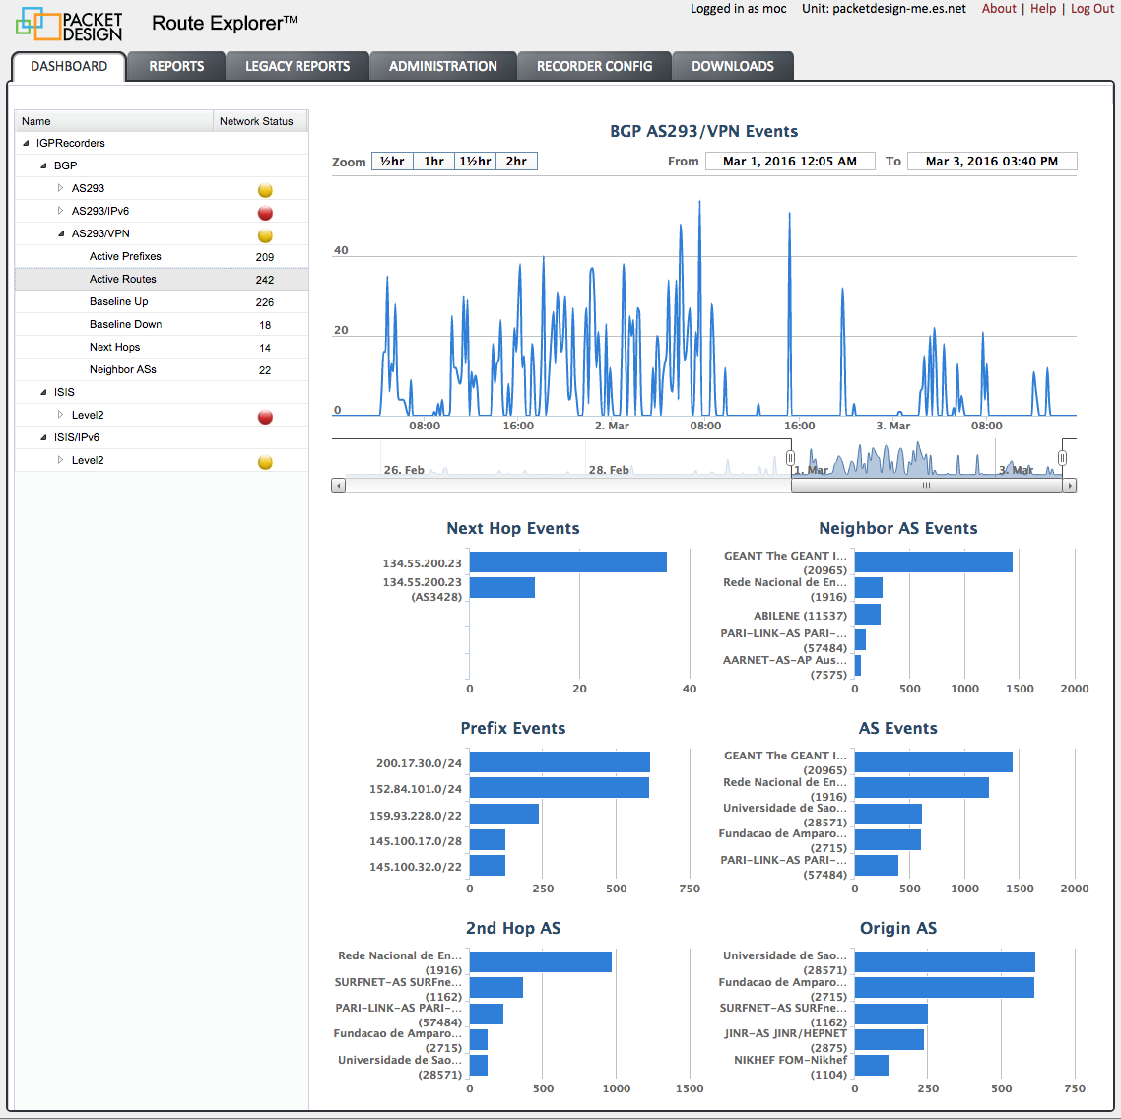
LHCONE ESnet BGP Highlight Report

Slide 14
LHCONE Site Example
Destination Routing
LHCONE DTN(S) DUAL-HOMED
VRF1
LHCONE
VRF1 No BGP export of
LHCONE routes to VRF2
Management
IBGP
VRF2
CAMPUS LANS
General
Internet
Firewall
If the LHCONE can be separated into a VR or VRF then standard destination based routing can be used

Slide 15
Multiple Overlay Networks
Scaling For Additional Overlay Networks
LHCONE DTN(S) DUAL-HOMED
VRF1
LHCONE
Management
IBGP
MESH
VRF2
CAMPUS LANS
General
Internet
Firewall
Management
2nd Overlay
LAN
VRF3
2nd Overlay
WAN
The additional overhead of protocol configuration pays back in scalability and powerful routing policy control.

Slide 16
Science Enclave DTNs
Science Enclave
Contributed by Eli Dart ESnet Science Engagement

Slide 17
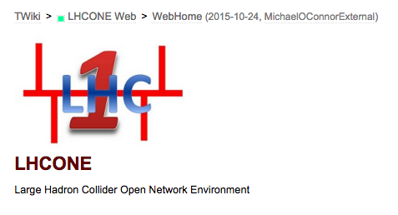
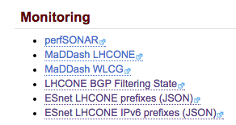
LHCONE BGP Filtering State Reporting twiki.cern.ch/twiki/bin/view/LHCONE/WebHome
A report containing LHCONE BGP filtering community tags in use. (updated hourly)
Community | Meaning
65001:ASN | Prepend Local ASN 1X to Export to Peer ASN
65002:ASN | Prepend Local ASN 2X to Export to Peer ASN
65003:ASN | Prepend Local ASN 3X to Export to Peer ASN
65010:ASN | Do not Export to Peer ASN

Slide 18
LHCONE BGP Filtering State Analysis
GMT: Wed Mar 9 20:45:00 2016
CERN(513)
128.142.0.0/16 PREPEND 2X(65002) to KIAE(59624)
128.142.0.0/16 DO NOT ANNOUNCE(65010) to CERN(513)
188.184.128.0/17 PREPEND 2X(65002) to KIAE(59624)
188.184.128.0/17 DO NOT ANNOUNCE(65010) to CERN(513)
KIAE-TRANSIT(57484)
144.206.255.128/26 PREPEND 2X(65002) to CERN(513)
CERN-WIGNER(61339)
188.185.128.0/17 PREPEND 2X(65002) to KIAE(59624)
188.185.128.0/17 DO NOT ANNOUNCE(65010) to CERN(513)
CERN Testing
ESnet Service: http://calendar.es.net/lhcone/lhconedata/lhcone-filter.txt

Slide 19
LHCONE BGP Filtering Guidelines
Service Definition document V1.0
The BGP filtering service is intended to be used by an LHCONE end site to prevent the distribution of their BGP route prefixes to another LHCONE end-site.
An individual BGP community tag will be used for each and every remote end site that is filtered.
A site will tag ALL of the route prefixes it exports into LHCONE uniformly.
NSP ASNs are NOT valid for use in LHCONE BGP Filtering communities.
NSPs will only provision this service at their customer edge and will NOT provision it on internal LHCONE NSP/NSP BGP peerings.
NSPs only filter prefixes for their directly attached customers on export to those customers. Otherwise they pass LHCONE BGP Filtering communities along without modification.
https://twiki.cern.ch/twiki/pub/LHCONE/LhcOneVRF/LHCONEBGPFilteringServiceDefinition.pdf

Slide 20
LHCONE BGP Filtering State Reporting twiki.cern.ch/twiki/bin/view/LHCONE/WebHome
A new report containing LHCONE BGP Ipv4 and Ipv6 route prefixes.

Slide 21
LHCONE IPv6
Connected Sites
March 2016
Site List:
ARNES-NET(2107)
ASGARR(137)
CEA-Saclay(777)
CERN(513)
DESY(1754)
FNAL(3152)
GEANT(20965)
IN2P3(789)
KIT(34878)
AGLT2(229)
NDGF(39590)
PIC(43115)
PURDUE(17)
THAIREN(24475)
THAISARN(3836)
UNINET-TH(836)
WISC-MADISON(59)

Slide 22
LHCONE Ipv6 Table
October 2015
32
2001:3c8::/32 GEANT(20965) TEIN2(24490) THAIREN(24475) UNINET-TH(836)
2001:f00::/32 GEANT(20965) TEIN2(24490) THAIREN(24475) THAISARN(3836)
42
2001:948:40::/42 NORDUNET(2603) NDGF(39590)
46
2a00:1398:104::/46 GEANT(20965) DFN(680) KIT(34878)
48
2001:1458:301::/48 GEANT(20965) CERN(513)
2001:18e8:804::/48 UINDIANA(19782) PURDUE(17)
2001:3c8:1012::/48 GEANT(20965) TEIN2(24490) THAIREN(24475)
2001:48a8:68f7::/48 MICH-Z(229)
2001:660:5009::/48 GEANT(20965) LHC1-RENATER(2091) IN2P3(789)
2001:760:4205::/48 GEANT(20965) ASGARR(137)
2001:760:4224::/48 GEANT(20965) ASGARR(137)
2001:948:30::/48 NORDUNET(2603) NDGF(39590)
50
2001:48a8:68f7:4000::/50 AGLT2(229)
2001:48a8:68f7:8000::/50 AGLT2(229)
2001:48a8:68f7::/50 AGLT2(229)
2001:48a8:68f7:c000::/50 AGLT2(229)
64
2001:1470:8000:403::/64 GEANT(20965) ARNES-NET(2107)
2001:1470:ff80:6d::/64 GEANT(20965) ARNES-NET(2107)
2001:638:700:1062::/64 GEANT(20965) DFN(680) DESY(1754)
2001:638:700:10a0::/64 GEANT(20965) DFN(680) DESY(1754)
2001:638:700:10bf::/64 GEANT(20965) DFN(680) DESY(1754)
2001:638:700:10c0::/64 GEANT(20965) DFN(680) DESY(1754)
22 IPv6 End Site Route Prefixes
IPv6 network advertisements are very large, standards need to be drafted

Slide 23
Thank You
Michael O’Connor moc@es.net
Network Engineering
Energy Sciences Network
Lawrence Berkeley National Lab
LHCOPN-LHCONE Meeting
Taipei Taiwan
March 13, 2016

