Slide 1

LHCC Referee Meeting
01/12/2015
ALICE Status Report
Predrag Buncic
CERN

Slide 2
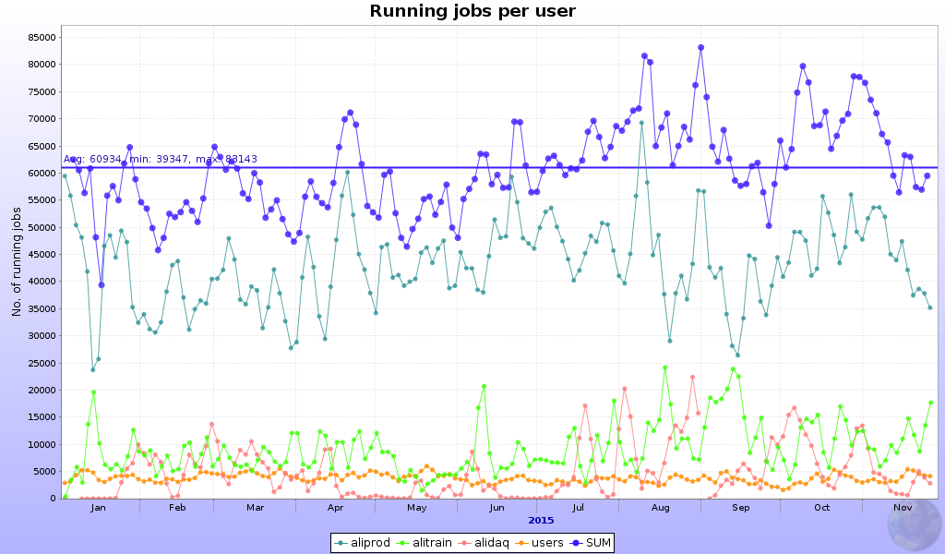
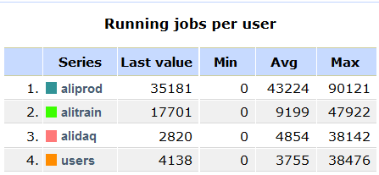
Grid usage
70%
16%
8%
6%

Slide 3
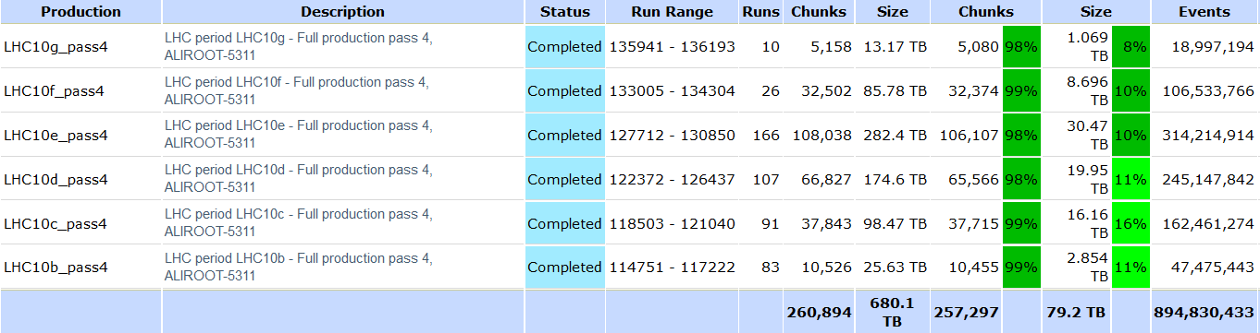
Data processing in 2015
MC – 96 cycles – usual number of productions
  1,952,334,979 events
  p-p, p-Pb, Pb-p, some Pb-Pb, some G4
RAW – reprocessed Run1 data

Slide 4
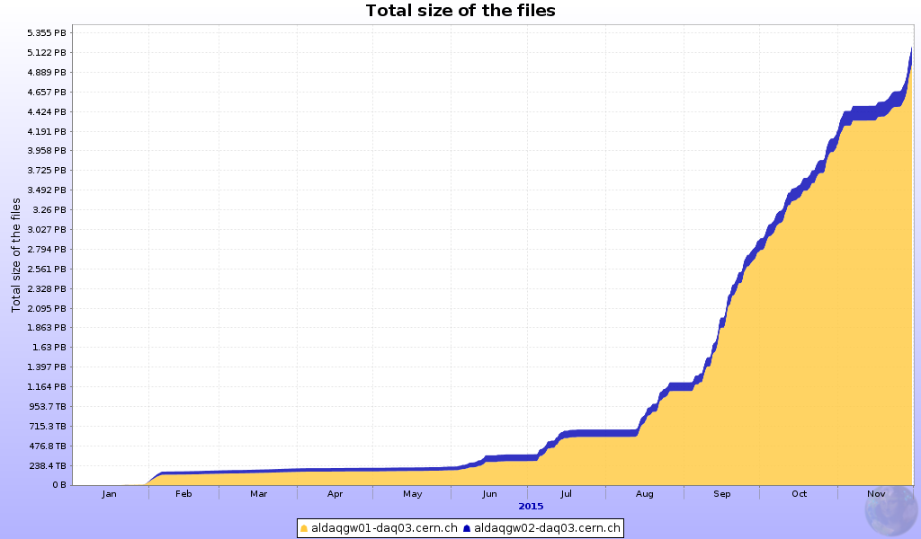
Run 2 progress
5.2 PB RAW
Registered data volume in 2015 – equal to the sum of 2010-2013

Slide 5
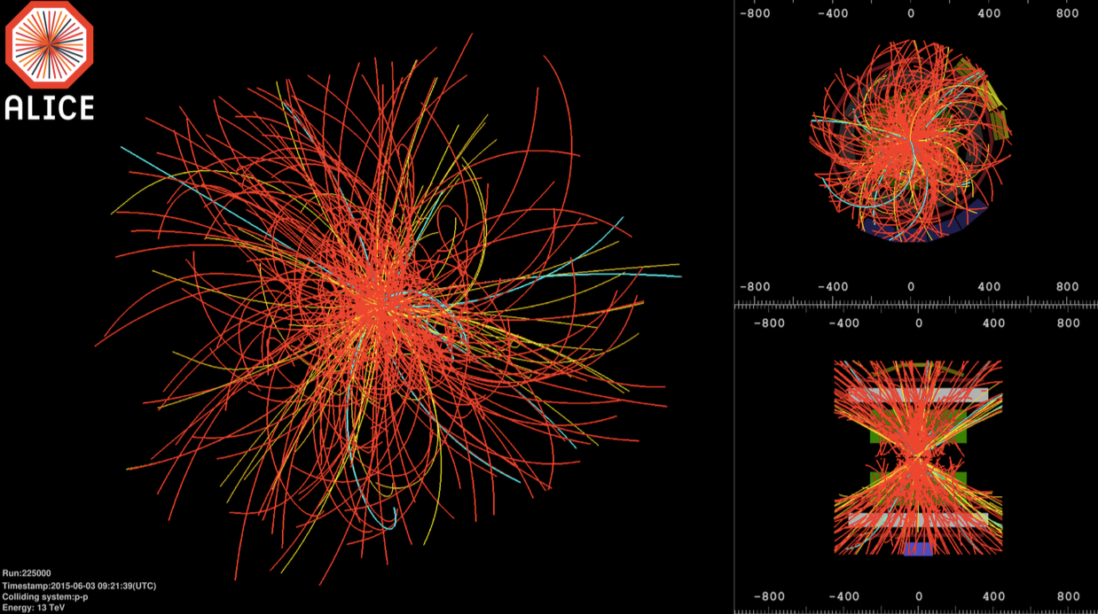
pp √s = 13 TeV
At highest interaction rates, events with pileup comparable to Pb+Pb collisions
TPC tracking code was modified to be able to correct for large distortions caused by the space charge build-up

Slide 6
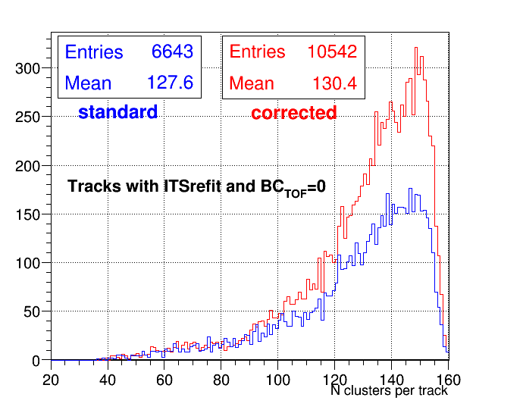
Test on 400 KHz interaction rate
New calibration step required to take these (time dependent) distortions
Comparing standard reconstruction with reconstruction using new correction:
  ITS Matching rate for triggered BC increases by ~60%
  N TPC clusters per track also increases
Note: ITS-matching was affected not only by the TPC track loss due to the distortions but also by wrong extrapolation from TPC to ITS

Slide 7
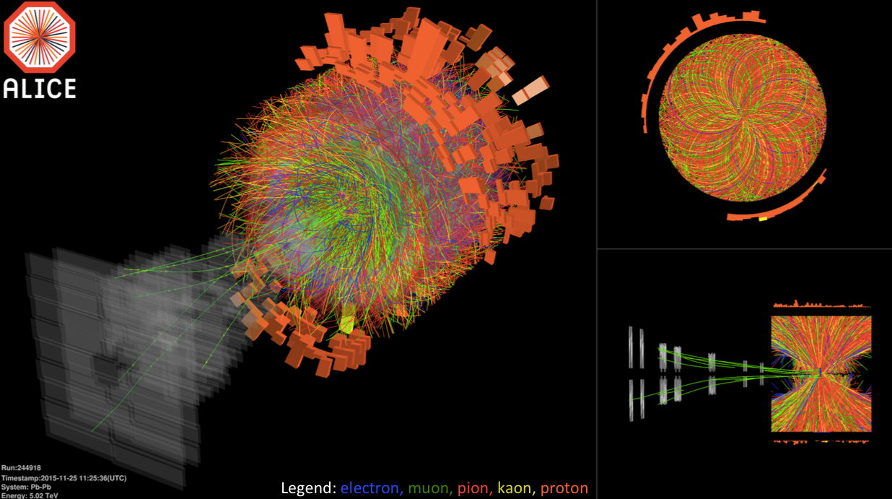
Pb-Pb at √s_{NN} = 5 TeV
Initial track seeding in the presence of distortions required to open the cuts in track search leading to increased memory usage
  => Request for temporary large memory queues on T1 sites

Slide 8
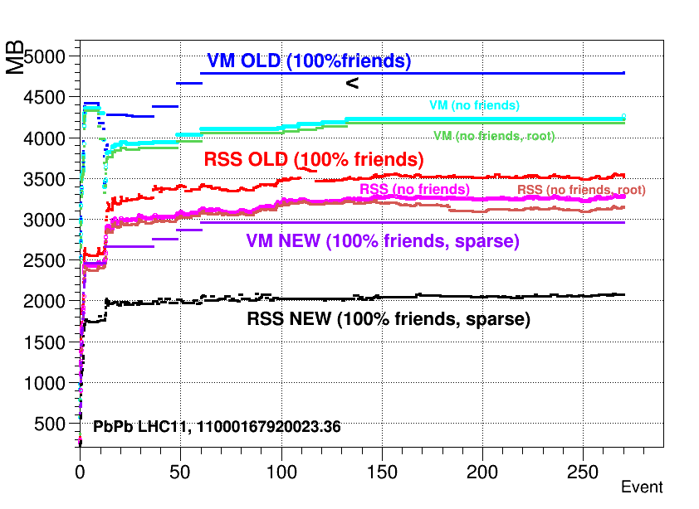
Memory consumption
Tests on the worst LHC11h data chunk
Now we are here
Last results obtained with modified code
  We remain under 2 GB/job limit for reconstruction

Slide 9
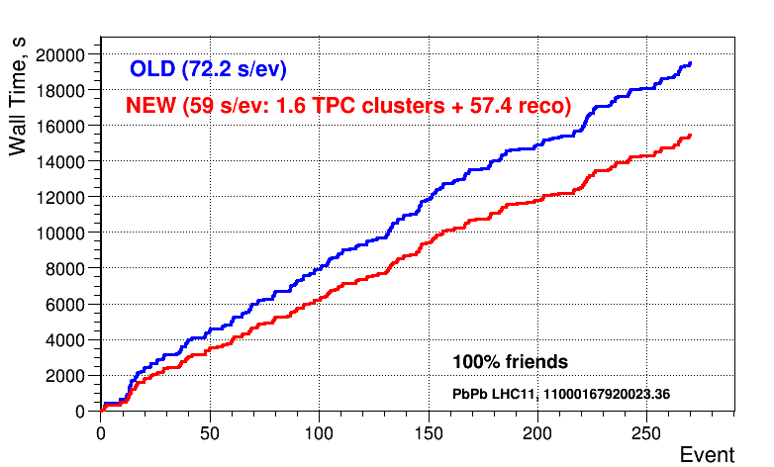
CPU performance
Tests on the same LHC11h data chunk
Gain of ~20% as by-product of memory optimization and optimization of TPC code
Unfortunately this gains were quickly lost due to increased complexity of events in Run 2

Slide 10
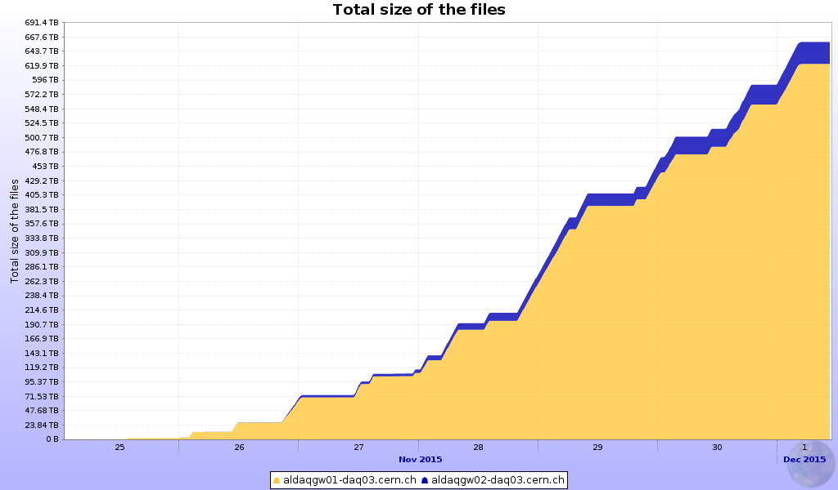
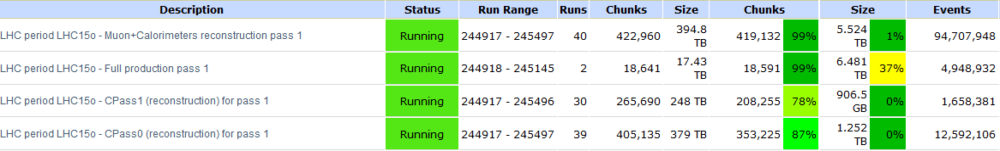
Status of Pb-Pb processing
Data taking
  Smooth operation
  40% of the data is
  replicated to T1s
Processing
  Fast cycle for Muon analysis and calorimeter calibration
  Full offline calibration cycle for global processing
  Special selection of runs for first physics
700 TB of RAW in one week

Slide 11
Expected disk space evolution (T0+T1s+T2s+O2)
Follow-up to O2 TDR
6-Oct: Meeting convened by the DRC with the 4 experiments to understand the global requirements
16-Oct: Meeting of ALICE (with IT and the WLCG
+ 15% / year (T0,T1)
+5%/ year (T2)
+02
PB
To be discussed
with CSRG
CRSG
Scrutinized
request
Conclusions
  Clarified projected evolution of resources at CERN
  O² architecture compatible with the WLCG.
  Bandwidth need from P2 to the Tier 0 will need to be increased.
    precise costing is being established.
  Bandwidth needs to the Grid will also increase and the requests
  to the Tier 1’s will be done in the near future.

Slide 12
First O2 milestones

Slide 13
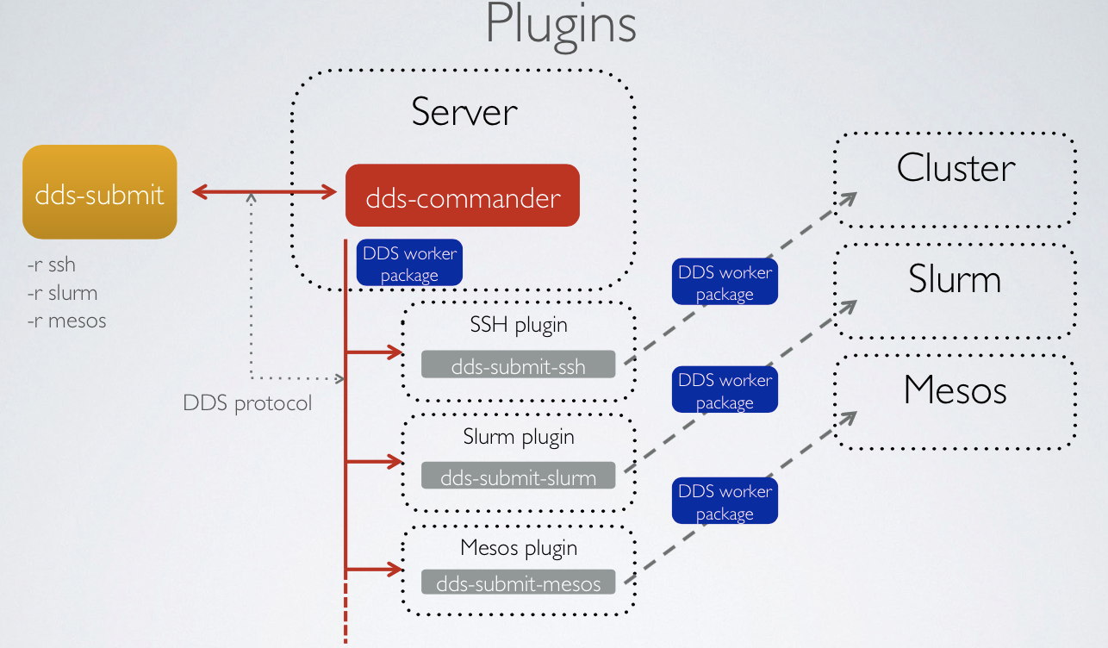
Dynamical Deployment System (DSS)
Current stable release - DDS v1.0 (2015-11-20, http://dds.gsi.de/download.html)
Home site: http://dds.gsi.de
User’s Manual: http://dds.gsi.de/documentation.html
DDS now provides pluggable mechanism for external schedulers

Slide 14
Software Lifecycle
tarballs
test results
source code
Develop
Build
and test
Deploy
and publish
Git-based
Integration builds
CVMFS, RPM, Ubuntu
Agile lifecycle: from code to published builds quickly, with automated tests
Philosophy: automatize as much as possible, trivialize human intervention
Objective for O²: refreshing aging infrastructure and paradigm
  Setup the infrastructure for running builds and tests: done
  Basic tools to build+publish current software and O²: done
  Visualization interface for the tests: In progress
  Automatic test and flagging of Pull Requests for O²: In progress
Basic infrastructure is ready way ahead of time: as of Sep 9, old system retired and already using it in production for current software

Slide 15
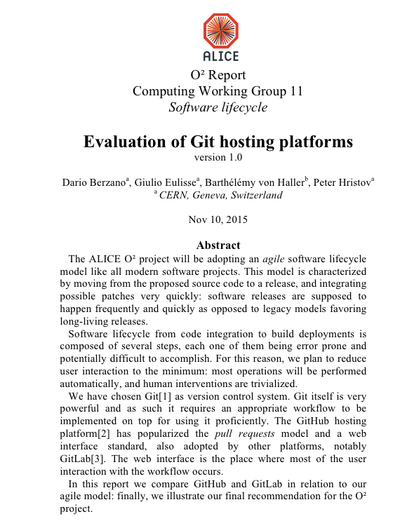
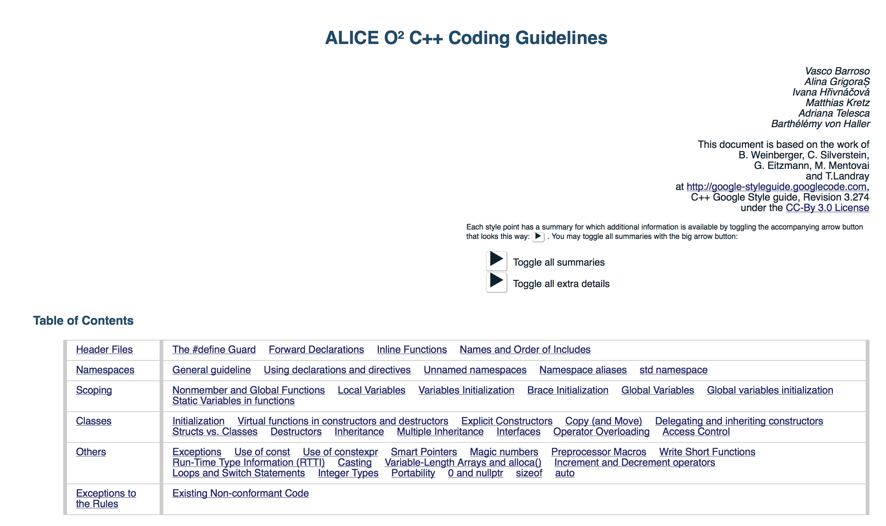
Software Tools and Procedures
Common license agreed: GPL v3 for ALICE O2 and LGPL v3 for ALFA

Slide 16
Summary
Data processing in 2015 follows usual pattern
  All requests have been fulfilled
  Number of tasks in the pipeline is manageable
  MC is, as usual, the main resources user (70%), followed by user tasks (22%) and RAW (8%)
Resources and infrastructure is able to cope with the production load
  Computing resources are stable and growing
Unexpectedly large distortions in TPC at high interaction rate required an extra calibration step and additional software development
  Now under control including memory per job
Work on O2 has started following the plan presented in the TDR

