Slide 1
LHC collimation
R. Bruce
on behalf of the CERN LHC collimation team
R. Bruce, 2015.11.16
1
Notes:
1
1

Slide 2
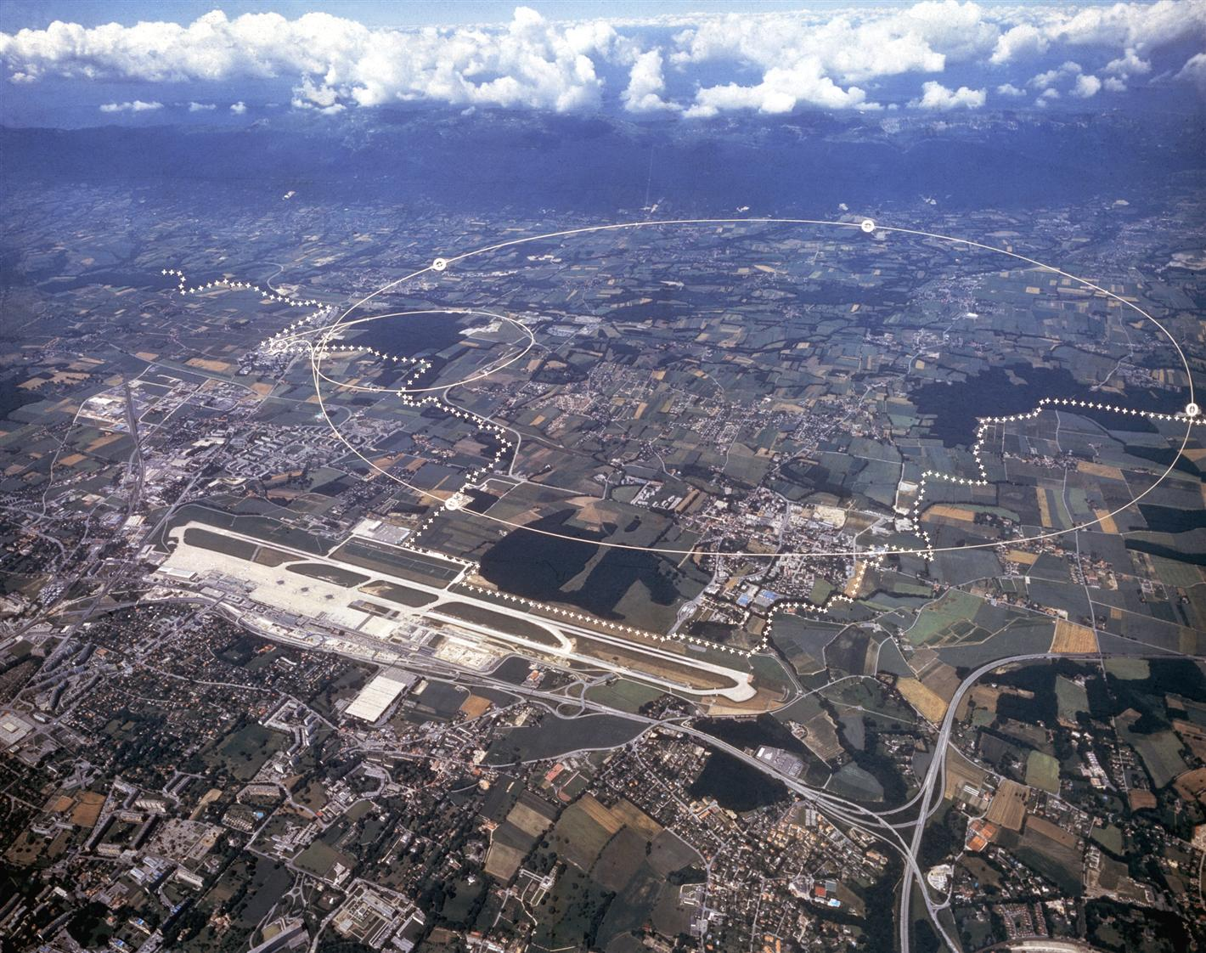
CERN
CERN is the world’s largest particle physics centre, founded in 1954
Located on the border between France and Switzerland
2600 employees, 7900 visiting scientists, 500 universities, 80 countries
LHC
France
Switzerland

Slide 3
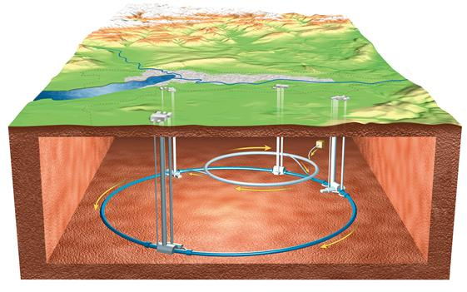
LHC (Large Hadron Collider)
Largest accelerator/collider (together with LEP) and highest energy ever
Design started in the early 1980’s, approved in 1995
Built in old LEP tunnel to collide
  7 TeV protons
  0.57 PeV Pb⁸²⁺
  nuclei (fully stripped ions)
4 interaction points (IPs) with experiments ATLAS, CMS, LHCb, ALICE
8 straight sect.,
8 arcs
www.cern.ch

Slide 4
Some LHC figures
27 km circumference
100 m underground
Almost 10 000 magnets, many superconducting
1.9 K working temperature of superconductors
10⁻¹³ atm vacuum pressure
Nominal LHC: 362 MJ stored beam energy

Slide 5
Physics motivation
PROTONS
  Find Higgs particle (ATLAS, CMS)
    Explain origin of mass
  Search for supersymmetric particles (ATLAS, CMS)
    Unification of forces
    Dark matter
  Balance between matter and antimatter in the universe
    Symmetry breaking in b-meson decay (LHCb)
HEAVY IONS
  Find and study quark-gluon plasma (ALICE)
    State of matter believed to have existed in the early universe. No colour confinement

Slide 6
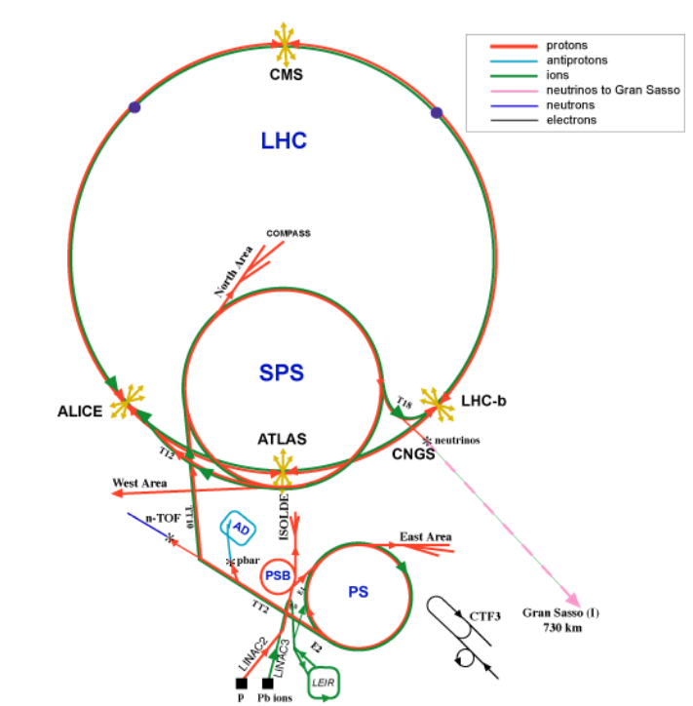
CERN complex
LHC last in chain of accelerators

Slide 7

LHC stored energy
Huge stored energy per beam : 362 MJ for nominal configuration,
675 MJ for planned upgrade HL-LHC
Beams could be highly destructive if not controlled well
v = 7 knots
675 MJ = kinetic energy of
USS Harry S. Truman
cruising at 7 knots

Slide 8
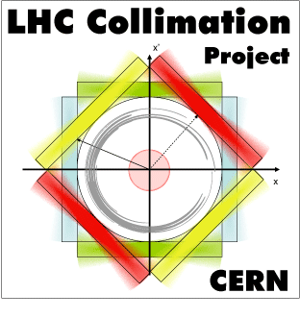
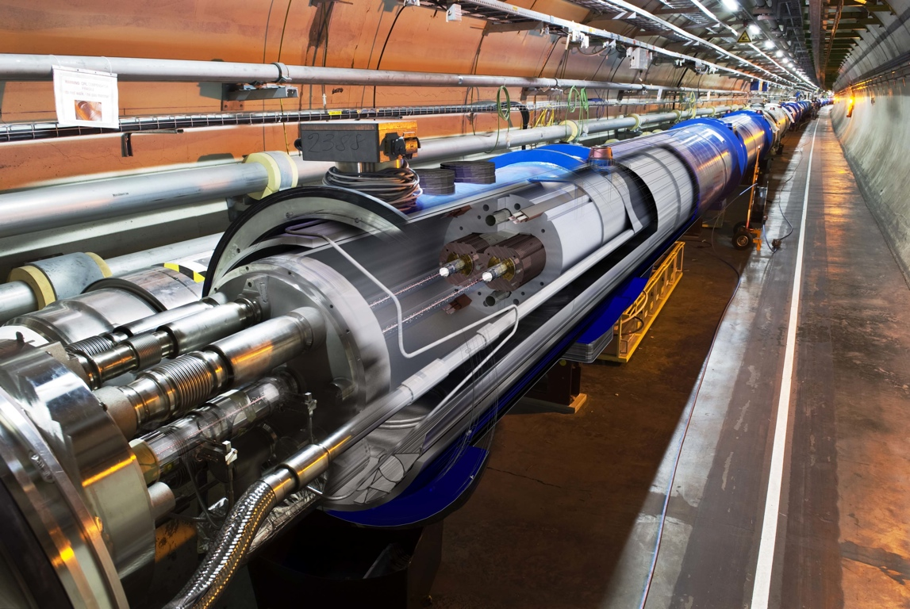

LHC challenge
Superconducting coil:
Aperture: r = 17/22 mm
T = 1.9 K, quench limit
~ 1e6 protons
Factor ~10⁸
Collimators play an essential role to prevent dangerous losses
  Collimator = movable absorber block, installed so that any particle that get far from the wanted trajectory is intercepted there and not by sensitive elements, e.g. magnets
Proton beam:
3e14 protons
(design: 362 MJ)

Slide 9
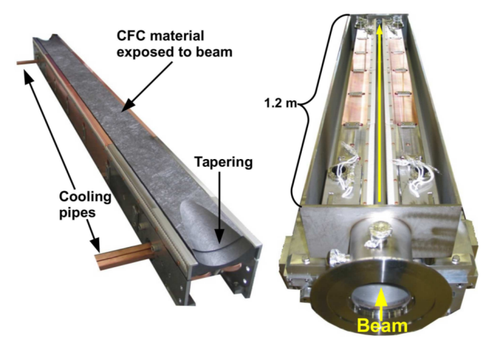
LHC collimators
Two jaws, beam passing in between, most are 1 m long

Slide 10
Roles of LHC collimation
Beam halo cleaning: Safely dispose of unavoidable beam losses
  allow high-intensity operation below quench limit of superconducting magnets
  Confine losses in dedicated regions to minimize radiation doses to sensitive equipment or personnel.
Passive machine protection: Absorb beam losses in case of beam failures
  protect sensitive equipment from damage and/or quenches
Physics debris cleaning: Catch losses from collision process in experiments.
  As for halo cleaning: stay clear of quenches and confine losses
Reduce background in experiments
  Catch incoming losses upstream of the detectors.

Slide 11
Beam loss mechanisms
Halo population and emittance growth from several sources:
  Collisions in experiments, long-range beam-beam effect
  Intra-beam scattering, Touschek effect, space charge
  Scattering on rest gas
  Beam acceleration, RF gymnastics
  Imperfections on RF, magnets, feedback
  Non-linearities, dynamic aperture
Fast beam failures
  Failure of magnets, RF cavities. Especially dangerous: bending dipoles and kickers

Slide 12
Where to add collimators
Global protection of whole ring or transfer line from beam-halo
  Possibly more cost-efficient than adding local protection to many elements
  Collimators should be the smallest normalized aperture limitation
  Which particles do we want to intercept – large betatron amplitudes or energy errors? Betatron vs momentum collimation
Local protection in front of sensitive equipment or just downstream loss source, such as collider experiment or dump kicker
  Simplest approach but often enough!
  Collimator should have smaller physical aperture than the element. Often fixed mask

Slide 13
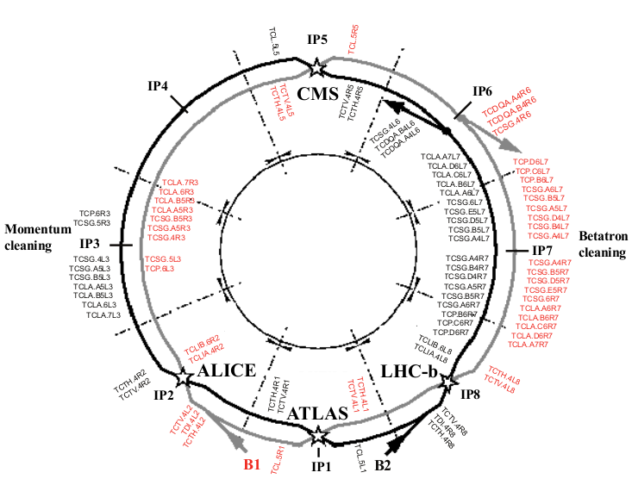
Global protection:
LHC collimation layout
LHC has separate insertions for
betatron (IR7) and momentum
cleaning (IR3).
In total about 100
collimators!
C. Bracco

Slide 14
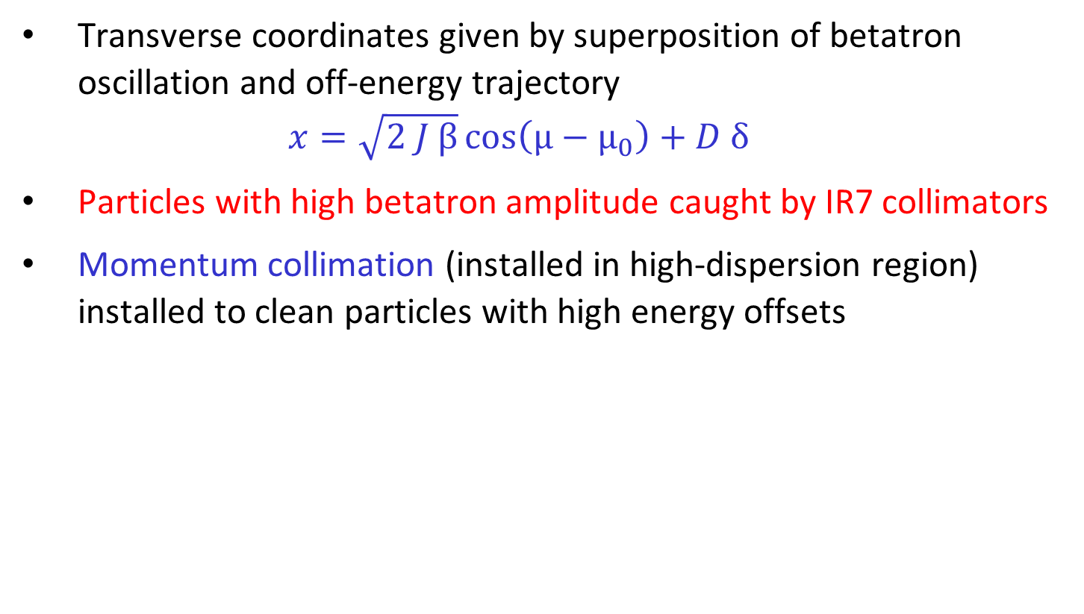
Betatron and momentum Collimation
Transverse coordinates given by superposition of betatron oscillation and off-energy trajectory
$x=\sqrt{2 J β}\cos\left(μ−μ_{0}\right)+D δ$
Particles with high betatron amplitude caught by IR7 collimators
Momentum collimation (installed in high-dispersion region) installed to clean particles with high energy offsets

Slide 15
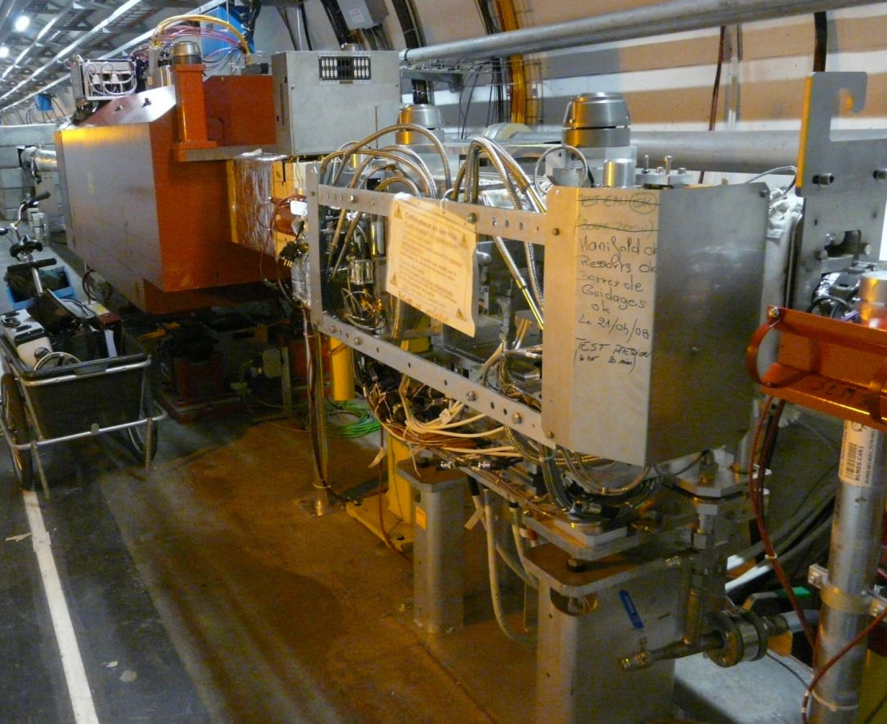
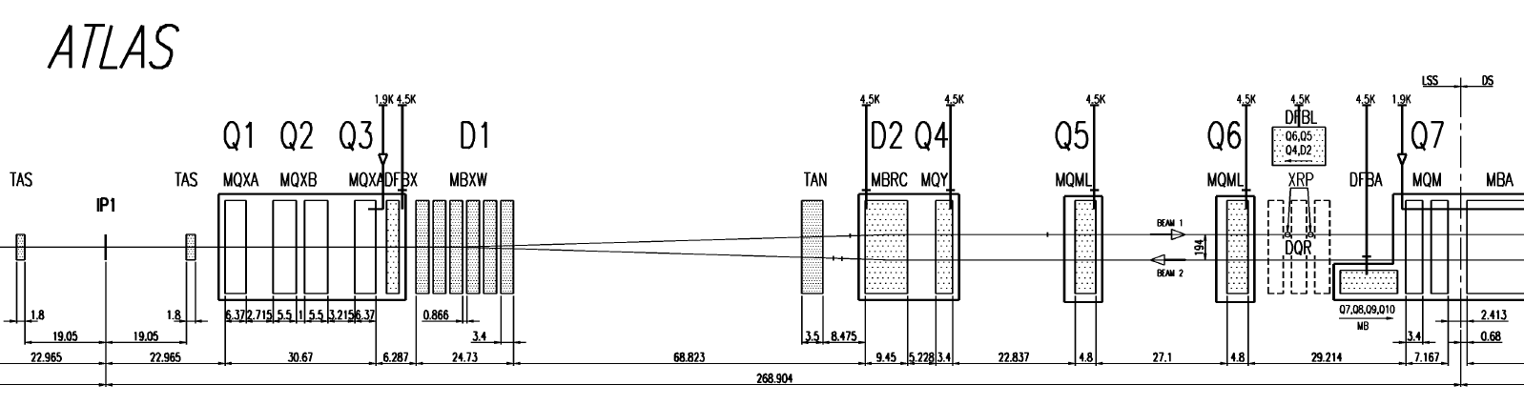
Example of local protection
LHC interaction point:
  Local protection on outgoing beam to catch collision debris
  Local protection on incoming beam to reduce background and shield aperture bottleneck

Slide 16
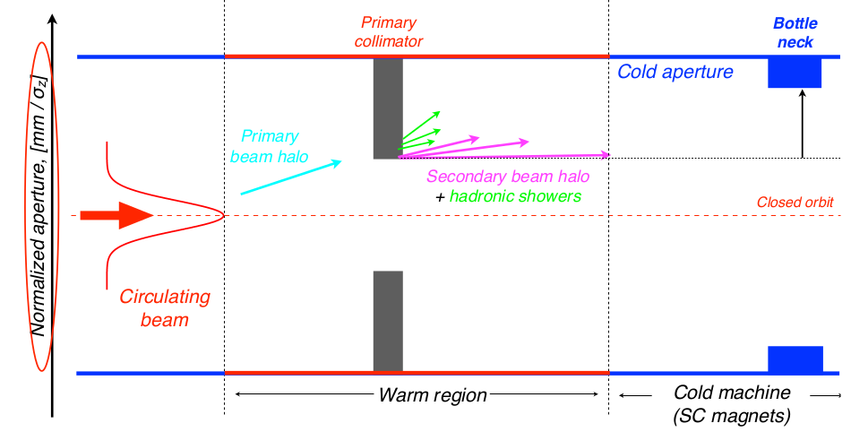
How many collimators?
Simplest approach: single-stage cleaning.
S. Redaelli

Slide 17
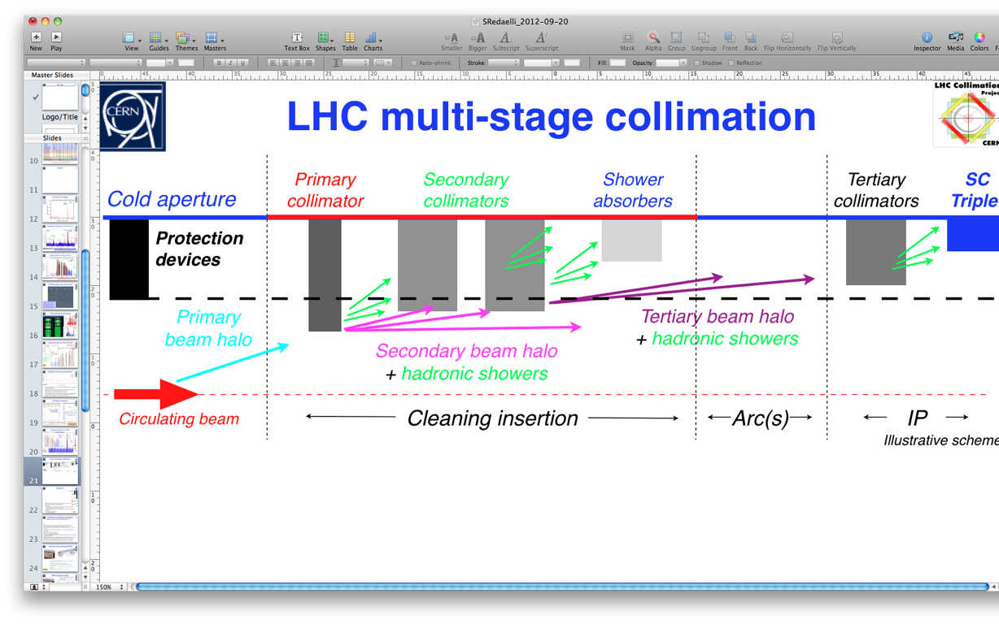
Single or multi-stage
If single stage does not provide sufficient cleaning (usually based on simulation studies): add more stages
Two stages commonly used: scatterer intercepting primary halo, absorber catching out-scattered particles
LHC: 5 stages including protection devices needed.
S. Redaelli

Slide 18
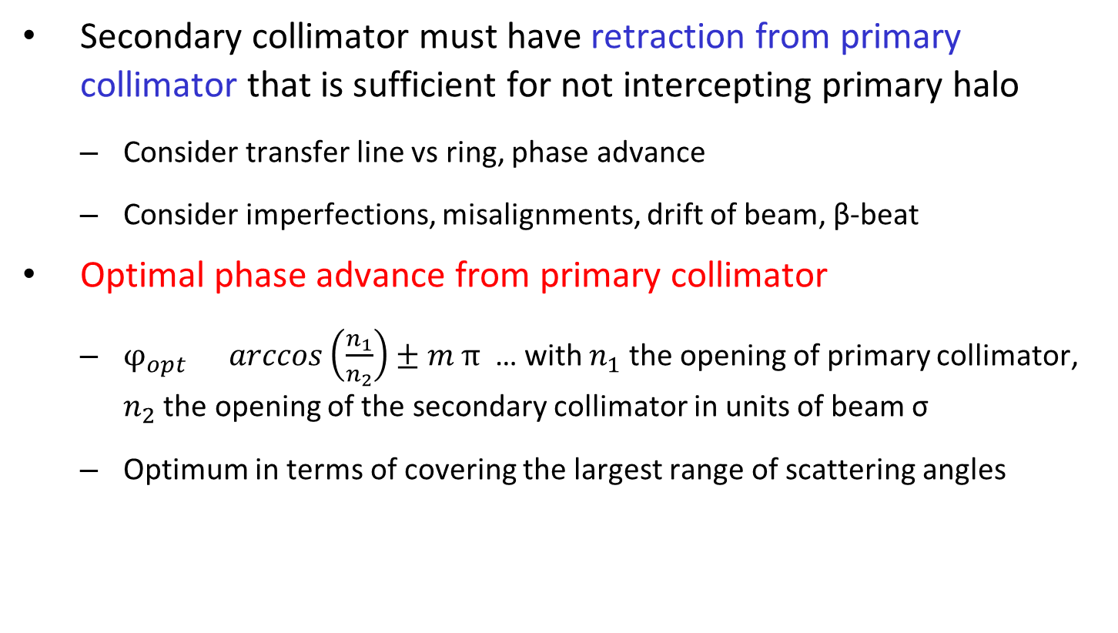
Placement of secondary collimators
Secondary collimator must have retraction from primary collimator that is sufficient for not intercepting primary halo
  Consider transfer line vs ring, phase advance
  Consider imperfections, misalignments, drift of beam, β-beat
Optimal phase advance from primary collimator
  $φ_{opt}=arccos\left(\frac{n_{1}}{n_{2}}\right)±m π$ … with $n_{1}$ the opening of primary collimator, $n_{2}$ the opening of the secondary collimator in units of beam σ
  Optimum in terms of covering the largest range of scattering angles

Slide 19
Movable vs fixed devices
If collimator opening does not need to be changed, fixed masks could be considered
  Fixed masks more sensitive to errors: alignment, optics, orbit. If problems, need to open machine to fix!
LHC: very different beam sizes and normalized aperture to protect at injection energy and top energy. Movable devices necessary!
  Movable devices allow optimization of cleaning by alignment using achieved orbit beta function. Robust vs imperfections!
  Movable collimators significantly more challenging in terms of engineering design. Control system needed. More expensive!

Slide 20
Choice of material
Several parameters influence choice of material
Cleaning efficiency (absorption rate) – short interaction length better
Robustness in case of high impacts or accidents
Resistance to radiation damage effects, activation
RF impedance: Maximize Electrical Conductivity
Mechanical properties: thermal behavior, brittleness, stability, easy to machine
Vacuum behaviour: minimize outgassing
Availability, price

Slide 21
LHC collimator materials
Tertiary collimators made of tungsten for optimal absorption. Not optimal robustness
Advanced R&D ongoing to find materials for future collimators (A. Bertarelli et al.)
  Molybdenum Graphite composite, possibly with molybdenum coating, seems to be most promising option at the moment
  Experimental program on radiation resistance in collaboration with GSI, BNL, Kurchatov
  Experimental program at CERN to verify robustness - HiRadMat

Slide 22
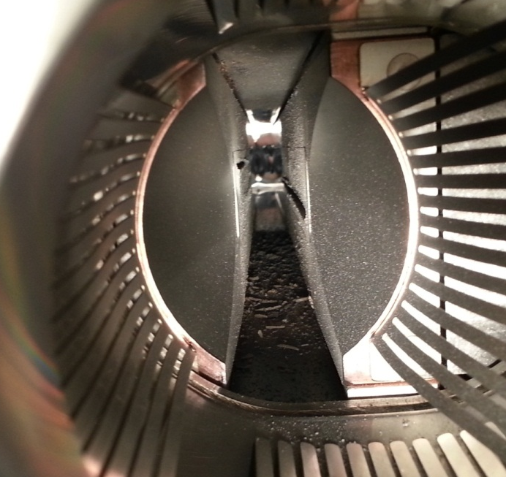
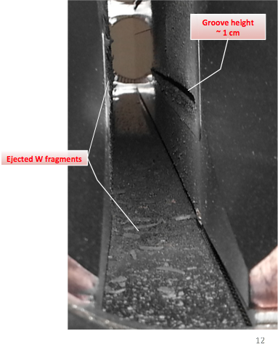
Experimental tests of beam impact
A. Bertarelli et al.
HiRadMat experiment
440 GeV proton beam on collimator
Total energy about 70-700 kJ
Up to 72 bunches, 50 ns apart. Total duration: 3.6μs
Clear visual signs of damage…
Test 1
(1 LHC bunch @ 7TeV)
Test 2
(Onset of Damage)
Test 3
(72 SPS bunches)
A. Bertarelli, F. Carra et al.

Slide 23
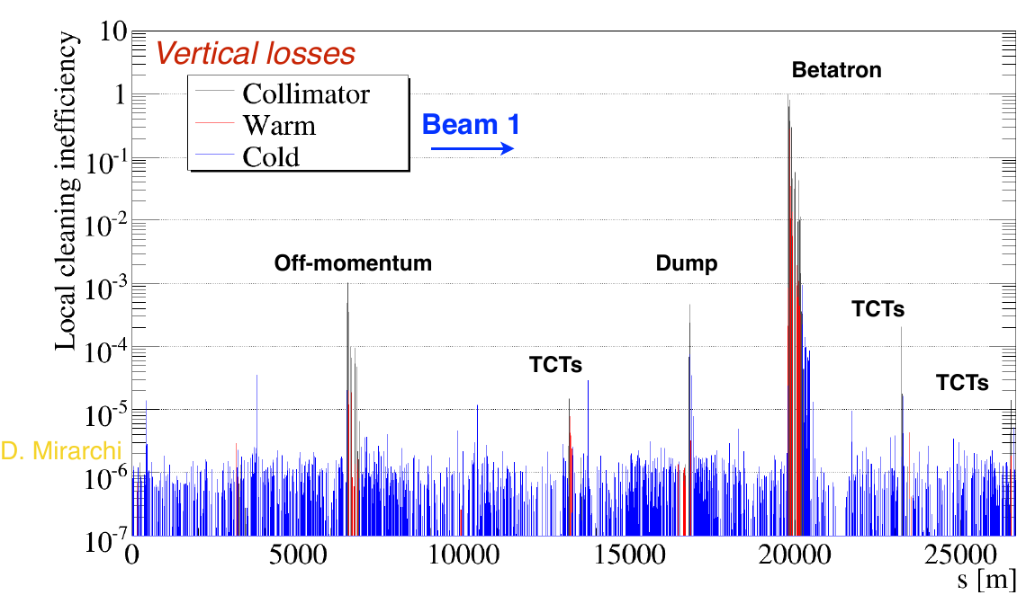
LHC cleaning performance
Collimation cleaning qualified by provoked losses (loss map)Loss distribution around ring measured

Slide 24
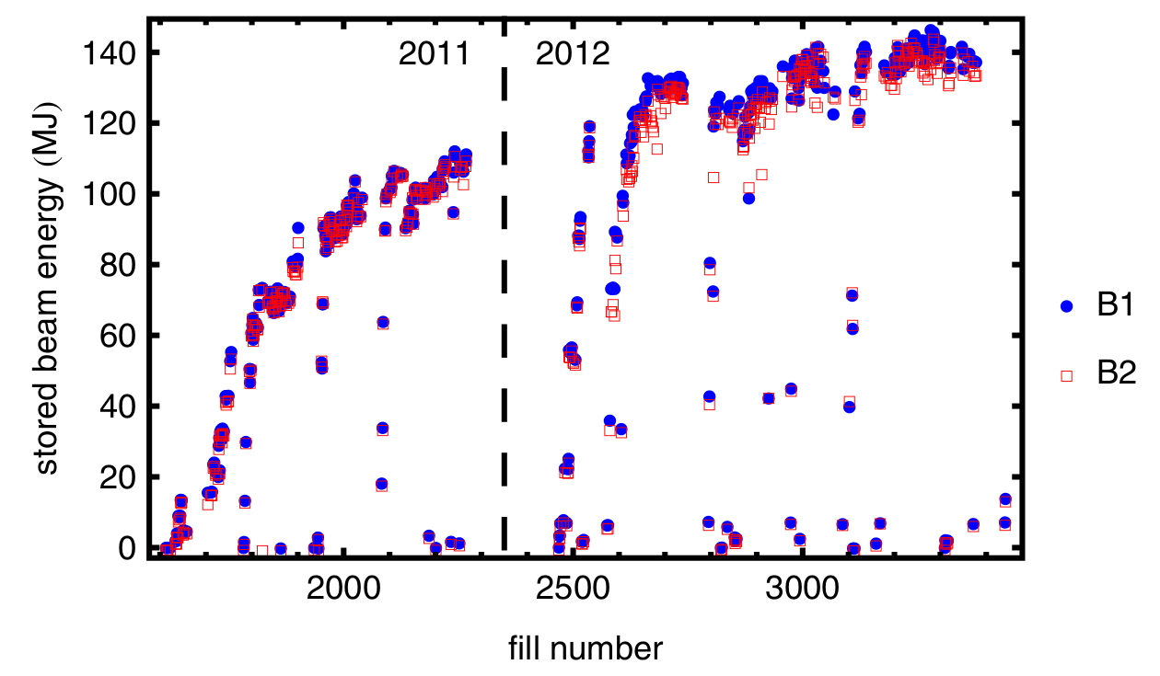
Stored energy in Run 1
LHC collimation worked very well in Run 1 (2010 – 2013)
Routinely stored ~140 MJ beams over hours. No beam-induced quenches during physics operation

Slide 25
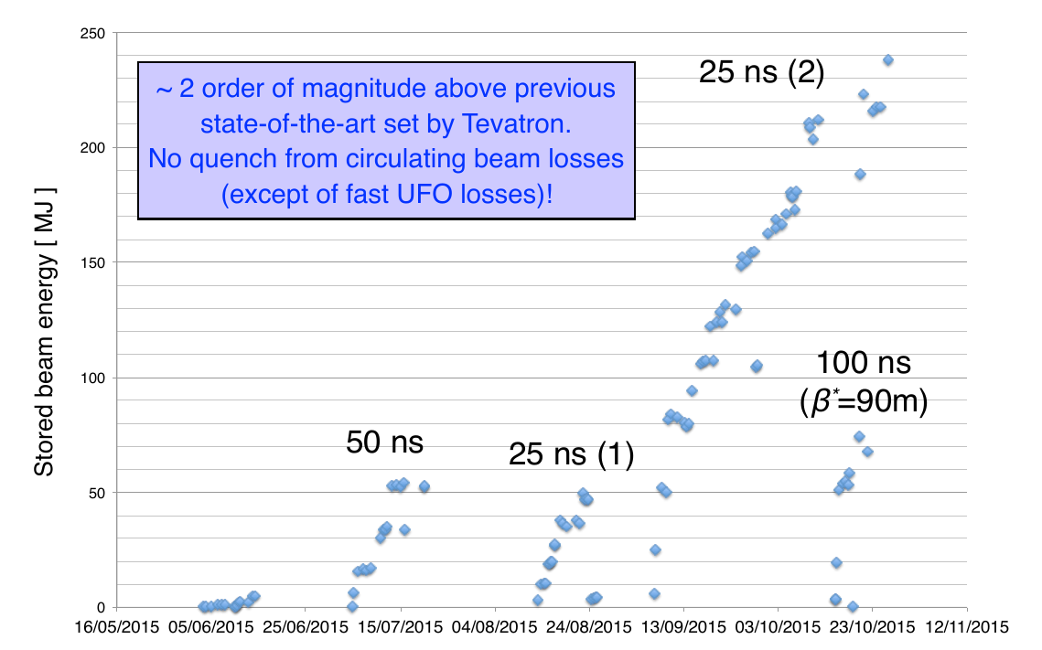
Stored energy in 2015
S. Redaelli

Slide 26
Summary
LHC collimators have a wide range of applications: protect against quenches, radiation damage, experimental background, direct damage from beam impact…
  About 100 collimators
  Operational experience: No beam-induced quenches (yet) with circulating beam during physics operation
  Handled losses of ~1 MW without quench
More challenges ahead: doubled stored energy in HL-LHC

