Slide 1

The validation of a tumour control probability (TCP) model for supporting radiotherapy treatment planning.
Karolina Kokurewicz
Supervisors: Dino Jaroszynski, Giuseppe Schettino
Notes:
basicly

Slide 2
Outline
Aims of the project
Robustness analysis in radiotherapy
Robustness analysis for radiobiological models
Tumour Control Probability Model
Input data and the BioSuite software
Results
Conclusions
Future Perspectives
Notes:
At the first
And then more specifically
In radiotherapy as well as in the context of the radiobiological models
In the next step I’m going to introduce the TCP
I will tell something about the software I used for my research, results I’ve got, conclusions and future prerspectives

Slide 3
Project aims
The project is focused on the validation of the radiobiological model for radiotherapy outcome through an identification of the impact of changes (uncertainties) in various model components on model outcome. This aims at:
estimating the accuracy of radiobiological parameters and the robustness of the model
adopting the biologically optimized plans in radiotherapy treatment planning
moving towards personalised treatment planning
Notes:
Form the definition of validation, which means to declare or make legally valid
This is exactly the meaning of validation we use for making the models usable in practice.
Through the validation we look at the impact
To in the next step could adapt
- Focused on very individual needs

Slide 4
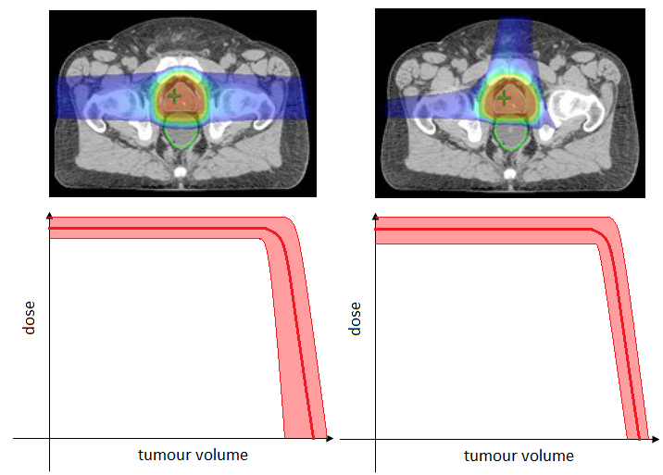
Robustness analysis in radiotherapy
In radiotherapy the treatment plan robustness is tested through geometric verification.
Different plans may result in the same physical dose distribution but with a different level of uncertainties in relation to the uncertainties in positioning.
Notes:
Geometrical verification is a procedure usually performed in radiotherapy to check if the geometric accuracy delivered is within the limits set by the uncertainty margin/ is there is any discrepancy between intended and actual treatment position/ to ensure that the right radiation dose has been given to the right place.
So far all the commercial treatment planning systems, which are available, optimise plans in terms of the physical dose, neglecting the biological effectiveness of a given dose distribution.

Slide 5
Robustness analysis in radiotherapy
The errors might effect dose distribution and healthy tissues. Therefore the robustness protocol is defined to:
allow an identification of a specific patient that may benefit from a more individual way of approaching the radiotherapy goals, and
select the best plans which carry minimum variation in the dose distribution for the largest uncertainties.
There is a lot of interest in including the biological effectiveness as this will improve the treatment and it would also allow to account for individual patient sensitivity. A way to do this is to evaluate the treatment plans using radiobiological models.
Notes:
The errors which can occur through the geometric verification
To be as close the best option as posible
That’s why we need to establish
Large changes in the output variable imply that the particular input varied is important in controlling model behaviour. However, the model is not suitable for clinical adoption as its predictions are subject to large uncertainties.

Slide 6
Robustness analysis for radiobiological models
The robustness analysis, in terms of radiobiological models, aims at defining the changes in the output of a model as a function of uncertainties in the input parameters. In the next step the values of various inputs of the model are varied (as if they were subjected to uncertainties) and the resultant change in the output variable is monitored.
Large changes in the output variable imply the particular input varied is important in controlling model behaviour. However the model is not suitable for clinical adoption as its predictions are subjected to large uncertainties.
Notes:
If we see the large changes in the model output using particular input varied… how much it is important in controlling model behaviour
but on the other side
However, because there are very sensible to variations.

Slide 7
Project plan
Literature review
Selection of the clinical endpoint
Extraction of the reported values of radiobiological parameters
Preparation of the clinical data (dose volume histograms)
The BioSuite software learning and testing
Calculation of the model outcome for different sets of parameters
Data analysis – defining the outcome of the model as a function of the variation of the input parameter
Notes:
The most important part of the project was
In terms of a getting a right format readable
Of course I had to learn first how to use the software
To calculate the mode to perform is as a function of the in…

Slide 8
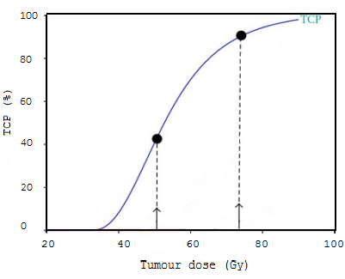


Tumour Control Probability Model
The probability of killing all tumour cells is expressed by the Tumour Control Probability (TCP) model.
$TCP=exp\{−ρvexp⁡[−αD_{tot} −\frac{βd^{2}}{f}+ γ(T−T_{k})$]}
Where:
ρ – density of tumour cells
$v$- tumour volume
α - the initial slope of the surviving curve
β - the degree of the survival curve
d - dose per fraction
D_{tot} - total dose
f - the number of fractions
T - overall treatment time
$T_{k}$ - time at which the cells start to repopulate
γ - repopulation constant
GRAPH
Notes:
History of formula, from where does it come from.
The graph shows that TCP strongly depends on a total dose. The higher dose delivered the higher the probability that all tumour cell were killing. However the shape might be different depending on:
treated volume
density of cells within this volume
dose rate
dose distribution
fractionation
treatment duration
α and β parameters of the linear quadratic model of cell killing
Share into physical and biological parameters
$T﷮p$ - the time necessary to double
the number of growing tumour cells
In most cases, like in the case of the TCP Marsden model, models also make use of parameters which can only be derived from experimental data.

Slide 9
The role of TCP in Radiotherapy
The role of TCP model in radiotherapy is to:
• provide information on the biological equivalent of dose delivery
• quantify the effect of radiation quality
• guide biologically-based optimization algorithms

Slide 10
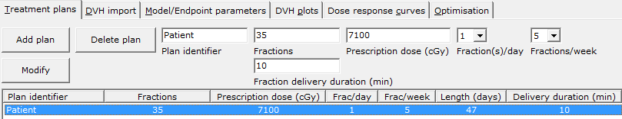
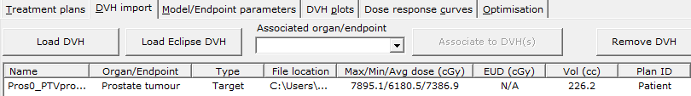
Input data and BioSuite program
BioSuite is a software developed to calculate the outcome of tumour control probability model as well as to perform treatment optimisation (the calculation of the optimal number of fractions and dose per fraction).
Treatment plan
constrains
Patient dose volume histogram
Notes:
In radiobiology, models are mathematical frameworks based on a set of assumptions and simplifications which take doses (for example DVHs) and patient specific variables as inputs and return an estimate of complication probabilities.

Slide 11
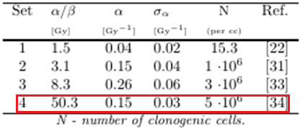
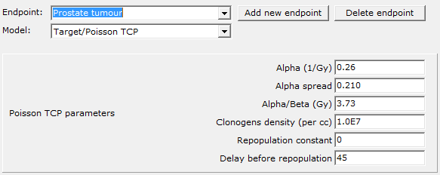
Input data and BioSuite program
Input parameters:
22. D. Brenner, E. Hall, Fractionation and protraction for radiotherapy of prostate carcinoma, Int. J. Radiat. Oncol., Biol., Phys., 1999, Vol. 43, No. 5: 1095-1101.
31. J. Wang, X. Li, C. Yu, S. DiBiase, The low alpha/beta ratio for prostate cancer: What does the clinical outcome of HDR brachytherapy tell us?, Int. J. Radiat. Oncol., Biol., Phys., 2003, 57: 1101-8.
33. E. Nahum, B. Movsas, E. Horwitz, C. Stobbe, J. Chapman, Incorporating clinical measurements of hypoxia into tumour local control modelling of prostate cancer: implications for the α/β ratio, Int. J. Radiat. Oncol., Biol., Phys., 2003, 57: 391-401.
34. A. Nahum and J. Chapman, In response to Dr. Orton, Int. J. Radiat. Oncol., Biol., Phys. 2004, 58: 1637-1639.
Notes:
The repopulation constant and repopulation delay were assumed to be 0 for the prostate cancers because the time scale of cell proliferation is much longer than the overall treatment time as prostate tumours are slowly growing tumours and the time from the beginning of the treatment to the starting of the accelerated proliferation is relatively short. There could be a significant time effect for very long treatment durations.
Red frame in the table – the parameters obtained for the cells including a fraction of the hypoxic cells.

Slide 12
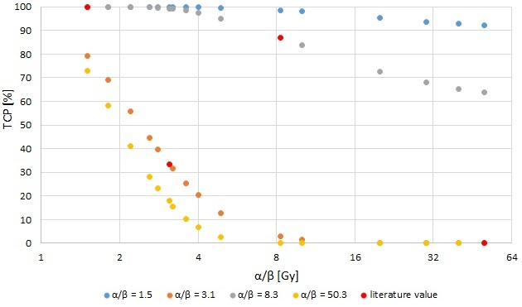
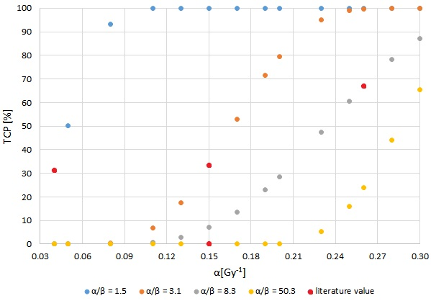
The relations between TCP and model parameters
Different sets of parameters the same treatment plan
α/β = 1.5 Gy – Brenner and Hall (1999) α/β = 3.1 - J. Wang et al. (2003)
α/β = 8.3 – Nahum et al. (2003) - fraction of oxygenated cells α/β = 50.3 - Nahum and Chapman (2004) - fraction of hypoxic cells
Notes:
The graphs show TCP as a function of the variation of one of the input parameters. The red points indicate the TCP values calculated for the literature sets of parameters. We can see how TCP changes around these points when α and α/β parameters are subsequently increased or decreased. However, there is not a common pattern of changes for all four parameters in both of the cases.

Slide 13
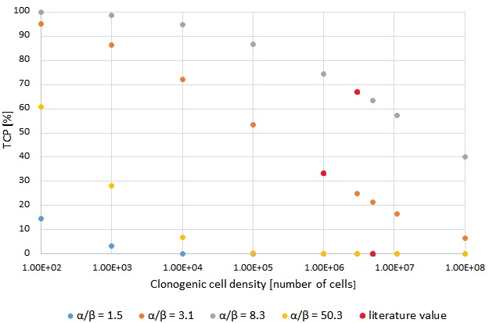
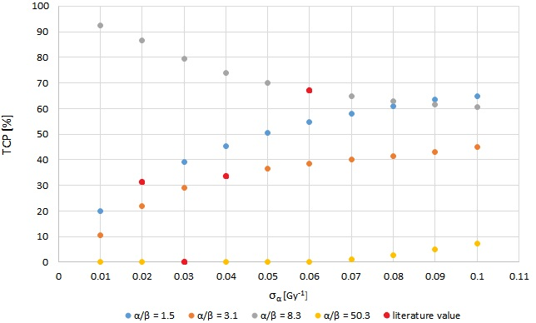
The relations between TCP and model parameters
Different sets of parameters the same treatment plan
α/β = 1.5 Gy – Brenner and Hall (1999) α/β = 3.1 - J. Wang et al. (2003)
α/β = 8.3 – Nahum et al. (2003) - fraction of oxygenated cells α/β = 50.3 - Nahum and Chapman (2004) - fraction of hypoxic cells
Notes:
The same graphs were plotted for clonogenic cell density and σ_{α}.

Slide 14
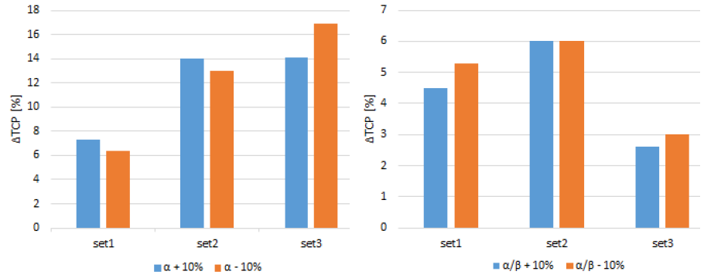
The robustness of TCP model
Notes:
These two graphs show the relation between ΔTCP and the model parameters α and α/β. The vertical axis represents ΔTCP which was defined as a change of TCP when increasing and decreasing the parameter value by 10%. For the set4 ΔTCP was equal 0% over the certain range of the α/β parameter for the chosen clinical case. The sets 1-3 show the variation in TCP between 6-17% for α and between 2.5-6% for α/β. Generally it can be seen that a small/marginal deviation from the default value of the α parameter effects TCP more than in the case of the α/β parameter .

Slide 15
Conclusions
1. Different literature data presents the self-consistent sets of parameters which give the best possible TCP for the specific case.
2. Sensitivity of the TCP model to uncertainties of its parameters cannot be explicitly defined since each set of parameters is unique and shows individual relation with the model outcome.
3. The results show how a 10% change in α parameter might lead to a 17% change in TCP, whereas in the case of α/β parameter this is just 6% (assuming that in both cases all of the rest parameters were left unchanged).
4. TCP model might be applicable in treatment planning systems introducing a proper adjustment to the clinical case; however it might bring serious consequences when the biological or physical uncertainties will occur. Therefore further investigation has to be carry out to introduce radiobiological models in treatment planning systems.

Slide 16
Future perspectives
1. Performing the multi-dimensional representation of the distribution of TCP using automatically generated sets of parameters to investigate the influence of uncertainties of 6 parameters on TCP.
2. Building a in-home program for calculating TCP.
3. Experimental validation of the model using different dose fractionations.
4. Performing the Monte Carlo simulations for the proton and high energy electron beams in terms of the physical effects (DNA double-strand break).
5. Performing the optimisation for proton and X-ray therapies and developing the new dose fractionation regimes so that the best TCP will be achieved.

Slide 17
Thank you for your attention!

