Slide 1
Bruker Energy & Supercon Technologies (BEST)
EUCARD2 status by Bruker HTS
CERN, 01.12.2015
Notes:
Title picture can be exchanged in the masterslide.

Slide 2
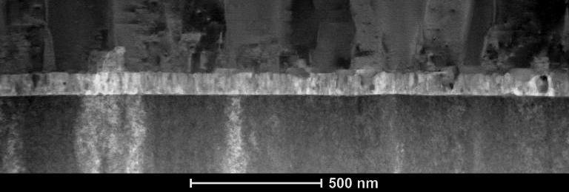
Outline
New production site
First Ic-s in PLD600
PLD 300
12mm production
Cu, Ag, 50µm substrate tests,
EUCARD2 plan
Gustaaf Van Tendeloo
Alexander Meledin,
Uni Antwerpen
EUCARD2 , Bruker HTS, CERN, 01-12- 2015
2

Slide 3
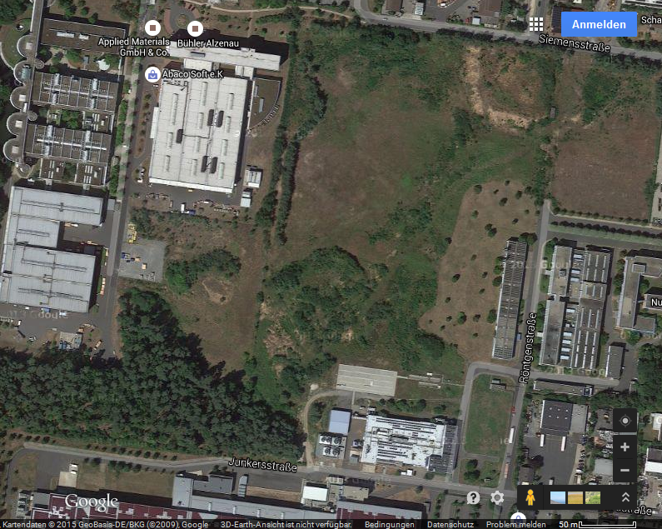
HTS PILOT-LINE PRODUCTION
Actual Status
RELOCATION OF BHTS IN Q3 2015
  current site
  new site
Page 3
3
Page 3

Slide 4
Bruker HTS: new site
Provided by U. Betz
Gustaaf Van Tendeloo
Alexander Meledin,
Uni Antwerpen
EUCARD2 , Bruker HTS, CERN, 01-12- 2015
4

Slide 5
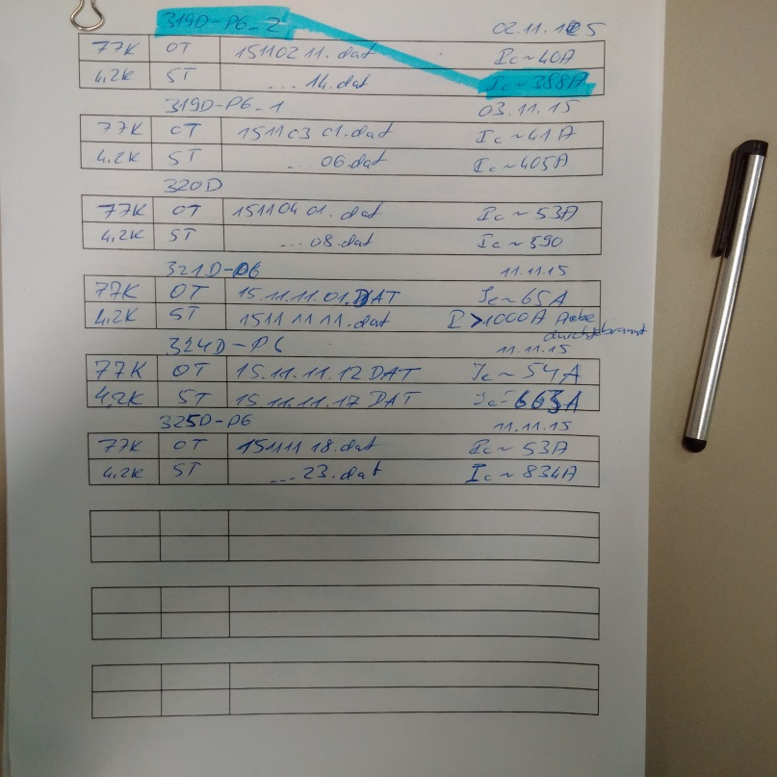
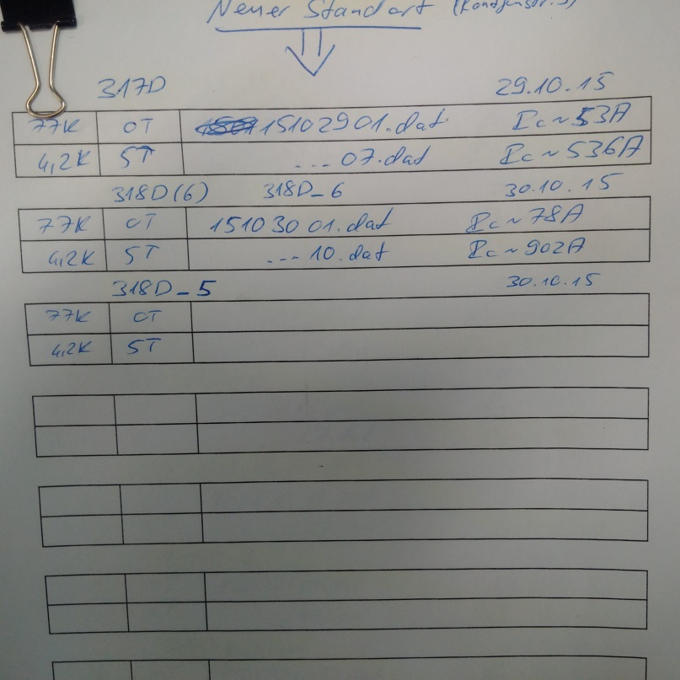
First short tapes with Ic =800 - 1000A at 4.2K, 5T, B//c; w=4mm
Gustaaf Van Tendeloo
Alexander Meledin,
Uni Antwerpen
EUCARD2 , Bruker HTS, CERN, 01-12- 2015
5

Slide 6
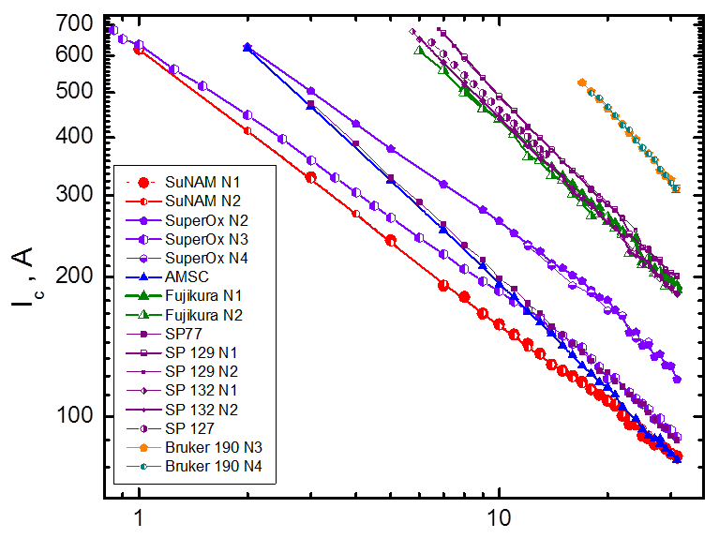
Comparison I_{c}(4K; B): FSU + BHTS, 2015
PLD600, new site, Oct 2015
309 A at 31 T
1-905N3
1-905N4
D. Abraimov, D. Larbalestier, … Nov 2014
B, T
Bruker 14017-2-1-905 tape in LHe
EUCARD2 , Bruker HTS, CERN, 01-12- 2015
6

Slide 7
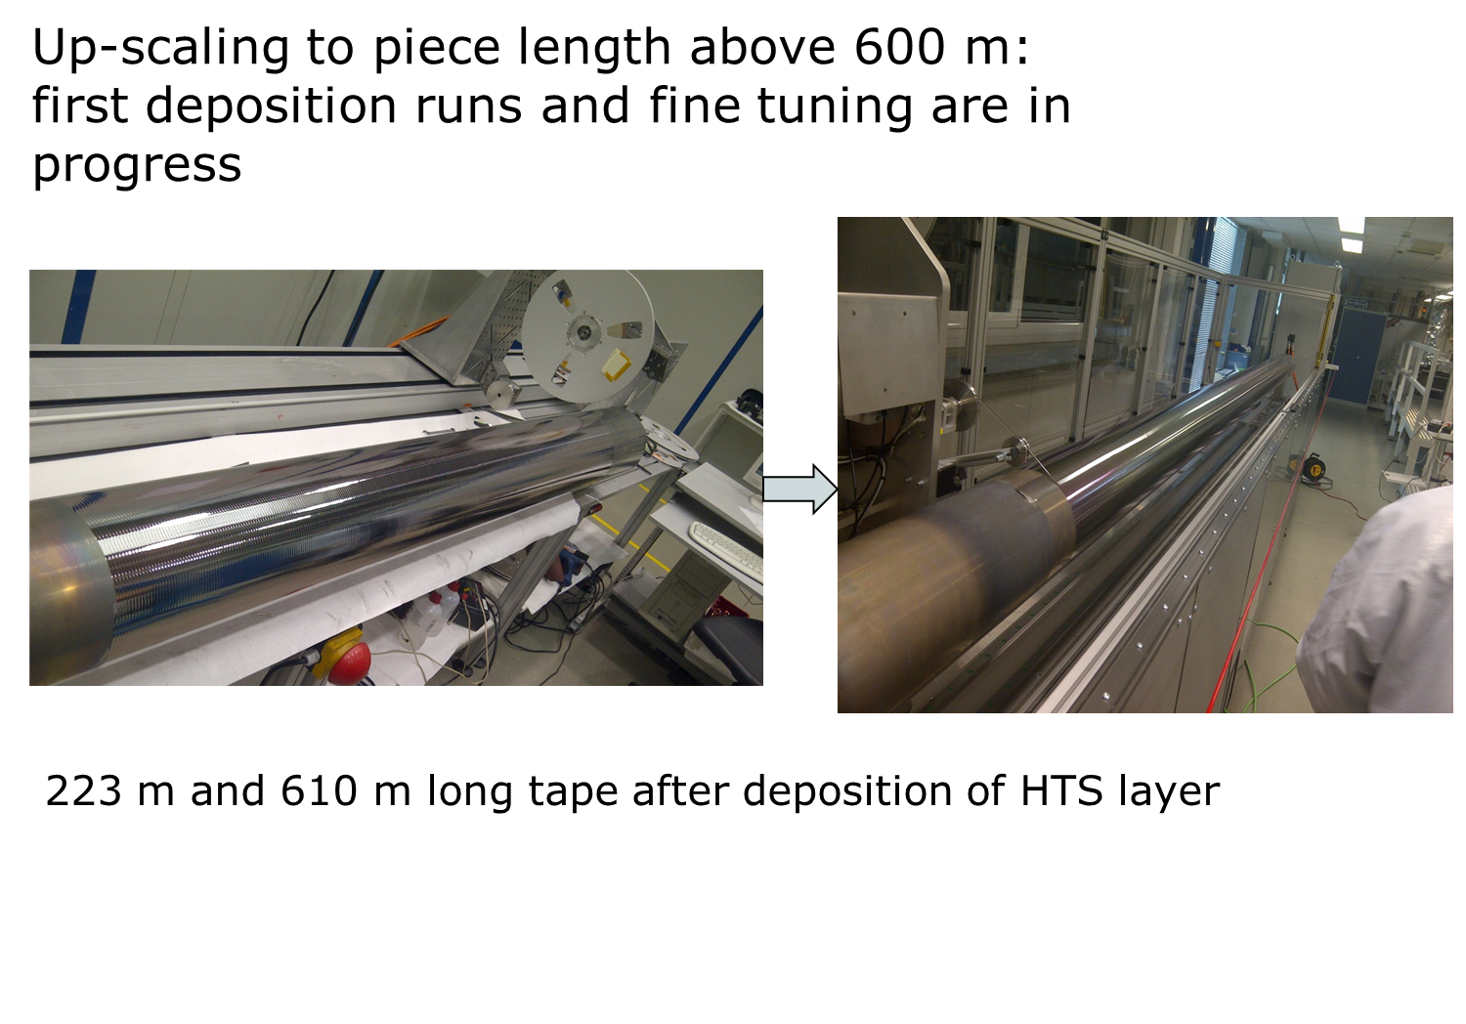
7
Page 7

Slide 8
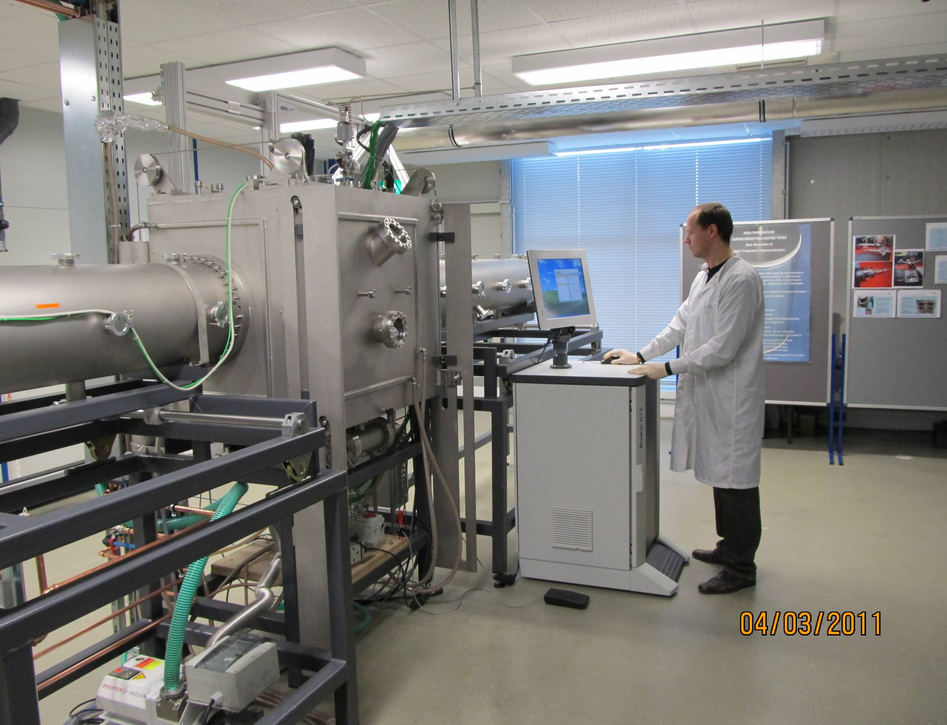
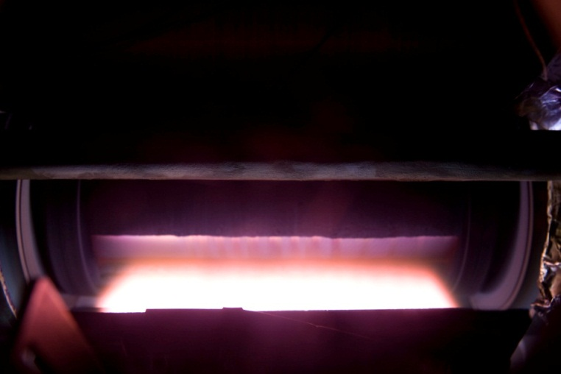
CC/module production: HR-PLD
Optical system
PLD2 = PLD300.
Laser beam guide
6 beam HR-PLD
Deposition chamber
MB-PLD machine with deposition area of 0.13m²

Slide 9
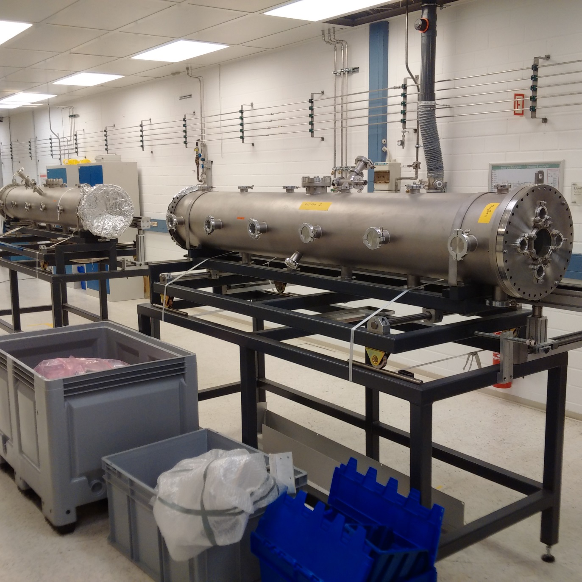
Available parts of PLD300
Gustaaf Van Tendeloo
Alexander Meledin,
Uni Antwerpen
9

Slide 10
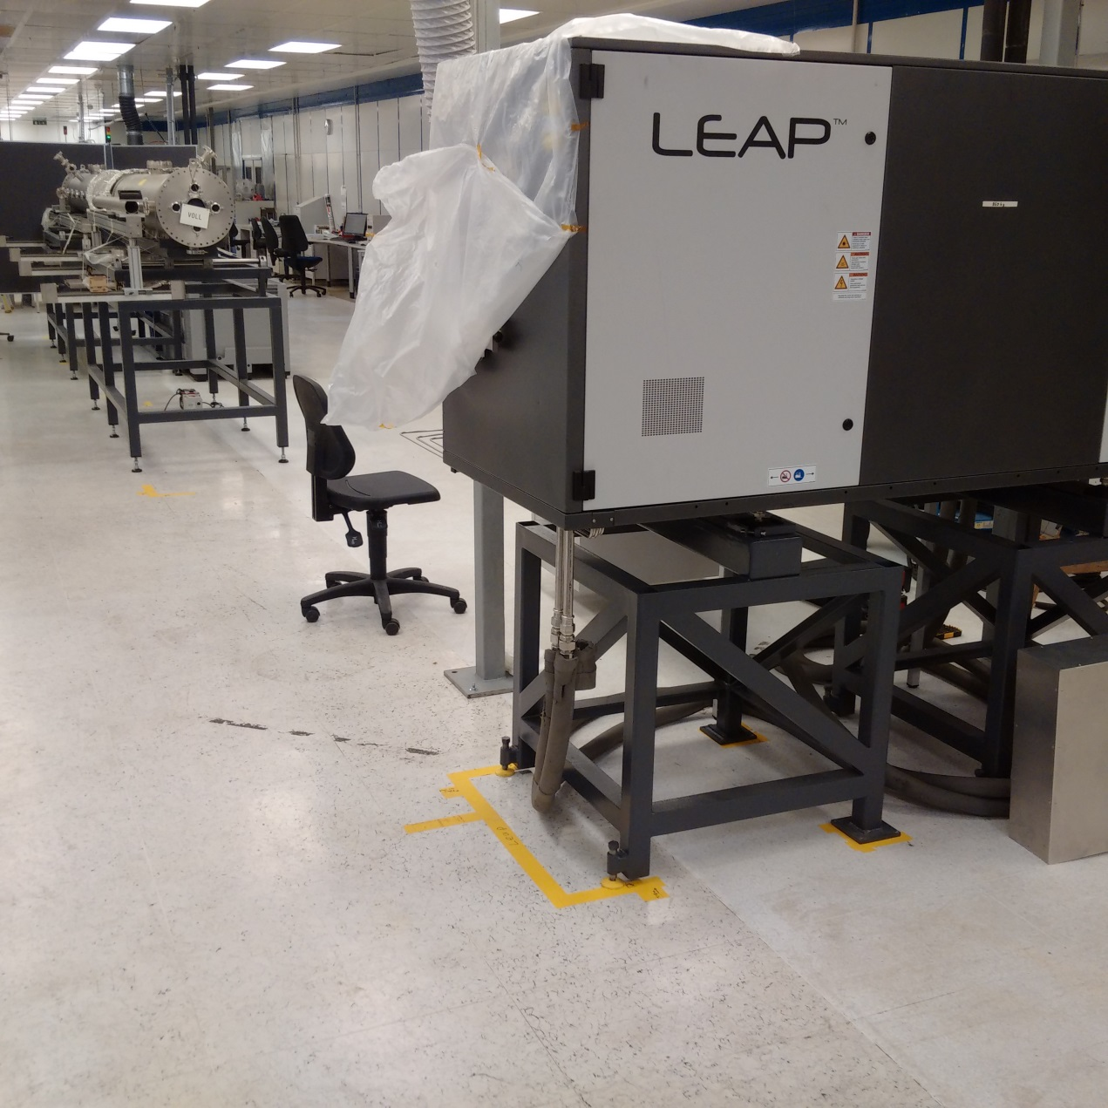
Units of PLD300
Gustaaf Van Tendeloo
Alexander Meledin,
Uni Antwerpen
10

Slide 11
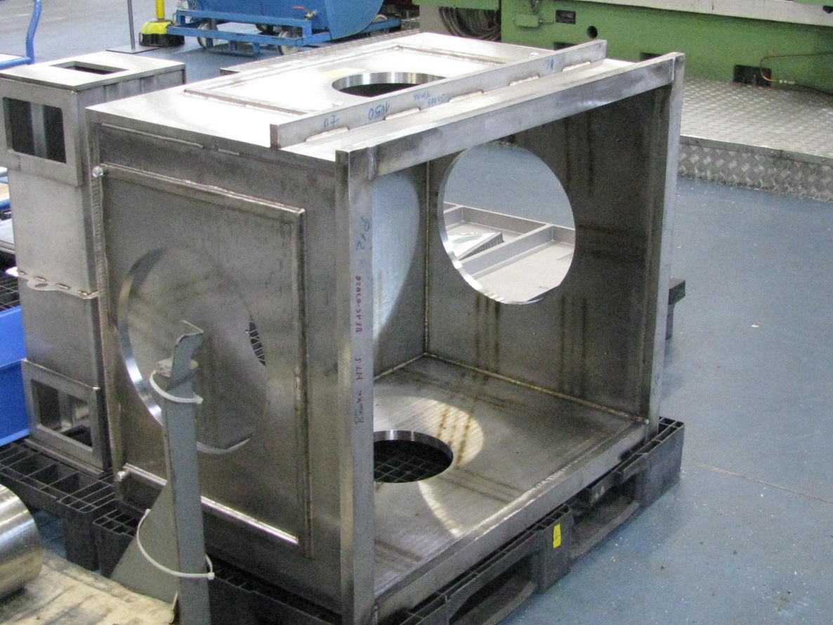
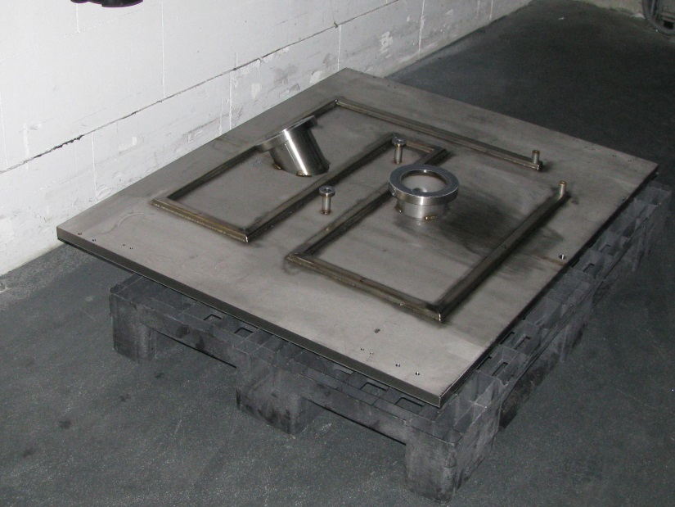
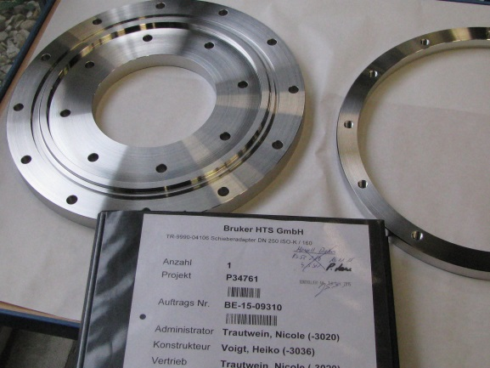
New Chamber of PLD300:
Pfeiffer Vacuum says few days needed to accomplish chamber
Gustaaf Van Tendeloo
Alexander Meledin,
Uni Antwerpen
EUCARD2 , Bruker HTS, CERN, 01-12- 2015
11

Slide 12
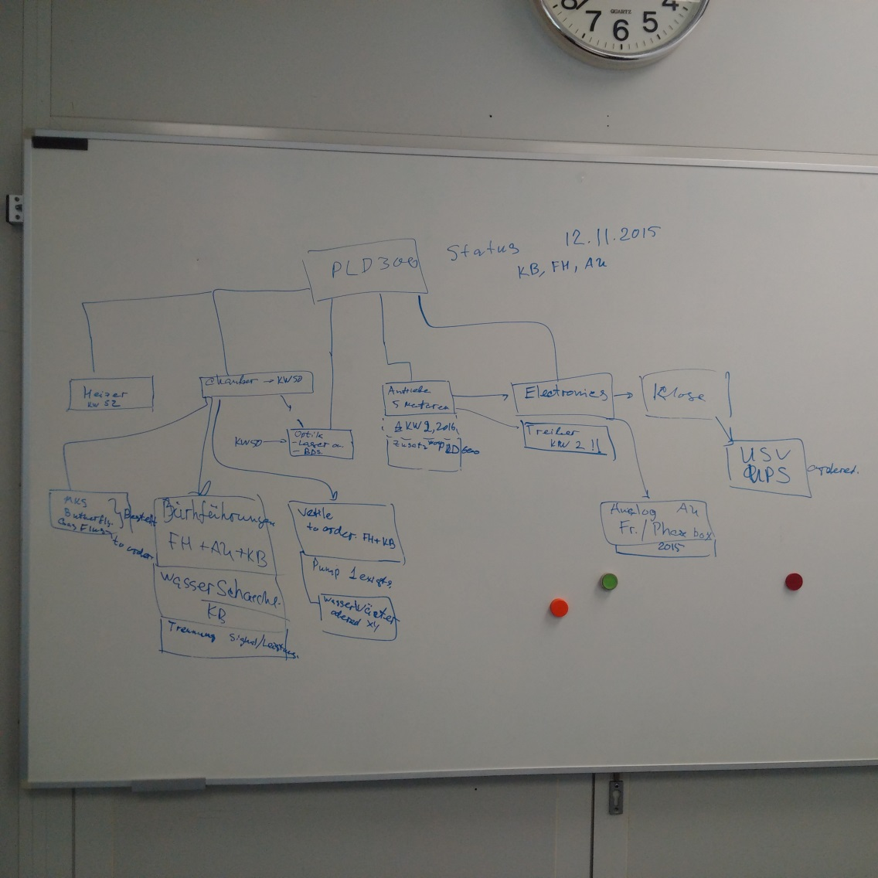
PLD 300: assembling (time-plan) status 2015-12-01
Chamber: CW50
Optics: CW51 (laser port)
CW1 (BDS, chamber)
Assembling starts: CW51
Heater: CW52
Power suppls delivered
Target unit: CW2
Chamber accessories: CW2
Motors, drives: CW1
System control: CW4
Gustaaf Van Tendeloo
Alexander Meledin,
Uni Antwerpen
12

Slide 13
EUCARD2: 12mm production
Cu, Ag, 50µm substrate tests

Slide 14
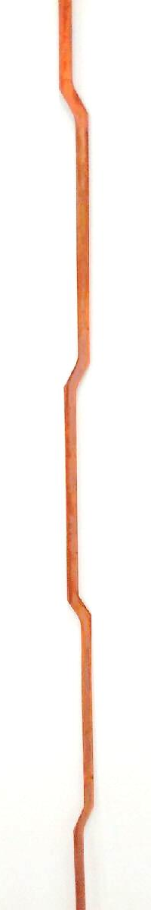
Additional protection of tape after punching at KIT
Suppression of dog boning is implemented. This suppression is found to be dependent on quality of punching.
Two new defects were introduced to the 36m long tape: one from low-current end (delta x = 1.5 m from the end). Other defect was at distance 21 (?) m. Reason: errors in tape handling (not during plating step!)
Confidential
Confidential

Slide 15
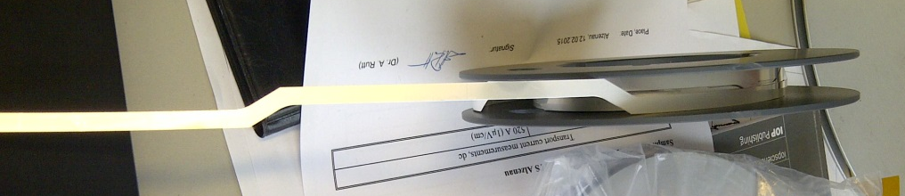
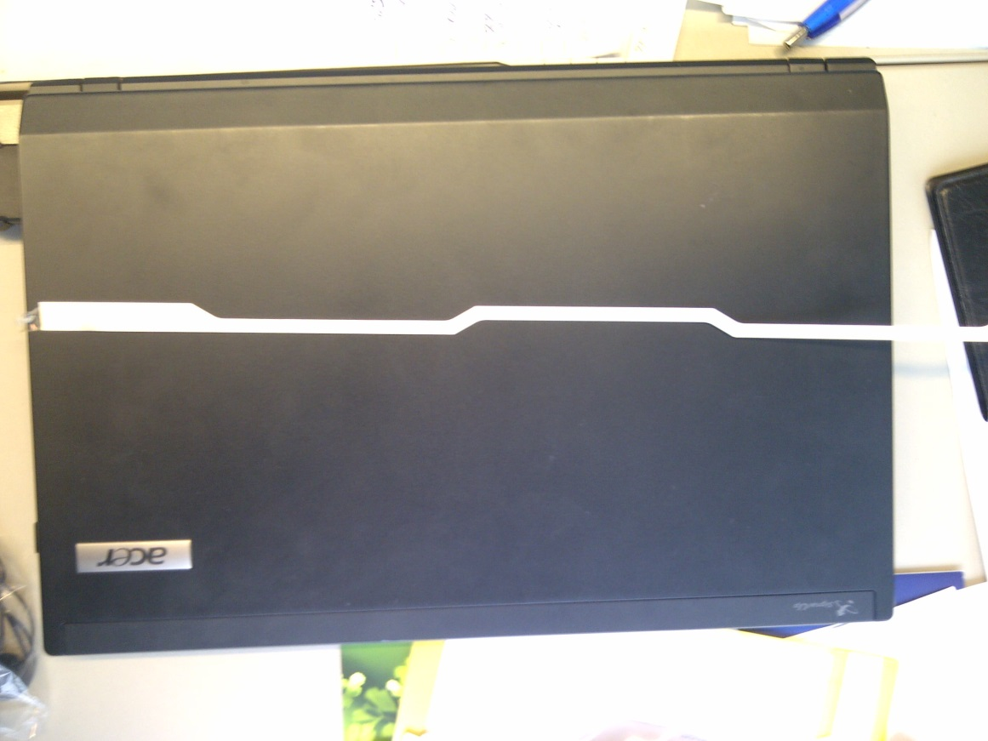
EUCARD2: SS+Ag tapes recently punched by KIT
Confidential
Confidential

Slide 16
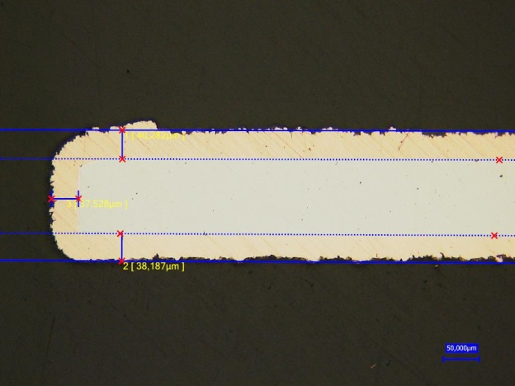
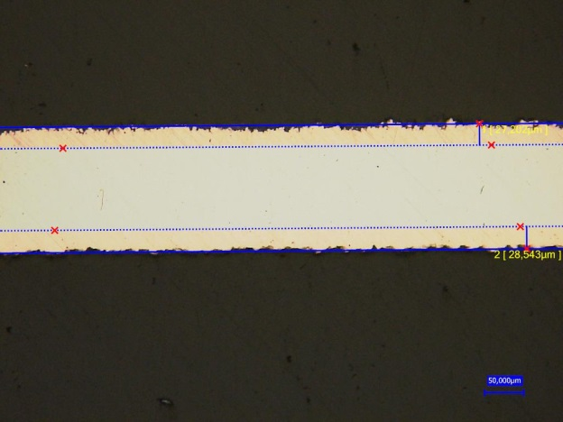
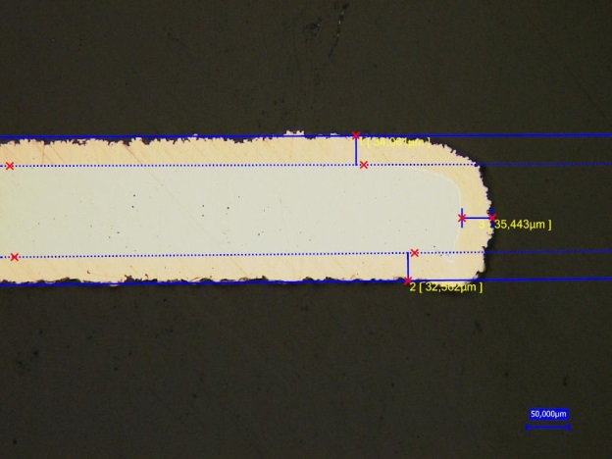
Newest progress in suppression of dog-boning: is important in case of meander-punched tapes
35 µm
Cu thickness: 27µm in the middle
38µm at the edge
Confidential
Confidential

Slide 17
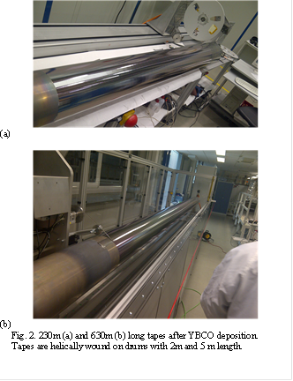
First 610m long tapes (w=4mm) processed in PLD600 (May-June 2015)
Confidential
EUCARD2 , Bruker HTS, CERN, 01-12- 2015
17

Slide 18
EUCARD2 plan in WP10 + suppl. order
Jan 150m
Feb 250m
Mar 280m
Apr 280m
May 280m
Gustaaf Van Tendeloo
Alexander Meledin,
Uni Antwerpen
18

Slide 19
WP10: REBCO Tapes:
Cern specs Nov. 2015
Tape parameters
  Tape width: 12 mm
  Tape thickness: 0.1 mm (SP, SuperOX, Sunam) … 0.14 (BHTS) mm
  Electrodeposited copper layer (after punching): 2 x 20 μm
  Engineering current density (20 T, 4.2 K) > 400 A/mm² (target 600 A/mm² )
  Critical current (20 T, 4.2 K) > 500 A (target 670 A)
  Unit length: minimum 50 m (> 30 m needed for magnet construction)
    UL for Aligned Blocks: 20 m (1.2 mm thick cable) to 28 m (0.8 mm thick cable)
    UL for Cos Theta: 17 m (1.2 mm thick cable)

Slide 20
Cut tape geometry
Optimal geometry as defined by KIT
α
t
g
R
R
p
t = 5.9 mm
g = 0.2 mm
α = 30 °
p = 300 mm
R = 1...2 mm

Slide 21
Summary
BHTS is transferred by 100% to new building.
Installation works with equipment are in progress.
Installation and commisioning is practically completed.
Fine tuning of process parameters: 2015
New equipment for 12 mm tape is ordered in the end of August. New PLD300 will be assembled in 2015; will be put in operation in the beginning of 2016.
Suppression of dog boning is implemented. This suppression is found to be dependent on quality of punching.
EUCARD2 , Bruker HTS, CERN, 01-12- 2015
Confidential

Slide 22
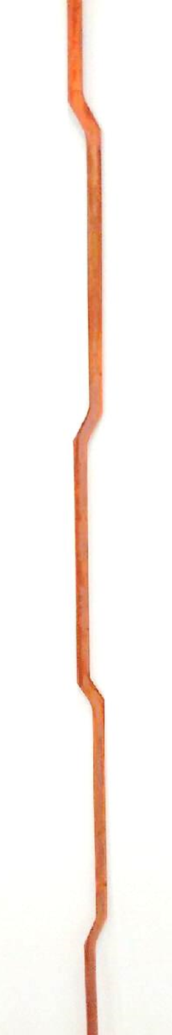
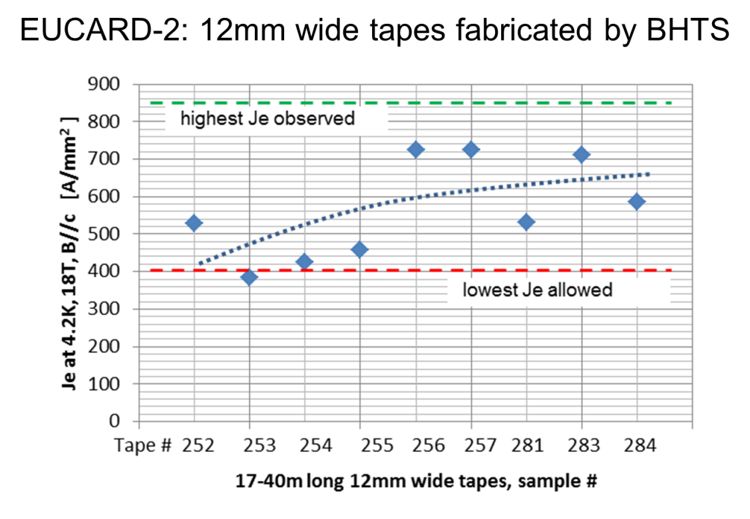
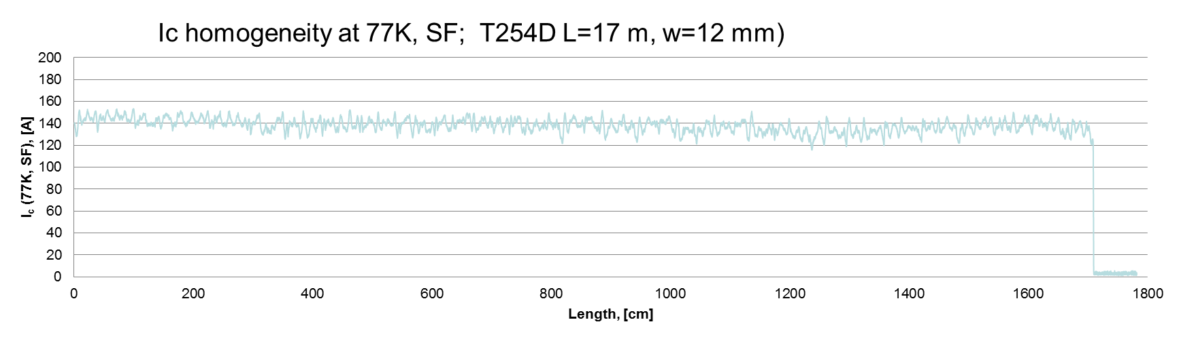
12mm wide tape technology for EUCARD2 CERN
VISIT POSTER 3A-WT-P-02.03
BHTS manufactured several 12mm wide tapes for EUCARD2, CERN
  The high field performance (18T) was checked, a minimum Je of 400 A/mm² @ 4.2K/18T is required for the C12 tapes
22
Page 22

Slide 23


Innovation with Integrity
Copyright © 2014 Bruker Corporation. All rights reserved. www.bruker.com
Notes:
No pictures on last slide!

Slide 24
Supporting foils:
EUCARD2 , Bruker HTS, CERN, 01-12- 2015

Slide 25
Ic(B) in different piece lengths (4.2K, B//c)
I_{c}(B) at B perpendicular to tape surface measured in liquid He. Coated tapes are 4 mm wide tape with 45 µm thick Cu plating. YBCO thickness corresponds to 1.5-2 µm. Fractions of the 22 m long batch of best quality was measured in wide field range at FSU/NHFML, Tallahassee (D. Abraimov, 2014). Measurements of fractions of 120-230 m long batches of average quality were performed by Bruker HTS/Bruker EAS, Alzenau/Hanau. The n-values measured were in between 42 and 52.
25
Page 25

