Slide 1





HTS insert for a particle accelerator using a twisted stacked cable
John Himbele, Arnaud Badel, Pascal Tixador

Slide 2
Outline of contents
HTS twisted stacked magnet design
  - 2D magnet cross-section
  - 3D magnet ends
Current distribution analysis
Future aspects
Conclusions

Slide 3
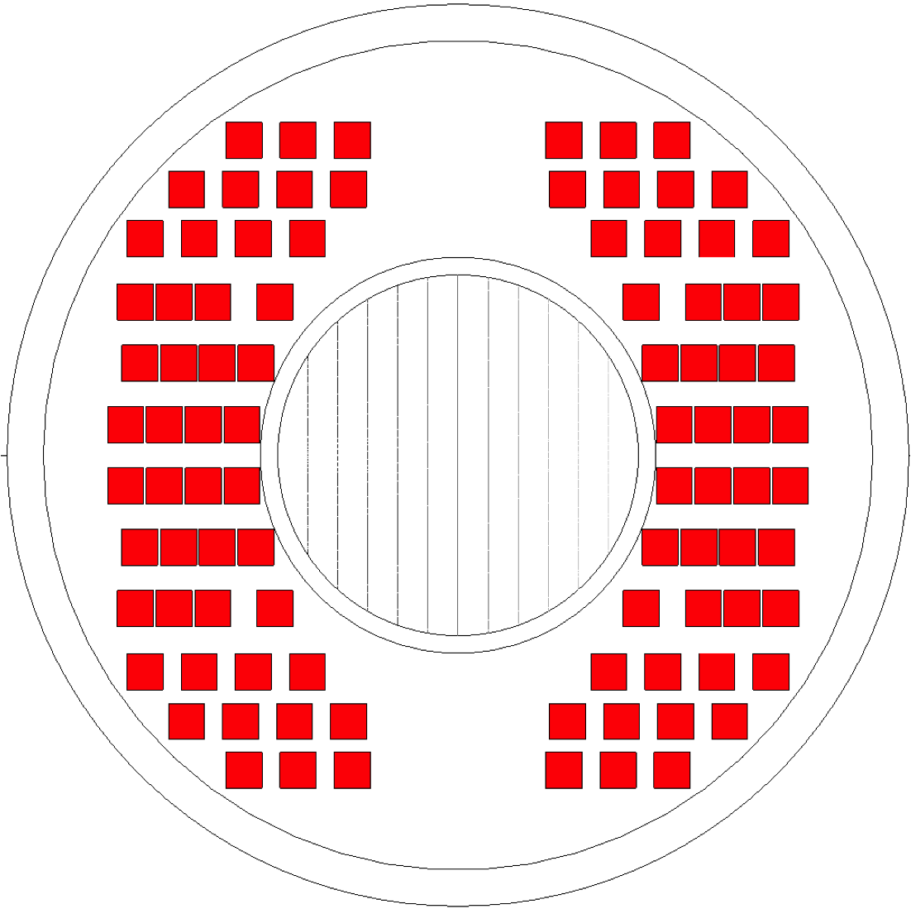
2D HTS twisted stacked design
46-turns HTS insert
Parameter | Value
Center field B0 | 17 T
Current density J_{op} | 650 MA/m²
Operating current I_{op} | 10.4 kA
Conductor area | 1472 mm²
Field quality B₃/ B₅ | 1.5/ 0.78 units
Inner/ external tube | 2/ 4 mm
17 T
Main highlights of twisted stacked design
4 x 4 mm block-coil consisting 20 ReBCO stacked tapes of 4 mm wide achieves required I_{op} = 10 kA with 46-turns HTS stacked cable.
Three or four block-coils are assembled and aligned in horizontal to facilitate the mechanical architecture and winding.
Good field quality as possible within range of J_{op} = 600 – 700 A/mm².

Slide 4
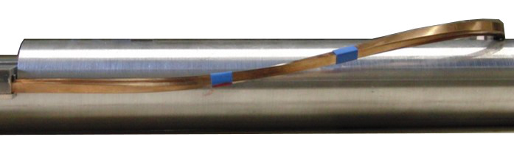
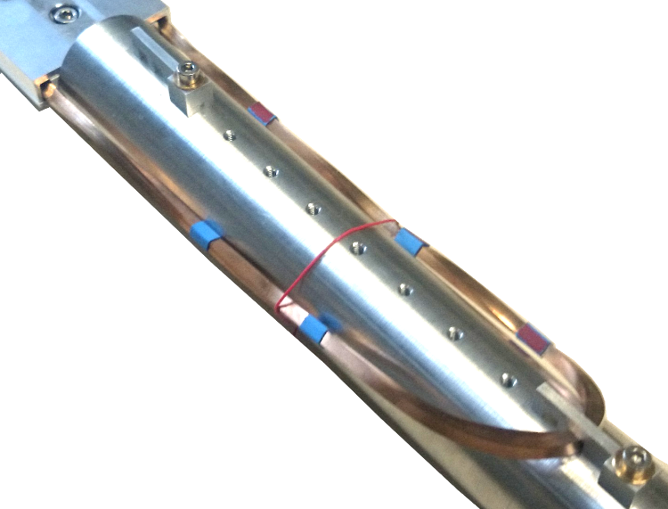

Winding topology
2D magnet ends cross-section at twist part
Racetrack coil (above beam tube)
180° twist one side
0° on the other
Flared-ends coil (below beam tube)
180° twist one side
360° twist on the other
Flared-ends coil
Winding head
360° twist
90º twist
ew + 90º twist
180° twist
Straight part

Slide 5
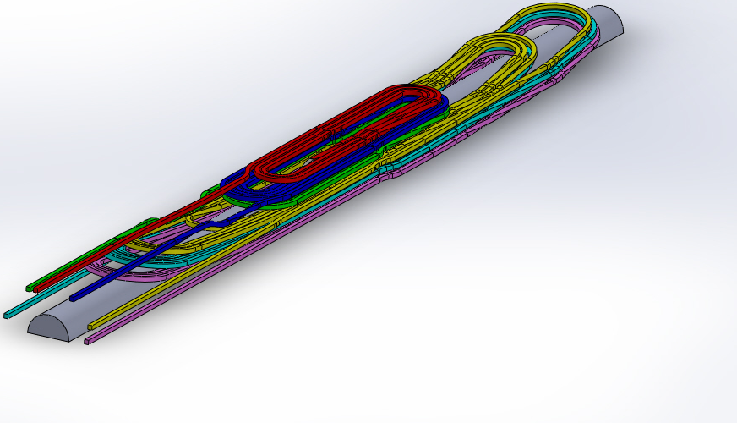
3D magnet ends
Hardway bend: > 2 m
Easyway bend > 10 mm
Twist pitch = 1.8 º/mm
Transposition side
40 cm
Layer-jump side
- Total length of straight part: 15 m
- Total length of magnet ends: 0.8 m
- Total length of stack cable
in magnet ends: 22 m
40 cm
Main highlights of 3D HTS coil-ends
46-turns HTS insert is consist of six double pancakes. Three coils at top and at bottom are the racetrack and flared-ends coils, respectively.
Double pancake is connected with layer jump. Layer jump is done with twist + ew bending or with hw bending.

Slide 6
Outline of contents
HTS twisted stacked magnet design
  - 2D magnet cross-section
  - 3D magnet ends
Current distribution analysis
Future aspects
Winding test
Conclusions

Slide 7
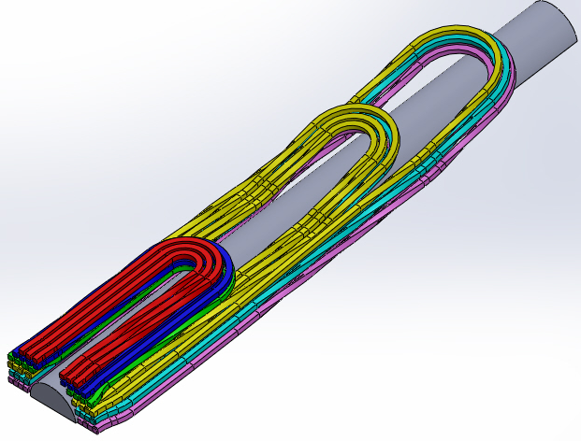
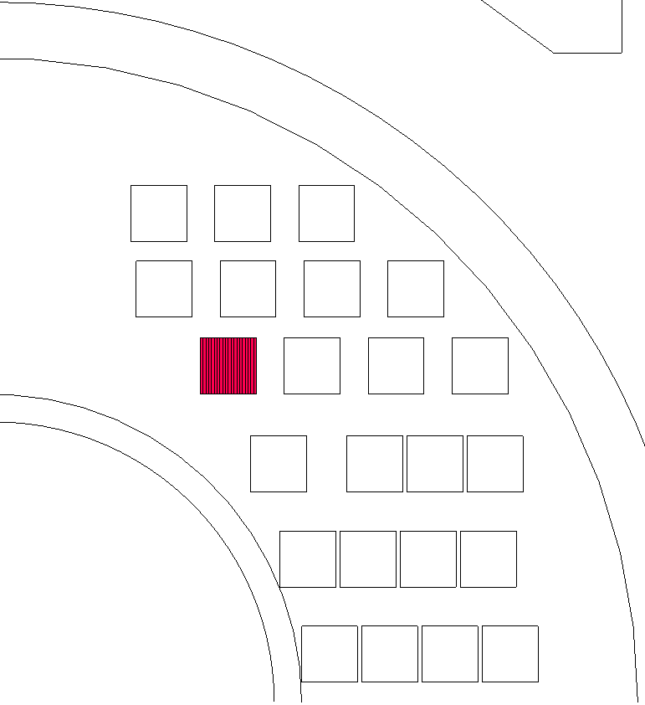
Current distribution 〜 Introduction 〜
Twisted stacked cable (TSC) has only one twist per turn out of 15m long insert.
Stacked tapes are insulated each other in order not to allow the current sharing.
Current distribution of TSC depends on contact resistance.
20 stacked tapes

Slide 8
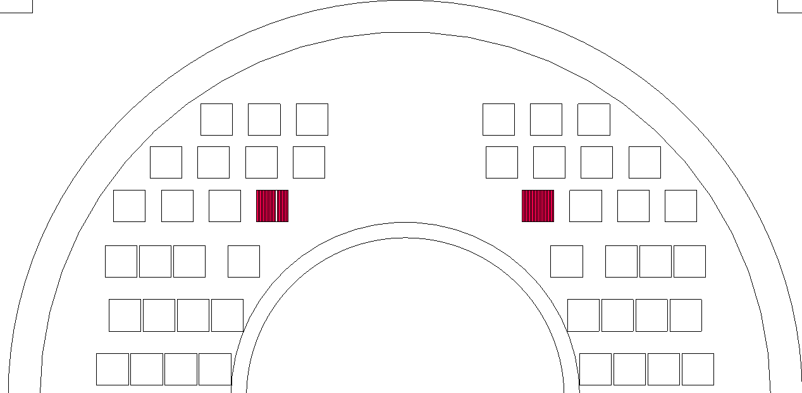
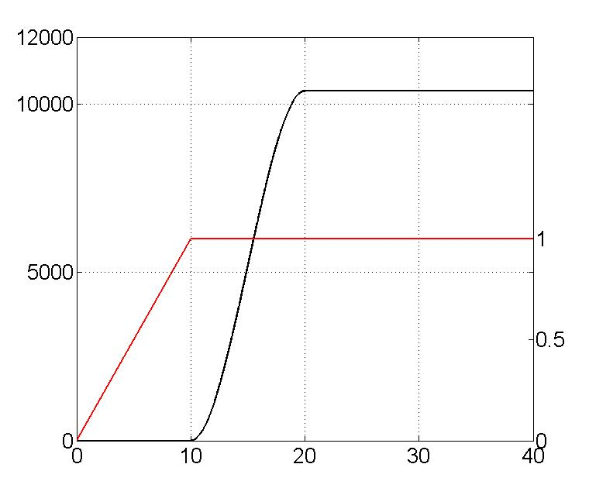
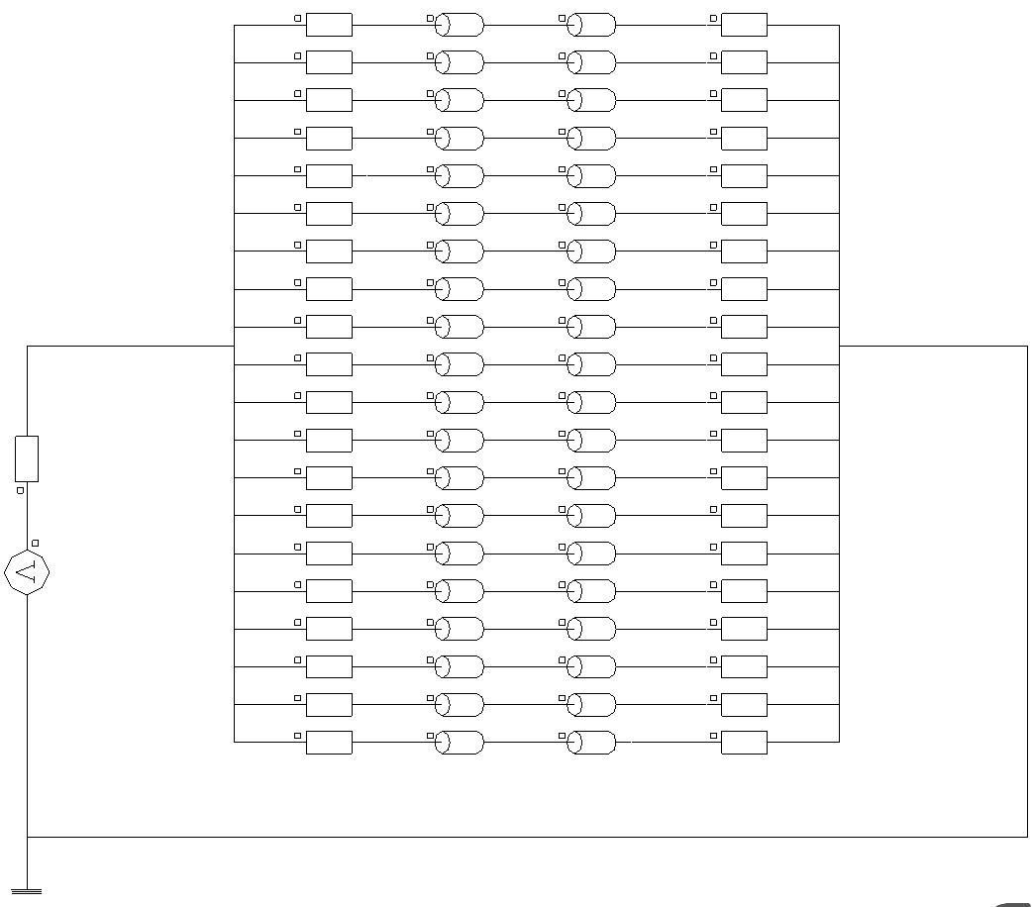
Current distribution 〜 Numerical setup 〜
Specification for HTS tape
Engineering current density J_{e} | 1000 MA/m²
n-value | 20
Operating condition
0 T → 1 T
0 A → 0.65*J_{e}
(= J_{op})
Ramp current
Current [A]
External field
Field [T]
R_{sc} + R_{contact}
Time [s]

Slide 9
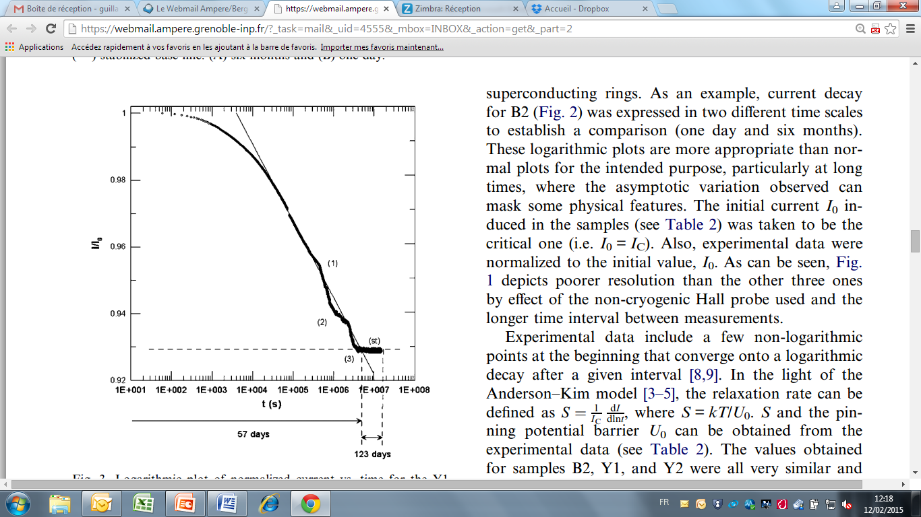
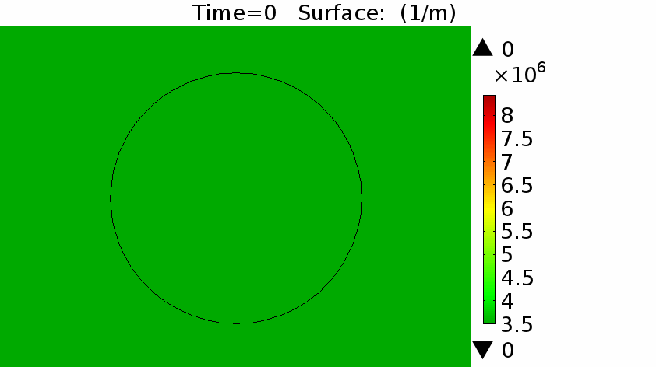
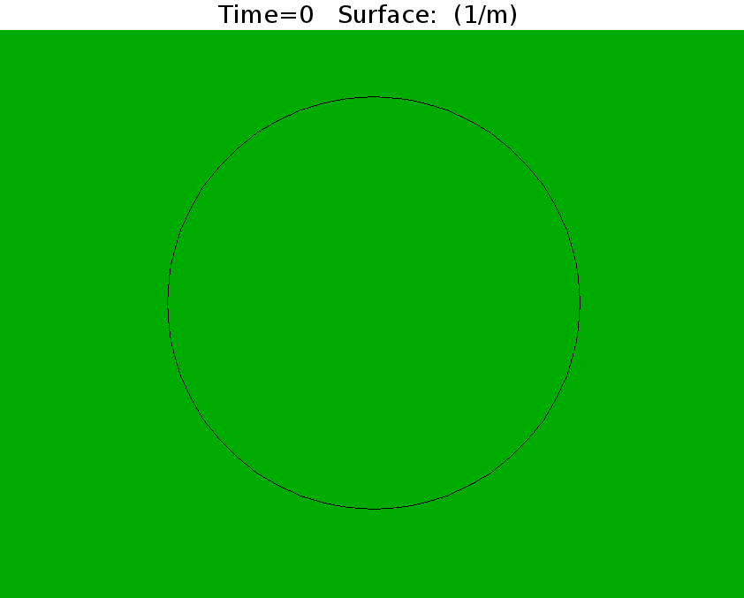
Current distribution 〜 Numerical setup 〜
Using the right E-J characteristics for the material
H. Gonzáles-Jorge et al., “Evidence of current stabilization after long-time decay in High-T_{c} superconductors”, Cryogenics, 2004

Slide 10
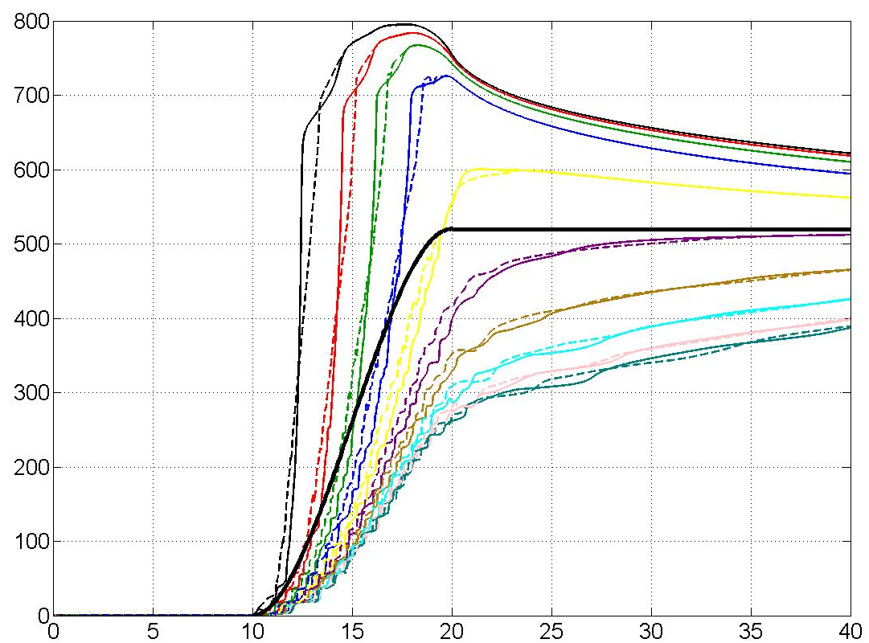
Current distribution 〜 1st step 〜
15 m long magnet + Constant contact resistance R = 1000 nΩ
B_{a} = 1T, I_{a} = 0A
I_{a} = 10.4 kA
(3) Homogenization
(2)
Current remains zero during the external field. (Twist transposition)
Tapes at edges have more current due to a shielding current in middle.
Current equilibrates depending on total resistance and inductance.
Tapes at edges
Current [A]
Tapes in middle
(1)
Time [s]

Slide 11
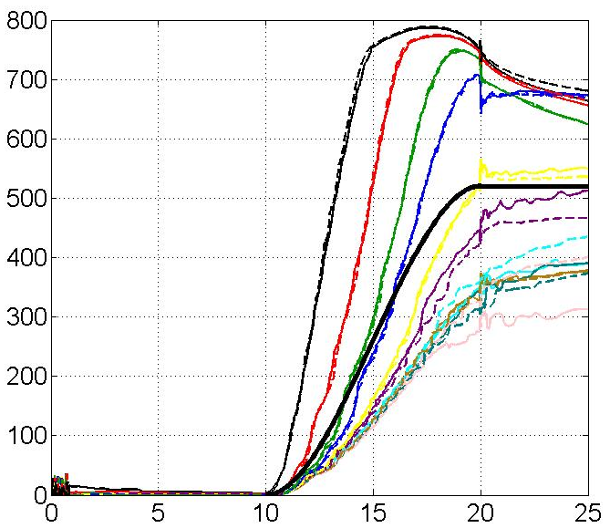
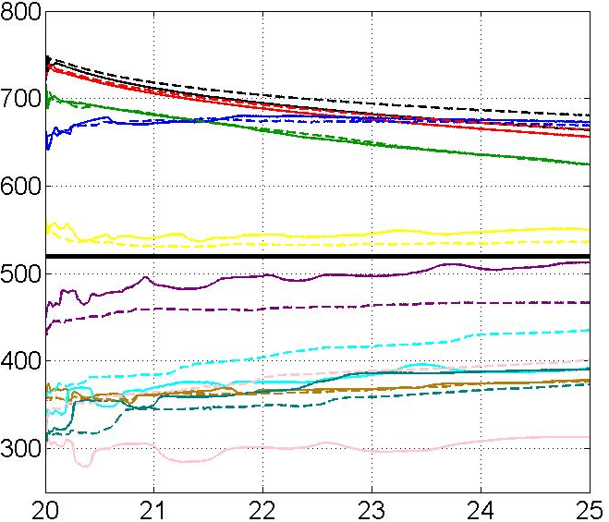
Current distribution 〜 2nd step 〜
15 m long magnet + Random contact resistance R (= R’ + ΔR’)
R’ = 1000 nΩ
α = 0 – 0.5
B_{a} = 1T, I_{a} = 0A
I_{a} = 10.4 kA
Homogenization
ΔR’ = αR’
α₁: 0.38
α₂: 0.4
α₃: 0.43
α₄: 0.04
α₅: 0.2
α₆: 0.13
α₇: 0.4
α₈: 0.22
α₉: 0.46
α₁₀: 0.09
α₁₁: 0.13
α₁₂: 0.07
α₁₃: 0.07
α₁₄: 0.43
α₁₅: 0.29
α₁₆: 0.27
α₁₇: 0.07
α₁₈: 0.43
α₁₉: 0.31
α₂₀: 0.18
Tapes at edges
Current [A]
Tapes in middle
Time [s]

Slide 12
Current distribution 〜 2nd step 〜
15 m long magnet + Random contact resistance R (= R’ + ΔR’)
R’ = 1000 nΩ
α = 0 – 0.5
B_{a} = 1T, I_{a} = 0A
I_{a} = 10.4 kA
Homogenization
ΔR’ = αR’
α₁: 0.38
α₂: 0.4
α₃: 0.43
α₄: 0.04
α₅: 0.2
α₆: 0.13
α₇: 0.4
α₈: 0.22
α₉: 0.46
α₁₀: 0.09
α₁₁: 0.13
α₁₂: 0.07
α₁₃: 0.07
α₁₄: 0.43
α₁₅: 0.29
α₁₆: 0.27
α₁₇: 0.07
α₁₈: 0.43
α₁₉: 0.31
α₂₀: 0.18
Next step
Long period analysis
Smaller R’ with less variation α
Anisotropic dependency
Divide all block into 20 tapes
Tapes at edges
Current [A]
Tapes in middle
Time [s]

Slide 13
Outline of contents
HTS twisted stacked magnet design
  - 2D magnet cross-section
  - 3D magnet ends
Current distribution analysis
Future aspects
Conclusions

Slide 14
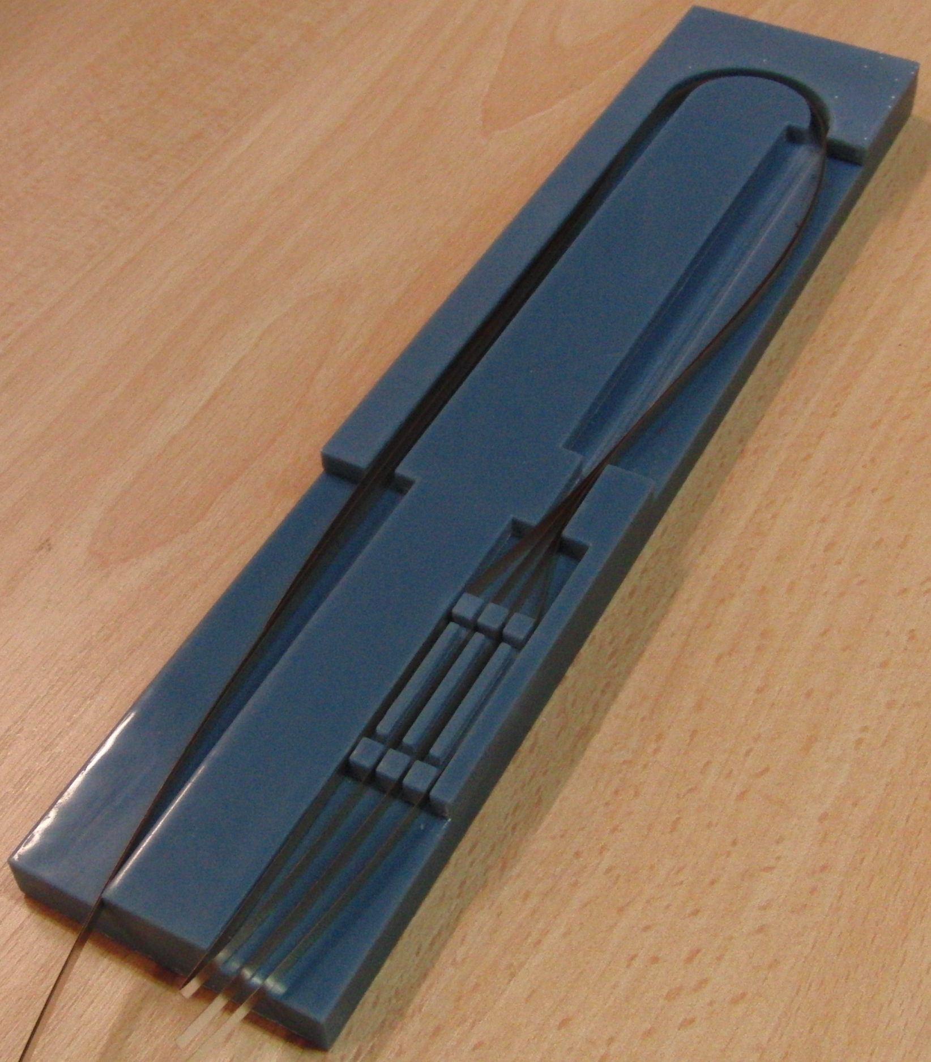
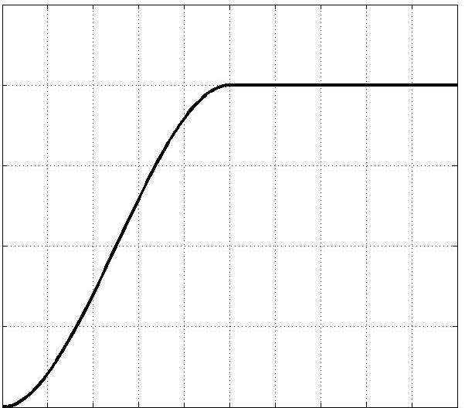
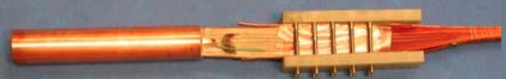
Test for current distribution
<Objective>
To see the current distribution of twisted stacked cable
with the ramp current. And to see the behavior after the
end of the ramp current (Long period test).
<Plan>
Test at 77 K in Grenoble
December/ 2015
Test under external field
January or February/ 2016
Fresca 10 T test station ?
Twist part
Pick-up coil
Hole sensor
0.5 I_{c}
Ramp current
Current
Electrical joints (MIT)
Time

Slide 15



Conclusion
46-turns HTS twisted stacked design achieved a field of 5 T with J_{e} = 650 MA/m² and a good field quality. Large J_{e} is needed as the background filed penetrate into c-axis at twist part. The relative magnet ends’ positions of HTS insert and LTS outsert may maintain the large J_{e}.
Twisted stacked cable needs to be insulated because there is only one twist per turn out of 15 m long HTS insert. Therefore, the current distribution is determined by the contact resistance. Further analysis is ongoing.
Current distribution test of twisted stacked cable is planed to especially see after the end of the ramp current.

