Slide 1
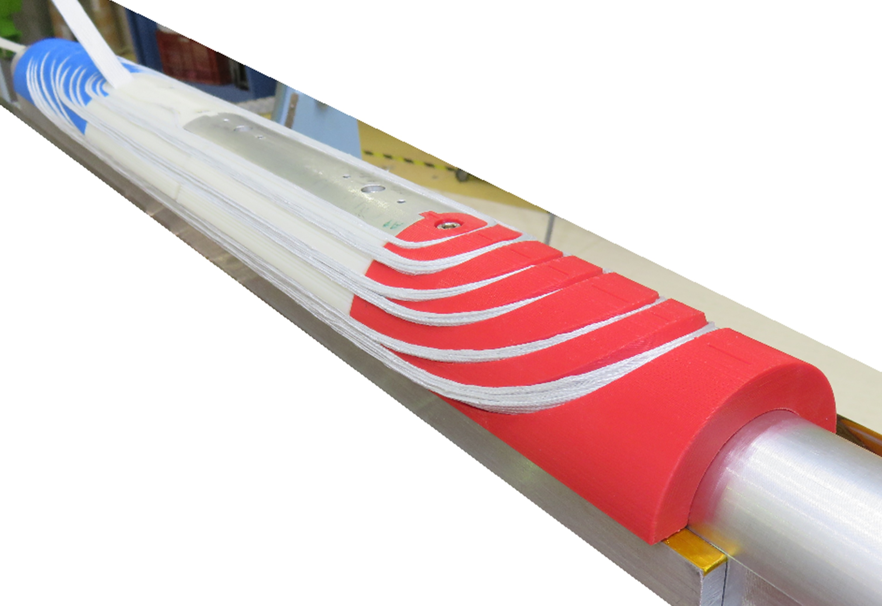

EuCARD-2 dipole status: cos-θ
WP10.3
Clément Lorin/Maria Durante
(CEA)
1 - dec - 2015
CERN
Acknowledgements: Arnaud Acker and Jean-François Millot

Slide 2
Roebel cable options
Two cable options
  13 x 140 µm tapes (baseline: Bruker) leading to magnet design A
    12 x 1.2 mm² with 100 µm insulation
  15 x 100 µm tapes (plan B) leading to magnet design B
    12 x 1.0 mm² with 125 µm insulation
  In both cases: 12.0 mm total width, 300 mm twist pitch, 5.5-5.9 mm meander width
  Performance: J_{e,tape} (18 T, 4.2 K, //c) = 600 A/mm²

Slide 3
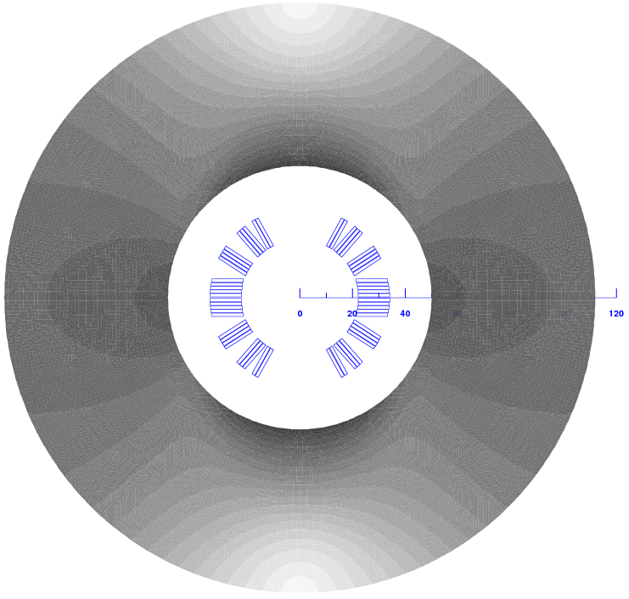
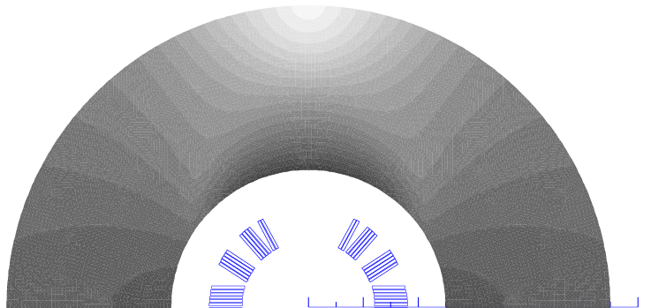
Magnetism Standalone Mode
Layout | Unit | Cosϑ A | Cosϑ B
Iop | kA | 11.68 | 10.06
Bop | T | 5 | 5
Bpeak | T | 5.7 | 5.8
Ic | kA | 14.4 | 15.2
LL margin | (%) | 20 | 34
T margin | K | 20 | 30
Sd. inductance | mH/m | 0.49 | 0.73
coil inner radius | mm | 22 | 24
yoke inner raidus | mm | 50 | 50
yoke outer raidus | mm | 112 | 110
Nb. of turns | - | 14 | 17
Unit len. of cond. | m | 20 | 24
B
A

Slide 4
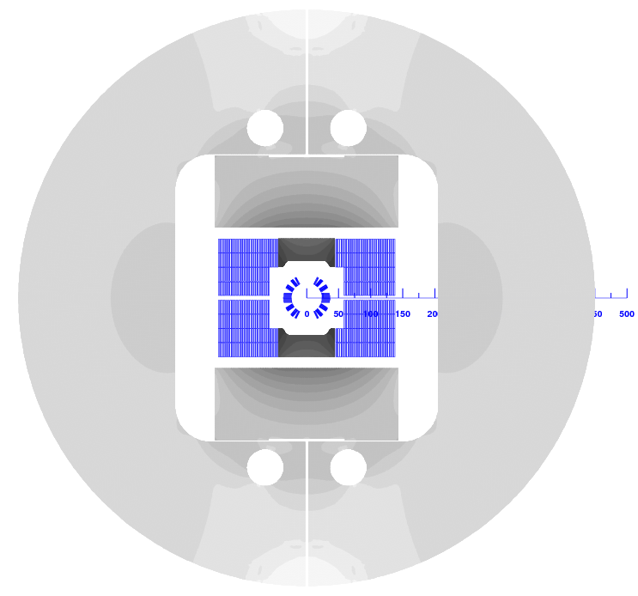
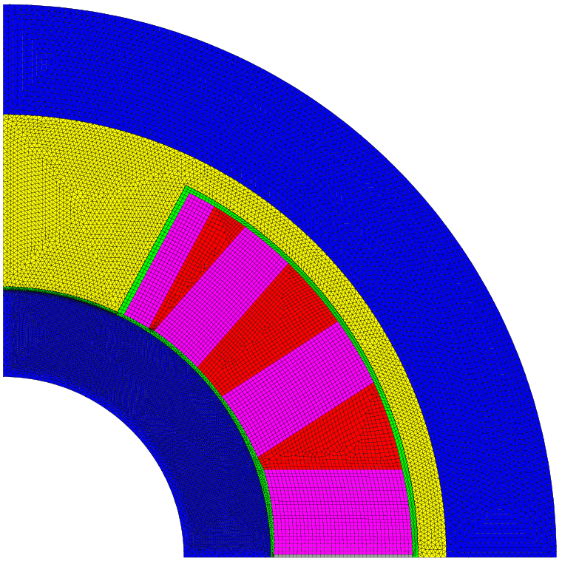
Magnetism & Mechanics Insert Mode
Layout | Unit | Cosϑ A | Cosϑ B
Iop | kA | 6.4 | 7.1
Bop | T | 2.1 + 13 | 2.6 + 13
Ic | kA | 7.1 | 7.9
LL margin | (%) | 10 | 10
T margin | K | 8 | 8
S. inductance | mH/m | 0.37 | 0.55
M. inductance | mH/m | 1.37 | 1.77
coil inner radius | mm | 22 | 24
inner tube th. | mm | 6 | 8
outer shell th. | mm | 12 | 10
Fx per ½ coil | kN/m | 1226 | 1669
Fy per ½ coil | kN/m | -60 | -95
Fz | kN | 61 | 90
σ_{T} | MPa | 140 | 155
σ_{R} | MPa | 75 (~50) | 110 (~70)
azi. deflection | µm | 125 | 140
von Mises inner | MPa | 600 | 760
von Mises outer | MPa | 240 | 250
Layout | unit | Cosϑ A & B
bore radius | mm | 16
external radius | mm | 49
pad (collar) th. | mm | 2.5

Slide 5
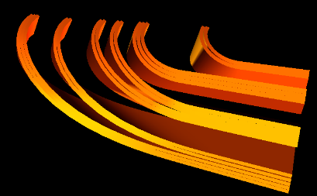
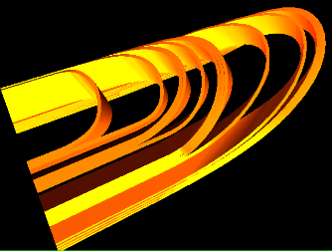
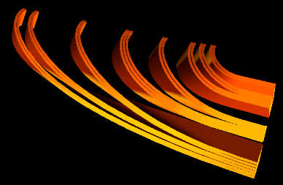
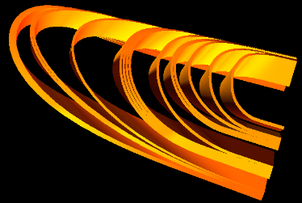
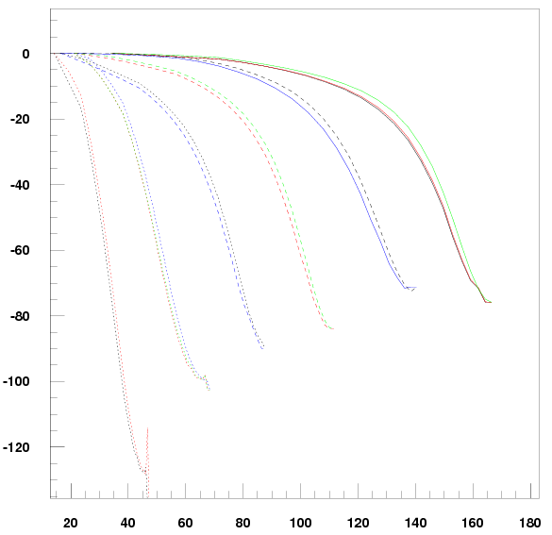
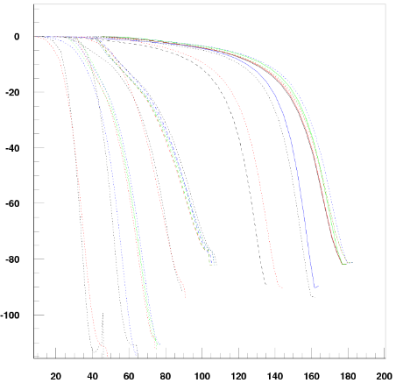
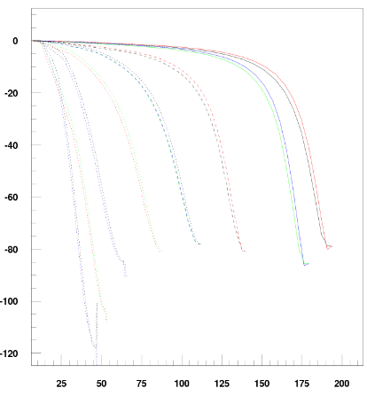
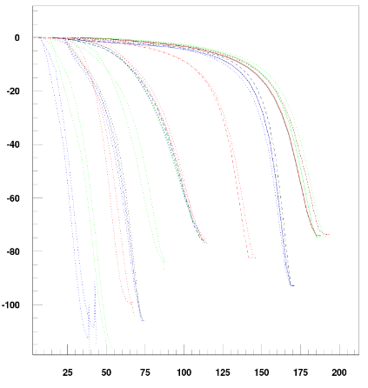
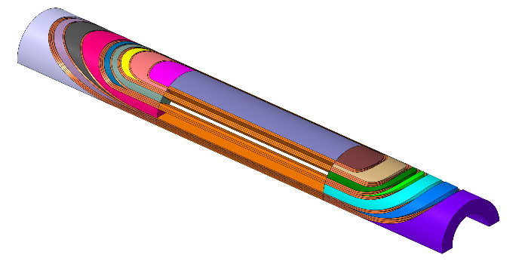
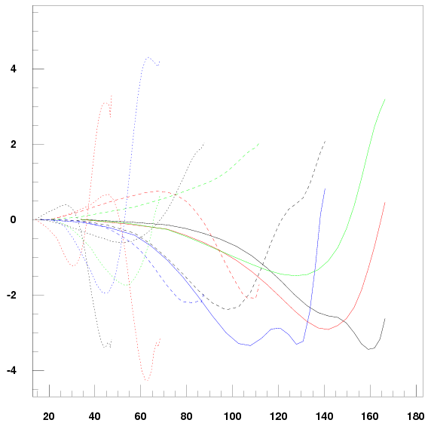
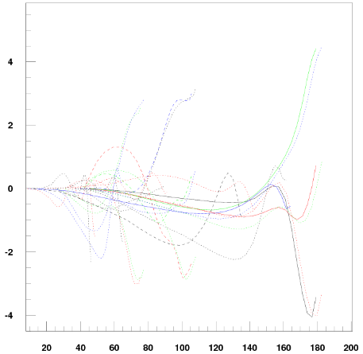
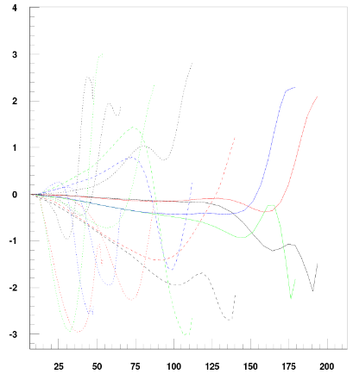
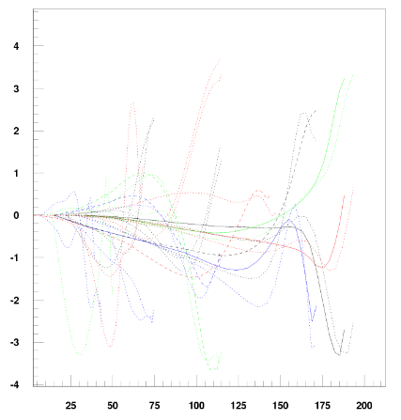
End designs
Design A
Design B
Return
Lead
Return
Lead
(ew,hw)_{min} | Cosϑ A | Cosϑ B
Return | (7.3 mm, 23 cm) | (7.9 mm, 32 cm)
Lead | (8.5 mm, 22 cm) | (8.3 mm, 27 cm)
Curv. easyway
100 m⁻¹ -> 10 mm
A
Curv. hardway
4 m⁻¹ -> 25 cm

Slide 6
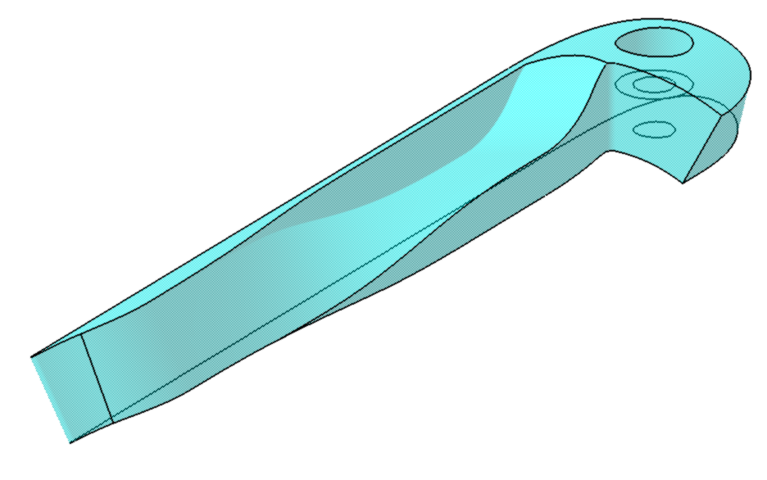
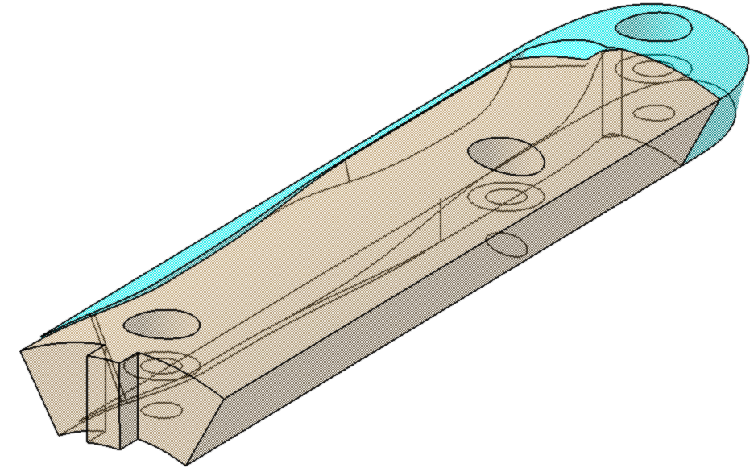
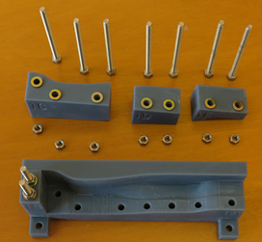
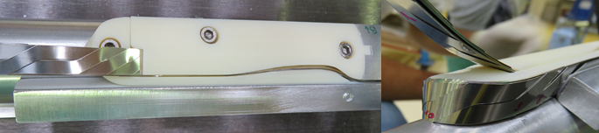
Conductor outwards path
Winding tests: July 2015
Twisting tests: Jan 2016
Designed at CEA - Printed at CERN – Tests to be done at KIT
Arnaud Acker

Slide 7
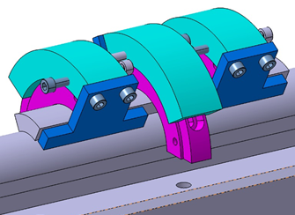
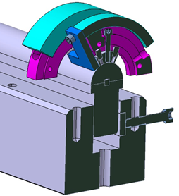
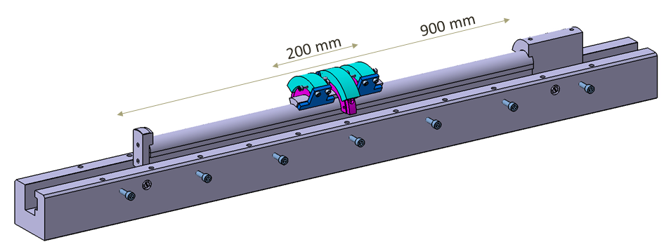
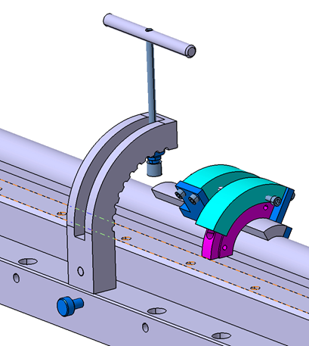
Tooling: Mandrel – Beam – Central post -Tooling
Jean-François Millot

Slide 8
Planning
Detailed drawings of coil (A&B) : End of December 2015
CAD magnet and tooling 2D detailed drawings (A): End of February 2016
Dummy cable: 2 x 20 m – End of March 2016
Procurement (A): End of May 2016
Superconducting cable: 3 x 20 m – End of June 2016
Dummy coils (winding-impregnation): Mid of July 2016
Dummy magnet assembling: End of July 2016
Start working of SC magnet: September 2016

