Slide 1
Magnet plan & issues
WP10 general meeting
01/12/2015
Maria DURANTE
On behalf of Task 10.3

Slide 2
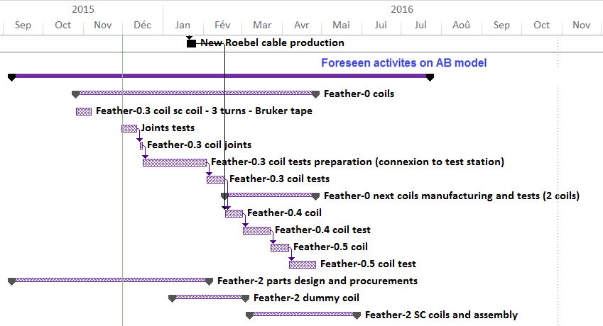
Magnet plan – AB model

Slide 3
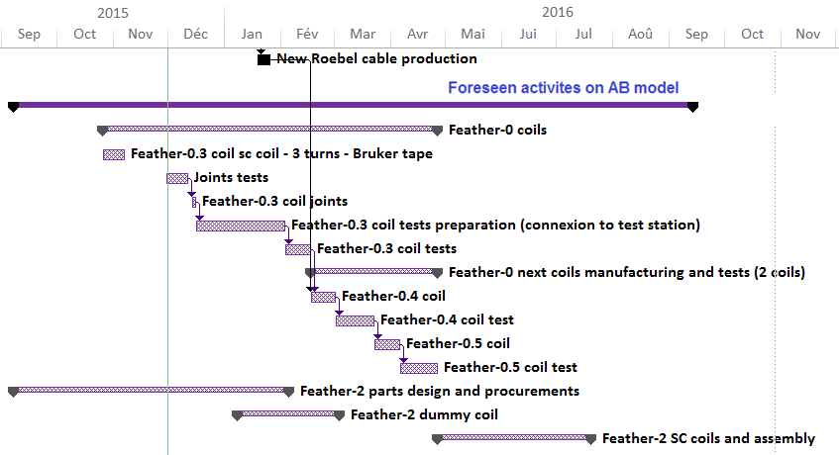
Magnet plan – AB model

Slide 4
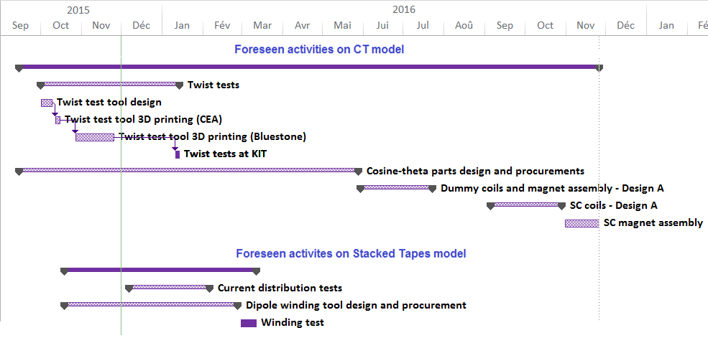
Magnet plan – CT and stacked tapes models

Slide 5
Tape and cable needs
ABdesign
  Dummy 0.8 mm thick :
    20 m ( 3 x 6 m UL) for Feather-0 → December 2015
    2 x 30 m UL from GCS for Feather-2 available
    2 x 30 m UL for Feather-2 → February 2016
  SC 0.8 mm thick :
    20 m (3 x 6 m UL) for Feather-0 → December 2015
    3 x 30 m UL for Feather-2 → March 2016
CT design
  For Design A :
    Dummy 1.2 mm thick : 3 x 20 m UL → March 2016
    SC 1.2 mm thick : 3 x 20 m UL → June 2016
  For Design B :
    Dummy 1.0 mm thick : 3 x 24 m UL → March 2016
    SC 1.0 mm thick : 3 x 24 m UL → June 2016
Stacked tapes block design
  Needs for 200 m, 4 mm wide, 0.14 mm thick tape
  For first single layer coil : 20 x 1.8 m UL = 36 m → March 2016

Slide 6
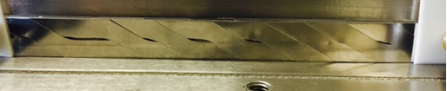
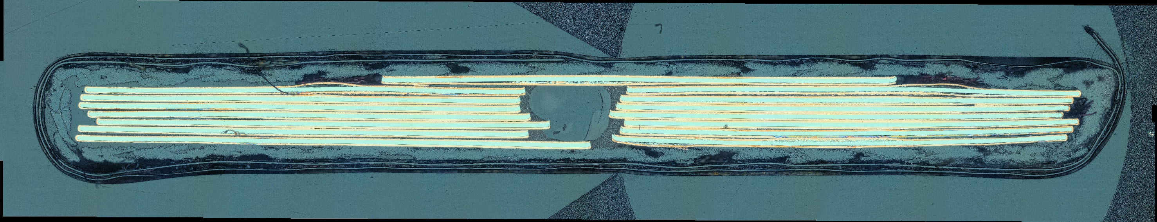
Cable geometry
Cable thickness
  Baseline cables:
    Cable A, Bruker tapes, 13 x 140 µm thick tapes: 1.1 +/- 0.1 mm thick
    Cable B : 15 x 100 µm thick tapes : 0.9 +/- 0.1 mm thick
    Cable 0.8 mm : ?
Cable width
  12 mm +/- ?
Strands distribution, longitudinally
  300 mm transposition pitch will help
Strands distribution, right/left side
  Fiber rope, or insulated copper wire in the central hole → also helping for stress
  Kapton maybaum

Slide 7
Insulation/Impregnation
Insulation for Roebel cable : glass fiber sleeve, 0.1-0.125 mm thick completed by epoxy resin impregnation
Need for charged resin (difficult with glass sleeve)?
  Feather-0.3 resin impregnation without filler
  On-going test at Twente University → see Marc’s talk

Slide 8
Joints
Joints at the end of the coils, between Roebel cable and stacks of tapes.
  Solder choice
  Soldering procedure avoiding temperature > 250 °C for more than few seconds
Joint configuration test campaigns carried out by Task 3 and Task 2
→ see Jérôme and Glyn talks
Tests to be done on 12 mm wide splices, at 77K and 4K
→ joint for Feather-0.3

Slide 9
Protection
For AB model, protection studies done for Roebel cable made up of 0.1 mm thick tapes
To be done for Bruker cable, 0.14 mm thick tapes
For CT model, protection studies for Bruker cable → see Tina talk
  High copper current densities
    100 µm ss substrate → 50 µm ss substrate and more copper ?

Slide 10
Instrumentation
Voltage taps
Temperature sensor
Pick up coil + (50µm/50µm 20+20 turns x 5)
Optical fiber used in Feather-0.3 (seems too fragile)
Acoustic recording (one put aside or two for redundancy)
Copper wire in a glass sleeve in the Roebel center

