Slide 1
EHN1 Extension Activities Schedule
Anne Laure Perrot EN/MEF- LE
Bastien Rae EN/MEF- LE
CERN Neutrino Platform General Meeting
19th November 2015

Slide 2
Outline
EHN1 extension integration
EHN1 access layout
EHN1 extension activities schedule
preliminary

Slide 3
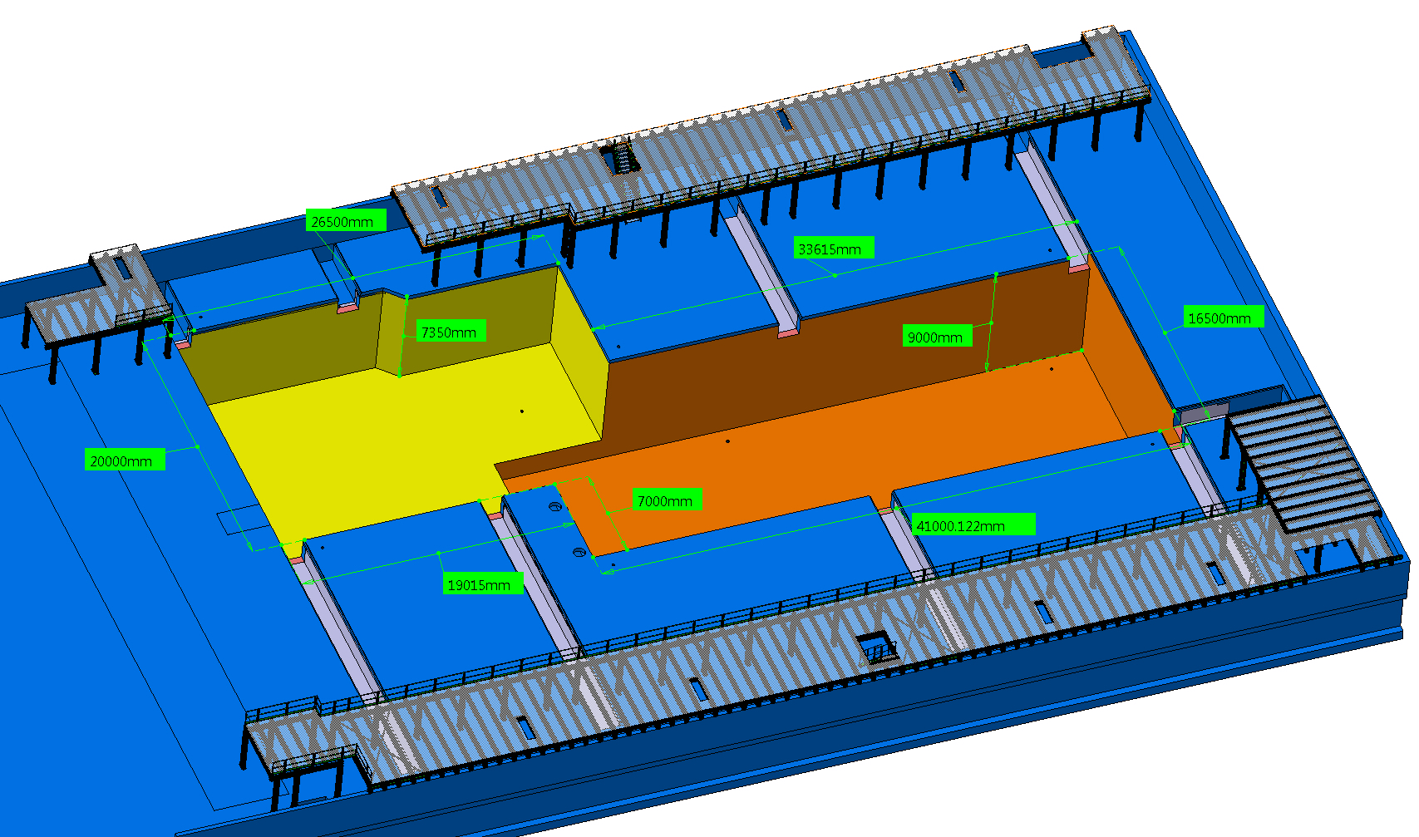
EHN1 extension integration
Building as delivered by the civil engineering at the handover
Jura side
Lausanne /
North side
Current North Wall
Saleve side

Slide 4
EHN1 extension integration
Courtesy V. Clerc, S. Girod EN/MEF
Jura side
Current North Wall
Lausanne /
North side
EHN1 extension
Courtesy V. Clerc, S. Girod
Saleve side

Slide 5
EHN1 extension integration
Courtesy V. Clerc, S. Girod EN/MEF
Cryogenics
external platform
H2 beam line extension
WA105
detector
ProtoDune
detector
H4 beam line extension

Slide 6
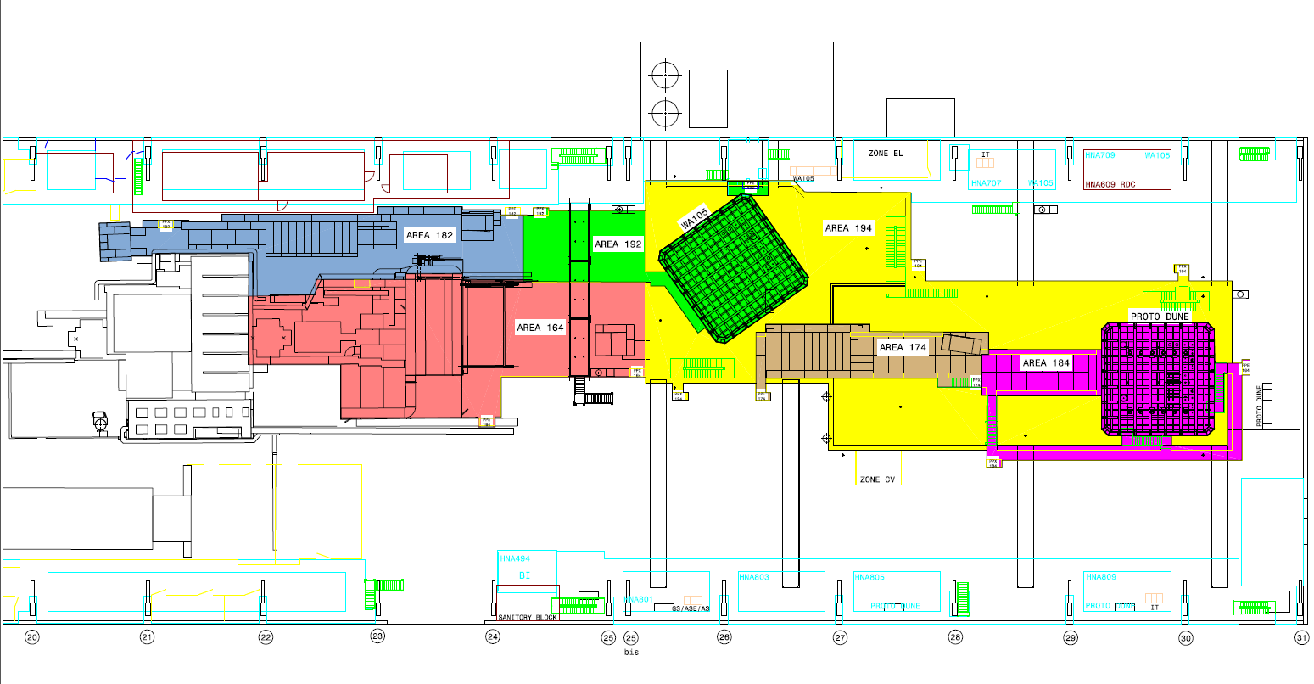
EHN1 extension – access layout
Current North Wall
area 182
area
area 194
192
area 164
area 174
area 184
area 194
Courtesy I. Efthymiopoulos, S. Girod EN/MEF

Slide 7
EHN1 extension – areas definition for planning
Jura side
H2 beam line extension
Lausanne side
H4 beam line extension
Saleve side

Slide 8
EHN1 extension – areas definition for planning
Jura side
PIT A
PIT B
Lausanne side
Saleve side

Slide 9
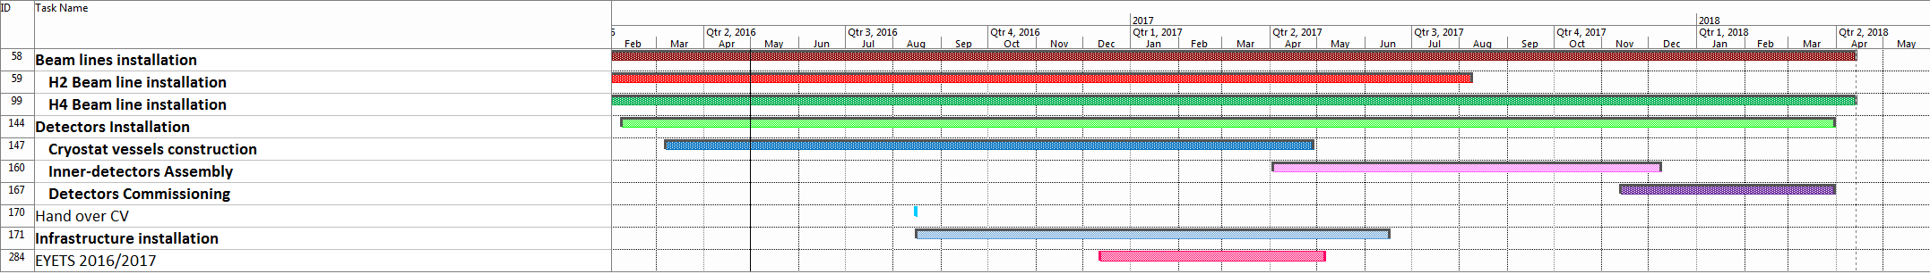
Timeline
preliminary
Handover CE
delayed last week by 1 ½ month to Mid August 2016
2016
2017
2018
EYETS
Handover CE
Courtesy B. Rae EN/MEF

Slide 10
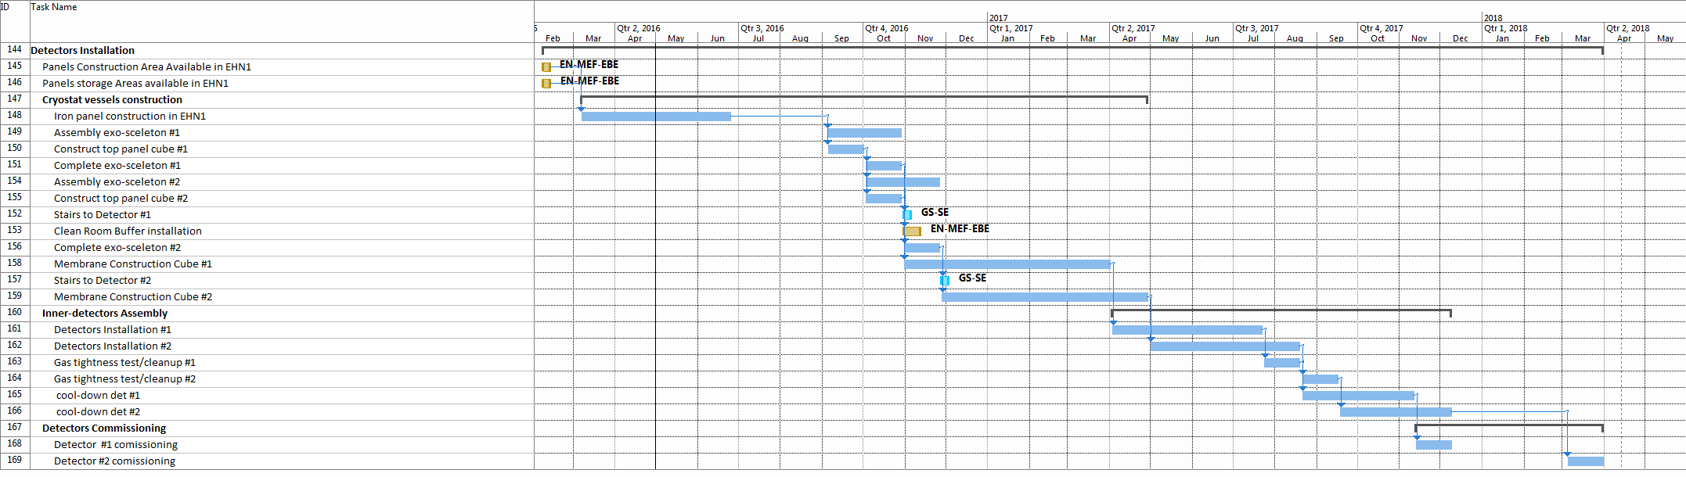
Schedule – Detectors
preliminary
April
2017
Dec
2017
March
2016
May
2017
Nov.
2017
April
2018
Cryostat Vessels construction
No access to the pits
for the other teams
Inner detector + cryo test &CD
commissioning
Courtesy B. Rae EN/MEF

Slide 11
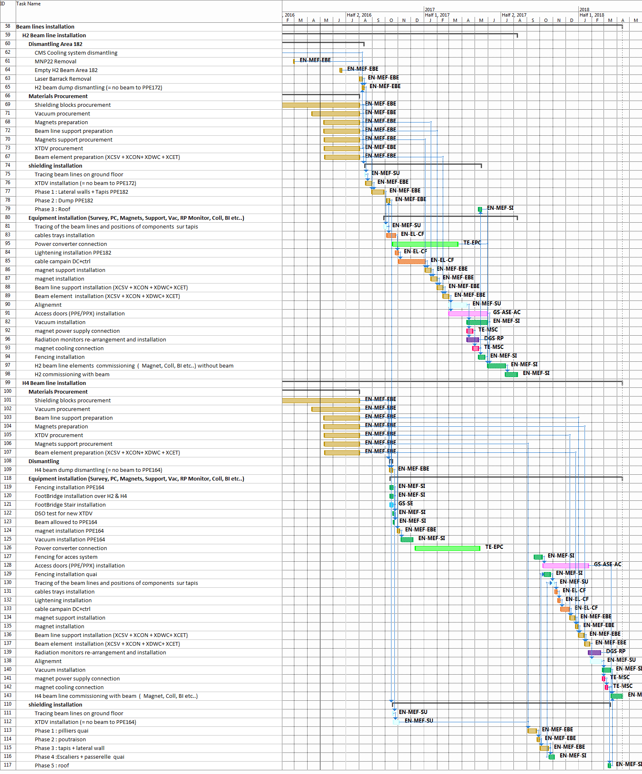
Schedule – Beam lines
preliminary
Handover CE
Mid- August 2016
October
2016
August
2017
April
2018
H2 beam line
Dismantling area 182
Shielding installation
Material procurement
Eqpt installation
Commissioning
H4 beam line
H4 beam dump dismantling
Eqpt installation in 164
Material procurement
Eqpt installation in 174 & 184
Commissioning
H4 quai & shielding installation
Courtesy B. Rae EN/MEF

Slide 12
Schedule – Beam lines
preliminary
October
2016
August
2017
April
2018
2016
H2 beam line
Material procurement
H4 beam line
Material procurement
Courtesy B. Rae EN/MEF

Slide 13
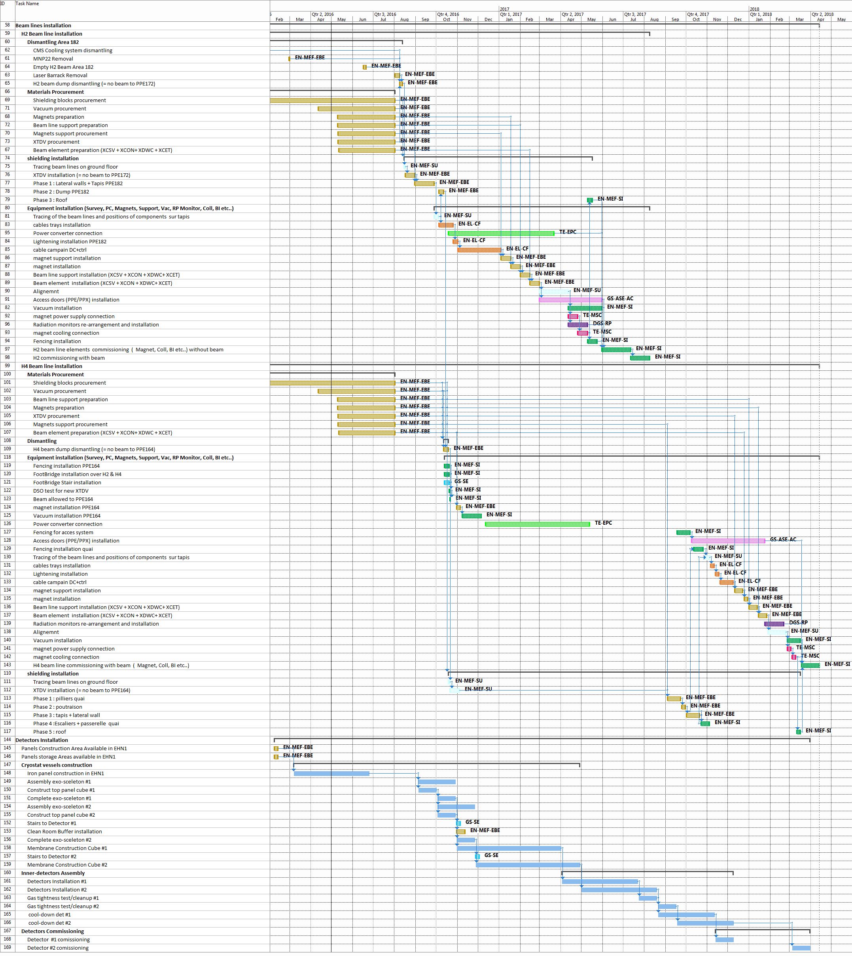
Schedule – Beam lines & Detectors
preliminary
Handover CE
Mid- August 2016
H2 beam line
Open points:
1. access conditions to the pits during the detectors gas thightness tests & cool down
Current planning: access granted in the pits during the gas thightness tests and the cool down (if not delay of 16 weeks for H4 beam line installation)
H2 commissioning
H4 beam line
no access to the pits
2. co-activity between H2 commissioning & detector installation – to be checked!
Remark:
- Installation of clean room for Proto Dune avoids the ealier installation of the H4 quai.
Cryostat
Vessel assembly
Start of H4 quai installation
detectors
End of inner detect. inst.
Courtesy B. Rae EN/MEF

Slide 14
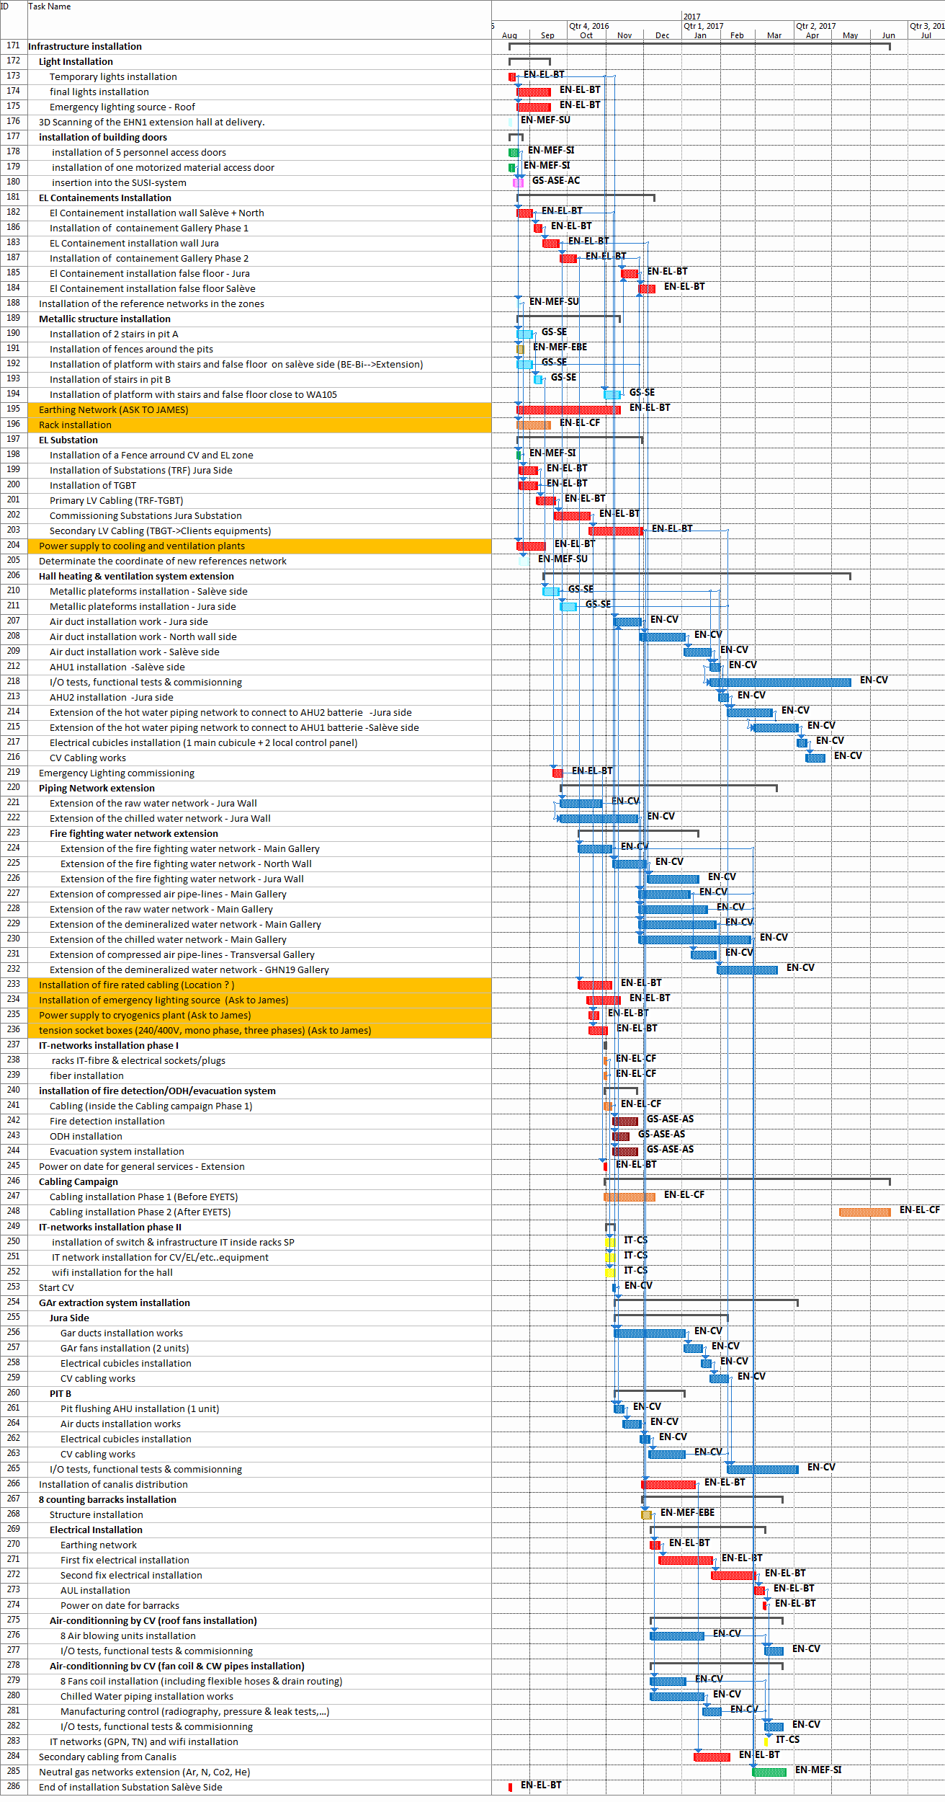
Schedule – Infrastructures
preliminary
EN/EL
EYETS
CF section: No activity during EYETS (12 th Dec.2016 – 5th May 2017)

Slide 15
Schedule – Infrastructures
preliminary
EN/CV
Hall heating & ventilation
8 th November 2016 – May 2017
Piping network
Start: end September 2016
GAr extraction system
Start:8 th November 2016
Air pulsing system
Start: 8 th November 2016
Counting barracks air conditionning
Start: 7 th December 2016

Slide 16
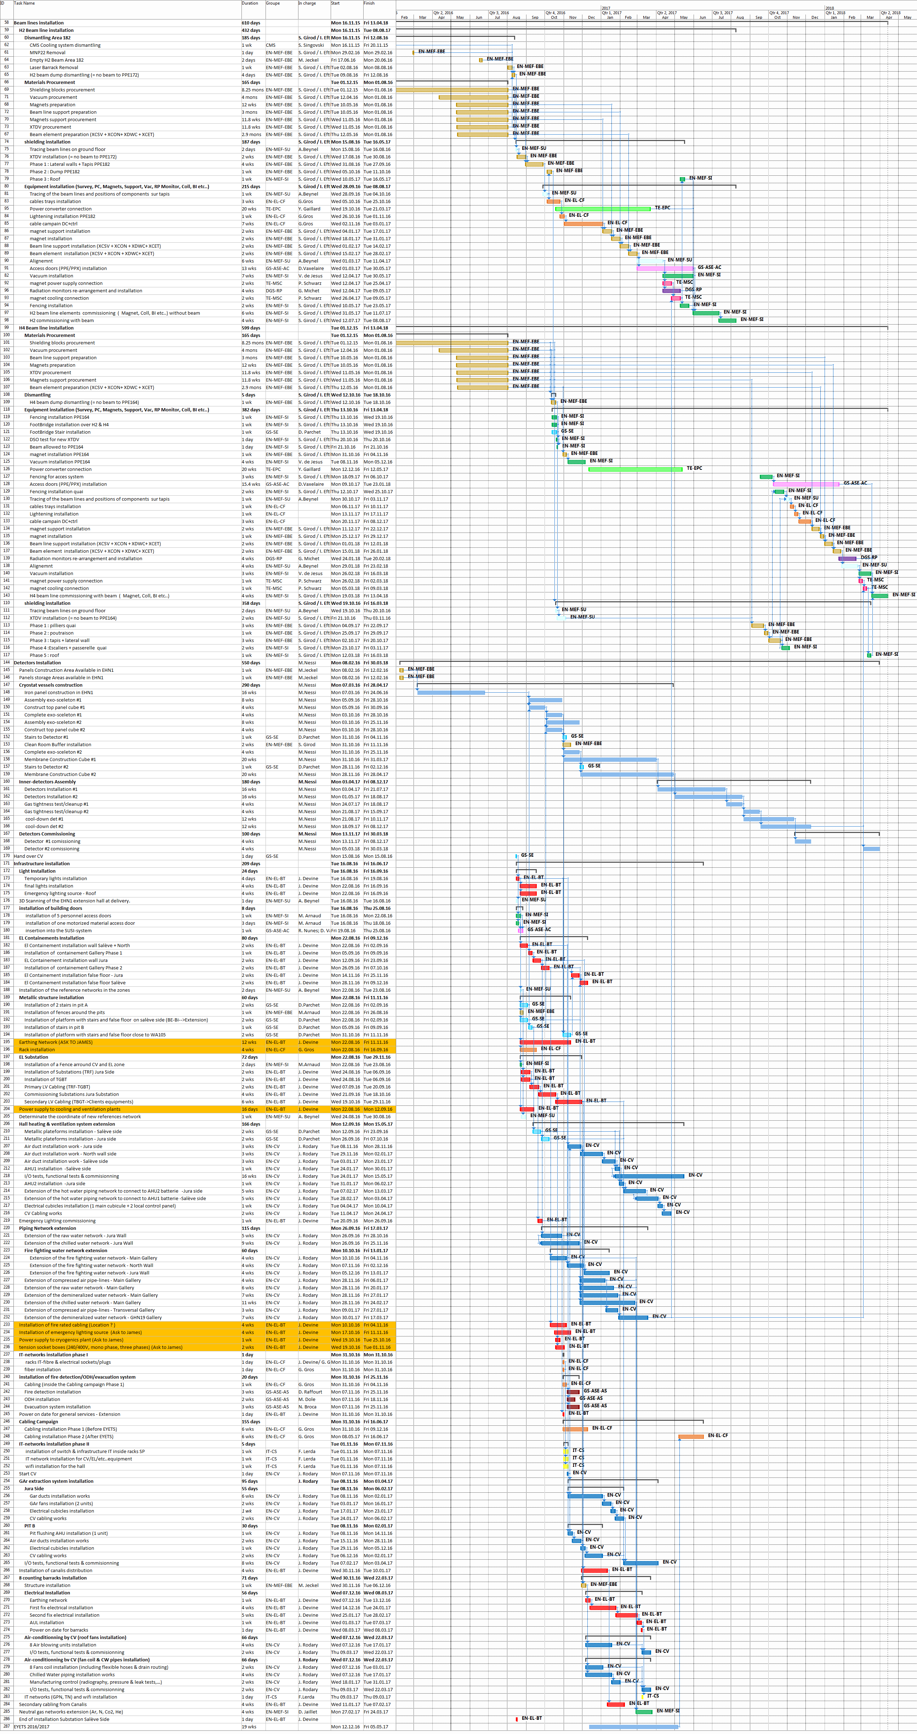
Schedule – Overall planning
preliminary
Handover CE
Mid- August 2016
April
2018
H2 beam line
H4 beam line
Start H4 quai installation
EYETS 2016 - 2017
detectors
End of Inner detector 2
infrastructure
Hall heating and ventilation
8 th November 2016 – May 2017
EN/EL-CF: no activity during EYETS
12 th Dec.2016 – 5th May 2017

Slide 17
Schedule - summary
preliminary
All activities identified for
H2 & H4 beam lines extension
Infrastructure installation
Detectors installation: all main steps known.
Last week first circulation of overall planning
To go ahead in the co-activity / sequences definition:
Important to know:
the installation procedure for cryostats & detectors installation
the cryogenics system integration
the constraints during gaz tightness test and detectors cool down.

