Slide 2

Extraction and Recombination Septa and Kickers status
Jan Borburgh, M. Atanasov, W. Bartmann, L. Ducimetiere, Mike Hourican, T,. Kramer, Thierry Masson, Antoine Prost, L. Sermeus

Slide 3
Outline
PSB extraction area and septa
BE.KFA14L1
BE.SMH15L1
BT.SMV10
BT.KFA10
BT.SMV20
BT.KFA20
Conclusions

Slide 4
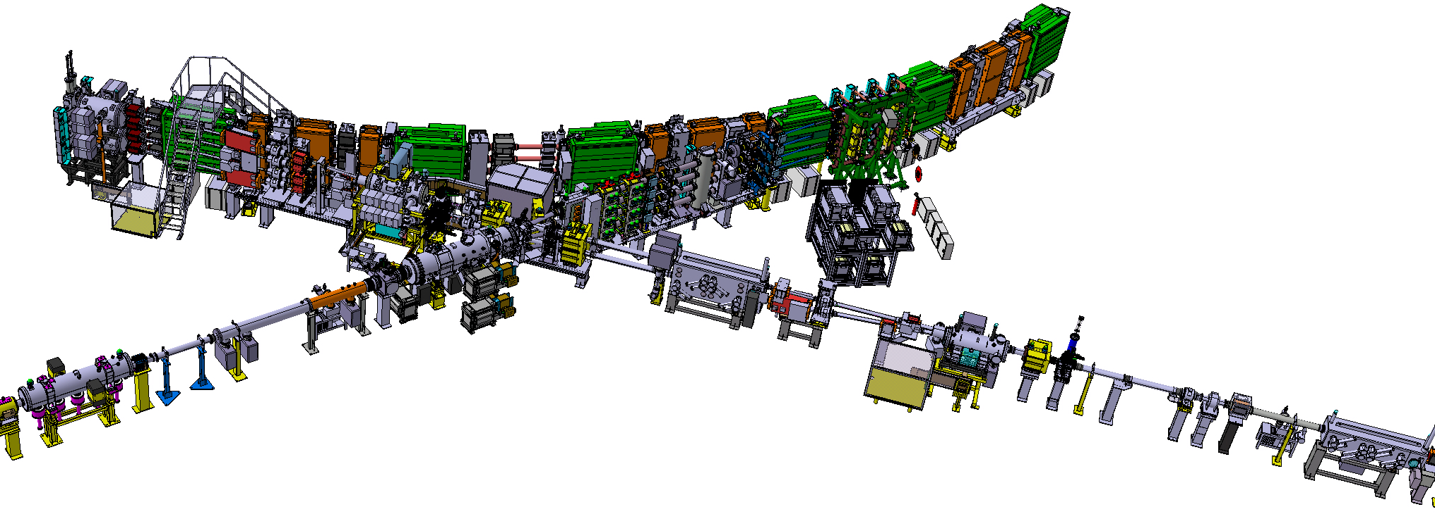
Equipment concerned
KFA14L1 - Horizontal Extraction Kicker
BESMH - Horizontal Extraction Septum
KFA10 kicker – Vertical recombination 4 to 2
SMV10 septum – Vertical recombination 4 to 2
KFA20 kicker – Vertical recombination 2 to 1
SMV20 – Vertical recombination 2 to 1

Slide 5
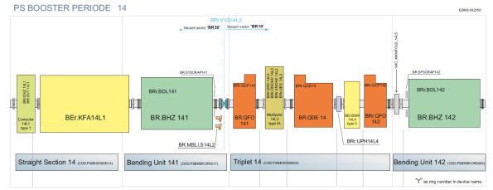
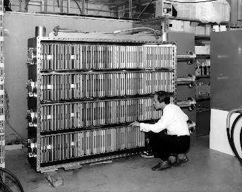
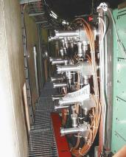
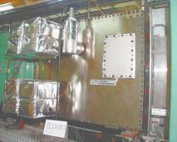
Extraction BE.KFA14L1
1 vacuum tank installed ~1970
16 magnets (4 per ring, 2 types)
No spare
All magnets have been refurbished in 2000 for the 1.4 GeV upgrade.
The poor quality glued original ferrite blocks have been replaced by C shaped ones of 8C11 type.

Slide 6
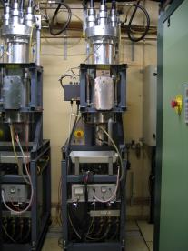
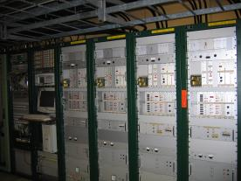
Extraction BE.KFA14L1
1 generator per ring supplies for magnets in parallel
PFL made of 4×25 Ohm SF₆ cables in //
Transmission cables same type as PFLs
Nominal Voltage @ 2GeV → 55 kV (max. 60 kV); increased breakdown risk
‘PSB to PS Kicker’ functional spec released.
System measured in lab:
  no saturation
  rise time assumed to be within spec
LIU planning:
  Design and build improved full spare (lower beam impedance, improved magnet impedance matching)
  Ready by end of LS2; not installed

Slide 7
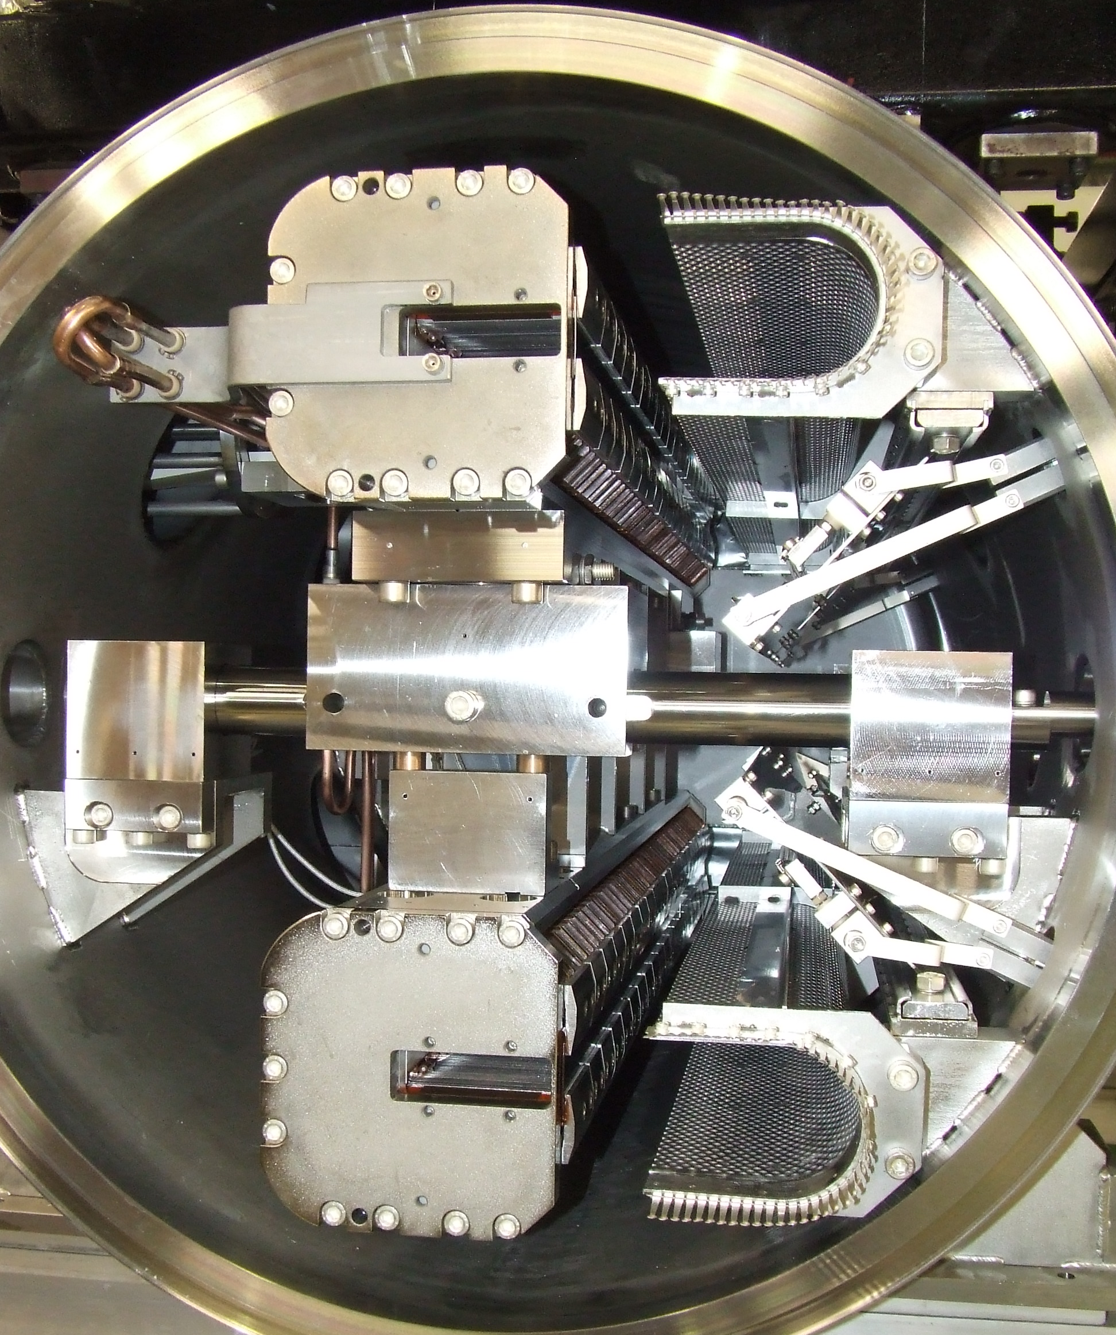
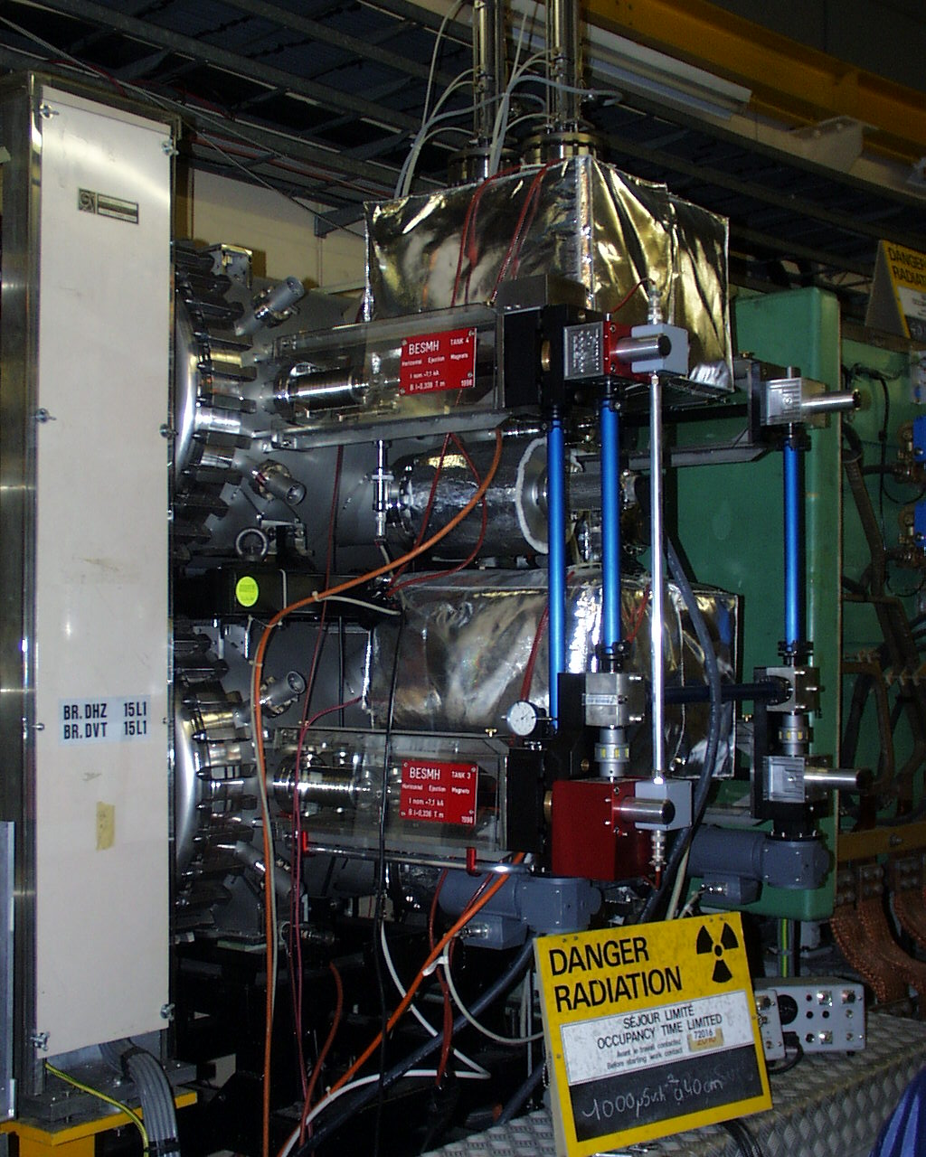
BESMH

Slide 8
BESMH Horizontal Extraction Septum
Scope of the upgrade
  Excitation current increased from 7 kA to 9.6 kA
  Deflection angle increased from 47 mrad to 49 mrad
  Cross section of in-vacuum copper busbars increased from 200 mm² to 400 mm²
  In-parallel cooling scheme per vacuum tank – cooling capacity increased from 1.9 l/min to 6.6 l/min
  No change of envelope and no impact on other facilities => no ECR
  No functional nor engineering specification planned.

Slide 9
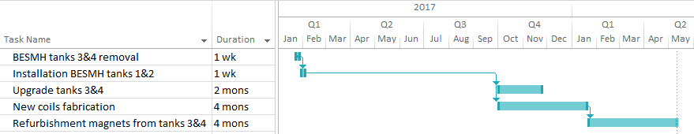
BESMH Horizontal Extraction Septum
Project status and outlook
  1 system (tanks 1 and 2) upgraded, ready for installation during EYETS.
  1 system (tanks 3 and 4) currently installed in the booster since 1998. To be upgraded after exchange and a cool-down period.
Cool down period
Budget requested: 60 kCHF; code 99236
Spent 59.5 kCHF
APT WU completed
No APT WU for installation (standard exchange covered by exploitation).

Slide 10
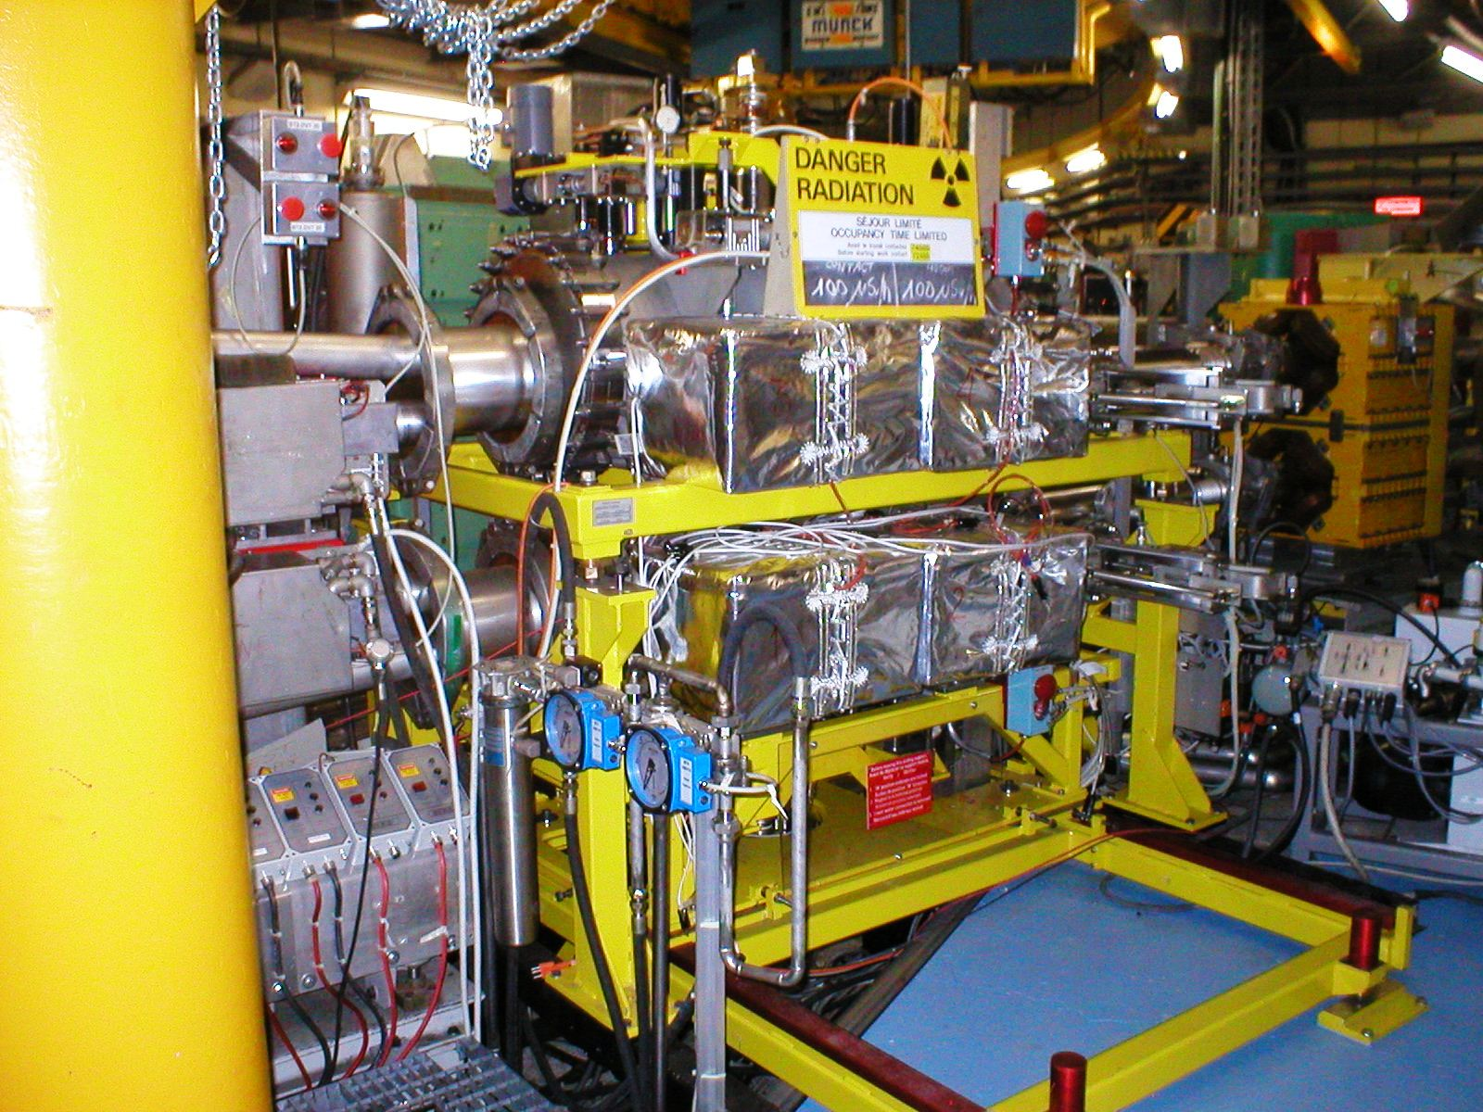
BT₁⁴.SMV10

Slide 11
SMV10 vertical recombination 4 to 2
Scope of the upgrade
  Increase of magnetic length to 1225 mm -> increase magnet physical length to 1300 mm;
  Preserve aperture (60.4 h x 102 v);
  6 magnets to be built: 2 operational + 4 spares;
  Displace beam observation equipment (ECR released: EDMS 1494819);
  ECR for the upgrade released (EDMS 1459318);
  Functional specification released (EDMS 1461559);
  Engineering specification to be compiled.

Slide 12
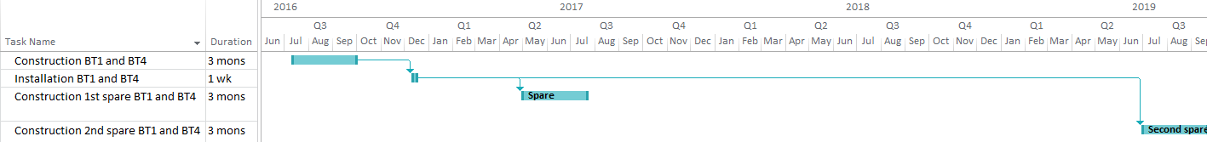
SMV10 vertical recombination 4 to 2
Project status and outlook
  Design finished.
  Part procurement started
  Tentative planning, pending available (human) resources:
  2 magnets to be constructed by end of 2016 – possibly ready for installation during next year’s EYETS
  2 operational spares to be ready for Q2 2017
  2 spares for Q3 2019

Slide 13
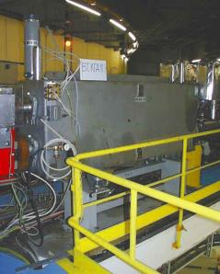
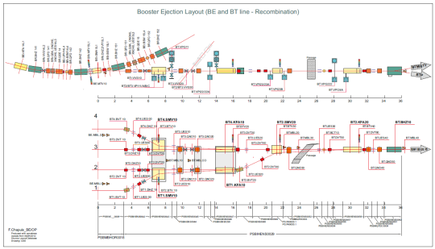
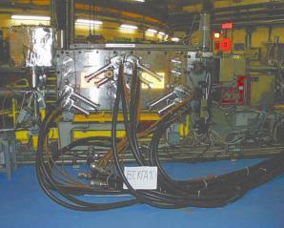
Kicker BT.KFA10
1 vacuum tank installed ~1970
4 magnets (2 per ring, 2 types)
Glued ferrite C cores of unknown type (4L1?)
No spare

Slide 14
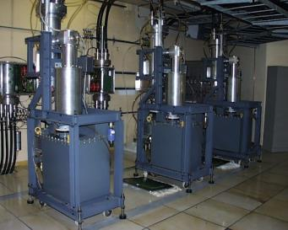
Kicker BT.KFA10
1 generator per ring (2&3) supplies two magnets in parallel
PFL made of 4×25 Ohm SF₆ cables in //
Transmission cables same type as PFLs
Nominal Voltage @ 2GeV → 55 kV (max. 60 kV)
‘PSB to PS Kicker’ functional spec released.
  System to be re-measured in tunnel in December 2015 (rise time likely outside spec)
LIU planning:
  Build new full spare with vacuum tank
    Design and produce parts in 2016
    Build new kicker in 2017
    Install during LS2
NOTE: measurements in tunnel crucial to be able to design new kicker!

Slide 15
Work to be done: BT.KFA10
Measure present kicker rise time as it doesn’t fit the predicted values.
Measurement performed in the ring. It seems that the poor rise time is due to the presently assumed 4L1 ferrite.
Measurements will be repeated in December with a improved vertical resolution oscilloscope.
BT1.KFA10
Kick rise time (2-98)%
-measured 121ns
-simulated 8C11: 101ns
-simulated 4L1: 125ns

Slide 16
Work to be done: BT.KFA10
Produce CATIA 3D models and 2D drawings of the present vacuum tank, magnets, connection boxes.
3D models ready.
EN\MME waiting for our feedback before doing 2D drawings.
Ferrite cross sectional area to be increased to prevent saturation at the ends.
Build new magnets (with new ferrite blocks) and vacuum tank and install it in the PSB during LS2.
Not started yet.
The magnet configuration must be slightly modified to pulse them from the same side.
This work should have the highest priority.
Measure BT.KFA10 configuration in Lab. By using spare BT2.KFA20 (equipped with 8C11 ferrite).
Aim to do this before/during YETS 2015-2016
Modify the present kicker magnets after exchange to have an operational spare.

Slide 17
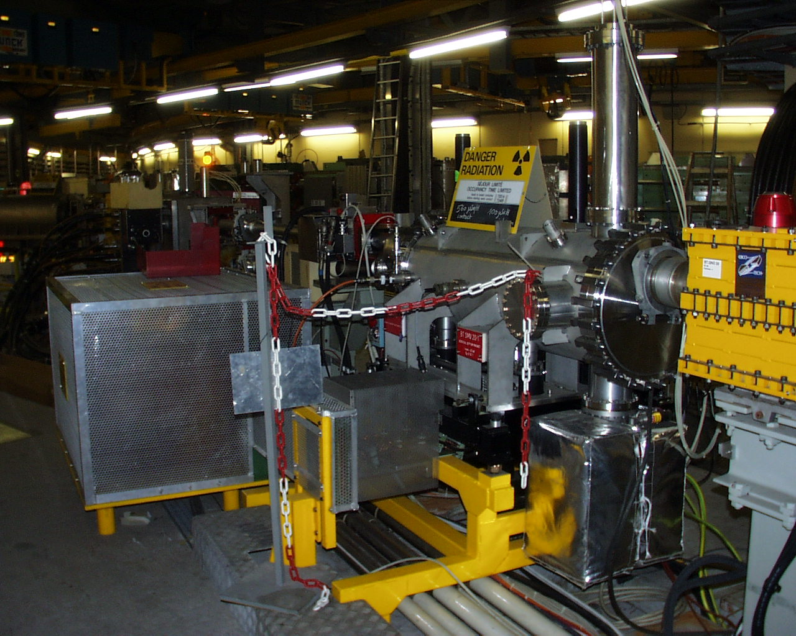
SMV20

Slide 18
SMV20 vertical recombination 2 to 1
Scope of the upgrade
  Increase magnetic length to 1225 mm -> increase magnet physical length to 1300 mm;
  Preserve aperture (60.4 h x 102 v);
  3 magnets to be built: 1 operational + 2 spares;
  Displace beam observation equipment (ECR released: EDMS 1494823);
  ECR for the upgrade released (EDMS 1459320);
  Functional specification released (EDMS 1461559);
  Engineering specification to be compiled.

Slide 19
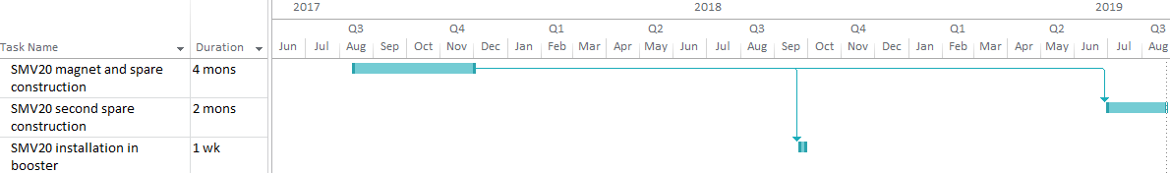
SMV20 vertical recombination 2 to 1
Project status and outlook
  Design finalised
  Part procurement started
  Initial planning:
  2 magnets to be constructed in 2017 – installation in LS2
  1 spare for Q3 2019

Slide 20
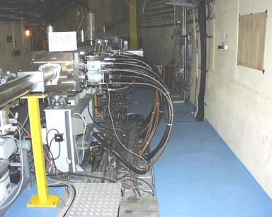
Transfer BT2.KFA20
1 vacuum tank refurbished in 2000
2 magnets designed for 800 MeV beam deflection (same as BT.KFA10 ones)
1 fully operational spare exists
Ferrite type is CMD5005 (equivalent 8C11)

Slide 21
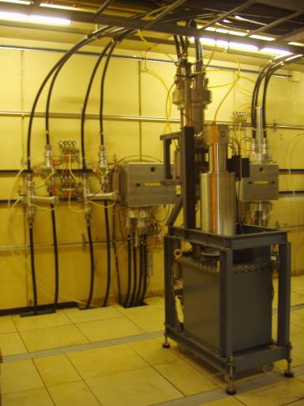
Transfer BT2.KFA20
1 generator (magnets are charged with the PFL)
PFL made of 4×25 Ohm SF₆ cables in //
Transmission cables same type as PFLs
Nominal Voltage @ 2GeV → 36.5 kV (max. 37 kV)
Required ∫B.dl for 2 GeV can be achieved.
Rise time of system unclear. Cannot measure ∫B.dl waveform in PSB; Spare system not identical.
It will be verified if a change in optics can provide some additional margin for this equipment.
NOTE: Crucial to do precise measurements on system in BT line to know what needs to be done!

Slide 22
Work to be done: BT2.KFA20
Perform measurements in the ring to confirm the predicted rise time better than 105 ns.
Measurements will be hopefully made in December. Vacuum chamber to be opened to install a magnetic field probe and measure the kick of one magnet.
Improvements, if necessary, to be studied after the measurement.

Slide 23
Conclusions
    Extraction kicker spare 14L1 will be prepared, but less critical since present system compliant with requirements.
    Extraction septum ready for installation. Parts for upgrading the spare are available.
    Recombination septa mechanical parts manufacture is ongoing and deliverables are arriving on schedule. Installation likely in LS2, not before.
    Recombination kicker KFA10 outside specifications, a new kicker will be built. Design phase is on critical path now.
    Recombination kicker KFA20 dynamic performance unclear, but required beam deflection is within reach with present system.
    Crucial to do precise measurements on kickers in BT line to determine what needs to be improved to respect rise time specification!

Slide 24
Documentation
PSB-MSMI-ES-0001 – FS of the BT.SMV recombination septa (EDMS 1461559)
PSB-MSMIC-EC-0001 – ECR for the upgrade of BT.SMV10 (EDMS 1459318)
PSB-MSMID-EC-0001 – ECR for the upgrade of BT.SMV20 (EDMS 1459320)
PSB-LJ-EC-002 – ECR for the relocation of BI equipment BT.BTV10/30 (EDMS 1494819)
PSB-LJ-EC-003 – ECR for the relocation of BI equipment BT.BTV30 (EDMS 1494823)
PS-MKKIK-ES-0001 – FS for PSB to PS kicker systems (EDMS 1488286)

