Slide 1
Coulomb excitation of the two proton-hole nucleus ²⁰⁶Hg
IS547
CERN-ISOLDE, Geneva, Switzerland (M. Kowalska, E. Rapisarda, T. Stora, F.J.C. Wenander)
GSI, Darmstadt, Germany (H. Grawe)
IRFU/SPhN, CEA Saclay, France (M. Zielinska)
Lund University, Sweden (J. Cederkaell, D. Rudolph)
Technische Universitat Darmstadt, Germany (Th. Kroell)
Universitat zu Koln, Germany (M. Seidlitz, B. Siebeck, P. Reiter, N. Warr)
University of Brighton, UK (F. Browne, A. Bruce, O. Roberts)
University of Liverpool, UK (P. Butler, L. Gaffney, D. Joss, G. O'Neill, R.D. Page)
University of Manchester, UK (S. Freeman)
University of Surrey, UK (T. Alexander, W. Gelletly, Z. Patel, Zs. Podolyák, P.H. Regan, E. Simpson, P.M. Walker, E. Wilson)
Spokesperson(s): Zsolt Podolyák (z.podolyak@surrey.ac.uk)
Local contact: Elisa Rapisarda (elisa.rapisarda@cern.ch)
INTC October 2012

Slide 2
Isomeric states (from fragmentation)
*
*
■
■
■
Gottardo et al.
PRL109(2012)162502
²¹⁰Hg:
PLB 725 (2013)292
■
■
²⁰⁸Hg,²⁰⁹Tl
N. Aldahan et al., PRC80, 061302(R) (2009).
M.Reed et al., PRL 105 (2010) 172501, PRC 86 (2012) 054321
(ESR storage ring)
Isomeric state
*
RISING: isomeric decays
S. Steer et al., Phys. Rev. C 84 (2011) 044313

Slide 3
Even-even nuclei around ²⁰⁸Pb
Pb
1.9
Z=82
s1/2
d3/2
h11/2
In box: E(4⁺)/E(2⁺) ratio

Slide 4
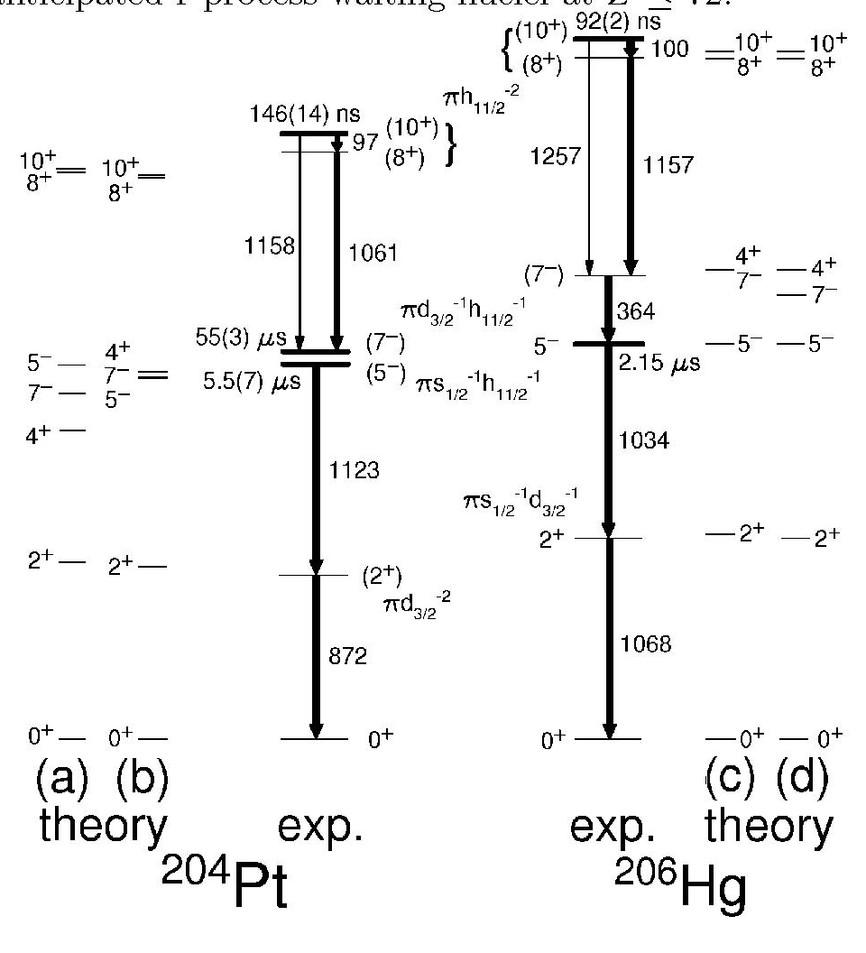
Shell-model calculations (M.Górska, H.Grawe, H. Maier, A.Brown)
and (d):TBME from L.Rydstrom et al, NPA512(1990)217 (based on Kuo-Brown interaction)
(b) and (c): three TBMEs modified
Δ(d_{3/2} h_{11/2}; d_{3/2} h_{11/2})₇₋ = +135 keV
Δ(s_{1/2} d_{5/2}; s_{1/2} d_{5/2})_{2+,3+} =+230 keV (monopole only)
Δ(d_{3/2} h_{11/2}; s_{1/2} h_{11/2})₆₋ changed to +0.160 MeV (fit for B(E2)
Good description of energies and B(EL)s
S.Steer et al., Phys. Rev C78 (2008) 061302(R)

Slide 5
Transition strengths in ²⁰⁶Hg and ²⁰⁴Pt
Nucleus | Transition | Exp. (W.u.) | SM _{standard} (W.u.) | Sm_{mod} (W.u.)
206Hg | B(E3;10+->7-) | 0.25(3) | 0.17 | 0.21
206Hg | B(E2;10+->8+) | 0.94(15) | 0.87 | 0.87
206Hg | B(E3;5- ->2+) | 0.18(2) | 1.17 | 0.90
204Pt | B(E3;10+->7-) | 0.19(3) | 0.21 | 0.22
204Pt | B(E2;10+->8+) | 0.80(8) | 2.64 | 1.22
204Pt | B(E2;7- ->5-) | 0.017-0.0034 | 1.21 | 0.0037
204Pt | B(E3;5- ->2+) | 0.039(5) | 0.713 | 0.612
Effective charges: 1.5e (E2) and 2.0e (E3)
S.Steer et al., Phys. Rev C78 (2008) 061302(R)

Slide 6
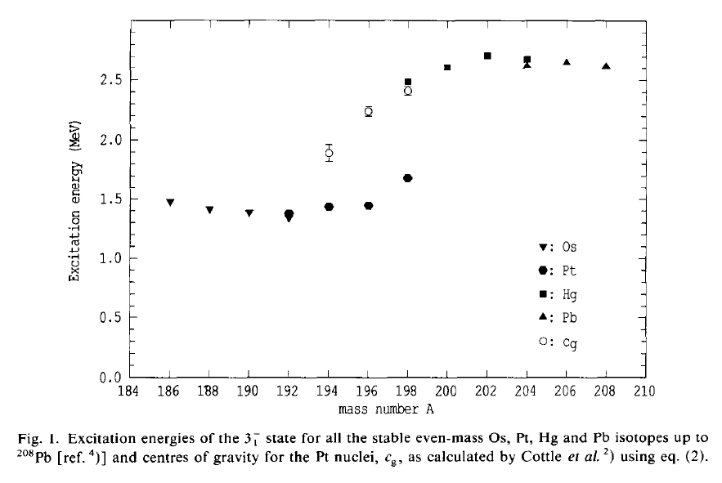
Collective octupole excitations
=> Expected collective 3⁻ state at ~2.7 MeV in 206Hg

Slide 7
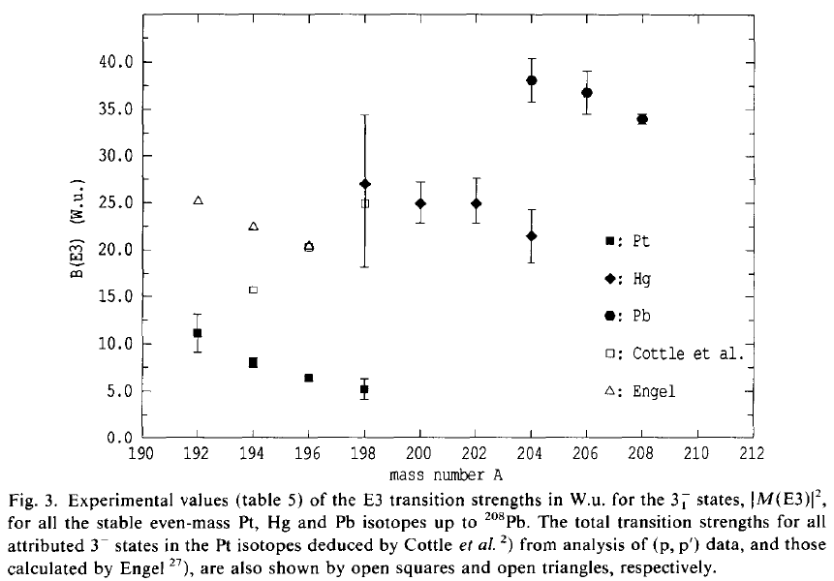
Systematics of B(E3) transition strengths
Pb
Hg
Pt
C.S. Lim, W.N. Catford, R.H. Spear, Nucl. Phys. A 522, 635 (1991)

Slide 8
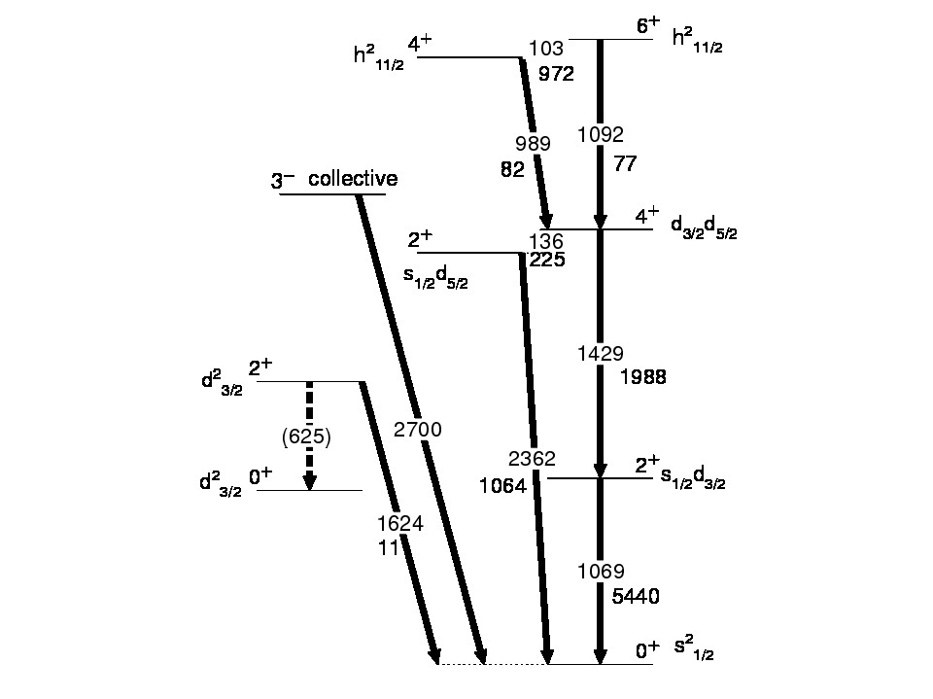
Theoretical calculations
To be determined:
B(E2;0⁺ -> 2⁺)
B(E2;2⁺ -> 4⁺)
B(E2;0⁺ -> 2⁺₃)
B(E3;0⁺ -> 3⁻)
E(4⁺)
E(2⁺₃)
E(3⁺)
B(E2↑) in e²fm⁴

Slide 9
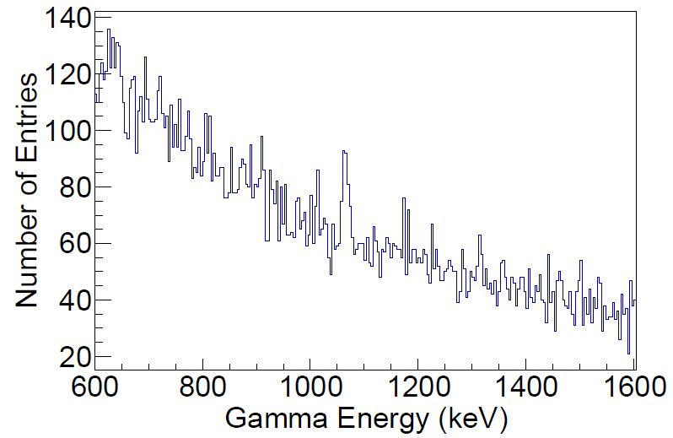
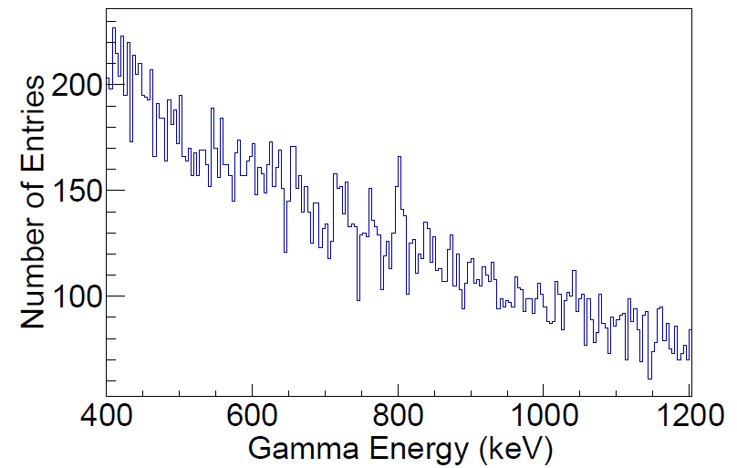
Coulex of ²⁰⁶Hg at relativistic energies (GSI, October 2012)
1068
²⁰⁶Hg
410x10⁶ ions
But there are issues, no B(E2)
803
²⁰⁶Pb
calibration point
166x10⁶ ions
T. Alexander et al., PhD thesis

Slide 10
Yield calculations
Using GOSIA and Shell Model results
Beam from molten lead target: ²⁰⁶Hg (~50%) and ²⁰⁶Pb(~50%)
Average available ²⁰⁶Hg beam intensity: 1.2x10⁶ pps
E_{beam} =845 MeV (4.1 MeV/u)
Target: ¹²⁰Sn 2 mg/cm²
MINIBALL (8% efficiency)+ CD Si detector (16-53⁰)
In order to reduce rate on Si, we consider
²⁰⁶Hg beam: 2x10⁵ pps (much below what is available)
Yields:
2⁺ → 0⁺ 9000/day
4⁺ → 2⁺ 170/day
3⁻ → 0⁺ 45/day
2⁺₃ → 0⁺ 50 /day
Accepted beam-time: 15 shifts (5 days)

Slide 11
October 2012

Slide 12
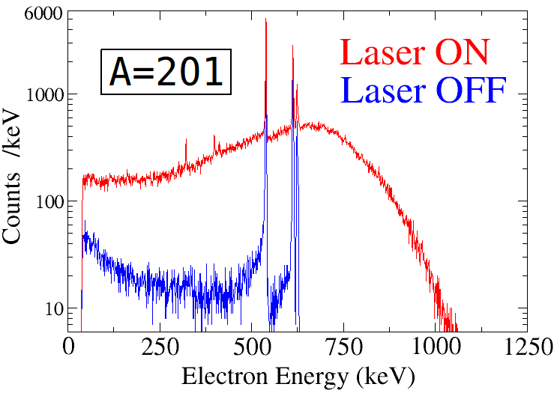
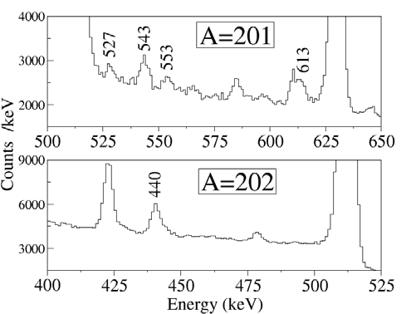
IS447: Along the N=126 closed shell: study of 201,203,205Au through its πh_{11/2}⁻¹ isomeric decay
Performed in 2008 and Sept. 2010
201Au yield: ~6x10⁴ 202Au yield: ~2x10³ (for 1.6 µA proton beam)
A.Y. Deo et al., Structures of ²⁰¹Po and ²⁰⁵Rn from EC/β⁺-decay studies,
Phys. Rev. C 81, 024322 (2010)
A.Y.Deo et al., EC/β+ decay studies across N = 126:213Fr and 213Rn,
in preparation
M. Bowry, First extraction of neutron-rich gold isotopes at ISOLDE,
ISOLDE newsletter, Spring 2011.

Slide 13
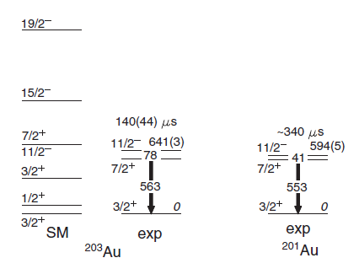
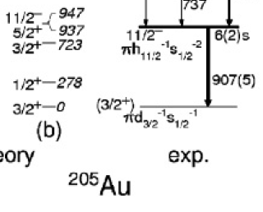
IS447: Along the N=126 closed shell: study of 201,203,205Au through its πh_{11/2}⁻¹ isomeric decay
Performed in 2008 and Sept. 2010
205Au 203Au 201Au
S. Steer et al., Phys. Rev. C 84, 044313 (2011)

Slide 14
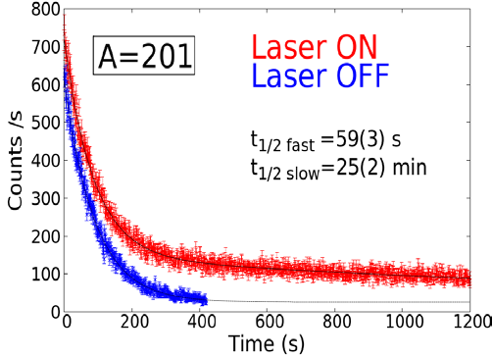
IS447:
IS447: Along the N=126 closed shell: study of 201,203,205Au through its πh_{11/2}⁻¹ isomeric decay
Performed in 2009 and Sept. 2010

Slide 16
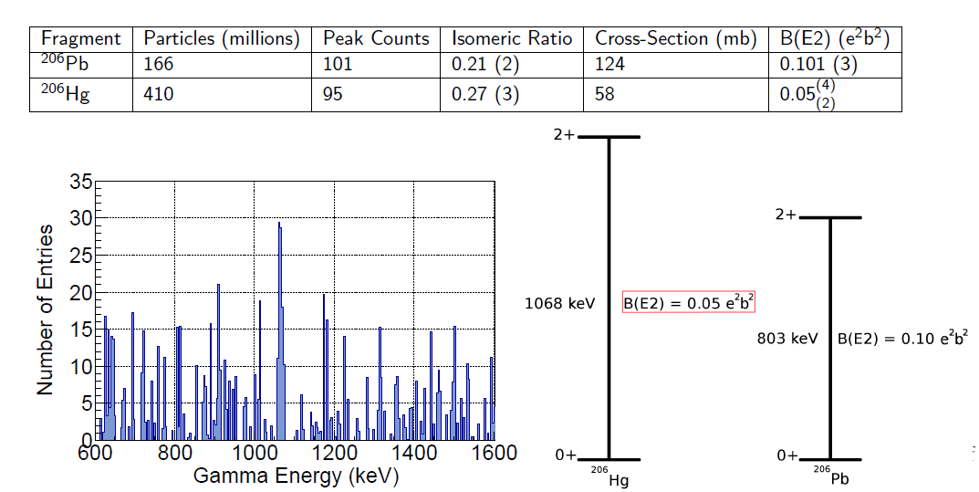

Preliminary results
²⁰⁶Pb ²⁰⁶Hg ²¹⁰Po
2+->0+ 803 keV 1068 keV 1181 keV
2.80(9) W.u. 1.4(+1.1-0.5) W.u. 0.56(12) W.u.
SM: 5.2 W.u.
10+->8+ 0.99(18) W.u.
SM: 0.87W.u.
SM by Grawe, Kuo-Brown, modified to describe ²⁰⁶Hg and ²⁰⁴Pt
S.Steer et al., Phys. Rev C78 (2008) 061302(R)
T. Alexander et al.

Slide 17
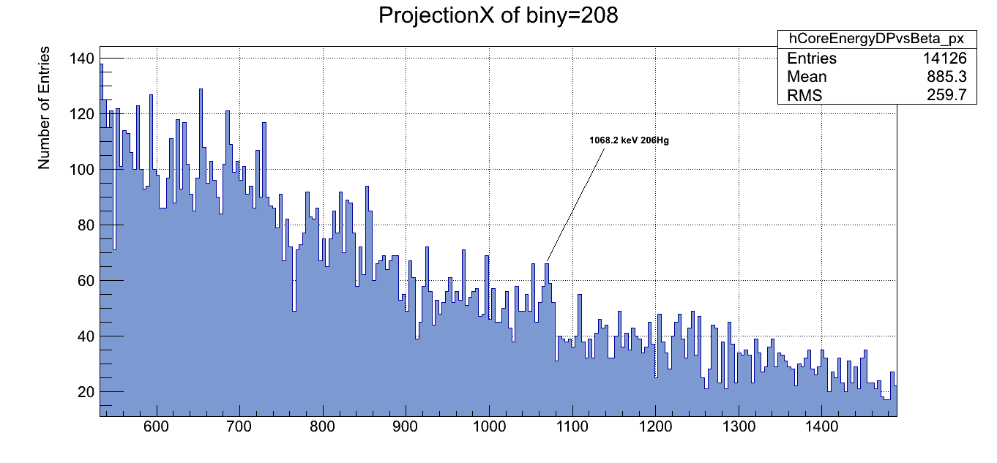
Coulex of ²⁰⁶Hg at relativistic energies (GSI, October 2012)
1068 keV: 2⁺->0⁺
Difficulty: isomeric beams also present
(the amount of the isomeric 0⁺₂ cannot be determined)

Slide 18
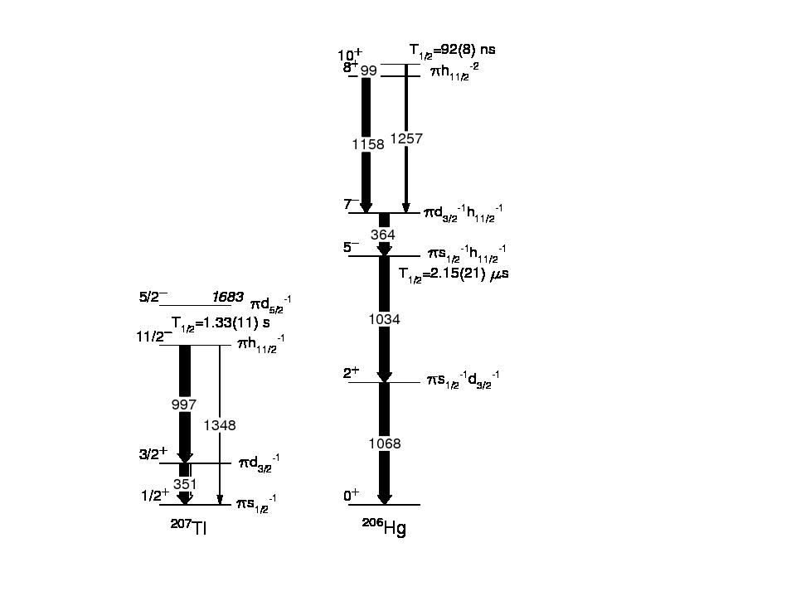

Slide 20
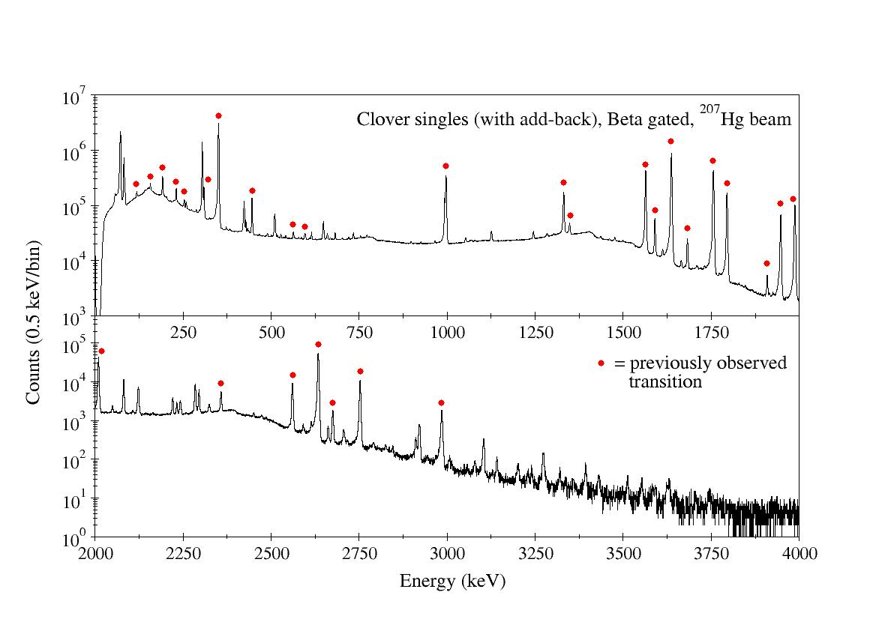
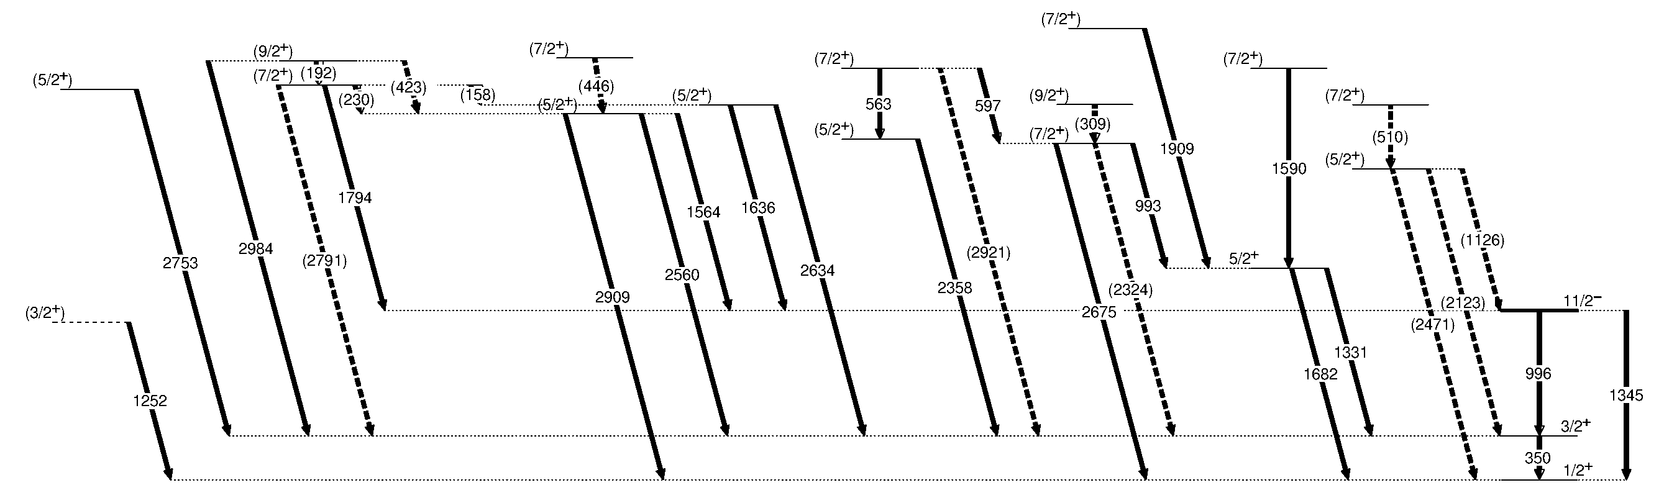
²⁰⁷Tl
207Hg delivery ~ 12 kHz over 42 hours
More complete level scheme
New transitions and levels
Angular correlations needed for I^{π}
Difficult due to geometry
207Tl

Slide 21
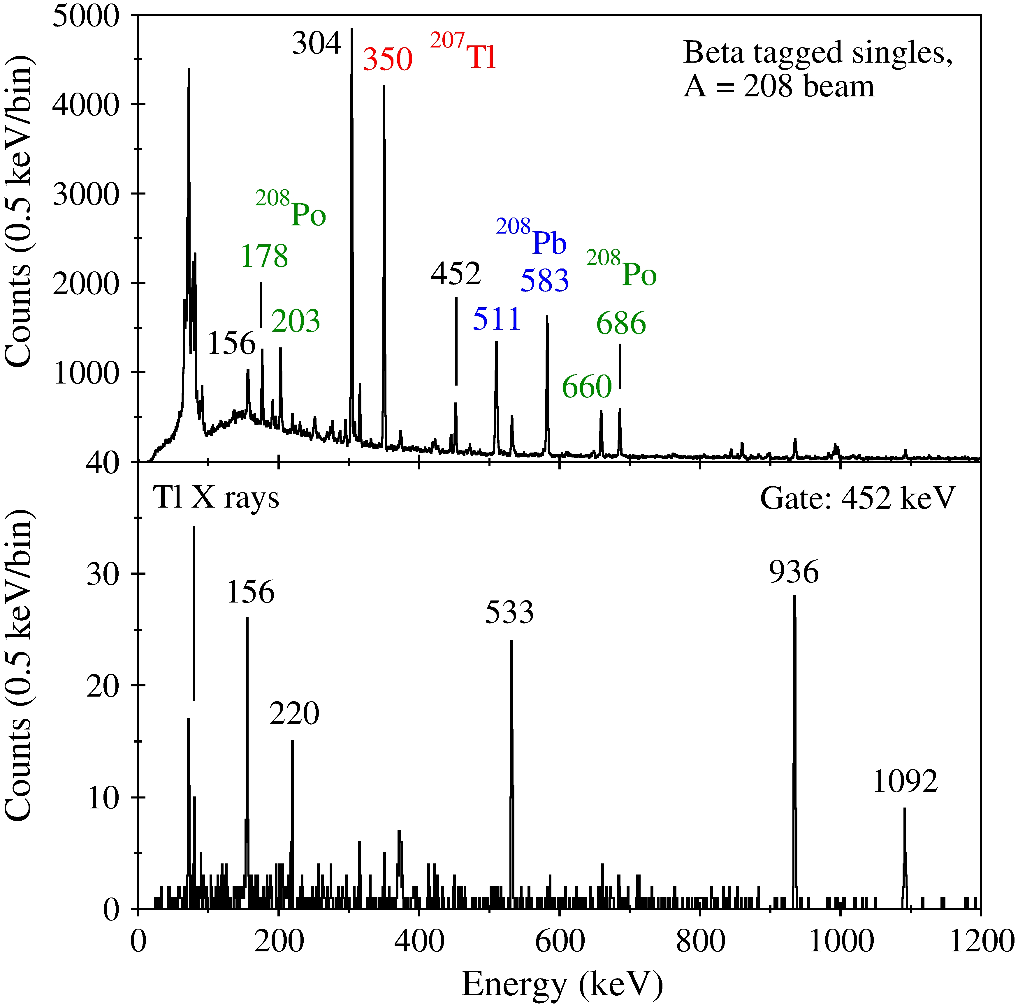
²⁰⁸Tl: proton-neutron interaction
differences with previous work
-half-life much shorter than
the published 41 min
-completely different from
what was reported
from beta decay
Previously observed 452 keV transition present in these data.
Tl X rays in coincidence with this transition.
All other coincidences (and lack thereof) inconsistent with previous 208Hg beta decay results.
How was ²⁰⁸Hg produced in p+Pb?
208Pb(t,3p)208Hg (T. Stora’s suggestion)
9 hours
R. Carroll et al., to be published

Slide 22
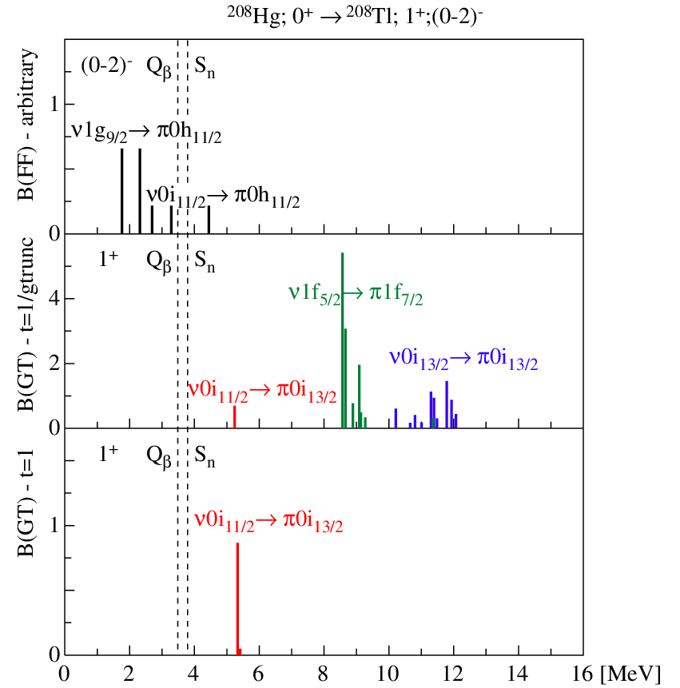

Slide 23
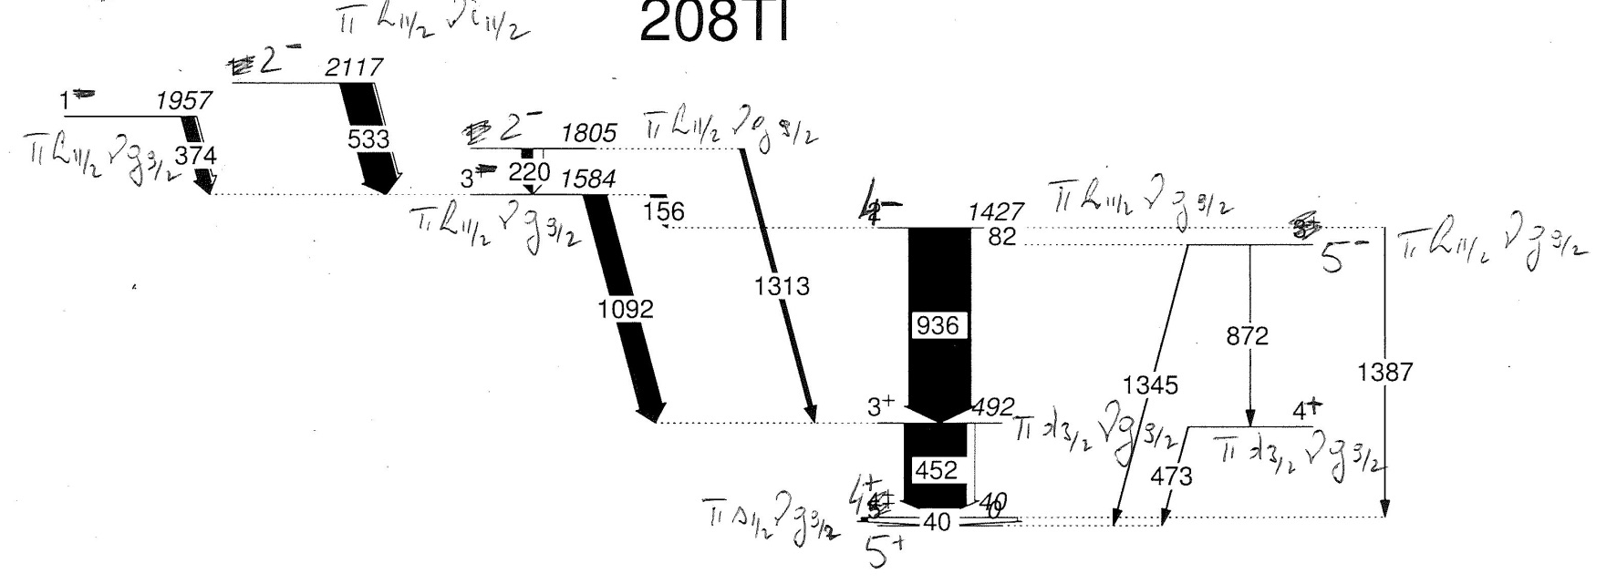
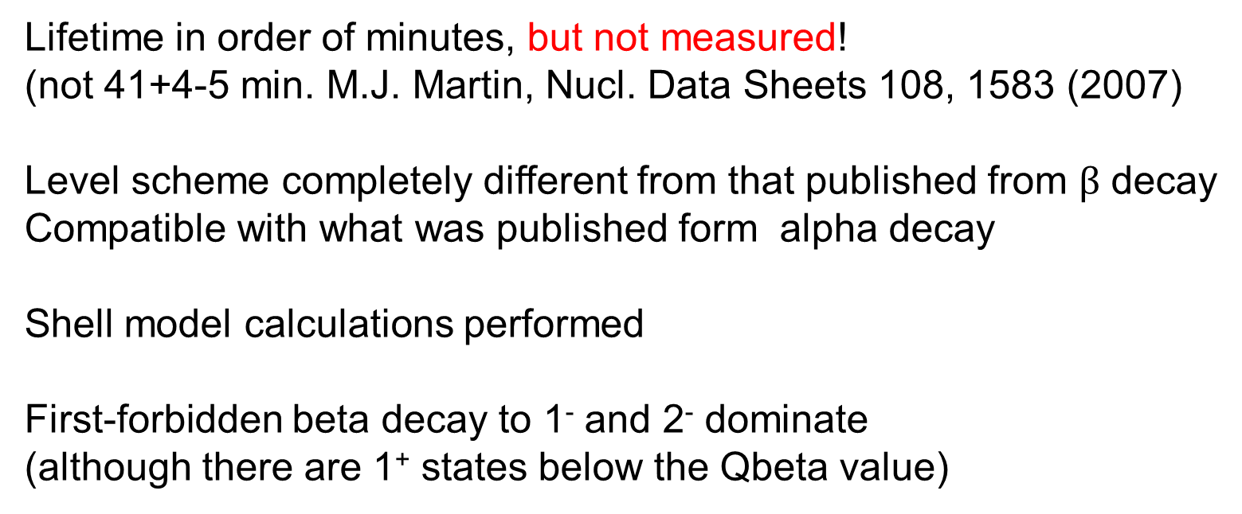
preliminary
Lifetime in order of minutes, but not measured!
(not 41+4-5 min. M.J. Martin, Nucl. Data Sheets 108, 1583 (2007)
Level scheme completely different from that published from $β$ decay
Compatible with what was published form alpha decay
Shell model calculations performed
First-forbidden beta decay to 1⁻ and 2⁻ dominate
(although there are 1⁺ states below the Qbeta value)

Slide 24
Isomeric states
■
A.Gottardo et al.,
PRL (2012)
■
²⁰⁸Hg,²⁰⁹Tl
N. Aldahan et al., PRC80, 061302(R) (2009).
Isomeric state
*

Slide 25
π ν
i13/2 i11/2
h9/2 g9/2
Z=82 N=126
s1/2 p1/2
d3/2 f5/2
Structure of neutron-rich N ≥ 126 nuclei
Zsolt Podolyák
Pb
1.4
1.4
1.9
s1/2
d3/2
h11/2
In box: E(4⁺)/E(2⁺) ratio

