Slide 1
Linac3 upgrade ECR
Modification of the GTS-LHC ion source extraction region in Linac3
3/12/2015
Ville Toivanen

Slide 2
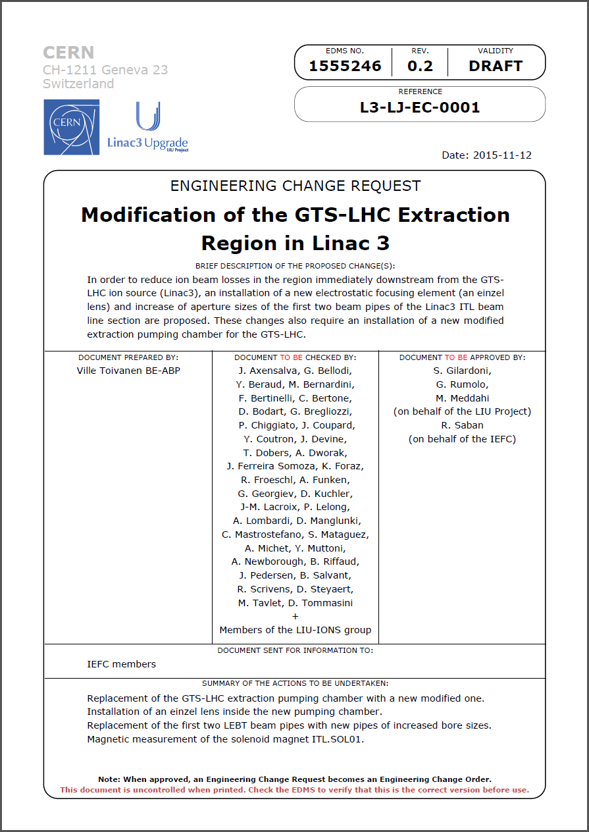
Introduction
Linac3 upgrade motivation and goals
  Mitigate the beam losses taking place immediately downstream from the ion source
  Improve ion source tuning flexibility by decoupling ion production and beam transport in the extraction region
Implementation
  Relax aperture restrictions in the beginning of the Linac3 ITL beam line (low energy beam transport)
  Install a new focusing element, an einzel lens, downstream from the existing GTS-LHC extraction electrodes
Linac3 upgrade ECR references
  LIU-IONS ECR L3-LJ-EC-0001
  EDMS 1555246

Slide 3
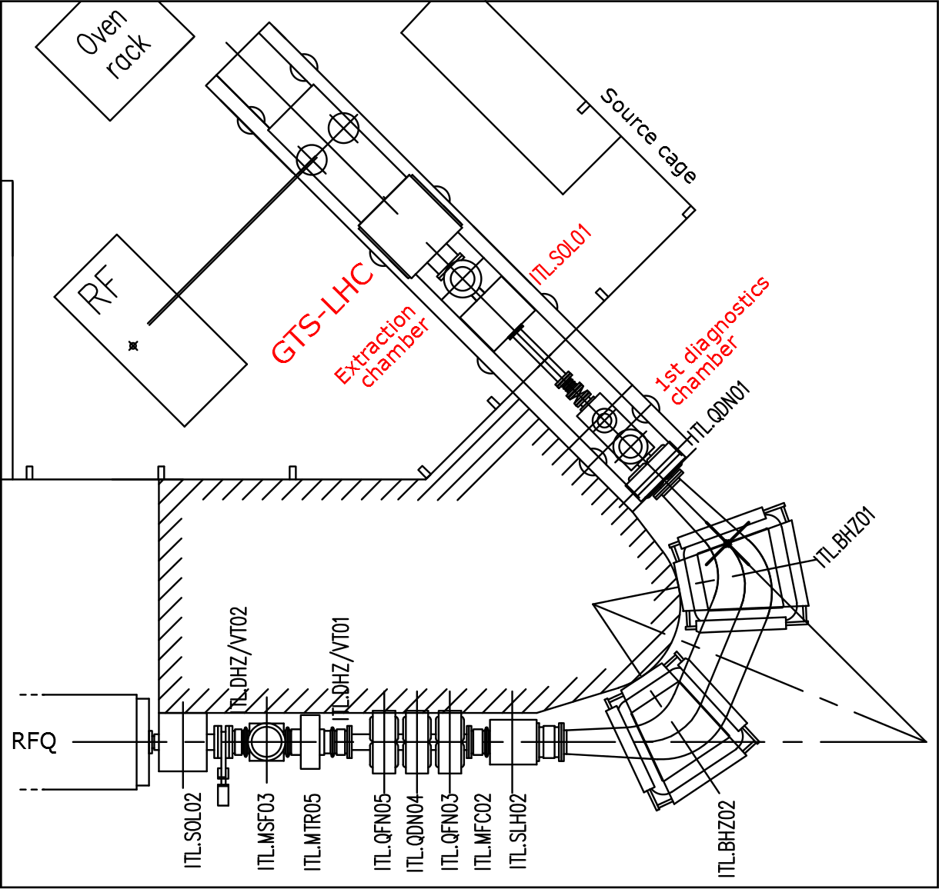
Linac3 ion source and ITL beam line
Region of interest
GTS-LHC beam extraction system
Extraction chamber
1st ITL beam pipe through ITL.SOL01
2nd ITL beam pipe with bellows
Gate valve ITL.VVS10
+ einzel lens

Slide 4
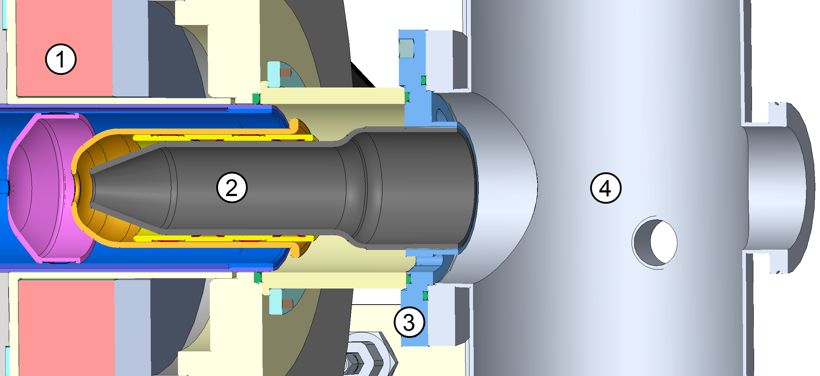
Existing GTS-LHC extraction region
65
Ion source body
Extraction electrodes
Fixing point (flange) for extraction electrodes
Extraction chamber

Slide 5
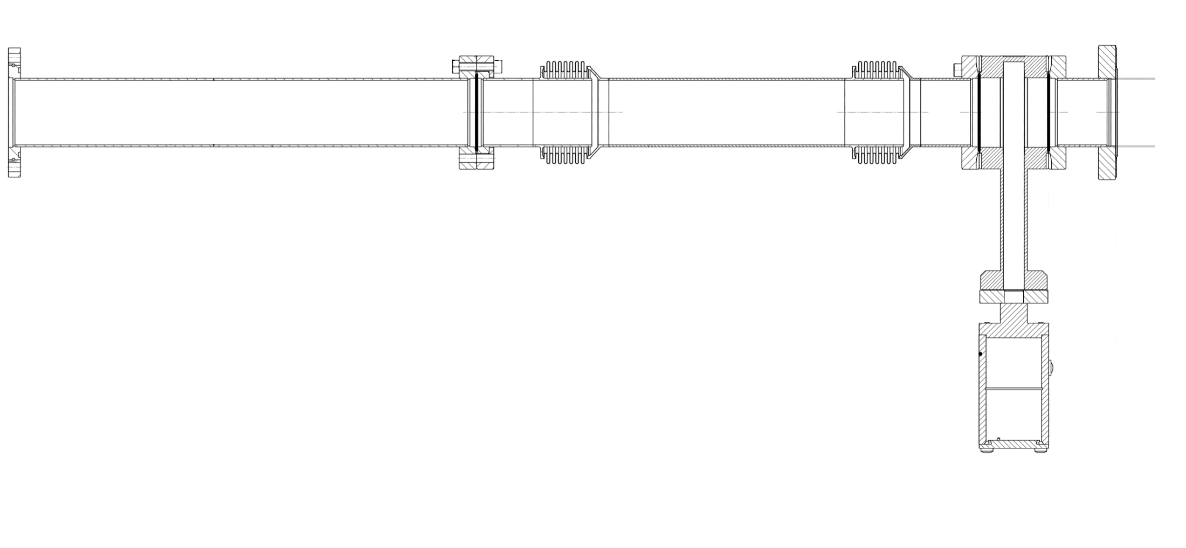
Existing ITL section through ITL.SOL01
Ion source extraction chamber
1st diagnostics chamber and spectrometer
ITL.SOL01
65
110
42
320
58
420
1062.3
Ref.: LICLM___0231 (First pipe incorrect, should be LICLM___0245)

Slide 6
Linac3 Modifications

Slide 7
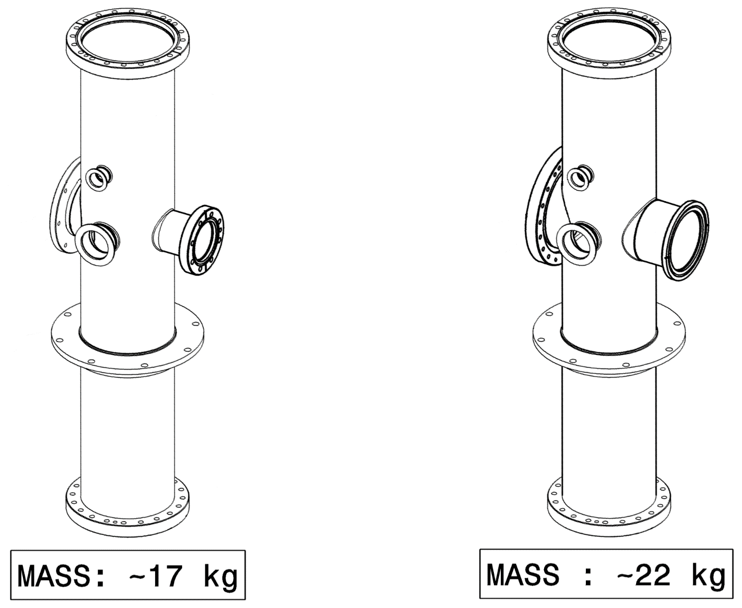
New extraction chamber
Existing chamber
New modified design
Input port:
100 mm ID
ISO-F DN100
Input port:
138 mm ID
DN150CF
Output port:
100 mm ID
DN100 Quick CF
Output port:
65 mm ID
DN63CF

Slide 8
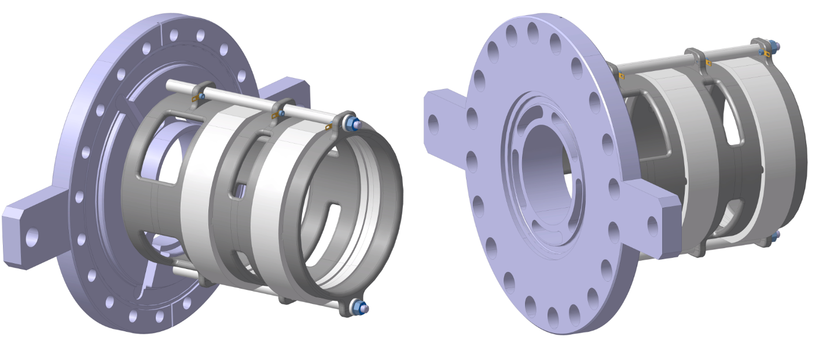
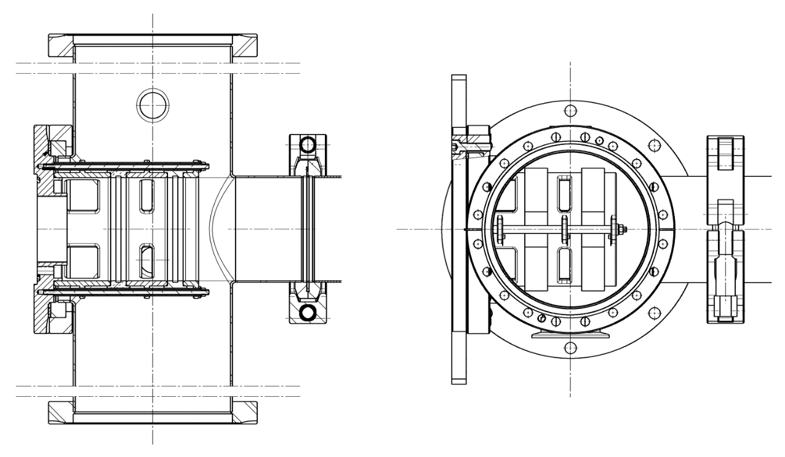
New einzel lens
New stainless steel flange
Titanium and MACOR lens assembly

Slide 9
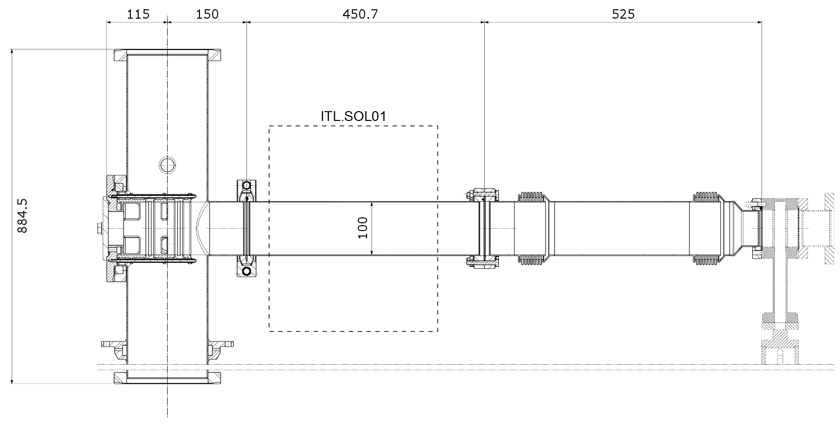
New ITL section beam pipes
Ion
source
Existing
ITL line
Quick CF
CF
CF
From 65 mm to 100 mm bore pipes

Slide 10
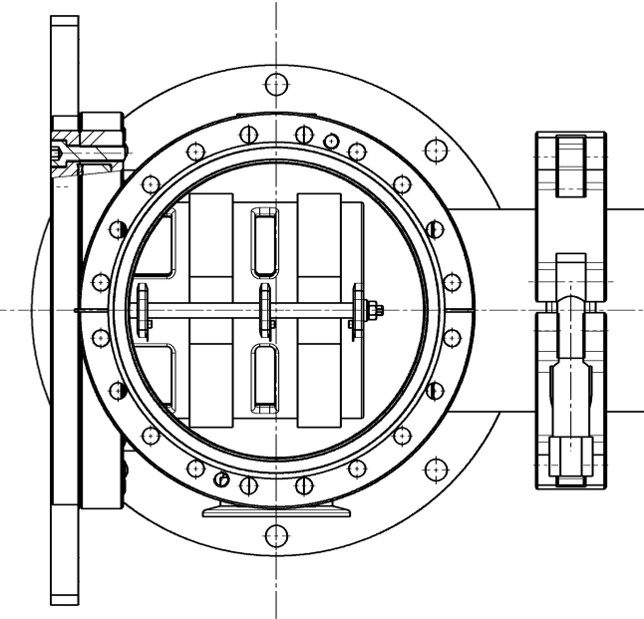
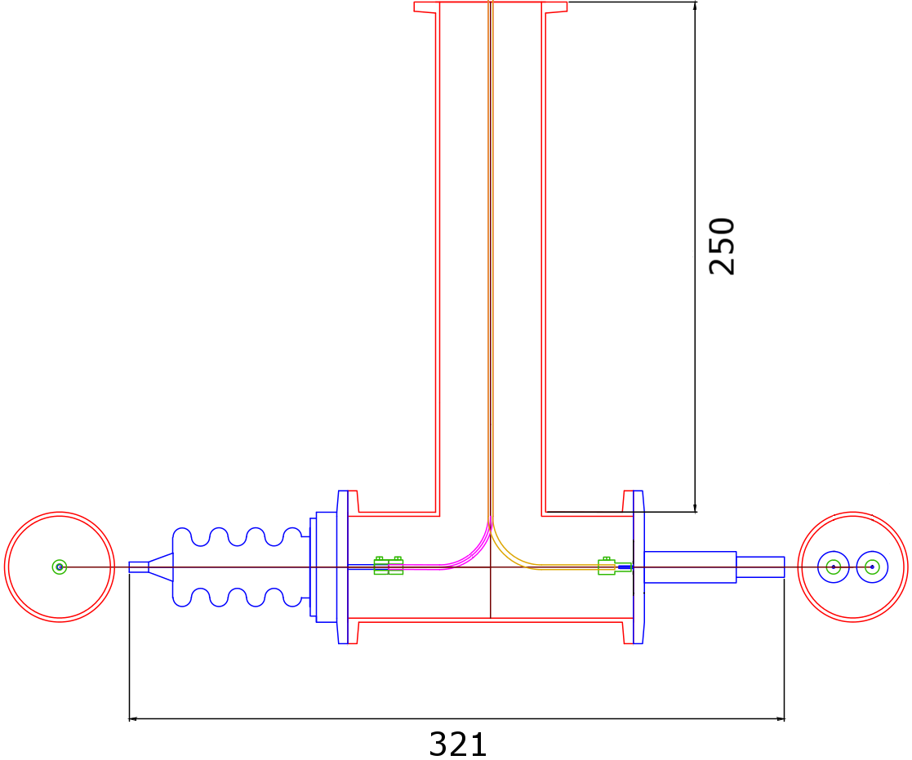
Electrical issues
New HV power supply for the einzel lens, installed in the rack next to the existing extraction power supplies
Einzel lens and existing extraction system cabling through a new T-piece on the side of the extraction chamber
Cabling:
  HV cable for einzel lens
  Control cables for einzel lens power supplies
  Vacuum side with Kapton coated UHV compatible cable
  All cabling will be done by BE-ABP
Pb shielding
Einzel
IE

Slide 11
Controls
Hardware: a new 12 bit PLC remote station (no CPU)
  Einzel lens control and the existing ion source controls divided between the existing PLC unit and the new one
Software:
  Einzel lens voltage control to the ion source FESA class
  Control available in the ion source knob in INCA
Both will be done by BE-ABP

Slide 12
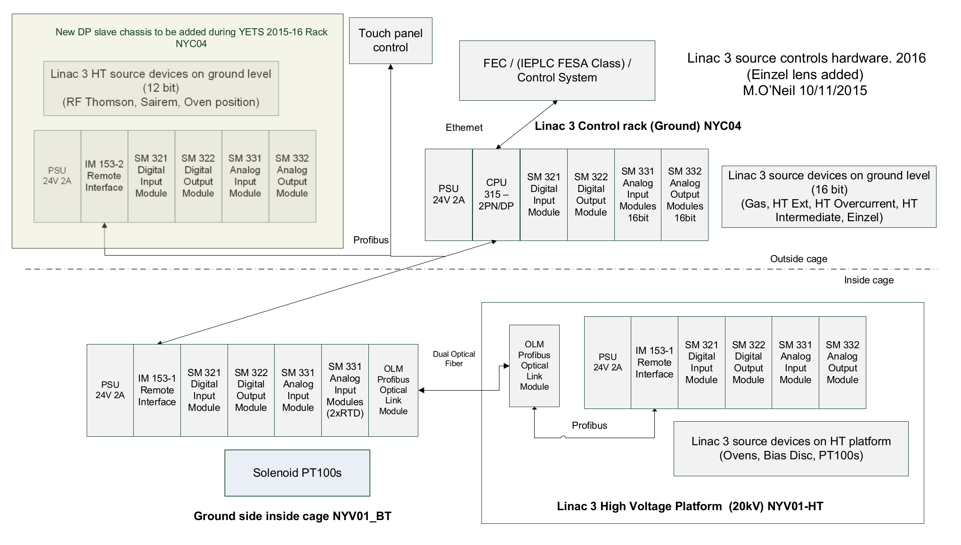
Source control hardware at Linac3

Slide 13
ITL.SOL01 measurement
Verification of field and calibration of solenoid ITL.SOL01
Linac3 upgrade work during YETS2015-16 provides a possibility to remove ITL.SOL01 from Linac3 for magnetic measurements
To be measured before installation of the new welded beam pipe
Magnet will be removed 4.1.2015 and will be returned 12.1.2015 (no flexibility in schedule)

Slide 14
Realization and group support
EN-MME | EN-MEF | EN-HE
Design and production of new parts | Alignment work (ITL.SOL01 and extraction chamber) | Transport of ITL.SOL01 from Linac3 to magnetic measurements, to flange welding and back to Linac3
Welding of beam pipe flange after installation through ITL.SOL01
Main contacts
Yannick Coutron Didier Steyaert Pierre Moyret | Tobias Dobers

Slide 15
Realization and group support
TE-MSC | TE-VSC | BE-ABP
Magnetic measurements of ITL.SOL01 | Disassembly of existing vacuum parts and installation of new ones at Linac3
Disconnection and reconnection of ITL.SOL01 at Linac3 | Off-site vacuum test of the new chamber and the einzel lens | Off-site HV test of the einzel lens (at the same time as the vacuum test)
 |  | Removal, modification and installation of lead shielding around the area of modifications
 |  | Installation of the einzel power supply and cabling
 |  | Controls modifications (hardware and software)
Main contacts
Dominique Bodart Thomas Zickler | Alice Michet Jose Ferreira Somoza | Michael O’Neil Sebastien Bertolo Detlef Küchler Ville Toivanen

Slide 16
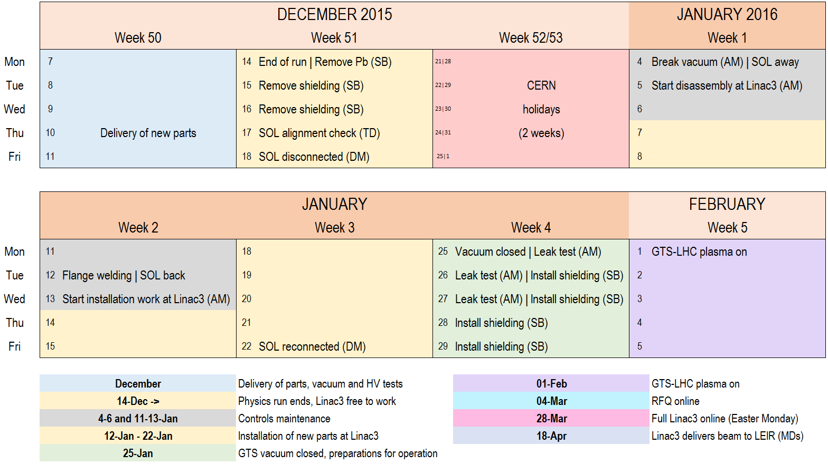
Schedule

Slide 17
ADDITIONAL SLIDES

Slide 18
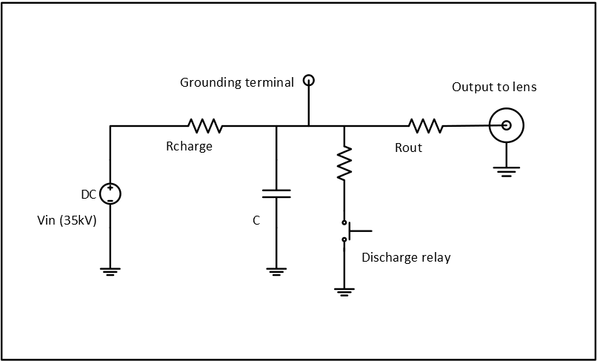
Einzel lens voltage stabilization
If beam loading on the lens, a capacitor may be required to stabilize the voltage during beam pulse
Operation with beam will show if needed or not
Preparations made to realize such a system

Slide 19
Comments from first ECR round
“It should be added that increasing the acceptance of the first part of the LEBT has the effect of transporting more current of unwanted charge state for a longer distance with potential implication on beam qualities.” (Alessandra Lombardi)
“Cabling request not yet received! Due to the huge cabling activity in PSR during YETS 2015/2016, no cabling activity in Linac3 before de 15th of February.” (Patrick Lelong)
“I would just add to the list of works on page 9: (1) TE-VSC : removal/extraction of existing vacuum chambers, (2) BE-ABP : removal of lead shielding.” (Giulia Bellodi)
“A local grounding system (perche de terre) installed in the immediate proximity of the Heinzel lens is not mentioned but should be added to secure interventions on the source.” (Jean-Marc Cravero)
“Nice document, but the new vacuum chamber drawings referred to in this documents has not be created with the correct numbers according to the CERN naming convention and none of drawings has been send for approval to TE/VSC by the approval leader.” (Jan Hansen)
“(1) Please clarify the comment from Jan Hansen and be sure that vacuum chamber are ready. (2) Cabling (if I am not wrong) is done internally by BE-ABP, no request for EN-EL.” (Julie Coupard)

Slide 20
Current situation
Design work has been completed
Production is going on at the workshop – all parts will be delivered in December 10th
Off-the-shelf items have been ordered and received
Control system hardware expansion is under way

Slide 21
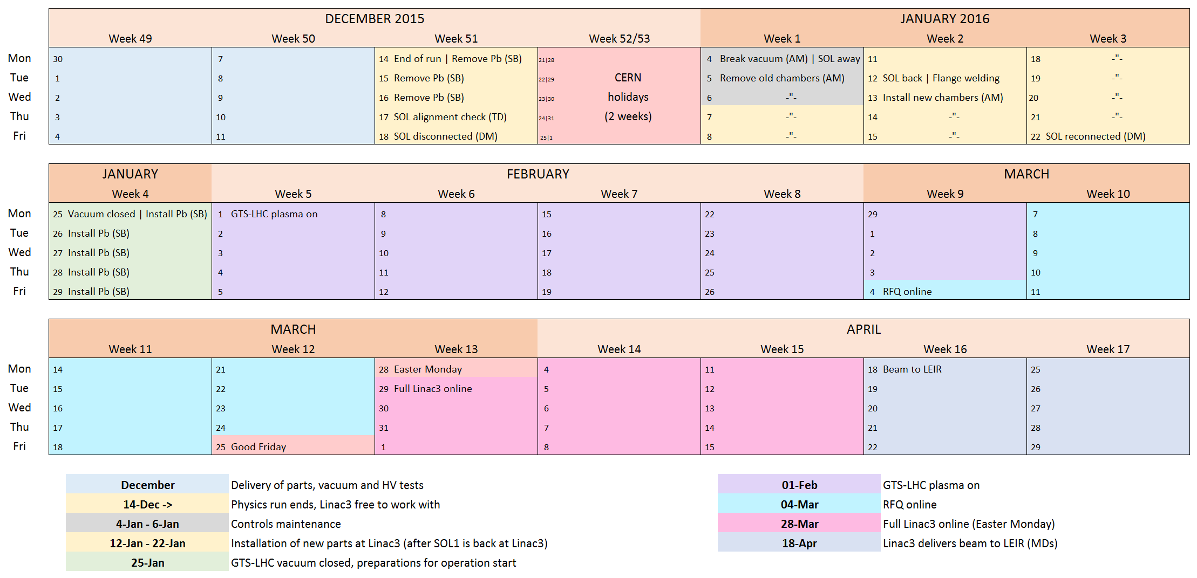
Full schedule

