Slide 1
Diatomic molecules as probes for variation of fundamental constants
A. Borschevsky
The Van Swinderen Institute for Particle Physics and Gravity, University of Groningen

Slide 2
Molecular (and atomic) experiments
Inexpensive alternative to high energy accelerator research
Alternative to observational astrophysical studies: possibility of selecting best possible system for measurements
Can reach extremely high sensitivities

Slide 3
Molecular experiments to detect VFC
Molecular spectra are sensitive to both α and μ=m_{p}/m_{e}
Makes sense to attempt to measure variation in both constants in a single experiment
New methods for creation and trapping of cold molecules open exciting prospects for search for VFC
Many schemes to obtain enhanced sensitivity to VFC
The observable effects are expected to be very small, thus we need:
  very sensitive systems
  extremely precise measurements

Slide 4
What can theory do?
General research of the phenomena.
  Study the influence of VFC on molecular properties
  Predicting and explaining the mechanisms behind enhanced sensitivity
Support of experimental research.
  Identification of molecular candidates with enhanced sensitivity (that are also suitable for experiments!)
  Supplying the necessary parameters for the interpretation of the results (e.g. dependence of the transition energies on α or μ))
  Calculations of the practical parameters needed for the experiment (spectra, lifetimes of levels, etc.).

Slide 5
Enhancement mechanisms
Accidental near degeneracy of two close lying levels may enhance the relative sensitivity to VFC by several orders of magnitude (δω/ω goes to infinity as ω goes to zero)*
Different dependence on α (or μ) – levels of different nature
ω₀
ω’
α₀
α’
α’
ω₀
ω₀
α₀
α’
α
* Flambaum & Kozlov, 2009

Slide 6
X ²Π cations of dihalogens and hydrogen halides
Nearly degenerate vibrational levels of the ²Π_{1/2} and ²Π_{3/2} states
HBr⁺, DBr⁺, Br₂⁺, I₂⁺, Ibr⁺, Icl⁺, IF⁺, and various isotopologues
Using available experimental and calculated spectroscopic constants, we reproduce the molecular potential energy curves by the Rydberg-Klein-Rees (RKR) procedure to locate the promising transitions
L. F. Pašteka, A. Borschevsky, V.V. Flambaum, and P. Schwerdtfeger, PRA 92, 012103 (2015)

Slide 7
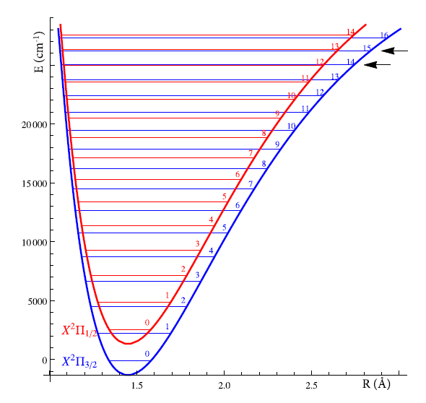
X ²Π cations of dihalogens and hydrogen halides
H⁷⁹Br⁺
I₂⁺
L. F. Pašteka, A. Borschevsky, V.V. Flambaum, and P. Schwerdtfeger, PRA 92, 012103 (2015)

Slide 8
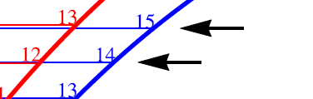
X ²Π cations of dihalogens and hydrogen halides
123 cm⁻¹
19 cm⁻¹
H⁷⁹Br⁺
I₂⁺
L. F. Pašteka, A. Borschevsky, V.V. Flambaum, and P. Schwerdtfeger, PRA 92, 012103 (2015)

Slide 9
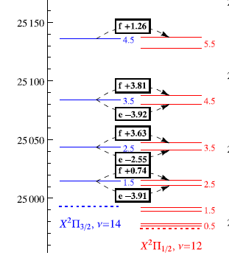
X ²Π cations of dihalogens and hydrogen halides
123 cm⁻¹
19 cm⁻¹
H⁷⁹Br⁺
I₂⁺
L. F. Pašteka, A. Borschevsky, V.V. Flambaum, and P. Schwerdtfeger, PRA 92, 012103 (2015)

Slide 10
X ²Π cations of dihalogens and hydrogen halides
123 cm⁻¹
X ²Π_{3/2}, ν=14, J=1.5
X ²Π_{1/2}, ν=12, J=2.5
ω=0.74 cm⁻¹
19 cm⁻¹
H⁷⁹Br⁺
I₂⁺
L. F. Pašteka, A. Borschevsky, V.V. Flambaum, and P. Schwerdtfeger, PRA 92, 012103 (2015)

Slide 11

X ²Π cations of dihalogens and hydrogen halides
A_{e}, A⁽¹⁾~α² ω_{e}, A⁽¹⁾~ M_{red} ^{-1/2} ~μ^{-1/2} ω_{e}x_{e}, B_{e}~ μ⁻¹
L. F. Pašteka, A. Borschevsky, V.V. Flambaum, and P. Schwerdtfeger, PRA 92, 012103 (2015)

Slide 12
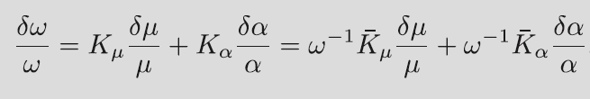
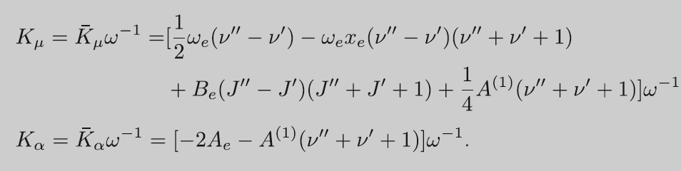
X ²Π cations of dihalogens and hydrogen halides
and are the absolute enhancement factors (dependent on the transition, but not on ω).
K_{α} and K_{μ} are the relative enhancement factors (dependent on ω)
L. F. Pašteka, A. Borschevsky, V.V. Flambaum, and P. Schwerdtfeger, PRA 92, 012103 (2015)

Slide 13
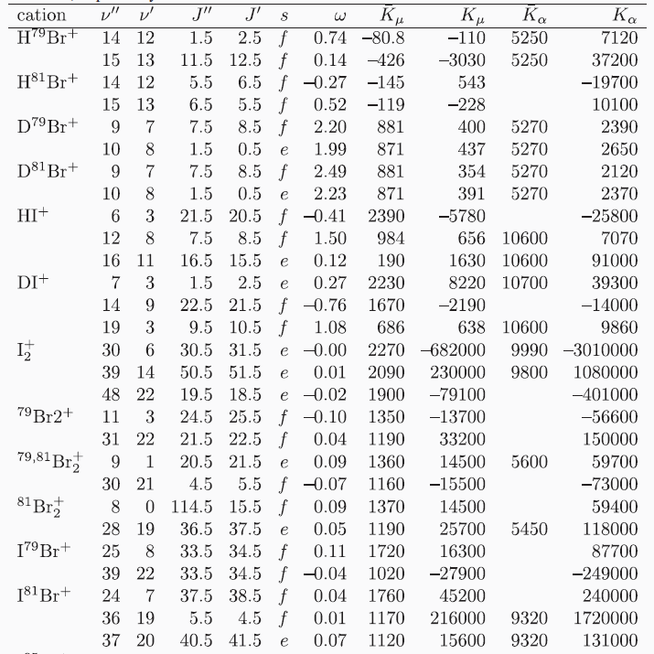
L. F. Pašteka, A. Borschevsky, V.V. Flambaum, and P. Schwerdtfeger, PRA 92, 012103 (2015)

Slide 14
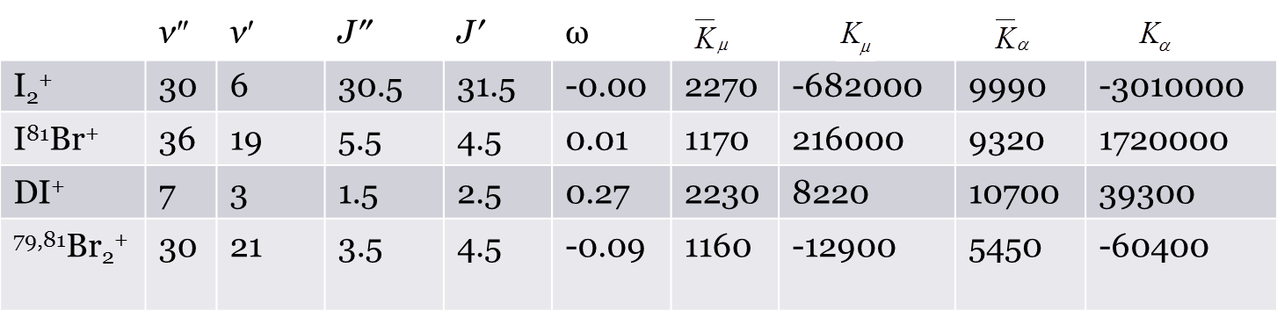
L. F. Pašteka, A. Borschevsky, V.V. Flambaum, and P. Schwerdtfeger, PRA 92, 012103 (2015)

Slide 15
Promising systems; dedicated measurements are needed
L. F. Pašteka, A. Borschevsky, V.V. Flambaum, and P. Schwerdtfeger, PRA 92, 012103 (2015)

Slide 16
Molecular iodine
Readily available
Well studied
Spectroscopic constants are known with high precision

Slide 17
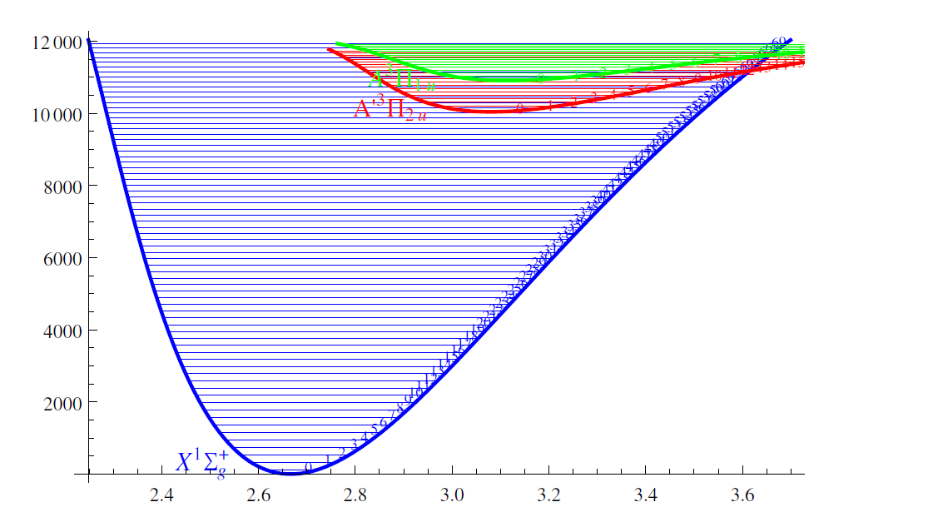
Molecular iodine
Readily available
Well studied
Spectroscopic constants are known with high precision

Slide 18
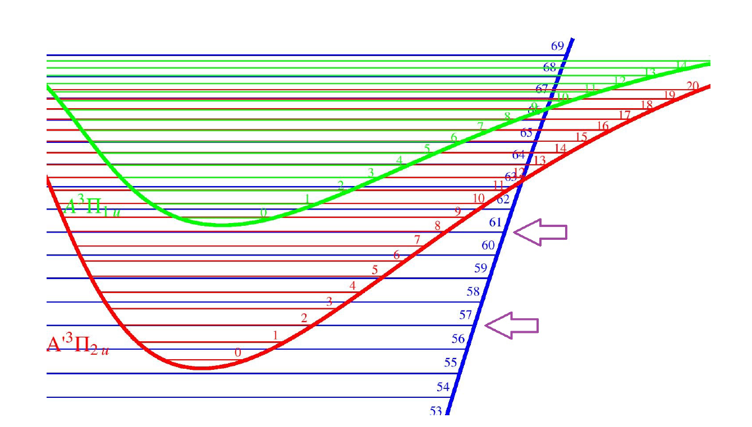
Molecular iodine

Slide 19
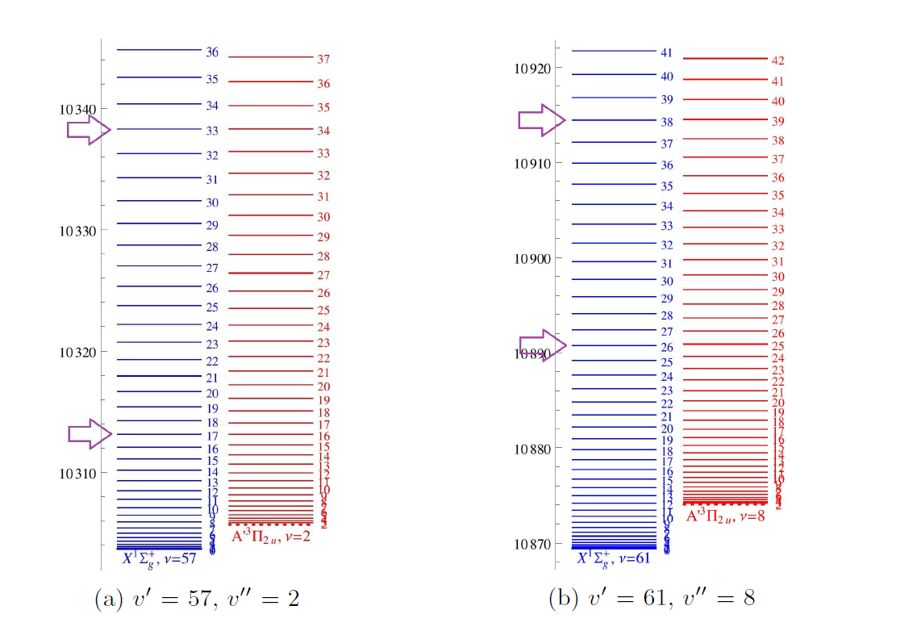
Molecular iodine

Slide 20
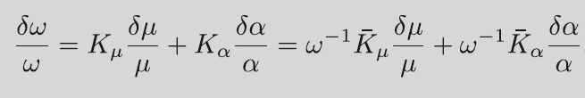
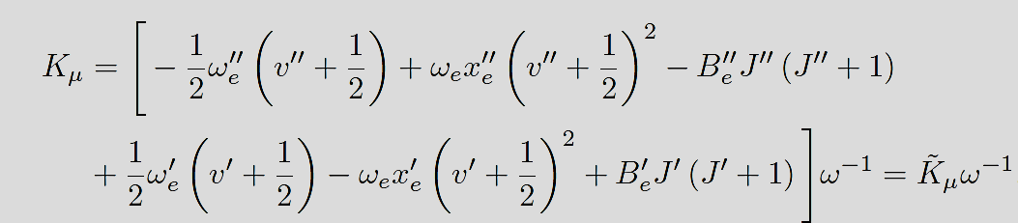
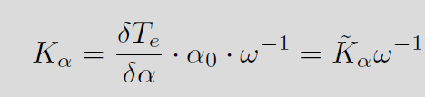
Molecular iodine
Relativistic coupled cluster
calculations

Slide 21
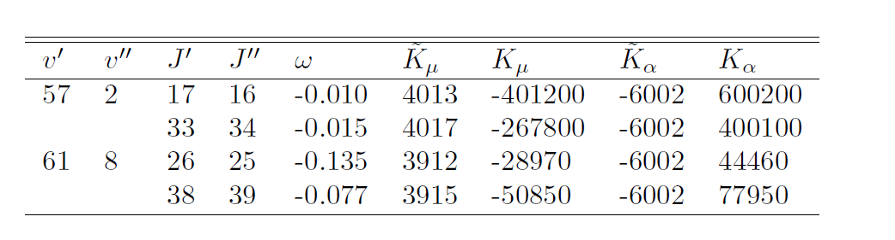
Molecular iodine
Bachelor thesis of Liam Kelly
Work in progress!

Slide 22
And now for something completely different…

Slide 23
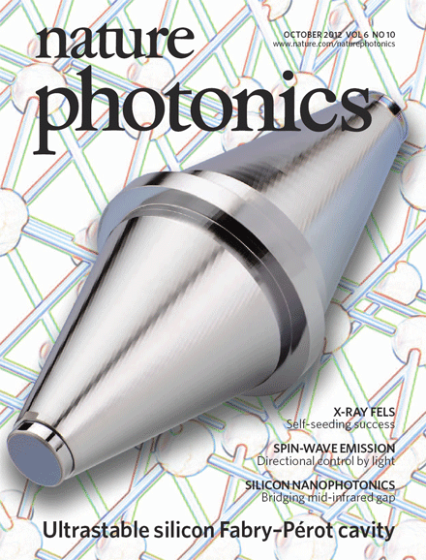
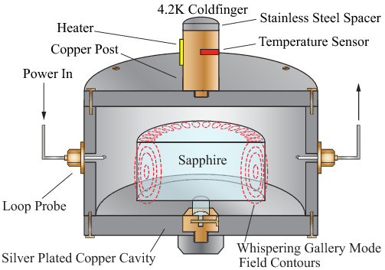
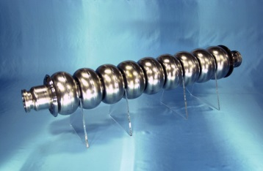
Bond length dependence on α
Motivation: using laser interferometers to search for VFC (and dark matter)
Stadnik & Flambaum, PRL 114 161301 (2015), PRA 93, 063630 (2016)
For example:
Strontium optical lattice clock – silicon
single-crystal optical cavity
Hydrogen maser – cryogenic sapphire
oscillator
Niobium cavity

Slide 24
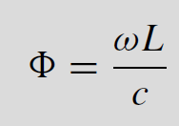
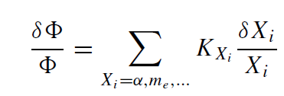
To obtain K_{α} we need to know how ω and L vary with α.
ω-atomic transition frequency
L- length of the cavity

Slide 25
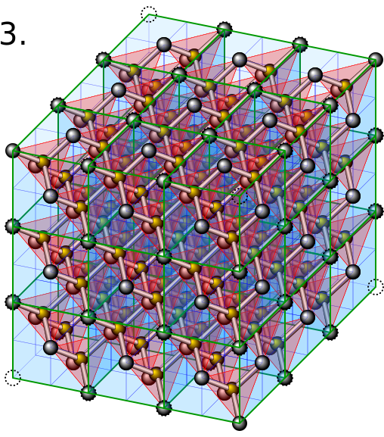
To obtain K_{α} we need to know how ω and L vary with α.
ω-atomic transition frequency
L- length of the cavity
Relativistic atomic codes
Solid state calculations (DFT)
R_{e} in diatomic molecules as first
approximation (DFT, but also
sophisticated coupled cluster methods)

Slide 26
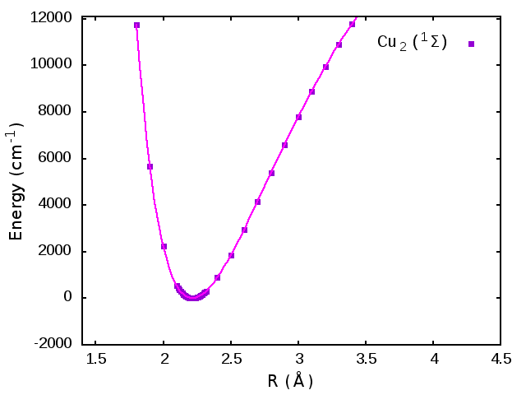
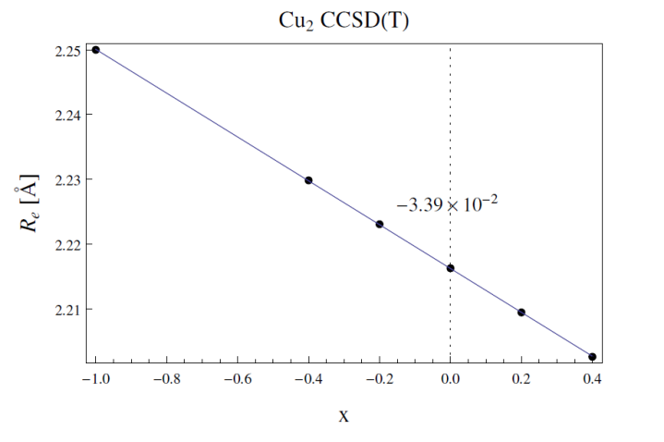
Test systems: noble metal dimers
Simple systems, ¹Σ ground states
Calculate potential energy curves for different values
of X=(α/ α₀)²-1; use different methods (DHF, CCSD(T), DFT)
using DIRAC15 program:
Obtain ∂R_{e}/∂X:

Slide 27
Test systems: noble metal dimers
Results (Å):
Negative values: valence s orbitals forming the bond are contracted by relativity (larger X→ stronger relativistic effects)
Effect scales linearly with Z²:
 |  |  | DFT
 | DHF | CCSD(T) | VWN | PBE | CAMB3LYP
Cu₂ | -0.042 | -0.034 | -0.030 | -0.033 | -0.033
Ag₂ | -0.118 | -0.085 | -0.078 | -0.091 | -0.088
Au₂ | -0.405 | -0.295 | -0.271 | -0.270 | -0.288
Cu₂

Slide 28
Test systems: noble metal dimers
Results (Å):
Agreement between approaches, and between different DFT functionals
Solid state calculations with FPLO program using PBE functional give for solid Cu -0.030 Å. For these systems, dimer is a good approximation.
 |  |  | DFT
 | DHF | CCSD(T) | VWN | PBE | CAMB3LYP
Cu₂ | -0.042 | -0.034 | -0.030 | -0.033 | -0.033
Ag₂ | -0.118 | -0.085 | -0.078 | -0.091 | -0.088
Au₂ | -0.405 | -0.295 | -0.271 | -0.270 | -0.288

Slide 29
Other systems
Si₂ (silicon crystal), AlO (sapphire), Nb₂ (solid niobium), Al₂
Results (Å):
Much smaller effects (lighter elements)
Less straightforward agreement between the methods
Preliminary numbers, further study needed.
 | DHF | CCSD(T) | DFT (PBE) | Solid (DFT)
Al₂ (³Π_{u}) | 9.88*10⁻⁴ | 2.26*10⁻⁴ | 8.50*10⁻⁴ | 7.29*10⁻⁴
Si₂ (³Σ_{g} ) | -7.74*10⁻⁵ | 3.43*10⁻⁵ | 2.97*10⁻⁴ | -7.41*10⁻⁴

Slide 30
Conclusions
Diatomic molecules and ions can act as extremely sensitive probes for VFC
Many enhancement schemes can be found; further dedicated theoretical and experimental studies are needed

Slide 31
UNSW, Sydney: Victor Flambaum
Centre for Theoretical Chemistry and Physics, Massey University, Auckland, New Zealand:
Peter Schwerdtfeger
Lukaš Pašteka
The Van Swinderen Institute, University of Groningen, The Netherlands:
Anastasia Borschevsky
Yongliang Hao
Liam Kelly

Slide 32
UNSW, Sydney: Victor Flambaum
Centre for Theoretical Chemistry and Physics, Massey University, Auckland, New Zealand:
Peter Schwerdtfeger
Lukaš Pašteka
The Van Swinderen Institute, University of Groningen, The Netherlands:
Anastasia Borschevsky
Yongliang Hao
Liam Kelly
Thank you for your attention!

