Slide 1

A FIRST ATTEMPT TO REVIEW THE ALIGNEMENT SPECIFICATIONS FOR THE TRIPLET
CERN, 15th March 2016
WP2 meeting
E. Todesco
CERN, Geneva Switzerland

Slide 2
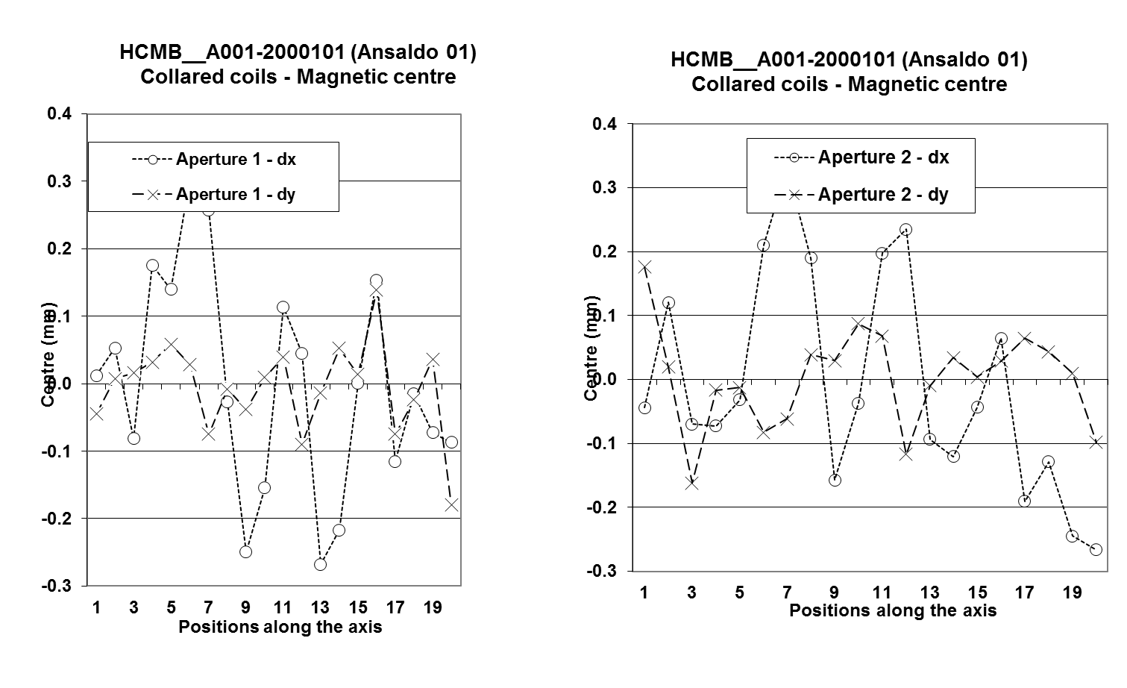
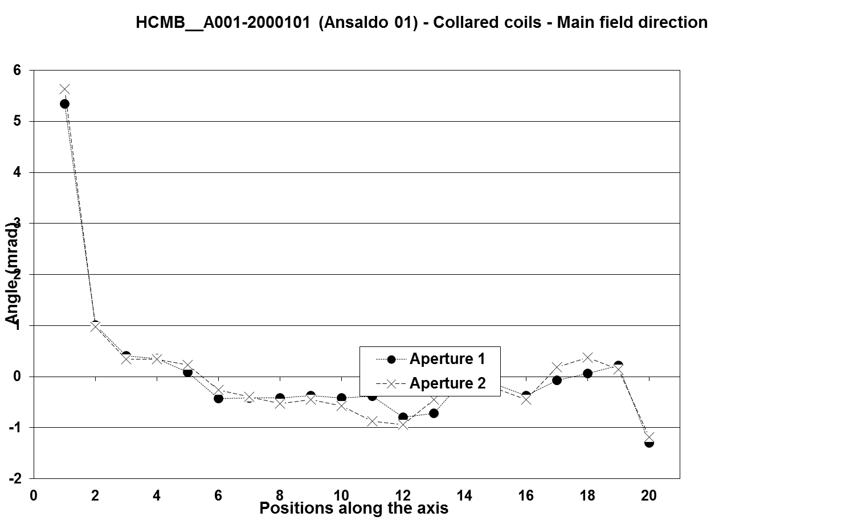
VARIATION ALONG THE AXIS
One needs to specify the length of the measuring mole (integral) to specify the waviness of the
  centre of the quadrupole
  direction of field
In the LHC production we had measuring moles of 750 mm
  I would suggest specifying something similar

Slide 3
VARIATION ALONG THE AXIS
Waviness
  I would set a target on the peak to peak (better than on the sigma)
  ±0.5 mm for the centre
  ±2 mrad for the axis direction
    This corresponds on a position of the midplane within ±0.11 mm

Slide 4
COLD MASS FOR Q1/Q3
Case of Q2a and Q2b
  The average axis is well defined and can be measured with a stretched wire
  The magnet average axis will be aligned with respect to the beam with the precision ensured by the geometry colleagues
Case of Q1 /Q3: two magnets split in two
  One needs a alignement requirement for the two magnets in the cold mass
    I would start from the hypothesis that the two axis with respect to the common axis are
      ±0.5 mm for the centre
      ±2 mrad for the axis direction (corresponds to ±0.5 mm in the outer part of the cold mass)

Slide 5
VARIATION ALONG THE AXIS
Today there is a draft under discussion giving
  Offset: +/- 0.2 mm
  Roll: +/- 0.5 mrad
  Pitch: +/- 1 mrad
  Yaw: +/- 0.5 mrad
    With a 4 m long magnet, a longitudinal (along the axis, not in the transverse plane) angle of 0.5 mrad can bring the end of the magnet out of 2 mm !
  I am not sure these angles are the best way to express things
  We should have an iteration on this
On the top of the Q1/Q3 one should add the precision of the survey (capability of alignment)

