Slide 1

DIFFERENCE IN TRANSFER FUNCTION BETWEEN D1 AND D2 IN VIEW OF SERIES POWERING
CERN, 15th March 2016
WP2 meeting
E. Todesco
CERN, Geneva Switzerland

Slide 2
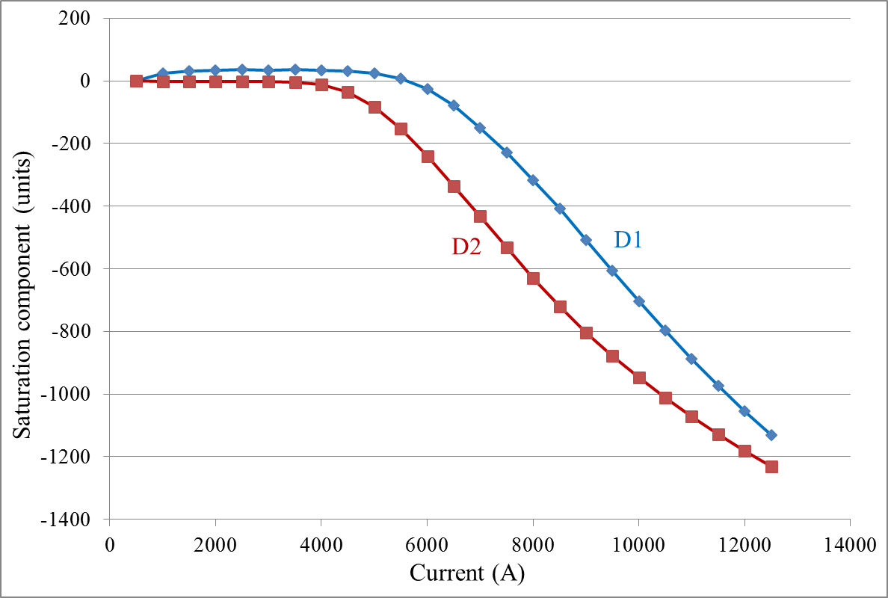
DIFFERENCE IN THE TRANSFER FUNCTION
There is a maximum 2% difference (200 units) between the D1 and D2 field for the same current

Slide 3
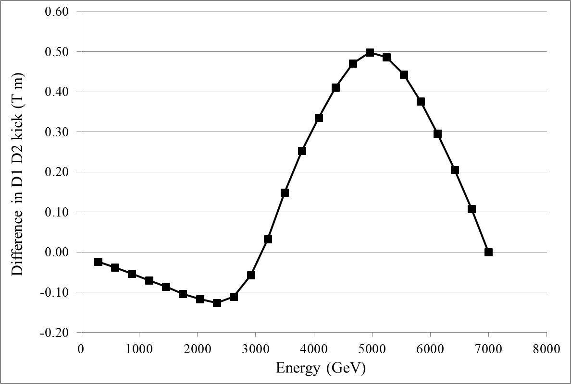
DIFFERENCE IN THE KICK
If we match the length to have 35 T m at 12.000 kA, the difference in the kick along the ramp is at most 0.5 T m

Slide 4
CONCLUSIONS
Solutions
  Adding a trim
    Not the best option for the PC colleagues
    More cables to bring down
  Making the D2 corrector 0.5 T m stronger (from 5.0 to 5.5 T m), ie 18 cm longer
    It’s tight but one can find some space
    This would also give 5.5 T m in the Q4 corrector
  Making the D1 corrector 0.5 T m stronger (from 4.5 to 5.0 T m), ie 24 cm longer
    Space there is precious

