Slide 1

Internship at THE Port
Science and Society

Slide 2
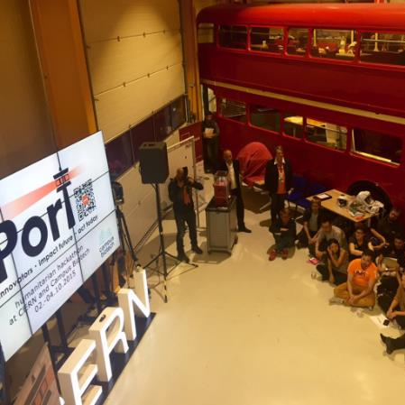

About
Notes:
https://wildmeds.files.wordpress.com/2015/10/fullsizerender-1.jpg?w=680

Slide 3
THE Port - Philosophy
„We combine creative minds from CERN and non-profit organisations in interdisciplinary teams to work on humanitarian technology related benefits to society.“

Slide 4
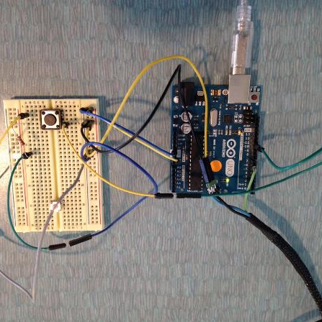
Constructing a Speech Time Regulator

Slide 5
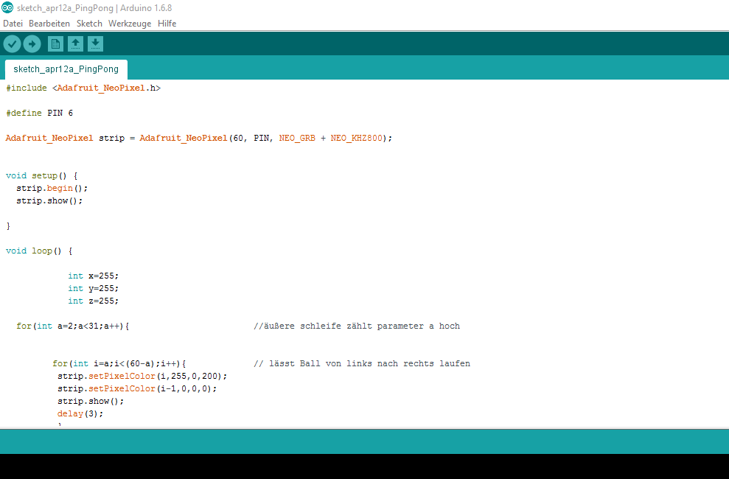

Slide 6
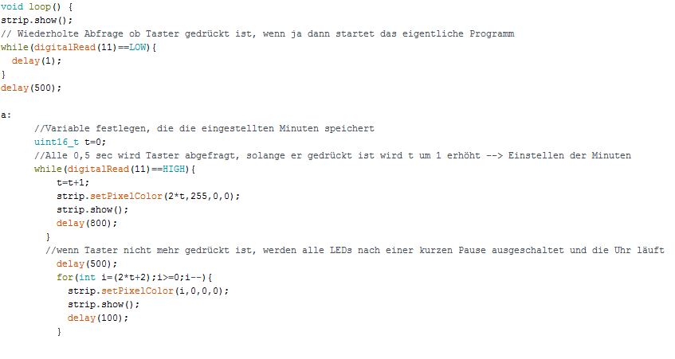

Slide 7
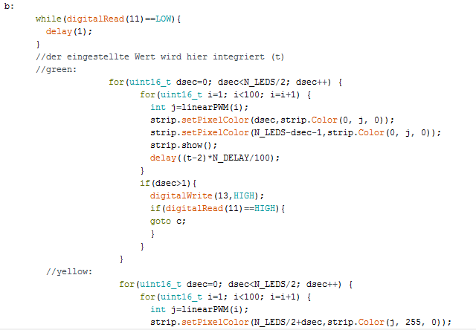

Slide 8
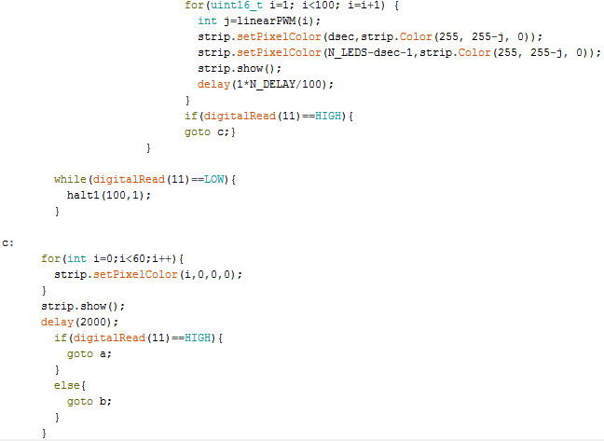

Slide 9
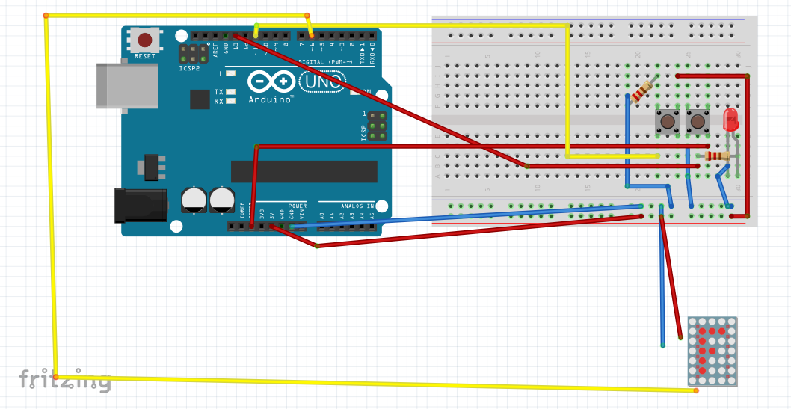
Wiring Diagram

Slide 10
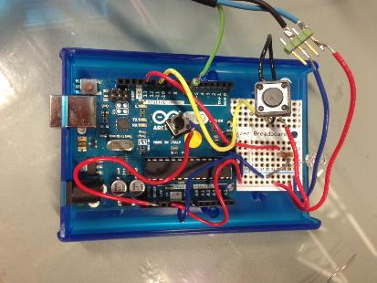
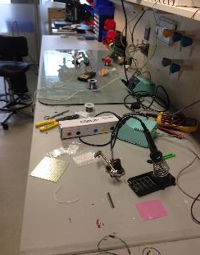
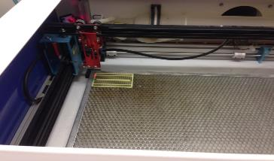
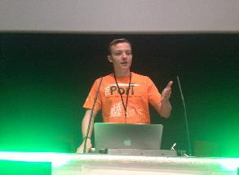
Lasering, Soldering, Presenting

Slide 11

Helping at the Hackathon
Notes:
http://theport.ch/home/open-geneva-2016-campus-biotech/

Slide 12

Hackathon - What?
Finding Solutions
Notes:
http://www.heatseekerz.net/types-of-puzzle-video-games/

Slide 13
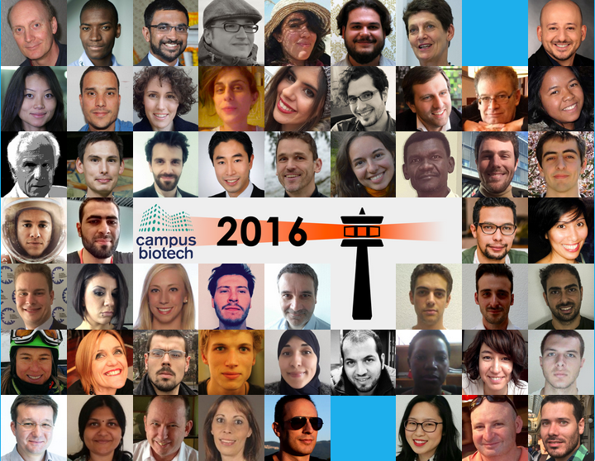
Hackathon - Who?
People
between 16 and 60
from 25 Countries
of different fields of expertise
Notes:
http://theport.ch/home/open-geneva-2016-campus-biotech/

Slide 14

Hackathon - Why?
Bridging the gap between Science and Society
Notes:
http://miriadna.com/desctopwalls/images/max/Golden-Gate-%28San-Francisco%29.jpg

Slide 15
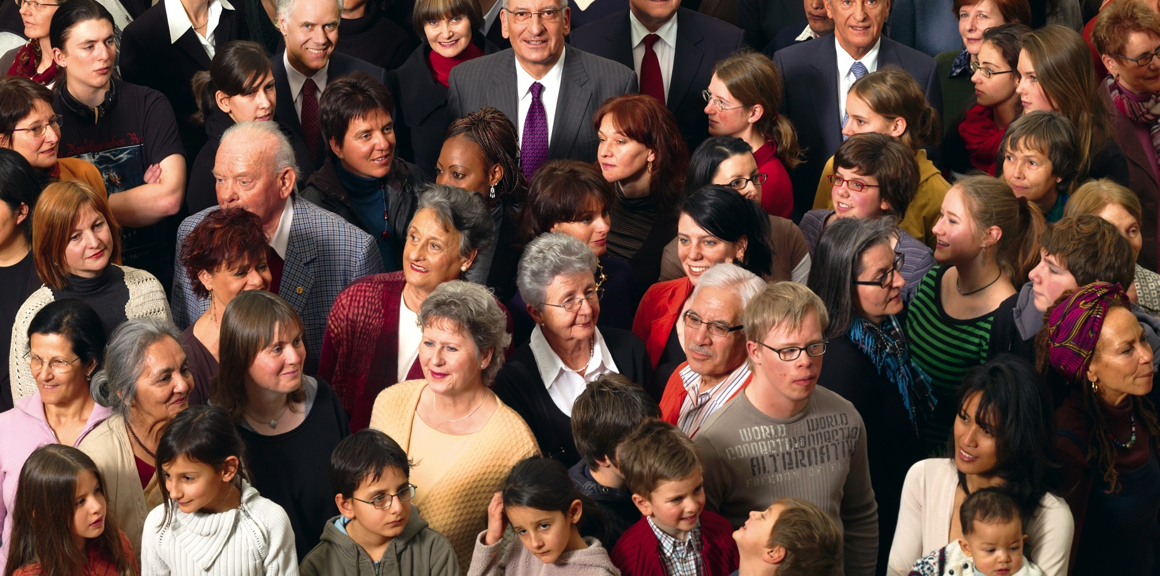
Hackathon - Why?
Connecting People
Notes:
https://upload.wikimedia.org/wikipedia/commons/c/c7/Bundesrat_der_Schweiz_2008_Teil_1.JPG

Slide 16

Hackathon - Why?
Helping
Notes:
http://www.namisantaclara.org/wp-content/uploads/2015/09/helping-hand.jpg

Slide 17
Hackathon - How?
6 weeks of preparation
Presenting results publicly
60 hours of intense hacking
Notes:
http://www.virak.com/images/cours/external-communication.gif

Slide 18
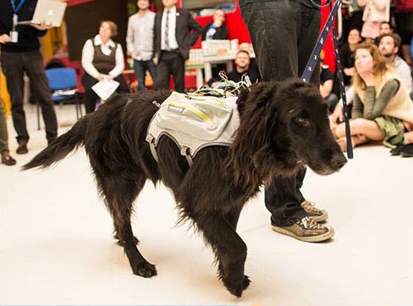
Outcomes
Notes:
http://theport.ch/portfolio-item/pier83-team-smartdog/

Slide 19






Open Geneva

Slide 20
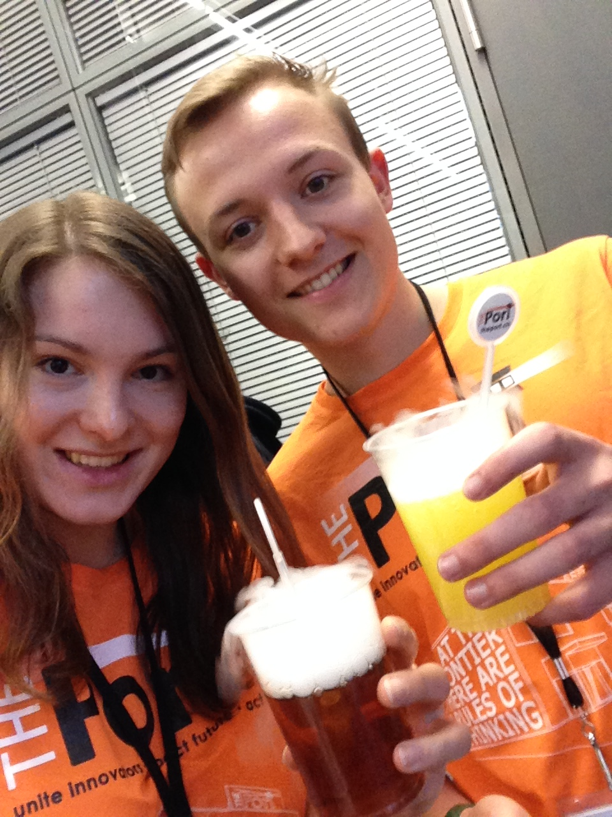
Open Geneva

Slide 21

Convy Data to the new website-structure

Slide 22
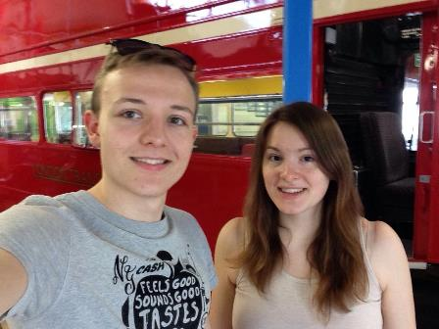
Absolve a selfie-scavenger-hunt

Slide 23
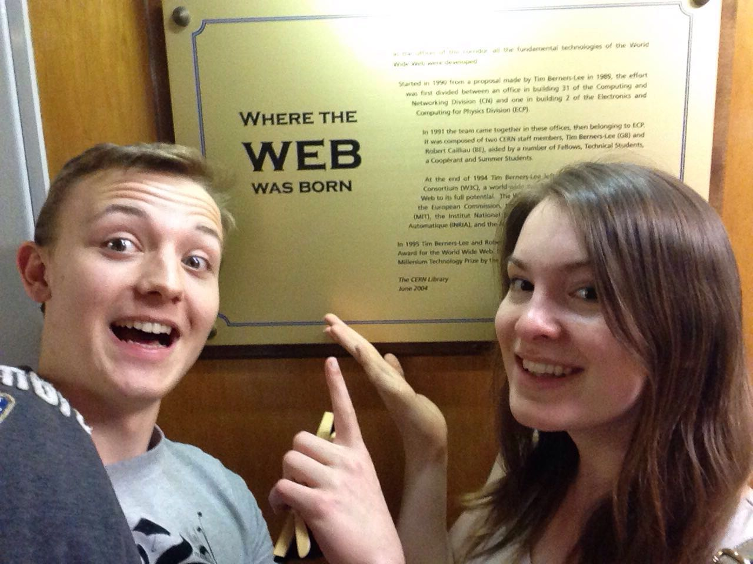
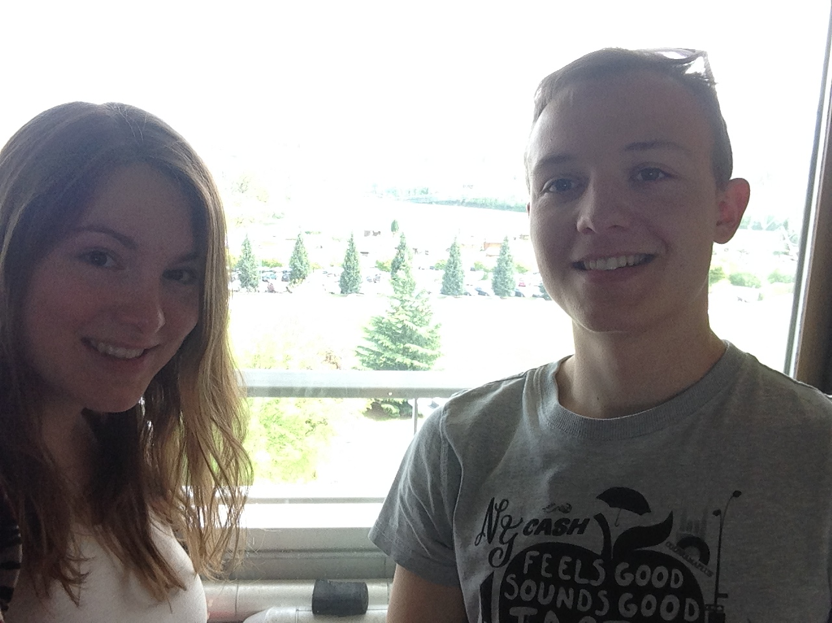
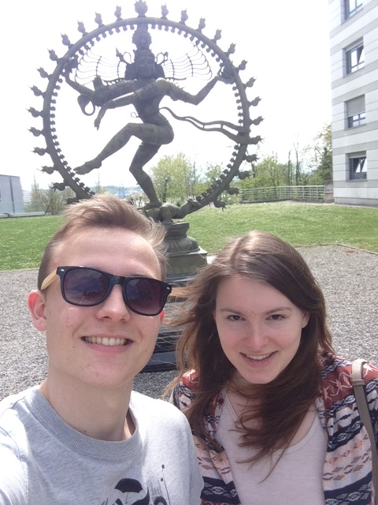

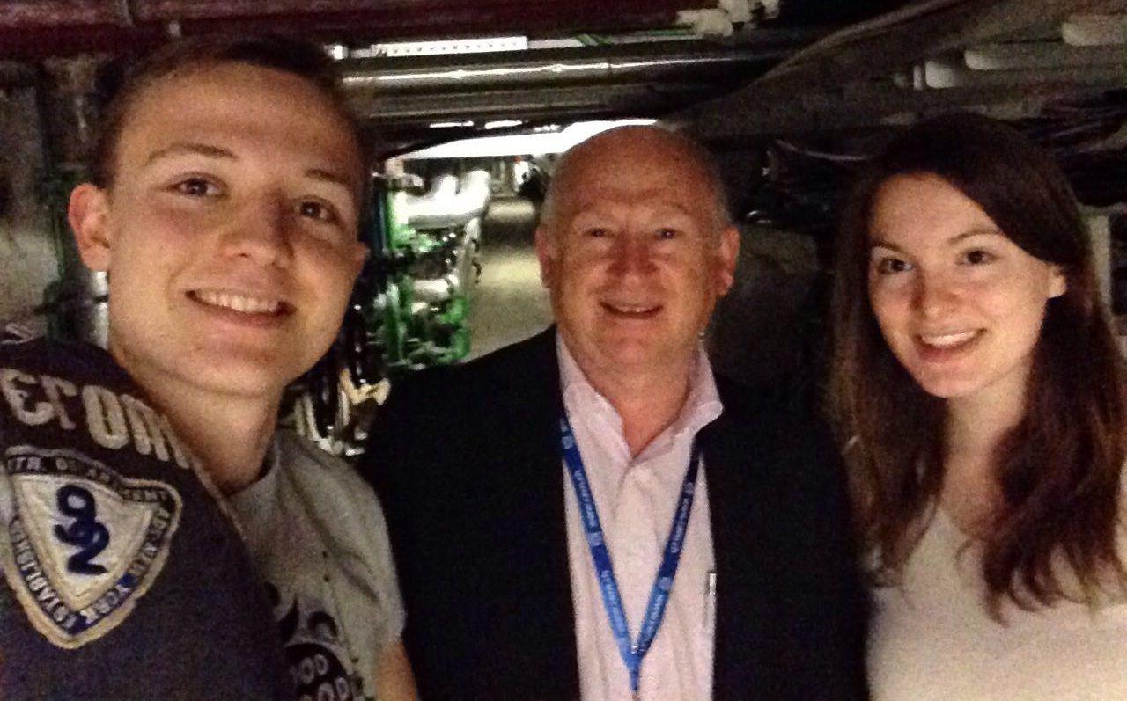
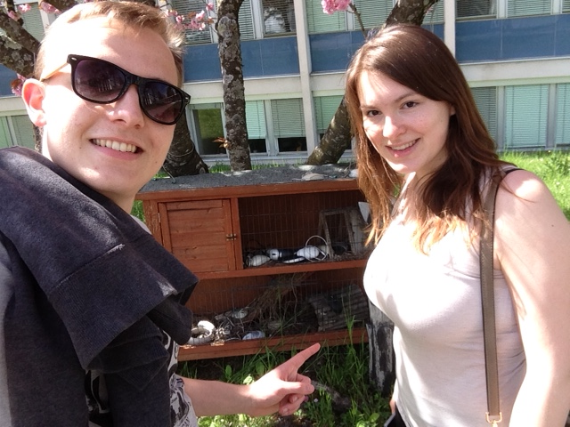
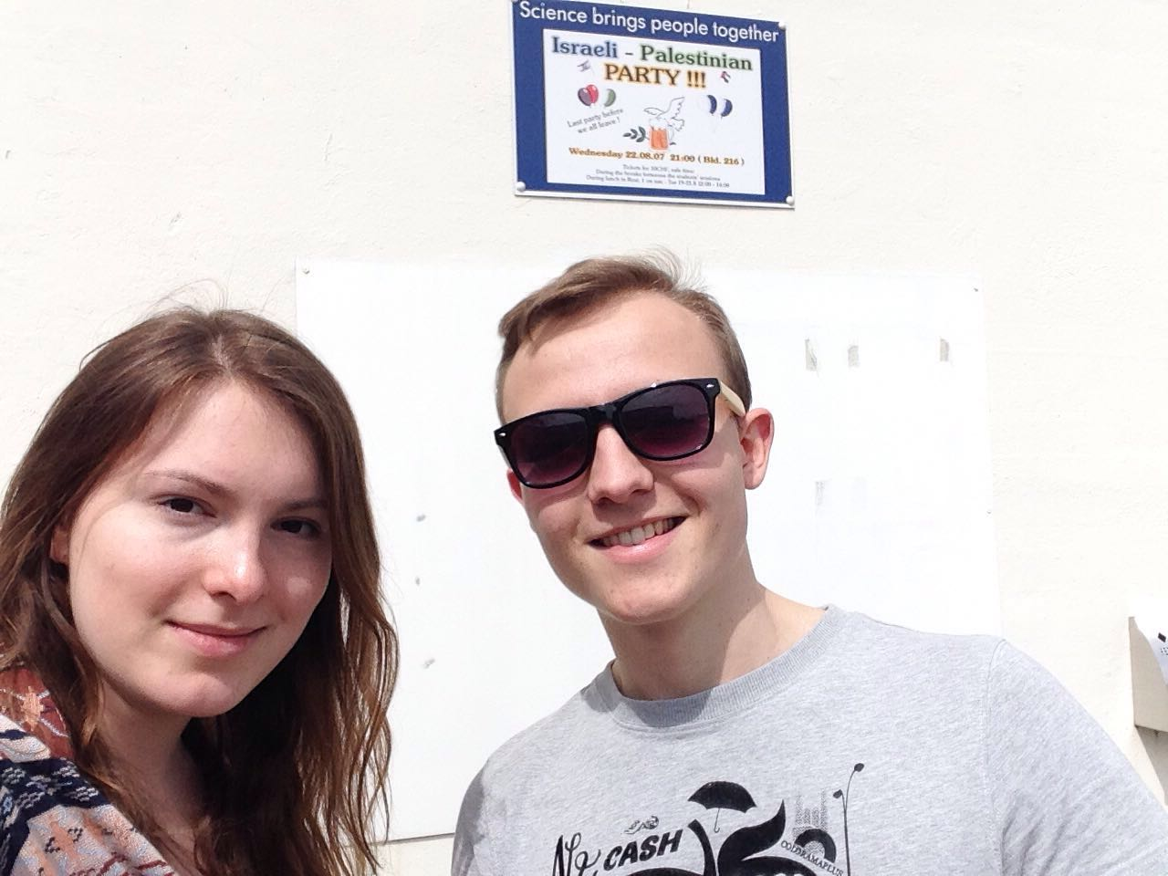
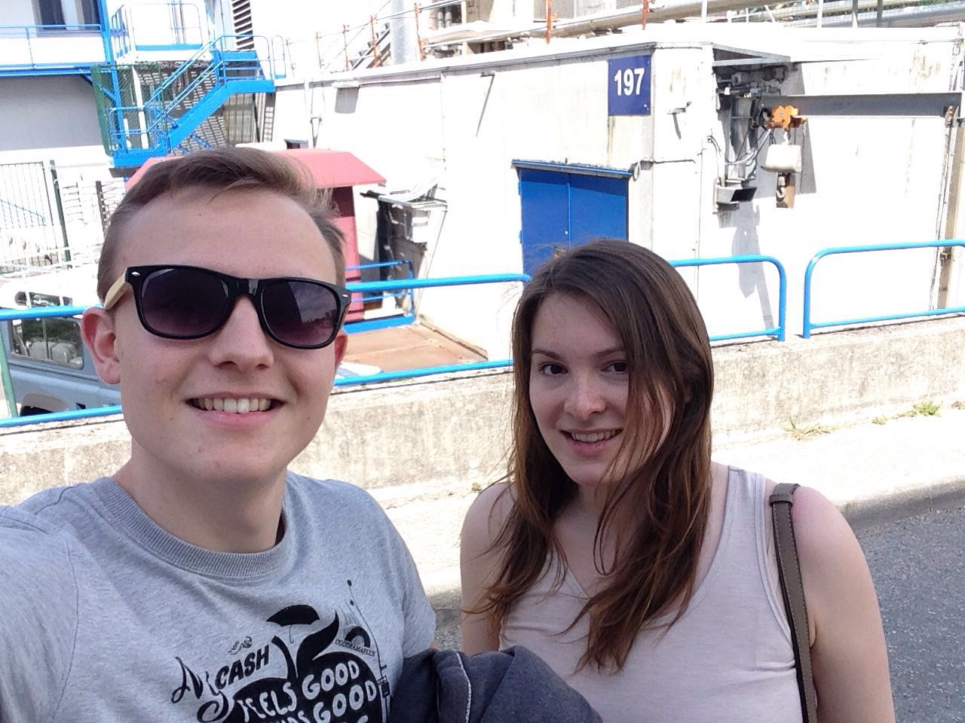
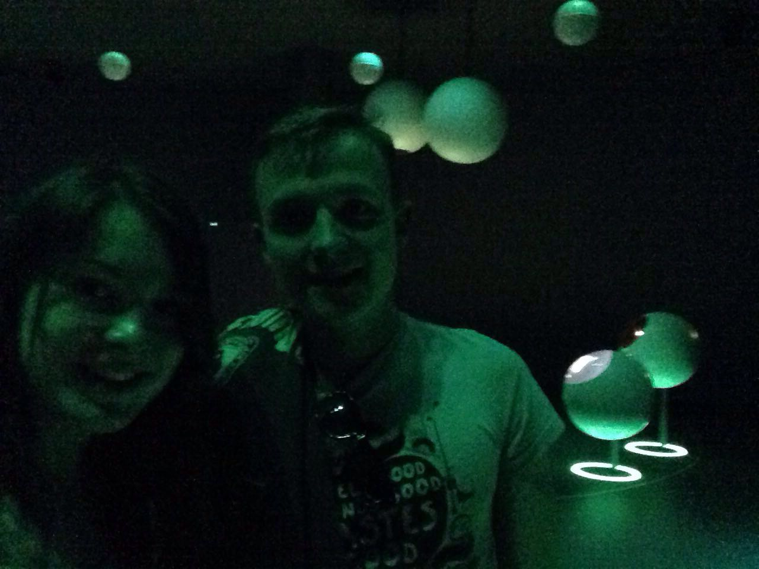

Slide 25
Sources
https://wildmeds.files.wordpress.com/2015/10/fullsizerender-1.jpg?w=680
http://theport.ch/home/open-geneva-2016-campus-biotech/
http://theport.ch/home/open-geneva-2016-campus-biotech/
http://www.heatseekerz.net/types-of-puzzle-video-games/
http://miriadna.com/desctopwalls/images/max/Golden-Gate-%28San-Francisco%29.jpg
https://upload.wikimedia.org/wikipedia/commons/c/c7/Bundesrat_der_Schweiz_2008_Teil_1.JPG
http://www.namisantaclara.org/wp-content/uploads/2015/09/helping-hand.jpg
http://www.virak.com/images/cours/external-communication.gif
http://theport.ch/portfolio-item/pier83-team-smartdog/
https://wordpress.org/about/logos/

