Slide 1
Radiation Resistant Lighting
Ben Fiedler
22.04.2016
Supervisor: J. Devine

Slide 2
Context
LHC generates radiation when running
Maintenance and upgrades are performed by humans in between runs → need for proper heating, cooling, ventilation and lighting
Goal: Develop a radiation resistant lighting system for the LHC
My project: emergency lighting for safe egress

Slide 3
Emergency lighting
Radiation resistant light system is installed already (“test zones”)
Open question: How long will these luminaires last?
System level test (“the whole thing”):
  100 kGy: Loss of approx. 40% of light output
  Functional validation
My project: Component level test for LEDs and PMMA plastic
  Gain better understanding of behavior of components
  Estimate lifetime of components → System lifetime

Slide 4
Test system design
Design, solder and program a test box
Measure the light output of a LED over an extended period of time
Components:
  LED to be tested
  Light sensor
  Arduino
  Temperature sensor
  USB device for logging data
  Light tight box
  Source code (See it on GitHub)

Slide 5
How it works
The system is connected to a logging device
The system calibrates itself
  Initial conditions (LED off) are determined
  The LED is switched on
  LED achieves operating temperature

Slide 6
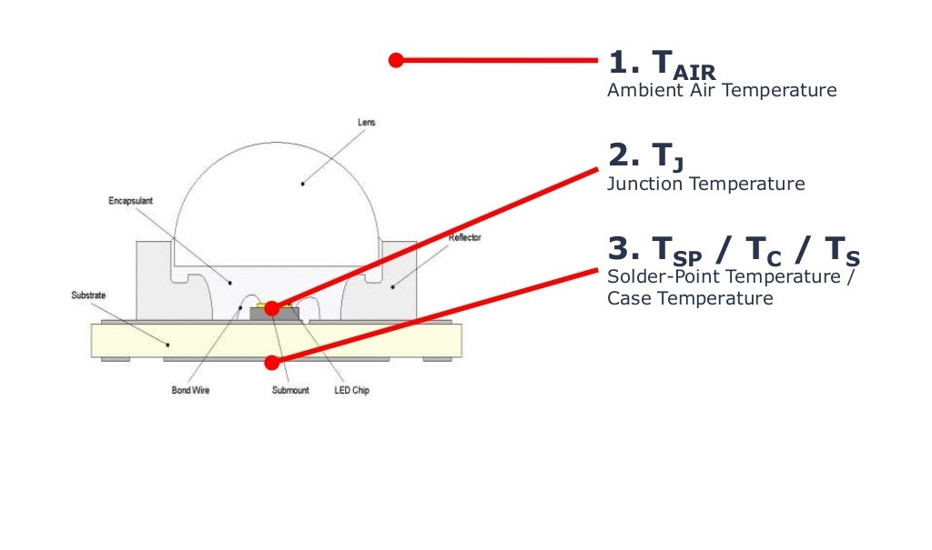
LED operation
src: http://image.slidesharecdn.com/ledlifetimeedndigikeylfi2010-12740463825976-phpapp02/95/led-lifetime-edn-digikey-at-lfi-2010-6-638.jpg?cb=1422627563

Slide 7
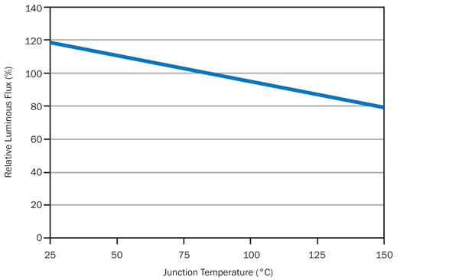
LED temperature vs relative light output
http://www.ledrite.com/images/data_cree_jtchart.jpg

Slide 8
How it works
The system is connected to a logging device
The system calibrates itself
  Initial conditions (LED off) are determined
  The LED is switched on
  LED achieves operating temperature
Actual data is recorded
  Once a minute
  Both light output and temperature

Slide 9
The Test Box
Plastic box with all components installed inside
Cables to provide power and take data:
  Ingoing: The LED and its power supply
  Outgoing: USB cable to connect to logging device
External program controls interior

Slide 10
Data capturing
Three Variables in testing:
  Radiation ← This is the important one
  Time
  LED temperature
Elimination of variable temperature by waiting for calibration
Long sampling time accounts for time variable
Radiation left as only parameter

Slide 11
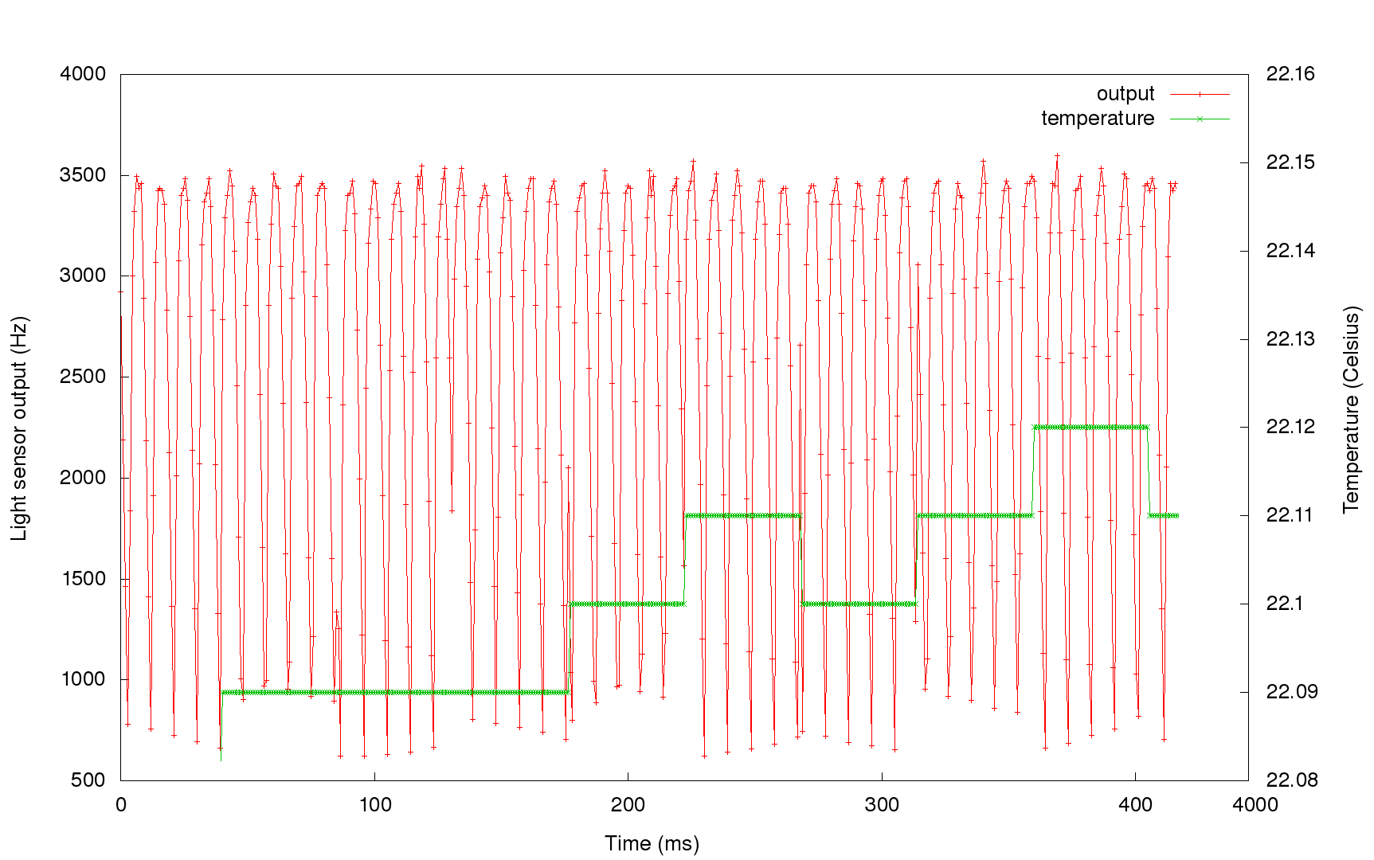
Example Data (one sample)

Slide 12
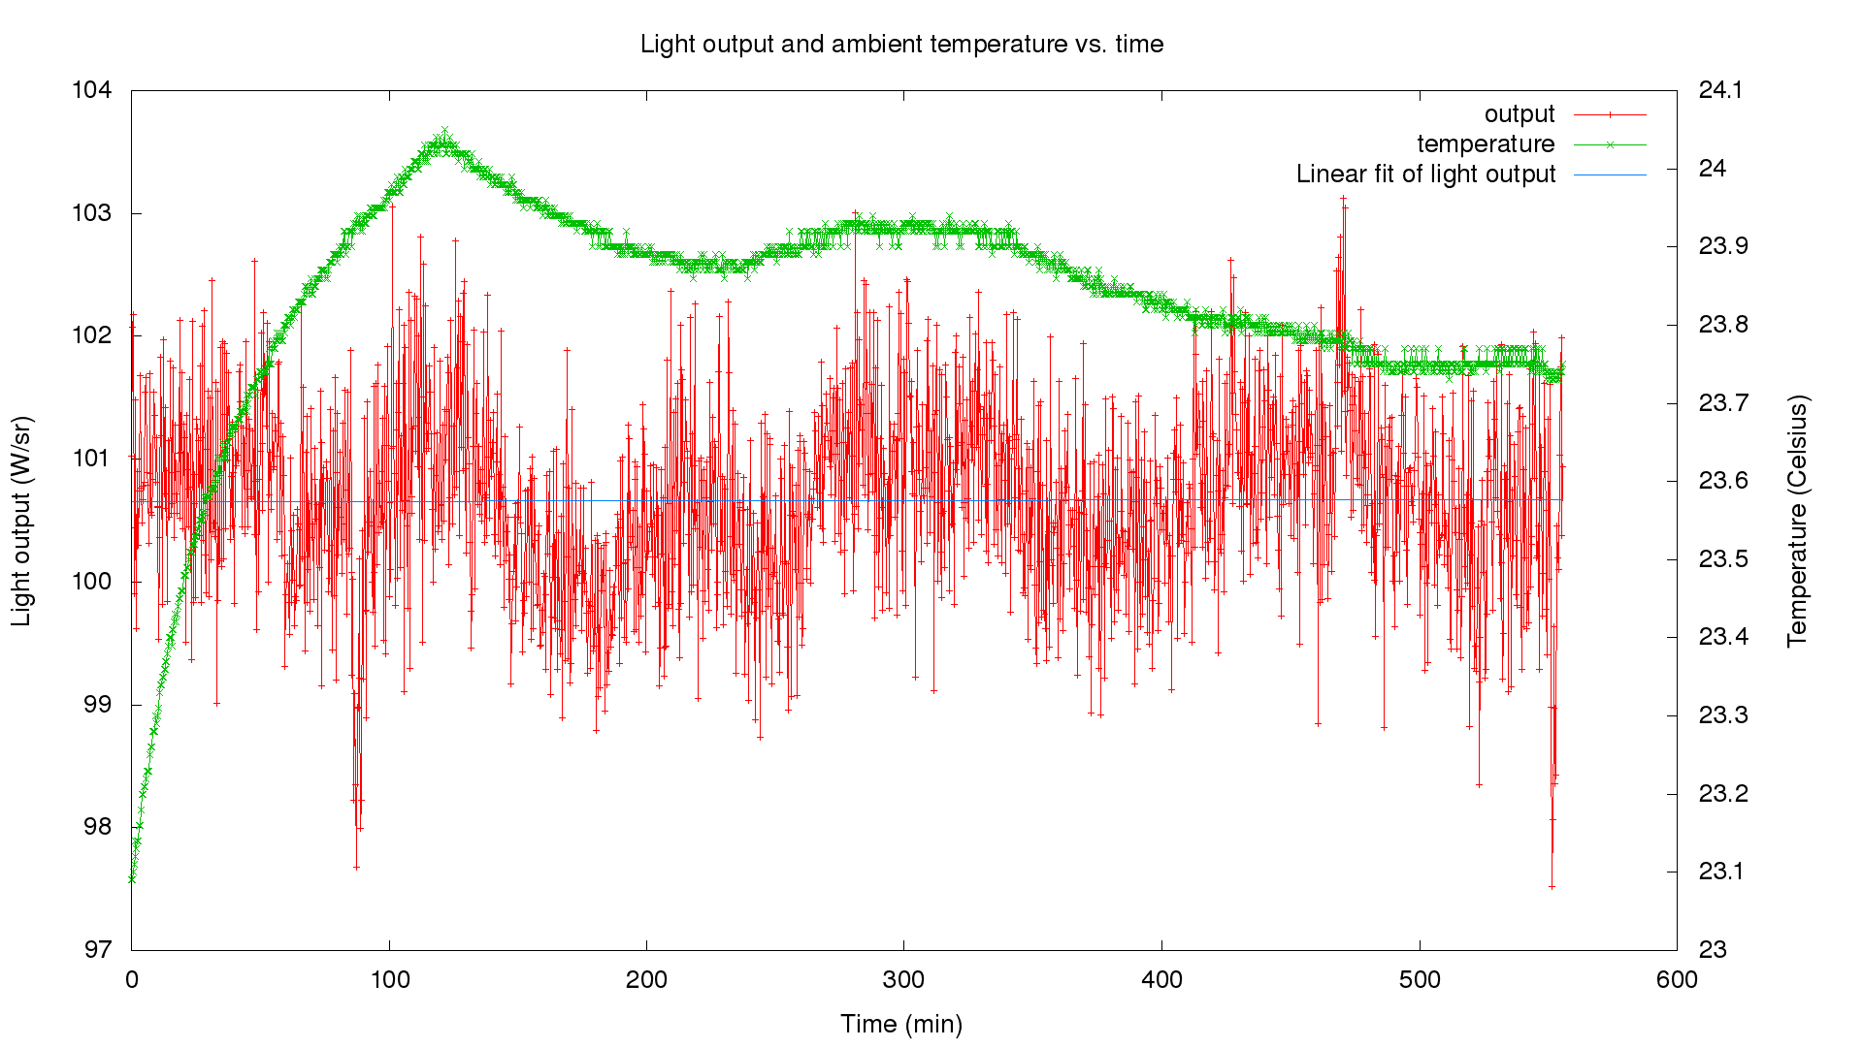
Example Data (avg. long run)

Slide 13
Conclusion
Test Box is minimal working product built in two weeks
Minor errors still included:
  Too large heat sink → Use an isolator
Future work includes:
  PCB design for “mass-production”
  Enhancing box features, more program features (automated plotting, …)
  Design the same system for PMMA plastic / glass → color output

Slide 14
Evaluation
Work was combination of hardware and software work
Mostly independent work, encouragement to work by myself and implement my own solutions
I enjoyed it a lot and learned much about electrical engineering, microcontrollers and hardware-software interfaces
Only criticism: Delivery time of the system’s components, therefore I idled some time

Slide 15
Thank you for your attention
Any questions left?

