Slide 1
Measurement of the charge collection properties of a pixel sensor for ITK
Florian Haslbeck
April 22th
Notes:
DATUM!!

Slide 2
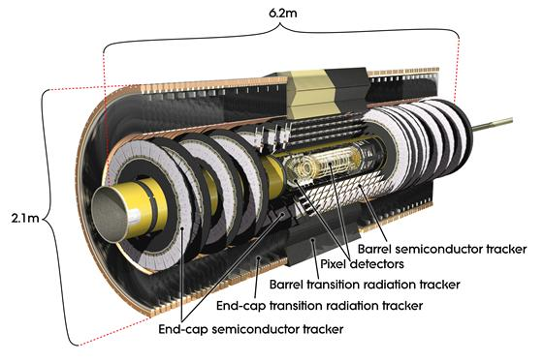
The ATLAS Experiment – Inner Detector
Inner Detector (ITK)
  Pixel Detector
  Semiconductor
  Tracker
  Transition Radiation
  Tracker
Source: http://atlas.cern/discover/detector/inner-detector: 16/04/18, 11:38
Aim: 1. more pictures per second
2. higher resolution
3. higher radiation resistance

Slide 3
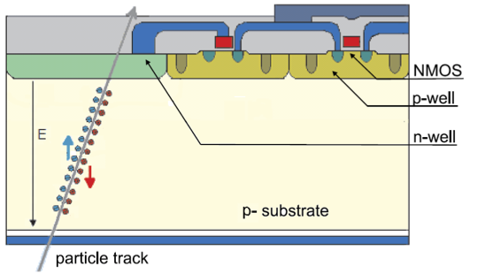
TCT Measurements
current
V
Ionisation
Potential
Notes:
Problem: Laser is 10x width

Slide 4
TCT Measurement
Laser
Trigger
DRS
Data
50 ns delay
Readout
λ= 600 nm
λ= 1000 nm
Hit
Signal
DUT
Signal
Amplifier
Diode
Notes:
Characterisiery¡ugn pixel
Ionisation bz laser
Measure bz potential I diode
100 -> 10, nee dto make it smaler

Slide 5
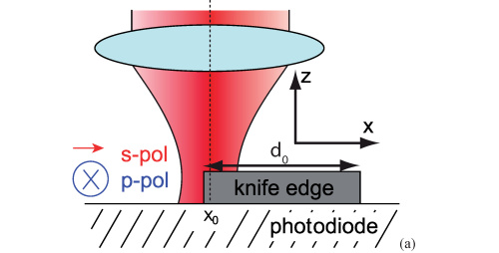
Knife Edge Method
Knife Edge Method
aim: determination of the beam‘s width
need: 6 - 10 μm
but in lab: > 100 μm
TCT Measurement
  Voltage and Surface Scan with an IR Laser
  controlled by python
  fit data to the function P(X)
Diode

Slide 6
Knife Edge Method
Scanning with fixed intensity
Variable test conditions:
  aperture: 0 – 6 mm
  voltage : 150 - 250V
  x and z coordinates

Slide 7
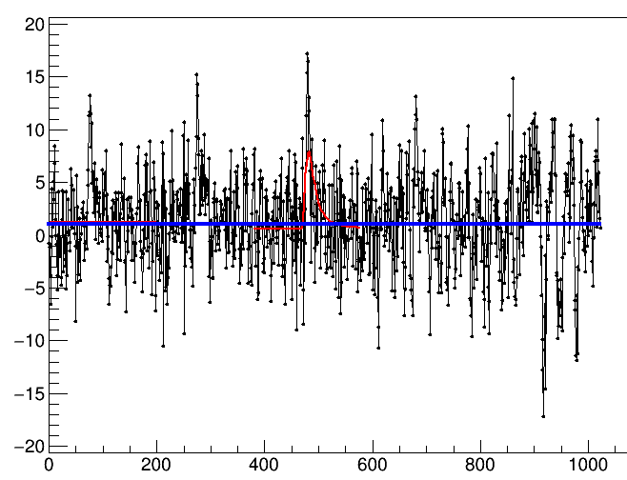
Low Pass Filter Implementation
Low Pass Filter:
  aim: reduction
  of the noise
moving average
Notes:
Explain what is meant with size and average

Slide 8
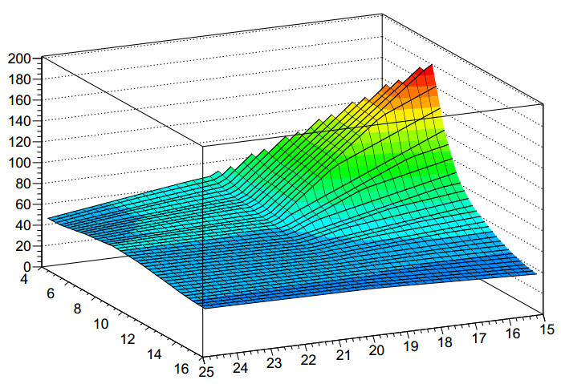
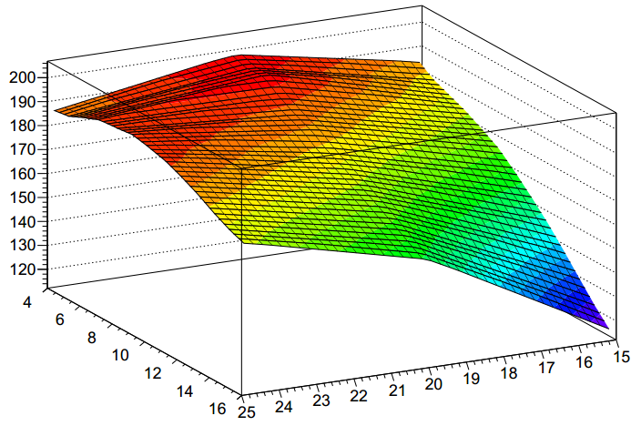
Low Pass Filter
signal
signal
numbers of
samples to average
numbers of samples to average
integration size
integration size
1. Signal = (signal + background ) – backround
2. Significance = signal / sqrt(backround)

Slide 9
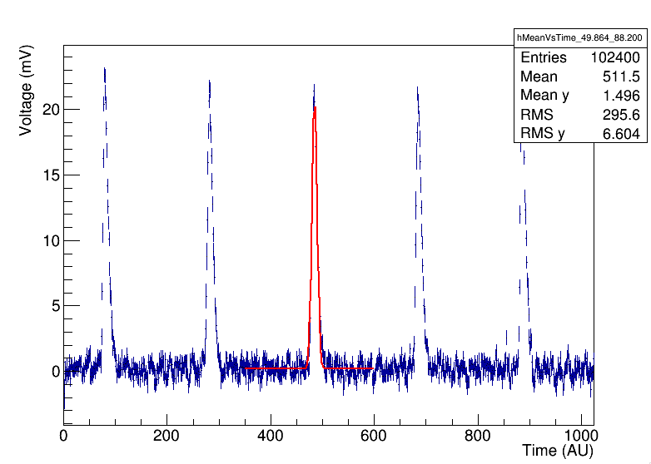
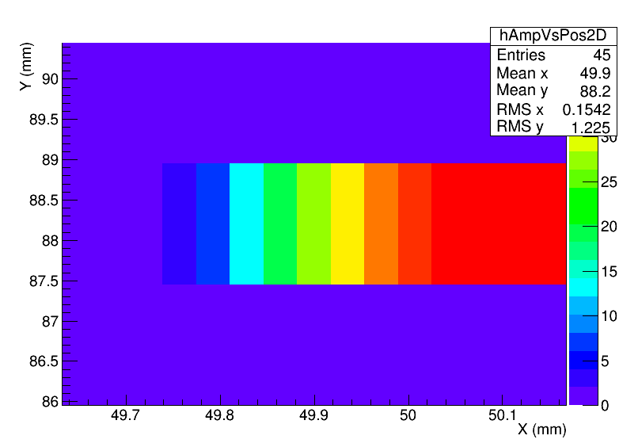
Average over many events
average of many events: 1. Identify the peaks
2. No noise
→ almost a perfect result

Slide 10
Conclusion
Aim: 1. more pictures per second
2. higher resolution
3. higher radiation resistance
Determination of the beam’s width
by the Knife Edge Method
Implementation of a Low Pass Filter
Best result by using the average of many events

