Slide 1

Beam Instrumentation
T. Lefevre (BE-BI)
M. Barros Marin, C. Boccard, A. Boccardi, B. Dehning, J. Emery,
M. Gasior, R. Jones, T. Levens, J. Olexa, E. Piselli, J. Storey

Slide 2
Outline
Beam position monitor
Resolution of the current BPM orbit/trajectory mode
Need for extra BPMs around the cavity ?
Head-tail monitor
Tool for measuring crabbing
Status and plans
Emittance monitoring
Wire scanner
BGI
No sync. Light if operation foreseen below 350GeV
Beam loss monitoring
Any need for add. BLM for cavity protection system ?

Slide 3
BPM in SPS – new MOPOS
New MOPOS electronic being developed
Based on LogAmp and rad-hard digital FE (GEFE)
Resolution over ±15mm aperture, for large intensity beams (>2.10¹⁰ p):
Orbit mode: 0.1 mm
Trajectory mode: 0.4 mm
Batch by batch measurements possible
Will also include a DOROS acquisition channel
Installation foreseen for LS2 but the fiber infrastructure is installed already in BA6

Slide 4
New BPMs around the crab cavities ?
Possible pick-ups
SPS BPM design: conical flange
BPCN - Ø80mm, 180mm long strip-line, possibly spares, Zt=6ohms
LHC BPM design : CF and helicoflex so no bake-out above 180C.
BPMWI, Ø80mm, enlarged Button 40mm, Zt=1.1ohm, body and button existing
BPMSX, 81mm, 120mm strip-lne, Zt=4ohms, body and feedthrough but no electrode
SLAC collimator: Conical flange, Ø80mm, enlarged buttons, helicoflex so no bake-out above 180C
….. Decision as soon as possible since in most cases it involves manufacturing

Slide 5
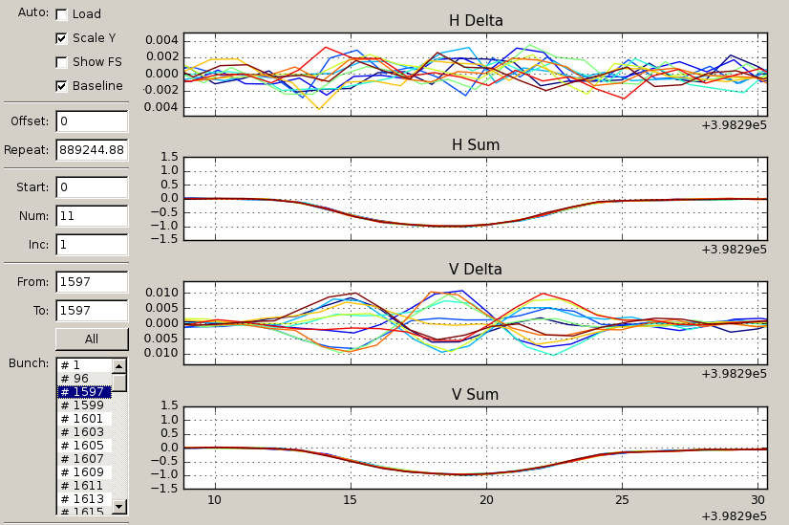
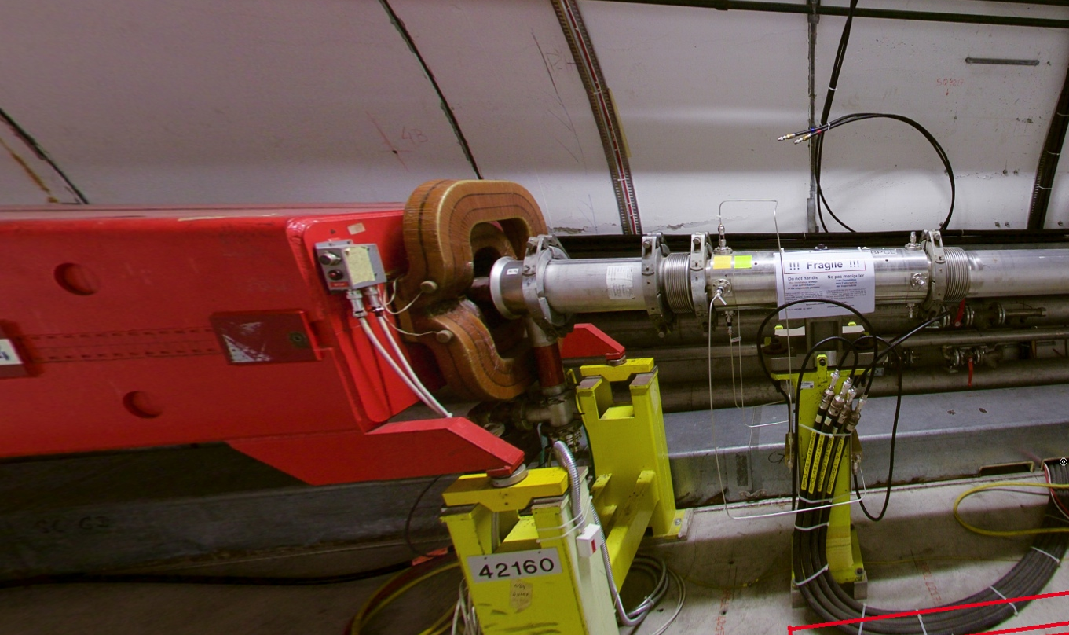
SPS Head-tail monitor
Acquisition of BPM sum/delta signals with fast Digitizer (10GSPS)
“Features”
Limited resolution – 100um
Long acquisition length possible
(1.6 second)
Slow readout speed
Large file size

Slide 6
SPS Head-tail monitor
Potential for crabbing measurements
Phase advance being looked at by ABP
Hope the pick-up is located at position with an adequate phase advance..
Current HT needs to be adapted to match the input voltage (to cope with lower intensity bunches) with switchable attenuators
Foreseen upgrade and on-going developments
Required beam tests in 2016
Measure more precisely the resolution of the system (using bumps or K-modulation)
Software upgrades already planned for 2016
New FESA3 class optimised for instability measurements
Post-processing (data reduction) done on window machine controlling the digitizers

Slide 7
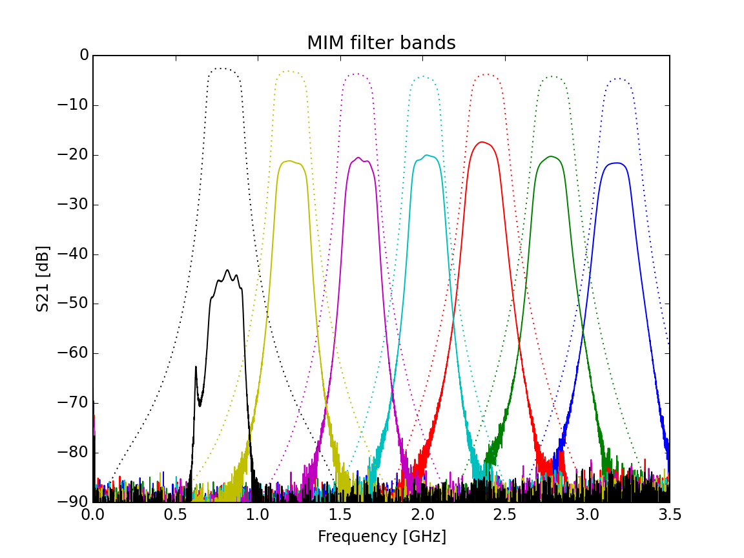
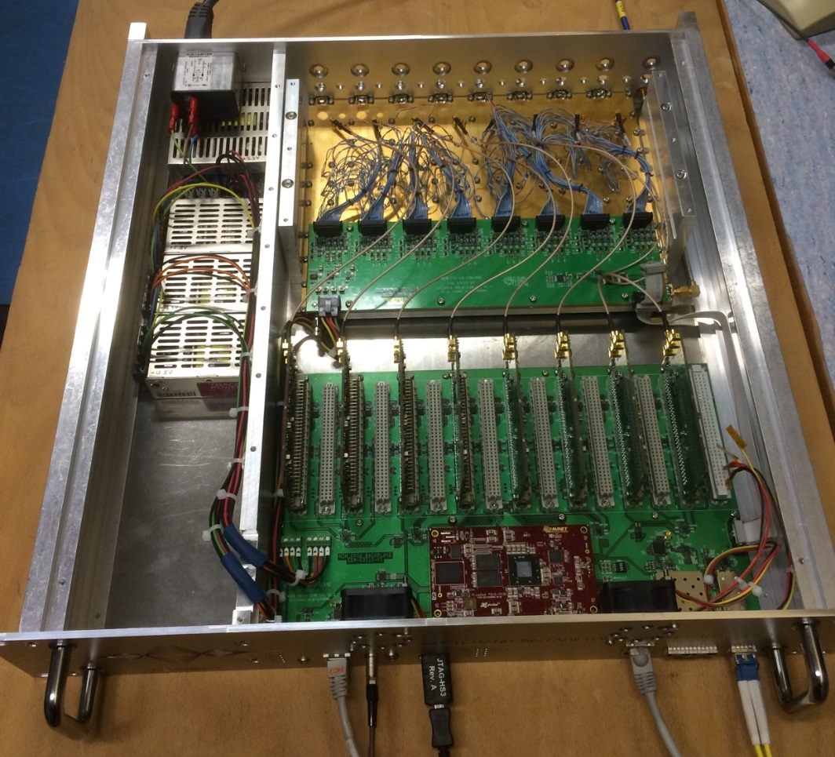
SPS Head-tail monitor
On-going developments (LHC or HL-LHC driven)
Higher sensitivities with a Multi-band instability Monitor
Looks at different frequency components of BPM signal using RF filter bank.
From the relative power in the bands can determine mode number.
Diode detectors & 24-bit ADCs
Sensitive but not bunch-by-bunch

Slide 8
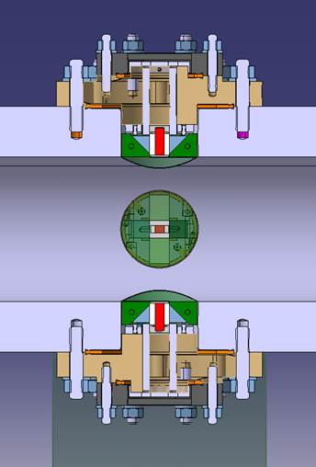
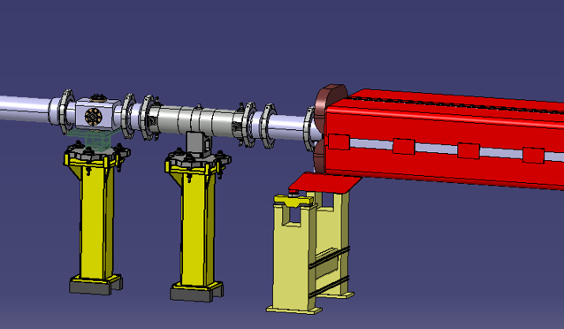
SPS Head-tail monitor
On-going developments (LHC or HL-LHC driven)
Faster time response with EO-BPM
A fibre-coupled design with laser and detectors housed 160 m away from accelerator tunnel.
Incoming light is collimated by a lens and polarized before entering the crystal.
The electric field of passing bunch at the crystal induces a rotation in the polarization, by the linear Pockels electro-optic effect.
Light emerging from the crystal passes through an analyser and is then fibre-coupled to the distant photodetector.
EO-BPM
BPCL.421

Slide 9
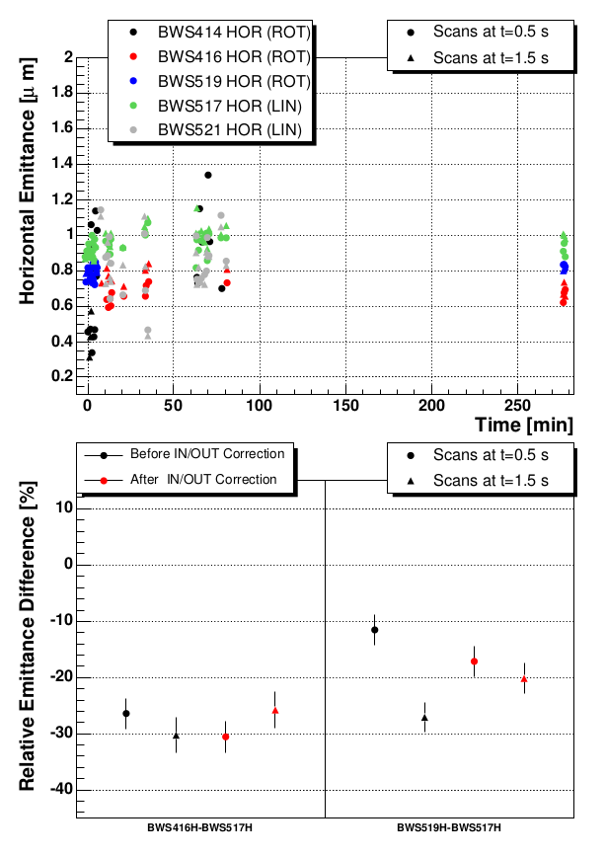
Comparisons of different SPS wire scanners
Linear scanner accuracy established be comparison of two linear scanners (optical ruler)
Measurements over several hours
Intensity 3E10 protons (TOTEM beam, one bunch)
Low dispersion scanners compared
Emittance smaller < 1 um at 26 GeV
Emittance measurement repeatability estimated by error bars, horizontal plane
Relative error few % with a 1 um beam
Vertical plane smaller errors
Thesis: F. Roncarolo

Slide 10
Wire scanner intensity limits and measurements errors
Scanners | Linear | Rotational | New rotational 517 vertical
Intensity limit max: E=26 GeV, emittance= 1um | 3.60E+12 | 2.40E+13 | 1.50E+14
Intensity limit max: E=270 GeV, emittance= 1um | 1.10E+12 | 7.30E+12 | 4.50E+13
Statistical error (single scan, beam size) | 40 to 100 um | 40 to 100 um | similar to linear
Repeatability (single scan, beam size) | 14 um | 70 um | similar to linear
Maximum number of scans per year | 40000 | 10000 | more as all others

Slide 11
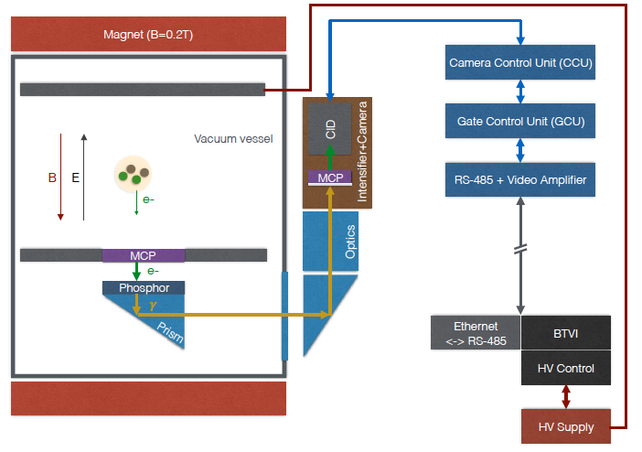
BGI

Slide 12
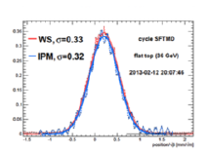
BGI
Assumptions:
Emittance = 1um
Point Spread P = 400um +/- 100um (based on measurements in 2013)
Expected performance
Re-commissioning of the BGI foreseen in 2016
Reliable operation of BGI
MCP gain calibration (weighting factors)
Understand PSF and resolution
Energy (GeV) | Beam width (mm) | Relative error (%)
26 | 1.8 | 1
270 | 0.55 | 13

Slide 13
Conclusions
BPM
Possibly new MOPOS (including DOROS) for few selected BPMs in BA6
New BPMs around the crab – To be decided as soon as possible
HT
Would work without major modifications if phase advance OK
New EO-Pick-up and MIM under-development – possibly available by 2018
WS would work as baseline instrument for emittance measurements
BGI needs to be re-commissioned but would ultimately be the device for continuous emittance monitoring
Do we need extra BLMs around the crab-cavity ?

