Slide 1
SPS Transverse Damper with Crab Cavities
G. Kotzian, W. Hofle
BE-RF-FB, 11. January 2016 Crab Cavity SPS Tests Day I
https://indico.cern.ch/event/463435/

Slide 2
Recap: Transverse Feedback Systems
The transverse dampers [SPS Damper, Wideband FB] are feedback systems: they measure transverse oscillations [SPS Damper: bunch-by-bunch, Wideband FB: slice-by-slice] and damp them by fast electrostatic kickers.
BPM
Kicker
5ns Bunches
Active closed loop feedback
Analog
Front
End
Signal
Processing
BBQ
SUM
ADC
DAC
Power Amp
transverse
position
pre-processed
sampled
position
calculated
correction data
correction
signal
drive signal

Slide 3
Outline
Objective:
Illustrate operational modes of the SPS Transverse Damper, estimate the co-existence of damper and crab cavities (CC), address MD studies and potential diagnostics.
Structure:
SPS Damper Operating Modes
CC-Damper Interaction Scenarios → Proposal for MD studies
Beam Diagnostics Potential

Slide 4
SPS Damper Operating Modes
Damping of injection errors a.k.a. Injection Damping
handles large injection errors of the order of several mm
Fully independent systems in the horizontal and vertical plane
Cure of resistive wall impedance driven coupled bunch instability
threshold ~5x10¹² protons total intensity
between lowest betatron frequency and 20 MHz to damp all possible coupled bunch modes at 25 ns bunch spacing
individual bunch damping (sampling synchronous with bunches)
Boundary condition:
Counteract transverse emittance blow-up
preventing non-linearities from shredding bunches into filaments
Injection damping: feedback action must be sufficiently fast (kick strength)
Low instability detection threshold, to work immediately against arising instabilities at the very onset (position sensitivity/detection resolution)
[1] H.Bartosik et.al., “SPS CC TEST: ANALYSIS OF PAST MEASUREMENTS AND OUTLOOK TO FUTURE CAMPAIGNS INCLUDING THE REQUIRED INSTRUMENTATION”, at 4th Joint HiLumi LHC-LARP Annual Meeting 2014, Nov. 17-21, 2014.
QUESTION: How much impact of CC to be expected?
… challenging to benchmark → see studies by R. Calaga [1]

Slide 5
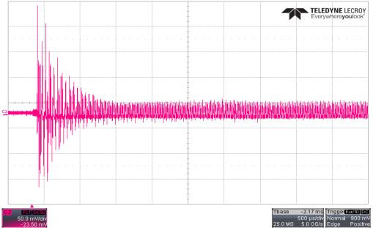
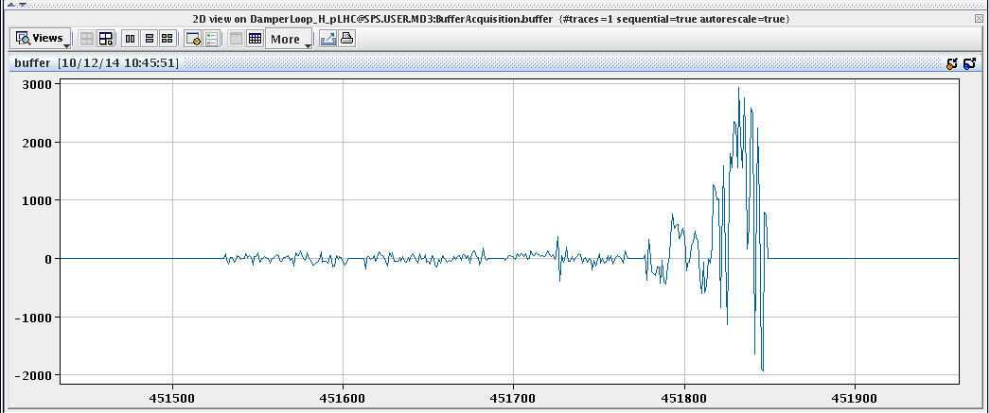
Examples: Damper Performance
1 ms
Logbook: [Monday 27-Oct-2014, 23:15]
How much impact of CC to be expected?
Injection damping → better than 1ms
Counteract coupled bunch instabilities, → up to highest mode at 25 ns spacing
approx. 0.7 ms
VERTICAL
HORIZONTAL
[10-Dec-2014, 10:45]
activity in the last injected batch
(+1st order roll-off
of damper gain)
1st batch
2st batch
3rd batch
4th batch

Slide 6

Damper-CC Interaction Scenarios (1)
(1) Damper in Passive Mode:
Open loop, no active excitation from TFB
Use damper for passive diagnostics and monitoring (see following slides)
Survey visibility of CC activity, to evaluate
Effect of CC during Injection Transients (several mm injection errors)?
Impact of CC on coupled bunch instabilities?
Results valuable for benchmarking CC-TFB interaction
Damper diagnostics potential and monitoring tools: (this list is not exhaustive)
Sensitivity of transverse damper to intra-bunch motion (resolve bunch motion >> 20 MHz)
Transverse Observation Box (bunch-by-bunch, turn-by-turn data)
Wideband Transverse Feedback (RF synchronous sampling)
Transverse BQM (GUI and logging application readily available)
assess beam effects in the presence of crab cavities only
NB: Define an adequate metric to quantify impact of CC.
RMS transverse activity
Damping time
Emittance growth
…

Slide 7
Damper-CC Interaction Scenarios (2)
(2) Active Mode: Driven Excitation
Open loop, active excitation with TFB
Use damper to actively perturb the beam with known patterns (single transverse deflection, sinusoidal excitation)
generate a test pattern similar to what is expected with active crabbing:
New Wideband kickers in BA3 (BW up to 700 MHz)
Driven transverse excitation → CW 400.79 MHz (bunch synchronous)
Allows for reproducible tests e.g. to calibrate diagnostics or exploration of parameters
(3) Active Mode: Active Feedback
Closed loop transverse feedback
Examine impact of co-existence: CC + TFB
Once CCs installed and available in 2018
Complementary test bench, could be made available well before installation and testing with Crab Cavities in 2018

Slide 8
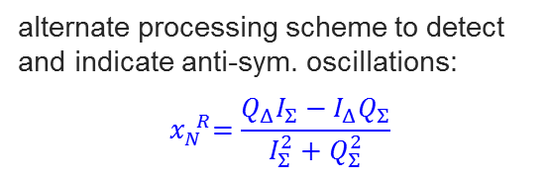
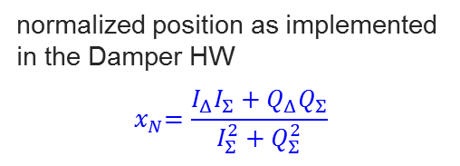
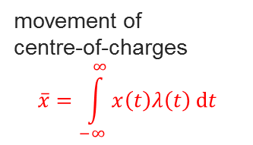
Beam Diagnostics Potential (1)
Sensitivity of transverse damper to intra-bunch motion
Separation in even/odd modes, turn-by-turn data
cases shown:
LHC ADT
Simulation Results: Symmetric Excitation
Simulation Results: Anti-Symmetric Excitation
400 MHz
Centre-of-charges oscillations
detectable by damper → feedback
400 MHz
Measure this quantitatively in 2016
movement of
centre-of-charges
$$\overline{x}=\int_{−∞}^{∞}{x\left(t\right)λ\left(t\right) \text{d}t}$$
normalized position as implemented
in the Damper HW $${ x}_{N}=\frac{I_{Δ}I_{Σ}+Q_{Δ}Q_{Σ}}{I_{Σ}^{2}+Q_{Σ}^{2}}$$
alternate processing scheme to detect and indicate anti-sym. oscillations: $${ x}_{N}^{ R}=\frac{Q_{Δ}I_{Σ}−I_{Δ}Q_{Σ}}{I_{Σ}^{2}+Q_{Σ}^{2}}$$
G. Kotzian, W. Hofle, D. Valuch, “ADT SENSITIVITY TO INTRA-BUNCH MOTION”, at HSC meeting, Jan. 22, 2014.

Slide 9
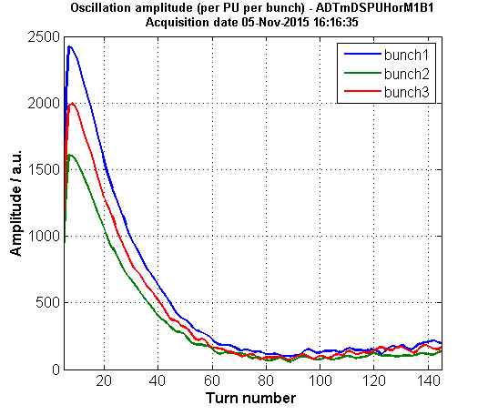
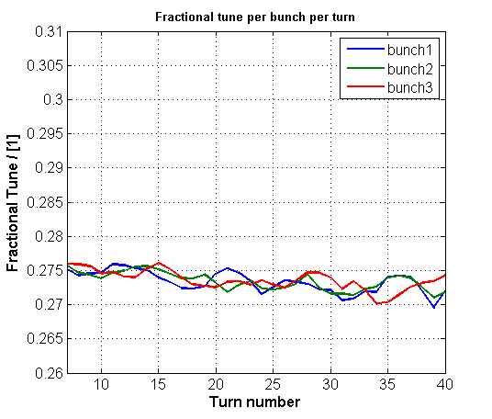



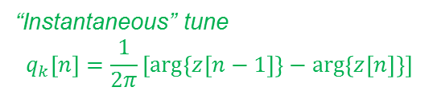
Beam Diagnostics Potential (2)
Observation Box
Bunch-by-bunch, turn-by-turn data
Prototype readily in place in BA2
Some development work to be done (FESA, logging, fixed display)
Work in progress
cases shown:
LHC ADT
Amplitude $A_{k}\left[n\right]=abs \{z\left[n\right]\}$
Frac. Tune $q_{k}\left[n\right]$
Inclination of $A_{k}\left[n\right]$ can be interpreted as “damping time”
(assuming the decay is exponential)
$τ\left[n\right]=\frac{Δn}{ln\left(A_{k}\left[n\right]/A_{k}\left[n+Δn\right]\right)}$
“Instantaneous” tune
$$q_{k}\left[n\right]=\frac{1}{2π}\left[arg\left\{z\left[n−1\right]\right\}−arg\left\{z\left[n\right]\right\}\right]$$
G. Kotzian, D. Valuch, “SPS AND LHC TRANSVERSE FEEDBACK PARAMETER EXTRACTION”, at LBOC 2014, Dec. 08, 2015.

Slide 10
Beam Diagnostics Potential (3)
Visualization of bunch motion:
Rapid identification of
quiet bunches
bunches with transverse center of mass motion
bunches with head tail motion
bunches with combination of center of mass and headtail motion with correlation
→ To be implemented
Work in progress
case shown:
LHC ADT
W. Hofle, “PERFORMANCE OF UPGRADED SPS DAMPER IN VIEW OF CRAB CAVITY TESTS COMPLEMENTARY TO HIGH BANDWIDTH TRANSVERSE FEEDBACK”, at 4th Joint HiLumi LHC-LARP Annual Meeting 2014, Nov. 17-21, 2014.

Slide 11
Beam Diagnostics Potential (4)
Transverse BQM: Description
10 bit resolution, 8 GSPS sampling rate
Uses exponentially tapered stripline
approx. 32 MSamples usable memory == max. 4k turns
GUI and logging application in operation (UI developed by F. Foulin, FESA support by G. Papotti)
In Operation
T. Mastoridis, “BEAM DIAGNOSTICS TOOLS FOR CRAB-CAVITY TESTS IN THE SPS”, at 4th Joint HiLumi LHC-LARP Annual Meeting 2014, Nov. 17-21, 2014.
Courtesy T. Mastoridis

Slide 12
Beam Diagnostics Potential (5)
Wideband Transverse Feedback: Present Status
This systems primary purpose is active feedback, currently demonstrated for single bunch operation.
8 bit resolution, 4 GSPS sampling rate (uses exponentially tapered stripline BPW), could allow for data compression/reduction at the source (e.g. by suppressing useless zero samples)
Synchronized to RF clock
Data processing and analysis software ready
Supported by LIU & US-LARP for 2016, but decision for full implementation not taken before Sept. 2016
Data Processing and Analysis Software ready
Courtesy J. Fox
J.D. Fox, “WIDEBAND FEEDBACK SYSTEMS CM23 PROGRESS AND PLANS”, at 4th Joint HiLumi LHC-LARP Annual Meeting 2014, Nov. 17-21, 2014.

Slide 13
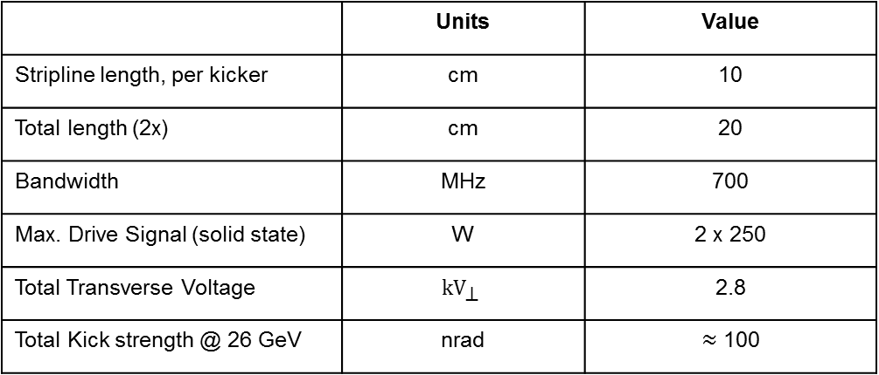
Brainstorming for MDs – before CC Installation (1)
Can we generate a test pattern similar to what is expected with active crabbing?
Driven transverse excitation, CW 400.79 MHz (bunch synchronous)
Use → wideband kickers in BA3 (BW up to 700 MHz)
Implement remote control interface
enable/disable excitation (timing)
adjust drive level and RF phasing
drive modulation (AM, PM)
Two new stripline kickers installed and available now (2016):
Two striplines at 55 GeV: 51 nrad, sufficient to do head-tail with +/- 51 nrad,
measure this quantitatively in 2016
 | Units | Value
Stripline length, per kicker | cm | 10
Total length (2x) | cm | 20
Bandwidth | MHz | 700
Max. Drive Signal (solid state) | W | 2 x 250
Total Transverse Voltage | $$\text{k}{\text{V}}_{\text{⊥}}$$ | 2.8
Total Kick strength @ 26 GeV | nrad | $≈$ 100
NB: no advantage for crab cavity tests (400 MHz) of slotline

Slide 14
Brainstorming for MDs – before CC Installation (2)
Can we detect & resolve this excitation with our current instruments?
SPS Damper [even & odd modes] → quantify Damper sensitivity to intra-bunch motion
Prepare Transverse BQM, Transverse Wideband Feedback for diagnostics
Use Head Tail Monitor from BI group
Test Multiband Instability Monitor (MIM)
etc.
Enable CW 400 MHz excitation during injection + damping
Wideband kickers in BA3
Single bunch, multiple bunches
Evaluate impact on injection damping (if any …) → develop adequate metric.
Enable CW 400 MHz excitation during flat bottom + damping
High intensity beams up to 4x72 trains
Modulated CW drive (AM, PM) and
Evaluate impact on coupled bunch instabilities (if any …) → metric?
Mid-Term plan (2017)

Slide 15
Brainstorming for MDs – with CCs in Place (2018)
Assess overall behavior of damper - CC interaction:
CC and TFB during injection → compare results against vs. CC and with driven excitation
CC and TFB throughout the cycle → compare results against vs. CC and with driven excitation
Furthermore / optionally:
Examine CC behavior at the presence of external transvers perturbation signals → inject test patterns (CW, modulated AM/PM)
… in 2018

Slide 16
THANK YOU
Questions?

