Slide 1
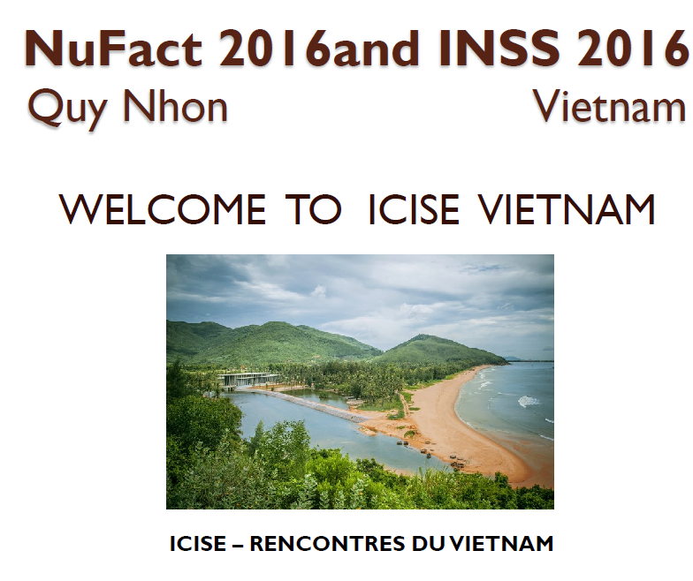
NUFACT15 → NUFACT16

Slide 2
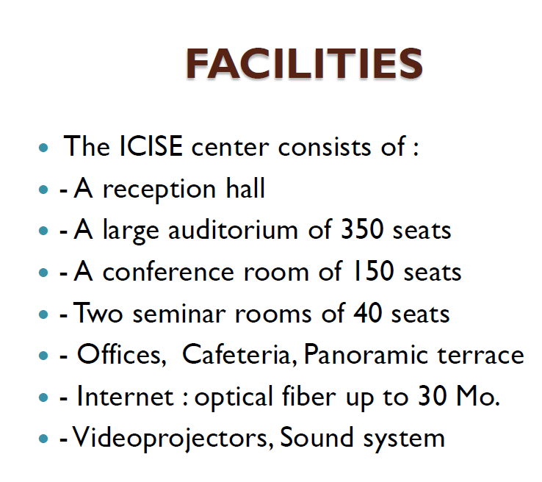
Four rooms
is this enough?
We may need 5.

Slide 3
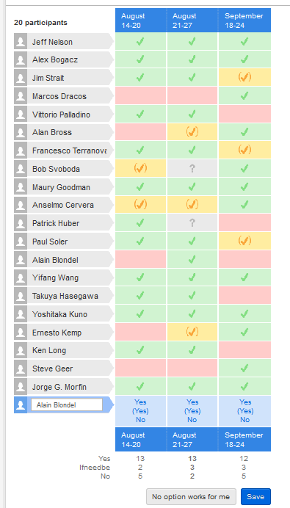
Propose to fix meeting dates
21-27 August 2016

Slide 4
Proposed Scientific Program Committee
Procedure followed previously:
-1- nominate chair:
Takashi Kobayashi has kindly agreed (two days ago)
I agreed to co-chair
➔ suggest to add Kobayashi-san to scientific aims task force
-2- ask previous members if they wish to continue
identify possible additional needs
➔ This second step will depend on outcome of task force
-3- Engage SPC and conveners early 2016 in active participation
towards definition of the program

Slide 5
Since outcome of task force is needed very soon
I would like to request that it is prepared no later than 5 December.
(a ~one page document is enough)
Meanwhile we can ask former SPC members if they want to continue
An urgent task is to complete conveners
-- status of conveners today (→ Vittorio/Jorge?)
-- who is missing -- what more is missing
need full set of committees before Xmas (on month from now)
Then can begin to draft agenda.

Slide 6
Working group | Conveners | Affilliation | comments
WG1: neutrino oscillation physics | Alex Sousa → Alex Himmel Mark Hartz Francesca Di Lodovico | Fermilab USA Kavli IPMU, Japan Queen Mary U. of London, UK
WG2: neutrino scattering physics | Kendall Mahn → Gabe Perdue Hide-Kazu Tanaka Marco Martini | MSU, USA ICRR, Japan Gent/Saclay, France
WG3: accelerator physics | Pavel Snopok → Ben Freemire Jingyu Tang Chris Densham | IIT, USA IHEP, China STFC, UK
WG4: muon physics | Andrew Norman → Craig Group Haibo Li Angela Papa | FERMILAB, USA IHEP, China PSI, Switzerland
? ex: sterile and right handed neutrinos ? | ? ? | ? ?

Slide 7
General remarks:
-- would like to avoid calling off conveners who agreed to continue.
-- but if we change orientations we may require some bevelling.
-- I noted that there was neither ‘scientific orientation’ nor ‘scientific conclusions’ talks at NUFACT15 -- so it is difficult to understand from the outside where it was all going.
There were as conclusions talks on where it is going in «Asia» and «Europe + US» which in itself bears some bias: where do I fit if a European works on Juno or T2K or HyperK?
-- there is a growing activity in searches for sterile and right handed neutrinos (normally the same but in practice used in different context).
I would propose to integrate this in the aims somehow.

