Slide 1
CLIC Cost at 3 TeV and 500 GeV
CDC meeting, 9.12.2008
Hans-H. Braun for CLIC cost & Schedule WG
Mick Draper, Katy Foraz, Claude Hauviller, Bernard Jeanneret,John Andrew Osborne, Germana Riddone, Pierre Strubin and Sylvain Weisz
- Cost estimate at 3TeV & 0.5 TeV distributed according to PBS
- Status and plans of cost study

Slide 2
2008 activities of CLIC cost & schedule WG
Established PBS
Reorganized 2007 estimate to adapt it to PBS (incl. CTC modifications)
Scaled estimate to 500 GeV version
Established specifications for cost estimate software tool
(see EDMS#975066)
Launched development for cost estimate software tool in IT / AIS
Established template and organization structure for cost database input
Established schedule for underground construction and installation
Established coloaboration with ILC cost WG.
Presently mostly on exchanged of informations.

Slide 3
CLIC material cost estimate for 0.5 TeV and 3 TeV
Estimate basis is same as end 2007, but adapted to new PBS structure
Scaling to 0.5 TeV for time being
very simplistic & optimistic

Slide 4
CLIC material cost estimate main beam for 0.5 teV and 3 TeV relative to 3 TeV total
Estimate basis is same as end 2007, but adapted to new PBS structure

Slide 5
CLIC material cost estimate drive beam for 0.5 teV and 3 TeV relative to 3 TeV total
Estimate basis is same as end 2007, but adapted to new PBS structure

Slide 6
CLIC material cost estimate CE and Services for 0.5 teV and 3 TeV
relative to 3 TeV total
Estimate basis is same as end 2007, but adapted to new PBS structure
Scaling to 0.5 TeV for time being
very simplistic & optimistic

Slide 7
Cost tool
Standardised EXCEL template to provide input
Development of tool at CERN using Excel DBE, oracle database and web interface similar to existing CERN management tools
(M. Draper, J. De Jonghe)
  first prototype ready by 2nd quarter 2009
  final version by end of 2009

Slide 8
Input Template 1/3

Slide 9
Template 2/3

Slide 10
Template 3/3

Slide 11
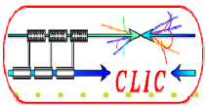
Definition of roles
Role of the coordinator (PBS, levels 2 and 3)
  Gather technical specifications, total numbers, delivery schedule
  Cost estimate from experts based on cost template
  Provide preliminary levels 2 and 3 estimates (even when level 4 is not available)
  Filling template for level 4 estimate based on input from experts
  Archive the system filled templates in EDMS
Role of experts
  Provide cost estimate input for the related system (PBS level 4)
Role of accountant, M. Draper
  Put all the numbers together

Slide 12
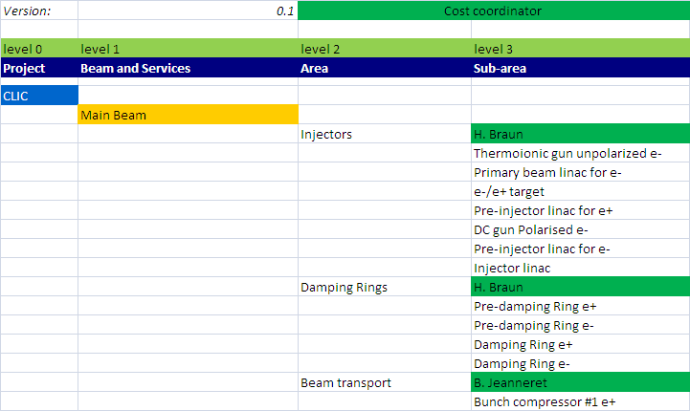
PBS levels 2 and 3 cost coordinators

Slide 13
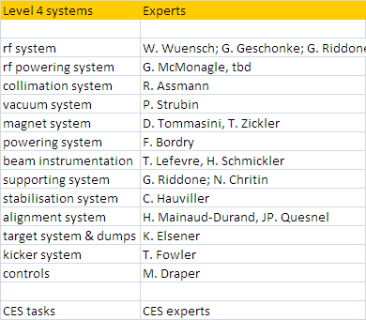
PBS level 4 experts

Slide 14

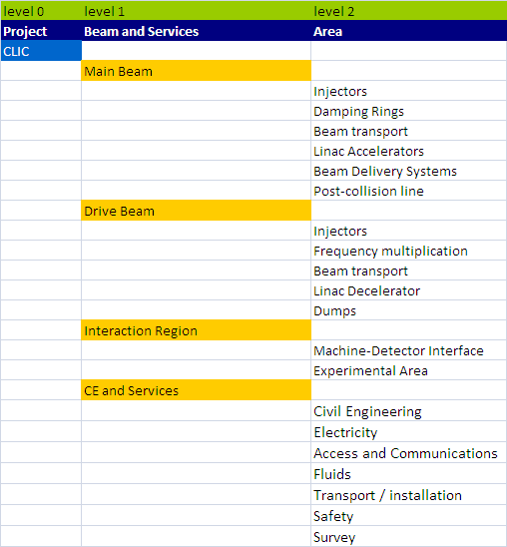
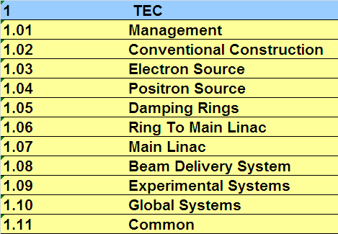
PBS comparison
CLIC
ILC

Slide 15
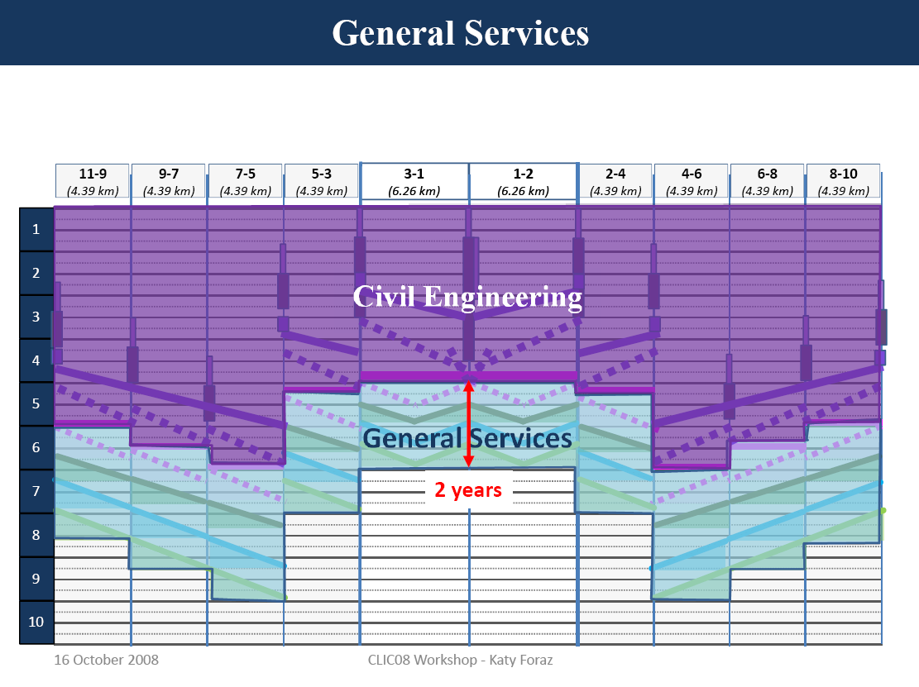

Slide 16
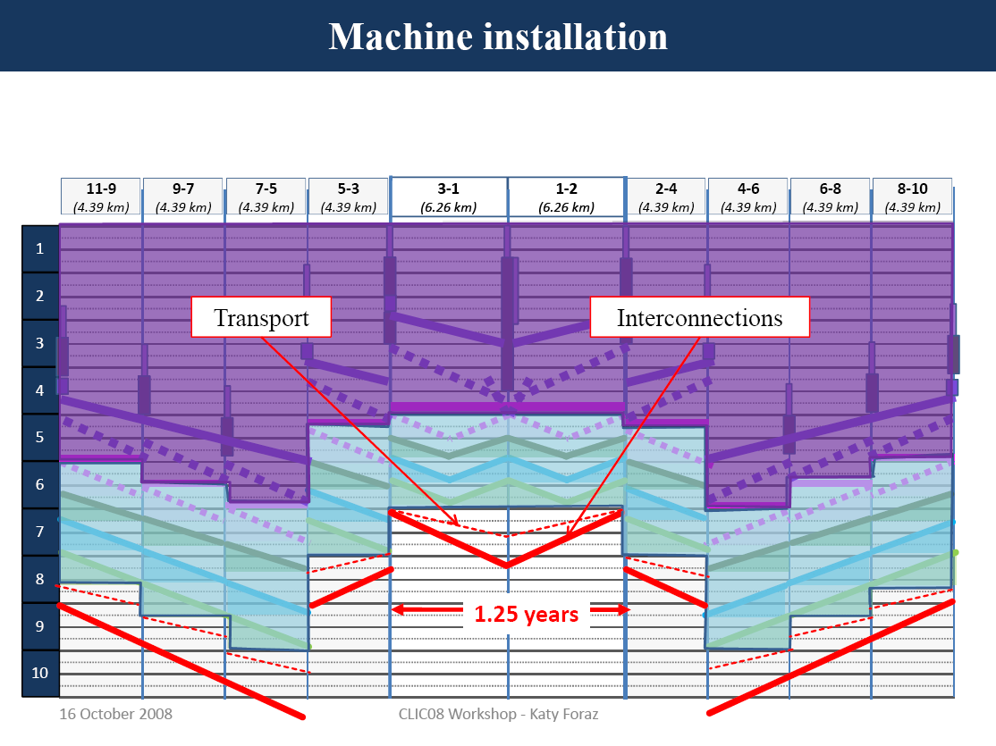

Slide 17
Cost & Schedule Future work
Schedule for PBS level 2 areas (K. Foraz)
Preparation of templates (coordinators)
  Schedule information
  Number of units
Filling of template (coordinators) with input from experts (archive in CERN EDMS structure)
Selected area estimates
- 2-beam module to be ready by Jan 09
- BDS based on ILC estimate
Full cost estimate to be ready by end of 09
Tool development in 2009 (prototype by 2Q 09, final version by end of 09)
Continue exchange with ILC colleagues (next WEBEX this Thursday)

Slide 18
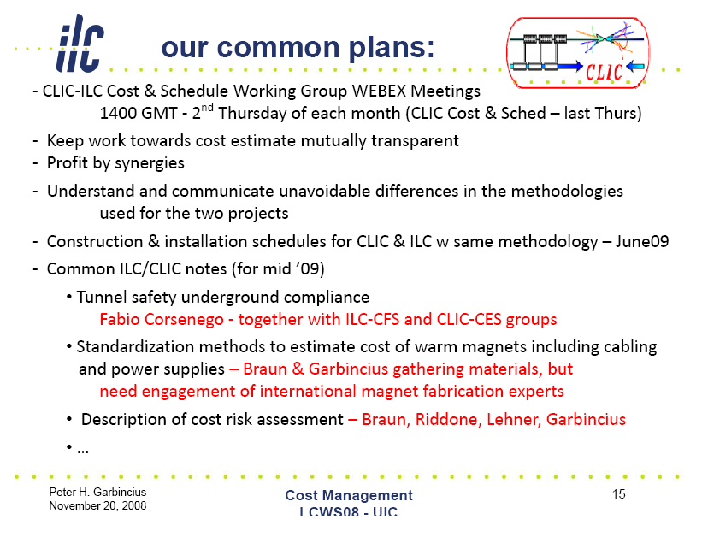
ILC-CLIC cost & schedule WG

Slide 19
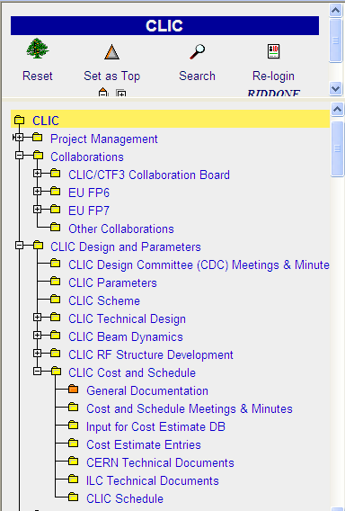
Documentation
Main documents available in EDMS
“Restricted access”

