Slide 1

Cosmology Perspectives
Professor George F. Smoot
Chaire Blaise Pascal
Paris Center for Cosmological Physics (PCCP)
Université Sorbonne Paris Cité - Université Paris Diderot – APC
Berkeley Center for Cosmological Physics
LBNL & Physics Department University of California at Berkeley
Notes:
Origin of Life and Implications for human well being.

Slide 2
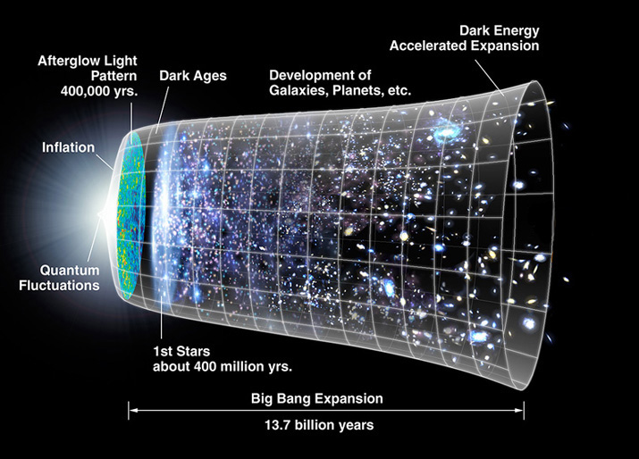
宇宙的簡史 Breve historia del universo; Brève histoire de l’univers
Lịch sử của vũ trụ
Краткая история Вселенной 우주의 간단한 병력 검사
Brief History of the Universe

Slide 3
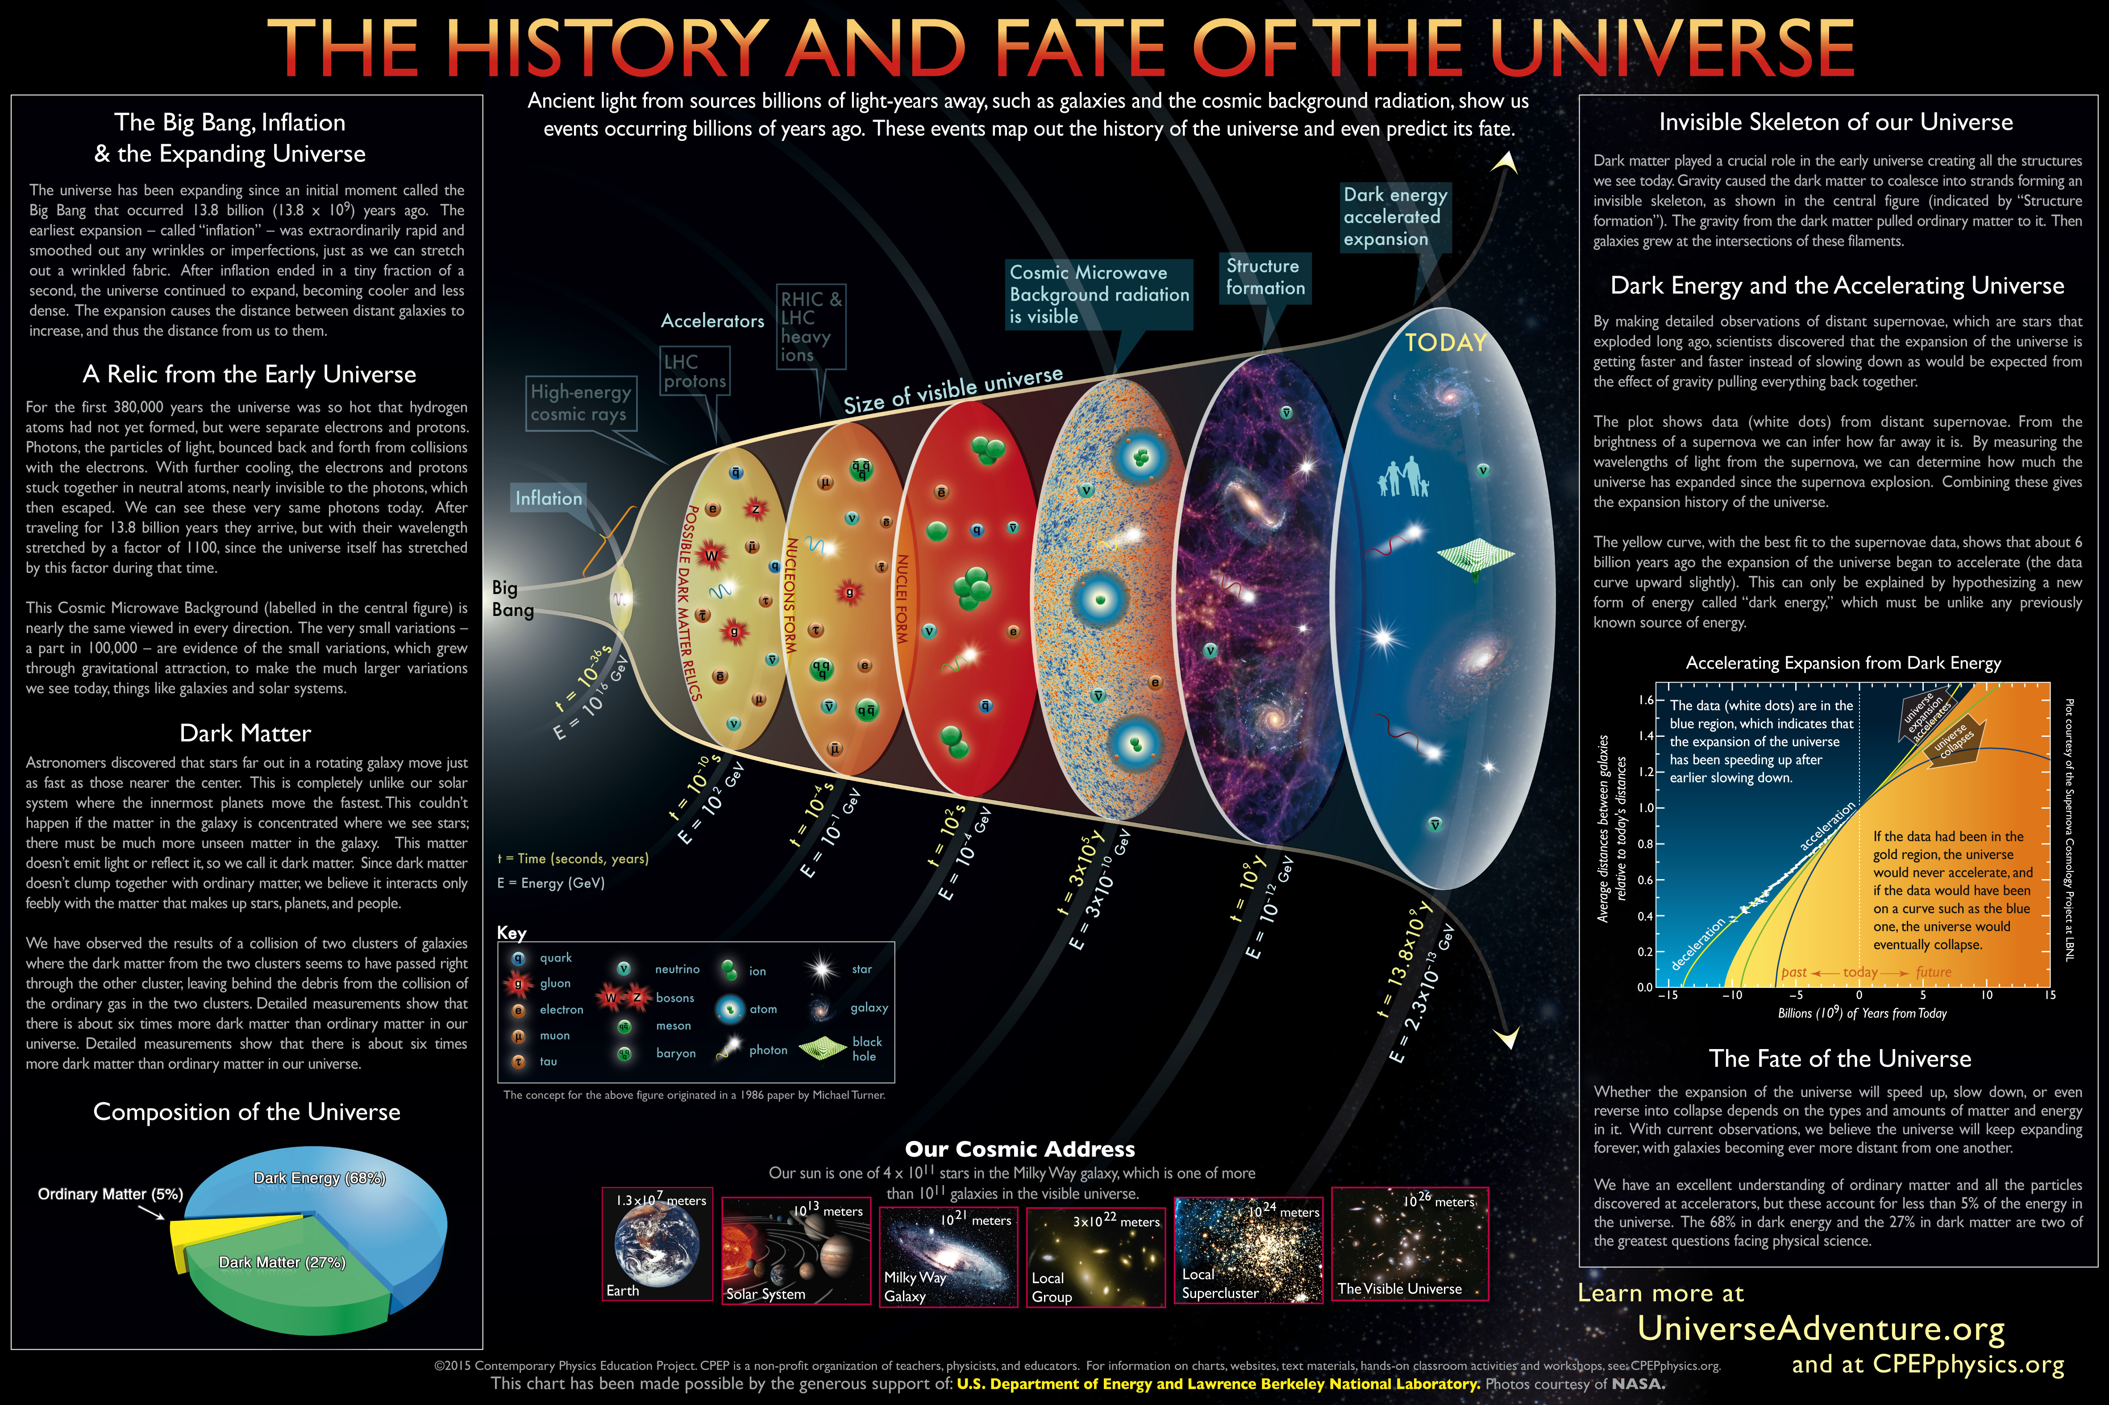

Slide 4
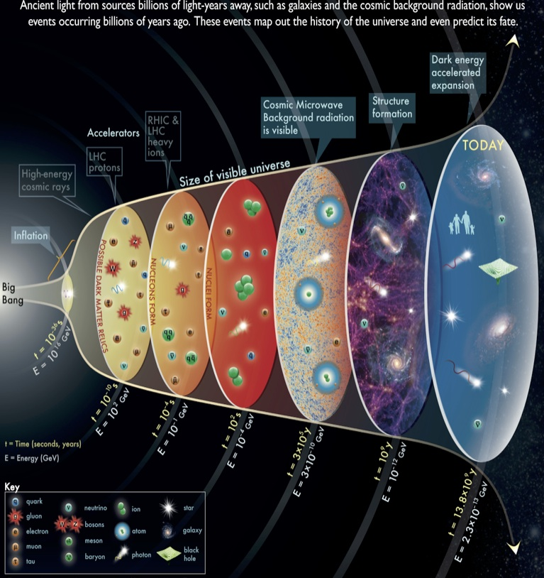

Slide 5
Particle (HEP) Physics vs Cosmology
Beginning Three Decades Ago
Standard Model Particle Physics formulation was finalized in the mid-1970s upon experimental confirmation of the existence of quarks
top quark (1995)
tau neutrino (2000)
the Higgs boson (2013)
Marked by continuing improved precision and rigour.
Physics Beyond the SM?
Neutrino Oscillation; mass: Solar (60’s-2002), Atmospheric (1998), Reactor (2002), Beam (2000s)
Cosmology
Many things not known or at least not better than factor of 2
CMB discovered (1965), found to be blackbody (1991), Anisotropy (1992), exploitation ever since leading towards precision and eventually to rigour.
Baryogensis concept (1967) by Andre Sakharov
Dark Matter suspected (70’s)
Inflation proposed (1980)
Accelerating Universe (1998)
Still unsolved issues

Slide 6
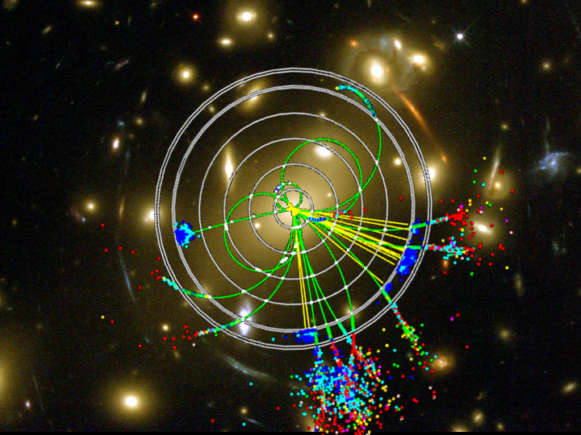
COLLIDER PHYSICS AND COSMOLOGY

Slide 7


Understanding Physics with LHC
Based on three legs:
Finding the Higgs
Supersymmetry (& extra dimensions)
Cosmology
  Dark Matter
  Baryogenesis
  Inflation / extra d
  Dark Energy
LHC Physics
Higgs
Boson
Cosmology
Supersymmetry,
Extra Dimensions

Slide 8
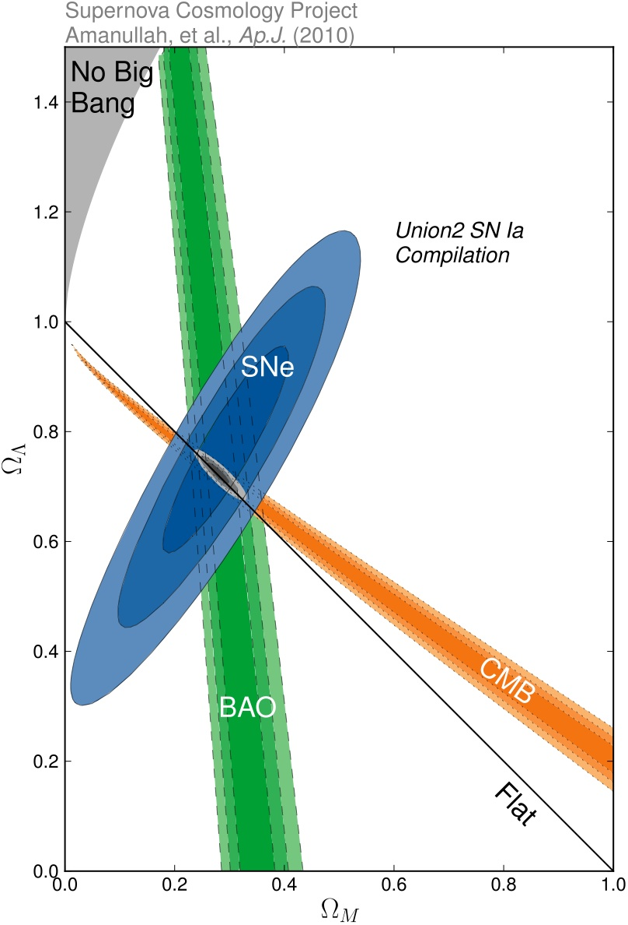
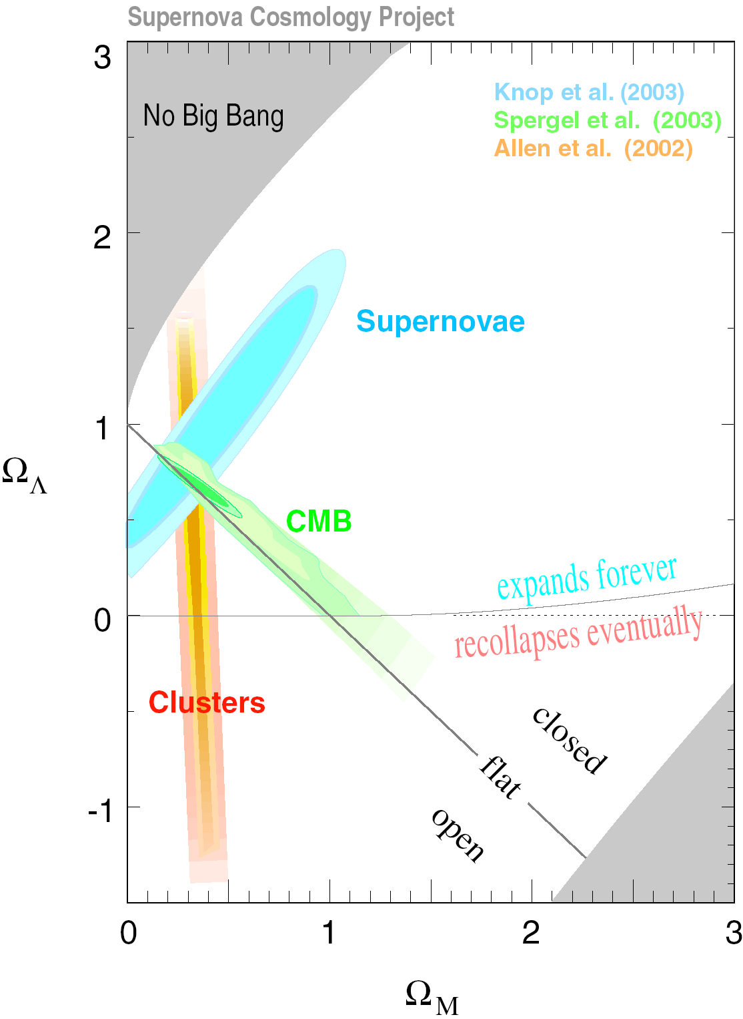
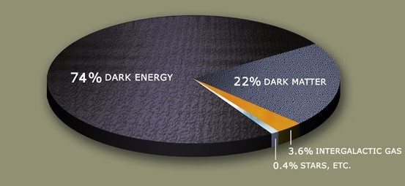
COSMOLOGY NOW
Remarkable agreement
Dark Matter: 23% ± 4%
Dark Energy: 70% ± 4%
Baryons: 4.5% ± 0.4%
Neutrinos: 2% (Σm_{ν}/eV)
Remarkable precision
Remarkable results

Slide 9
OPEN QUESTIONS
DARK MATTER
  What is its mass?
  What are its spin and other quantum numbers?
  Is it absolutely stable?
  What is the symmetry origin of the dark matter particle?
  Is dark matter composed of one particle species or many?
  How and when was it produced?
  Why does Ω_{DM} have the observed value?
  What was its role in structure formation?
  How is dark matter distributed now?
DARK ENERGY
  What is it?
  Why not Ω_{Λ} ~ 10¹²⁰?
  Why not Ω_{Λ} = 0?
  Does it evolve?
BARYONS
  Why not Ω_{B} ≈ 0?
  Related to neutrinos, leptonic CP violation?
  Where are all the baryons? Anti-baryons

Slide 10
THE DARK UNIVERSE
The problems appear to be completely different
  DARK MATTER
  DARK ENERGY
  INFLATION
  No known particles contribute
  All known particles contribute
  Apparently no known particles contribute
  Probably tied to
  M_{weak} ~ 100 GeV
  Possibly tied to
  M_{Planck} ~ 10¹⁹ GeV
  Probably tied to
  M_{Planck} ~ 10¹⁹ GeV
  Several compelling solutions
  No compelling solutions
  No compelling solutions

Slide 11
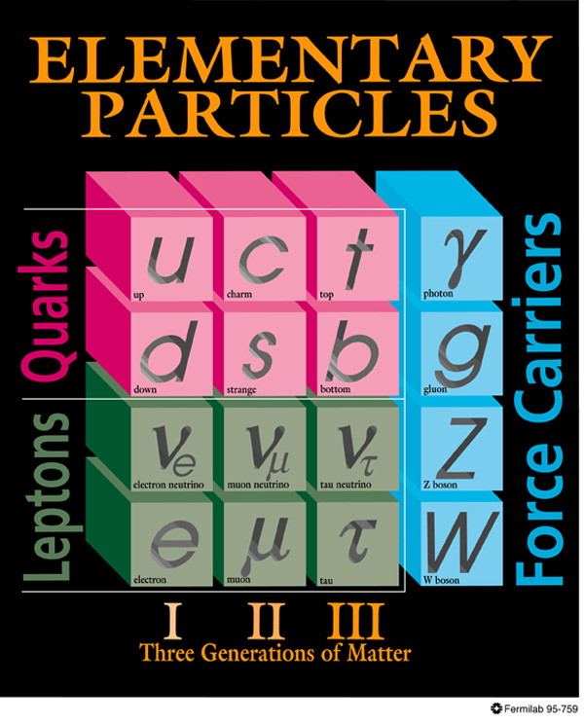
DARK MATTER
  Known DM properties
  Gravitationally interacting
  Not short-lived
  Not hot
  Not baryonic
  Unambiguous evidence for new physics

Slide 12
DARK MATTER CANDIDATES
The observational constraints are no match for the creativity of theorists
Candidates: primodial black holes, axions, warm gravitinos, neutralinos, sterile neutrinos, Kaluza-Klein particles, Q balls, wimpzillas, superWIMPs, self-interacting particles, self-annihilating particles, fuzzy dark matter,…
Masses and interaction strengths span many, many orders of magnitude, but not all candidates are equally motivated

Slide 13
IDENTIFYING DARK MATTER
Are Ω_{collider} and Ω_{cosmo} identical?
Calculate the new
Ω_{hep}
Yes
No
Yes
Congratulations! You’ve discovered the identity of dark matter and extended our understanding of the Universe to T=10 GeV, t=1 ns (Cf. BBN at T=1 MeV, t=1 s)
Which is bigger?
Did you make a mistake?
Yes
Ω_{cosmo}
Ω_{collider}
No
Yes
No
No
Does it
decay?
Can you discover another particle that contributes to DM?
Are you sure?
Yes
No
Yes
Can you identify a source of entropy production?
No
Think about
dark energy
No
Yes
No
Does it account for the rest of DM?
Can this be resolved with some non-standard cosmology?
Yes

Slide 14


Slide 15
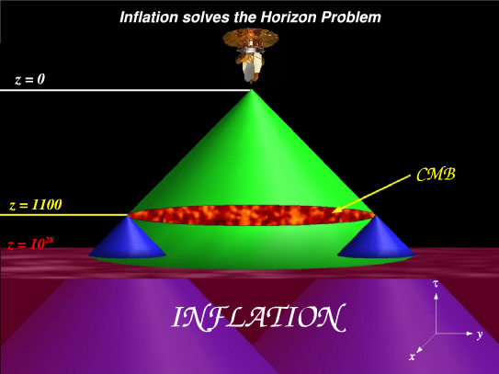

Slide 16
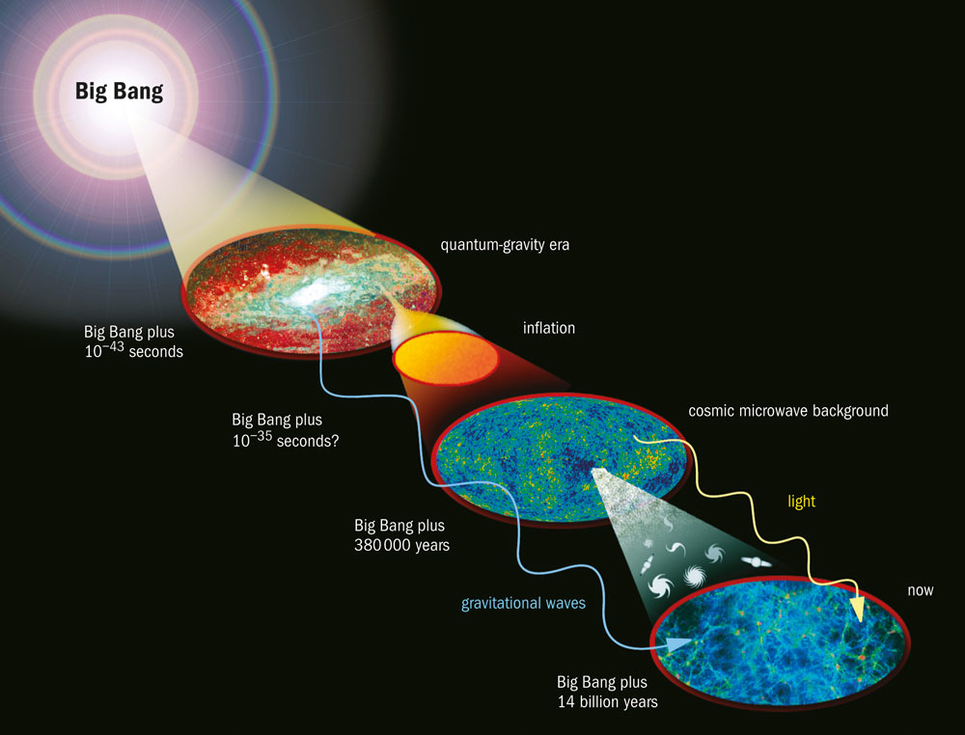

Slide 17
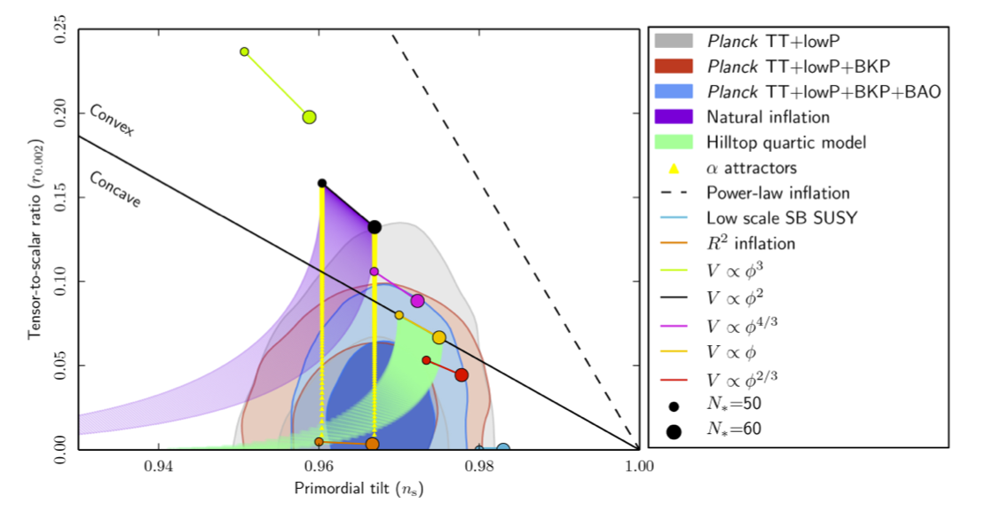
Planck 2015 Constraints on Inflation
Calls for quite flat potential

Slide 18
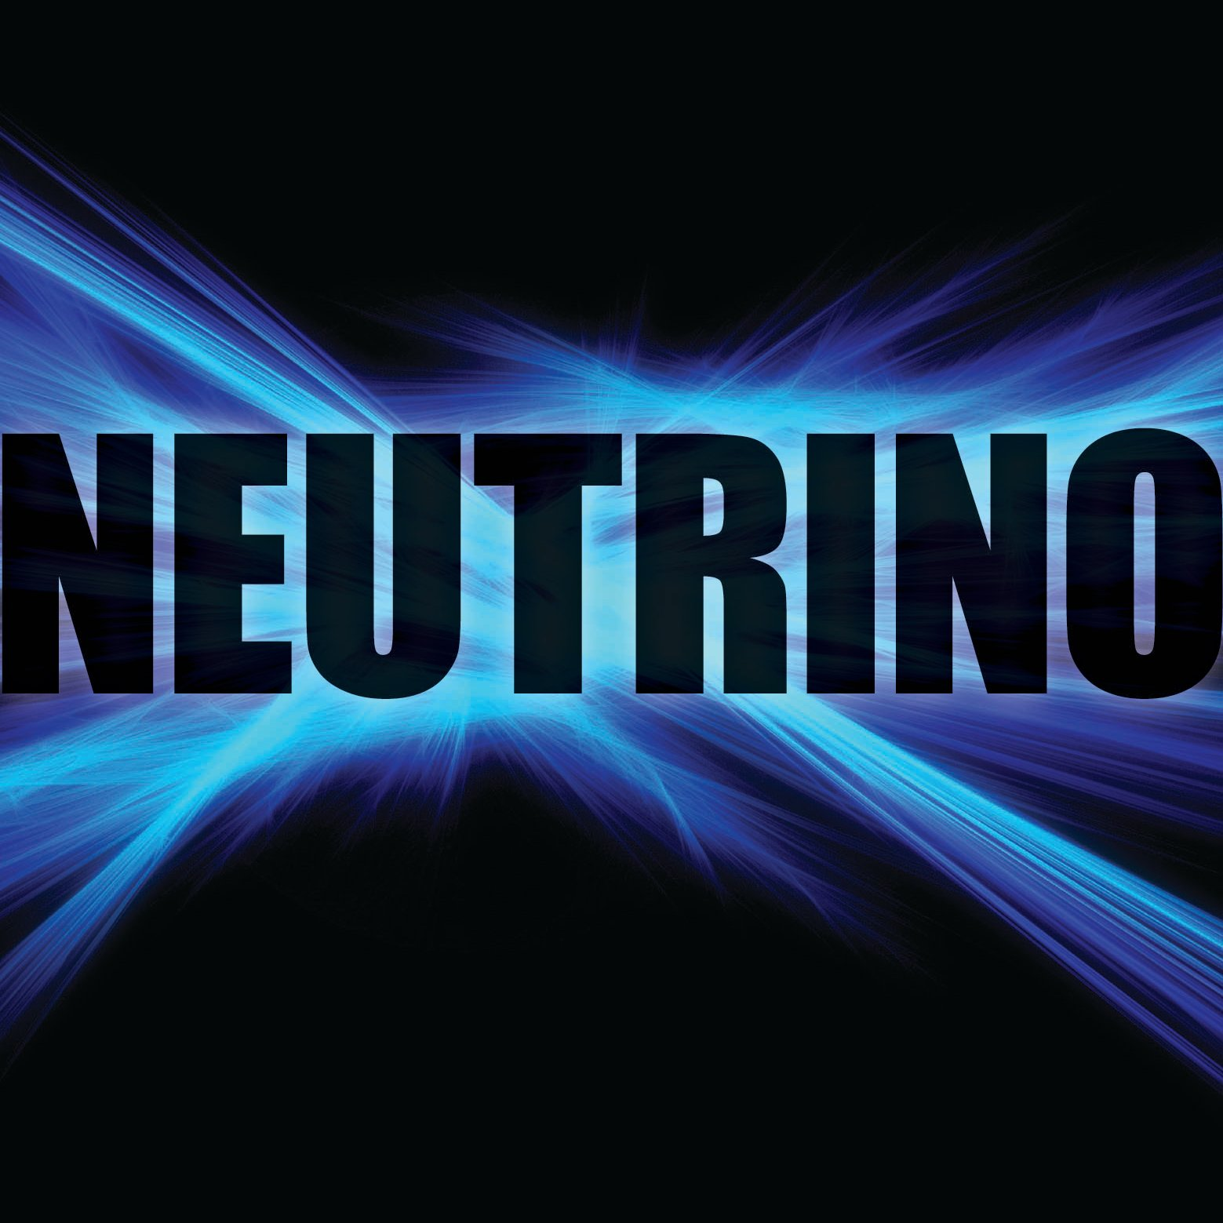

Slide 19
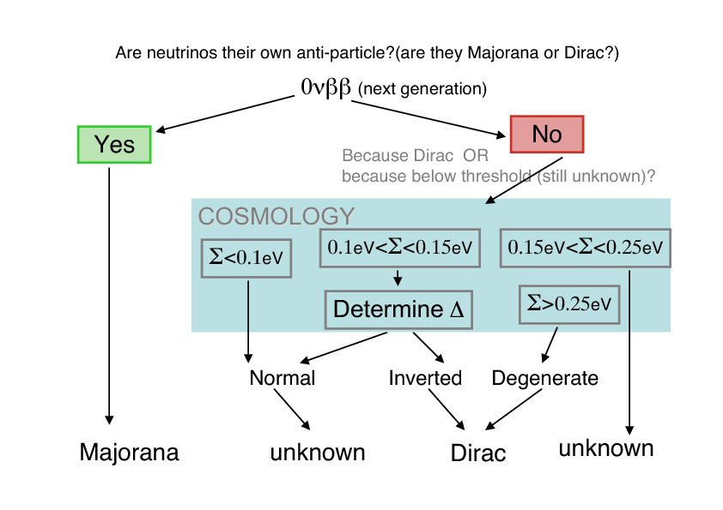
From Raul Jimenez

Slide 20
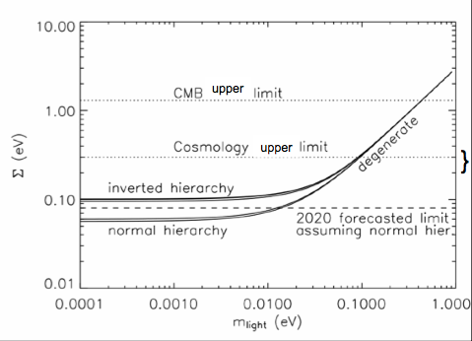
CMB and Cosmology Limits on Neutrinos
From Lucia Verde
Notes:
Overview of the constraints in neutrino masses: the solid lines show the constrains from oscillations. The dotted horizontal lines show the cosmology constraints (cosmology constrains the total mass) and the dashed horizontal line shows the forecasted limit for cosmological data that will (if all goes according to plans) be available in 2020. The bracket on the right hand side shows the forecasted constraints (in the next year or so) from the Katrin experiment. From Lucia Verde

Slide 21
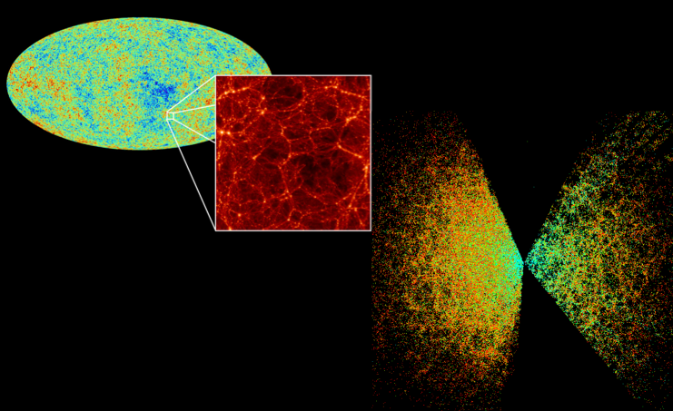
Cosmology Limits on Neutrinos

Slide 22

Cf. Ph.D. Forum talks

Slide 23
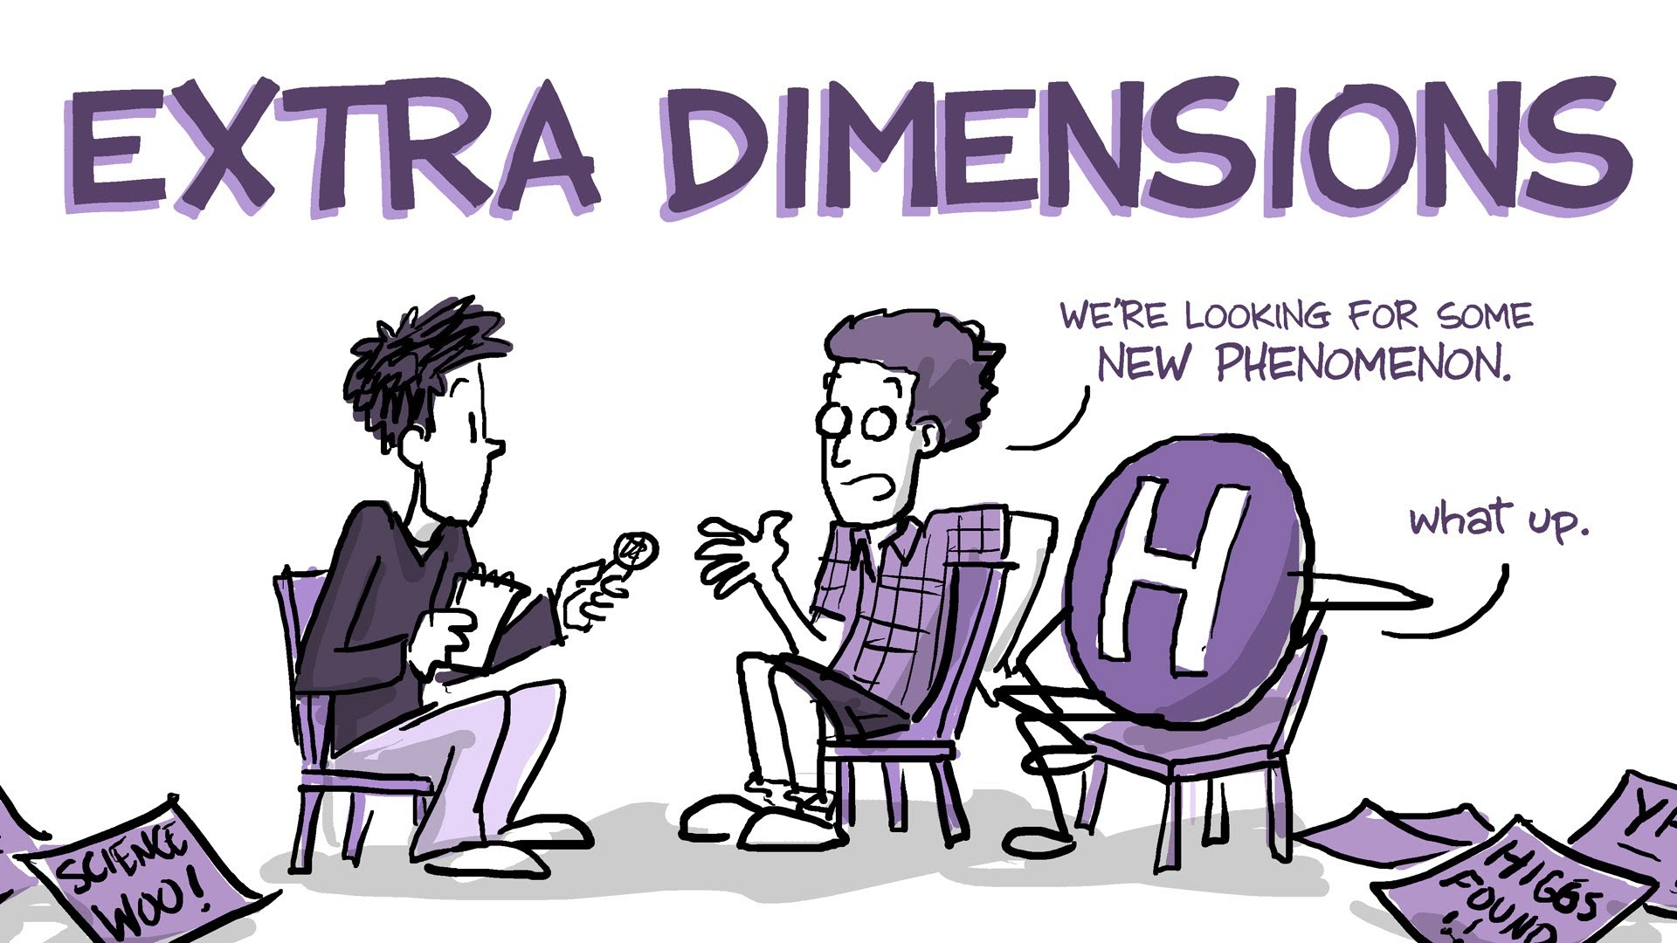

Slide 24
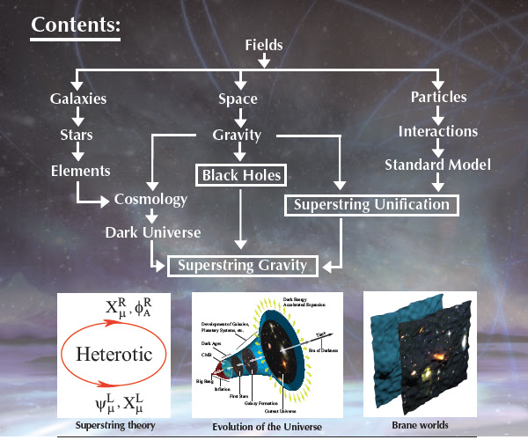
Movie: What to do with LHC now that the Higgs is discovered?

Slide 25
Conclusions Cosmology Perspectives
The joining of cosmology and HEP has been fruitful; especially in terms of motivating new physics and concepts
Most of the flow for new physicshas been from cosmology to HEP; however, we can hope that it will also soon flow the other way and HEP will give ideas and observations that point the way for cosmology
Note: that standard model of cosmology is based upon General Relativity (100 yrs old) and SM Particle Physics (~40 yrs) both for calculations and ideas of how to add mechanisms & components

