Slide 1

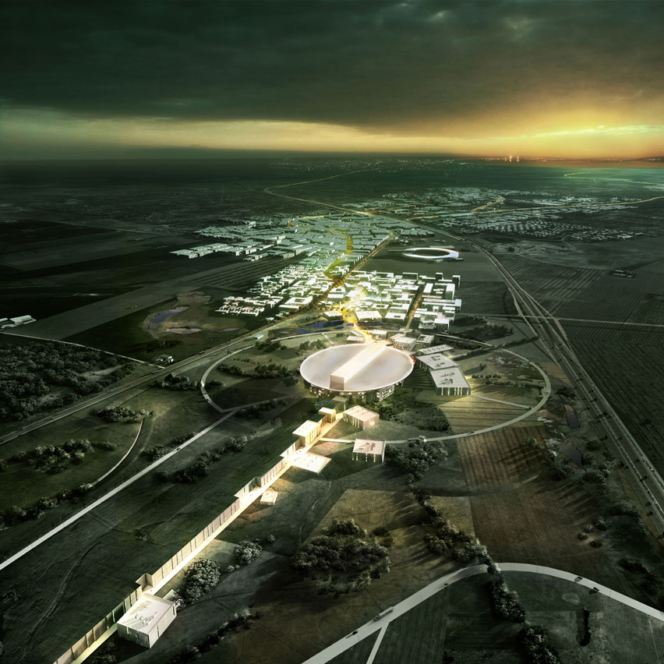
ESSnuSB
Project for Leptonic CP Violation Discovery based on the European Spallation Source Linac
ESSnuSB
Elena WILDNER
CERN
for the ESSnuSB Collaboration

Slide 2



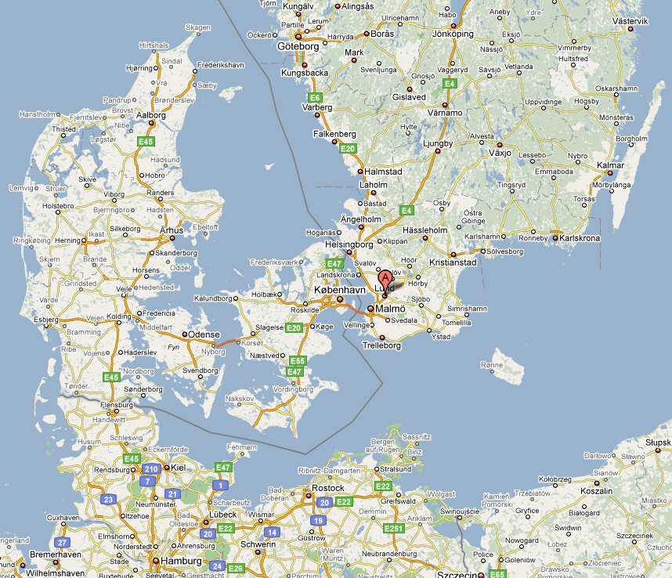


The European Spallation Source (ESS)
ESS is a neutron spallation source that is being built by a collaboration of 17 European countries.
ESS is located in southern Sweden (Lund)
ESS Technical Design Report, April 23, 2013, ESS-doc-274
http://europeanspallationsource.se/documentation/tdr.pdf

Slide 3
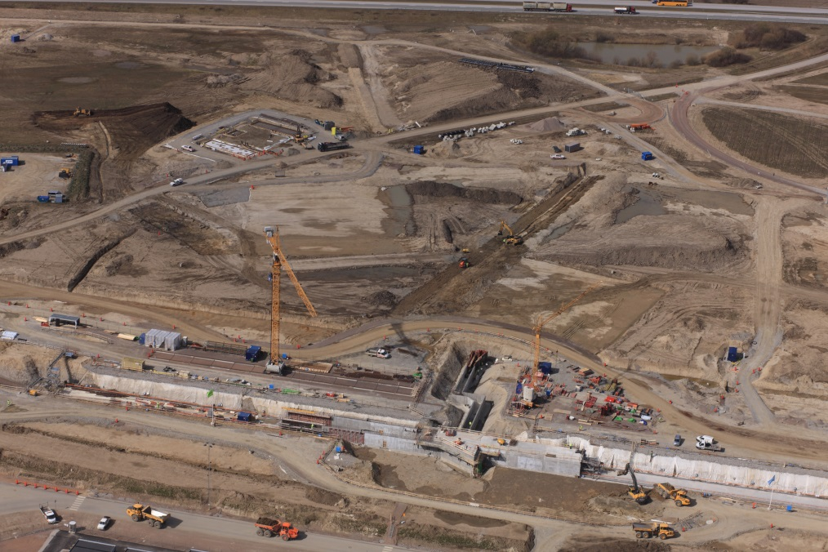
The linac tunnel on 10 april 2015

Slide 4

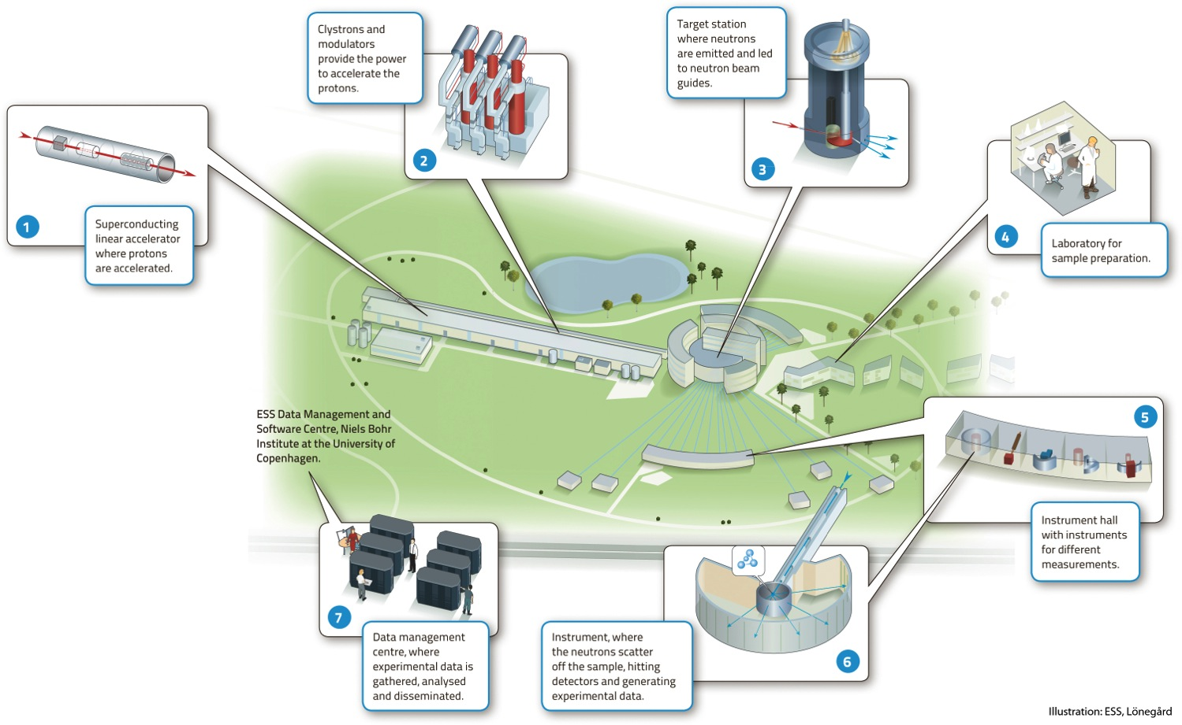


ESS as proton driver for spallation

Slide 5
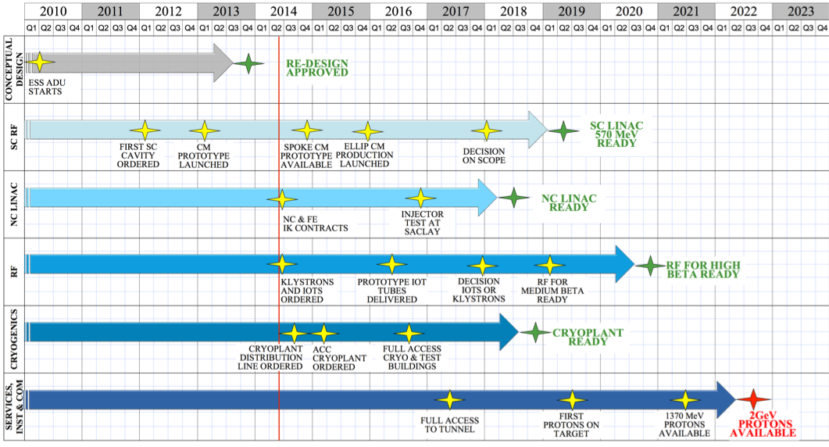
ESS LINAC PROJECT SCHEDULE
6
6

Slide 6
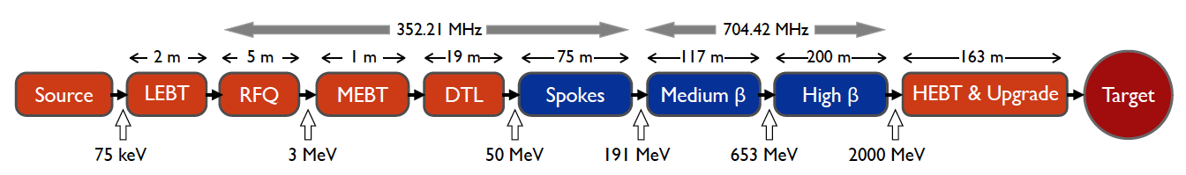
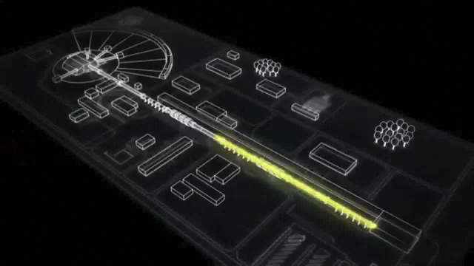
ESS 5MW proton linac
The ESS will be a copious source of spallation neutrons
5 MW average beam power
125 MW peak power
14 Hz repetition rate (2.86 ms pulse duration, 10¹⁵ protons)
2.0 GeV protons (up to 3.5 GeV with linac upgrades)
ESS Technical Design Report, April 23, 2013
ESS-doc-274
http://europeanspallationsource.se/documentation/tdr.pdf

Slide 7
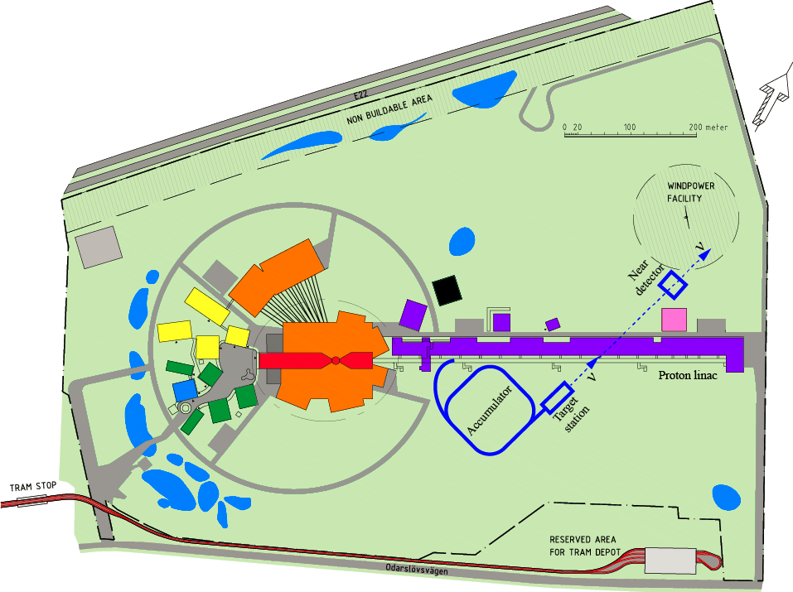
ESSnuSB on ESS site
> 2 GeV
2 GeV
p
H⁻
Neutron
spallation
target
Target Station 25 m below ground level
Decay tunnel under the linac!
URGENT STUDY of ground water!
Bending Radius:
133 m for 3 GeV
(70 m for 2 GeV)

Slide 8
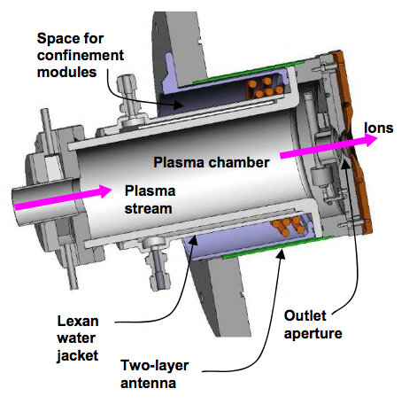
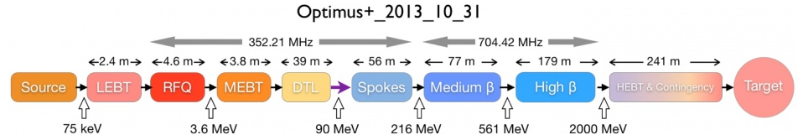
ESS H- acceleration for neutrinos
?
H-
?
The ESS linac for neutron spallation: proton acceleration 14 Hz
Duty factor low (4%); some additional capacity is available
Repetition rate can be increased to permit extra acceleration cycles (total power of extra cycles 5 MW)
ESS would accelerate in total 10 MW!
Charge in the accumulator 1.1 10¹⁵ protons 2 GeV, big challenge
>2.7x10²³ 2 GeV p.o.t/year

Slide 9
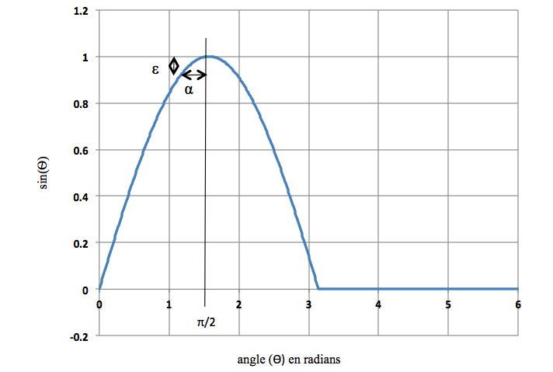
ESS Accumulator for neutrino production
Constraints on present neutrino target focusing system: short pulses
Solution: reduce beam pulse length:
  Shorten the linac pulse by accumulating the linac beam
Accumulator constraints
  Reasonably-sized accumulator ring circumference and apertures
  Multiturn injection of high intensity linac beam: we need H-
  High intensities may cause collective effects and beam loss
τ_{H} 1.5 μs
τ₀ = 100 μs

Slide 10
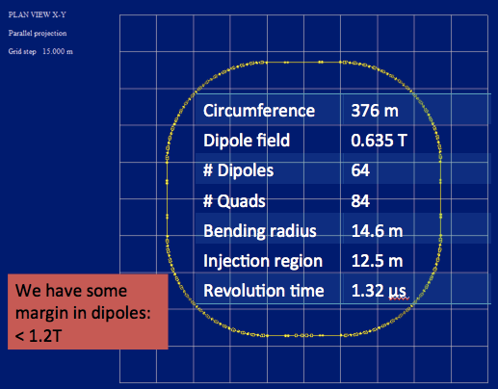
ESS Accumulator for neutrino production (II)
Accumulator lattice based on Spallation Neutron Source, Oak Ridge
Layout optimization and beam dynamics
Transfer lines and extraction of beam from linac
Switchyard

Slide 11
Linac Pulsing, options
Neutrino (H- -pulse)
Neutron (proton pulse)
71.4 ms, 14 Hz
35.7 ms
Insert one H- pulse 28 Hz
May need several accumulators
28 Hz
2.86 ms
71.4 ms, 14 Hz
Mitigation of charges in accumulator: shorter pulses, higher pulsing requency of linac.
Implies some overhead (cavity filling)
14.28 ms
70 Hz
0.7 ms
2.86 ms

Slide 12
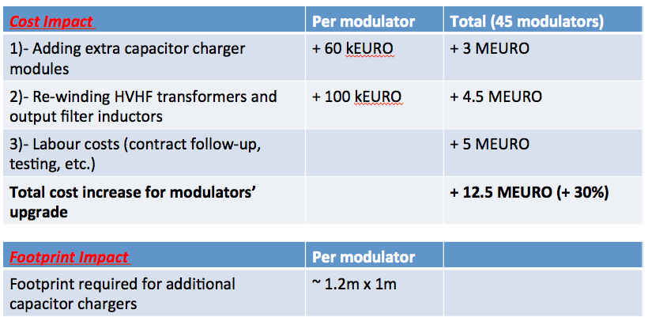
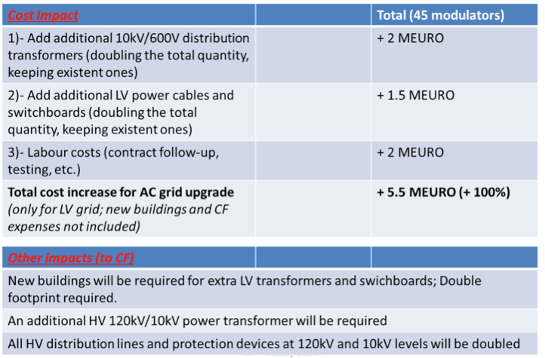
The Linac has to be upgraded
To be prepared for preferably at an early stage
List of need prepared and taken into consideration by the accelerator division
Some options already built in
Infrastructure upgrades are important to plan for

Slide 13
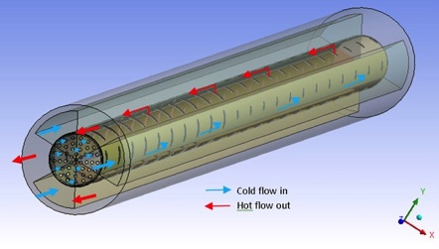
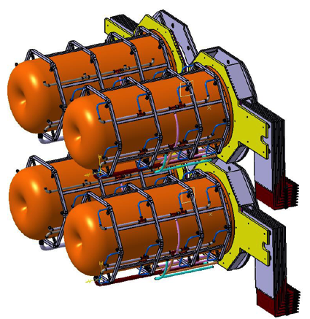
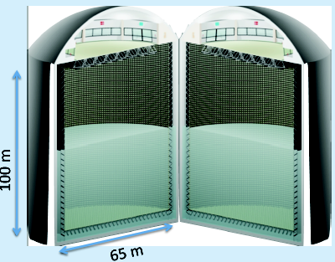
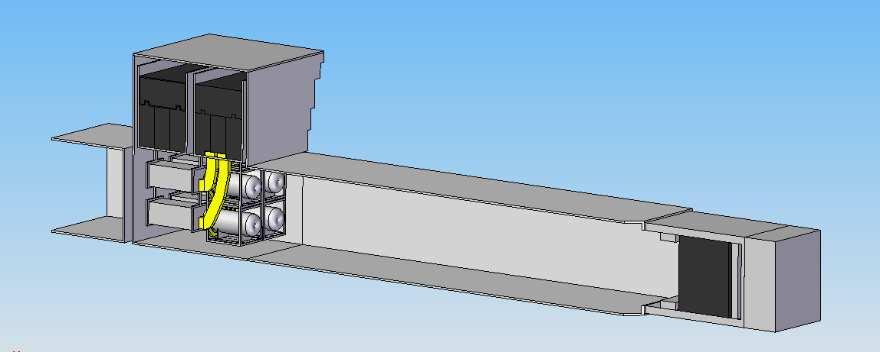
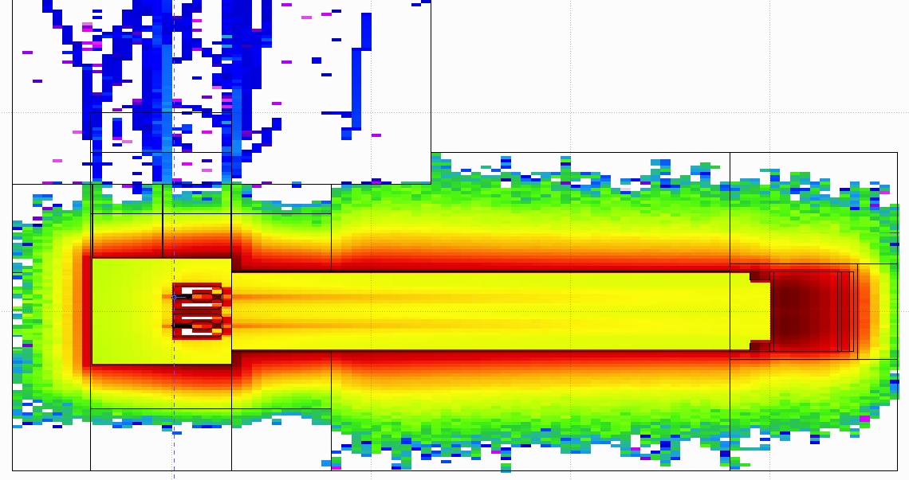
Existing Expertise
ESSνSB
BENE (2004-2008)
ISS (2005-2007)
EUROν (2008-2012)
LAGUNA (2008-2010)
LAGUNA-LBNO (2010-2014)
SNS (USA)

Slide 14
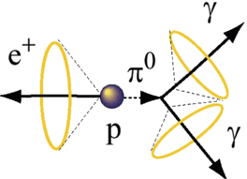
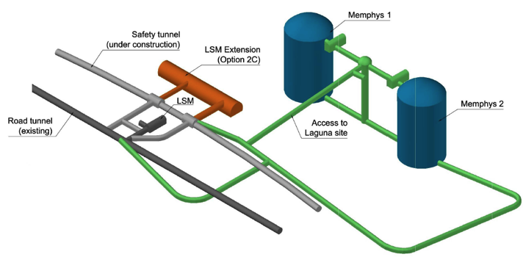
The MEMPHYS WC Detector
(MEgaton Mass PHYSics)
Proton decay
Astroparticles
Understand the gravitational collapsing: galactic SN ν
  Supernovae "relics"
Solar Neutrinos
Neutrino Oscillations (Super Beam, Beta Beam)
Atmospheric Neutrinos
500 kt fiducial volume (~20xSuperK)
Readout: ~240k 8” PMTs
30% optical coverage
(arXiv: hep-ex/0607026)

Slide 15
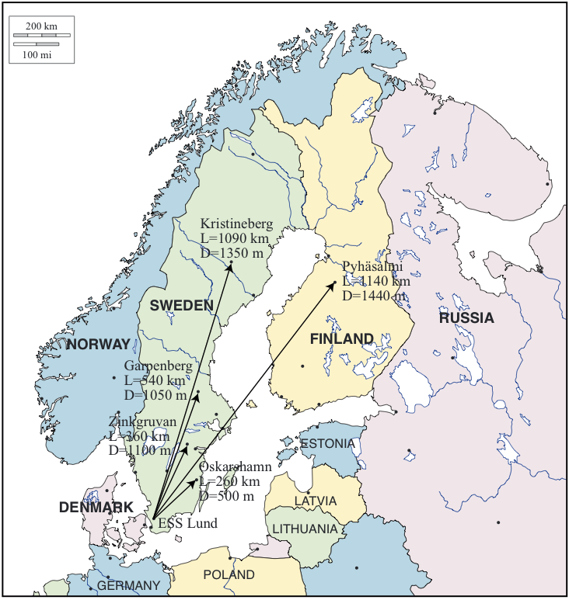
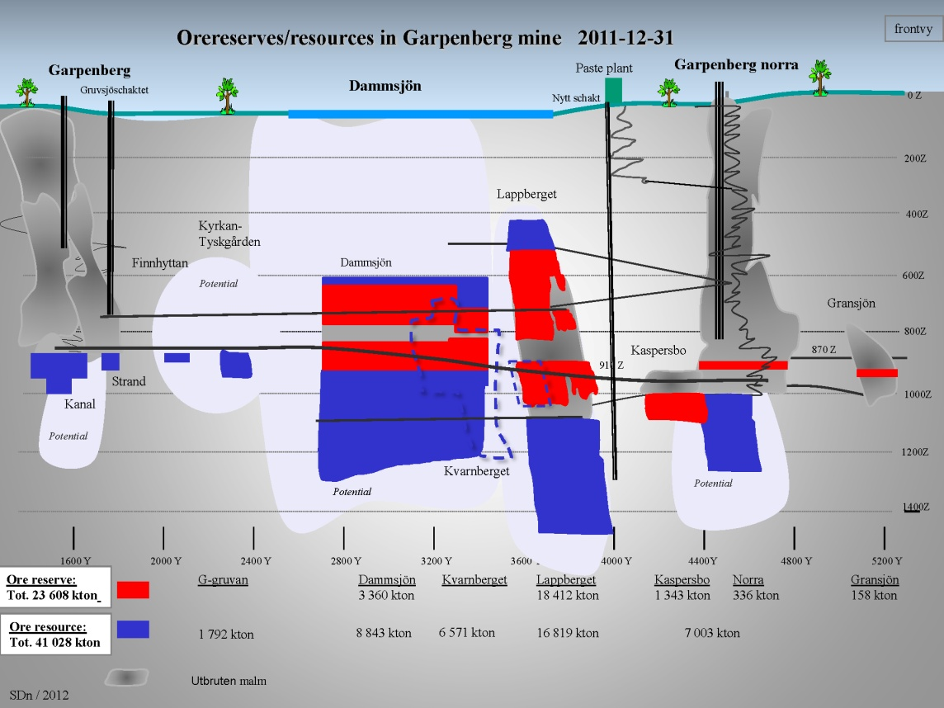
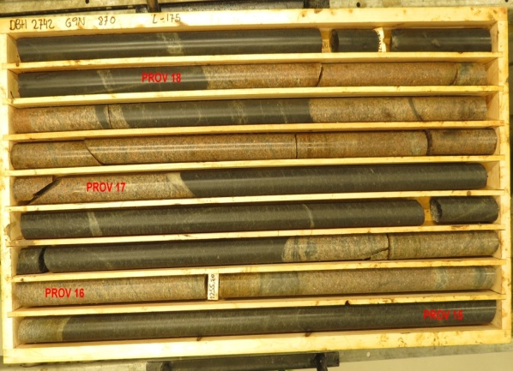
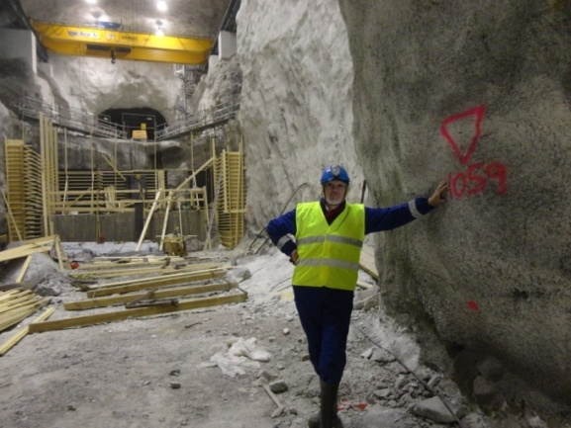
Possible locations for far detector

Slide 16
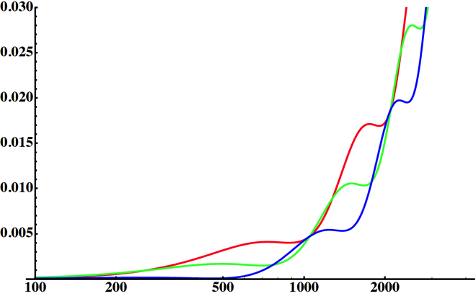
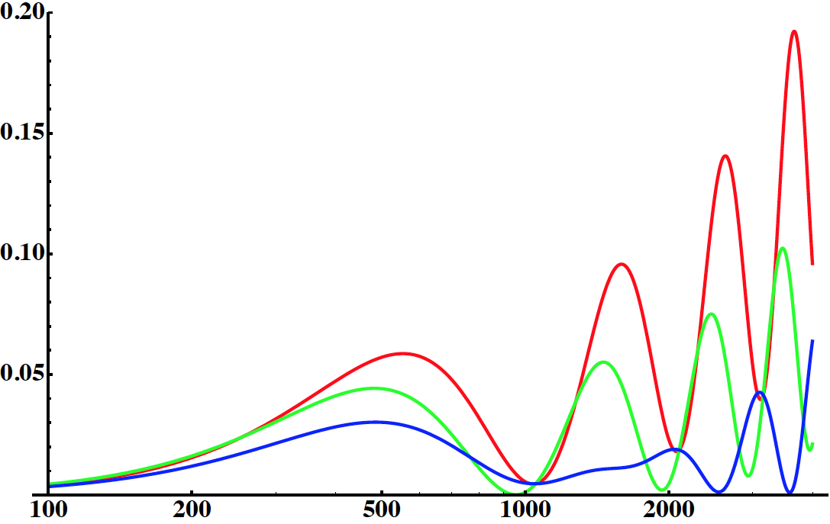
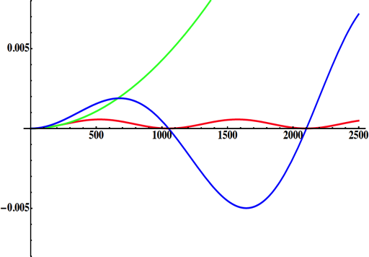
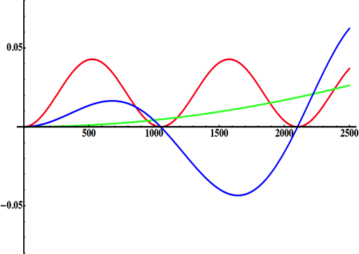
Neutrino Oscillations with "large" θ₁₃
2nd oscillation maximum
P(ν_{μ}→ν_{e})
1st oscillation maximum
θ₁₃=1º
("small" θ₁₃)
δ_{CP}=-90
δ_{CP}=0
δ_{CP}=+90
θ₁₃=8.8º
("large" θ₁₃)
L/E
L/E
solar
atmospheric
for "large" θ₁₃ 1st oscillation maximum is dominated by atmospheric term,
for small θ₁₃ 1st oscillation maximum is better
atmospheric
solar
L/E
L/E
CP interference
(arXiv:1110.4583)
θ₁₃=1º
CP interference
θ₁₃=8.8º
1st oscillation max.: A=0.3sinδ_{CP}
2nd oscillation max.: A=0.75sinδ_{CP}
more sensitivity at 2nd oscillation max.
(see arXiv:1310.5992 and arXiv:0710.0554)

Slide 17
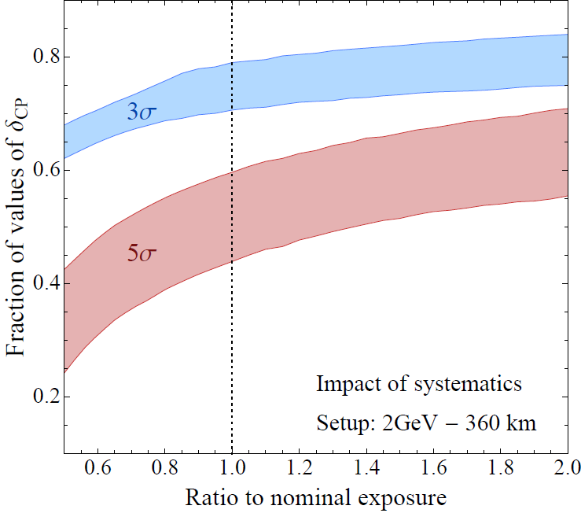
Systematic errors and exposure
for ESSnuSB systematic errors see 1209.5973 [hep-ph] (lower limit "default" case, upper limit "optimistic" case)
P5 requirement: 75% at 3 σ
High potentiality
Neutrino Factory reach
60% of the δ_{CP} range could be reached to at least 5 σ
10 years
20 years
(courtesy P. Coloma)

Slide 18
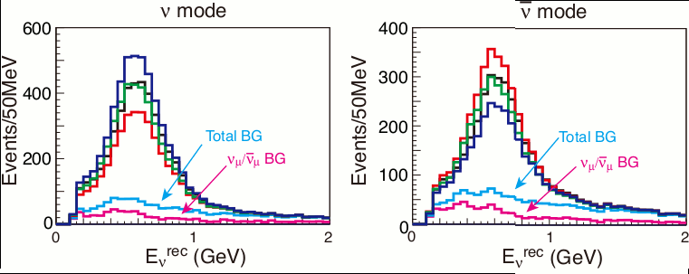
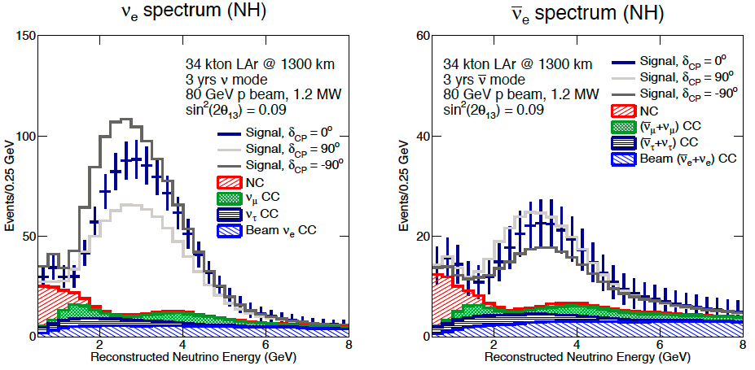
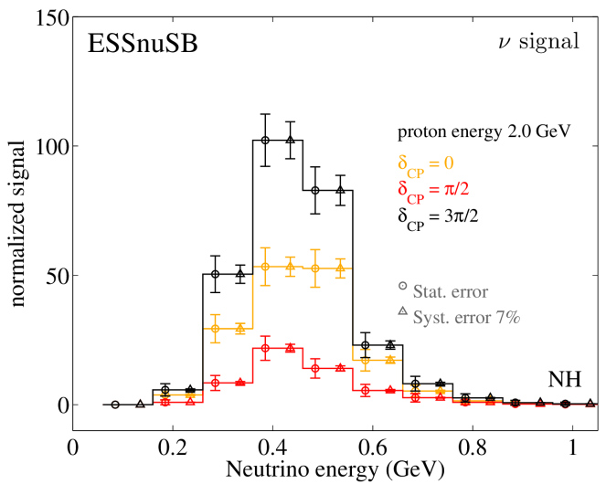
The sensitivity of the neutrino energy distribution to δ_{CP}
ESSnuSB second maximum Hyper-K first maximum LBNE first maximum
Hyper-K
LBNE
δ_{CP}
Red=π/2
Green= π
Blue=3 π/2
Events/50MeV
Relative difference in counts at maximum between δ_{CP} = 3π/2 and π/2 :
105/22 = 4.8 510/340 = 1.5 110/65 = 1.5

Slide 19
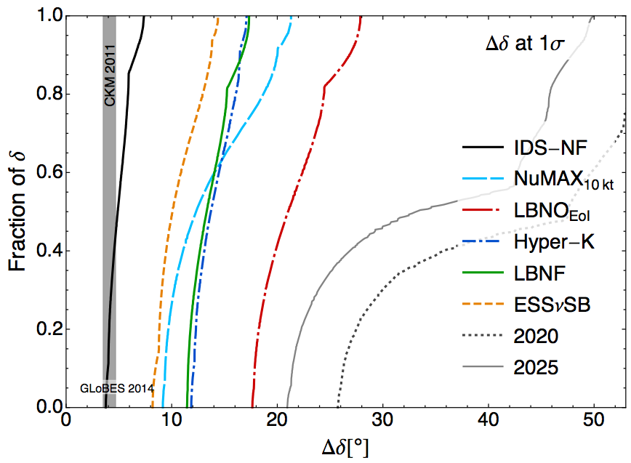
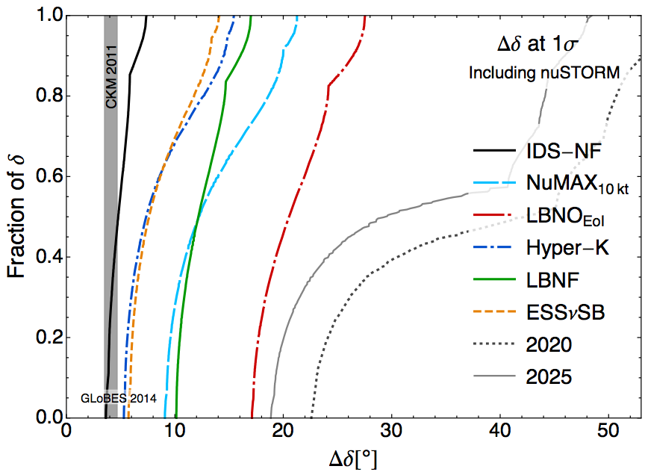
Results including nuSTORM
Systematics are basically the same as before.
nuSTORM plots assume that cross sections are determined at the 1% level of precision, removing the constraint between the cross sections for different flavors, they are all allowed to vary independently in the fit.
LBNF (40 kton detector, 1.2MW beam power)
Pilar Coloma et al.

Slide 20
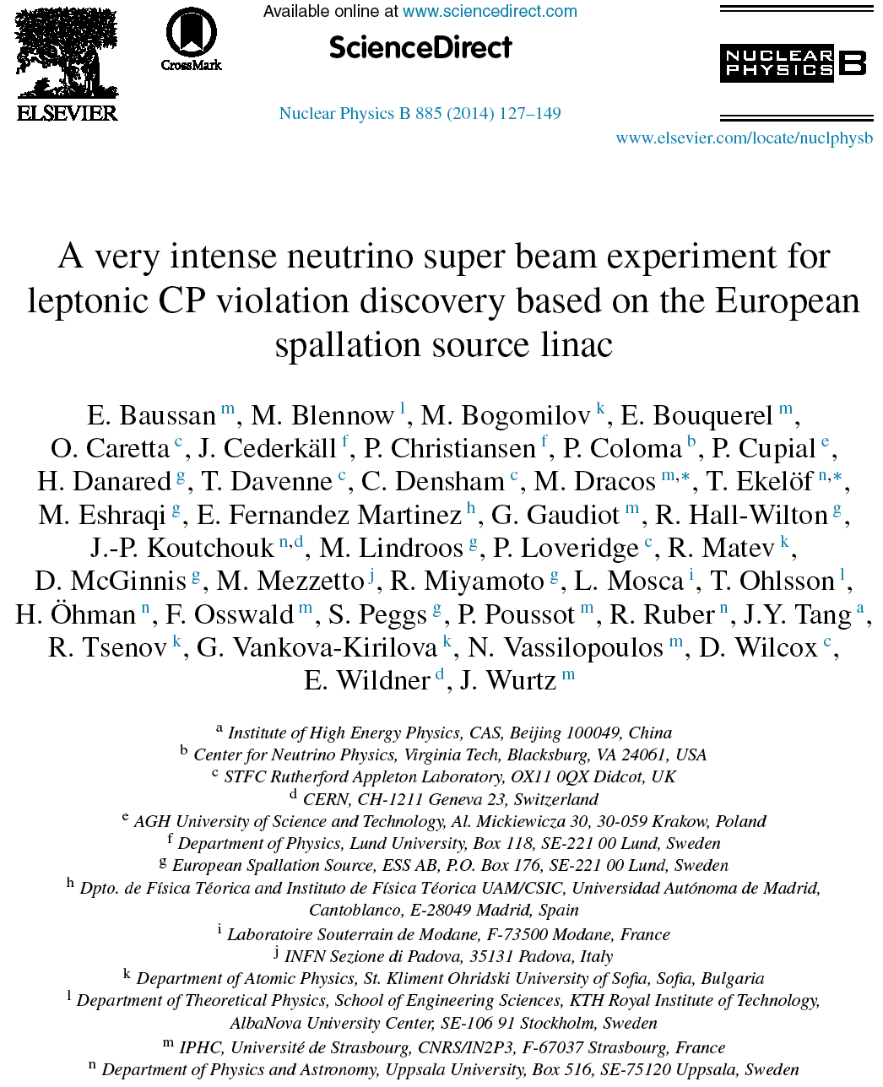
ESS Neutrino Super Beam
arXiv:1212.5048
arXiv:1309.7022
14 participating institutes from 10 different countries,
among them ESS and CERN
EU H2020 Design Study application has been submitted recently !

Slide 21
When and to what price ?
Total price of ESSnuSB including the detector is 1.2 BEUR:
  100 MEUR linac
  200 MEUR accumulator
  200 MEUR target station
  700 MEUR the far detector
If we have our CDR in 2018 and if we convince everybody to build this facility, we could start construction at the moment when the neutron facility will be ready, i.e., 2023. The construction of the neutrino facility could be completed 2030 when we will be able to start data taking.

Slide 22
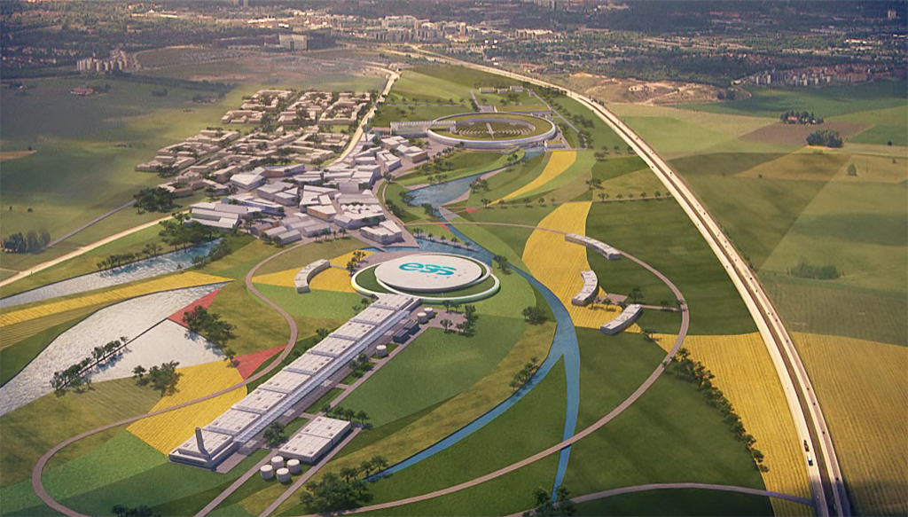
Conclusions
CP Violation intense neutrino beams are needed
  Profit of the worlds most powerful linac ar ESS
Better CPV sensitivity at the 2nd oscillation maximum (theta13 rel. large)
  Mines available at a good distance
ESS will have enough protons to go to the 2nd oscillation maximum increasing the sensitivity to CPV.
The European Spallation Source Linac will be ready in less than 10 years
CPV: 5 σ could be reached over 60% of δ_{CP} range (ESSνSB)
Full complementarity with a long baseline experiment on the 1st oscillation maximum using a LAr detector.
A feasibility Design Study for ESSnuSB has now to be made
  Collaborators are welcome: experiment, detector, physics, accelerator

