Slide 1
Current Status and Future Prospects of Neutrino Oscillations
Yifang Wang
Institute of high energy physics
Invisibles 15，June 24，2015

Slide 2
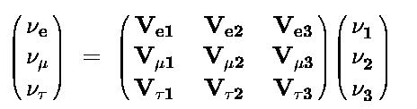
Neutrino Oscillation
If the neutrino mass eigenstate is different from that of the weak interaction, neutrinos can oscillate: from one type to another during the flight:
ν_{e}
ν_{μ}
ν_{e}
ν_{μ}
Oscillation probability：
P(ν_{e}−>ν_{μ}) = sin²(2θ) sin²(1.27Δm²L/E)
Oscillation
amplitude
Oscillation
frequency
Oscillation matrix for 3 generations：
Known parameters： θ₂₃，θ₁₂，|ΔΜ²₂₃|， ΔΜ²₁₂
Recent progress: θ₁₃
Unknown parameters: mass hierarchy(ΔΜ²₂₃), CP phase δ

Slide 3
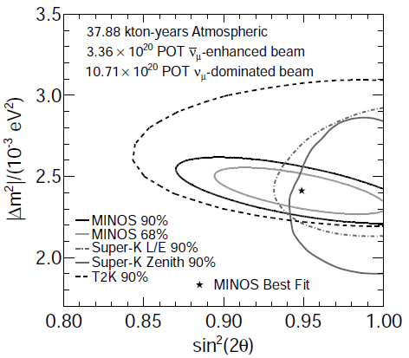
Atmospheric Neutrinos
Determination of θ₂₃ & |ΔM²₂₃ |
Current experiment: SuperK, Icecube
  Still improves θ₂₃ & |ΔM²₂₃ |
  3 flavor analysis for
    θ₂₃ octant
    mass hierarchy
    CP phase
Future experiments
  INO, PINGU/Icecube,
  HyperK
MINOS
ArXiv:1304.6335
3

Slide 4
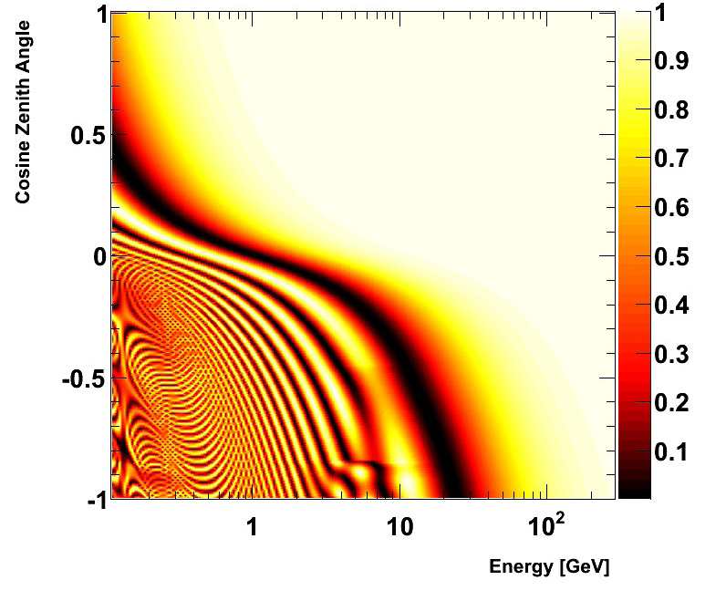
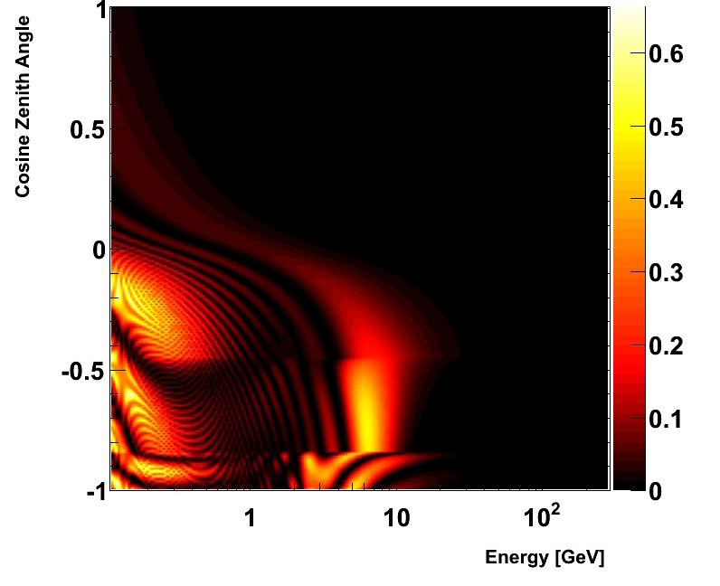
Three Flavor analysis: Sub-leading Effects
Roger Wendell@Neutrino 2014
P(ν_{μ}→ν_{μ} )
P(ν_{μ}→ν_{e} )
interference
  matter effect
solar
Thanks to the huge statistics and large θ₁₃, we can look for:
  Mass hierarchy: enhanced high E upward going ν_{e} due to the matter effect
  Octant of oscillation: enhanced low energy ν_{e} due to the solar term
  CP phase δ: interference between these two

Slide 5
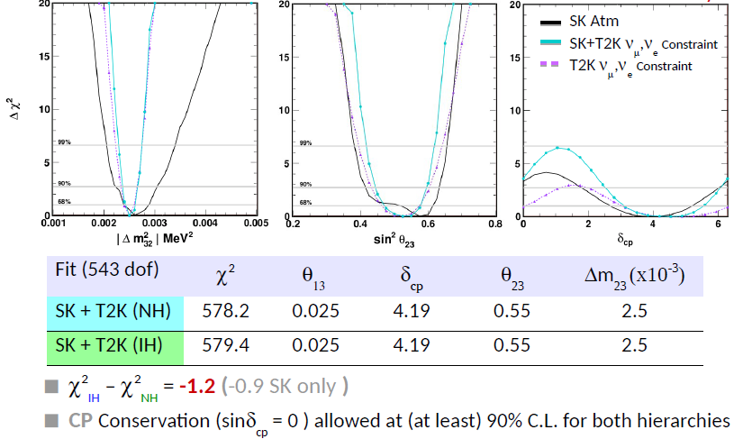
Fitting Results: SuperK + T2K
R. Wendall@neutrino2014
No preference on mass hierarchy
Sin²θ₂₃ ~ 0.6 less favored
δ_{CP} ~ 2/3π still favored
Same detector, generator and reconstruction: easy for systematic error correlation
MINOS is not included yet

Slide 6
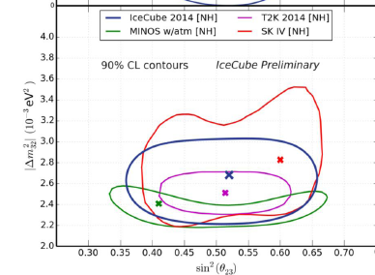
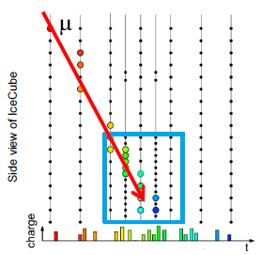
IceCube/DeepCore
IceCube: 5160 PMTs over 1 km³,DeepCore: 600 PMTs over 0.02 km³
Sensors separation: 7-70 m, Light yield：a few p.e. @ 10 GeV
Cosmic-μ rate is 10⁶ higher than ν
Already better than SuperK !
J.P. Yáňez@neutrino2014

Slide 7
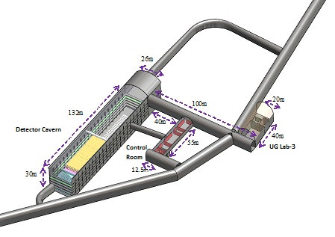
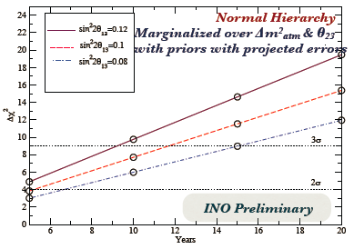
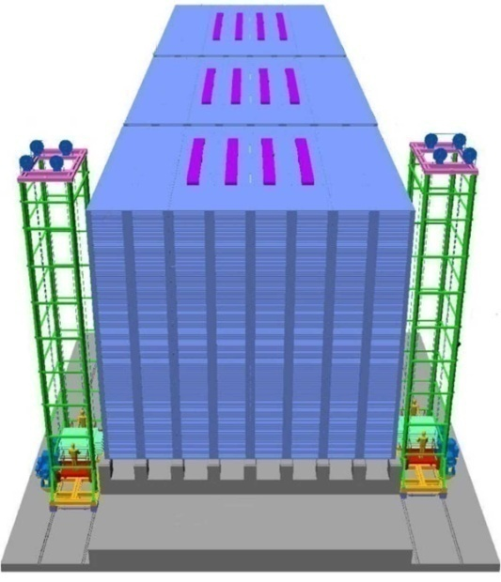
Future experiment: INO
INO(India-based Neutrino Observatory): 50kt magnetized iron plates interleaved with RPCs: Sign sensitive
Construction started, operational: 2018
Sensitivity to mass hierarchy: ~3σ after 10 years running
Choubey@neutrino’12

Slide 8
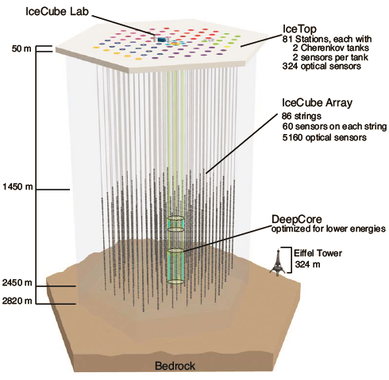
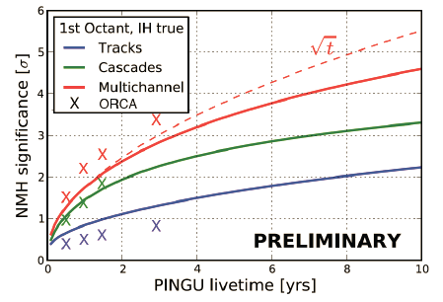
Future experiments: PINGU(& ORCA)
A large ice Cerenkov detector with E_{thresh} < 10 GeV
  Add 40 strings with 20 m spacing
  ~ 20× photocathode density
  Existing IceCube as the VETO
Equivalent target mass: +10 Mt
Sensitivity: ~ 3σ in ~ 3 years
D. Grant@neutrino 2014
2015-6-24

Slide 9
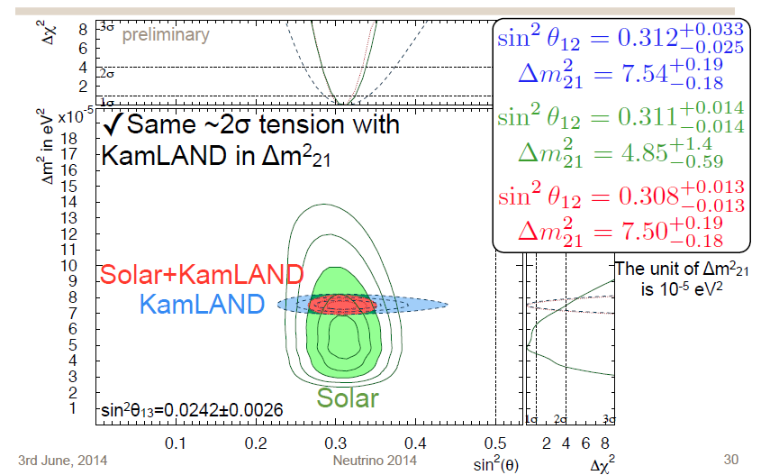
Solar neutrinos
Measurement of θ₁₂ & ΔM²₂₁
Current experiments: Borexino, SuperK
Future experiment:
  SNO+, XMASS, LENA, JUNO…
Koshio@neutrino 2014

Slide 10
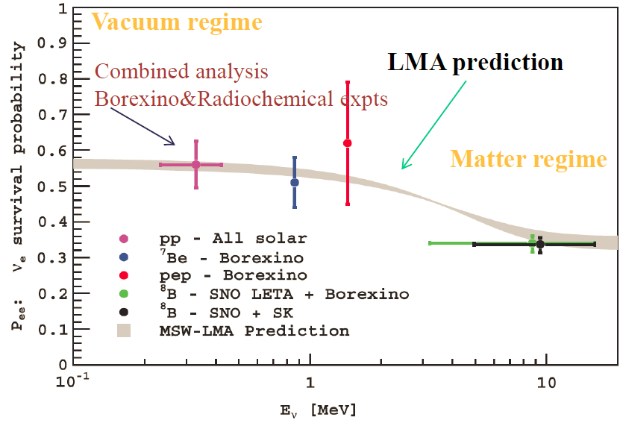
Confirmation of the Solar Model and the Neutrino Oscillation
Accomplished:
  ⁷Be flux
  ⁸B flux down to 3 MeV
  pep flux & limit on CNO
Future:
  pp neutrinos
  CNO
Ranucci @ neutrino 2014

Slide 11
Future
Better oscillation measurements
  Seasonal variations
  Spectrum distortion
  Day-night effect
Non-standard interactions
  Flavor changing NC
  Sterile neutrinos
  Mass varying neutrinos
Solar physics:
  Understand the stellar formation by measuring the metallicity of the Sun’s core
    Precision 8B flux
    CNO flux
SuperK
Borexino
SNO+
XMASS
JUNO
HyperK
LENA
…

Slide 12
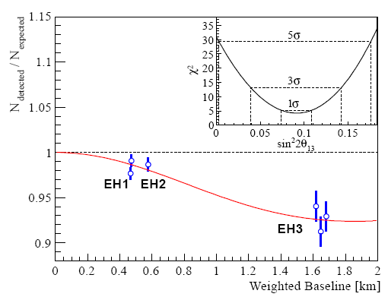
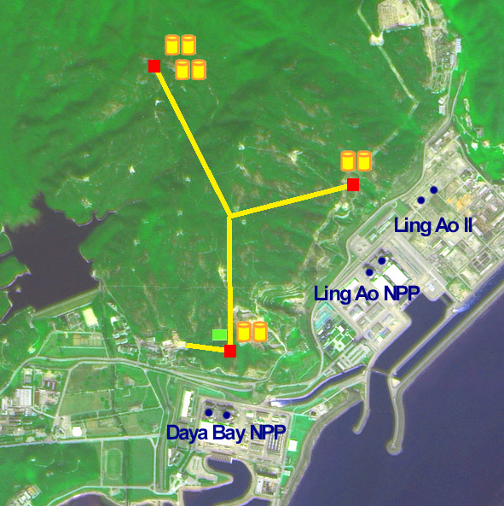
Reactor neutrinos
Established θ₁₃ Oscillation
Future: Mass hierarchy
  JUNO, RENO-50
Daya Bay
Daya Bay
F.P. An et al., NIM. A 685(2012)78
F.P. An et al., Phys. Rev. Lett. 108, (2012) 171803, citation > 1200

Slide 13
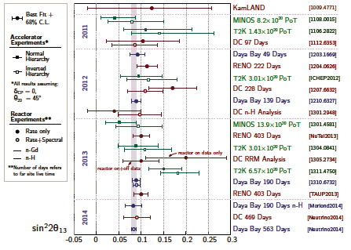
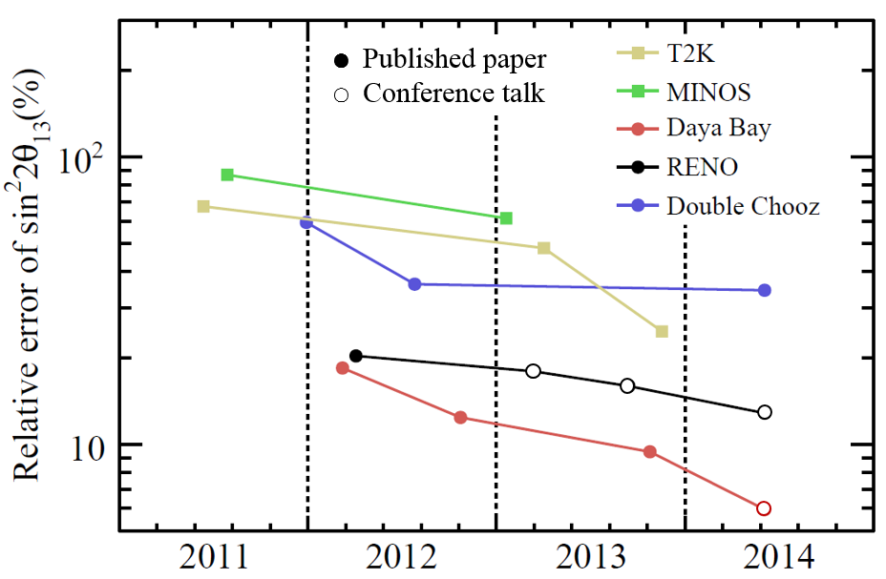
Comparison of θ₁₃ Measurements
Accelerator experiments assuming δ_{CP}=0, θ₂₃=45⁰

Slide 14
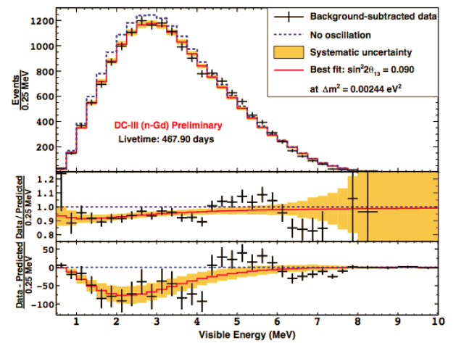

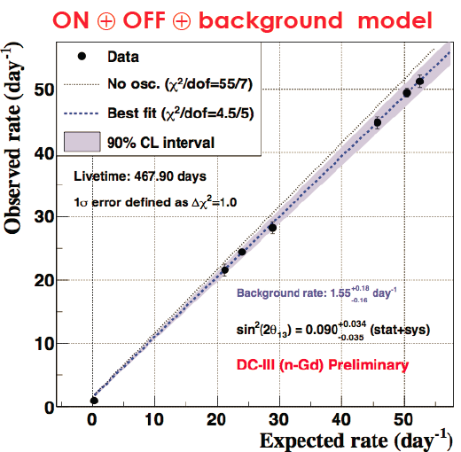
Double Chooz: Results and Prospect
Reactor rate modulation: background measurement
nGd rate+shape analysis for far detector only
Near detector ready
Expected final precision on sin²2θ₁₃ : ~ 10-15%

Slide 15
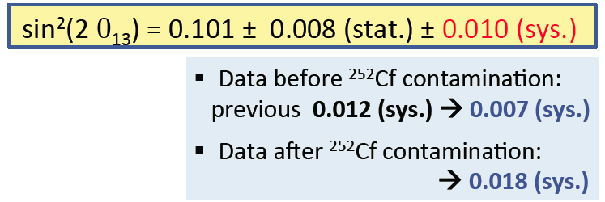
RENO: Results and Prospects
Also reactor rate modulation analysis
New results on nGd & nH rate analysis
Shape analysis is on the way
Reduced systematics but ²⁵²Cf contamination worsened the uncertainty
Future prospects: 7% precision
nGd rate analysis
nH rate analysis

Slide 16
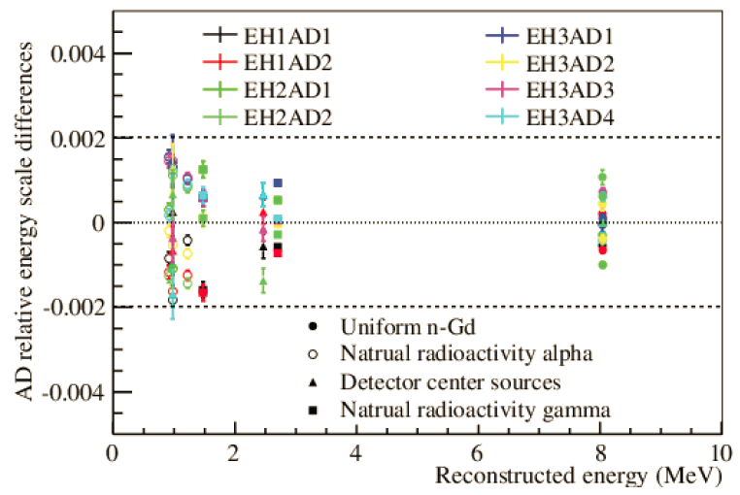
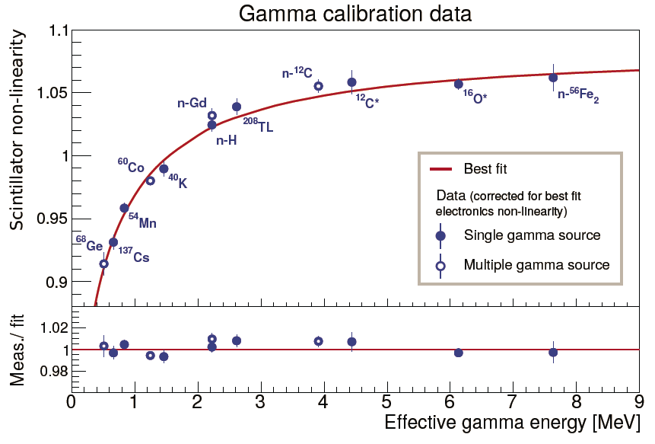
Daya Bay
Detailed and precise corrections for non-linearity
Continue to improve: reduced backgrounds and systematics
Rate + Shape analysis for nGd events
Rate analysis for nH events
Relative energy scale difference: <0.2%
Non-linearity uncertainty < 1%

Slide 17
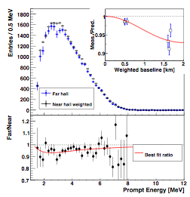
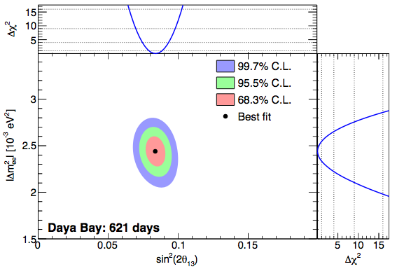
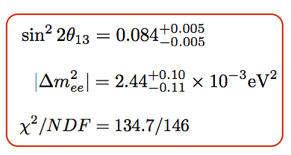

Recent Results
nGd rate+shape
nH rate
Δ(sin²2θ₁₃)/sin²2θ₁₃ ~ 6%, the best among all mixing angles
Δ(ΔM²_{ee})/ΔM²_{ee}~ 5%, similar to that of MINOS
nH results ~4.5σ, independent check

Slide 18
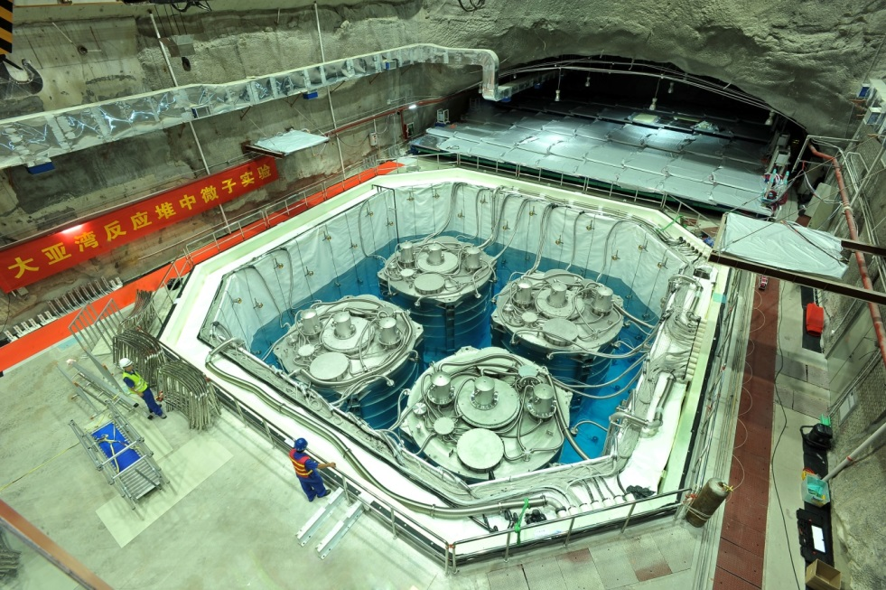
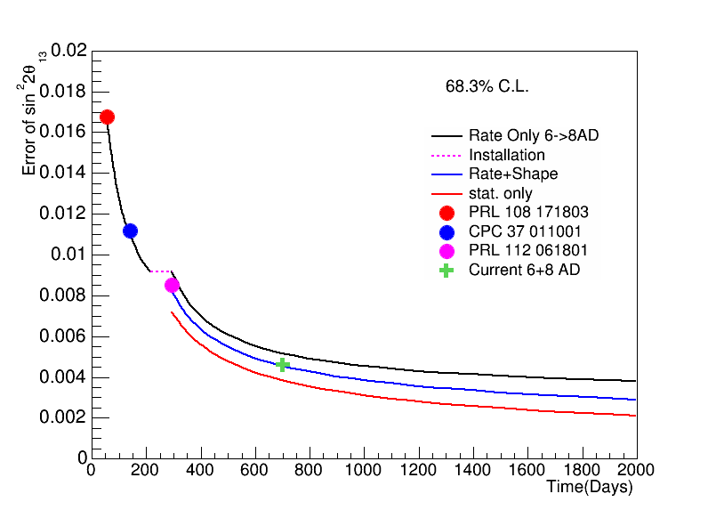
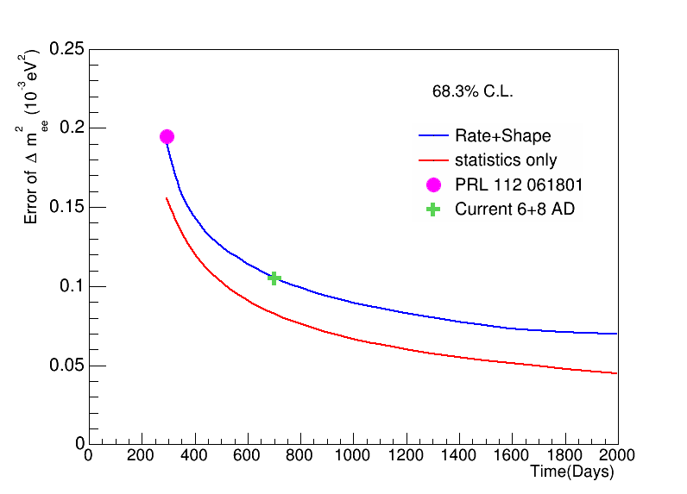
Future Prospects
Precision still dominated by statistics
Continue to improve systematics
Data taking until 2017
Precision expected:
  Δ(sin²2θ₁₃) ~ 0.003 ➔ ~ 3%
  Δ(ΔM²_{ee}) ~ 0.07 ➔ ~3%
MINOS 1-σ on Δm²_{μμ}

Slide 19
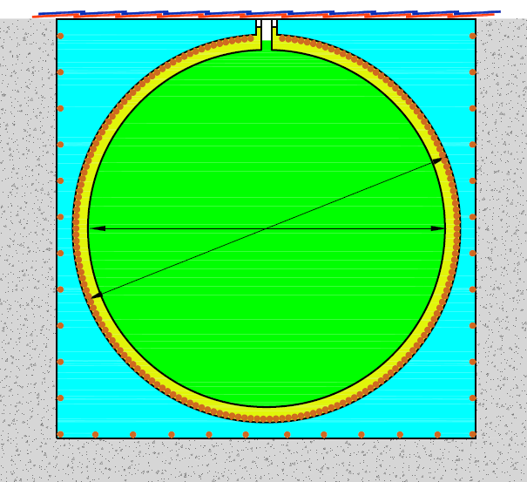
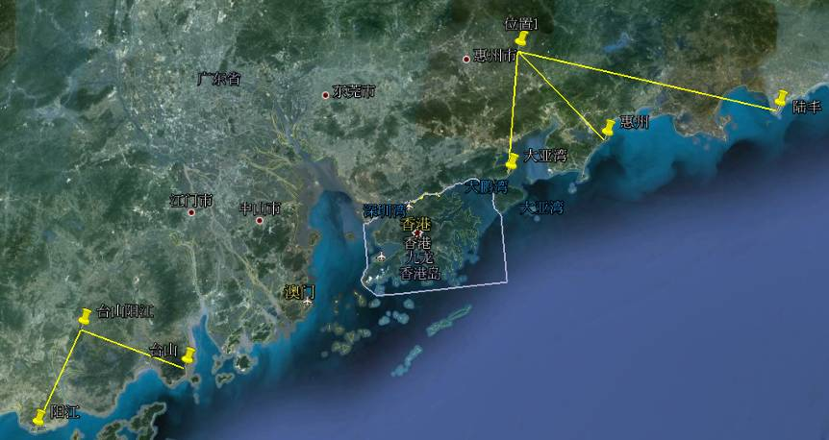
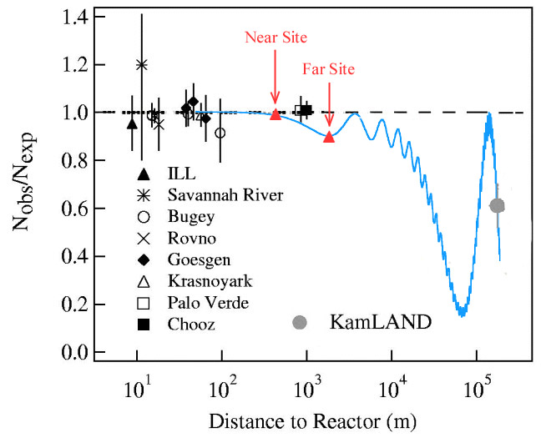
Future Experiment: JUNO
 | Daya Bay | Huizhou | Lufeng | Yangjiang | Taishan
Status | running | planned | approved | Construction | construction
power/GW | 17.4 | 17.4 | 17.4 | 17.4 | 18.4
Daya Bay
60 km JUNO
20 kt LS
Previous site
~15000 20” PMTs
Lufeng
Huizhou
Daya Bay
Current site
Hong Kong
Talk by YFW at ICFA seminar 2008, Neutel 2011; by J. Cao at NuTurn 2012 ;
Paper by L. Zhan, YFW, J. Cao, L.J. Wen, PRD78:111103,2008; PRD79:073007,2009
Taishan
Yangjiang

Slide 20
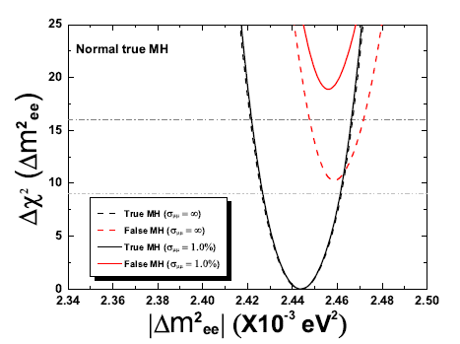
Physics Reach
Thanks to a large θ₁₃
  Detector size: 20kt
  Energy resolution: 3%/√E
  Thermal power: 36 GW
Mass hierarchy
Precision measurement of mixing parameters
Supernova neutrinos
Geoneutrinos
Sterile neutrinos
……
Y.F. Li et al., arXiv:1303.6733
 | Current | Daya Bay II
Δm²₁₂ | 3% | 0.6%
Δm²₂₃ | 5% | 0.6%
sin²θ₁₂ | 5% | 0.7%
sin²θ₂₃ | 10% | N/A
sin²θ₁₃ | 14%➔ 4% | ~ 15%
For 6 years，mass hierarchy cab be determined at 4σ level, if Δm²_{μμ} can be determined at 1% level

Slide 21
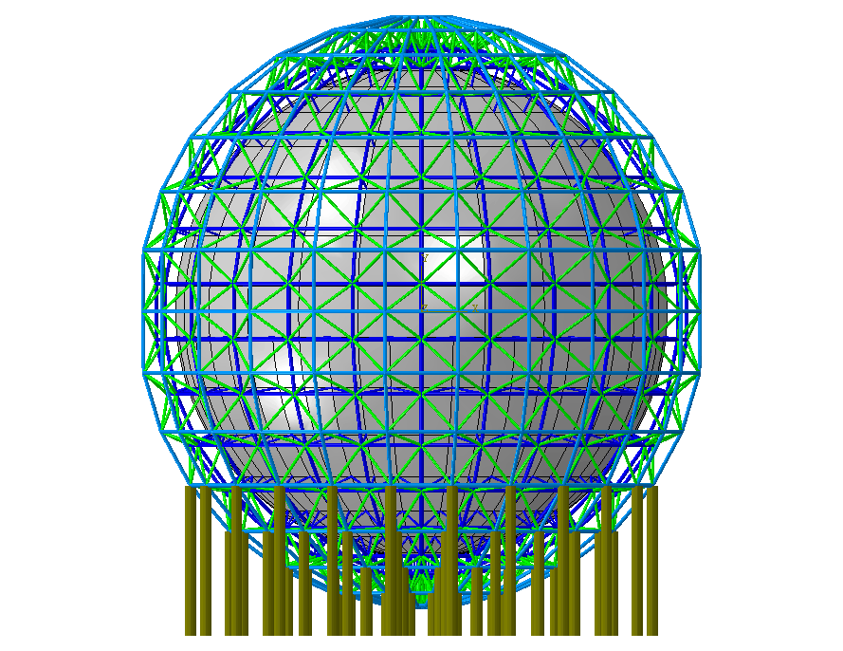
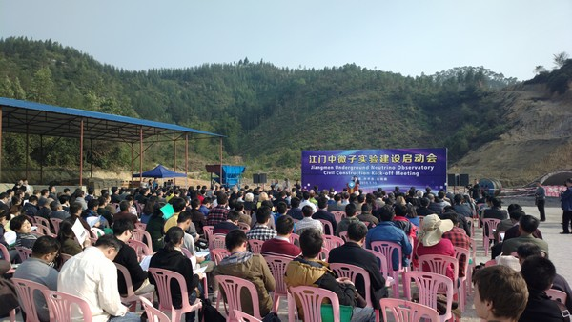
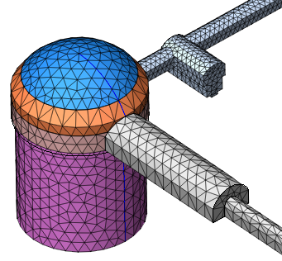
Status of JUNO
Schedule:
Civil preparation：2013-2014
Civil construction：2015-2017
Detector component production：2016-2017
PMT production：2016-2019
Detector assembly & installation：2018-2019
Filling & data taking：2020
Grounding breaking on Jan. 10, 2015

Slide 22
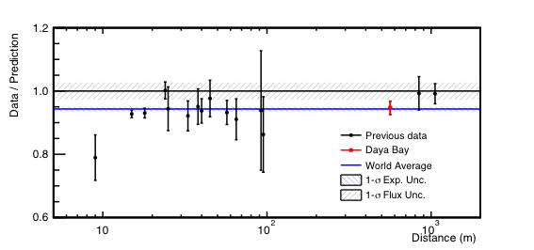
Reactor neutrino anomaly
By a new flux calculation, there may exist a reactor neutrino flux deficit: 0.943±0.023. A 3σ effect ?
Confirm by other calculations and measurements
Oscillation with sterile neutrinos ? Many experiments:
  Radioactive sources: CeLAND(¹⁴⁴Ce in KamLAND), SoX(⁵¹Cr in Borexino),…
  Accelerator beams: IsoDAR, Icarus/Nessie, …
  Reactors: Nucifer, Stereo, Solid, SCARR, …
Daya Bay

Slide 23
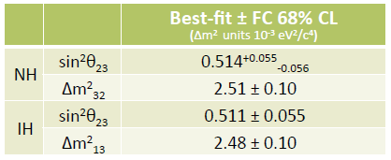
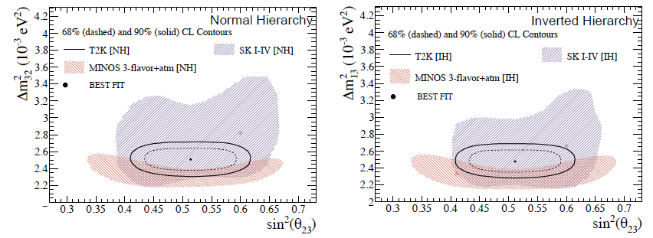
Accelerator Neutrinos
Determination of θ₂₃ and |ΔM²₂₃|
Current experiments: T2K
Future experiment:
  DUNE, T2HK, INO, …
  Neutrino factories
C. Water@neutrino2014
Phys. Rev. lett. 112(2014)181801

Slide 24
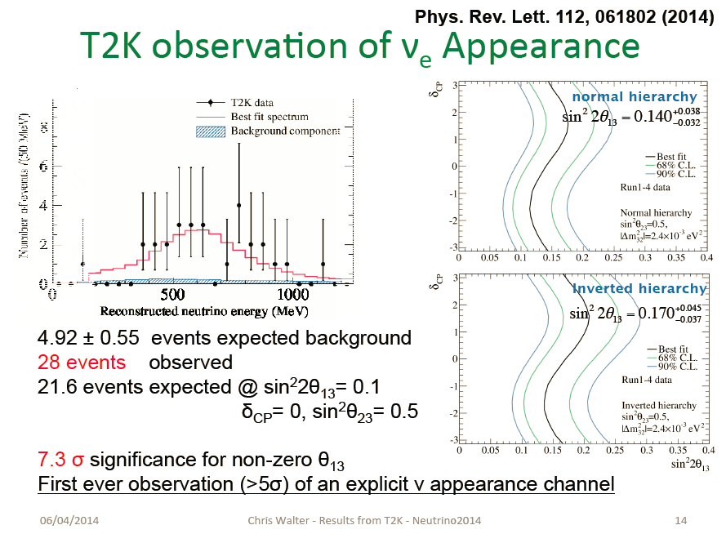

Slide 25
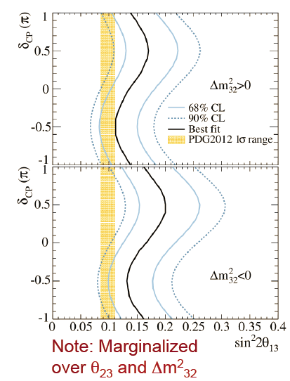
CP Phase is known ?
C. Water@neutrino2014
Taking reactor θ₁₃ results, CP phase is constrained to be close to –π/2
This is a very lucky value for NOVA and other accelerator experiments
Mass hierarchy and CP phase will be known soon ?

Slide 26
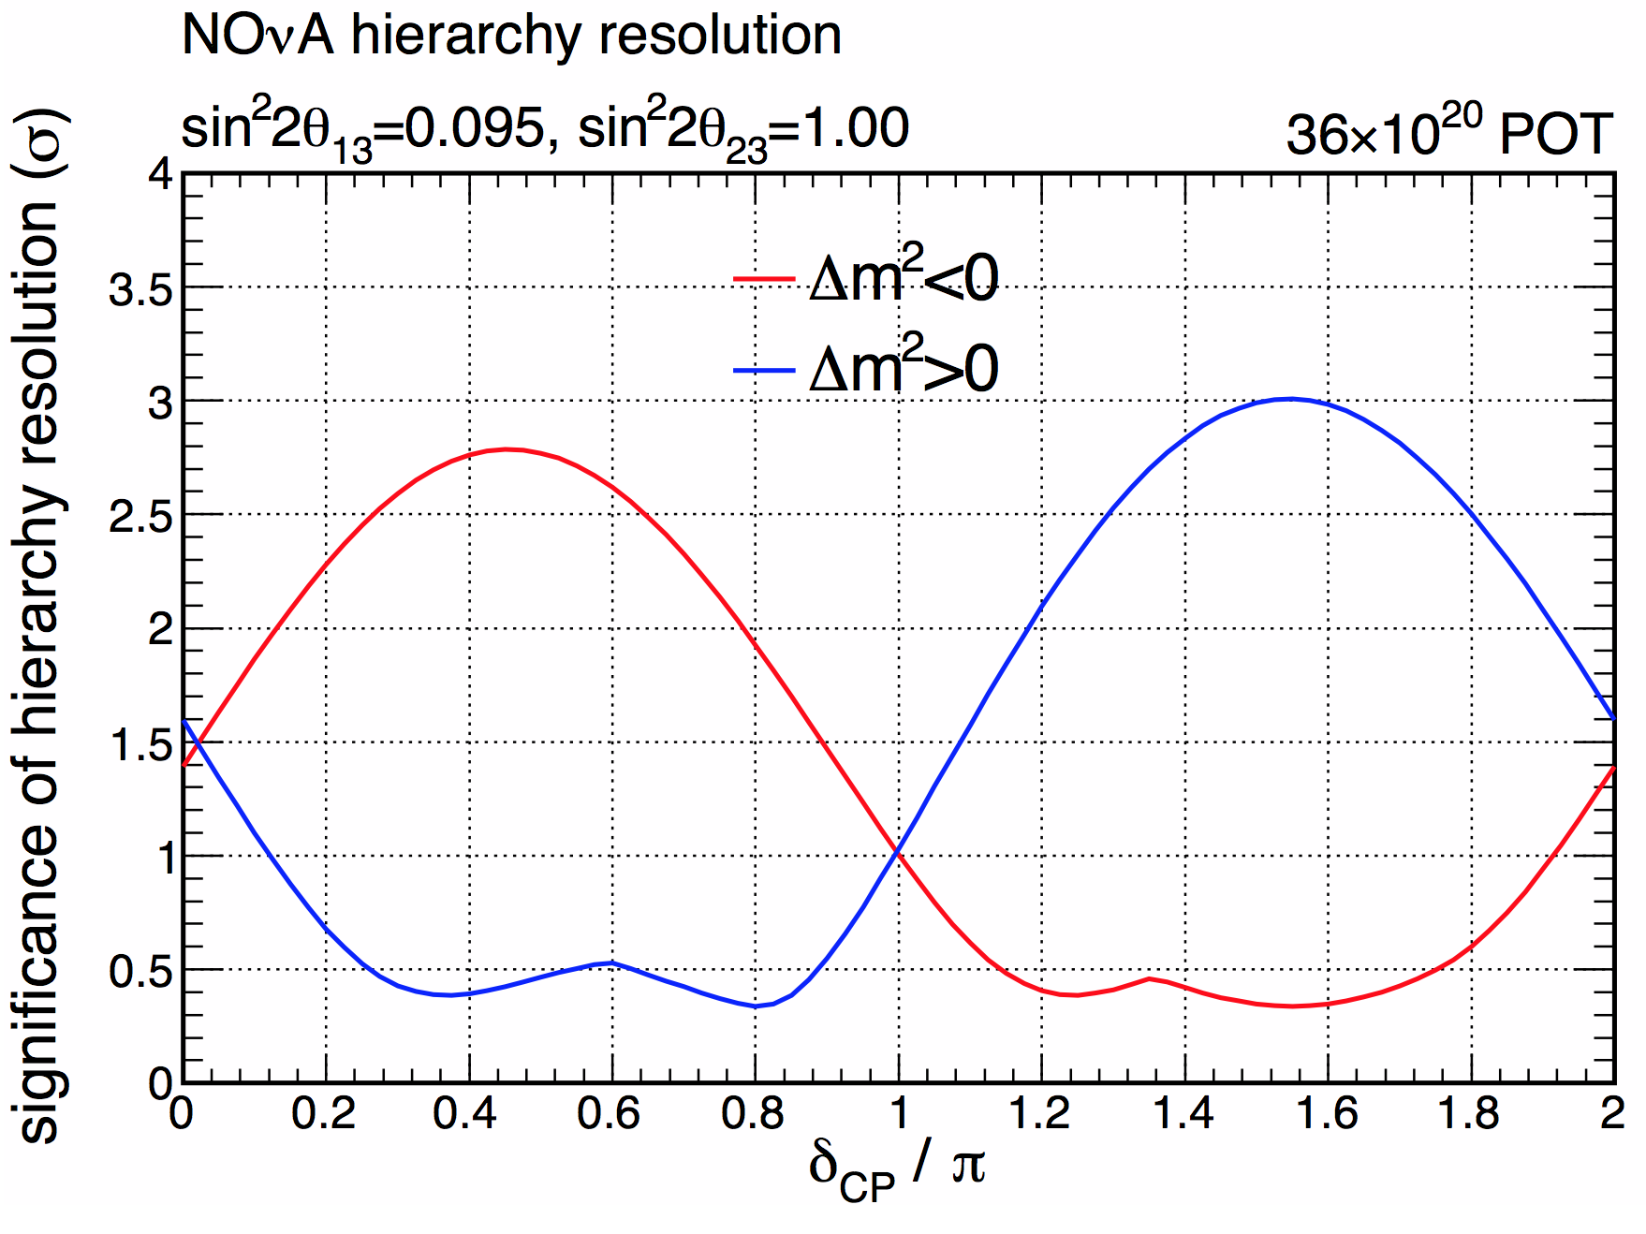
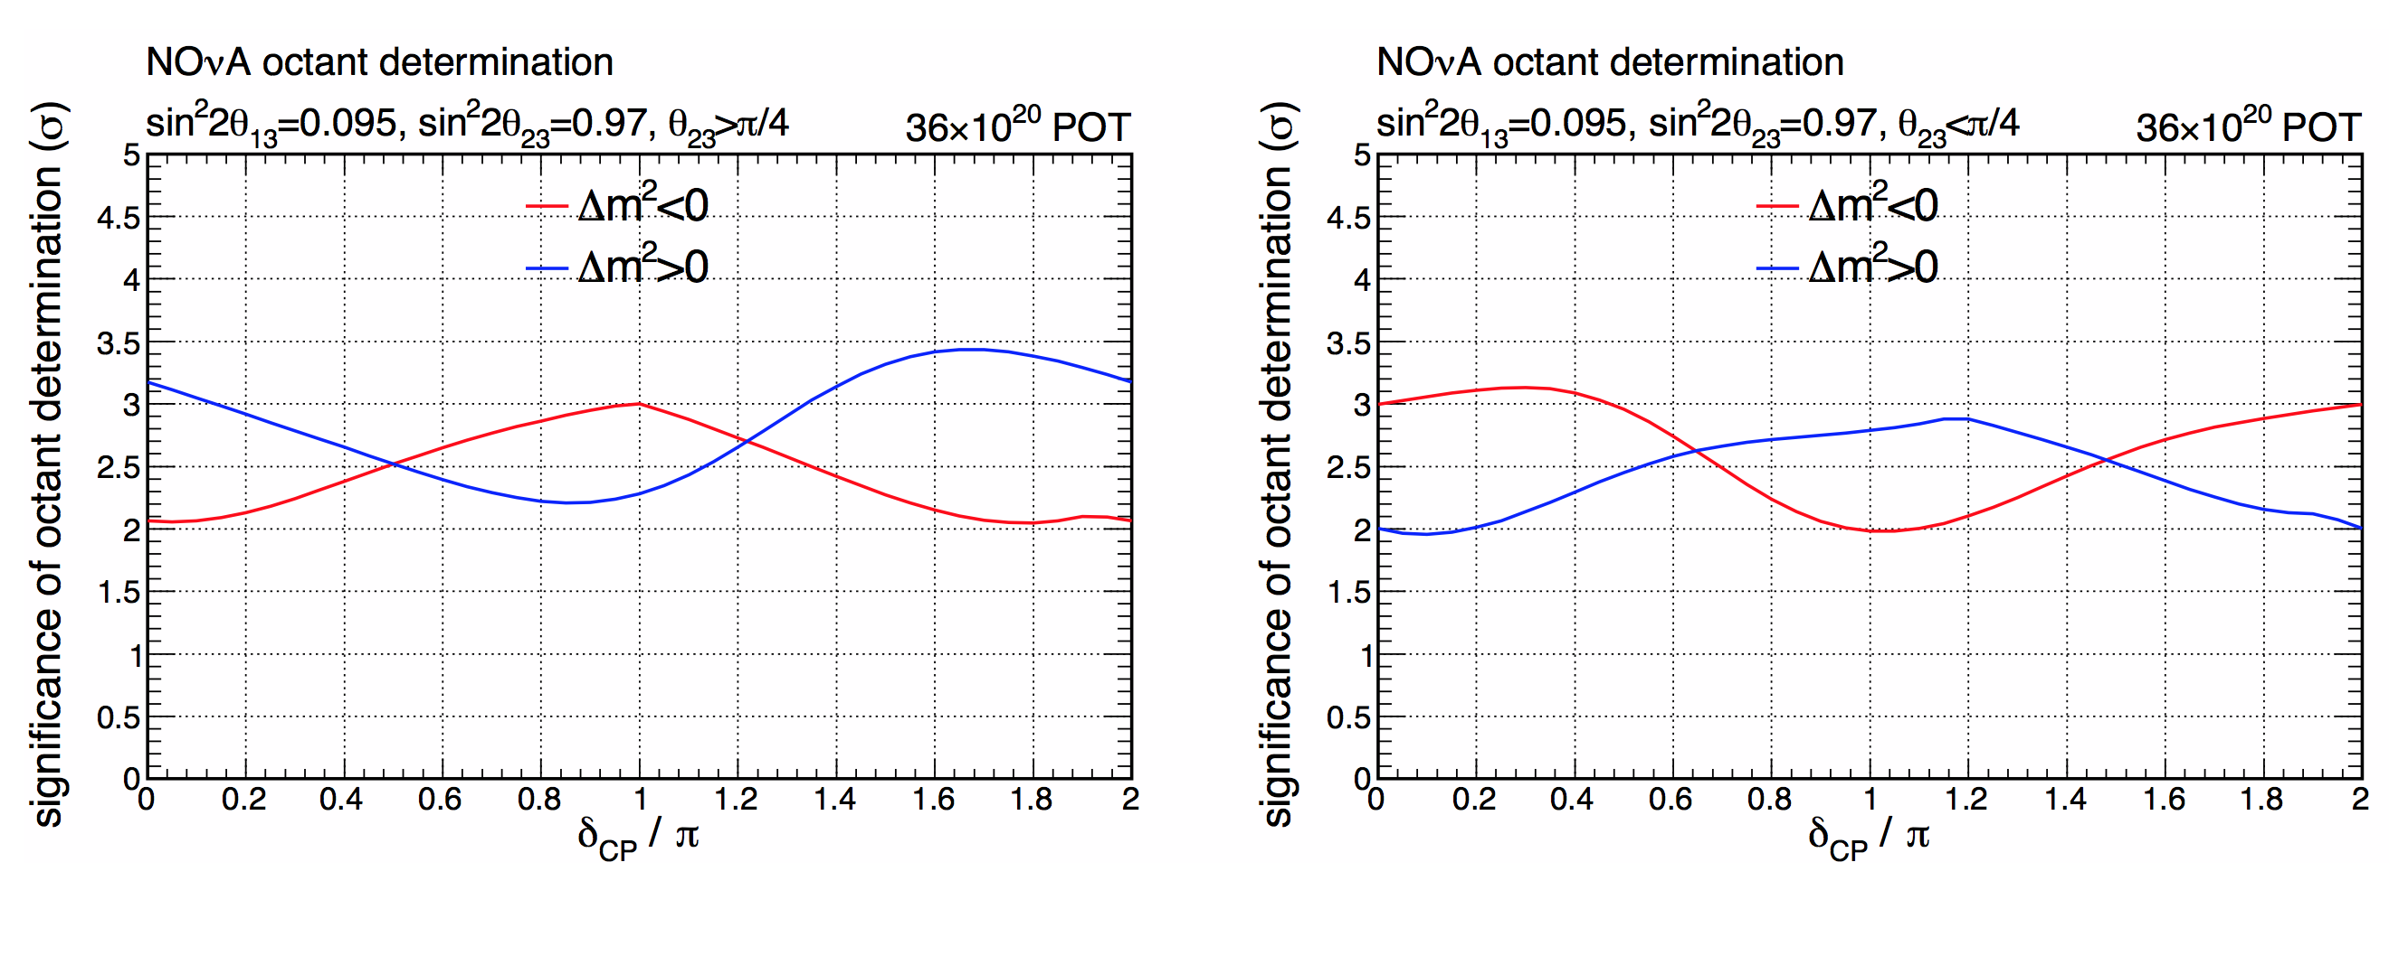
Nova：Physics Reach
May get mass hierarchy if lucky
For non-maximal θ₂₃ octant determination: > 95% CL for all δ_{CP} @ sin²2θ₂₃ = 0.97

Slide 27
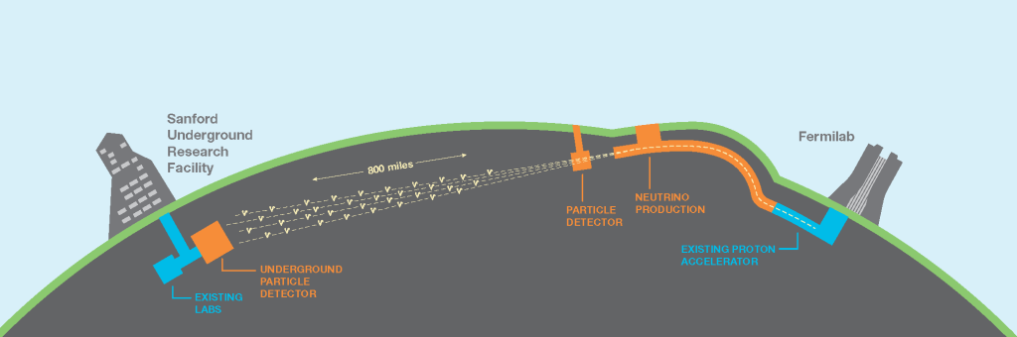
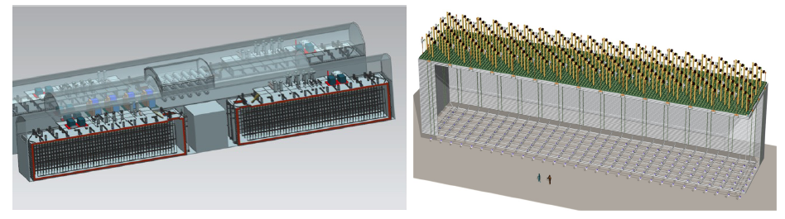
LBNF/DUNE
LAr detector: two options

Slide 28
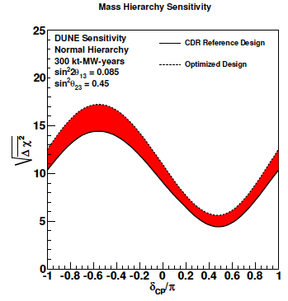
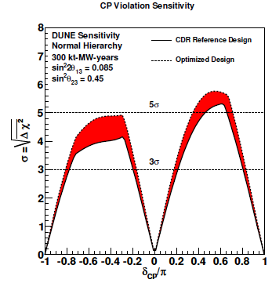
Physics at DUNE
Exposure: 300 kt⋅W
First phase: Two 10 kt detector with a 1.2 MW proton power
Future: 40 kt with a 2.4 MW proton power
Goal: 850 kt⋅W

Slide 29
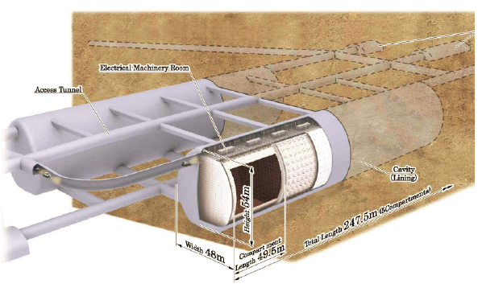
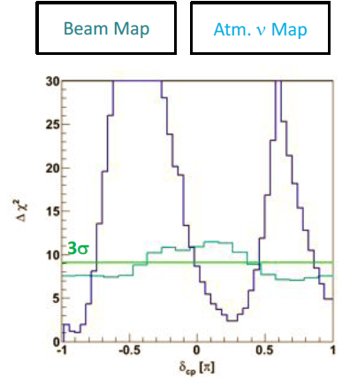
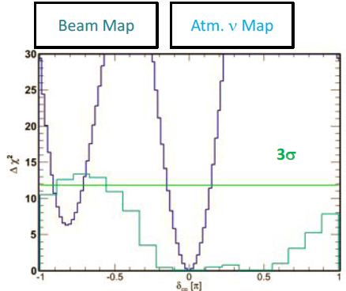
Future experiment: T2HK
1 Mt water Cerenkov detector
99000 20” PMT, 20% coverage
Octant issue: Δsin²θ₂₃ < 1%
Mass hierarchy: complementary to T2HK
CP: T2HK much better
CP
hierarchy
Wendell@HyperK open meeting 2012

Slide 30


Neutrino Factory
All channel available
  Large ν_{e} (ν_{e} bar) flux
  High energy ν_{e} (ν_{e} bar) flux
Rate ∝ E_{n} @ fixed L/E
  Optimize event rate@L/E
  Optimize MH
  Optimize CP sensitivity
Our dream machine:
  CP phase δ at 10-15% level

Slide 31


A New Type of Neutrino Beam for CP (MOMENT)
Detector
Detector：
Flavor sensitive
Charge sensitive
NC/CC sensitive
Neutrinos after the target/ collection/decay:
~ 5×10²¹ ν/year
Cao et al., arXiv:1401.8125

Slide 32

Why MOMENT ?
Easier and cheaper in comparison with neutrino factories, by abandoning muon cooling and acceleration stage.
Its CW mode makes the target system slightly easier.
The lower beam energy at ~ 300 MeV maybe optimal: free from pi0 background
J.Formaggio and G.Zeller,
Rev. Mod.Phys. 84.3(2012)1307
2015-6-24

Slide 33
Summary
Atmospheric neutrinos are improving the precision of θ₂₃ & ΔM²₂₃; sub-leading effects can be used to determine the mass hierarchy & CP phase.
Solar neutrinos continue to provide improved measurements of θ₁₂ & ΔM²₁₂; solar-related and other astrophysics issues require much larger detectors.
Reactor neutrinos provided precise measurements of θ₁₃ & ΔM²₁₃; next generation experiments can measure precisely θ₁₂ & ΔM²₁₂ & ΔM²₂₃, determine the mass hierarchy, and study many astrophysics issues.
Sterile neutrino issues will be settled by experiments at reactors and/or using radioactive sources & accelerators, sooner or later.
Mass hierarchy and CP phase will be known in a not too far future

