Slide 1
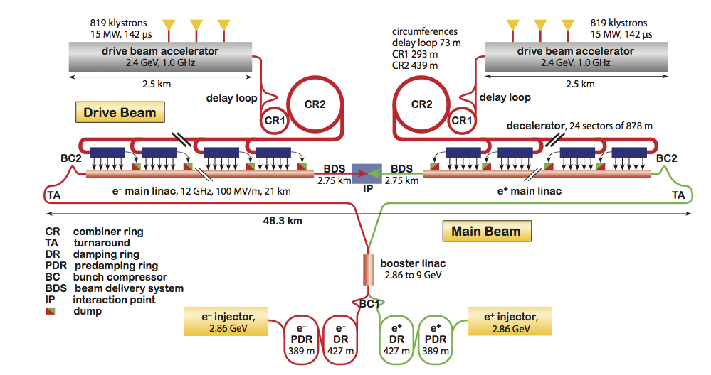
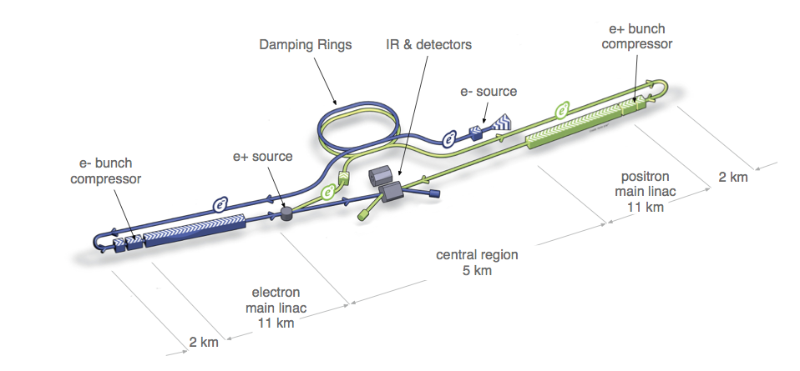
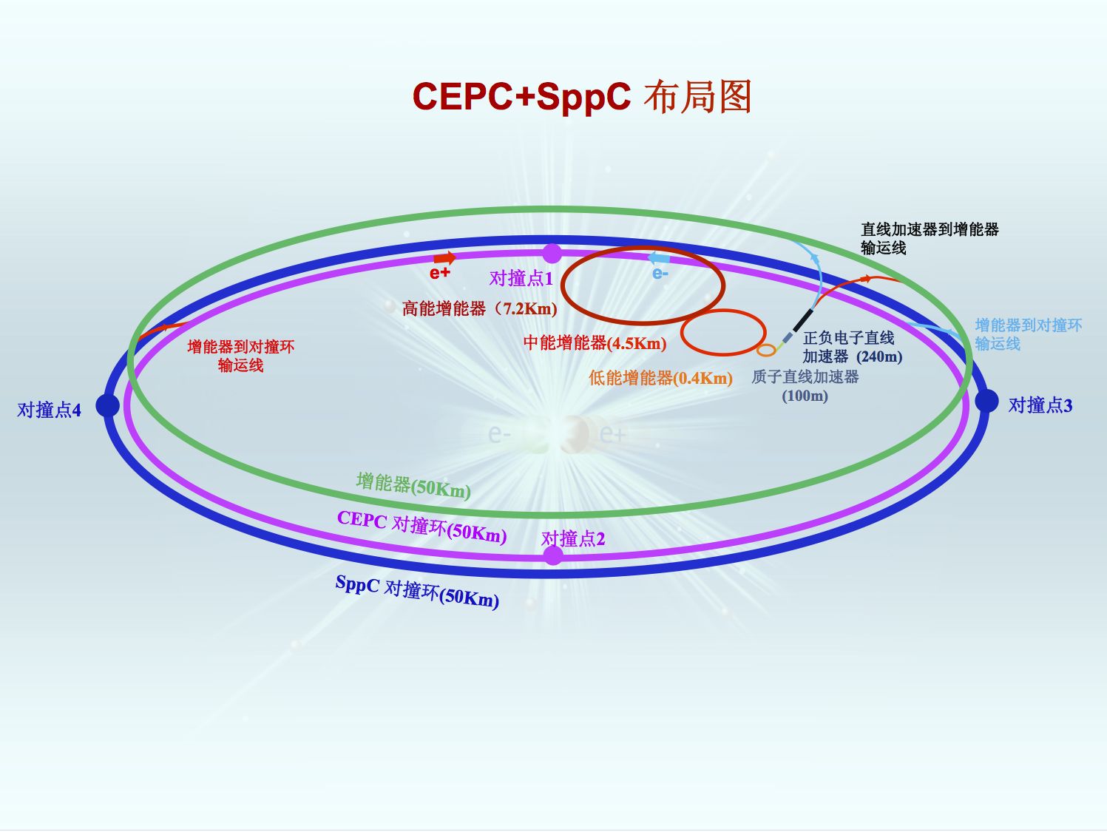
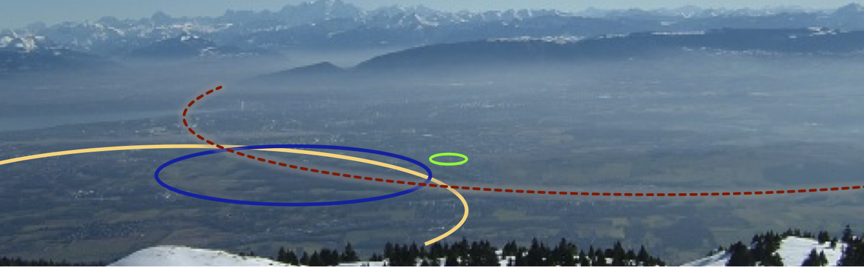
Physics opportunities at
future high-energy colliders
Present questions in particle physics
Main options for future high-E colliders and their physics case
Fabiola Gianotti, CERN Physics Department
Invisible15, Madrid, 26/6/2015

Slide 2

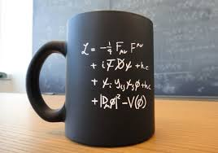
What did we accomplish so far in particle physics ?
With the discovery of the Higgs boson,
we have completed the Standard Model
(> 50 years of theoretical and experimental efforts !)
Note: fermions (c, b, t, τ) discovered at accelerators in the US, bosons (g, W, Z, H) in Europe …
We have tested the Standard Model with very
high precision (wealth of measurements since early ‘60s,
in particular at accelerators)
it works BEAUTIFULLY (puzzling …)
no significant deviations observed (but difficult
to accommodate non-zero neutrino masses)
However: SM is not a complete theory of particle physics, as several outstanding
questions remain, raised also by experimental observations (e.g. dark matter,
Universe’s accelerated expansion) that cannot be explained within the SM.
These questions require NEW PHYSICS

Slide 3


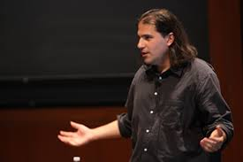
Main questions in today’s particle physics (a non-exhaustive list ..)
Why is the Higgs boson so light (so-called “naturalness” or “hierarchy” problem) ?
What is the origin of the matter-antimatter asymmetry in the Universe ?
Why 3 fermion families ? Do neutral leptons, charged leptons and quarks behave similarly?
What is the origin of neutrino masses and oscillations ?
What is the composition of dark matter (23% of the Universe) ?
What is the cause of the Universe’s accelerated expansion (today: dark energy ?
primordial: inflation ?)
Why is Gravity so weak ?
Puzzling: NO evidence of new physics from LHC (yet …)
N. Arkani-Hamed
In other words: at what E scale(s) are the answers to these questions ?

Slide 4
These questions are compelling, difficult and intertwined → require all approaches we have in
hand (made possible also by strong advancements in accelerator and detector technologies): high-E colliders, neutrino experiments (solar, short/long baseline, reactors, 0νββ decays), cosmic surveys, dark matter direct and indirect detection, precision measurements of rare decays and phenomena, dedicated searches (WIMPS, axions, dark-sector particles), …
Main questions and main approaches to address them
High-E High-precision Neutrino Dedicated Cosmic
colliders experiments experiments searches surveys
Higgs , EWSB x
Neutrinos x x x x
Dark Matter x x
Flavour, x x x x
CP-violation
New particles x x x x
and forces
Universe x
acceleration
Combination of ALL these complementary approaches crucial to explore the largest range of E
scales, properly interpret signs of new physics → build coherent picture of underlying theory

Slide 5
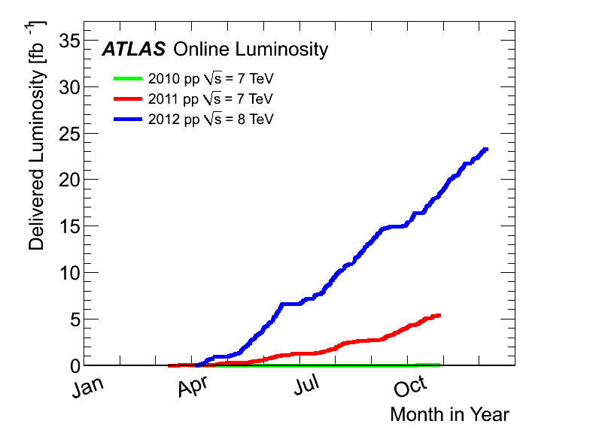
Luminosity of a collider
n. of particles
per bunch
n. of bunches
n. of turns
per second or repetition rate
2012:
23 fb⁻¹
at 8 TeV
beam size at IP
4th July seminar
2011
5.6 fb⁻¹
at 7 TeV
Achieved peak luminosity in
LHC Run-1: ~ 7.7 x10³³ cm⁻² s⁻¹
2010
0.05 fb⁻¹
at 7 TeV
N = ∫Ldt x σ (pp → X)

Slide 6
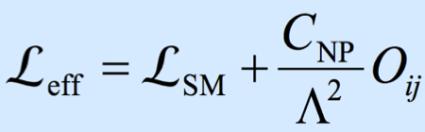
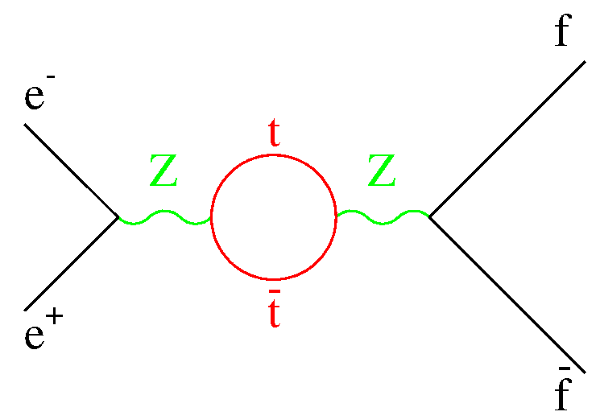
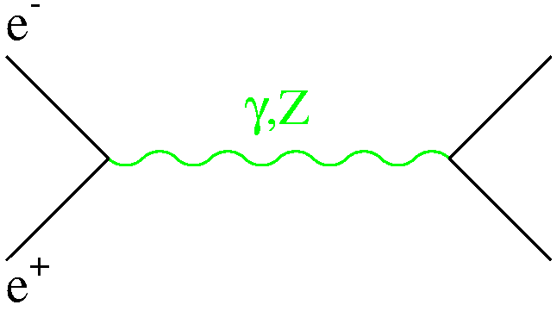
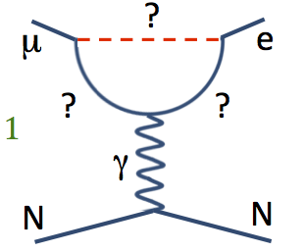
3 main complementary ways to search for (and study) new physics at accelerators
Direct
production of a given (new or known) particle
e.g.: Higgs production at future e⁺e⁻ linear/circular colliders
at √s ~ 250 GeV through the HZ process
→ need high E and high L
Indirect
precise measurements of known processes
look for (tiny) deviations from SM expectation from quantum effects (loops, virtual particles)
sensitivities to E-scales Λ>> √s → need high E and high L
√s ~ 90 GeV
● ⁻
E.g. top mass predicted by LEP1 and SLC in 1993:
m_{top} = 177 ± 10 GeV; first direct evidence
at Tevatron in 1994: m_{top} = 174 ± 16 GeV
X*
● ⁺
Rare processes
suppressed in SM → could be enhanced by New Physics
e.g. neutrino interactions, rare decay modes → need intense beams, ultra-sensitive (massive)
detectors (“intensity frontier”)
E.g. transitions between charged leptons of different families with Lepton-Flavour-Violation: μ→eγ (MEG@PSI), μ→e (COMET@JPARC, Mu2e@FNAL).
Suppressed in SM, can occur if new physics
Note: flavour violation observed for ν (e.g. ν_{μ} → ν_{e}) and quarks (e.g. t→ Wb)

Slide 7
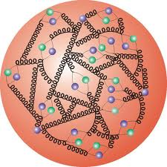
e⁺e⁻ colliders
vs
pp colliders
p = E_{beam}=√s/2
e⁺
e⁻
E_{beam}=√s/2
x₁ p
x₂ p
p
p
Energy of elementary interaction known
→ strong constraint for final-state reconstruction
Energy of elementary interaction not known
Only two elementary particles collide
→ clean final states
Mainly EW processes → “democratic” production
of all kinematic accessible particles coupling to Z/γ*
Elementary interaction (hard) + interaction
of “spectator” q,g (soft) overlap in detector
EW processes suffer from huge backgrounds
from strong processes → detector performance!
In rings √s limited by e± synchrotron radiation:
Synchrotron radiation is ~ (m_{p}/m_{e})⁴ ~ 10¹³
smaller
E_{loss} ~ 2.5 GeV/turn
LEP2 (E_{beam}~ 100 GeV)
clean environment → precision
measurements are optimal
high energy easier to achieve → ideal
machines for discovery at energy frontier
Note: this is an oversimplified picture ! Many discoveries at e⁺e⁻ machines (τ-lepton, gluon, etc.)
and beautiful precision measurements at hadron colliders (W mass, B-physics, etc.)

Slide 8
Options for and physics potential
of future high-energy colliders
Linear and circular e⁺e⁻ colliders
Very high-E proton-proton colliders
Disclaimer: due to time limitation, I will not discuss other opportunities (μμ, ep, γγ colliders)

Slide 9
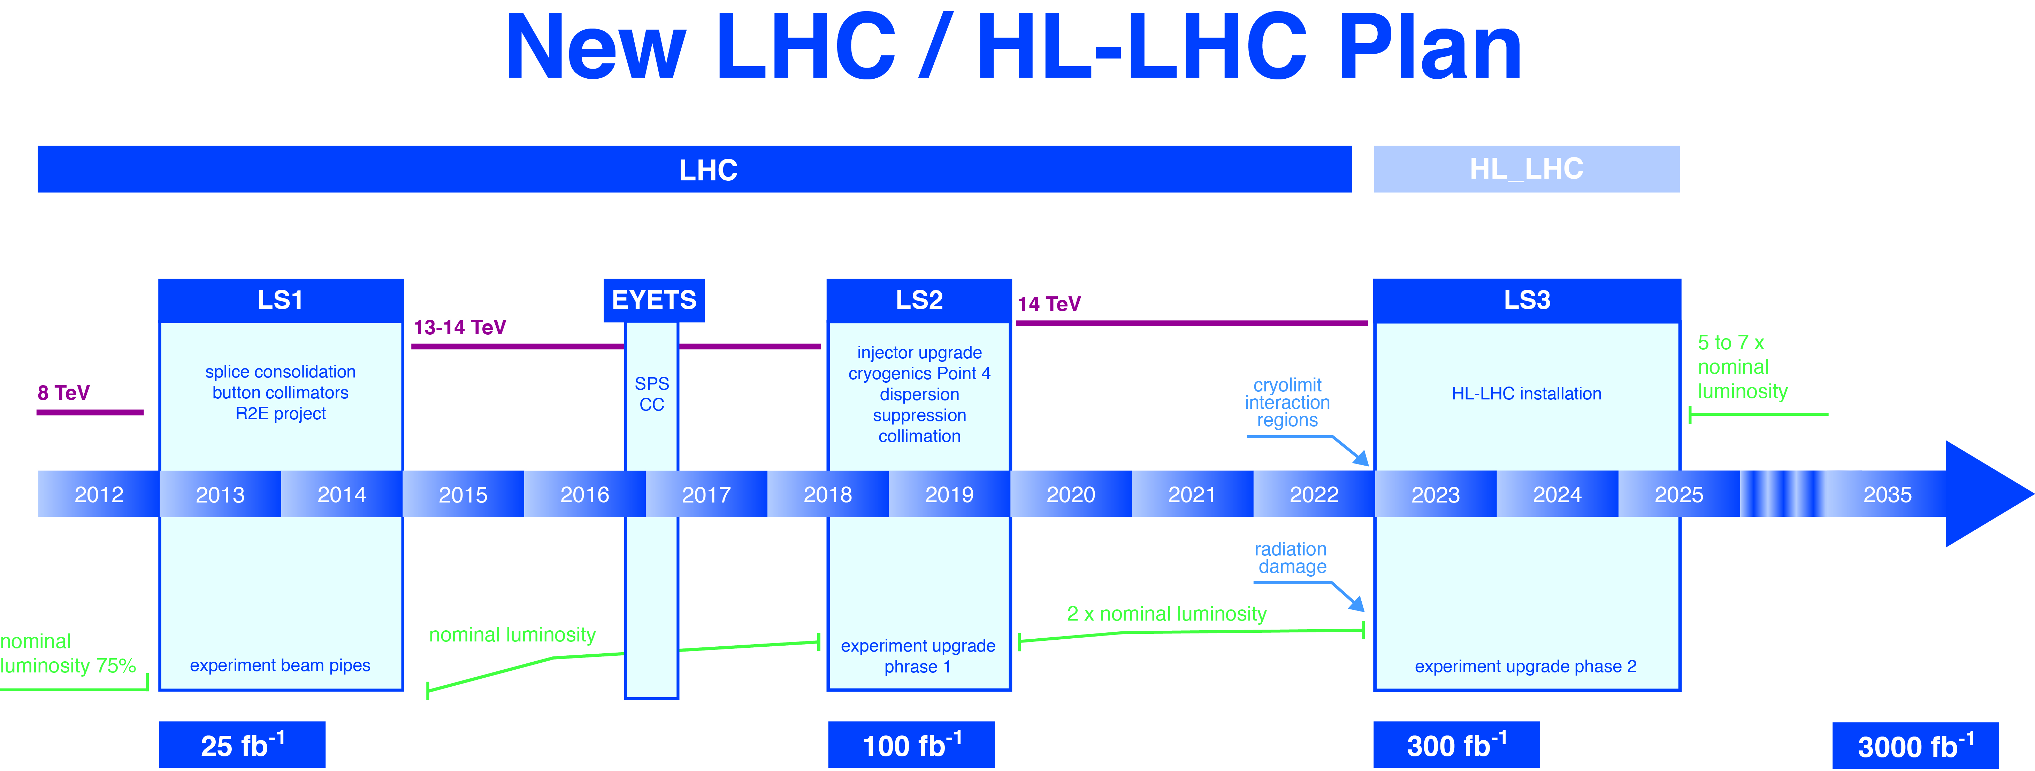
The present and near/medium-term future: LHC and HL-LHC
Schedule
being
updated
L~7x10³³
L=1.3x10³⁴
L=2-3x10³⁴
L=5x10³⁴
Full exploitation of LHC project with HL-LHC (√s ~ 14 TeV, 3000 fb⁻¹) is crucial
Present highest-E accelerator:
detailed direct exploration of the TeV scale up to m ~ 10 TeV
measurements of Higgs couplings to few percent
Results will inform the future

Slide 10
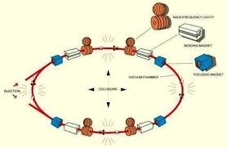
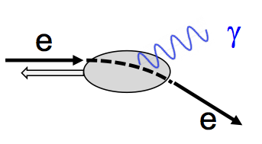
Future high-E e⁺e⁻ colliders
L~ 10³⁴-10³⁵ cm⁻² s⁻¹
√s (GeV) Main physics goals
90 Z-boson precision EW measurements beyond LEP, SLC
180 WW precision physics (mass at threshold)
250 Higgs precision physics (HZ)
350 Higgs precision physics (HZ, Hνν), top precision physics (mass at threshold)
500-3000 ttH, HH (including self-couplings), direct searches for new physics
Complementary
Linear colliders Circular colliders
√s reach multi-TeV limited to < 500 GeV
by synchrotron radiation SR ~ E⁴_{beam}/Rm⁴
Luminosity low repetition rate (few Hz) large number of continuously
→ L from squeezing circulating bunches → larger beam size
beams to ~ nm size → smaller beamstrahlung
→ large beamstrahlung → cleaner environment, smaller E spread
Injection fresh bunches need to short L lifetime (~ 30’) due to burn-off
be injected at each cycle → continuous top-up e± injection
L vs √s increases at high E increases at low E
(beam size decreases) (less SR → RF power accelerates more bunches)
Number of 1 several
interaction regions

Slide 11
International Linear Collider (ILC)
Technical Design
Report released
in June 2013
Total length: 31 km
√s=250 (initial), 500 (design), 1000 (upgrade) GeV
L ~ 0.75-5 x 10³⁴
(running at √s=90, 160, 350 GeV also envisaged)
Main challenges:
~ 15000 SCRF cavities (1700 cryomodules), 31.5 MV/m gradient
1 TeV machine requires extension of main Linacs (50 km) and 45 MV/m
Positron source; suppression of electron-cloud in positron damping ring
Final focus: squeeze and collide nm-size beams
Japan interested to host → decision ~2018 based also on ongoing international discussions
Mature technology: 20 years of R&D experience worldwide
(e.g. European xFEL at DESY is 5% of ILC, gradient 24 MV/m, some cavities achieved > 30 MV/m)
→ Construction could technically start ~2019, duration ~10 years → physics could start ~2030

Slide 12
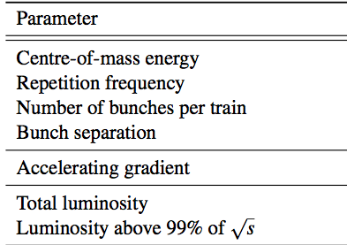
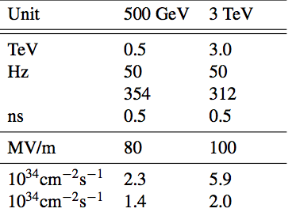
Compact Linear Collider (CLIC)
Conceptual Design Report end 2012
Main challenges:
100 MV/m accelerating gradient
needed for compact (50 km) multi-TeV
(up to 3 TeV) collider
Short (156 ns) beam trains → bunch
spacing 0.5 ns to maximize luminosity
Keep RF breakdown rate small
2-beam acceleration (new concept):
efficient RF power transfer from
low-E high-intensity drive beam
to (warm) accelerating structures
for main beam
Power consumption (~600 MW !)
Preservation of nm size beams and
final focus
Detectors: huge beamstrahlung
background (20 TeV per beam
train in calorimeters at √s=3 TeV)
→ 1-10 ns time stamps needed
(*)
(*) Currently optimizing for initial stage at √s=350 GeV
If decision to proceed in ~2018 → construction could technically start ~2024,
duration ~6 years for √s ≤500 GeV (26 km Linac) → physics could start 2030++

Slide 13
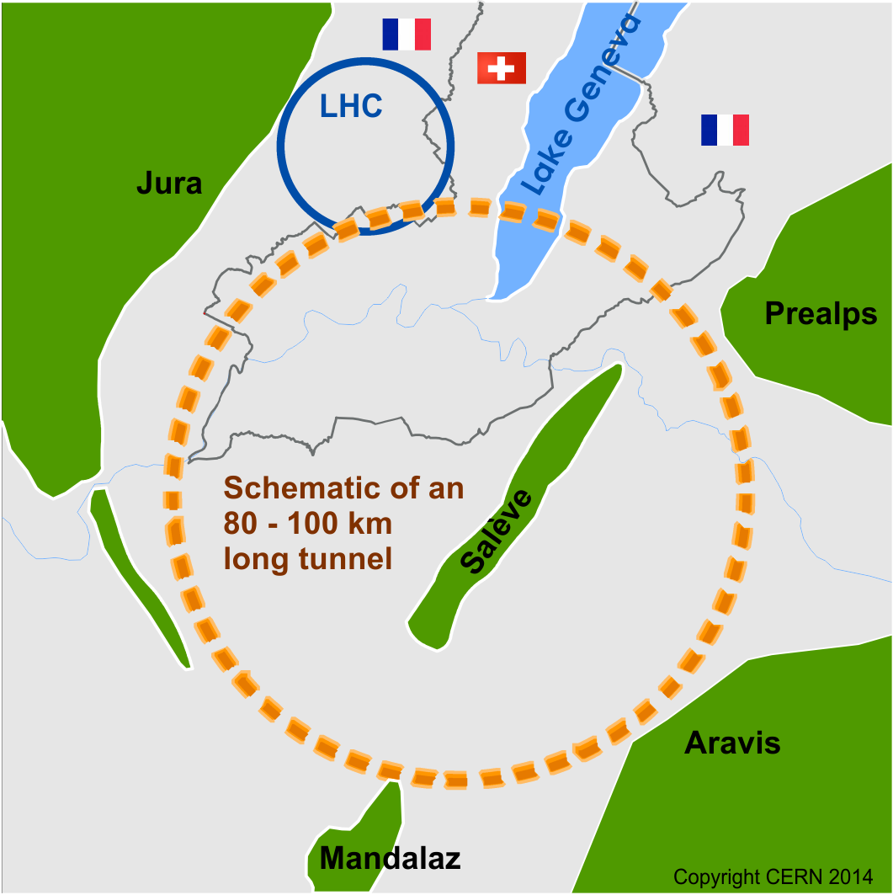

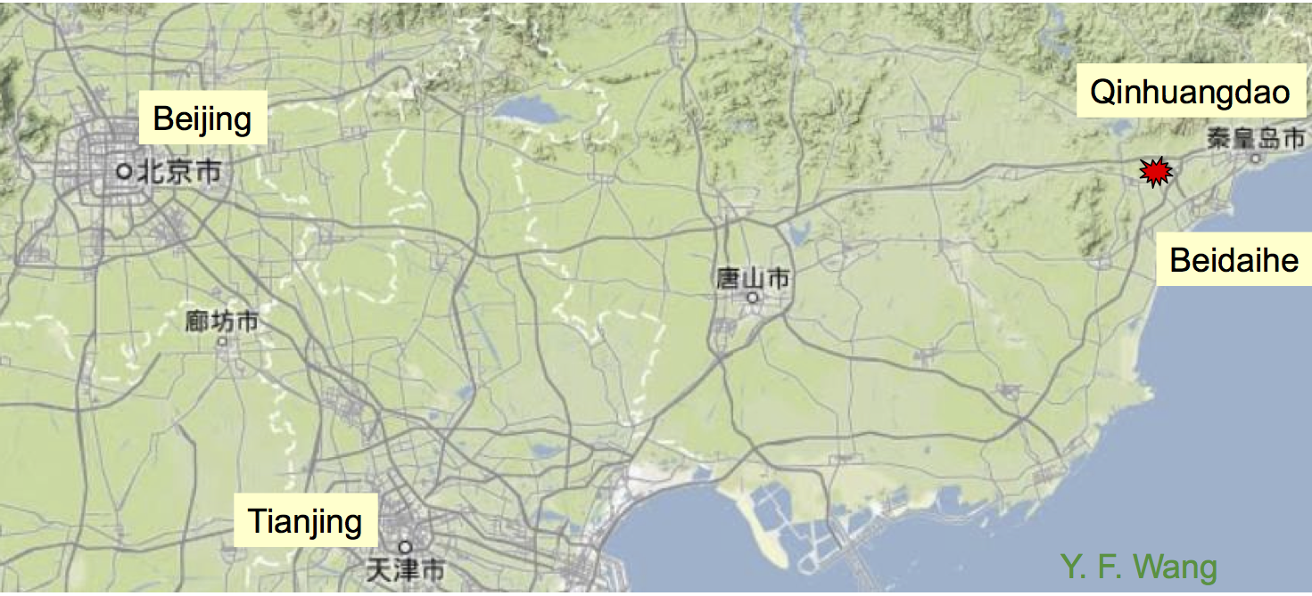
Future high-energy circular colliders
Parameters are indicative and
fast evolving, as no CDR yet
China: 50-70 km e⁺e⁻ √s=240 GeV (CepC)
followed by 50-90 TeV pp collider (SppC)
in same tunnel
50 km e⁺e⁻ machine + 2 experiments:
pre-CDR submitted
construction: 2021-2027
data-taking: 2028-2035
CERN FCC: international design study for
Future Circular Colliders in 80-100 km ring:
100 TeV pp: ultimate goal (FCC-hh)
90-350 GeV e⁺e⁻: possible intermediate step (FCC-ee)
√s= 3.5-6 TeV ep: option (FCC-eh)
Goal of the study: CDR in ~2018.
Possible site:
Qinghungdao
300 km

Slide 14
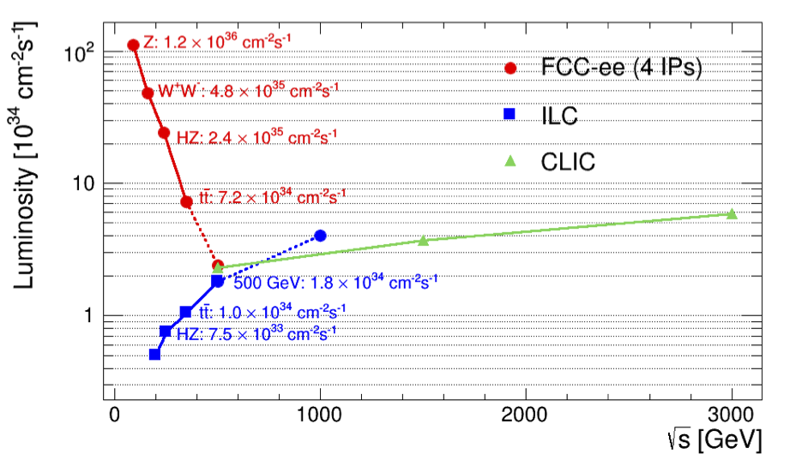
Summary of e⁺e⁻ colliders main parameters
CepC (2 IPs)
Circular
Modified from original version:
http://arxiv.org/pdf/1308.6176v3.pdf
Linear
Some typical energy points only
Size √s RF L per IP Bunch/train σ_{x} σ_{y} Lumi within Long. polarisation
km GeV MV/m 10³⁴ x-ing rate(Hz) μm nm 1% of √s e⁻/e⁺
CEPC 54 240 20 1.8 4x10⁵ 74 160 >99% considered
FCC-ee 100 240 20 6 2x10⁷ 22 45 >99% considered
ILC 31 250 14.7 0.75 5 0.7 7.7 87% 80%/30%
ILC 31 500 31.5 1.8 5 0.5 5.9 58% 80%/30%
CLIC 48 3000 100 6 50 0.04 1 33% 80%/considered

Slide 15
Future pp colliders
Ring (km) Magnets (T) √s (TeV) L (10³⁴)
LHC 27 8.3 14 up to 5
HE-LHC 27 16-20 26-33 5
SppC-1 50 12 50 2
SppC-2 70 19 90 2.8
FCC-hh 100 16 100 ≥ 5
p(TeV) = 0.3 B(T) R(km)
Magnet technology:
Nb₃Sn ok up to 16 T;
HTS=High-Temperature-
Superconductors
needed for 20 T
May reach ~2x10³⁵
More parameters of 100 TeV FCC-hh
HL-LHC FCC-hh
Bunch spacing 25 5-25
N. of bunches 2808 10600
Pile-up 140 170
E-loss/turn 7 keV 5 MeV
SR power/ring 3.6 kW 2.5 MW
Interaction Points 4 4
Stored beam energy 390 MJ 8.4 GJ
Challenges (many, daunting, ...):
magnet technology, tunnel excavation,
stored beam energy, …
As an Airbus 380 at full speed

Slide 16
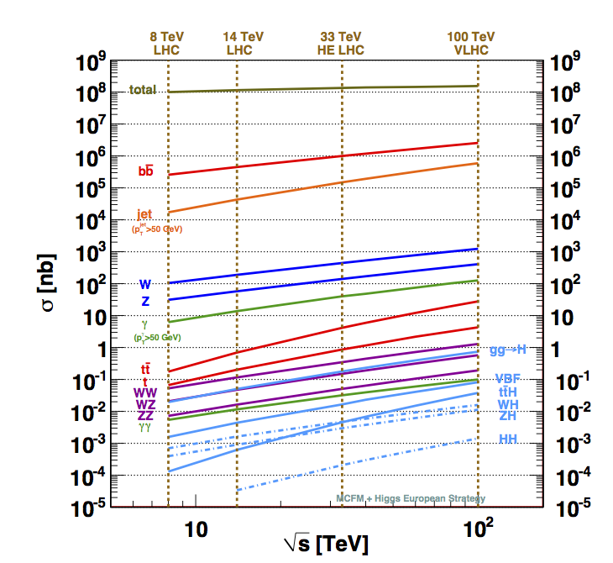
Cross sections vs √s
Process σ (100 TeV)/σ (14 TeV)
Total pp 1.25
W ~7
Z ~7
WW ~10
ZZ ~10
tt ~30
H ~15 (ttH ~60)
HH ~40
stop ~10³
(m=1 TeV)
Snowmass report:
arXiv:1310.5189
→ With 10000/fb at √s=100 TeV expect: 10¹² top, 10¹⁰ Higgs bosons, 10⁸ m=1 TeV stop pairs, …

Slide 17
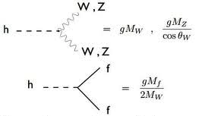
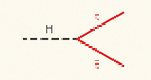
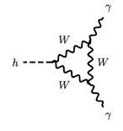
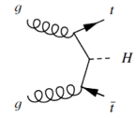
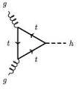
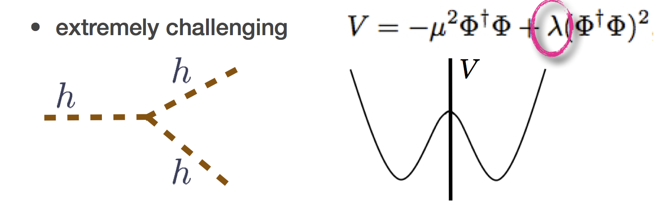
The Higgs boson as a door into new physics ?
Impact of New Physics on Higgs couplings to fermions and bosons
Scenarios exist with no new particles observable at LHC
→ New Physics would appear only through deviations to H couplings
→ 0.1-1% experimental precision needed for discovery
Δκ/κ ~ 5%/Λ²_{NP} (Λ_{NP} in TeV)
Higgs couplings from studies of:
decays (direct or via loops): H→ZZ, WW, γγ(loop), bb, ττ, cc, μμ
production: WH, ZH, ttH, gg → H (loop)
In addition: self couplings H→ HH
~ λ
LHC Run-1: ~20% precision on couplings to bosons and 3rd generation fermion (ttH indirect)
LHC 14 TeV, 300 fb⁻¹ (~2023): 5-10% precision
HL-LHC:
2-5% for most couplings
first direct observation of couplings to top (ttH → ttγγ) and 2nd family fermions (H→ μμ)
Higgs self-coupling ?

Slide 18
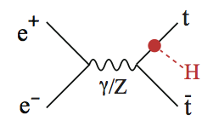
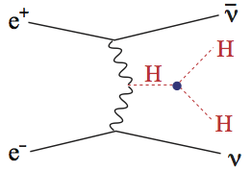
Integrated luminosities correspond to 10 years of running (3-5
years at each √s) for e⁺e⁻ and 5 years with 2 experiments for pp
√s (TeV) L (ab⁻¹) N_{H} (10⁶) N_{ttH} N_{HH}
FCC-ee* 0.24+0.35 10 2 -- --
ILC 0.25+0.5 0.75 0.2 1000 100
ILC-1TeV 0.25+0.5+1 1.75 0.5 3000 400
CLIC 0.35+1.4+3 3.5 1.5 3000 3000
ttH, HH: heavy final states
→ require energy (≥ 0.5 TeV) !
HL-LHC 14 3 180 3600 ttγγ 250 bbγγ
FCC-hh 100 6 5400 12000 tt4l 20000 bbγγ
* 4 IP
<10% of events usable
Couplings to “light particles”
K_{W} , K_{Z} , K_{g} , K_{c} , K_{τ} , K_{b} :
best measurements (few 0.1%) at
FCC-ee (clean; luminosity)
Couplings derived from heavy final states:
K_{t} : best measurements (≤5%) at
HL-LHC, ILC(1000), CLIC, FCC-hh
K_{HH} (self-couplings): best measurements (~ 10%)
at ILC(1000), CLIC, FCC-hh
(heavy final state → energy)
Rare decays: K_{μ} , K_{γ}
Best measurements (few 1%) at
HL-LHC, FCC-ee, FCC-hh, ILC (1000), CLIC
(luminosity and/or energy)

Slide 19
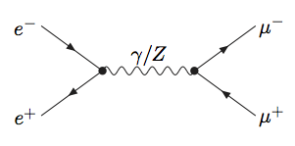
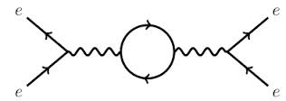
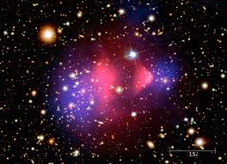
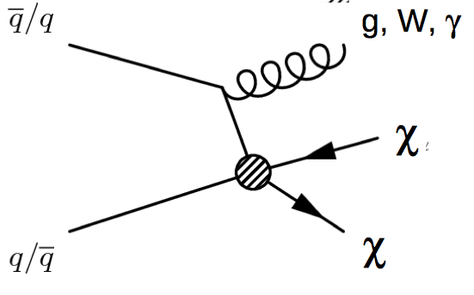
Direct and indirect sensitivity to high-E new physics
e⁺e⁻ colliders
Direct: discovery potential for new particles
coupling to Z/γ* up to m ~ √s/2
Indirect: via precise measurements
→ ILC/CLIC/FCC-ee can probe up to Λ_{NP}~O(100) TeV
p⁺
*
p⁻
HL-LHC (3000 fb⁻¹) :
Direct: discovery potential up to m~10 TeV for single particles (~30% larger than 300 fb⁻¹)
Indirect sensitivity up to ~50 TeV (e.g. quark compositeness scale)
A 100 TeV pp collider is the instrument to explore the 10-50 TeV E-scale directly
Examples:
Discovery potential for excited quarks q* (expected if quarks are composite): m ~ 50 TeV
Discovery potential for Z’ (expected if additional forces exist): m ~ 30 TeV
Discovery potential for SUSY squarks and gluinos (pair produced): m ~ 15 TeV
SUSY has excellent candidate
for dark matter (lightest
neutralino χ⁰): discovery reach
up to ~ 4 TeV → cover most
of region allowed by cosmology
Mono-jet/γ/W from initial-state radiation provides
trigger
χ⁰ are invisible
→ missing E
SUSY would also explain why Higgs mass is so light (“naturalness” problem)

Slide 20
Conclusions
The extraordinary success of the LHC is the result of the ingenuity, vision and perseverance of the worldwide HEP community, and of more than 20 years of
talented, dedicated work → the demonstrated strength of the community is an
asset also for future, even more ambitious, projects.
With the discovery of a Higgs boson, after > 50 years of superb theoretical and
experimental work the SM is now complete. However major questions remain.
The full exploitation of the LHC, and more powerful future accelerators, will be
needed to address them and to advance our knowledge of fundamental physics.
No doubt that future high-E colliders are extremely challenging projects
Didn’t the LHC also look close-to-impossible in the ’80s ??
However: the correct approach, as scientists, is not to abandon our exploratory
spirit, nor give up to financial and technical challenges. The correct approach is
to use our creativity to develop the technologies needed to make future projects
financially and technically affordable
We already did so in the past … →

Slide 21
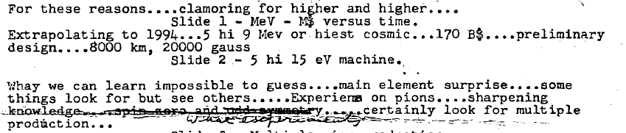
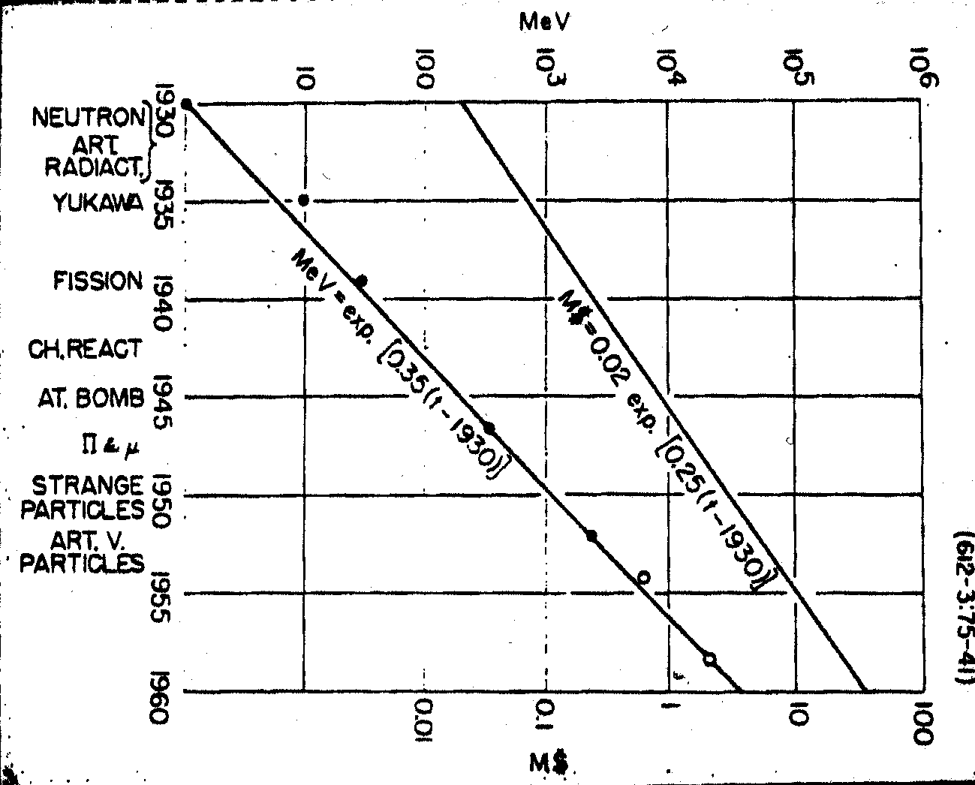
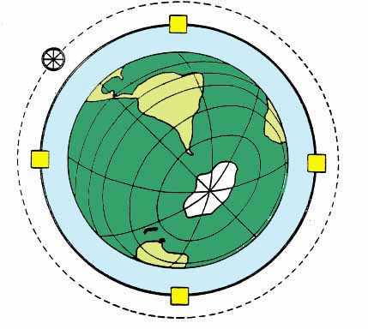
From E. Fermi, preparatory notes for a talk on
“What can we learn with High Energy Accelerators ? ”
given to the American Physical Society, NY, Jan. 29th 1954
Fermi’s extrapolation to year 1994:
2T magnets, R=8000 km (fixed target !),
E_{beam} ~ 5x10³ TeV → √s ~ 3 TeV
Cost : 170 B$
Was that hopeless ??
We have found the solution:
we have invented colliders
and superconducting magnets …
and built the Tevatron and the LHC

Slide 22

THANK YOU !

Slide 23
SPARES

Slide 24

How to choose the future high-E collider project(s) ?
LHC Run-1 brought us a certitude: the Higgs boson as the key of EWSB
H(125) needs to be studied with the highest precision → door to new physics ?
→ low m_{H} makes H accessible to both circular and linear colliders, with different pros/cons
complete exploration of EWSB needed (HH production, V_{L}V_{L} scattering, look for possible
new dynamics, etc. ) → requires multi-TeV energies
LHC Run-2 and beyond may (hopefully !) bring additional “no-lose theorems”:
if new (heavy) physics is discovered
→completion of spectrum and detailed measurements of new physics likely
require multi-TeV energies
if indications emerge for the scale of new physics in the 10-100 TeV region
(e.g. from dijet angular distributions → Λ compositeness)
→ need the highest-energy pp collider to probe directly the scale of new physics
Regardless of the detailed scenario, and even in the absence of theoretical/experimental preference for a specific E scale, the directions for future high-E colliders are clear:
highest energy → to explore directly E scales of 10-100 TeV
highest precision → to probe the largest E scales indirectly → possibly up to few 1OO TeV
Thanks also to great technology progress, many scientifically strong opportunities
are available: none of them is easy, none is cheap.
Decision on how to proceed, and the time profile of the projects, depends on science (LHC
results), technology maturity, cost and funding availability, global (worldwide) perspective

Slide 25
Main questions in today’s particle physics
Higgs boson and EWSB
m_{H} natural or fine-tuned ?
→ if natural: what new physics/symmetry?
does it regularize the divergent V_{L}V_{L} cross-section
at high M(V_{L}V_{L}) ? Or is there a new dynamics ?
elementary or composite Higgs ?
is it alone or are there other Higgs bosons ?
origin of couplings to fermions
coupling to dark matter ?
does it violate CP ?
cosmological EW phase transition
(is it responsible for baryogenesis ?)
Neutrinos:
ν masses and and their origin
what is the role of H(125) ?
Majorana or Dirac ?
CP violation
additional species ? sterile ν ?
Dark matter:
composition: WIMP, sterile neutrinos,
axions, other hidden sector particles, ..
one type or more ?
only gravitational or other interactions ?
The two epochs of Universe’s accelerated expansion:
primordial: is inflation correct ?
which (scalar) fields? role of quantum gravity?
today: dark energy (why is Λ so small?) or
gravity modification ?
Quarks and leptons:
why 3 families ?
masses and mixing
CP violation in the lepton sector
matter and antimatter asymmetry
baryon and charged lepton
number violation
Physics at the highest E-scales:
how is gravity connected with the other forces ?
do forces unify at high energy ?

Slide 26
LHC schedule beyond LS1
LS2 starting in 2018 (July) => 18 months + 3 months BC
LS3 LHC: starting in 2023 => 30 months + 3 months BC
Injectors: in 2024 => 13 months + 3 months BC
Physics
Shutdown
Beam commissioning
Technical stop
30 fb⁻¹
YETS
EYETS
YETS
LS 2
YETS
Run 2
Run 3
Run 2
LS 2
Run 3
YETS
LS 3
Run 4
YETS
LS 3
Run 4
300 fb⁻¹
LS 4
Run 5
LS 5
LS 4
Run 5
LS 5
(Extended) Year End Technical Stop: (E)YETS
3’000 fb⁻¹
LHC schedule approved by CERN management and LHC experiments spokespersons and technical coordinators (December 2013)

Slide 27
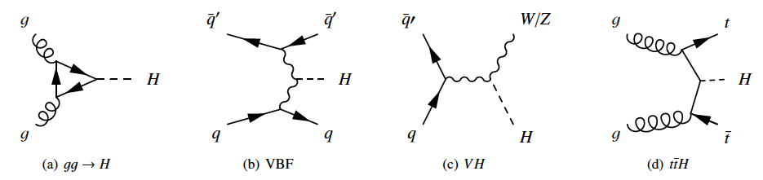
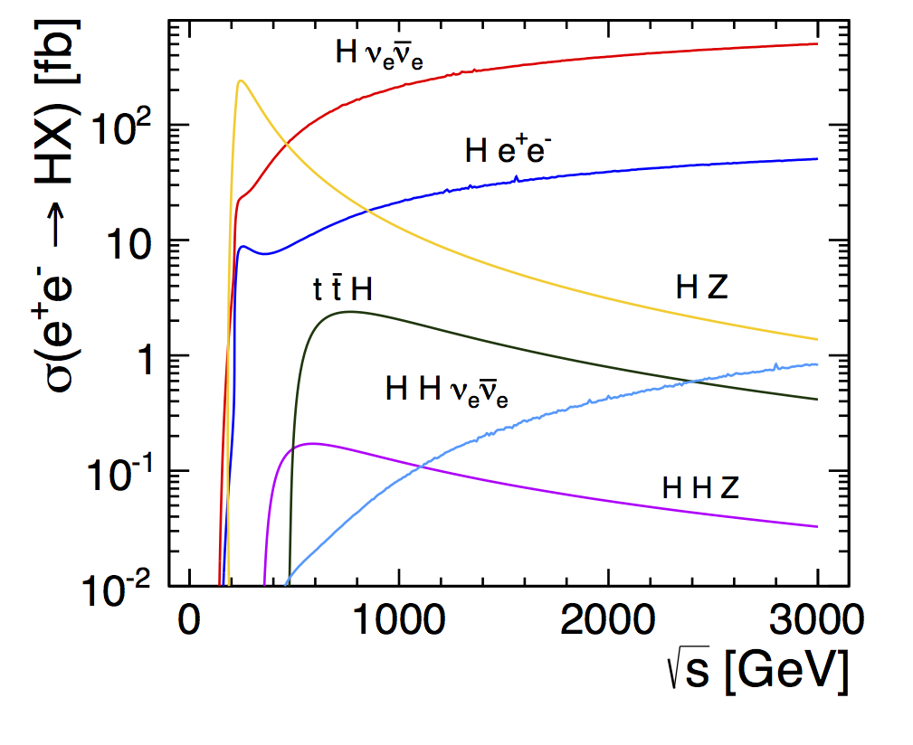
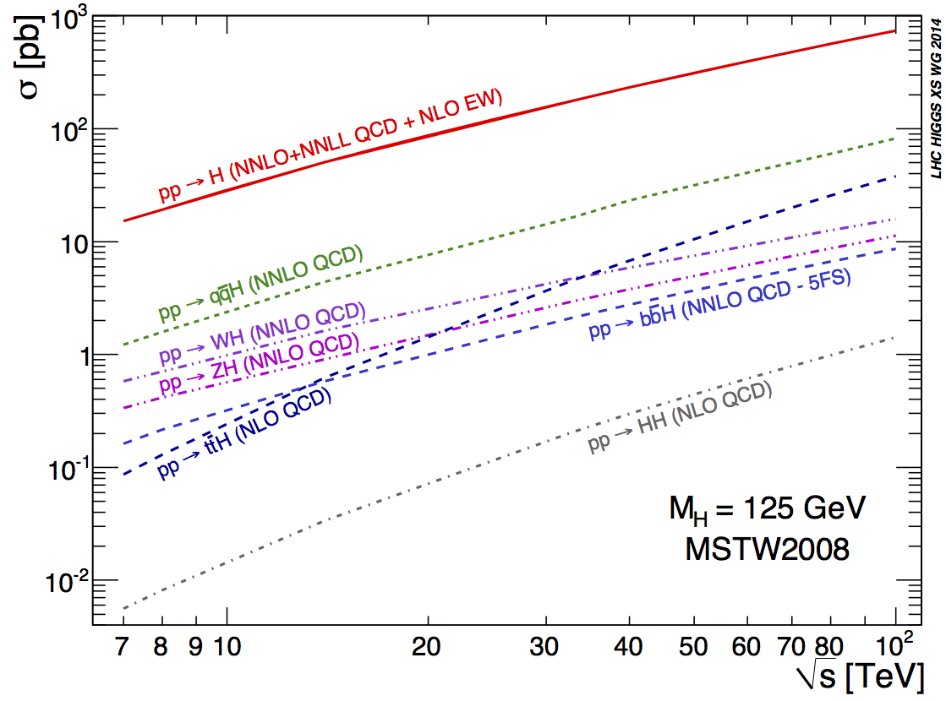
Higgs production vs √s
e⁺e⁻ colliders
pp colliders

Slide 28
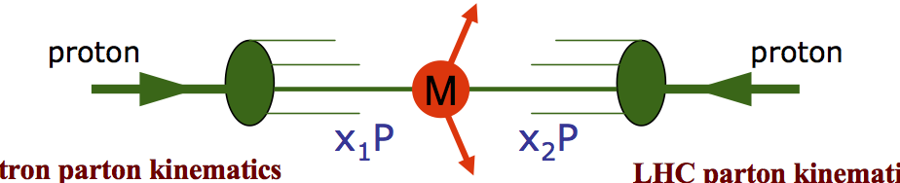

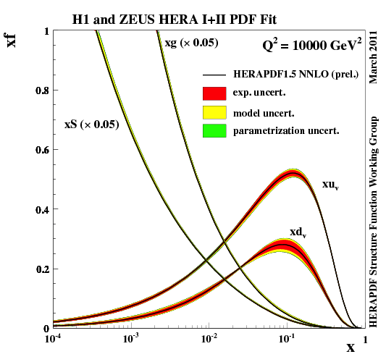
Parton Distribution Functions (PDF)
in the proton for Q² ~ m_{H}²
Elementary cross-sections scale like ~ 1/s.
However, for a fixed mass M of the
produced particle, the needed x_{1,2} to
produce it decrease with increasing √s.
Since the number of gluons increases
dramatically at small x, the resulting
cross-section increases with √s
(LHC and future hadron machines can be de
facto considered as “gluon-gluon colliders”)
√s ~100 TeV
√s ~14 TeV

Slide 29
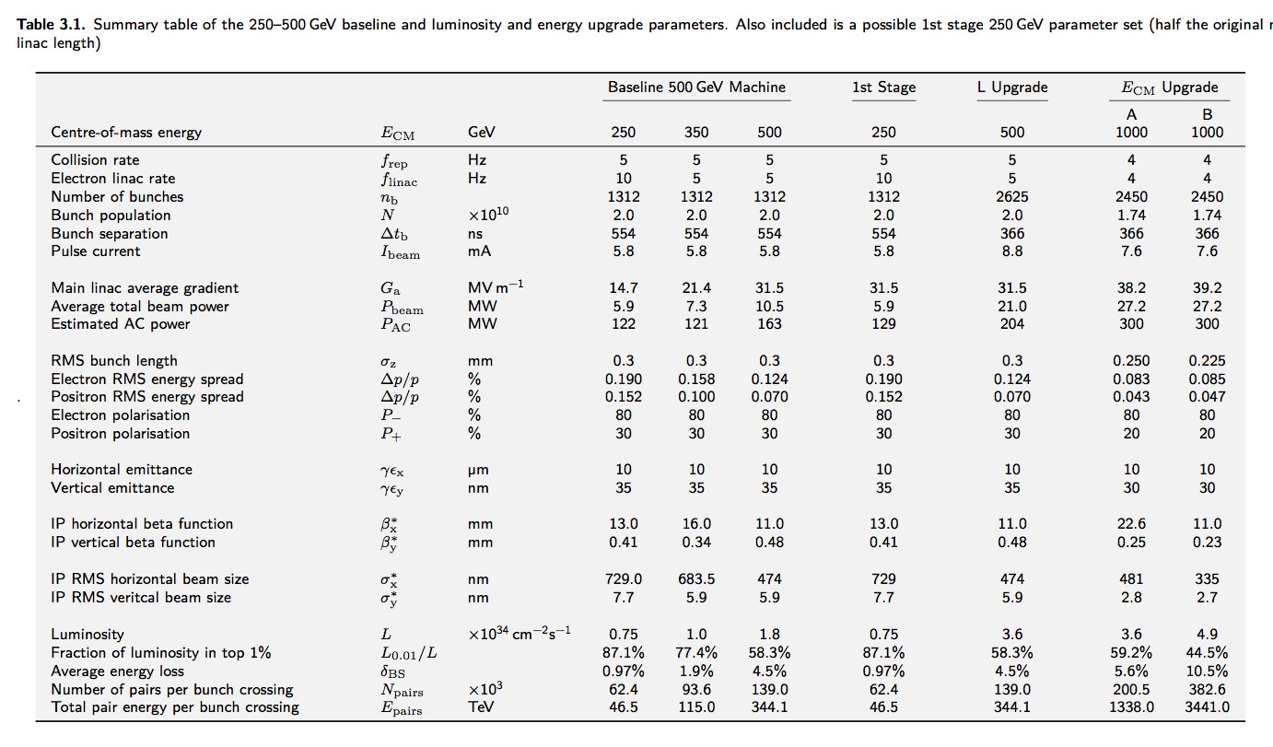

Slide 30
CEPC 参数表
Number of IPs | 2
Energy (GeV) | 120
Circumference (km) | 53.6
SR loss/turn (GeV) | 3.01
N_{e}/bunch (10¹¹) | 3.71
Bunch number | 50
Beam current (mA) | 16.6
SR power /beam (MW) | 50
B₀ (T) | 0.065
Bending radius (km) | 6.1
Momentum compaction (10⁻⁴) | 0.415
β_{IP} x/y (m) | 0.8/0.0012 (ratio:667)
Emittance x/y (nm) | 6.8/0.02 (ratio:333)
Transverse σ_{IP} (um) | 73.7/0.16 (ratio:470)
ξ_{x}/IP | 0.104
ξ_{y}/IP | 0.074
V_{RF} (GV) | 6.87
f _{RF} (MHz) | 700
Nature bunch length σ_{z} (mm) | 2.26
Bunch length include BS (mm) | 2.6
Nature Energy spread (%) | 0.13
Energy acceptance RF(%) | 5.4
Energy acceptance(%) | 2
n_{γ} | 0.22
δ_{BS} (%) | 0.07
Life time due to beamstrahlung-Telnov (minute) | 2028
Life time due to simulation (minute) | 150
L_{max}/IP (10³⁴cm⁻²s⁻¹) | 1.82

Slide 31
SppC参数表
Physics performance and beam parameters
Peak luminosity per IP | 1.0E34 | 5.0E34 | 5.0E34 | 5.0E34 | 1.2E+35 | cm⁻²s⁻¹
Beta function at collision | 0.55 | 0.15 | 0.35 | 1.1 | 0.75 | m
Circulating beam current | 0.584 | 1.12 | 0.478 | 0.5 | 1.0 | A
Max beam-beam tune shift perIP | 0.01 | 0.015 | 0.01 | 0.01 | 0.0075
Bunch separation | 25 | 25 | 25 | 25 5 | 25 | ns
Number of bunches | 2808 | 2808 | 2808 | 10600（8900） 53000（44500） | 5333
Bunch population | 1.15E11 | 2.2E11 | 1.0E11 | 1.0E11 | 2.0E+11
Normalized rms transverse emittance | 3.75 | 2.5 | 1.38 | 2.2 | 3.3 | mm
Beam life time due to burn-off | 45 | 15.4 | 5.7 | 19.1/15.9 | 8.7 | hour
Total / inelastic cross section | 111/85 | 111/85 | 129/93 | 153/108 | 140 | mbarn
Reduction factor in luminosity（F） |  |  |  |  | 0.85
Full crossing angle | 285 | 590 | 185 | 74 | 139 | mrad
rms bunch length | 75.5 | 75.5 | 75.5 | 80/75.5 | 75.5 | mm
rms IP spot size | 16.7 | 7.1 | 5.2 | 6.8 | 8.5 | mm
Beta at the 1st parasitic encounter |  |  |  |  | 19.5 | m
rms spot size at the 1st parasitic encounter |  |  |  |  | 43.3 | mm
Stored energy per beam | 0.392 | 0.694 | 0.701 | 8.4/7.0 | 5.4 | GJ
SR power per ring | 0.0036 | 0.0073 | 0.0962 | 2.4/2.9 | 1.5 | MW
Arc SR heat load | 0.17 | 0.33 | 4.35 | 28.4/44.3 | 45.8 | W/m
Energy loss per turn | 0.0067 | 0.0067 | 0.201 | 4.6/5.86 | 1.49 | MeV

Slide 32
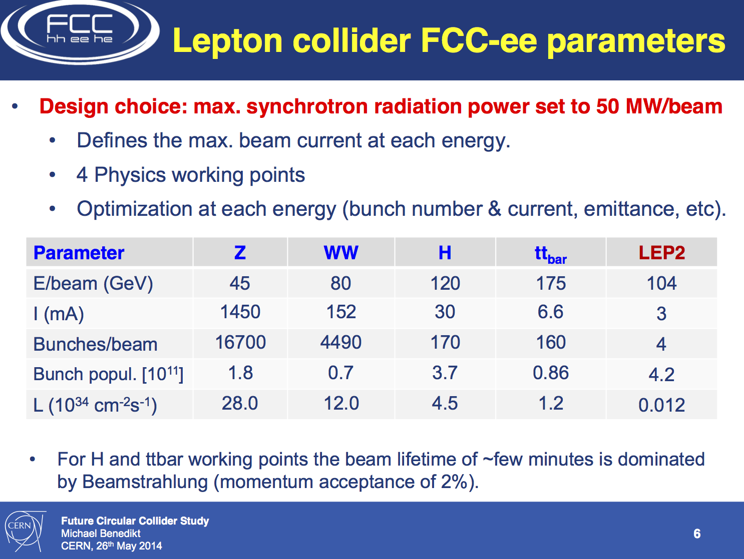
Circular e⁺e⁻ colliders

Slide 33
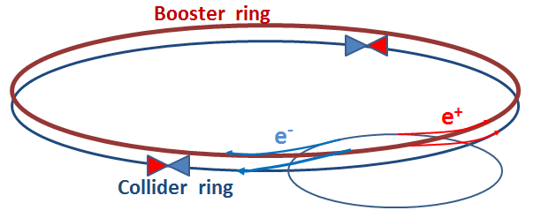
CepC FCC-ee
Ring (km) 53.6 100
√s (GeV) 240 240 350 90
E loss per turn (GeV) 3 1.7 7.5 0.03
Total RF voltage (GV) 6.9 5.5 11 2.5
Beam current (mA) 16.6 30 6.6 1450
N. of bunches 50 (one ring!) 1360 98 16700
L (10³⁴ cm⁻² s⁻¹)/IP 1.8 6 1.8 28
e±/bunch (10¹¹) 3.7 0.46 1.4 1.8
σ_{y}/σ_{x} at IP (μm) 0.16/74 0.045/22 0.045/45 0.25/121
Interaction Points 2 4 4 4
Lumi lifetime (min) 60 21 15 213
SR power/beam 50 MW 50 MW
Main challenges:
FCC ring size
Synchrotron radiation → 100 MW RF system
with high efficiency
Beam polarization for beam energy calibration at Z-pole and
WW threshold to <100 keV to measure m_{Z}, m_{W} to < MeV at FCC-ee
Machine design with large energy acceptance over full √s span
Note: Super-KEKB is an excellent “prototype”, with more stringent requirements on
positron rate, momentum acceptance, lifetime, β_{y}*

Slide 34
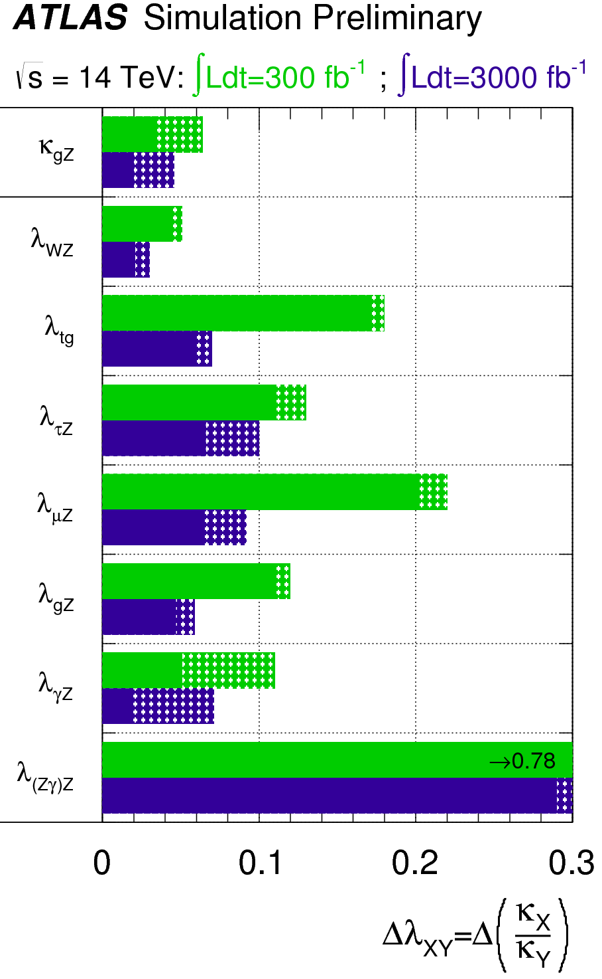
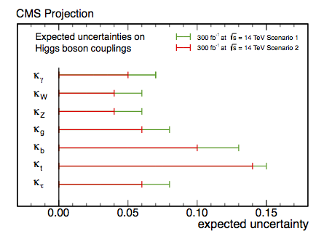
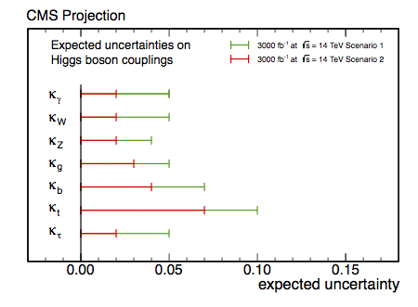
Measurements of Higgs couplings
300 fb⁻¹
Dashed:
theoretical
uncertainty
Scenario 1 (pessimistic): systematic
uncertainties as today
Scenario 2 (optimistic): experimental
uncertainties as 1/√L, theory halved
k_{i}= measured
coupling
normalized
to SM
prediction
λ_{ij}=k_{i}/k_{j}
3000 fb⁻¹
Main conclusions:
3000 fb⁻¹: typical precision 2-10% per
experiment (except rare modes)
→ 1.5-2x better than with 300 fb⁻¹
Crucial to also reduce theory uncertainties

Slide 35
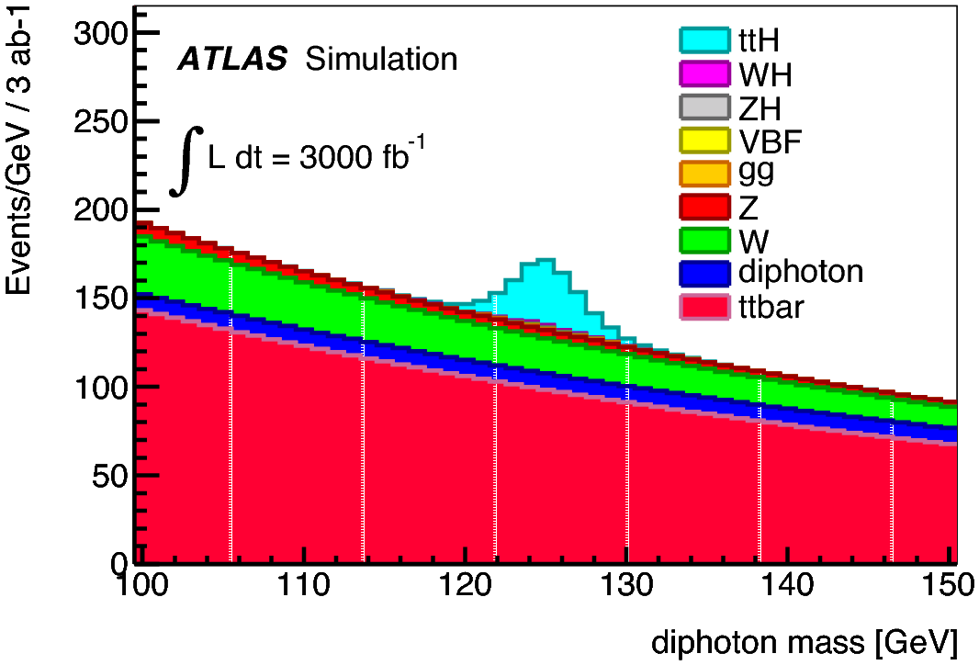
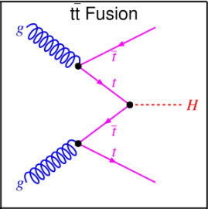
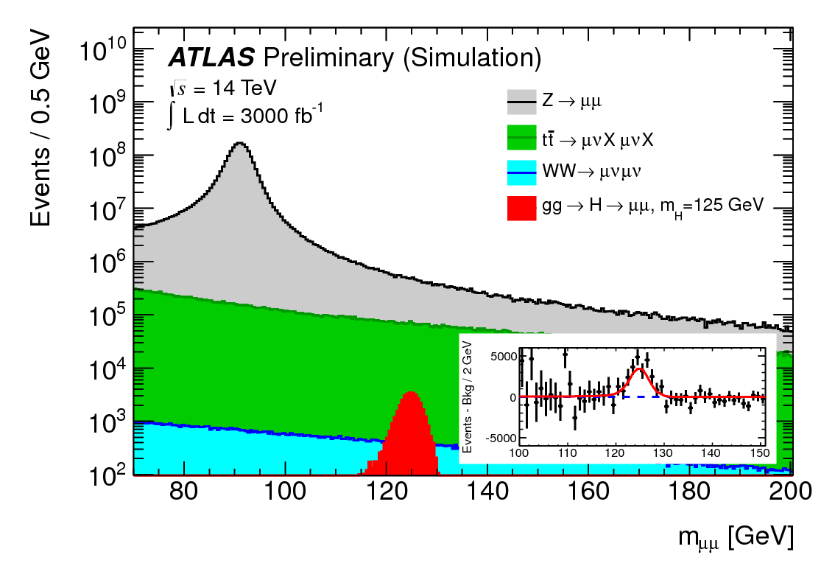
ttH production
with H → γγ
Gives direct access to Higgs-top
coupling (intriguing as top is heavy)
Today’s sensitivity: 6xSM cross-section
With 3000 fb⁻¹ expect 200 signal
events (S/B ~ 0.2) and > 5σ
Higgs-top coupling can be
measured to about 10%
H →μμ
Gives direct access to Higgs couplings
to fermions of the second generation.
Today’s sensitivity: 8xSM cross-section
With 3000 fb⁻¹ expect 17000 signal events
(but: S/B ~ 0.3%) and ~ 7σ significance
Higgs-muon coupling can be
measured to about 10%

Slide 36



Higgs cross
sections
(LHC HXS WG)
g_{HHH}~ λv
Higgs self-couplings difficult to measure at any facility (energy is mainly needed ..)
HL-LHC studies not completed yet … ~30% precision expected, but need 3000 fb⁻¹

Slide 37


Slide 38


VBS

Slide 39



The problem of the stability of the Higgs mass a.k.a “naturalness” problem
As any other particle (e±, …) in quantum mechanics Higgs mass receives radiative corrections
Mostly small, except top contribution: ~ m_{t}²Λ²
Λ² = energy scale up to which the SM is valid
(or, equivalently, new physics sets in)
bare
2 solutions
1) “Naturalness”: Higgs mass stabilized by new physics that cancel the divergences.
E.g. SUSY: the contribution of the supersymmetric partner of the top (stop)
gives rise to the same contribution with opposite sign → cancellation
BUT: cancellation only works if
stop mass not much larger than
top mass → this is one of most
compelling motivations for SUSY
(or new physics) at TeV scale
2) “Fine tuning”: the bare mass cancels the radiative corrections → this becomes more and
more “acrobatic” the higher the scale Λ up to which SM is valid (w/o new physics)
E.g. Λ = 10 TeV → M² (rad. corr) = 8265625 GeV² → need fine-tuned M_{bare}² = 8281250 GeV²
to get M_{H}²= (125 GeV)² = 15262 GeV²
Λ= 10¹⁹ GeV → need fine tuning of M_{bare} to the 33rd digit !! → UNNATURAL

Slide 40


To stabilize the Higgs mass (without too much fine-tuning), the stop should not be
much heavier than ~ 1-1.5 TeV (note: the rest of the SUSY spectrum can be heavier)
Present
limits
Mass reach extends by ~ 200 GeV
from 300 to 3000 fb⁻¹
most of best motivated mass
range will be covered at HL-LHC

Slide 41


Slide 42


Why is the Higgs so light ?
Need new physics (close-by, ~TeV scale)
to “stabilize” the divergent Higgs mass
In the SM, corrections to m_{H}
diverge as ΔM_{H}² ~Λ² (Λ = E scale
up to which SM is valid)
“Naturalness” problem
E.g. the SUSY partner of the top (stop) gives rise to
same diagram with opposite sign → cancellation
Searches for stop quarks so far unsuccessful
HL-LHC can probe up to 1.5 TeV
HL-LHC, 14 TeV 3000 fb⁻¹
Dark Matter searches
FCC-hh, 100 TeV 5000 fb⁻¹
Fraction of minimal SUSY parameter space that can
be excluded at 95% CL by present experimental
constraints and direct DM searches at pp colliders
Arbey, Battaglia, Mahmoudi

Slide 43
A 100 TeV pp collider would allow a definitive exploration of EWSB
By providing direct access
to EW theory in the unbroken regime
(√ŝ >> v=246 GeV)
V_{L}V_{L} scattering violates unitarity
at m_{VV} ~TeV without Higgs
exchange diagrams
KEYWORD: ENERGY !
Important to verify that:
H (125) regularizes the theory → a crucial “closure test” of the SM
Or, else: observe deviations in VV production compared to SM expectation → anomalous quartic (VVVV) gauge couplings and/or new heavy resonances → new physics
(Note: several models predict SM-like Higgs but different physics at high E)
ILC 1 TeV, 1 ab⁻¹ : indirect sensitivity to new resonances up to m~6 TeV (exploit e± polarization)
CLIC 3 TeV, 1 ab⁻¹ : indirect sensitivity to composite Higgs scale Λ~30 TeV from VV→ hh
100 TeV pp: huge cross-sections at high-mass: σ ~ 100 fb m_{WW}> 3 TeV; σ ~ 1 fb m_{HH} > 2 TeV
→ detailed direct studies

Slide 44



Evidence for EW VBS reported recently by ATLAS
in pp → W±W± jj channel giving 2 same-sign
leptons and 2 high-mass jets (m_{jj} > 500 GeV)
Significance of EW VBS signal: ~3.6σ
for large rapidity gap between 2 jets
Tagging these forward quarks
(jets) is crucial signature to
distinguish EW VBS from
the background
HL-LHC: measure SM EW cross-section to 10%; x2 higher sensitivity to anomalous couplings
than LHC@300 fb⁻¹, ~5% precision on parameters if new physics observed at LHC@300 fb⁻¹
ILC 1 TeV, 1 ab⁻¹ : indirect sensitivity to new resonances up to m~6 TeV (exploit e± polarization)
CLIC 3 TeV, 1 ab⁻¹ : indirect sensitivity to composite Higgs scale Λ~30 TeV from VV→ hh
100 TeV pp: huge cross-sections at high-mass: σ ~ 100 fb m_{WW}> 3 TeV; σ ~ 1 fb m_{HH} > 2 TeV
→ detailed direct studies
5
6
p_{T}^{j} >25 GeV
Maximum jet rapidity vs √s
calorimeter coverage over |η| ≥ 6 needed
at 100 TeV pp collider (ATLAS, CMS: |η|< 5)
→ challenging: pile-up, radiation, … !!
Contino et al.
|η| max jet

