Slide 1
Baryogenesis via mesino oscillations
Akshay Ghalsasi, dave mckeen, ann nelson
Invisibles 2015

Slide 2
Introduction to Baryogenesis
Universe is made up of baryons η = 5 x10⁻¹⁰
Sakharov conditions
Baryon number violation
C and CP Violation
Departure from thermal equilibrium
Motivation to make baryogenesis work at low temperatures

Slide 3
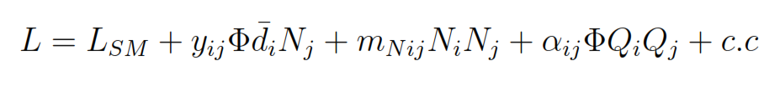
Lagrangian and mass hierarchy
colored scalars
singlet fermions
CP violation
B violation
N_{2,3}
O(TeV)
M
N₁

Slide 4
General Idea
T
N₃
T = 200 MeV
N
s
s*
CP Violation
Baryons

Slide 5
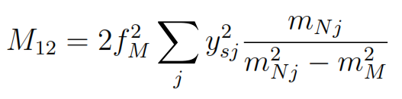
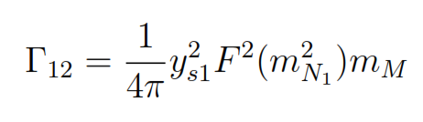
Oscillations
Off shell diagrams
s*
N₂
M
M*
s
N₂
O(TeV)
O(GeV)
M
M*
M
O(GeV)
N₁
s*
On shell diagrams via common final states
N₁
M
M*
s

Slide 6
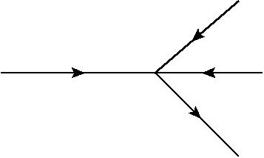
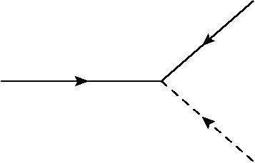

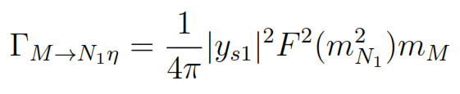
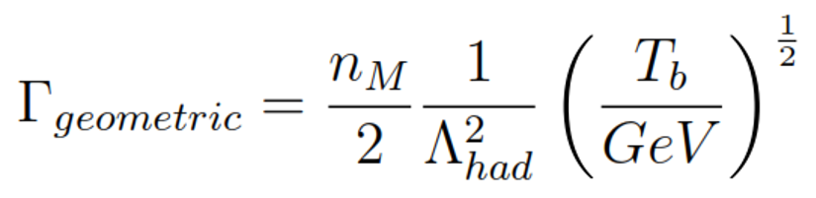


Decays and Annihilations
Decays
Annihilations
Q
N₁
M
Q
M
$$\overline{d}$$
$$η$$

Slide 7
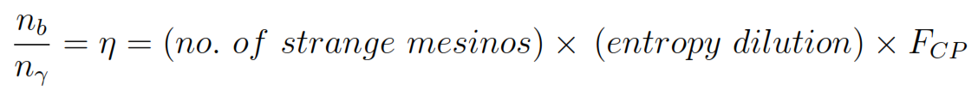

Maximum possible baryogenesis
The baryogenesis is given by
Maximum baryogenesis is given by

Slide 8
Conclusions and Future Work
This model gives us baryogenesis
Baryogenesis happens at MeV scale, hence don’t have to rely on a high reheating temperature
Energy scales around TeV so interesting for collider physics
Might be observable in Kaon anti Kaon oscillation
Mechanism can be used to generate asymmetric DM

Slide 9
Baryon Violation
Mesino Oscillation
Baryogenesis

