Slide 1


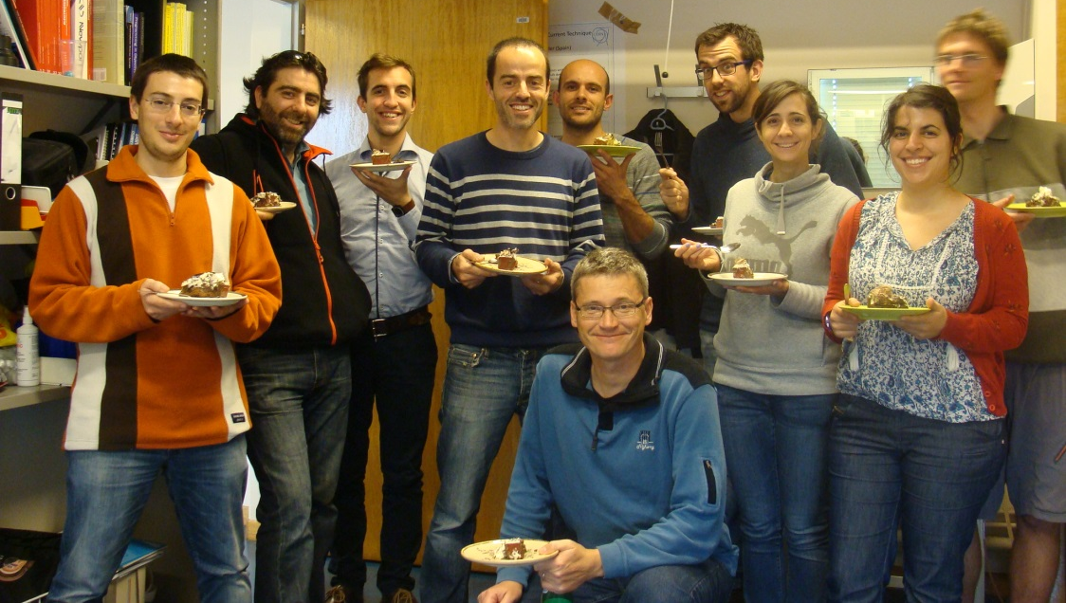
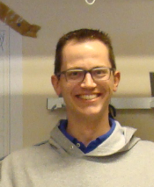
PH-DT-DD: SSD-Solid State Detectors
PH-DT-DD Meeting – 27.11.2015
R&D: Development of radiation tolerant silicon detectors
in the framework of RD50 and CMS
Service: Characterization of semiconductor detectors
The team today (CERN & visitors):
Esteban
Isidro
Hannes
Visiting Scientist:
Marcos Fernandez Garcia
Joaquin Gonzalez
Trainee/FTEC:
Celso Manuel
Pitaes Figueiredo
Isidro Mateu Suau (0.5 FTE)
CERN Staff
Michael Moll (0.5 FTE)
Julien
PhD students:
Hannes Neugebauer
Sofia OTERO UGOBONO
Laura Franconi
Esteban Curras Rivera
Fellow
Christian Gallrapp
Joaquin
Marcos
Celso
Laura
Sofia
Michael
Christian

Slide 2
Present Projects and Services
SSD activities at CERN
RD50 Collaboration
  Steering and Management of the RD50 collaboration (50 Institutes, 300 members)
    Michael is Co-Spokesperson, Maurice budget holder, Veronique secretary
  Characterization and simulation of radiation effects in silicon devices
    Development of characterization tools (TSC, edge-TCT, Two-Photon TCT, …)
    Measure damage parameter (CV,IV, CCE, TCT) and defect properties (TSC, I-DLTS)
    Simulate detector performance (TCAD, TRACS)
    Defect/Material engineering: p/n-type, different resistivity, impurities,…
  LGAD (Low Gain Avalanche Detectors) and APDs (Avalanche Particle Detectors)
    Fast timing applications
    Charge amplification in highly damaged detectors
  3D detectors, CMOS sensors, …
CMS Collaboration
  Sensor Development for the High Granularity Calorimeter (HGC)
Service
  Measurement of sensors for/with external groups
….its all about silicon sensors
and their application as HEP detector.

Slide 3
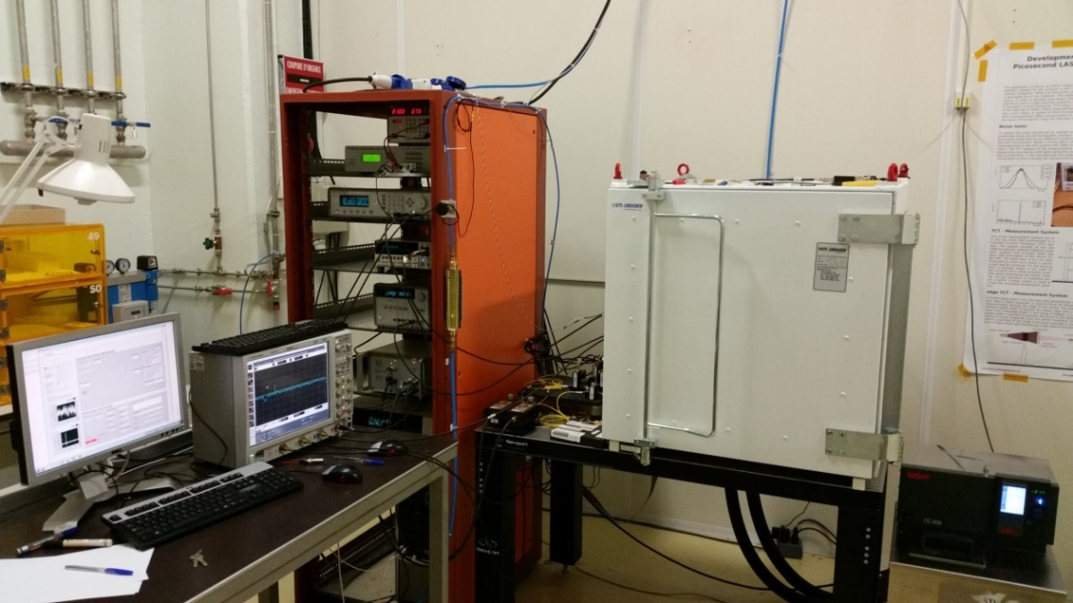
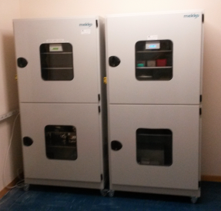
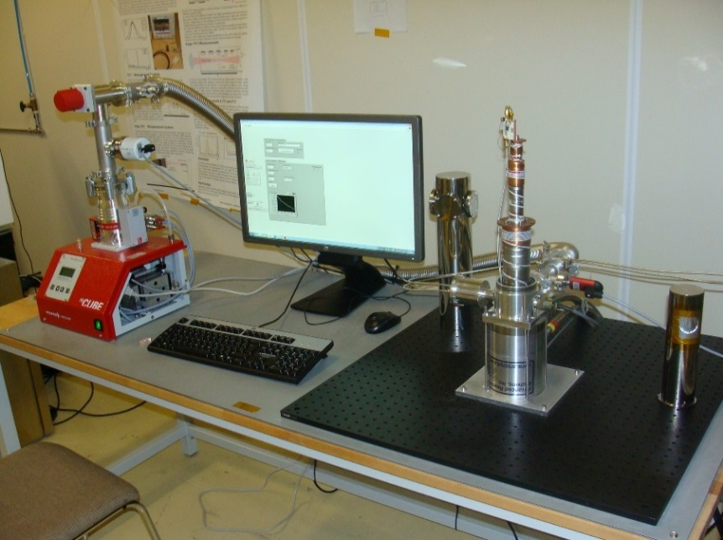
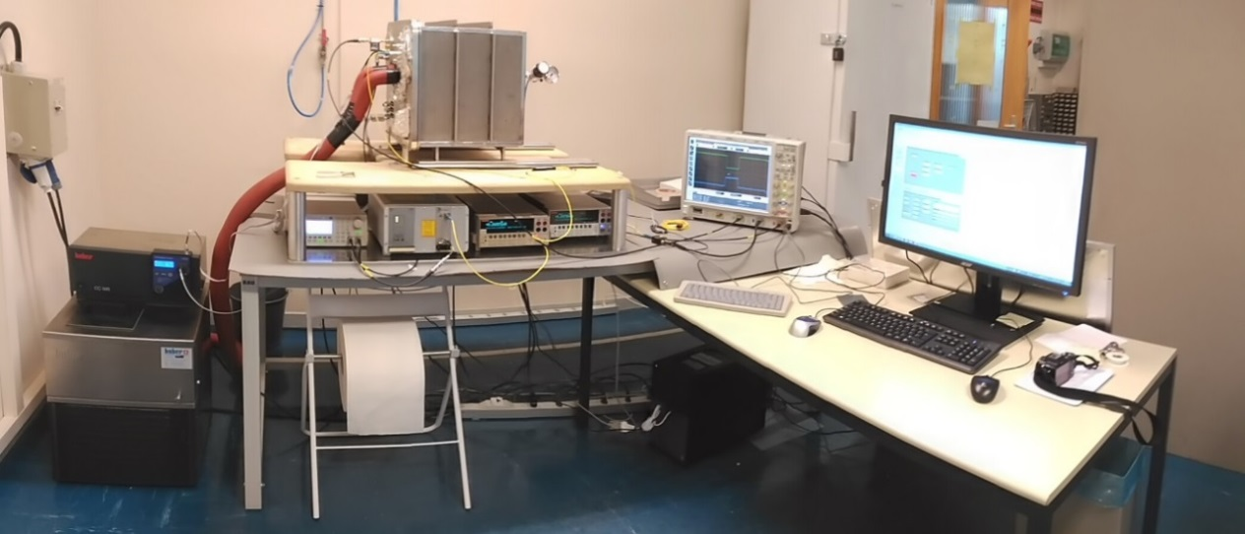
Infrastructure & Equipment
Bldgs.28/186 (4 labs, 1 sensor storage area, 4 offices, ..)
  IV/CV [2x], Alibava (CCE) [2x], Beta (CCE), e-TCT, TCT+; I-DLTS, TSC
New: 2015
New room 2015
-70C to 180C
Wafer/Sample storage
CCE (Charge Collection Efficiency)
TCT+: TCT (Transient Current Technique)
New: 2015
New lab 2015
Cooling to 10K
I-DLTS (Current Deep Level Transient Spectroscopy)
TSC (Thermally Stimulated Currents)

Slide 4
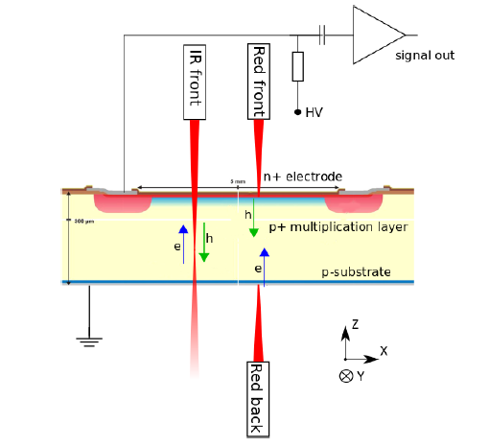
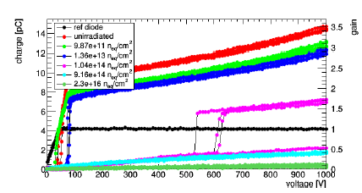
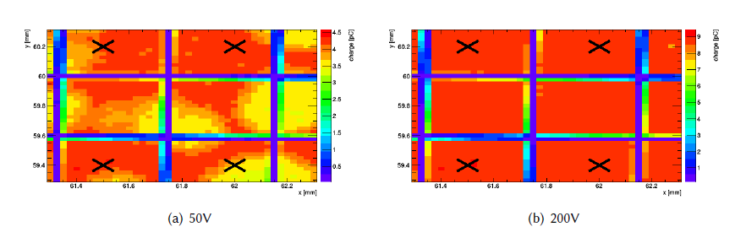
Sensors with intrinsic gain
Low Gain Avalanche Detectors LGAD
  Collaborative effort within RD50
  Produced at CNM Barcelona (RD50)
  Aim for (a) stable signal gain
  after irradiation (b) fast signals
  Problem:
  Loss of gain after irradiation!
  SSD at CERN:
    Irradiation, CV/IV, TCT
    CCE (beta, laser)
    homogeneity scans:
    Gain measurements

Slide 5
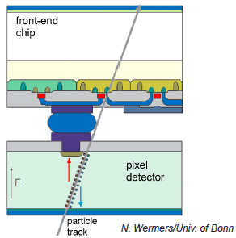
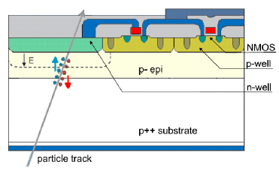
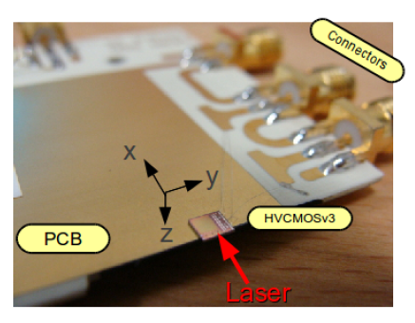
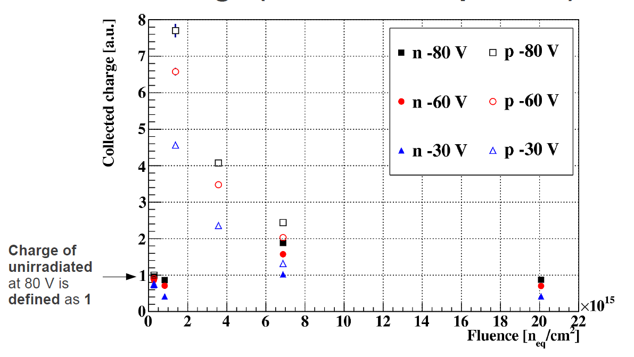
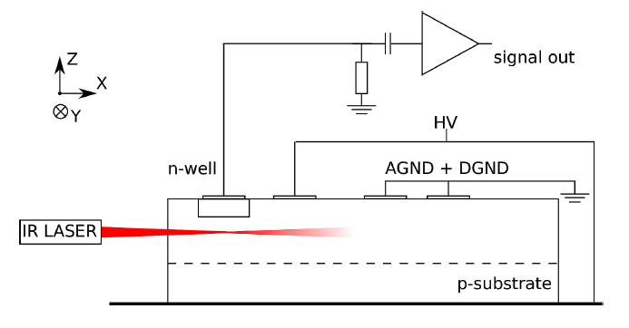
TCT and HVCMOS
CMOS sensors
  Today: Hybrid Pixel Detectors (HAPS)
  used in LHC experiments
  Vast efforts ongoing to develop
  monolithic sensors (MAPS) imbedding
  sensing volume and electronics
  in the same chip
  One flavour: DMAPS (Depleted MAPS)
  “HVCMOS”: HV = High Voltage
HAPS
MAPS
SSD: e-TCT measurements on irradiated HVCMOS sensors [ams H18, 10Ωcm]
  Irradiated sensors: Amount of collected charge is increasing with radiation damage!
    Reason: The doping is “de-activated” by radiation and compensating defects are produced → less space charge in detector → bigger active volume → bigger signal
    Unfortunately with further rising fluence signal reduces (trapping, too many defects)
    R&D: Optimize substrate for best performance in LHC fluence range
…to be presented on RD50 Workshop next week

Slide 6
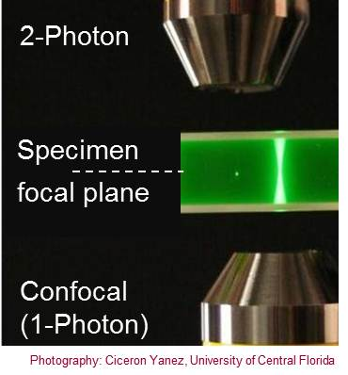
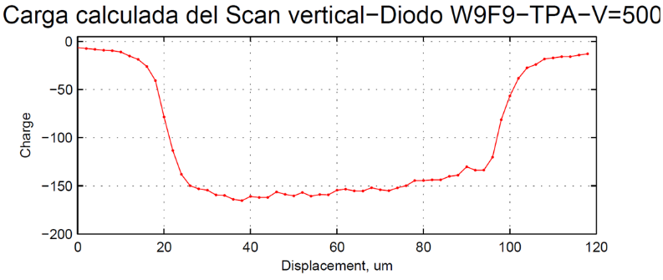
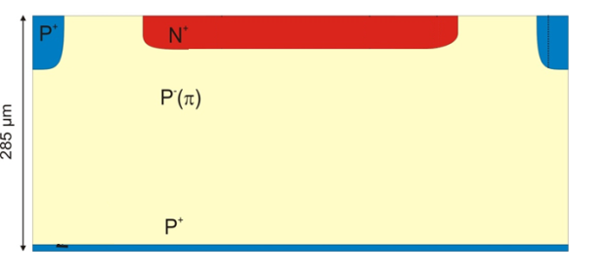
Outlook
Continue LGAD and TCT work
TPA – Two Photon Absorption [with IFCA]
Scanning beam through
detector:
80 x n_{index_Si} ∼ 280 um
Service (2015): eTCT for ATLAS (SOI) and CLIC (MAPS), timing measurements for CMS, CV/IV for LHCb UT CMS, TCT for RD50,…
2016: Reduction in manpower → Reduction in work program
2015 (9 FTE)
CERN Staff Physicist (0.5 FTE)
Trainee/FTEC: (1.5 FTE)
PhD students (4 FTE)
Fellow (1 FTE)
Visiting Scientist (2FTE)
2016 (4 FTE + X)
CERN Staff Physicist (0.5 FTE)
Trainee/FTEC: (0.5 FTE)
PhD students (2 FTE)
Fellow
Visiting Scientist (1FTE) + X (?)
Work program in 2016
Reduce service, keep most R&D, HGC
Look out for fresh resources!
TCAD, Damage parameterization
3D sensors
Focus: TCT, LGAD, timing sensors,
some work on defects

