Slide 1
Olivier Brunner, 9/12/2015
FCC RF R&D Coordination Meeting 3

Slide 2
Agenda of the day
Minutes approval, follow-up from last meeting (O. Brunner) 10'
Report from coordinator (E. Jensen) 10'
Progress reports from all task leaders 20'
Report from fellow activities 5‘
Specific reports
  Preliminary program for Rome(15’)
Tour de table 15'
AOB 5'
Next meetings: January 20
February 17
March 16
RF R&D Review: 1,2 March 2016 (tbc)

Slide 3
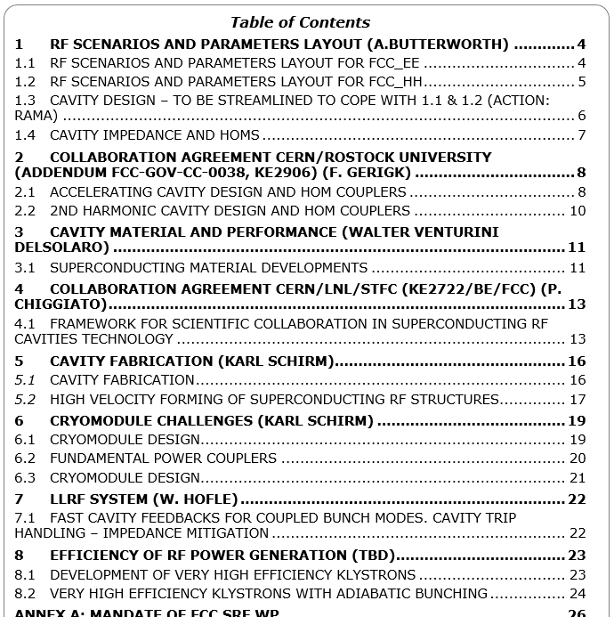
WP News (1)
New version of the document (see indico)

Slide 4
WP News (2)
Action list:
  WP1 to be completed, detailed and merged with WP2, (Andy & Rama)
  WP2: define & adjust goals, (Frank)
  WP3: propose a break down version (Walter)
  WP5.1 & WP6: complete and detail (Karl)

Slide 5
RF R&D WP Review in March
Main goals (my view!):
  Agree on FCC_hh RF system and FCC_ee staging scenarios:
      Phase 1: Reach the Higgs in first stage, Low Luminosity
        - intermediate: ≈2.2 GV, ≈ 25 MW/beam
      Phase 2: Reach the Higgs & the Z at nominal (see table previous page)
      - Higgs, high Luminosity: 5.5 GV, 50 MW/beam, 30 mA
      Z, high currents: 2.5 GV, 50 MW/beam, 1450 mA
      Phase3: physics @175GeV
  Define best compromise for phase 2 & 1?
    What is the optimum system for the Higgs @ nominal?
      What do we get for the Z pole?
    What is the optimum system for the Z pole @ nominal?
      Can we meet the requirements (1.45A, 16700 bunches, 3mm bl) ?
        loss factor ≈ 0.1 achievable (single cell)
        lower possible loss factor for 1, 2 4 cell cavities? (vs bunch length)
      Impact on bunch lenght limitation?
  What is the optimum upgrade for phase 3? Common RF system for both beams? Add 800MHz RF system?
The requirements vary considerably!
Main goals of WP 2

