Slide 1
The Greek Network on Detection Development - The SENERA NATO SfP Project
Outline:
Current Partners of the Network
Activities
Main facilities of the partners
SENERA NATO SfP Project
Conclusions

Slide 2
Current Partners of the Network
Institute of Nuclear and Particle Physics of NCSR “Demokritos” (INPP), contact: Aristotelis Kyriakis ( kyriakis@inp.demokritos.gr ) ,
Dimitris Loukas ( loukas@inp.demokritos.gr )
Institute of Nanoscience and Nanotechnology of NCSR “Demokritos” (INN), contact: Nikos Glezos (glezos@imel.demokritos.gr)
Greek Atomic Energy Commission (GAEC), contact: Costas Potiradis (cpot@eeae.gr)
Sensors electronics and Communications Laboratory – Technological Educational Institute of Sterea Ellada (TEISTE), contact: Haris Lampropoulos (lamprop@mail.teiste.gr)
Hellenic Army Academy (HAA), contact: Costas Karafasoulis (ckaraf@gmail.com)
Medical Instrumentation laboratory Technological Educational Institute of Athens (to be confirmed) (TEIATH), contact: George Loudos (gloudos@teiath.gr)

Slide 3
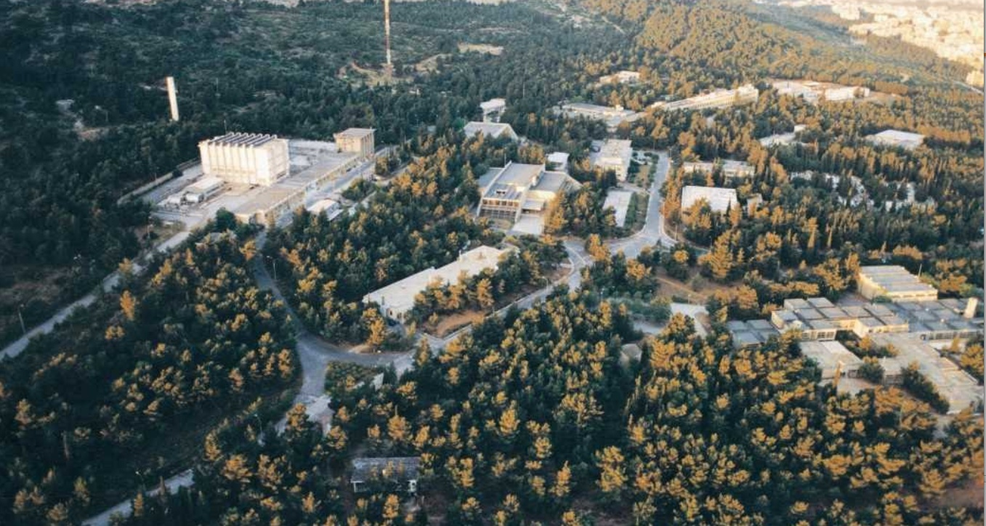
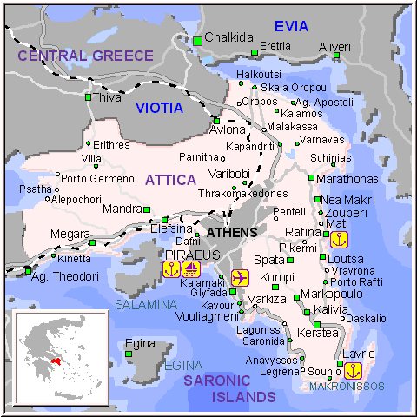
Current Partners of the Network Location
(6) TEIATH
(4) TEISTE
(5) HAA
(1) INPP
(2) INN
(3) GAEC

Slide 4
Activities: High Energy Physics
Participation in the ALEPH/LEP experiment: construction of a radiation monitor(based on Avalanched Silicon Photodiodes) for the Silicon Vertex detector of the ALEPH experiment.
Participation in the DELPHI /LEP experiment: construction of a part of the RICH detector
Conceptual Design of a Complete Powder X-ray Diffraction system with a Silicon Microstrip Detector
Participation in the CMS/LHC experiment:
  Construction and test of one quarter of the Preshower (Silicon based) sub-detector of the CMS
  Development of Silicon Sensors for the Phase II upgrade of the CMS/LHC Silicon tracker (New Activity)
  Tests for the CMS Binary Chip (CBS) designed for the upgrade of the CMS/LHC Silicon tracker (New Activity)

Slide 5
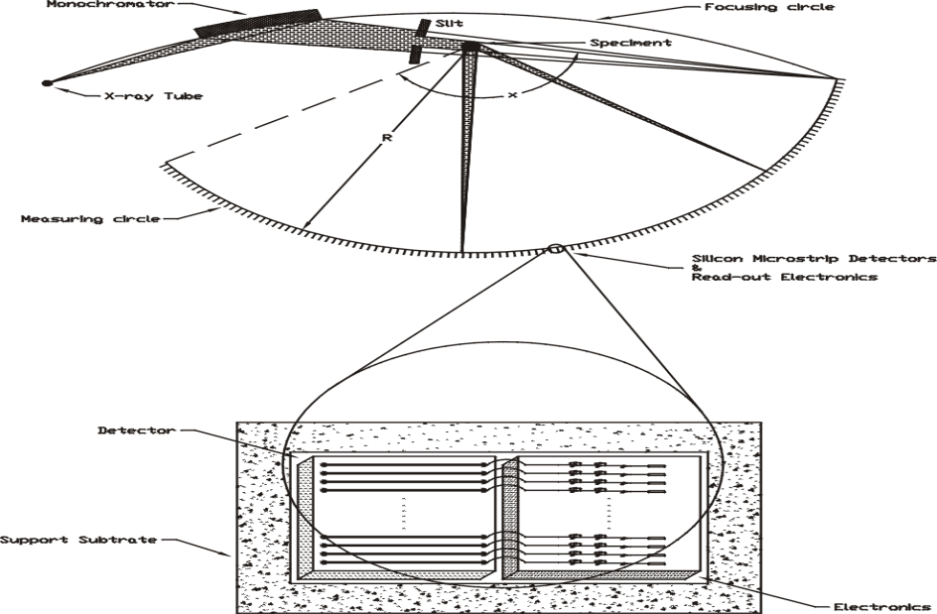
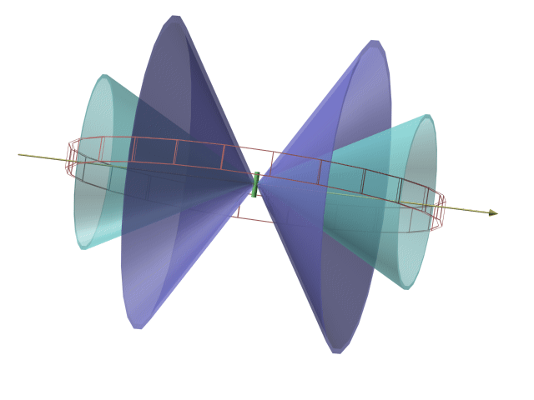
Institute of Nuclear & Particle Physics + Institute of Nanoscience and Nanotechnology
X-Ray Powder Crystallography
Conceptual Design of a Complete system
Diffraction Diagrams
Cone 1
Cone 2
NaI : step=0.02⁰, 10sec/step, t_{tot}=9.72h
X-ray beam
Film or
Linear Array
Capillary
Spherical Symmetry ==>
One dimension detector array
Si (32 channels in parallel) : step=1.4⁰,
5min/step, t_{tot}=6,25h
Sample grains : 5-10μm
Capillary :
Cylindrical
10mm-20mm in height
0.5-1.0 mm in diameter
mstrip : pitch 50μm
length ~ 5mm
~ 1.5 pF

Slide 6
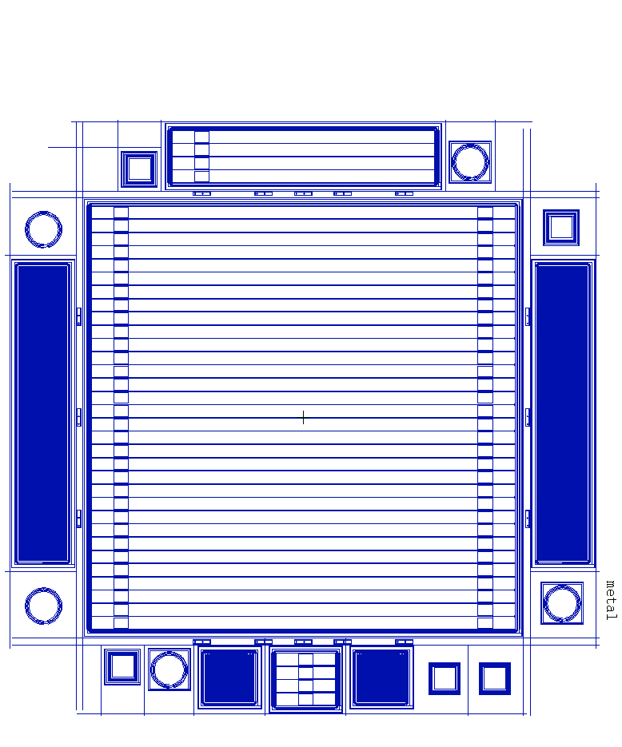
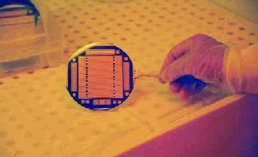
Institute of Nuclear & Particle Physics + Institute of Nanoscience and Nanotechnology
CMS Preshower Si Sensors
60mm x 60 mm : 32 strips

Slide 7
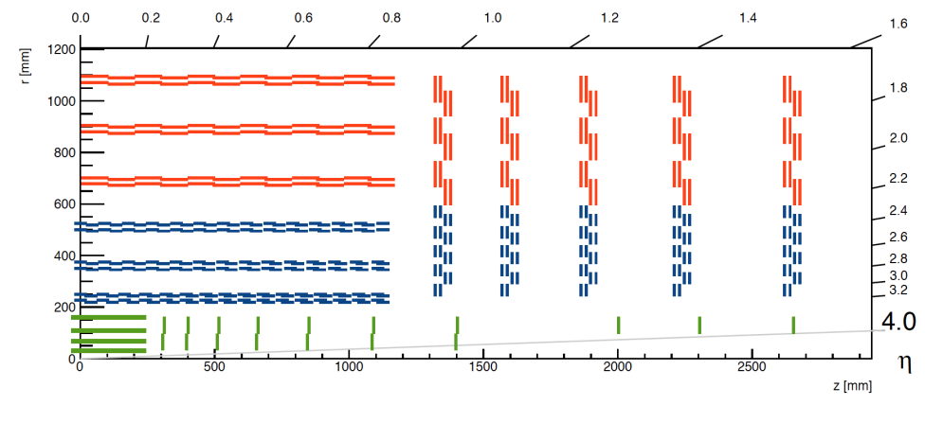
Institute of Nuclear & Particle Physics + Institute of Nanoscience and Nanotechnology
The Phase II CMS Tracker at LHC
Planar Pixels
Pixel sizes: 25 x 100 μm² or 50 x 50 μm²
reduced in surface by a factor of 6 compared to current pixels (100 x 150 μm²)
Detector thickness: 100 μm (reduced by a factor of 3 compared to current wafers (300 μm)
Increase the number of forward disks from 3 to 10
Total active surface : 4 m² (compared to 2.7 m² in Phase I)
Outer Tracker
15508 detector modules :
8424 2S (Strip-Strip) and 7084 PS (Pixel Strip) with a total of 218 m², 47.8 million
strips and 218 million macro-pixels
Work Plan:
Design & fabrication of sensor prototypes
Device simulations with TCAD
Evaluation of sensors & electronics
Participation in test beams
Contribution to module construction

Slide 8
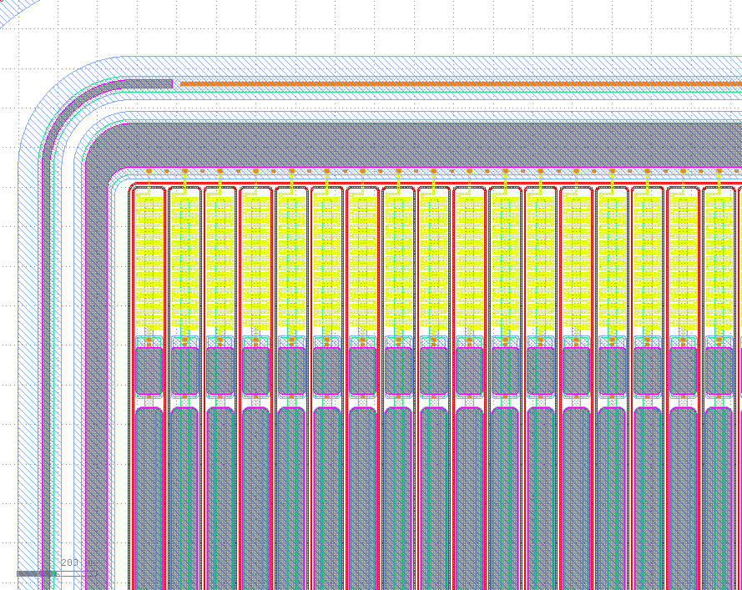
Institute of Nuclear & Particle Physics + Institute of Nanoscience and Nanotechnology
Baby Sensors
320 μm thick , 240 μm active
n on p
Pitch 90 μm
Implant width 24 μm
5cm
Baby Sensors: Capacitances
Baby Sensors
Backplane capacitance per strip | 1.86 pF
Interstrip capacitance | 1.32 pF
Total capacitance per strip | 4.62pF
Measured
Baby Sensors
Backplane capacitance per strip | 1.88 pF
Interstrip capacitance | 1.31 pF
Capacitance to second neighbour | 0.3 pF
Calculated lower limits

Slide 9
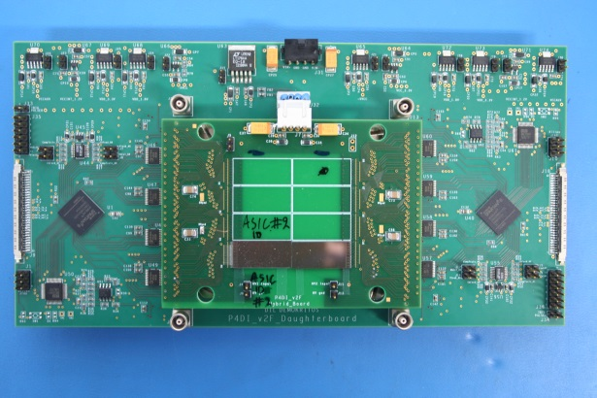
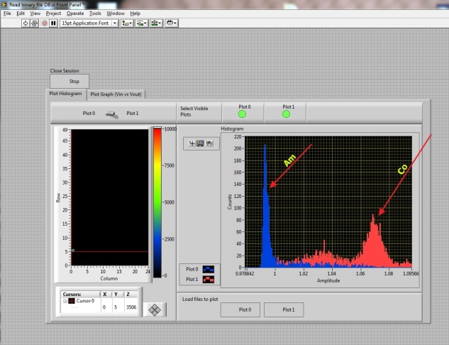
Technological Educational Institute of Sterea Ellada + Institute of Nuclear and Particle Physics + Greek Atomic Energy Commission
FP7 funded project

Slide 10
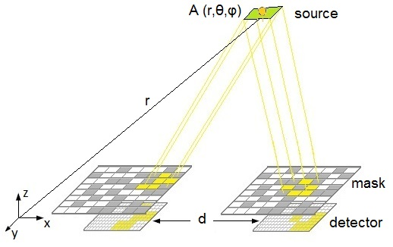
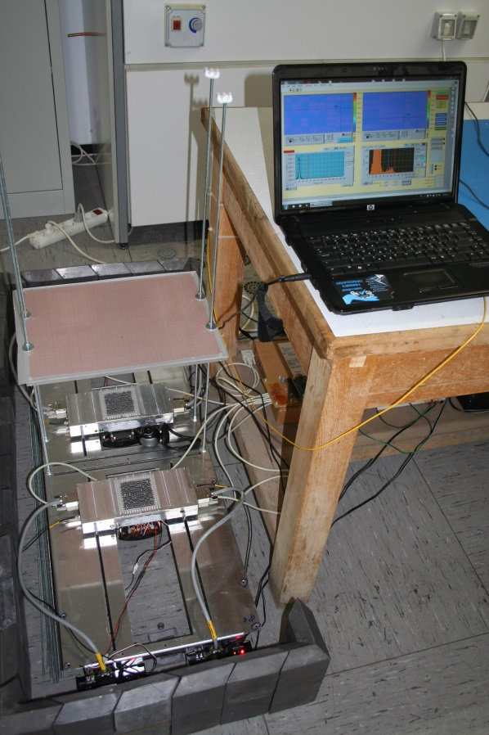
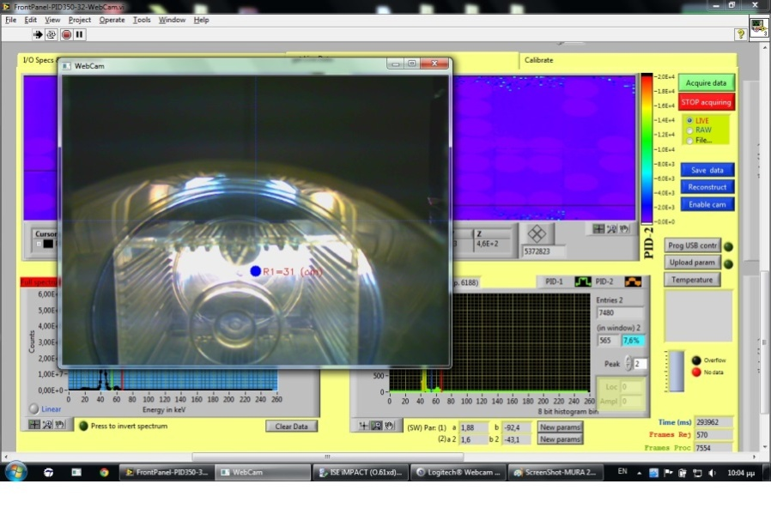
Technological Educational Institute of Sterea Ellada + Institute of Nuclear Physics+Greek Atomic Energy Commission + Hellenic Army Academy
FP7 funded project

Slide 11
Hellenic Army academy + Greek Atomic Energy Commission + Institute of Nuclear and Particle Physics
Funded by NATO SfP Program → SENERA
The project aims to develop core technologies for:
Distributed sensor networks for the localization and isotope identification of radioactive sources
Purpose to build a solution applicable to the diverse problems which one confronts when dealing with difficult to detect (either shielded or in a large crowd) sources in spaces without specific entrance and exit points

Slide 12
Activities: Medical Imaging

Slide 13
Medical instrumentation laboratory- TEI Athens
Group Aims
  The development of dedicated imaging systems and other Biomedical Instrumentation
  Applications in biomolecules multimodal imaging, including nanoparticles and theranostics
Current group members <15
Main funding (~3.2M€) and current projects
  VIVOIMAG, Horizon2020, Marie Curie RISE: Multimodal Imaging Of The In Vivo Fate Of Bone Transplants (coordinator)
  Aristeia II: Development of hybrid molecular imaging systems for Theragnostic applications - HYPERGNOSTIC (National Excellence project)
  TRIMAGE, FP7-Health-Innovation: An optimized trimodality (PET/MR/EEG) imaging tool for schizophrenia (WG leader)
  OncoNanoBBB, FP7-ΙΑΑP Marie Curie: Development and evaluation of a non invasive quantitative imaging technique for assessment of nanoparticle drug delivery across the blood-brain barrier. Applications for brain cancer therapeutics (coordinator)
  COST TD1007 on PET/MR technology and bimodal tracers (coordinator)
  COST TD1004 on Theragnostics (WG leader)
  Other smaller national projects…

Slide 14
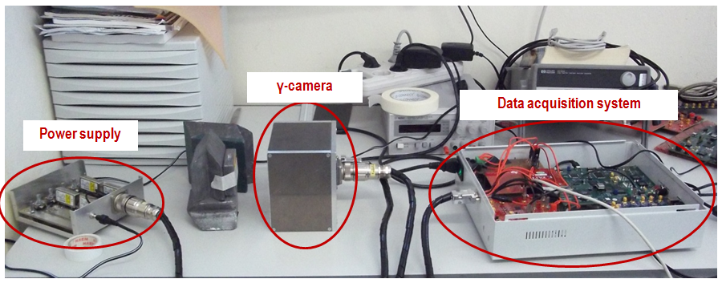
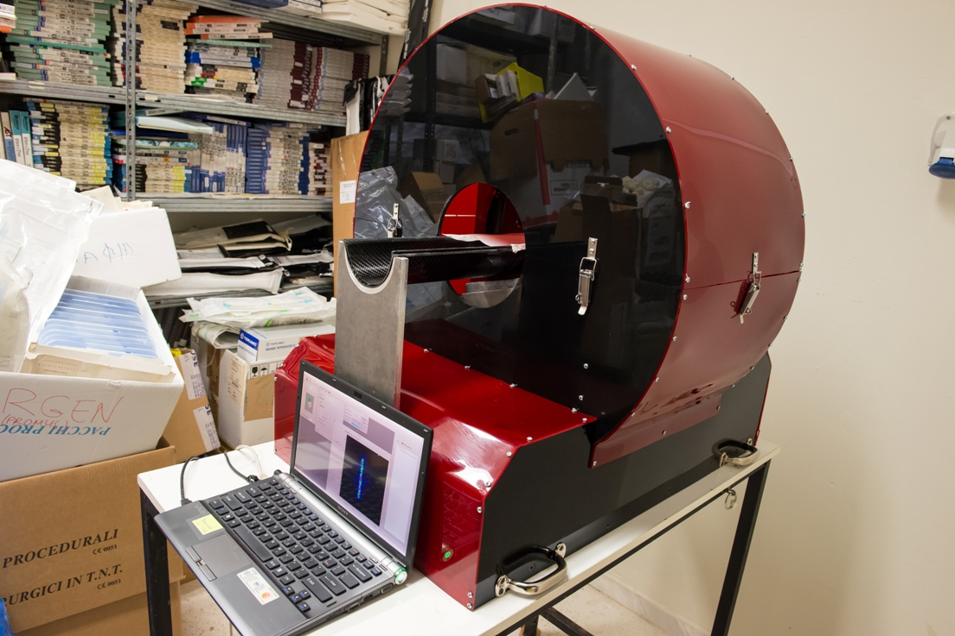
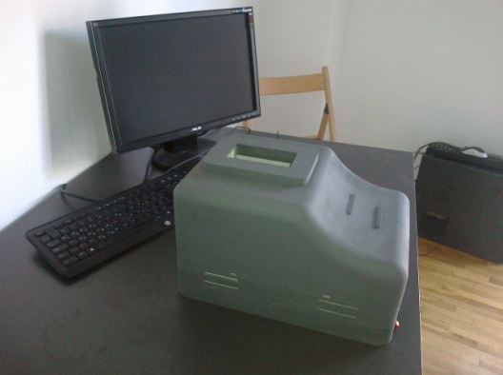
Development of prototype imaging systems
More than 9 years of experience in development of PET and SPECT systems has lead to…
In 2012:
  A first 10x10 planar system was constructed for Medical School, University of Patras
  Planar spatial resolution <2.5mm
  Lab version
In 2013:
  Upgrade to full tomographic SPECT
  Spatial resolution <2mm in planar and <4mm in SPECT mode
  Prototype version
In 2014:
  A bechtop prototype is being finalized
  Small size (like a printer) and low weight
  Compact electronics &USB connection to laptop
  Mouse sized (5x10cm field of view)
  Commercial version
Notes:
The group hosts prototype SPECT and PET systems and at the moment, in terms of a national excellence project upgrades the existing prototype to a SPECT/PET/CT suitable for mouse imaging. Original research work is carried out on the evaluation of Silicon Photomultipliers as detectors for low cost, MR compatible SPECT and PET systems.

Slide 15
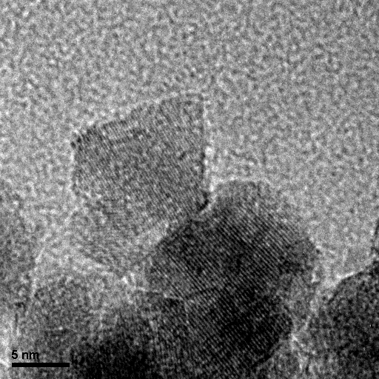
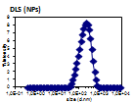
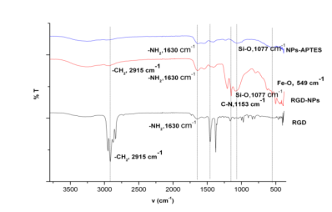
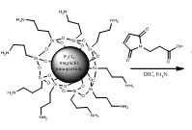
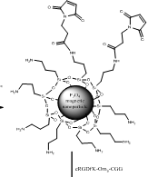
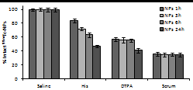
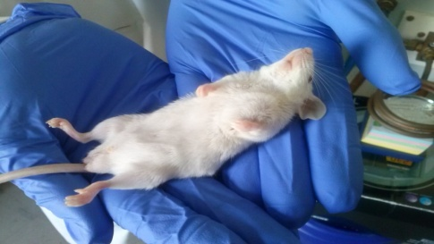
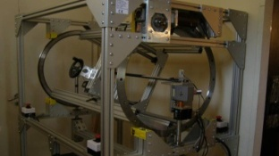
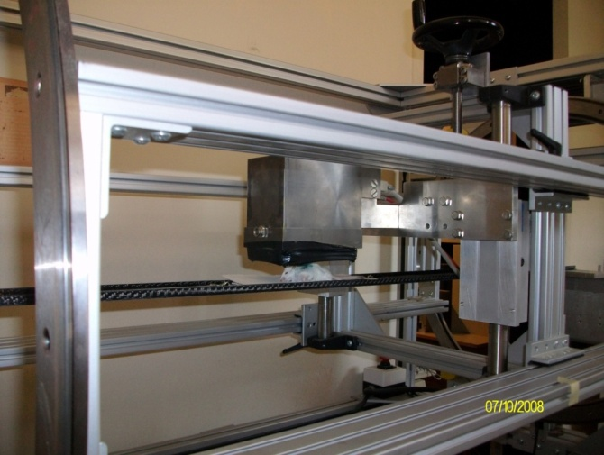
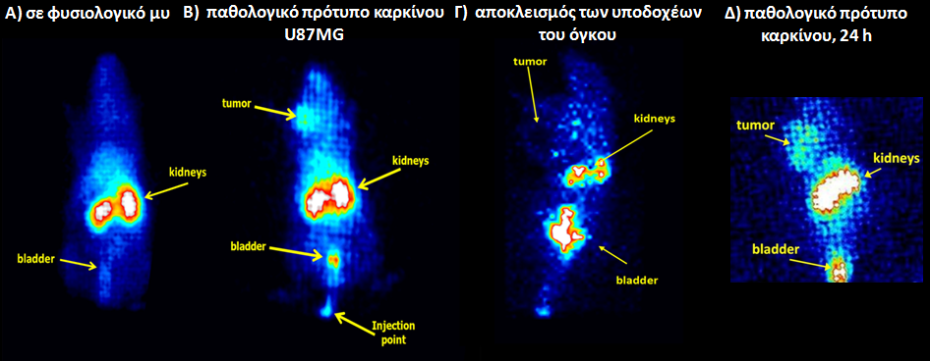


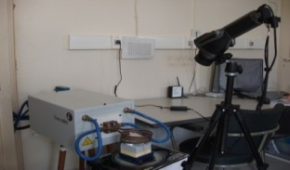
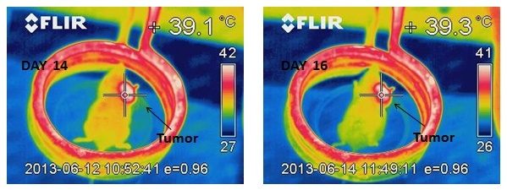
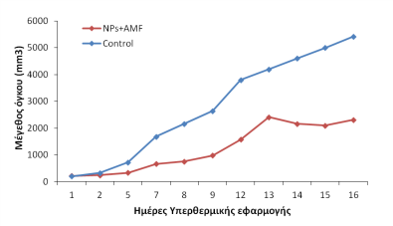
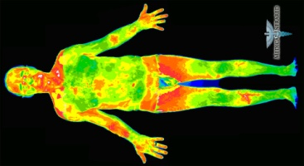
TEIA Imaging platform
TEM (NPs)
TEM (NPs-RGD)
FT-IR φάσμα
Design and evaluate NPs
Functionalization for targeting and imaging
Animal models and imaging systems
Dynamic and imaging studies in mice
Hyperthermia sessions and in vivo temperature monitoring
From...
To...
Notes:
TEIA imaging platform includes the design and labelling of nanoparticles and other biomolecules, the performance of animal studies with dedicated imaging systems and the performance of hyperthermia studies. This platform is being used by several groups in Europe and Greece in terms of several funded projects and has lead to numerous publications. The ultimate goal remains the translation of preclinical results to clinical practice.

Slide 16
Main facilities

Slide 17

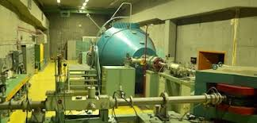
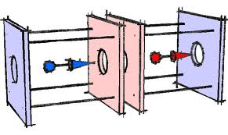
Institute of Nuclear & Particle Physics(I)
TANDEM Accelarator ( http://tandem.inp.demokritos.gr/ )
The accelerator is an electrostatic Van de Graaff Tandem accelerator with a maximum acceleration voltage of 5 MV. As such, it’s a low-energy ion-beam facility, one of the few accelerators of its kind in Europe. The machine can deliver monoenergetic protons in the range of 800KeV – 4.0MeV with resolution of a few KeV. A typical maximum flux than can be achieved on a 2mm x 2mm spot is around 10¹² protons/sec. In addiction there is a nomochromatic neutron irradiation facility for neutrons in the range of 0.6MeV to 12MeV, fluxes 10⁸ – 10⁹ neutrons/cm²/sec and resolution around 200KeV
X-rays lab:
X-ray tubes for irradiation and high rate tests

Slide 18
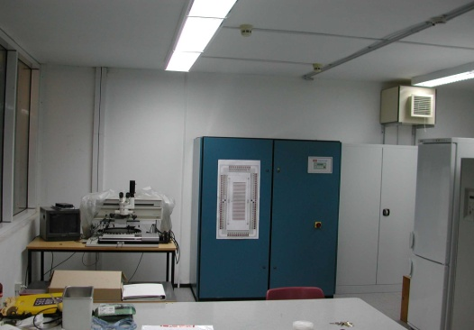
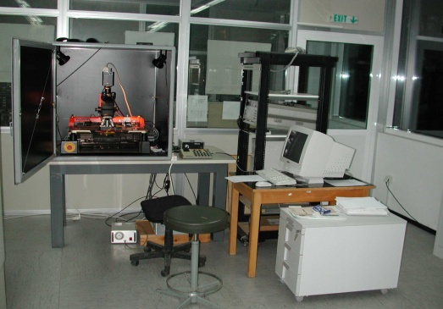
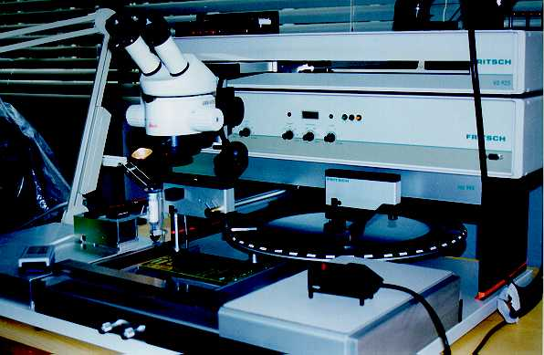
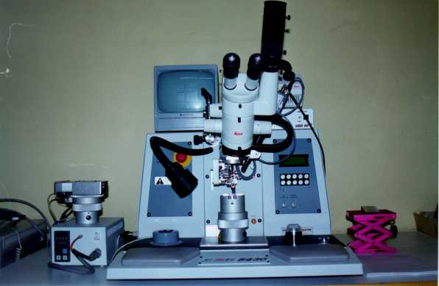
Institute of Nuclear & Particle Physics (II)
DETECTOR INSTRUMENTATION LABORATORY
Laboratory (80 m² ) with temperature and humidity
control
Probe Station : Carl Suss PA 150
CV : HP4092A
IV : Keihley 6517
SMD Placement : FRITSCH
Wire Bonding (Delvotec 5430)

Slide 19
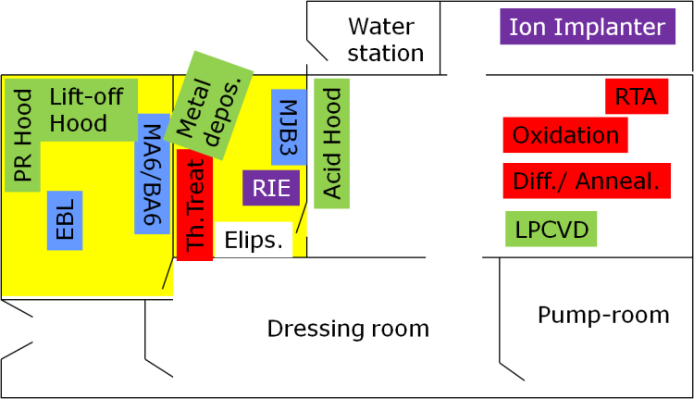
Institute of Nanoscience & Nanotechnology(I)
http://www.demokritos.gr/Contents.aspx?CatId=18&lang=en
Gray Area Facilities – A Full CMOS Laboratory
Packaging & Assembly
  Wafer Dicing
  Wire bonding
DC Electrical characterization
  2 Wafer probers
  Low-T wafer prober
  SPA, LCR, etc
Si micro-machining
  Lapping
  KOH hood
RF characterization
  Cascade wafer prober
  VNA ANRITSU
Polymer & Organic Electronics Lab
  Hybrid Si/organic
  OLED
  OPVs
  OFET
Plasma Lab
2 HD Plasma reactors
  SE
  MEMS
  Surface modification
Microfluidics Lab
  Contact angle meas.
  Microflow meas.

Slide 20
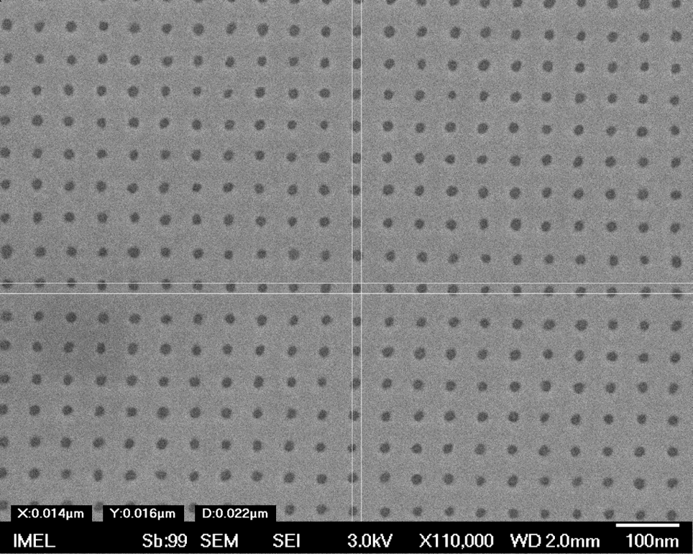
Institute of Nanoscience & Nanotechnology(II)
E-beam Lithography: Vistec EBPG5000plusES
Free-standing Si-NWs for
GAA nanoFET technology
http://www.demokritos.gr/Contents.aspx?CatId=18&lang=en
Sub-8nm feature
Arrays of 15nm nanoholes
Arrays of Si fin for FinFET
tecnology
P. Dimitrakis (Microelectronics Lab)

Slide 21
Network Activities: Environmental Radiation monitoring – Safety - Security
SENERA NATO SfP Project
“Localization
and Identification of Radioactive sources
with directional and non directional detectors”

Slide 22
The SENERA Project
Aim: Develop core technologies of distributed sensor networks for the localization and identification of radioactive sources for spaces without specific entrance and exit points
Institutions:
  → Hellenic Army Academy,Greece (HAA)
  → V.E. Lashkaryov Institute of Semiconductor Physics of NASU, Ukraine (ISP-NASU)
  → Greek Atomic Energy Commission, Greece (GAEC)
  → Institute of Nuclear and Particle Physics, NCSR Demokritos, Greece (INPP)
  →Technological Educational Institute of Sterea Ellada(TEISTE)
  → Hellenic Army General Staff R&IT Directorate, Greece(HAGS/R&IT Dir)
  → Chernivtsi National University, Ukraine (YFCNU)
  → National Center of Radiobiology and Radiation Protection, Bulgaria (NCRRP)
  → Research Institute of Electronic, Shizuoka University , Japan (RIE)
Funded by: NATO Science for Peace and Security Program
Total NATO Budget: 390,000 Euro
Duration: 36 months

Slide 23
Project Targets
Non-Directional Detectors: Develop spectroscopic detectors with mediocre efficiency due to the size of their crystals but with record energy resolution capability without cryogenic systems due to the use of Schottky or p-n CdTe diodes as the cheap, low-power members of the network.
Directional Detectors: Deploy devices based on pixel semiconductor radiation detectors (hybridized CdTe pixel detectors + photon counting and energy identifying CMOS ICs) that will be able to find the directional coordinates of a source by using both the coded aperture and the Compton scattering imaging techniques.
Use existing communication platform: Use smart phones and tablets as local processing units of both the directional and non-directional devices and as a means of internet connectivity of the network nodes
Data Fusion: Develop algorithms that will exploit the data provided by the network nodes with target to estimate the number, strength, identity and location of the sources using among others guided search which will exploit the spectroscopic information and the capabilities of the directional detectors.

Slide 24

Non-Directional Detectors (I)
Basic Concept
Continuous Region Monitoring
Setup a 2D array of sensors
Collect the Sensor Response
Try to estimate the position of the source using special designed algorithms
Perform the necessary correction due to background radiation
Simulation Software (SWORT)
5m
3m
SENSOR_{i}
Radioactive Source Position(X,Y,Z)

Slide 25
Non-Directional Detectors (II)
Simulation Sofware:
Perform a simulation of a system of 3 x 2 sensor array using the SWORD 5.0 (SoftWare for Optimization of Radiation Detectors) package developed by Naval Research Laboratory, Washington, DC and based on the GEANT4 V8.1 package which was developed at CERN (European Organization for Nuclear Research), Genève, Switzerland.
(https://rsicc.ornl.gov/codes/ccc/ccc7/ccc-767.htm l )
Basic Simulation Characteristics:
Geometry: 3 x2 sensors array, 3 in Horizontal (X) plain, 2 in Vertical (Y) plain.
Sensor Distance: 2.5m in Horizontal (X) plain and 3.0m in Vertical (Y) plain
Sensor Type: CdZnTe
Sensor Volume: 1cm x 1cm x 1cm
Source Type: Am-241
Source Activity: 1mCi
Source Shape: Sphere
Irradiation Period: 45 sec: 45sec

Slide 26
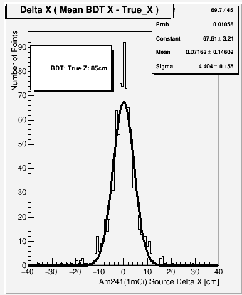
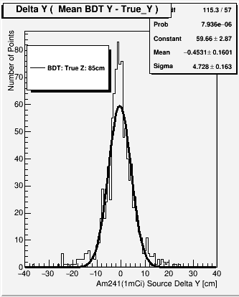
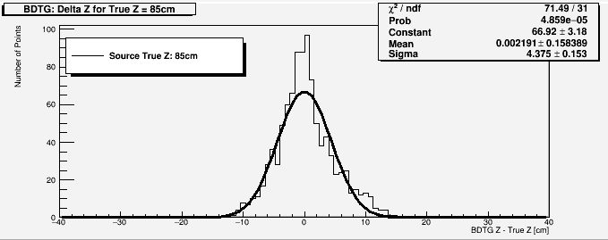
Non-Directional Detectors (III)
Spatial Radioactive source Resolutions: Horizontal Coordinate (left), Vertical Coordinate (Middle), Depth (right). The estimated resolution is around 5cm for a true source distance from the sensor plain of 85cm. Similar results are estimated for other distances as well.

Slide 27
Non-Directional Detectors (IV)
Fabrication of CdTe-based diodes with a laser induced p-n junction:
Development of a principally optimized laser-induced doping technique of a thin layer
of CdTe crystals and formation of a built-in p-n junction by irradiation of
the CdTe-metal structure from the CdTe side with YAG:Nd laser pulses (λ = 1064 nm, τ = 8 ns).
Schematic illustration of the In/CdTe/Au
diode detector measurement setup.
The ¹³⁷Cs radioisotope energy spectrum taken by the In/CdTe/Au detector at room temperature and applied bias voltage V = 200 V. The spectral response (energy resolution) from majority samples with low leakage current at room temperature was 2-4 % of FWHM (full width at half maximum) at the 662 keV peak at applied reverse bias voltage of 100-300 V
I-V characteristics of the In/CdTe/Au structures before (1) and after laser irradiation of the CdTe-In interface through the CdTe with 10 pulses of energy density of 424 mJ/cm² (2) and 50 pulses of 144 mJ/cm² (3). The In dopant film thickness was 0.5 µm.
K.S. Zelenska, D.V. Gnatyuk, T. Aoki, Formation of diode detectors by laser irradiation of CdTe-In interface from the semiconductor side, The 22nd International Symposium on Room-Temperature Semiconductor X-Ray and Gamma-Ray Detectors, (RTSD 2015), 2015 IEEE Nuclear Science Symposium & Medical Imaging Conference (2015 NSS/MIC), Conf. Program Book, 2015, Abstract R3A-52. (31 Oct. - 7 Nov. 2015, San Diego, CA, USA).

Slide 28
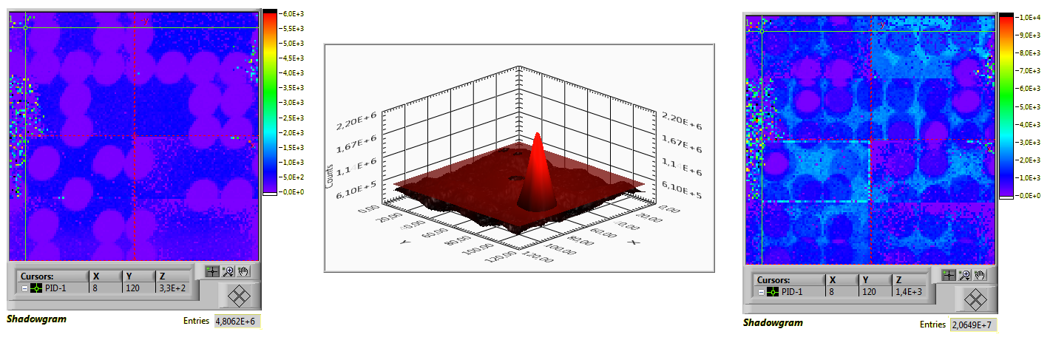
Directional Detectors (I)
Directional Detectors (I)
A pair of two pixellated CdTe hybrid detectors (PID-350) has been used in conjunction with two mosaicked MURA(Modified Uniform Redundant Arrays) coded masks to form a system of two directional detectors (DD). This configuration acts as a test-bench to design and implement algorithms for identifying one or more isolated radioactive sources and estimate their location when positioned within the Field of View (FoV) of the system.
Experimental shadowgram (left) of a radioactive Am²⁴¹ point-like source positioned off-axis at z=35cm from the system's reference frame and the corresponding deconvolved image (middle). When more than one sources lie within the FoV of the system, the resulting shadowgram is superimposed.

Slide 29
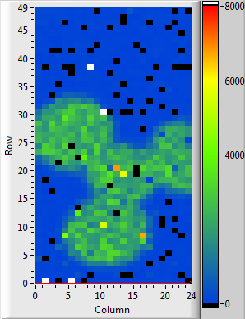
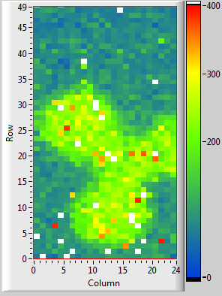
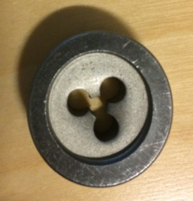
Directional Detectors (II)
CdTe+CMOS hybrids (P4DI) for the Compton Camera and Coded Aperture devices:
The basic block is the CMOS IC which its final version and testing are funded by the
SENERA Project.
(a)
(b)
(c)
Non-calibrated image of a cylindrical Pb head (a) with holes recorded with the P4DI hybrid by using (b) an Am-241 source (c) a Co-57 source. The head was placed 1cm apart from the hybrid’s surface and the sources were placed at 9 cm

Slide 30
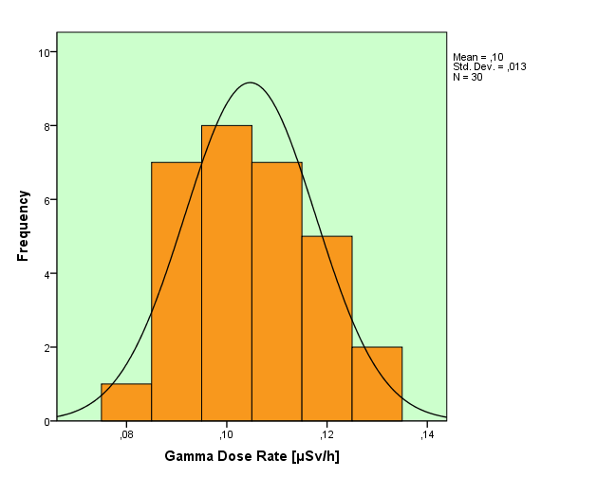
Background Measurements
Background measurement determine the concentration of naturally occurring radionuclides and manmade radionuclides, like nuclear weapons testing, past accident in background surface and subsurface soil. This information will be used to define the natural radioactivity on a site, the distribution on depth, as well for modeling.
Variable | N | AM | SD | Min | Max | Med | SW test (p value) | Skew. | Kurt. | GPS Coordinate
Point 1 (BG) | 10 | 0.115 | 0.011 | 0.10 | 0.13 | 0.115 | 0.258 | 0.00 | -1.03 | N42°37'49.9" E23°21'23.7"
Point 2 (BG) | 10 | 0.097 | 0.010 | 0.08 | 0.11 | 0.100 | 0.287 | -0.23 | -0.35 | N42°37'34.90" E23°21'22.30"
Point 3 (BG) | 10 | 0.102 | 0.012 | 0.09 | 0.12 | 0.100 | 0.046 | 0.43 | -1.46 | N42°37'47.70" E23°21'05.70"
Total (BG) | 30 | 0.105 | 0.013 | 0.08 | 0.13 | 0.100 | 0.062 | 0.23 | -0.71
Table includes the minimum (min), maximum (max), median (med), arithmetic mean (AM), standard deviation (SD), skewness (skew.), kurtosis (kurt.) and Shapiro-Wilk tests of normality (SW). Unit µSv/h

Slide 31
Conclusions
The Greek network is active in key technologies addressed by ERDIT
There are activities in:
Silicon sensors (for HEP)
Hybrid Pixel detectors with Cd(Zn)Te (for security – safety)
Silicon photomultipliers + scintillators (for PET)
Sensor networks - SENERA NATO SfP Project is our on goning network activity

