Slide 1
The glue that binds us all:
Imaging matter below the Fermi scale with an Electron-Ion Collider
Raju Venugopalan
Brookhaven National Laboratory
The glue that binds us all:
Imaging matter below 10⁻¹⁵ m with an Electron-Ion Collider
Raju Venugopalan
Brookhaven National Laboratory
Ortvay Kollokvium, Eotvos Univ.
Budapest, December 10, 2015

Slide 2
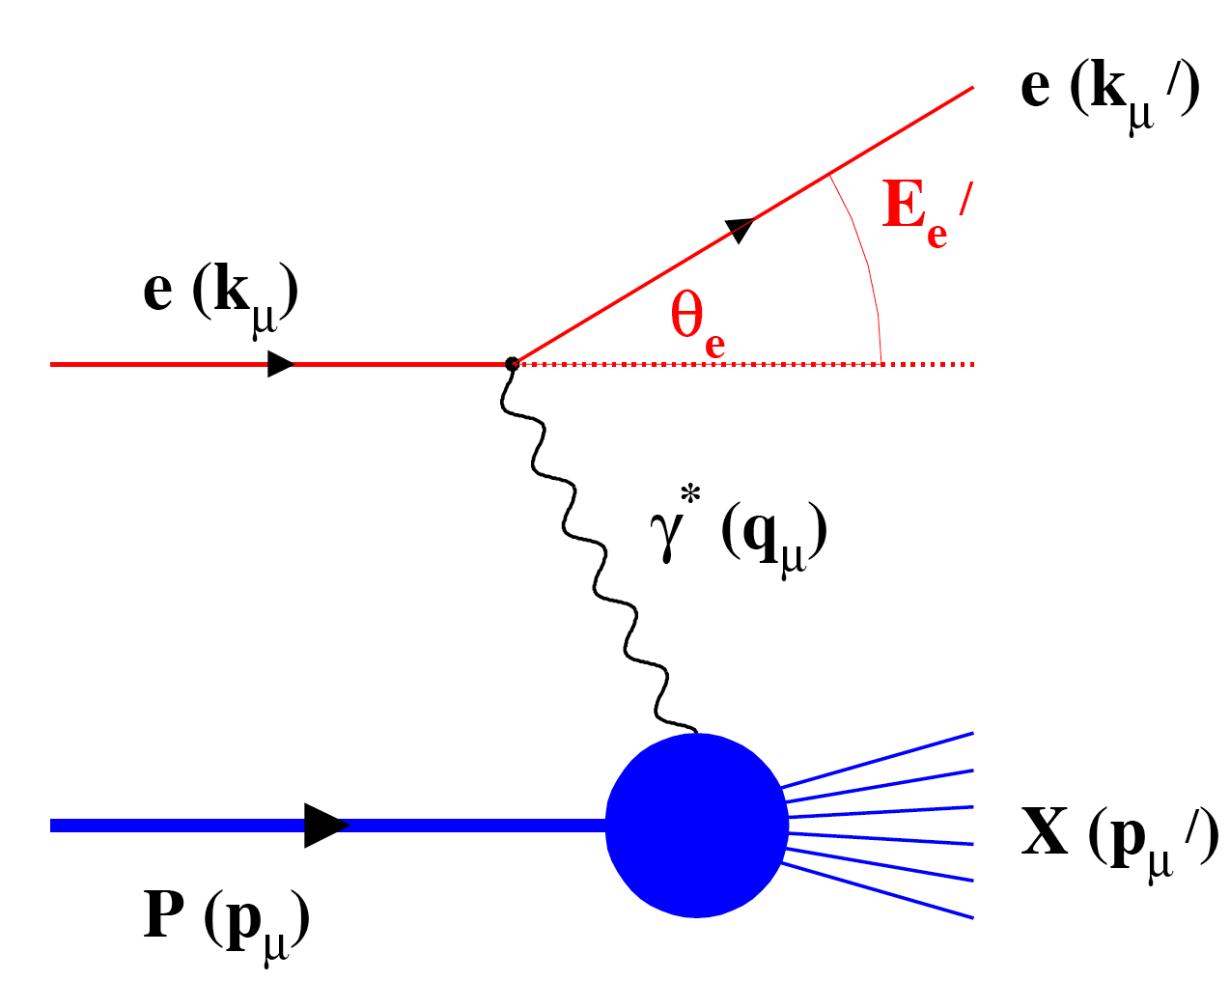
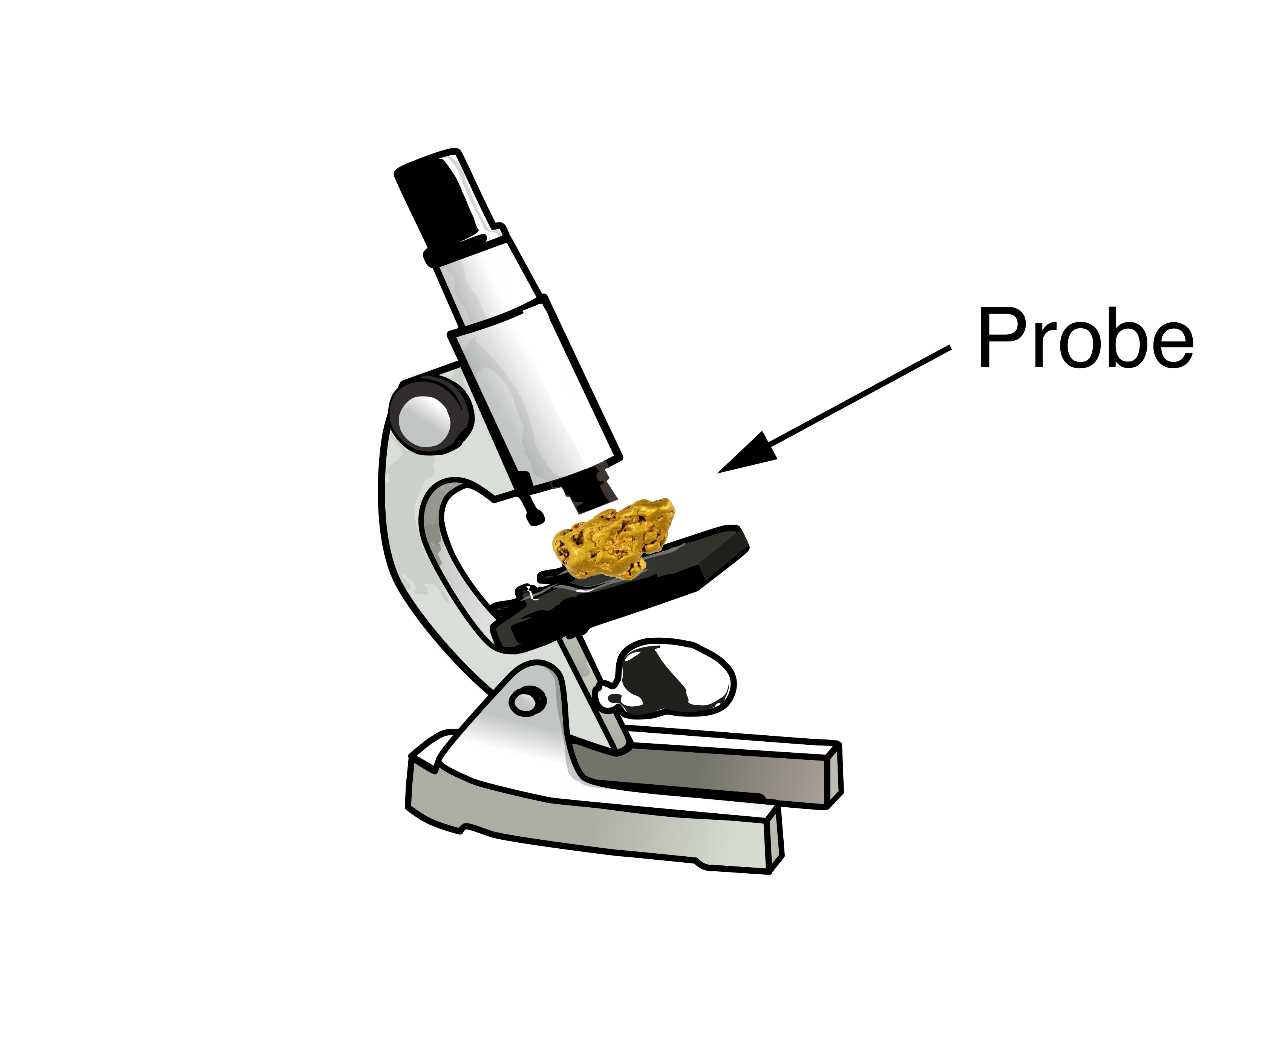
Structure of matter: Microscopes to Femtoscopes
Light Microscope
Wave length: 380-740 nm
Resolution: > 200 nm
SLAC,EMC,NMC,E665,BCDMS,
HERMES,JLab,COMPASS…
JLab 12 GeV
Electron Microscope
Wave length: 0.002 nm (100 keV)
Resolution: > 0.2 nm
HERA,
EIC,LHeC
Fixed Target Particle
Accelerator Experiments
Wave length: 0.01 fm (20 GeV)
Resolution: ~ 0.1 fm
Collider Experiments
Wave Length: 0.0001 fm
(10 GeV + 100 GeV)
Resolution: 0.01-0.001 fm

Slide 3
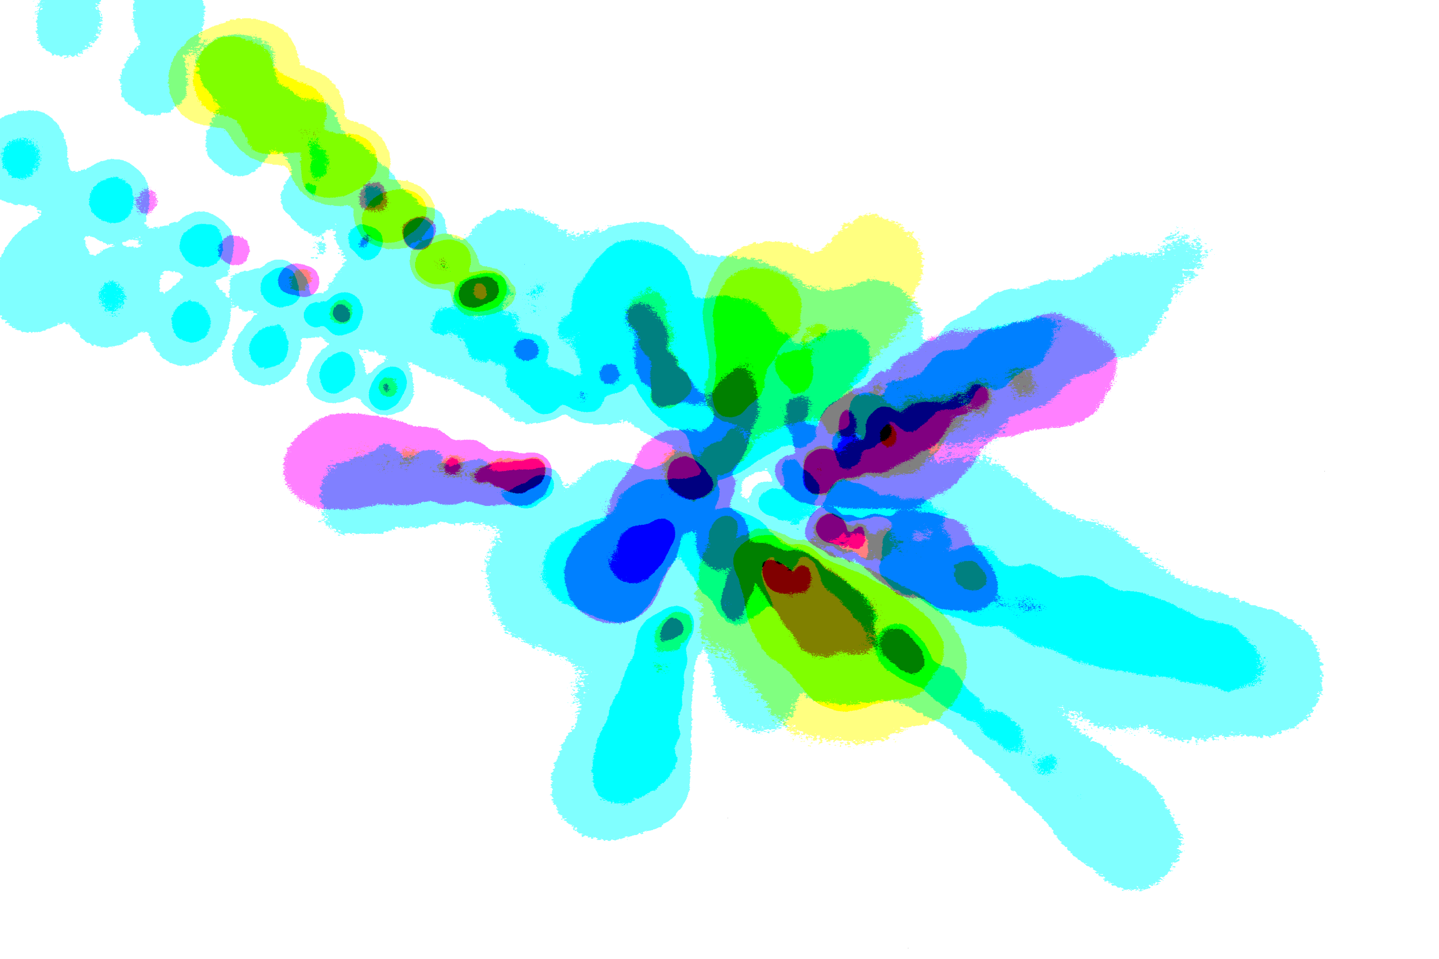
Science case for an EIC
A study of origins in four acts:
the essential mystery, what we know,
what we would like to know, and…how to get there

Slide 4
Act 1: The mysterious gluon

Slide 5
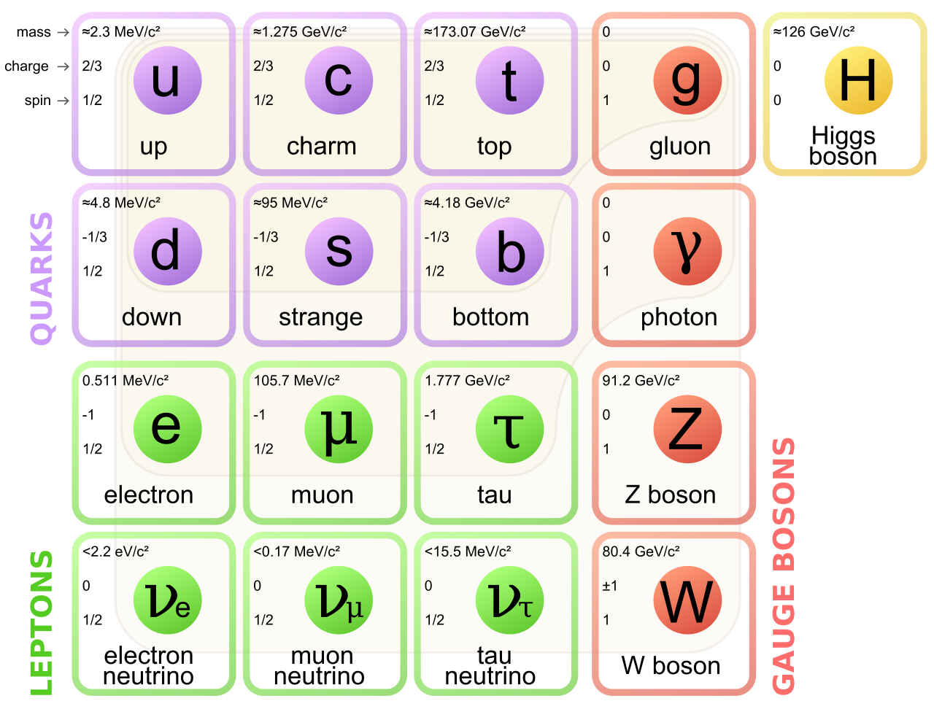
Gluons, the force carriers of the strong force,
are a fundamental building block of the standard model

Slide 6
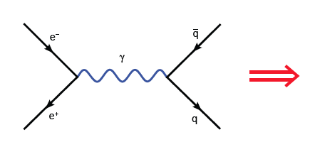
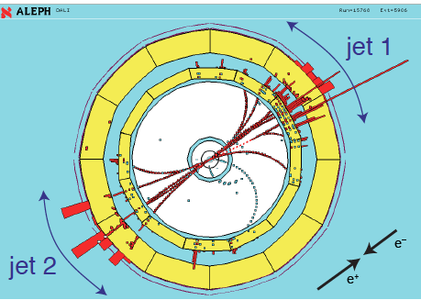
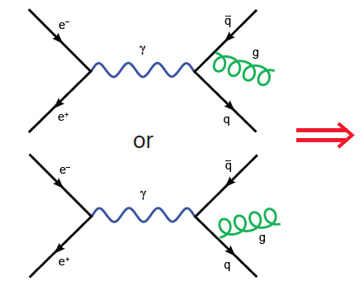
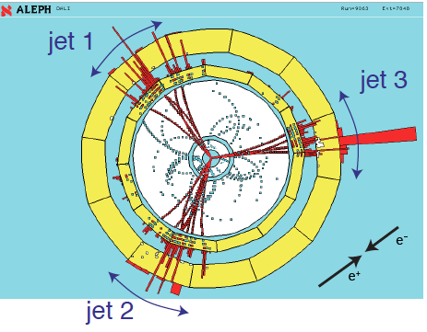

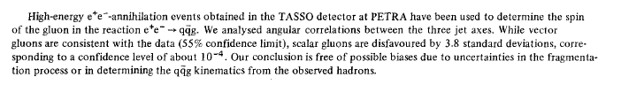
Discovery of the gluon
Physics Letters B, 15 December 1980

Slide 7
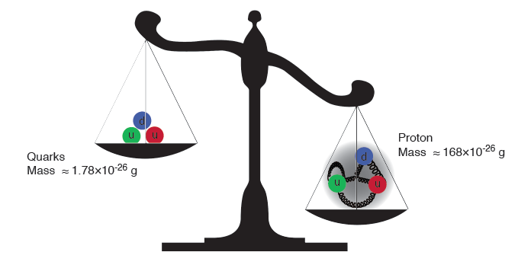
Gluons are massless…yet their dynamics is responsible for
(nearly all) the mass of visible matter
The Higgs “God particle” is responsible for quark masses
~ 1-2% of the proton mass.

Slide 8
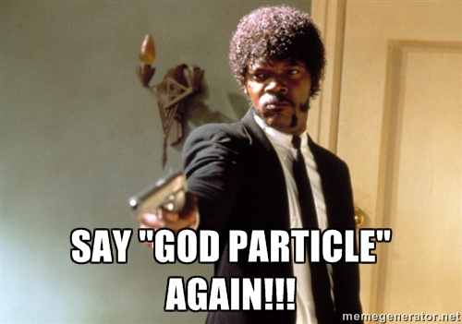

Slide 9
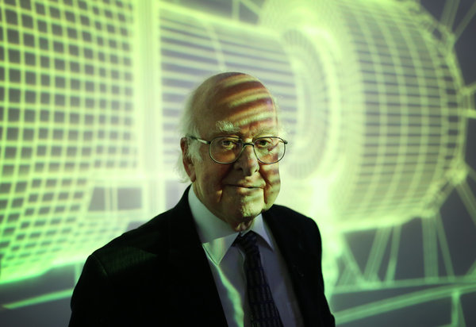
Higgs and the strong force
When he invented his boson in 1964, he said, “I wasn’t sure it would be important.”
He explained, “At the time the thought was to solve the strong force.”
NY Times, Sept. 15, 2014

Slide 10
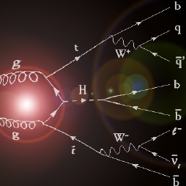
Higgs from Gluon fusion

Slide 11
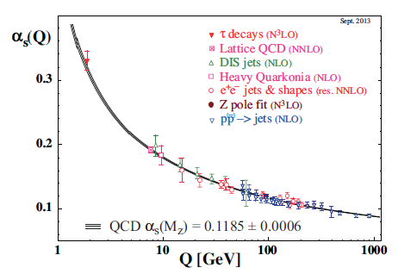
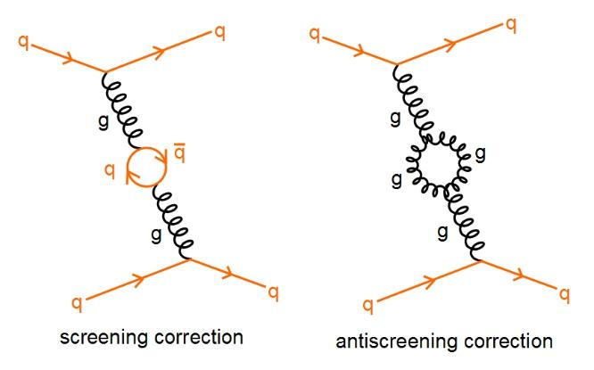

Asymptotic freedom: the role of glue
David Politzer
2004
David Gross
Frank Wilczek
The self-interaction (of color charged) gluons is fundamentally responsible for
the asymptotic freedom of quarks and gluons in Quantum Chromodynamics (QCD)

Slide 12
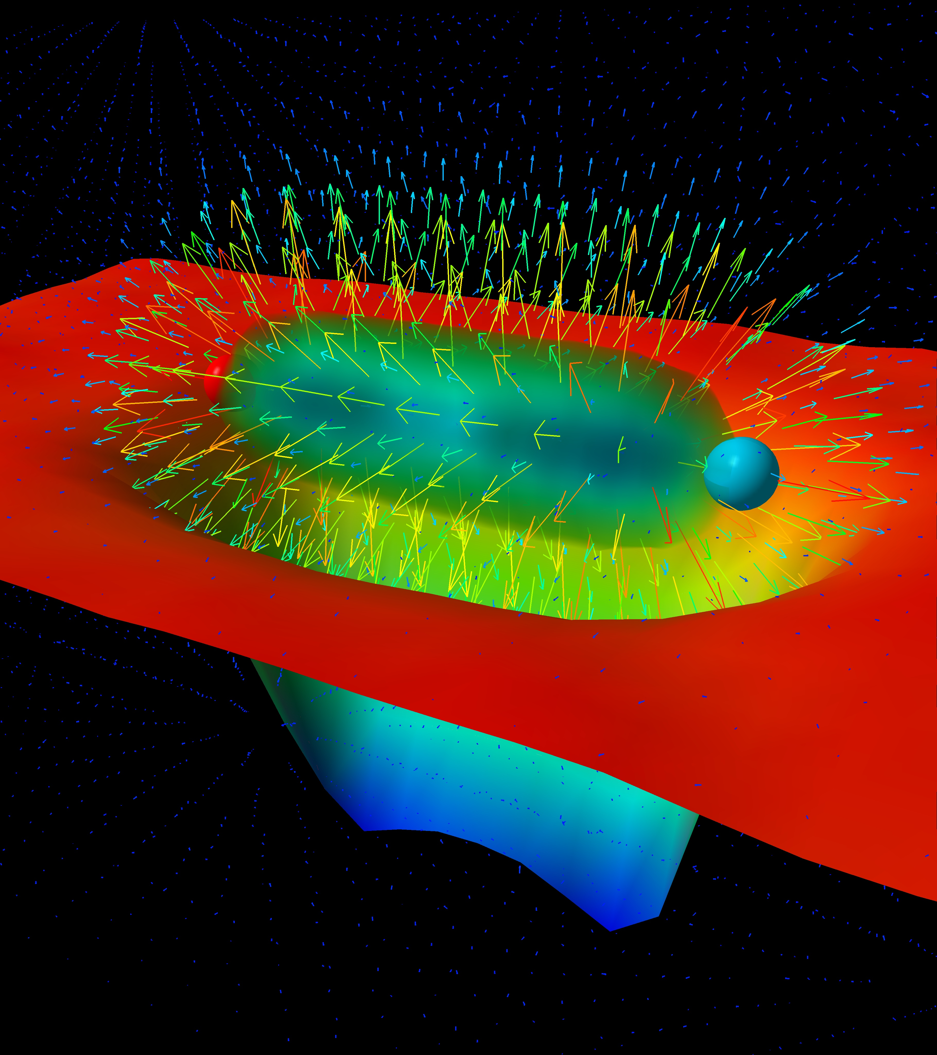
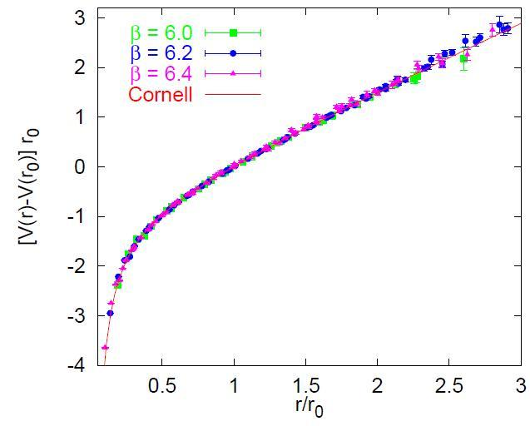
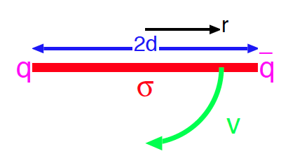
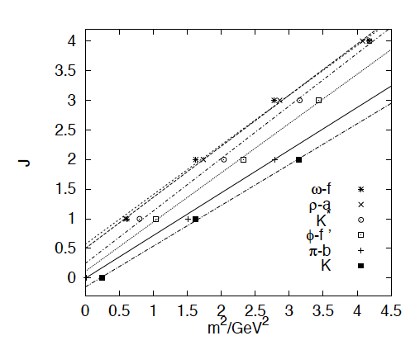
Quark (and Gluon) confinement: the role of glue ?
“Gluon” potential between
heavy quark-antiquark pair
Quarks experience force of 16 tons at
distances of ~ 1 Fermi (10⁻¹⁵ m)
Bali, hep-ph/0001312
“Regge” trajectories
Intuitive picture of quark confinement and
stringy pictures of mesons

Slide 13
The essential mystery
(Nearly) all visible matter is made up of quarks and gluons
But quarks and gluons are not visible
All strongly interacting matter is an emergent consequence of many-body quark-gluon dynamics.
Example: Mass from massless gluons and (nearly) massless quarks
There is an elegance and simplicity to nature’s strongest force we do not understand
Understanding the origins of matter demands we
develop a deep and varied knowledge of this emergent dynamics

Slide 14





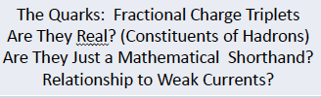


Act 2. Quantum Chromodynamics:
The Power and the Glory
From Gell-Mann’s 8-fold way to QCD: A lepidopteral metaphor
Jeffrey Mandula, Creutz-Fest 2014, BNL

Slide 15
Quantum Chromodynamics (QCD)
QCD - “nearly perfect” fundamental quantum theory of quark
and gluon fields F.Wilczek, hep-ph/9907340
Theory is rich in symmetries:
i
ii
iii
Gauge “color” symmetry: unbroken but confined
Global “chiral” symmetry: exact for massless quarks
Baryon number and axial charge (m=0) are conserved
Scale invariance of quark (m=0) and gluon fields
Discrete C,P & T symmetries
Chiral, Axial, Scale and (in principle) P &T broken by
vacuum/quantum effects - ”emergent” phenomena
Inherent in QCD are the deepest aspects of relativistic Quantum Field Theories (confinement, asymptotic freedom, anomalies, spontaneous breaking of chiral symmetry)

Slide 16
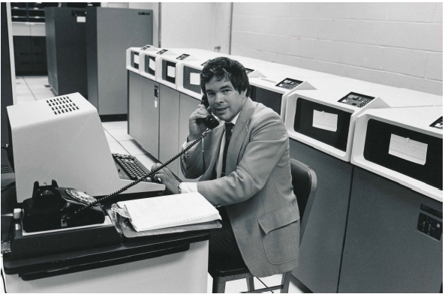
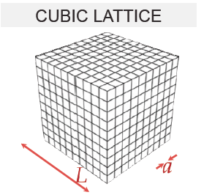
Numerical realization: Lattice QCD
(1982)
Kenneth G. Wilson
Lattice regularization (UV&IR) of QCD
First principles treatment of static
properties of QCD: masses, moments,
thermodynamics at finite T (& μ_{B} ?)

Slide 17
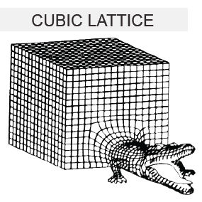
Numerical realization: Lattice QCD
(1982)
Kenneth G. Wilson
Formidable computational problem
Very challenging for dynamical
processes…

Slide 18
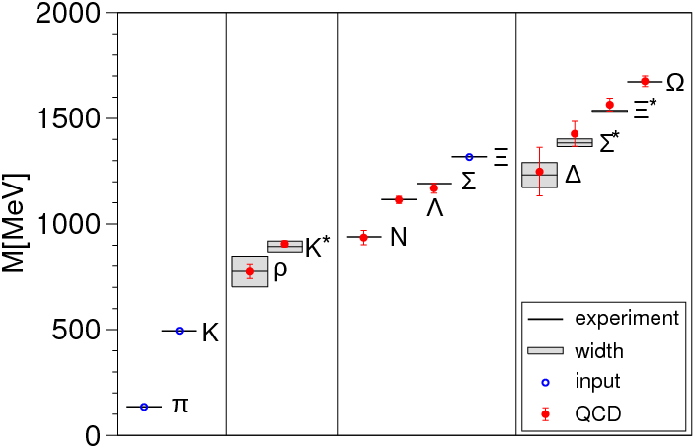
Precision QCD on the lattice
Durr et al., Science, 322 (2008)

Slide 19
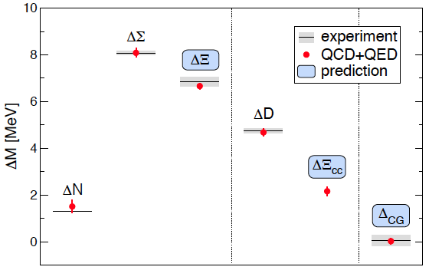
Precision QCD on the lattice
Coleman-Glashow
relation among
mass splittings
Budapest-Marseille-Wuppertal (BMW) Coll., arXiv:1406.4088

Slide 20
The deeply inelastic scattering (DIS) femtoscope
Measure of resolution power
Measure of inelasticity
Bjorken variable: Measure of momentum fraction of struck quark
quark+anti-quark
momentum distributions
gluon momentum distribution

Slide 21
The deeply inelastic scattering (DIS) femtoscope
Measure of resolution power
Measure of inelasticity
Bjorken variable: Measure of momentum fraction of struck quark
quark+anti-quark
momentum distributions
gluon momentum distribution

Slide 22
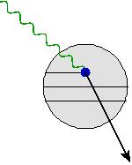
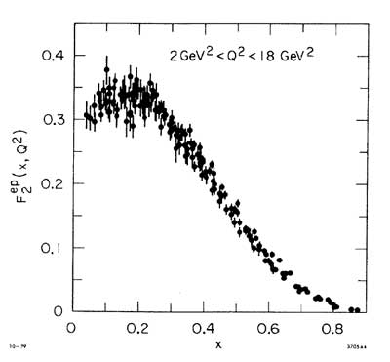
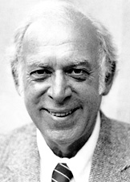
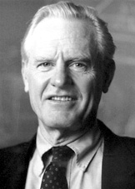

The deeply inelastic scattering (DIS) femtoscope
From SLAC fixed target
DIS… (late 1960s)
Discovery of quasi-free point-like quarks!
(1990)
Friedman
Kendall
Taylor

Slide 23
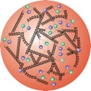
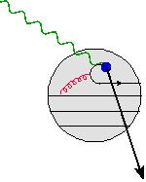
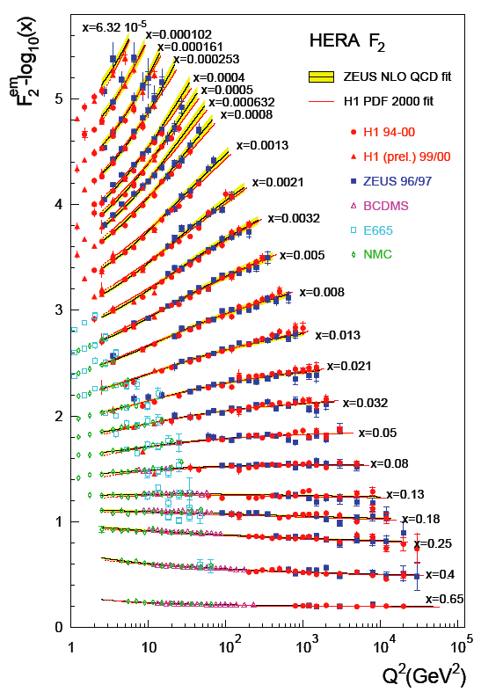
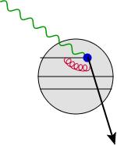
The deeply inelastic scattering (DIS) femtoscope
…to the HERA DIS collider (1990s)
Gluons and
“sea” quarks
SLAC
expts.
The proton at high energies
(small x) is dominated
by glue!

Slide 24
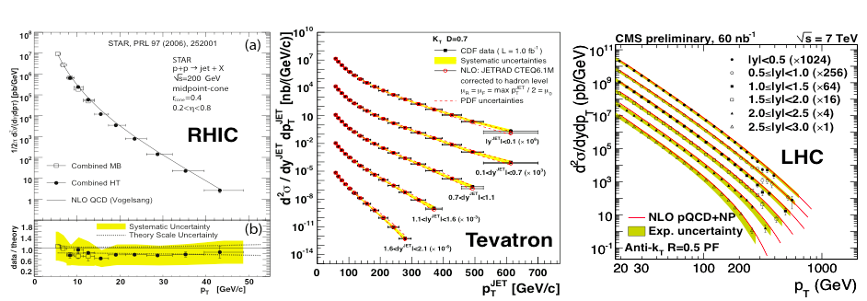
Perturbative QCD: now benchmark for new physics
Structure functions measured at
HERA electron-proton collider
Jet cross-sections: proton-proton collisions (RHIC &LHC)
and proton-antiproton collisions at Fermilab
At large momenta, the weak QCD coupling
(asymptotic freedom!) enables
systematic computations

Slide 25
F. Wilczek , “Quarks (and Glue) at the Frontiers of Knowledge”
Talk at Quark Matter 2014
Are we done ?

Slide 26
Act 3. Frontiers of our ignorance

Slide 27
Scattering in the strong interactions
Energy
Pomerons,
Reggeons ?
Unitary boundary
Quark and gluon
“quasi-particle” dynamics
Perturbative QCD
Meson exchange/
Soliton models
Chiral Pert. Theory
Λ_{QCD}
Momentum resolution: Q²
Perturbative QCD describes only a small part of the total cross-section
Lattice QCD is of very limited utility in describing scattering
Effective theories: how do quark and gluon degrees organize themselves
to describe the bulk of the cross-section ?

Slide 28
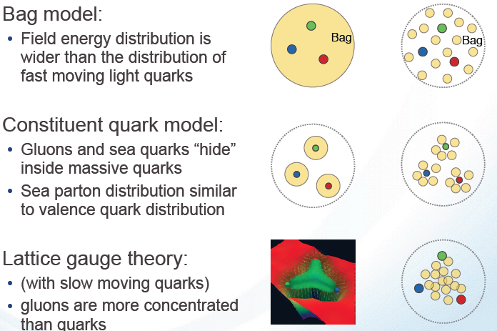
What does the proton look like ?
Static pictures
Glue dominated
boosted proton

Slide 29
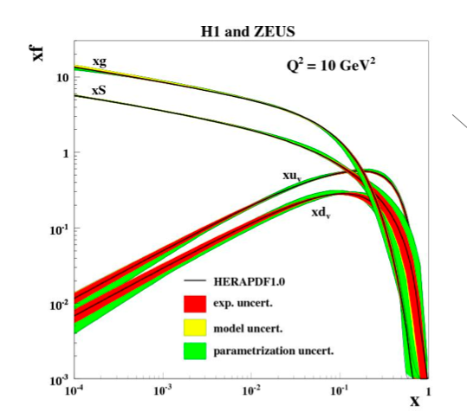
The boosted proton
In QCD, the proton is made up of quanta that fluctuate in and out of existence
Low Energy
or large x
High Energy
or small x
Wee parton fluctuations time dilated on strong interaction time scales
Long lived gluons can radiate further small x gluons…
Is the proton a runaway popcorn machine at high energies ?

Slide 30
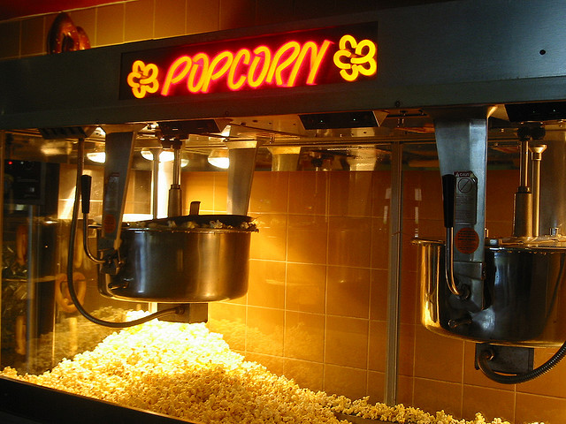
The boosted proton

Slide 31
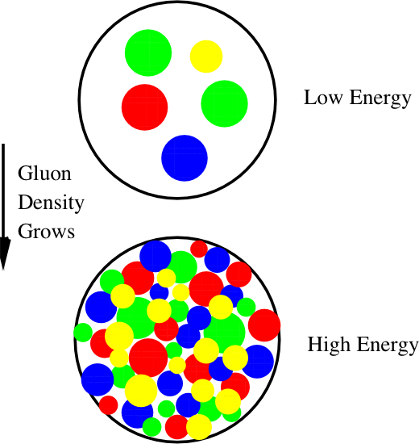
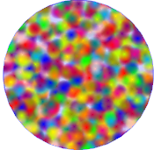
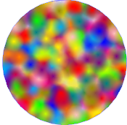
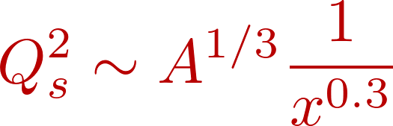
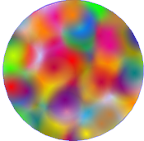
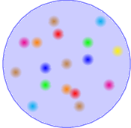





Boosted protons: classical coherence from quantum fluctuations
Emergent dynamical saturation
scale grows with energy
Powerful ``Wilsonian” RG equations
describe evolution in this landscape
Saturation
BFKL
1/Q_{S}²
DGLAP
How does this happen? What are the right degrees of freedom?
How do correlation functions of these evolve?
Is there a universal fixed point for RG evolution? Does the coupling run with Q_{s}² ?
How does saturation transition to chiral symmetry breaking and confinement?

Slide 32
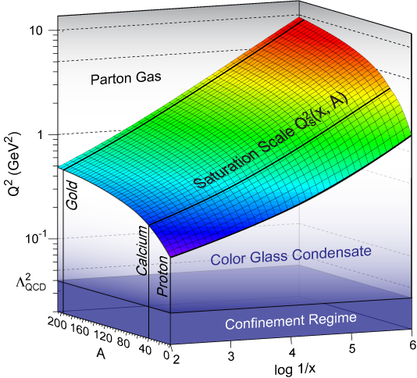
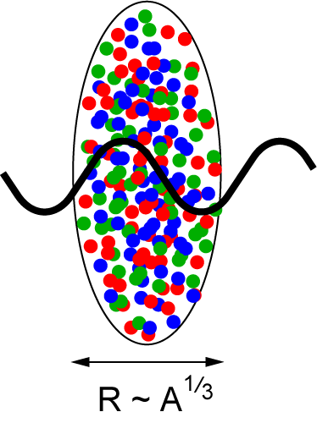
Many-body high energy QCD: a new frontier
A^{1/3} enhancement
of saturation scale in nuclei
resolution
nuclear size
energy
Dynamically generated semi-hard “saturation scale” opens window for
systematic weak coupling study of non-perturbative dynamics
Can we sneak up on confining dynamics “through the back door” ?

Slide 33
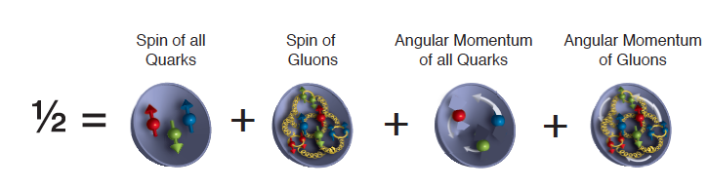
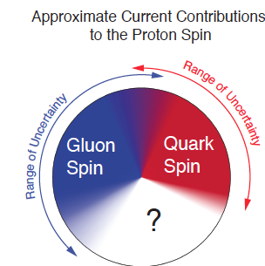
The proton’s spin puzzle
Fixed target deep inelastic scattering experiments
showed that quarks carry only about
30% of the proton’s spin
“Spin crisis” – a failure of the quark model
picture of three relativistic “constituent” quarks

Slide 34
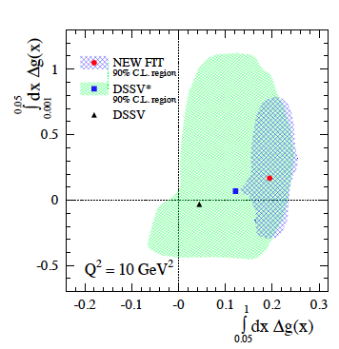
The proton’s spin puzzle
Clear evidence for gluon
polarization from RHIC polarized
proton-proton data
Gluons carry ~ 20-40 % of the
Proton spin
Where’s the rest ?
D. De Florian, R. Sassot, M. Stratmann, W. Vogelsang, PRL 113 (2014)

Slide 35
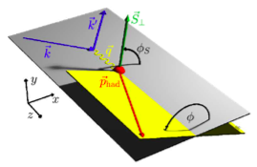
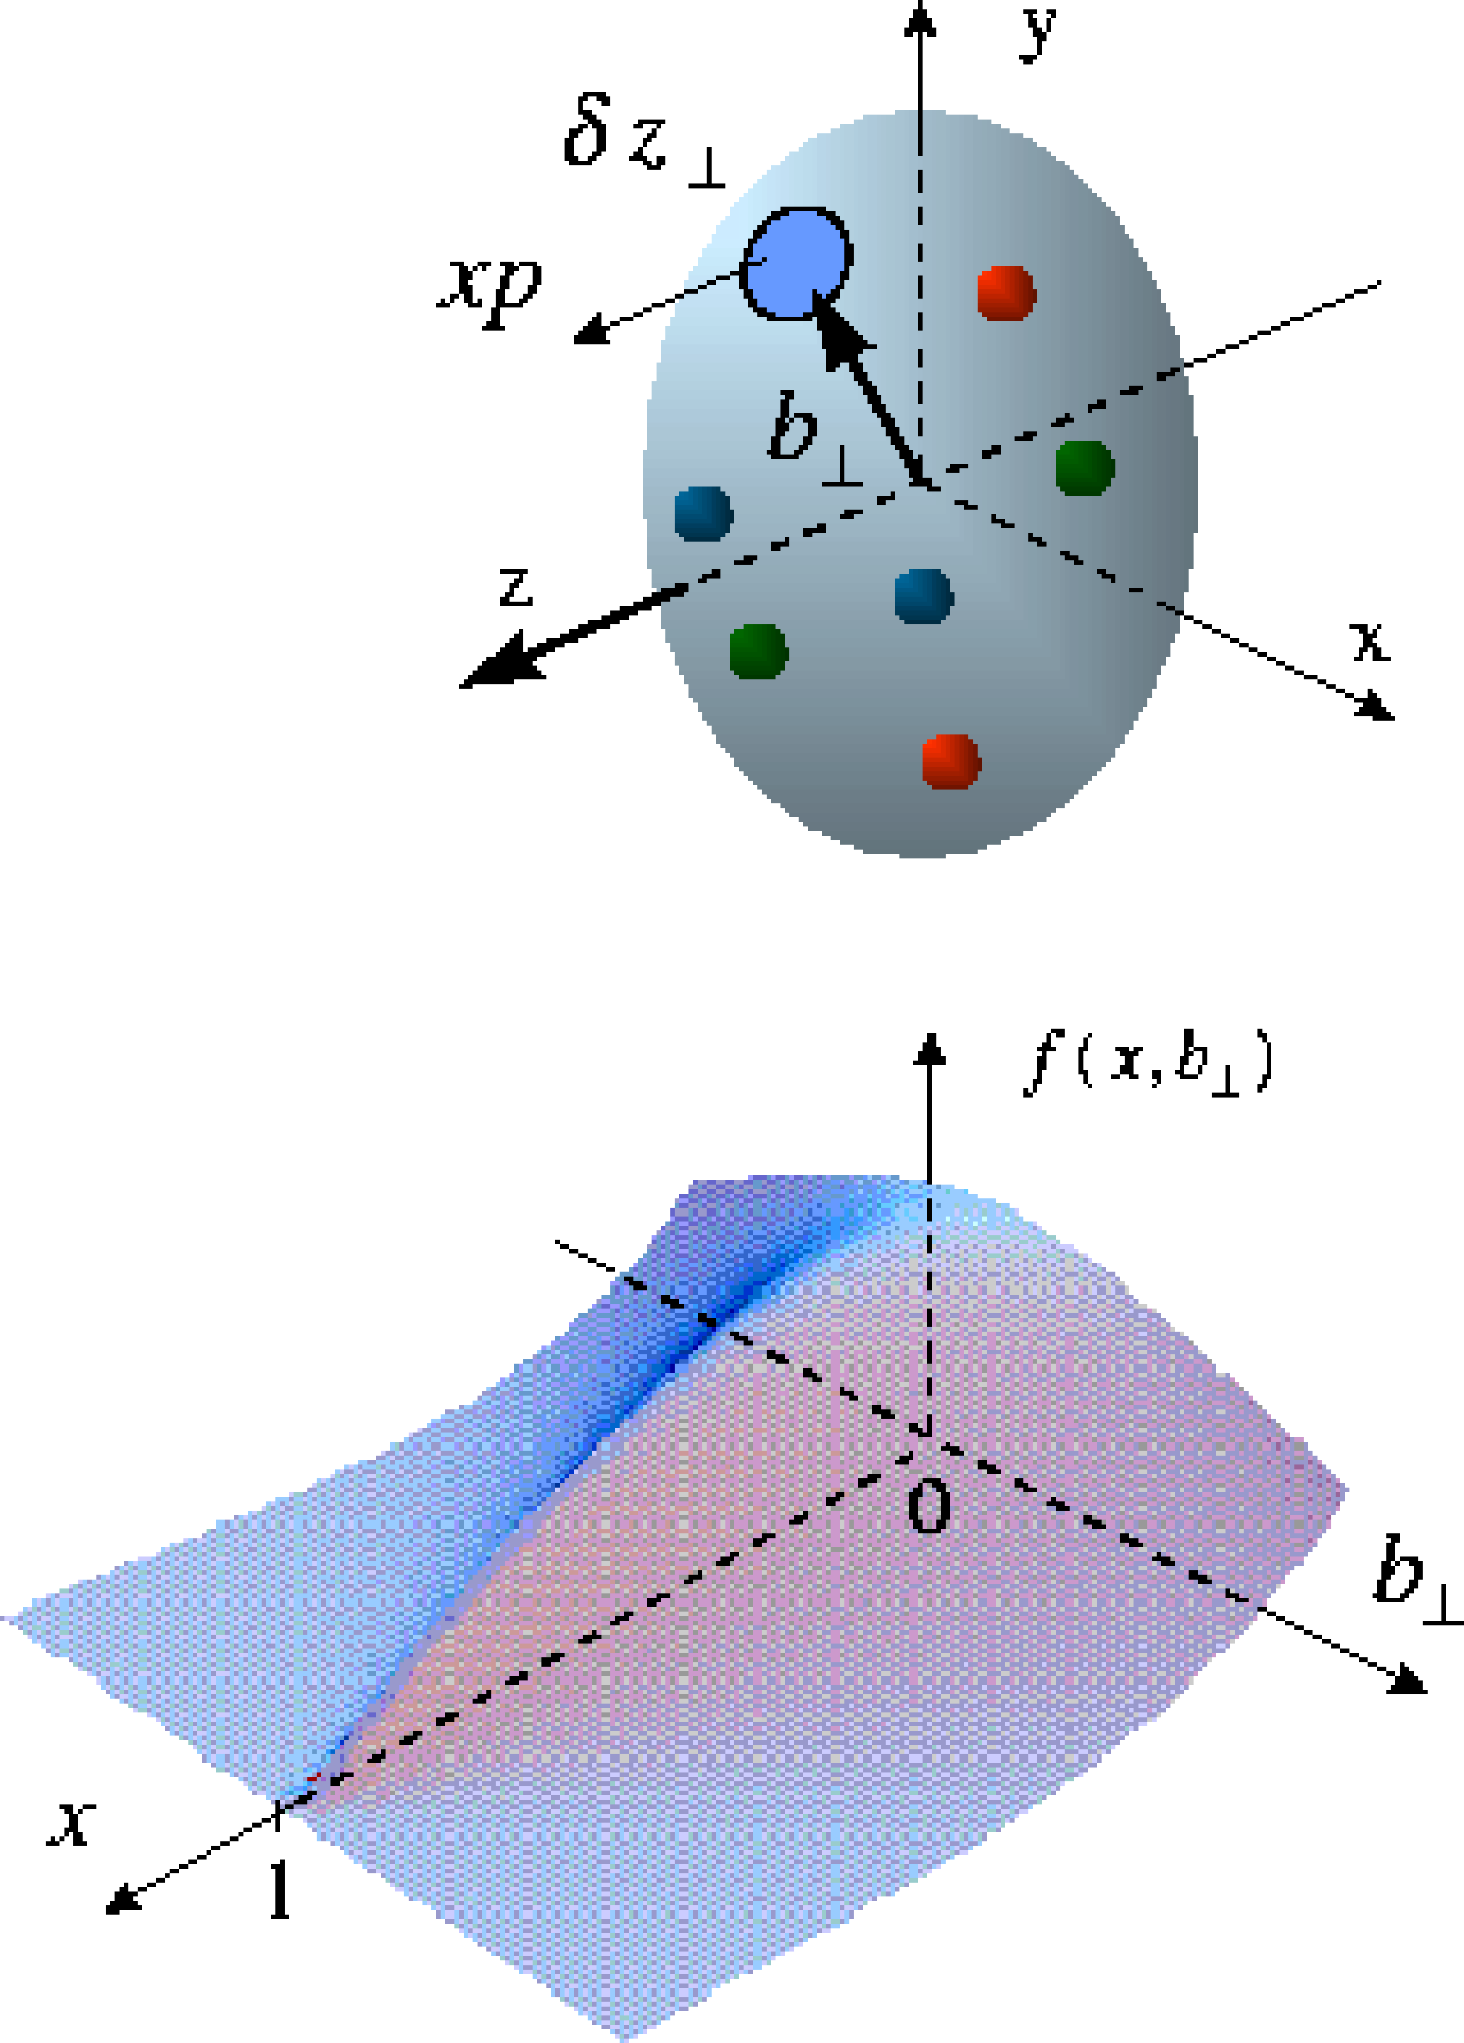
Imaging distributions of quarks and gluons ?
Transverse momentum dependent (TMD) distributions
Similar for gluons
e’
γ
e
γ_{L}*
(Q²)
x+ξ
x-ξ
~
~
p
H, H, E, E (x,ξ,t)
p’
t
Generalized parton distributions (GPDs)
Differential images correlating the spin, momentum and spatial distributions will provide fundamental insight into quark-gluon dynamics in nucleon structure

Slide 36



Nuclear glue: terra incognita
Quark (Gluon) distributions in nuclei- not simple superpositions
of nucleon Quark (Gluon) distributions
The nucleus as a QCD laboratory :
Understand how quarks and gluons fragment
and hadronize in and out of the medium
What is the quark-gluon nature of
nuclear short-range correlations ?

Slide 37
Act 4. EIC: the ultimate QCD machine?
The world’s first polarized electron-polarized proton collider
The world’s first electron-heavy ion collider
Luminosities: a hundred to up to a thousand times HERA
Fine resolution inside proton down to 10⁻¹⁸ meters

Slide 38


US Electron-Ion Colliders: accelerator designs
LHeC at CERN – center-of-mass energies of 1.2 TeV (4 times HERA)
electron-ion collisions; no polarized protons

Slide 39

http://science.energy.gov/np/nsac/

Slide 40



Slide 41

Select measurements
arXiv:1212.1701v3

Slide 42


Resolving the proton’s spin puzzle
-
dramatic reduction
of uncertainties:
world data
till eRHIC
now
eRHIC

Slide 43

A money plot
Nail down the valence, sea quark and gluon contributions
to the proton’s spin

Slide 44
A money plot
Significantly quantify the remaining orbital contributions

Slide 45
3-D imaging in semi-inclusive reactions
Polarized quark distribution
(Sivers function)
before and with EIC

Slide 46

Projected images of spatial gluon distributions
Generalized parton distributions (GPDs) uncover
3-D structure of matter below the Femto-scale:
High precision spatial tomography
gluon and sea quark distributions !

Slide 47

Entering terra-incognita in nuclei
Current knowledge on distributions of quarks and gluons in nuclei

Slide 48


Entering terra-incognita in nuclei
Dramatic improvement in precision extraction of nuclear gluons and sea quarks

Slide 49

The Transubstantiation of Quarks and Glue into mesons and baryons
Nu is a coherence length. Dialing it determines
whether quarks (gluons) fragment in or out of nucleus
Novel sensitivity to heavy quark
fragmentation

Slide 50

Diffraction for the 21st Century
M_{X}
Colorless
exchange
A TeV electron hits a nucleus (binding energy of 8 MeV/nucleon)
Day 1: prediction: nucleus remains intact in at least 1 in 5 events

Slide 51

Diffraction for the 21st Century
A TeV electron hits a nucleus (binding energy of 8 MeV/nucleon)
Day 1: prediction: nucleus remains intact in at least 1 in 5 events

Slide 52

EIC whitepaper
New opportunities

Slide 53




Probing rare glue fluctuations with ballistic protons
T. Lappi, H. Mantysaari, R. Venugopalan: PRL 114 (2015) 8, 082301
Can use “ballistic” protons in
Roman pots as a measure of
centrality dependence of
fluctuations
Central/min.bias double ratios
very sensitive probe of
fluctuations of strong gluon fields

Slide 54





Probing short-range NN interactions with EIC
G.A. Miller, M. D. Sievert, R. Venugopalan, to appear tomorrow
Use high energy DIS probes
to probe short-range nuclear
forces
Exclusive process
s_{NN} << s
Can access s_{NN}~ 12 GeV² with
very conservative EIC lumi.

Slide 55
Concluding Thoughts
Our knowledge of the fundamental structure of matter is clouded
by the vast fog of our ignorance
– though there are bright gems that shine through
At the heart of the matter is the confining dynamics of QCD –
this is many-body dynamics with gluons playing a lead role.
Addressing this requires deep and varied knowledge
– an EIC enables unique and unprecedented measurements.
The history of DIS informs us that surprises may be anticipated

Slide 56



Slide 57

Slide by Thomas Ullrich

Slide 58




Entering terra-incognita in nuclei
First measurements of gluons and sea quarks in heavy nuclei

Slide 59



Differential probes of many-body correlations
Zheng et al., PRD89 (2014) 074037
Di-hadron measurements are very sensitive to the evolution and dynamics of many body correlations—complementary suite of measurements to those in p+A collisions

Slide 60

April 2015

Slide 61

A final coda: definitive resolution of an LHC puzzle
What EIC will contribute:
Photo-production in e+A very nearly like p+A –the photon
fluctuates into a vector meson before hitting the nucleus
– all p+A correlation measurements feasible.
Varying momentum resolution Q² in e+A, one systematically
dials away “final state” interactions…

Slide 62



A final coda: definitive resolution of an LHC puzzle
LHC p+Pb collisions
@ 5.02 TeV/nucleon
Is the matter created…
…the world’s smallest droplet?
…or a novel form of gluon entanglement?

