Slide 1
Pomeron Femtoscopy from a unitary extension of Bialas-Bzdak model
T. Csörgő ^{1,2}
¹ Wigner Research Center for Physics, Budapest, Hungary
² KRF, Gyöngyös, Hungary
p+p @ ISR and @ 7 TeV LHC
Real extension of Bialas-Bzdak
New: focusing ReBB on low t region of dσ/dt of pp
Excitation functions
Pomeron Femtoscopy
arXiv:1204.5617
arXiv:1306.4217
arXiv:1311.2308
arxiv:1505.01415
+ manuscript in preparation

Slide 2
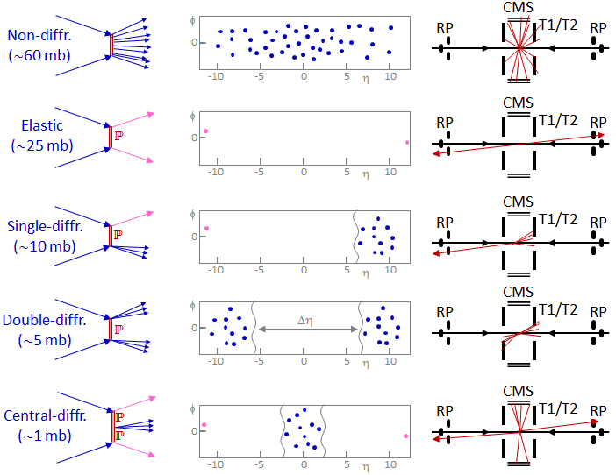
Pomeron physics at LHC with TOTEM
TOTEM TOTEM
TOTEM TOTEM
TOTEM TOTEM
TOTEM TOTEM
TOTEM TOTEM
Elastic and diffractive scattering: Pomeron (colorless) exchange

Slide 3
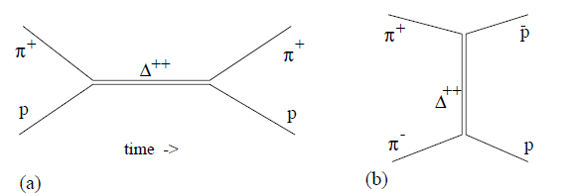







Introduction to Pomeron physics
Crossing symmetry:
Resonance production in s-channel: (a)
Interaction through resonance exchange in t-channel: (b)
R. Engel, hep-ph/0111396
E. Levin, hep-ph/9808486
s, t variables for elastic pp:

Slide 4
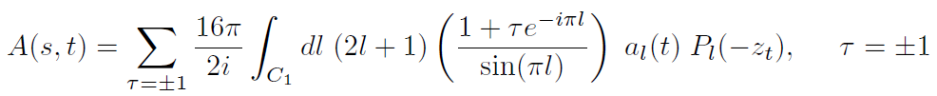


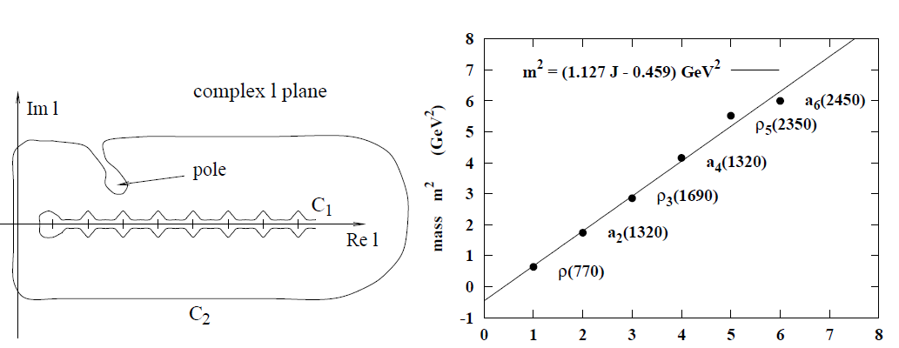
Regge theory
Regge trajectories,
pole at α(t) = l, α(t) = α(0) + α’(0) t

Slide 5
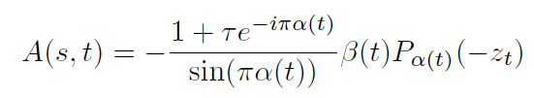

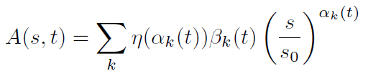
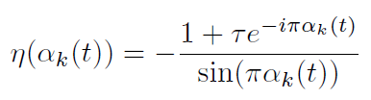
Reggeons
Summation is over Regge trajectories,
Reggeons = quasi-particle =
family of resonances with same quantum numbers
T. Regge, Nuovo Cim. 14 (1959) 951

Slide 6



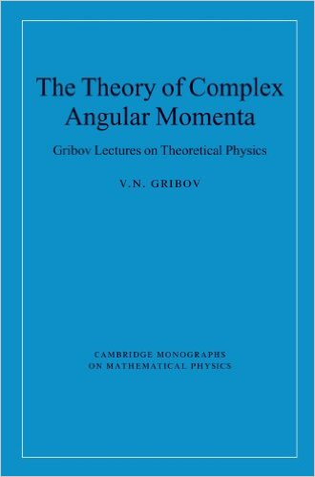




Pomerons and cross-sections
From data: σ_{tot}(s) constant or increasing with s
Pomeron (Pomeranchuk-on): Reggeon with Δ ~ 1
No resonances on the Pomeron trajectory,
For resonances: Δ_{max} ~ 0.5
Vacuum quantum numbers, rapidity gaps
V. N. Gribov and I. Ya. Pomeranchuk, Phys. Rev. Lett. 8, 343

Slide 7
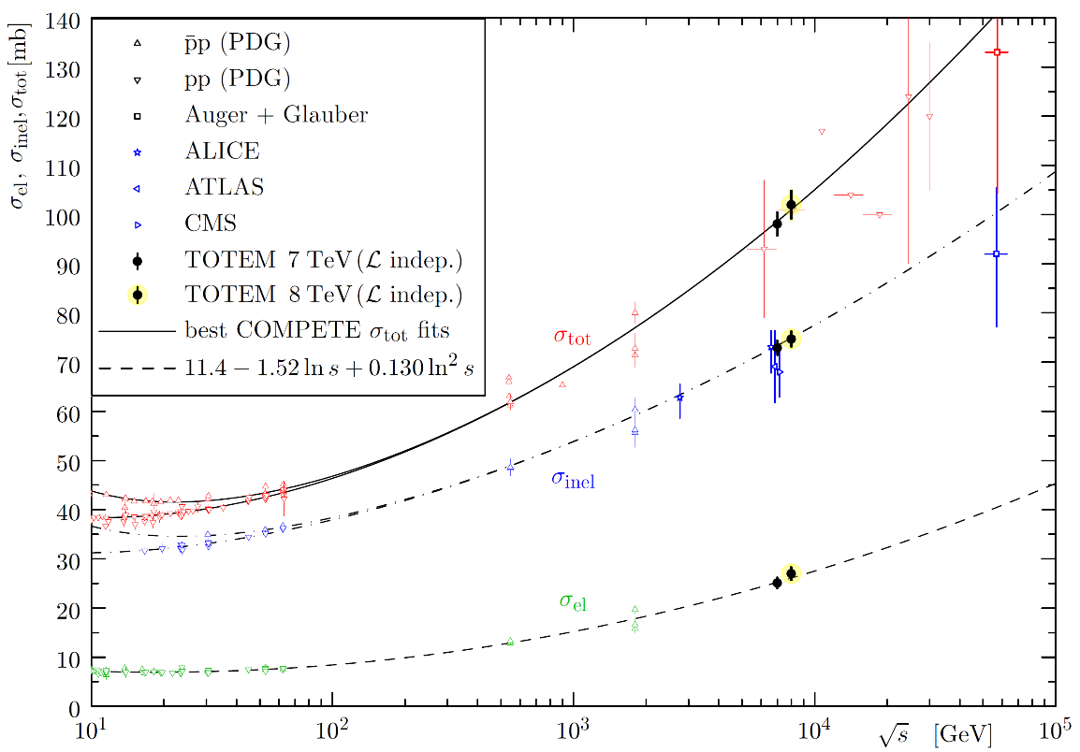
Pomerons and cross-sections
From LHC data: σ_{tot}(s) increases with ~ ln s
Froissart-Martin bound: σ_{tot}(s) ≤ C ln² s

Slide 8


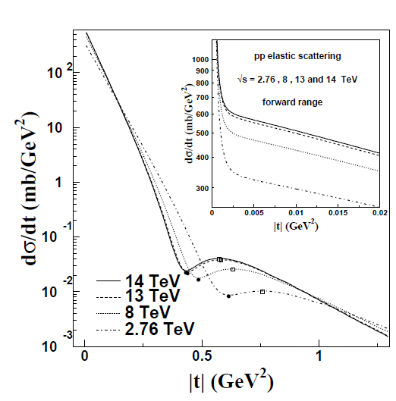

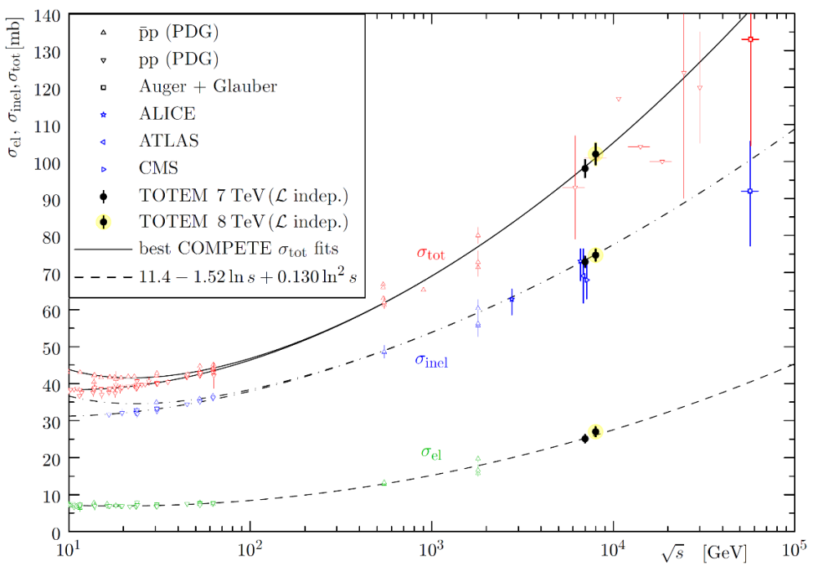

Gaussians in b: Pomerons in t!
Gaussian approximation:
elastic amplitude in impact parameter (b) representation
Gaussian b, Pomerons in t:
increase of the total cross-section
shrinking of the diffraction cone
both effects seen experimentally

Slide 9




S-matrix Unitarity, Optical Theorem
Note: diffraction also measures
|Fourier-transform|² images of
sources of elastic scattering
ideal for femtoscopic studies
several similarities e.g. non-Gaussian sources etc
Black (grey) disc limit (important)
→ σ(b) ~ θ(R-b)

Slide 10

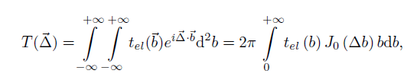


Diffraction in quark-diquark models
Bialas and Bzdak,
Acta Phys. Polon. B 38 (2007) 159
p= (q, d) or p = (q, (q, q))
σ(b) = b dependent prob. of interaction
→ connection to scattering centers
Structure of protons = ?
→ Diffractive pp at ISR (23.5 – 62.5 GeV) and LHC (7 - 8 TeV).

Slide 11



Diffraction a la Bialas and Bzdak
The quark-diquark model of Bialas and Bzdak has been analytically integrated in a Gaussian approximation,
assuming that the real part of forward scattering is negligible.
Two different pictures: p = (q, d) or p = (q, (q,q))
Note: p= (q,q,q) model fails, quarks are correlated
W. Czyz and L. C. Maximon, Annals. Phys. 52 (1969) 59
„Springy” p=(q,d) Pomeron model of Grichine, arxiv:1404.5768

Slide 12
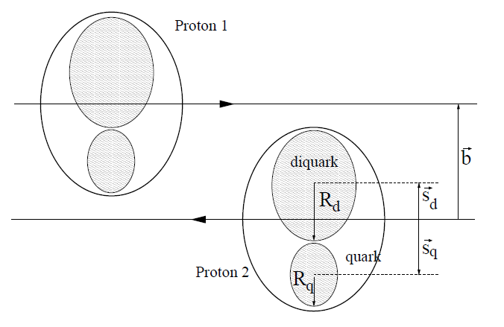
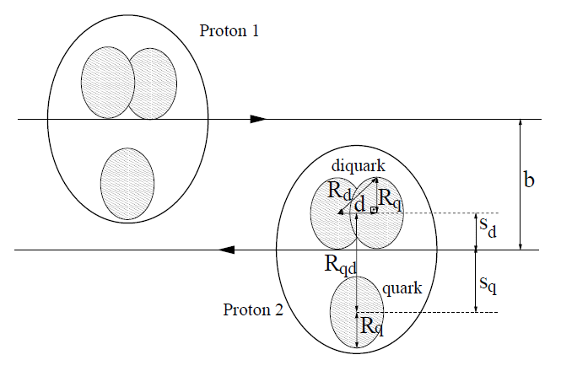
Diffractive pp scattering
p = (q, d)
p = (q, (q,q))

Slide 13
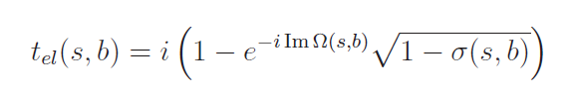

Real extended BB model for the dip
Bialas-Bzdak obtained
if Re (t_{el}) = 0
Real extension of an imaginary t_{el}
New parameter Im Ω added

Slide 14
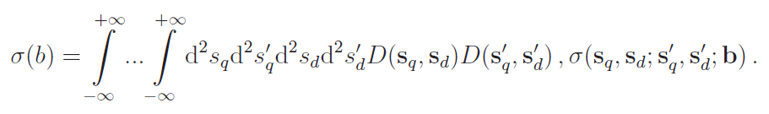
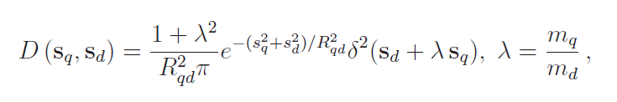
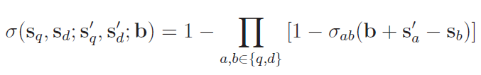


ReBB model for the dip (2)
Bialas-Bzdak model is „realized”:
p = (q,d)
p= (q, (q,q))
Gaussians in b
Pomerons in t?

Slide 15


ReBB model: two choices
Similar to a constant ρ
but
not favored
by data
For small values of
α
we recover
our first
attempt, the
αBB model
This choice is also favoured by data
T. Cs., F. Nemes, arxiv:1306.4217

Slide 16
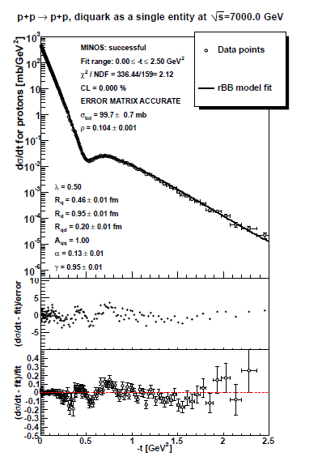

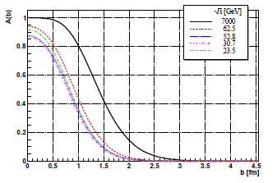


ReBB model, combined data sets
Shadow profile function
Fit range: 0 ≤ –t ≤ 2.5 GeV², not quite OK → check @ 8 TeV

Slide 17
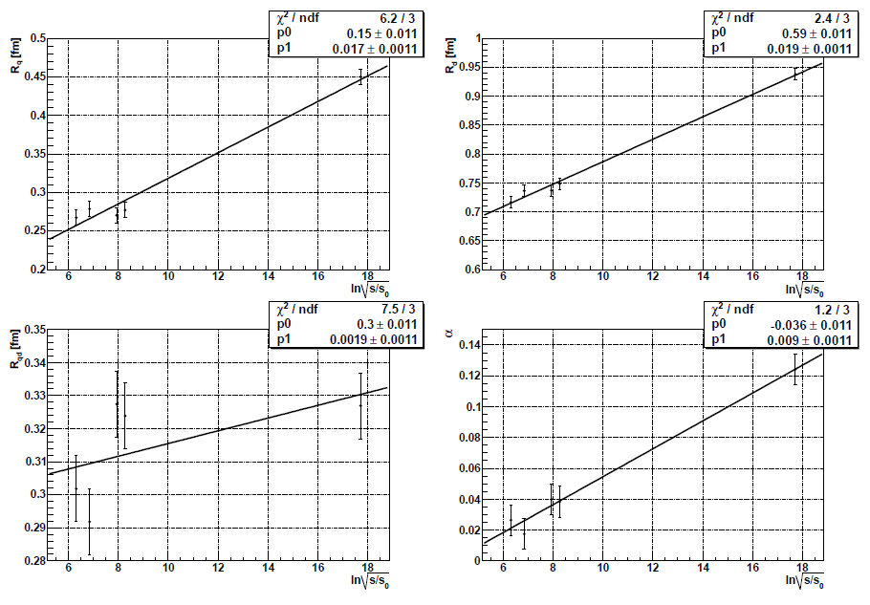
Excitation function: scaling in pp
Gaussians in b
Pomerons in t!
Geometric scaling: {R_{q}, R_{d}, R_{qd}, α} = p₀ + p₁ ln (s/s₀)

Slide 18
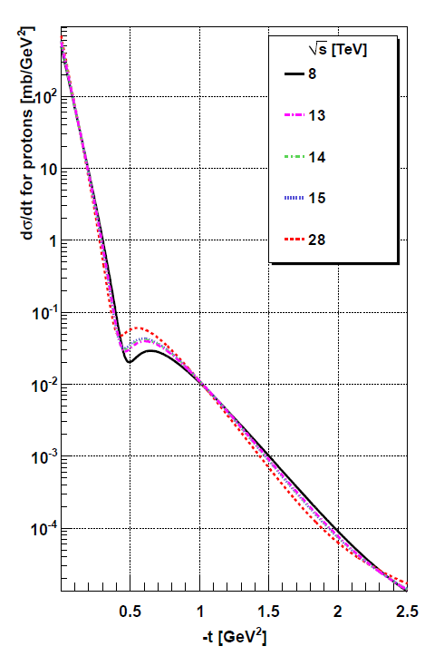
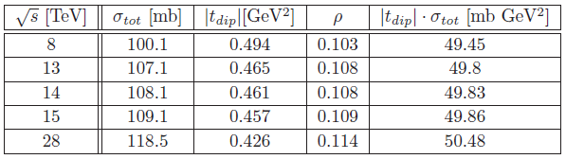
Excitation function: dσ/dt
Geometric scaling:
modest change
from 7 TeV to 28 TeV
Dips to lower –t by ~10%
σ_{tot} increases by ~10%,
with √s from 7 to 15 TeV
but t_{dip} σ_{tot} ~ const (2 %)
Similar to:
K.A. Kohara, T. Kodama, E. Ferreira,
arXiv:1411.3518

Slide 19
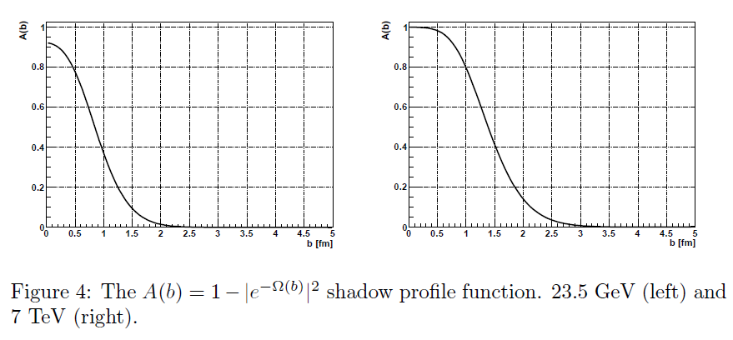
ReBB shadow profile functions
Indication of saturation at 7 TeV: A(b) ~ 1 at low b.
~ max probability of interaction at low b

Slide 20
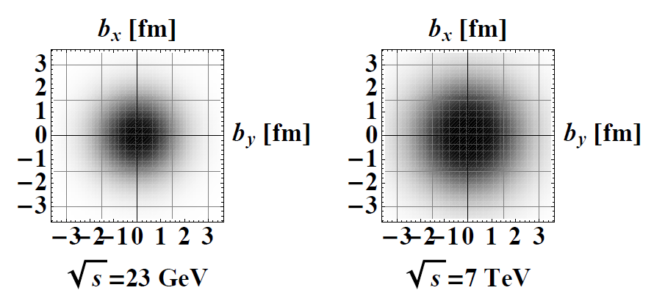
Imaging on the sub-femtometer scale
at 23 GeV ISR and 7 TeV LHC energy
What about 8 TeV and future LHC energies?

Slide 21
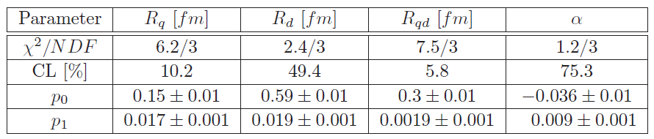
Geometric scaling in pp
Geometric scaling: {R_{q}, R_{d}, R_{qd}, α} = p₀ + p₁ ln (s/s₀)

Slide 22
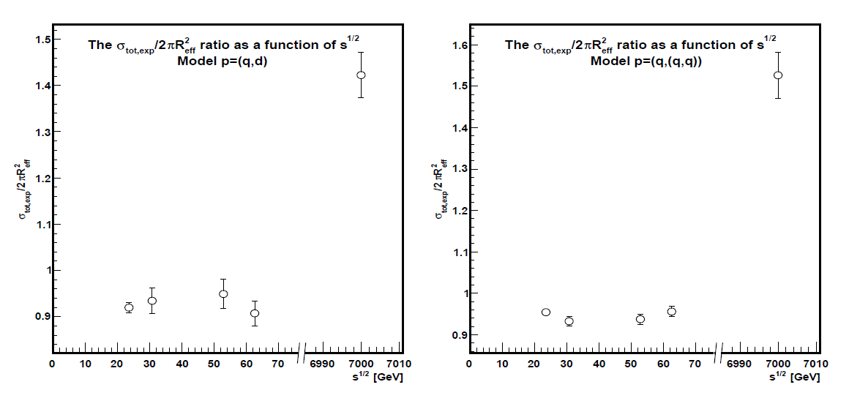

What have we learned?
Model independent effective formula:
works ~ well both for BB and αBB models
F. Nemes and T. Cs, arXiv:1204.5617
Froissart-Martin bound satisfied (new)!

Slide 23
What have we learned?
BB: Bialas-Bzdak
Gaussian in b:
Pomeron in t
ReBB model:
Pomeron Femtoscopy
on (q,d) level
ReBB model:
Froissart-Martin bound
Automatically satisfied!
BB → AA model

Slide 24
Thank you for your attention!
Questions?

Slide 25
Backup slides - TOTEM

Slide 26
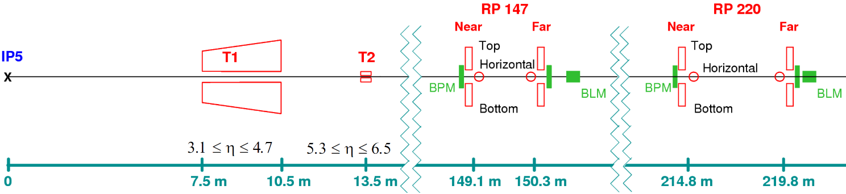
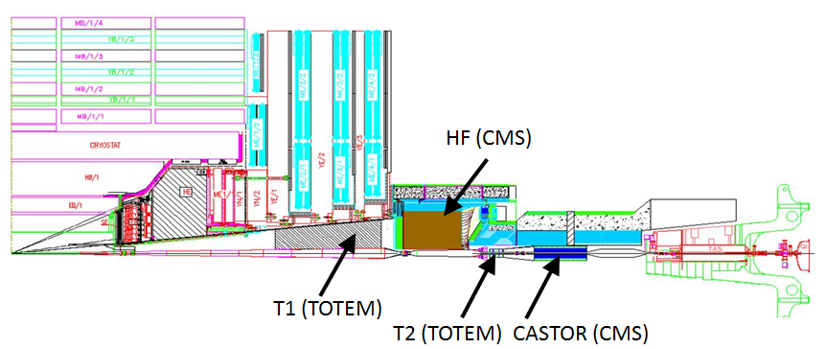
TOTEM – Experimental Setup at IP5
T1, T2: CSC and GEM Inelastic telescopes; RP: Roman Pots
[Details: JINST 3 (2008) S08007]. In this talk: TOTEM Roman Pots 220 m

Slide 27
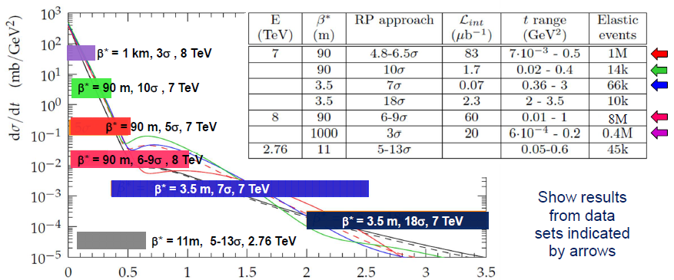
TOTEM data taking
July 2012 data, special LHC run , β* = 90 m, √s = 8 TeV
2 → 3 colliding bunch pair, 8 x 10¹⁰ p/bunch
Instantaneous L ~ 10²⁸ cm⁻²s⁻¹
11 h data taking, RP-s at 9.5 σ_{beam}
Integrated L ~ 735 μb⁻¹
7.2 10⁶ elastic events

Slide 28
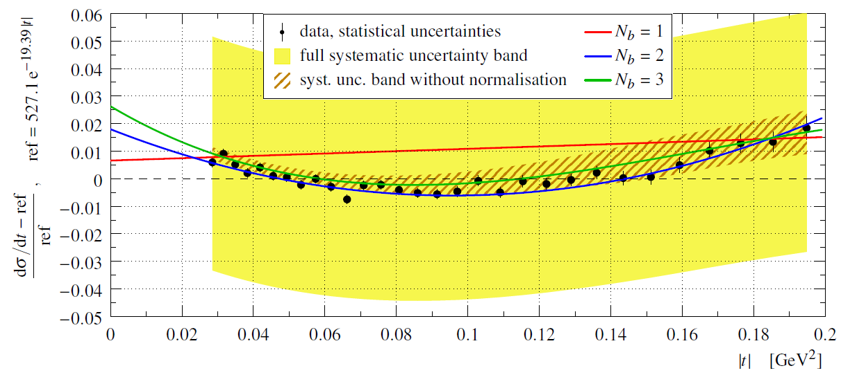
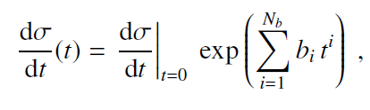



Differential cross-section @ 8 TeV
N_{b} = 1 fits excluded. Relative to best exponential, a significant 7.2σ deviation found.

Slide 29
Backup slides – ReBB

Slide 30
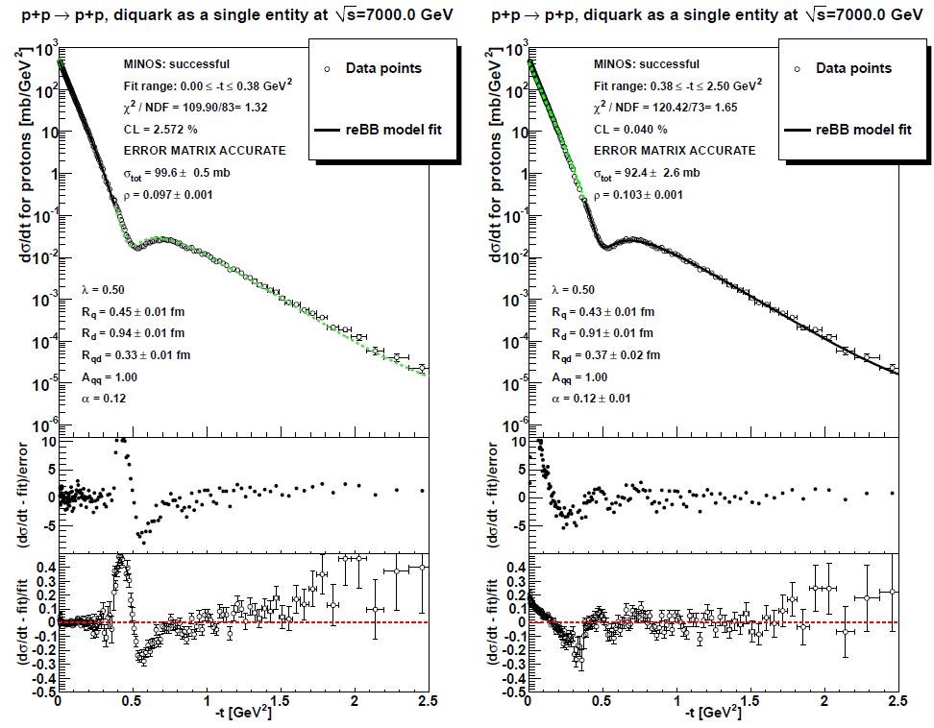
ReBB model, fit range studies
remarkable stability of extrapolation to the
unfitted region
fit: 0.36≤ –t ≤ 2.5 GeV², OK
fit: 0 ≤ –t ≤ 2.5 GeV², ~ OK

Slide 31
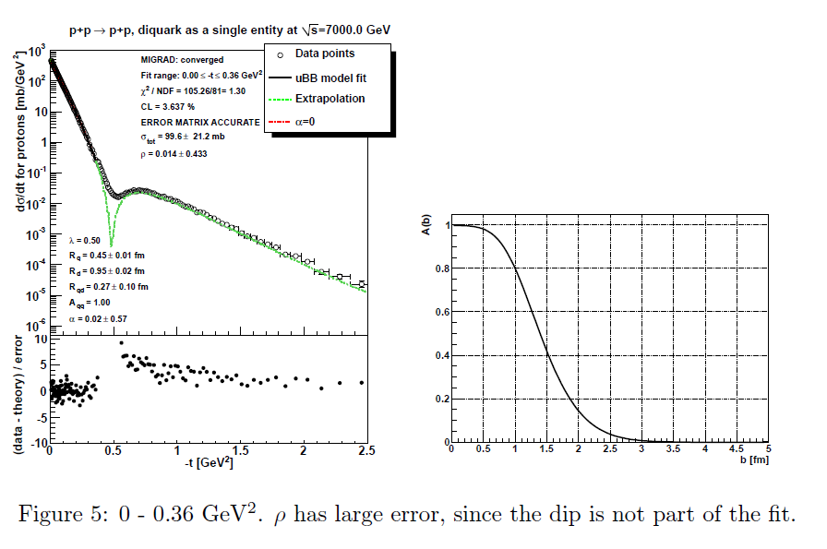
Focusing reBB on the low-t region
Saturation is apparent if fit range is limited to |t| < 0.36 GeV²

Slide 32
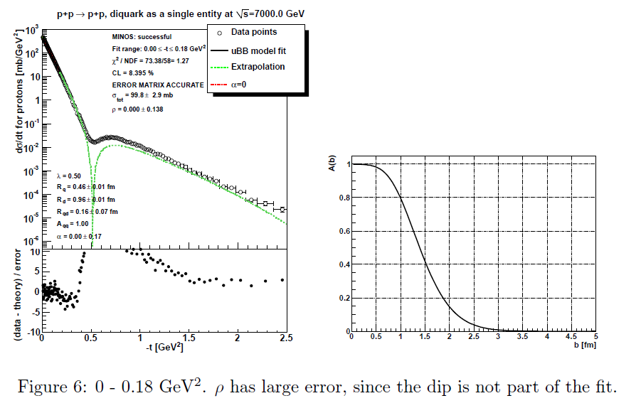
Focusing reBB on even lower -t region
Connection to TOTEM
Saturation still apparent, fit range |t| < 0.18 GeV²

Slide 33
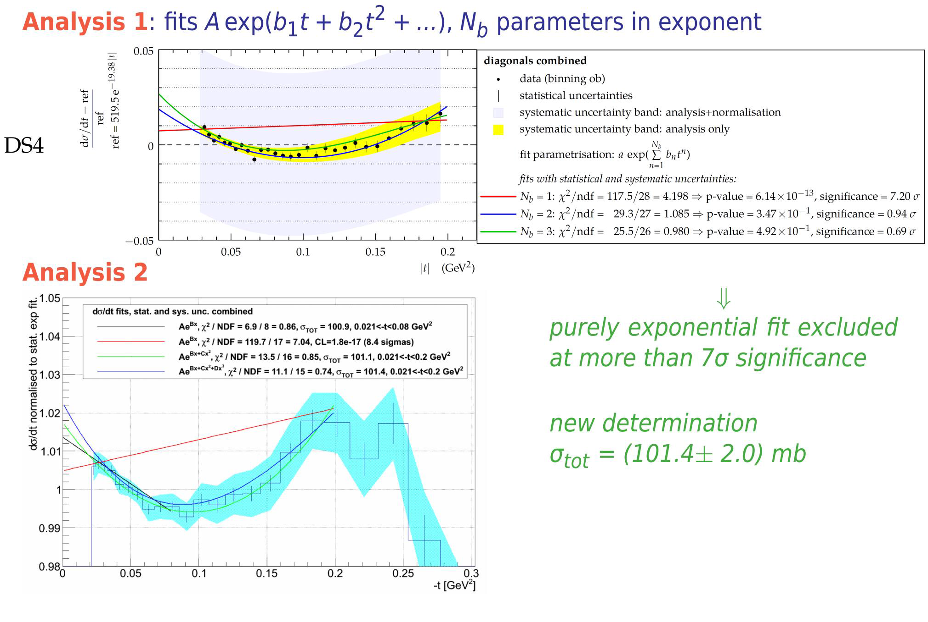
TOTEM 8 TeV pp data
Nucl.Phys. B899 (2015) 527-546
TOTEM pp data at 8 TeV
exponential shape
excluded at 7+ σ
Theoretical support, from ISR to LHC energies, unitarity
L. Jenkovszky and A. Lengyel,
arXiv:1410.4106

Slide 34
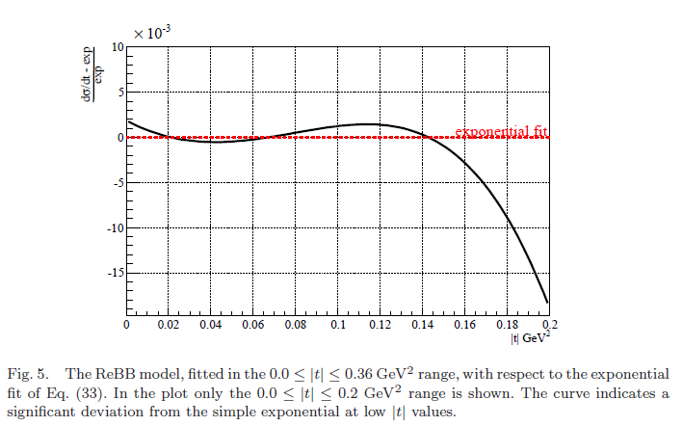
Non-exponential behaviour in ReBB
Similar
non-exponential feature
seen at 7 TeV as in 8 TeV
TOTEM data

Slide 35
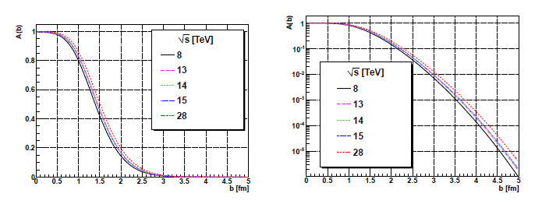
Predictions for the shadow profile
Blacker and Larger,
but not Edgier:
BnEL effect
at LHC energies
Similar to:
K.A. Kohara, T. Kodama,
E. Ferreira,
arXiv:1411.3518
but they also claim
an asymptotic BEL effect

Slide 36
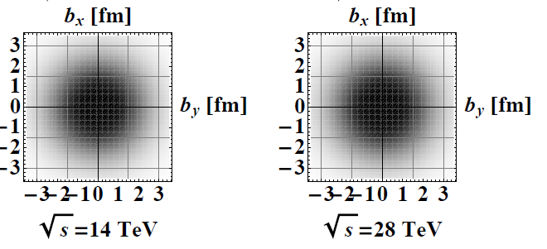
Predictions for the shadow profile
Blacker and Larger,
but not Edgier:
BnEL effect
at LHC energies
Results presented so far:
arxiv:1505.01415

Slide 37
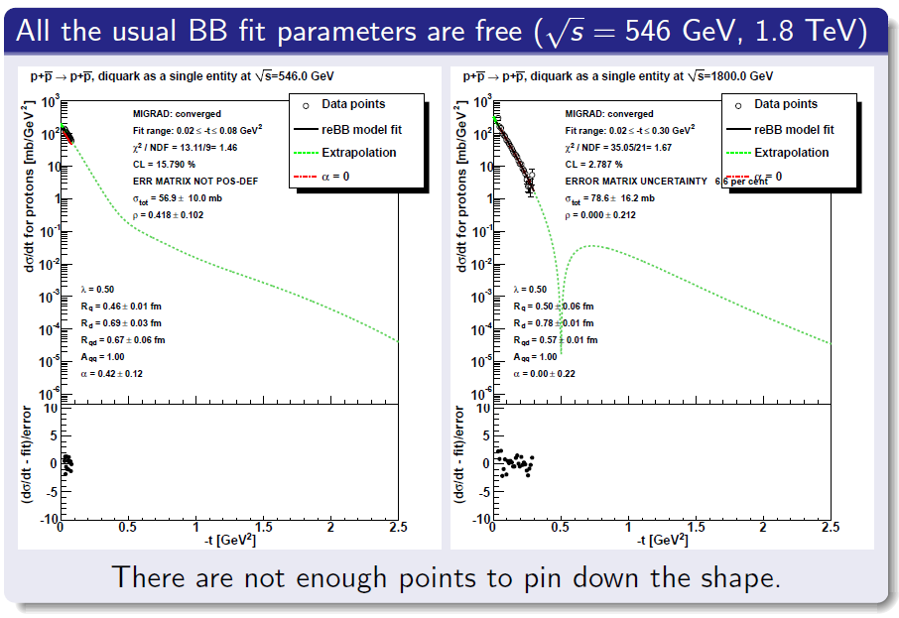
New results: pp data with ReBB model

Slide 38
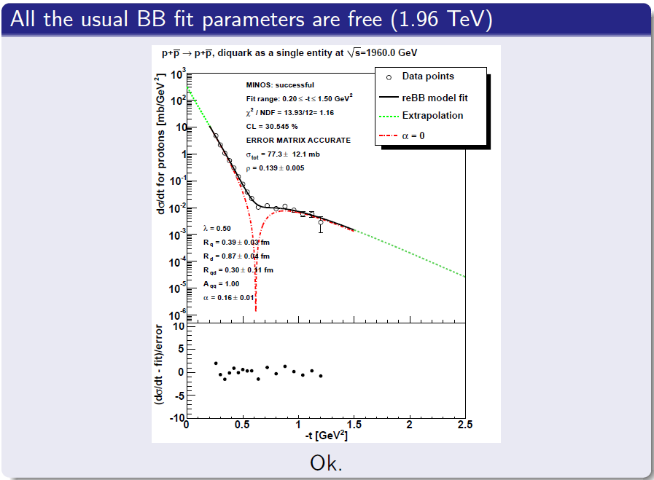
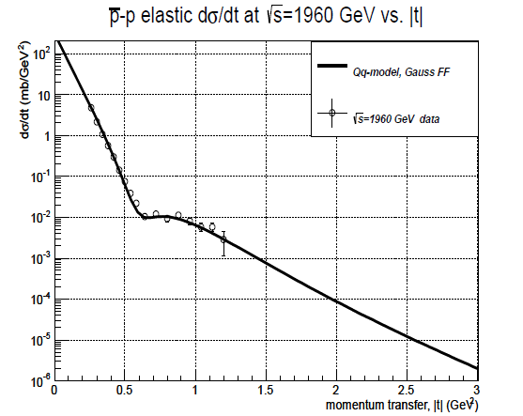
Tevatron pp data with ReBB model
Similar to:,
V. Grichine,
arxiv.org:1404.5768
p = (q, d) in a
„springy” Pomeron picture
also increases real part of t_{el}

Slide 39
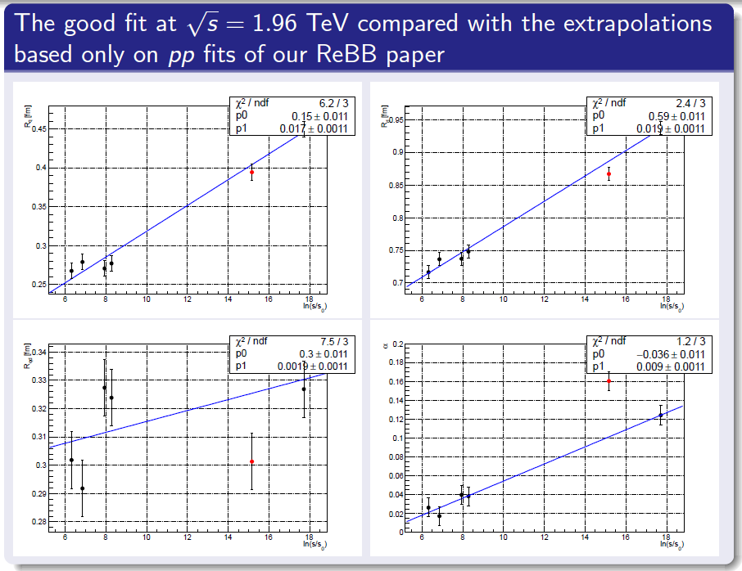
Tevatron pp data trends ReBB model
ReBB model works
also for elastic pp data
but pp is more „opaque” than pp.

Slide 40
Backup slides – Discussion

Slide 41
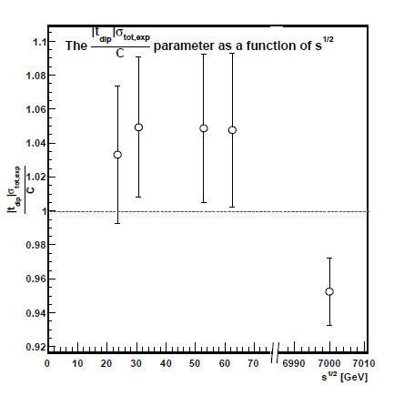


Black disc limit?
Geometric scaling,
but not the black disc limit:
T. Cs. and F. Nemes
arXiv:1306.4217
Int. J. Mod. Phys. A (2014)
C(data) ~ 50 mb GeV²
≠
C(black) ~ 36 mb GeV²

Slide 42
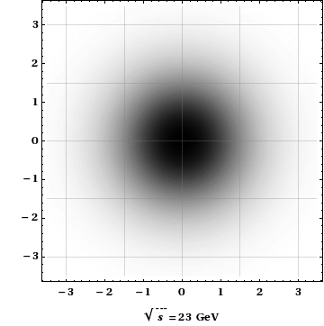
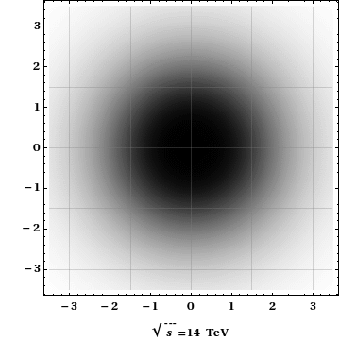
Motivation: Is the proton a black disc?
Recent papers by M. Block and F. Halsen address this topic :
Experimental confirmation: the proton is asymptotically a black disc, arXiv:1109.2041, Phys. Rev. Lett. 107 (2011) 212002

Slide 43
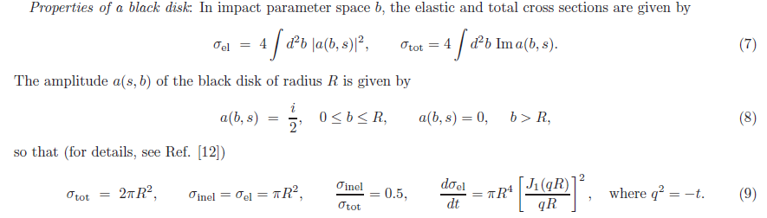
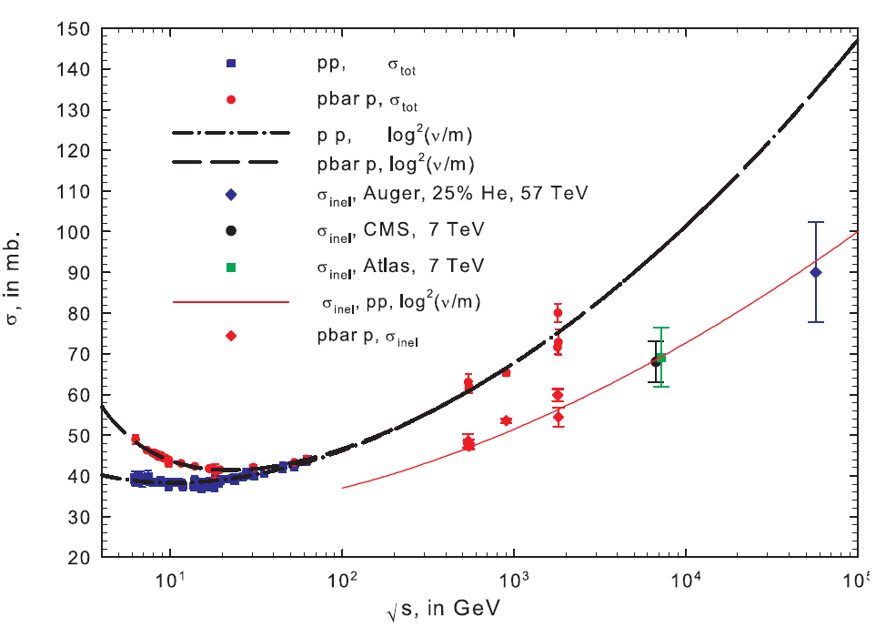
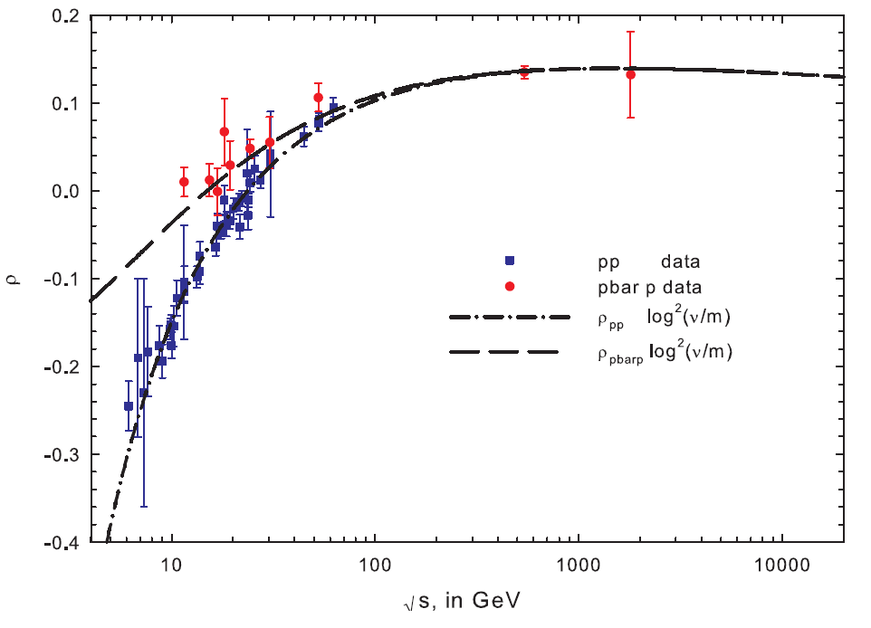
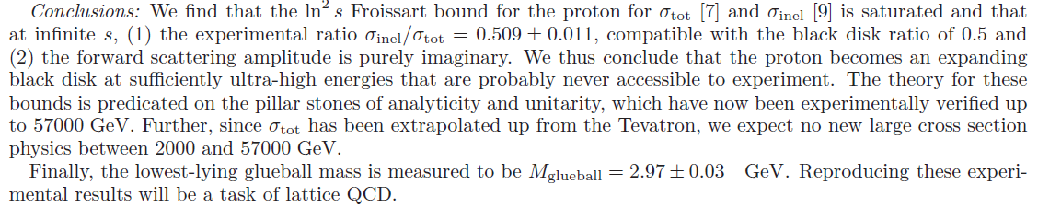
Properties of a black disc
M. Block and F. Halsen:
arXiv:1109.2041, Phys. Rev. Lett. 107 (2011) 212002
arXiv:1208.4086, Phys.Rev. D86 (2012) 051504
arXiv:1409.3196

Slide 44

Black Disc (BD) limit?
Scaling but
not in the black disc limit:
T. Cs. and F. Nemes
arXiv:1306.4217
Int. J. Mod. Phys. A (2014)
C(data) ~ 50 mb GeV²
≠
C(black) ~ 36 mb GeV²

Slide 45
Geometric scaling, but not BD limit?
Scaling but
not a black disc limit:
T. Cs. and F. Nemes
arXiv:1306.4217
IJMPA (2014)
G(z) = t dσ/σ_{tot} /dt
plotted vs
z = t/t_{dip}

