Slide 1
Multicore Accounting Update
John Gordon
WLCG MB
December 2015

Slide 2
MultiCore Usage
The campaigns to encourage sites to start publishing accounting information on the number of cores used were successful.
>99% of LHC usage reports #cores.
Of the remaining <1%, 90%+ is due to ARC CEs at DESY-HH
  Intractable interaction between ARC CE and PBS
  Should be fixable as CREAM was fixed.
Very low level of failed jobs on ARC CEs still report 0 cores with little or no cpu and small wall.

Slide 3
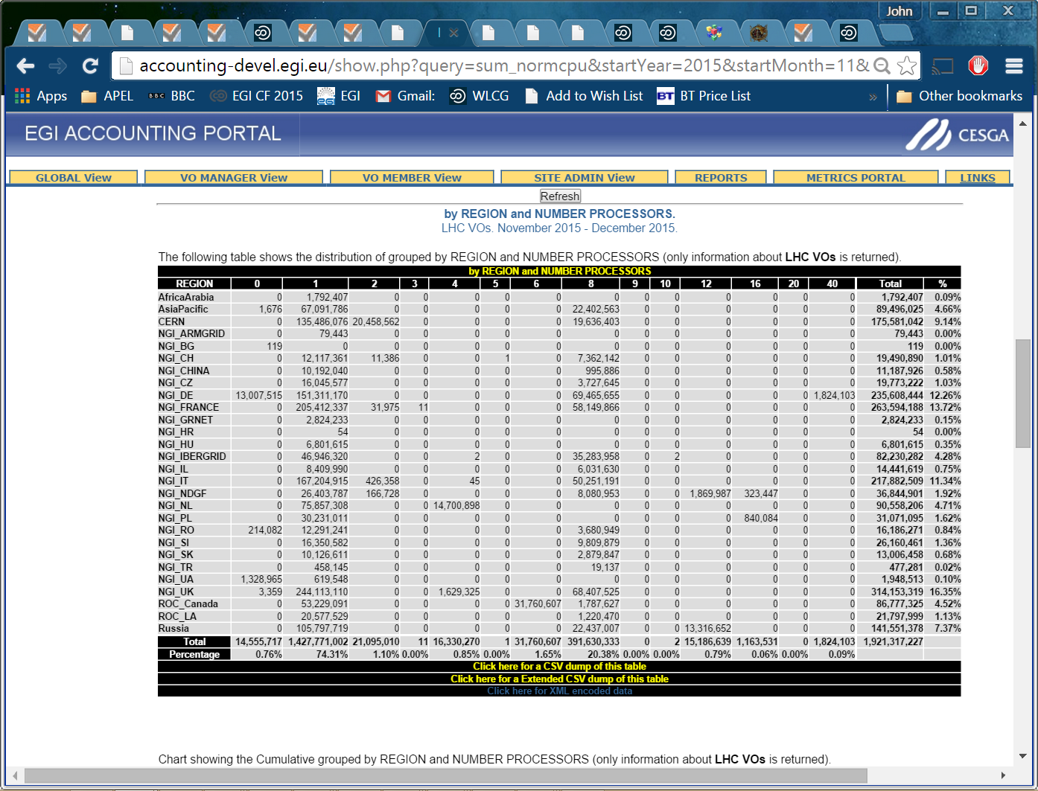

Slide 4
Monthly Reports
While waiting for APEL to migrate, the monthly WLCG Reports were adapted to take their data from the development portal with its information on cores used.
The November report, available now for checking by sites uses wallclock*ncores
Final checking of REBUS logic

Slide 5
Viewing in production portal
The Accounting Portal is in the middle of a major rewrite and they are loath to make major changes (lack of effort, etc)
They have added a new tree EMI3 alongside the EGI one and the former contains the data visible today on the development portal which now has historical data going back 18 months. (Earlier data will follow shortly)
The Tier1 and Tier2 trees (and reports?) are from the latest data and include SubmitHost, Number of Processors(cores) and Number of CPUs. Wallclock time is viewable as raw, normalised and normalised*ncores. The last number is used to calculate efficiency.
Please let us know of any discrepancies you see either with what is visible in the original production view (EGI) or with what you expect to see for your site.

Slide 6
