Slide 1
WLCG workshop in Lisbon
Andrea Sciabà
On behalf of the WLCG workshop organisers
WLCG MB
December 8, 2015

Slide 2
Motivations
Need to plan the evolution of WLCG over the next decade
  Preparation for Run3 and Run4 (HL-LHC) is the main goal
  Addressing medium term issues and resource optimisation also very important
Use the WLCG workshop to agree on the direction and kick-start the activities
See Ian’s talk at the October MB

Slide 3
Practical details
Dates: February Mon 1 – Wed 3 (morning): 2.5 days
Venue: Instituto Universitário de Lisboa
Registration open since October 15
  Via Indico, payment by bank transfer or if not possible by cash, not centrally managed by CERN
Accommodation
  50 rooms pre-booked in two hotels
Social dinner
  On Tuesday evening
Contact: wlcg-lisbon@cern.ch
Agenda:
https://indico.cern.ch/e/WLCG-Workshop-Lisbon-2016

Slide 4
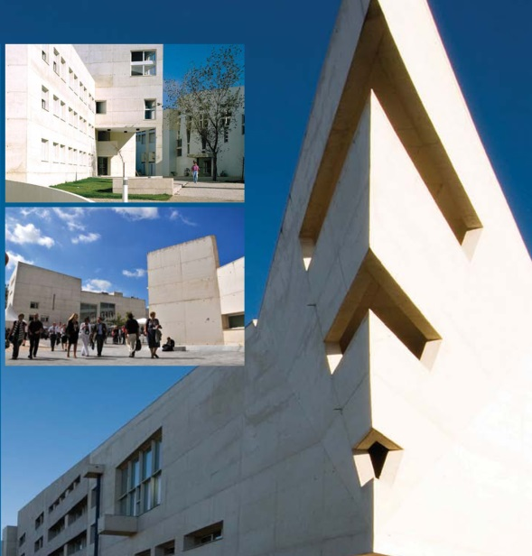
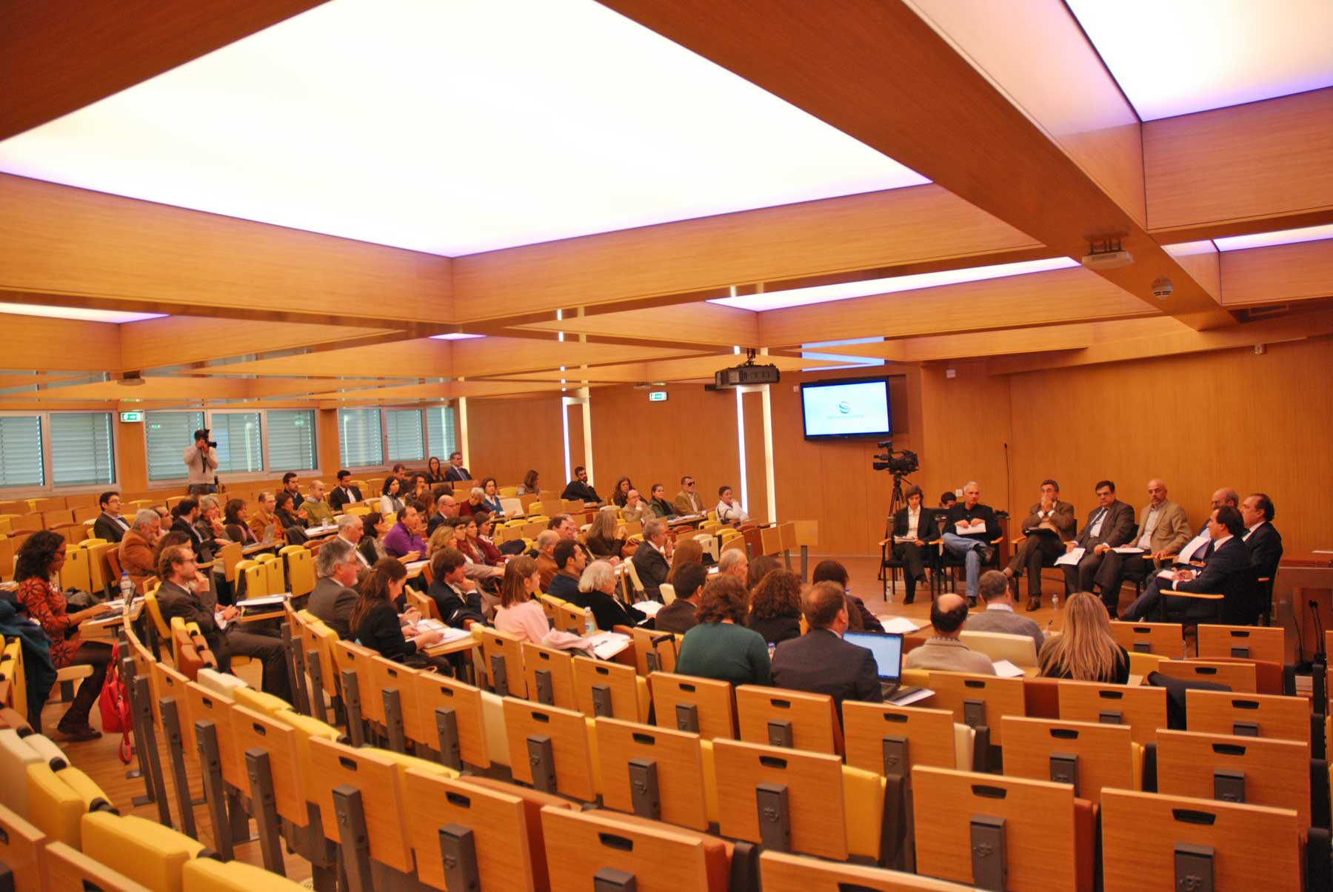
Venue
The venue will be at ISCTE - University Institute of Lisbon (ISCTE-IUL) is a public university established in 1972.
10 minutes from Airport by public transportation
Auditorium J. J. Laginha (BuildingI)
for 220 people

Slide 5
Workshop program: day 1
First day on medium term evolution
  Focus on current issues, ways to improve efficiency/lower costs, incremental evolution
  Compute
    Plugging cloud and VM-based resources into WLCG, trends in using supercomputers in WLCG, …
  Security and trust model
    Overview, trust fabric evolution, cyberthreats, security in evolving infrastructure, trust model between experiments and sites, …
  Data
    Data management tools, storage federations and their evolution, etc.
  Monitoring, Information System and Accounting
    Information system evolution, cloud integration, accounting and benchmarking on clouds, network monitoring, SAM, …
WLCG collaboration board meeting closing the day

Slide 6
Workshop program: day 2
Session entirely on the long term future (HL-LHC)
The final goal is to be prepared for the challenges of Run 3 and Run 4
Driven by new ideas, possibly “revolutionary”
Develop a common vision for the direction to take
No agenda yet
  Experiments to propose the topics to be discussed and shape the agenda
  Plan is to have many short presentations and lot of time for discussion

Slide 7
Workshop program: day 3
Summarise
Decide on future work and priorities
Set up working groups

Slide 8
Summary
  Next WLCG workshop dedicated to the future (short and long term)
  Goal is to have many fruitful discussions and a clear idea on how to proceed
  Many thanks to the local organisers from LIP

Slide 9
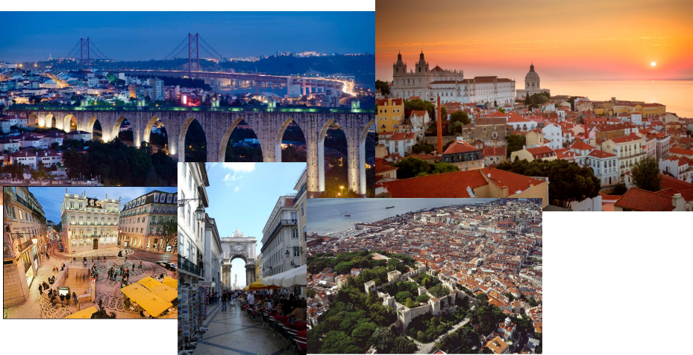
Questions?

Slide 10
Acknowledgements
Workshop organisers
  João Pina, Hugo Gomes, Jorge Gomes, Natália Antunes
  M. Alandes, M. Dimou, A. Forti, J. Flix, A. Sciabà
Conveners (so far)
  D. Duellmann, A. Forti, O. Smirnova, J. Templon

