Slide 1
Recent meetings
Ian Bird
WLCG MB
Dec 8th 2015

Slide 2
Computing RRB

Slide 3
General CRSG comments
2017; LHC machine planning:
  No HI run
  Shorter pp live time (compared to our earlier expectations) → but this seems unrealistically low in the light of 2015 experience in last months and compared to 2011-12 experience
CRSG have made reductions according to these new live times – may not be appropriate
  LHCb had themselves adapted their request
CRSG have also made cuts to encourage more use of HLT between fills
  Again – unrealistic if short turn around?
ATLAS and CMS resource needs for Phase 2 upgrade studies
  Included in CMS request (10% of CPU, 5PB disk)
  Not included in ATLAS request (could be ~20%)
Data preservation needs:
  Ability of experiments to re-analyse data vs making data open access
  Former is part of RSG process (and funding), latter is not – but has impact on resources and effort
Tendency overall for requirements to exceed flat budgets further into Run 2

Slide 4
Specific CRSG comments
ALICE:
  No HI run in 2017, but no change in ALICE requests
  ➔ needs justification
  CRSG reduced T1, T2 CPU to account for use of HLT now
ATLAS:
  Reliance on beyond-pledge CPU esp for MC leads to extra tape needs
CMS:
  Deficits in pledges for 2015 and 2016, and potentially 2017 (but too early to be sure)
  Significant jump in requirements for 2017
LHCb:
  Reduced tape needs: no 2nd copy of derived data
  LHCb reduced 2016 requirements: 6% for CPU, disk, 30% for tape
    Results in a bigger jump for 2017
  More simulation done in advance for 2016 and 2017

Slide 5
Final state of 2016 pledges
Following all updates of pledges for RRB

Slide 6
First look at 2017 pledges
RSG input on 2017, current state of input for 2017 (Incomplete at the moment)

Slide 7
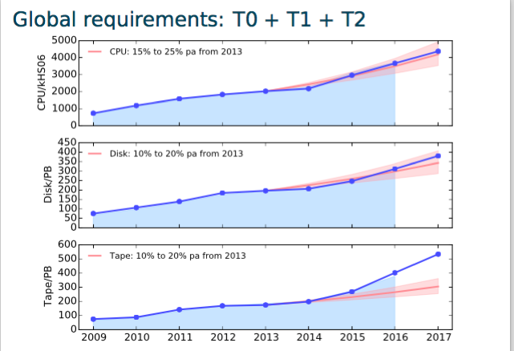
Evolution of requests
From Jonathan Flynn – RSG report to RRB Oct 2015

Slide 8
LHCC

Slide 9
LHCC meeting summary
The referees were presented with the summary of progress and successful start of Run 2.
  The agenda of that meeting is available here: https://indico.cern.ch/event/461711/.
There were no major concerns raised, and the project and experiments were congratulated at “how surprisingly successful the computing was”
During the closed session, the major issue discussed was the timescale for planning for the upgrades and how the cost envelope(s) would be obtained.
  What was agreed was that by the final LHCC meeting of 2016 we would propose a concrete timetable for working towards an upgrade TDR for HL-LHC by ~2020.
  The WLCG workshop in February next year will start this process.

Slide 10
Overview Board

Slide 11
Overview board
The board was updated on the status of progress in Run2, and thoughts about planning for the upgrades
The status of the preparations for the HNSciCloud project was presented,
  this will clearly have some impact on many of the European sites represented in the meeting
  Quite a lot of interest from US/OSG too
Discussion on relationship WCLG, EU-T0, OSG, EGI and other sciences

Slide 12
Position wrt new Tier 1s
On the question of new Tier 1s, there was a very clear statement from the OB that the current definition including tape services, high (“24x7”) service levels, and direct experiment support were the key features of Tier 1s and that these criteria should not be relaxed.
The document we wrote in 2012 is still the definitive set of Tier 1 requirements for sites wishing to become Tier 1s:
  https://espace.cern.ch/WLCG-document-repository/Collaboration/New%20Tier1%20Process/NewTier1-process-v1.2.pdf
However, may need to think about new class of sites that are not closely related to experiments, but that offer resources, and need some level of recognition for political/funding reasons

Slide 13
Relationship to other sciences
Discussed how WLCG should interact with other science communities as we progress in evolution of our infrastructure for the future.
  Presentations from EU-T0, EGI, and OSG presented the landscape of large and small science projects that have benefitted (and could potentially benefit) from work that WLCG does.
It was suggested that the best model would be one of partnership between WLCG and selected larger science projects to ensure that WLCG maintain some level of impact outside of HEP,
  But leaving the work of addressing the “long tail of science” to EGI and OSG
  Of course, not excluding the (re-)use of tools developed by WLCG !
It was also suggested that EGI and OSG could help broker such partnerships again in future
Action item to discuss how such partnerships could be created/strengthened

Slide 14
Other items
Agree that good idea to create a “Zephyr” prototype, to show it is feasible ~now
  Would be a demonstrator rather than a service
  Use to show that we (HEP) could actually build a science archive of general use

