Slide 1
Overview of grading considerations at CERN for a 16 T Dipole
(Block type coil configuration)
Susana Izquierdo Bermudez, Juan Carlos Perez, Etienne Rochepault
Acknowledgments: Bernardo Bordini, Paolo Ferracin, Friedrich Lackner, Nicolas Perey, Ezio Todesco, Davide Tommasini, Daniel Schoerling,

Slide 2
Content
Introduction
Design constrains
Electromagnetic designs overview
Technical challenges and “solutions”
Summary and next steps

Slide 3
Content
Introduction
Design constrains
Electromagnetic designs overview
Technical challenges and “solutions”
Summary and next steps

Slide 4
1. Introduction - CERN strategy
ERMC
Enhanced Racetrack Model Coil
16 T midplane field
Demonstrate field on the conductor
Coil technology development
RMM
Racetrack Model Magnet
16 T in a 50 mm cavity
Demonstrate field on the aperture
Mechanics (including inner coil support)
DEMO
Demonstrator Magnet
(blocks and cos-θ options under study)
Accelerator quality magnet

Slide 5
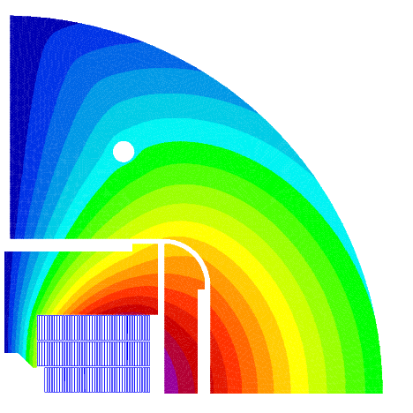
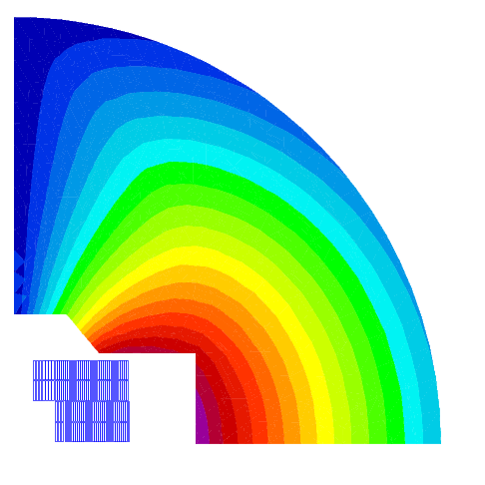
1. Introduction: ERMC/RMM
ERMC/RMM : A two stages project
Stage 1 priorities:
Demonstrate the field
      Design based on the “available” critical current density (~20% lower than FCC target at 18 T, 4.2 K)
      As field quality is not an objective, profit from the use of an iron pole to decrease the ratio between the field in the aperture and in the coil to ~ 1
Study the mechanics
Stage 2 priorities:
Coil size → Grading
  Design based on the target FCC critical current density
  High Field Nb₃Sn splice development needed
Field quality (b_{n}<10 units, including iron saturation)
  Still, it will need to be accommodated within the same structure, changing only the collar pack assembly

Slide 6
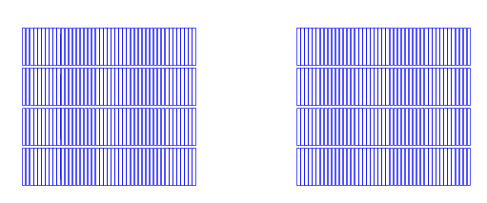
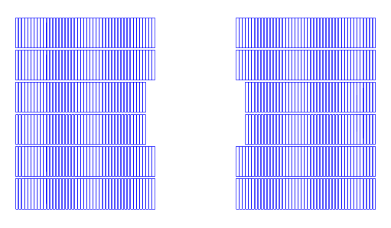
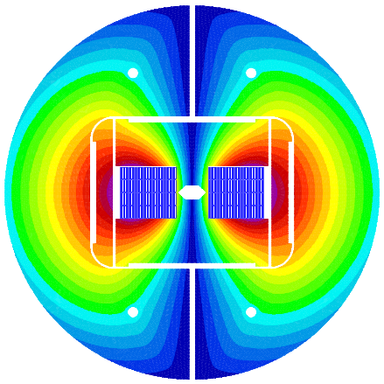
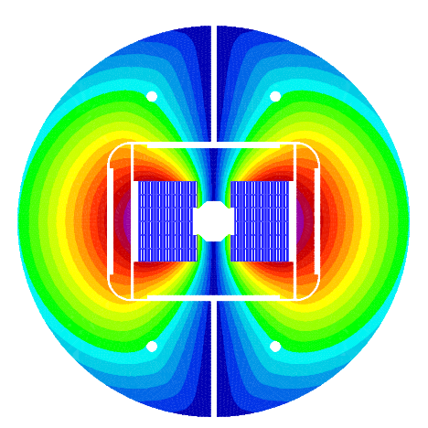
1. Introduction
Stage 1 priorities:
Demonstrate the field
      Design based on the “available” critical current density (~20% lower than FCC target at 18 T, 4.2 K)
      As field quality is not an objective, profit from the use of an iron pole to decrease the ratio between the field in the aperture and in the coil to ~ 1
Study the mechanics
ERMC
RMM
Stage 1 approach:
In order to optimise time and resources:
ERMC double pancakes will be used at top/bottom RMM coils.
Same structure for both magnets
  Keeping the possibility of having two set of pads to optimize the stress distribution on the coil.
Remark: Possibility to test also a single coil configuration
pad
pad
pad
pad
Details:
https://indico.cern.ch/event/446669/

Slide 7
1. Introduction
Stage 2 priorities:
Coil size → Grading
  Design based on the target FCC critical current density
  High Field Nb₃Sn splice development needed
Field quality (b_{n}<10 units, including iron saturation)
  Still, it will need to be accommodated within the same structure, changing only the collar pack assembly
KEY ISSUE: Development of Nb₃Sn High field internal splices
Strategy:
Magnet design following FCC targets in terms of critical current density and field quality
ERMC will be the base to test the coil technology development:
  It should allow the test of a single pancake
OBJECTIVE TODAY: PROVIDE AN OVERVIEW OF POSSIBLE GRADED DESIGNS INCLUDING TECHNICAL CHALLENGES AND IDEAS TO OVERCOME THEM.

Slide 8
Content
Introduction
Design constrains
Electromagnetic designs overview
Technical challenges and “solutions”
Summary and next steps

Slide 9
2.1 Strand
Strand diameter:
    From 0.7 to 1.1 mm
Copper to superconductor > 1
    Time margin for protection ≥ 50 ms
Strand critical current density:
  FCC Target:
  T_{c0} = 16 K, B_{c20} = 29.38 T, C₀ = 267845 A/mm²T, 0 % cabling degradation
    J_{c}(4.2K,16T) = 1507 A/mm²
    J_{c}(4.2K,18T) = 887 A/mm²
  ERMC/RMM:
  T_{c0} = 16 K, B_{c20} = 28.8 T, C₀ = - 255230 A/mm²T, 5 % cabling degradation
    J_{c}(4.2K,16T) = 1287 A/mm²
    J_{c}(4.2K,18T) = 735 A/mm²

Slide 10
2.2 Cable and Insulation
Number of strands
  “Preferred solution”: less than 40 strands.
  “Possible solution”: less than 50 strands. Experience in Berkley with HD cable (51 strand, 0.8 mm diameter)
  “Risky solution”: less than 60 strands. Mechanical stability of the cable can be a big issue
Cable insulation thickness = 150 µm
  Can be either only S2-glass or S2-glass/Mica
  Experience in 927 in terms of electrical robustness:
      MQXF: 150 µm S2-glass
        MQXFS_001 ~ 3.5kV
        MQXFS_101 ~ 6.25kV
      11T: 150 µm S2-glass/Mica before HT, 100 µm S2-glass/Mica after HT
        11T#110: > 7kV (limit of the capacitor discharge generator)
http://indico.cern.ch/event/395351/

Slide 11
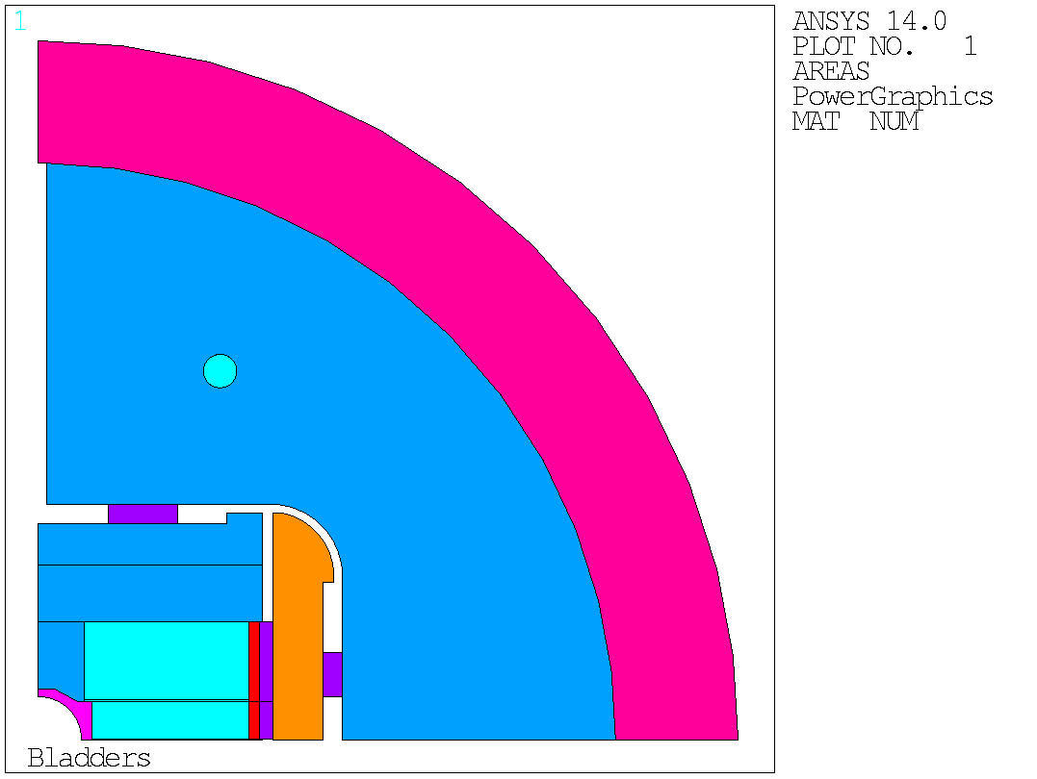
2.3 Size of the inner support structure
Based on RMM ANSYS analysis:
Wall thickness = 6 mm
R_{min} = 29 mm
4 mm
6 mm

Slide 12
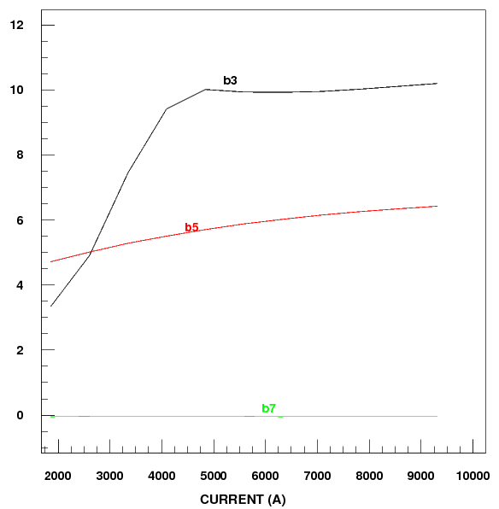
2.4 Overall magnet size
Shell thickness = 70 mm
Outer magnet diameter = 800 mm
Iron optimized to have small of saturation on field quality

Slide 13
Content
Introduction
Design constrains
Electromagnetic designs overview
Technical challenges and “solutions”
Summary and next steps

Slide 14
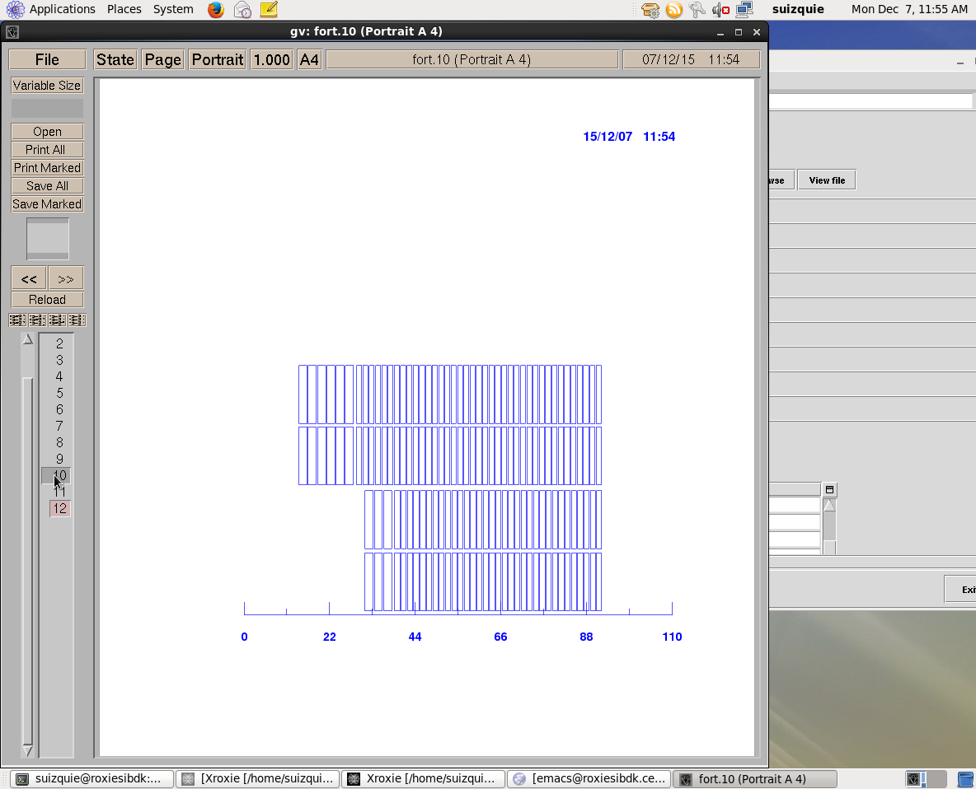
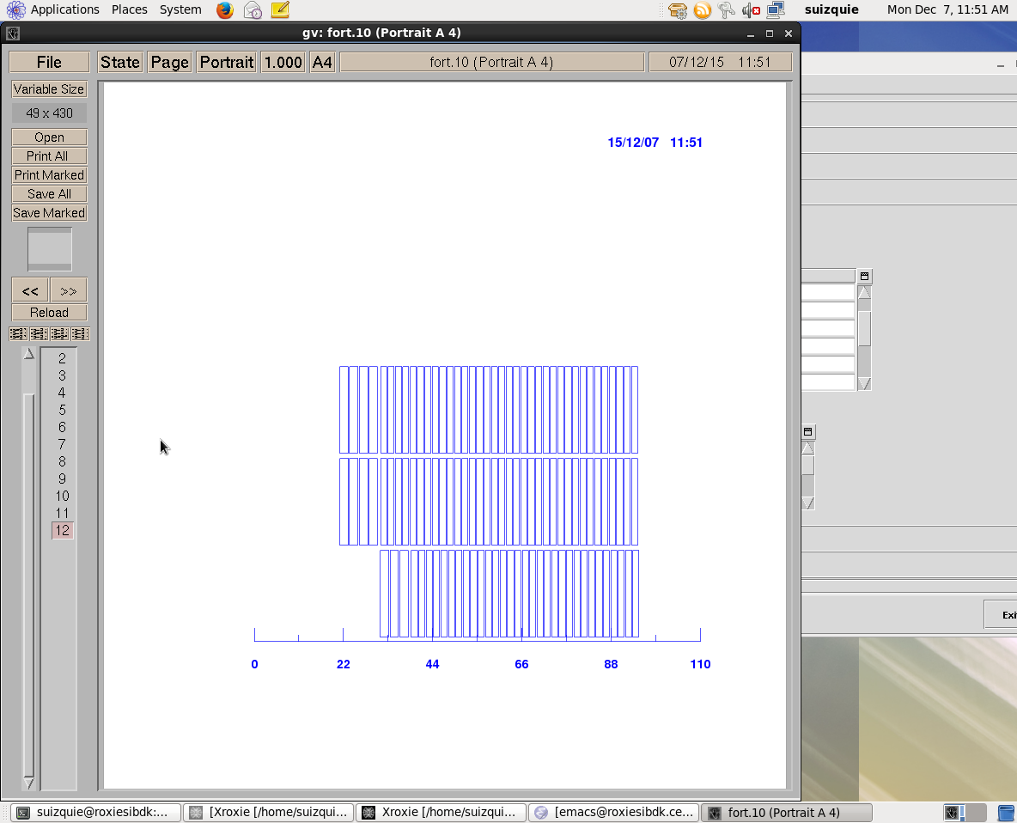

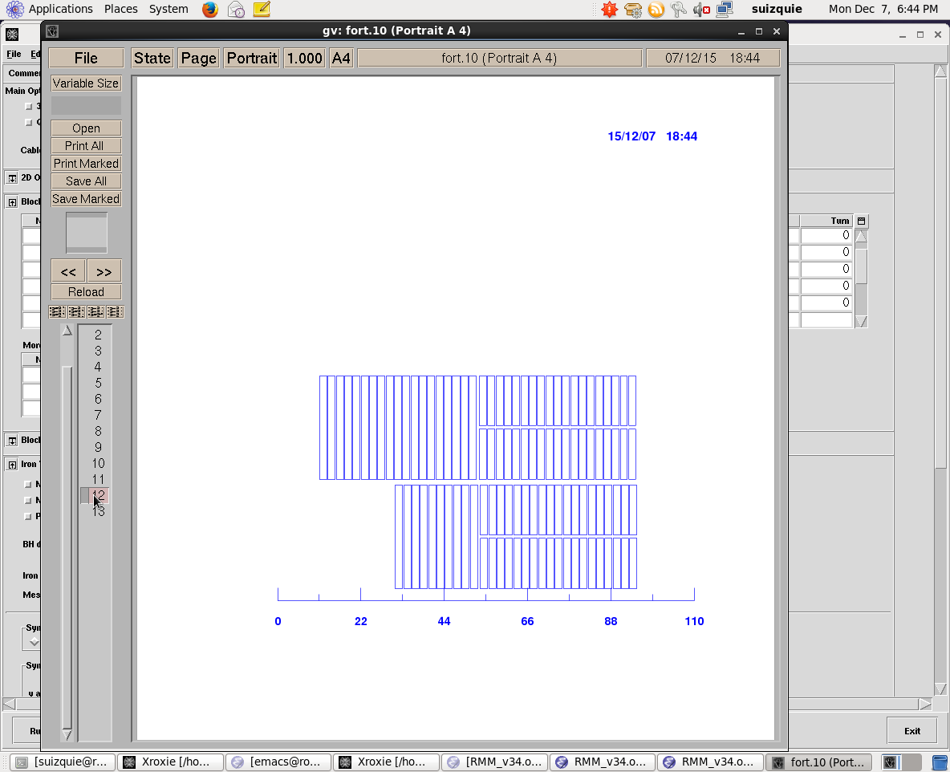
3. Electromagnetic designs overview
21.32 mm
21.32 mm
27.5 mm
14.92 mm
 | Design A |  | Design B |  | Design C |  | Design D
 | HF | LF | HF | LF | HF | LF | HF | LF
Strand Diameter, mm | 1.1 | 0.7 | 1.1 | 0.8 | 1 | 1 | 1 | 1
Number of strands | 26 | 40 | 36 | 50 | 40 | 19 | 51 | 51
Non-insulated cable width, mm | 14.92 | 14.92 | 21.32 | 21.32 | 21.32 | 10.13 | 27.5 | 27.5
Non-insulated cable thickness, mm | 2.08 | 1.32 | 2.08 | 1.52 | 1.89 | 1.89 | 1.89 | 1.89
Copper to Superconductor Ration | 1 | 1:2 | 1 | 1:2 | 1 | 1:2 | 1 | 1:2
A_{LF}/A_{FH} | 1.58 |  | 1.37 |  | 2.10 |  | 1.00
Some remarks:
Designs C&D challenging coil fabrication (details will be addressed later)
Designs B&D challenging cable (>40 strands)

Slide 15
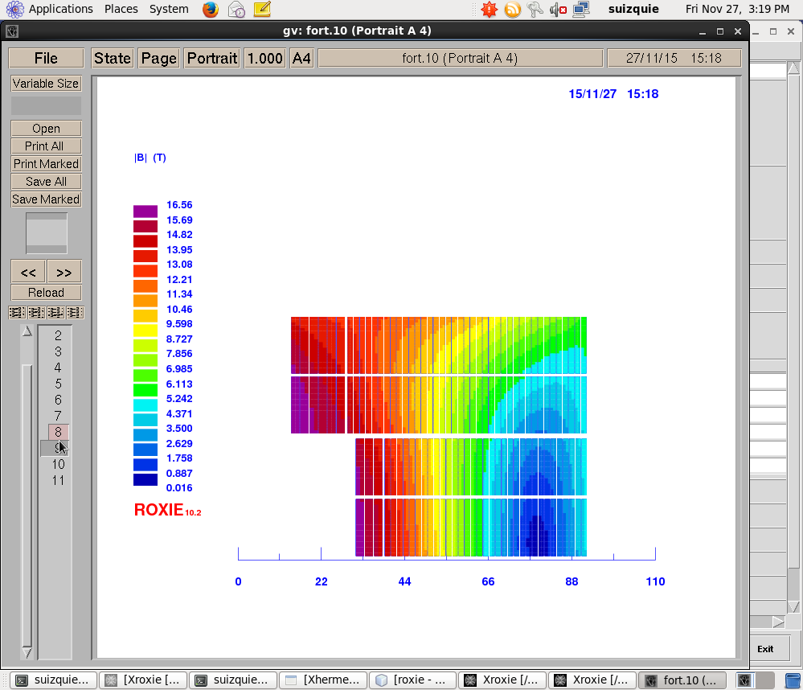
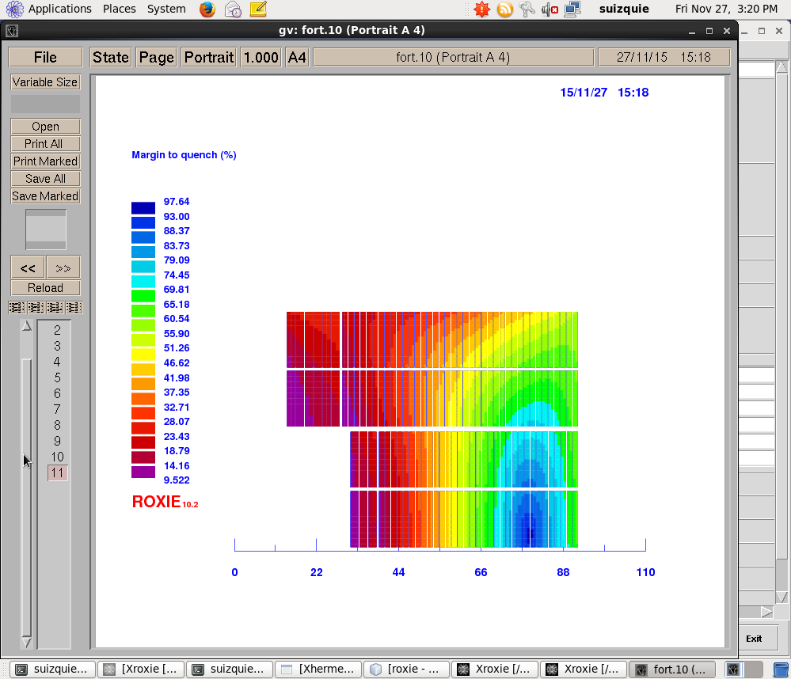
3. Design A
 |  | Design A
 |  | HF | LF
Strand & Cable
Strand diameter | mm | 1.1 | 0.7
Cu2SC ratio |  | 1 | 1.15
# of strands in cable |  | 26 | 40
Coil dimensions
number of conductors |  | 20 | 130
coil area (per aperture), including insulation | mm2 | 2898 | 12821
coil area (per coil) ,including insulation | mm2 | 1449 | 6411
conductor area per coil | mm2 | 4991
r | mm | 25
w/r | w_eq | 2.6
Equivalent coil width | mm | 65.2
Operation parameters (16T)
Inom | A | 9310 | 9310
Jsc | A/mm2 | 754 | 1300
Jcu | A/mm2 | 754 | 1131
Jeng | A/mm2 | 377 | 605
Joverall | A/mm2 | 257 | 378
Ratio LF/JF Joverall |  | 1.47
Bore field at Inom | T | 16.00
Conductor peak field at Inom | T | 16.58 | 14.71
Short sample limits
Short sample current Iss at 4.2 K | A | 10378 | 10382
Coil peak field at 4.2 K Iss | T | 18.20 | 16.20
Margin on the load line at 4.2 K | % | 10 | 10
Short sample current Iss at 1.9 K | A | 11465 | 11456
Coil peak field at 1.9 Iss | T | 19.90 | 17.70
Margin on the load line at 1.9 K | % | 19 | 19
v37
(11710 tons of Nb3Sn)

Slide 16
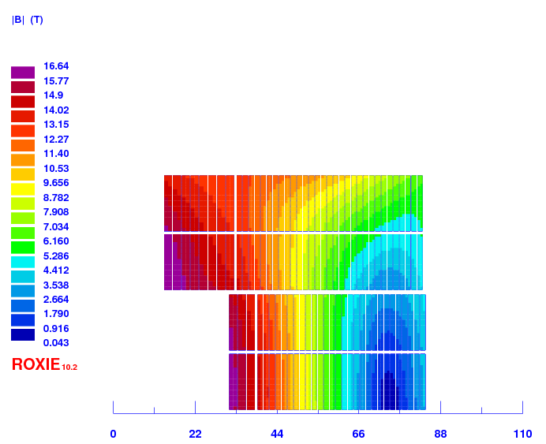
3. Design A - Enhanced
 |  | Design A |  | Design A - Enhanced
 |  | HF | LF | HF | LF
Strand & Cable
Strand diameter | mm | 1.1 | 0.7 | 1.1 | 0.7
Cu2SC ratio |  | 1 | 1.15 | 0.8 | 1.3
# of strands in cable |  | 26 | 40 | 26 | 40
coil dimensions
number of conductors |  | 20 | 130 | 22 | 118
coil area (per aperture), including insulation | mm2 | 2898 | 12821 | 3188 | 11638
coil area (per coil) ,including insulation | mm2 | 1449 | 6411 | 1594 | 5819
conductor area per coil | mm2 | 4991 |  | 4720
r | mm | 25 |  | 25
w/r | w_eq | 2.6 |  | 2.5
Equivalent coil width | mm | 65.2 |  | 62.8
Operation parameters (16T)
Inom | A | 9310 | 9310 | 9800 | 9800
Jsc | A/mm2 | 754 | 1300 | 714 | 1464
Jcu | A/mm2 | 754 | 1131 | 892 | 1126
Jeng | A/mm2 | 377 | 605 | 397 | 637
Joverall | A/mm2 | 257 | 378 | 271 | 397
Ratio LF/JF Joverall |  | 1.47 |  | 1.47
Bore field at Inom | T | 16.00 |  | 16.00
Conductor peak field at Inom | T | 16.58 | 14.71 | 16.65 | 14.24
Short sample limits
Short sample current Iss at 4.2 K | A | 10378 | 10382 | 10982 | 10943
Coil peak field at 4.2 K Iss | T | 18.20 | 16.20 | 18.35 | 15.70
Margin on the load line at 4.2 K | % | 10 | 10 | 11 | 10
Short sample current Iss at 1.9 K | A | 11465 | 11456 | 12148 | 12114
Coil peak field at 1.9 Iss | T | 19.90 | 17.70 | 20.10 | 17.10
Margin on the load line at 1.9 K | % | 19 | 19 | 19 | 19
Coil size can be reduced by 3.5 % when reducing the copper to superconductor ration from 1 to 0.8 in the high field region.
As a drawback, copper to superconductor ratios lower than 1 require R&D effort (difficult to achieve requirements with small cabling degradation)
v36
(11075 tons of Nb3Sn)

Slide 17
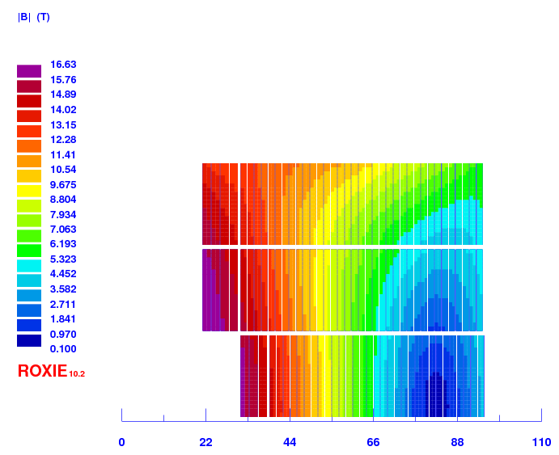
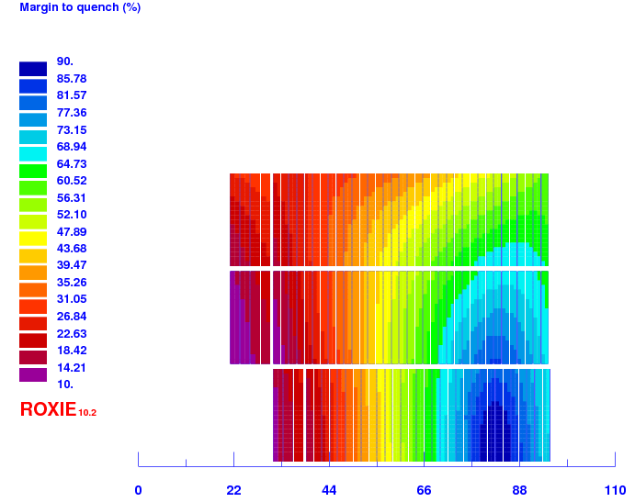
3. Design B
 |  | Design B
 |  | HF | LF
Strand & Cable
Strand diameter | mm | 1.1 | 0.8
Cu2SC ratio |  | 1 | 1
# of strands in cable |  | 36 | 50
coil dimensions
number of conductors |  | 11 | 101
coil area (per aperture), including insulation | mm2 | 2264 | 15897
coil area (per coil) ,including insulation | mm2 | 1132 | 7948
conductor area per coil | mm2 | 5829
r | mm | 25
w/r | w_eq | 2.9
Equivalent coil width | mm | 71.4
operation parameters (16T)
Inom | A | 12790 | 12790
Jsc | A/mm2 | 748 | 1018
Jcu | A/mm2 | 748 | 1018
Jeng | A/mm2 | 374 | 509
Joverall | A/mm2 | 249 | 325
Ratio LF/JF Joverall |  | 1.31
Bore field at Inom | T | 16.00
Conductor peak field at Inom | T | 16.63 | 15.29
short sample
Short sample current Iss at 4.2 K | A | 14198 | 14502
Coil peak field at 4.2 K Iss | T | 18.25 | 17.07
Margin on the load line at 4.2 K | % | 10 | 12
Short sample current Iss at 1.9 K | A | 15703 | 16035
Coil peak field at 1.9 Iss | T | 19.97 | 18.66
Margin on the load line at 1.9 K | % | 19 | 20
v29
(13678 tons of Nb3Sn)

Slide 18
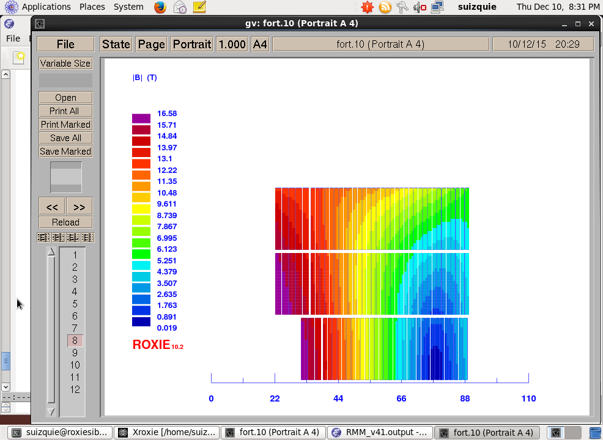
3. Design B - Enhanced
Coil size can be reduced by 6 % when increasing the grading ratio from 1.3 to 1.5
As a drawback, the number of strands of the low field cable is 57 → risk in terms of mechanical stability
Even for the enhance version, coil size is 3 % bigger than for the Design option A
 |  | Design B |  | Option B - Enhanced
 |  | HF | LF | HF | LF
Strand & Cable
Strand diameter | mm | 1.1 | 0.8 | 1.1 | 0.7
Cu2SC ratio |  | 1 | 1 | 1 | 1.2
# of strands in cable |  | 36 | 50 | 36 | 57
coil dimensions
number of conductors |  | 11 | 101 | 13 | 99
coil area (per aperture), including insulation | mm2 | 2264 | 15897 | 2676 | 13870
coil area (per coil) ,including insulation | mm2 | 1132 | 7948 | 1338 | 6935
conductor area per coil | mm2 | 5829 |  | 5233
r | mm | 25 |  | 25
w/r | w_eq | 2.9 |  | 2.7
Equivalent coil width | mm | 71.4 |  | 67.3
operation parameters (16T)
Inom | A | 12790 | 12790 | 12548 | 12548
Jsc | A/mm2 | 748 | 1018 | 734 | 1258
Jcu | A/mm2 | 748 | 1018 | 734 | 1049
Jeng | A/mm2 | 374 | 509 | 367 | 572
Joverall | A/mm2 | 249 | 325 | 244 | 358
Ratio LF/JF Joverall |  | 1.31 |  | 1.47
Bore field at Inom | T | 16.00 |  | 16.00
Conductor peak field at Inom | T | 16.72 | 15.33 | 16.72 | 14.79
short sample
Short sample current Iss at 4.2 K | A | 14198 | 14502 | 13993 | 14009
Coil peak field at 4.2 K Iss | T | 18.25 | 17.07 | 18.20 | 17.00
Margin on the load line at 4.2 K | % | 10 | 12 | 10 | 10
Short sample current Iss at 1.9 K | A | 15703 | 16035 | 15498 | 15505
Coil peak field at 1.9 Iss | T | 19.97 | 18.66 | 19.90 | 18.60
Margin on the load line at 1.9 K | % | 19 | 20 | 19 | 19
v41
(12278 tons of Nb3Sn)

Slide 19
3. Design C
 |  | Design C
 |  | HF | LF
Strand & Cable
Strand diameter | mm | 1 | 1
Cu2SC ratio |  | 1 | 2
# of strands in cable |  | 40 | 19
coil dimensions
number of conductors |  | 32 | 124
coil area (per aperture), including insulation | mm2 | 6061 | 11329
coil area (per coil) ,including insulation | mm2 | 3030 | 5665
conductor area per coil | mm2 | 5711
r | mm | 25
w/r | w_eq | 2.8
Equivalent coil width | mm | 69.5
operation parameters (16T)
Inom | A | 9800 | 9800
Jsc | A/mm2 | 624 | 1970
Jcu | A/mm2 | 624 | 985
Jeng | A/mm2 | 312 | 657
Joverall | A/mm2 | 207 | 429
Ratio LF/JF Joverall |  | 2.07
Bore field at Inom | T | 16.00
Conductor peak field at Inom | T | 16.53 | 12.99
short sample limits
Short sample current Iss at 4.2 K | A | 11263 | 10973
Coil peak field at 4.2 K Iss | T | 18.80 | 14.30
Margin on the load line at 4.2 K | % | 13 | 11
Short sample current Iss at 1.9 K | A | 12456 | 12087
Coil peak field at 1.9 Iss | T | 20.50 | 15.60
Margin on the load line at 1.9 K | % | 21 | 19
v26
(13400 tons of Nb3Sn)

Slide 20
3. Design C
Design limited by the high current density in the low field.
In order to be able to protect (time margin > 45 ms), we need a copper to superconductor ≥ 2.
  An increase of the copper to superconductor from 2 to 2.5 increases the time margin by ~ 5 ms.
  An increase on the operation current of ~ 1 kA implies 16 ms decrease on the time margin (assuming inductance does not change).

Slide 21
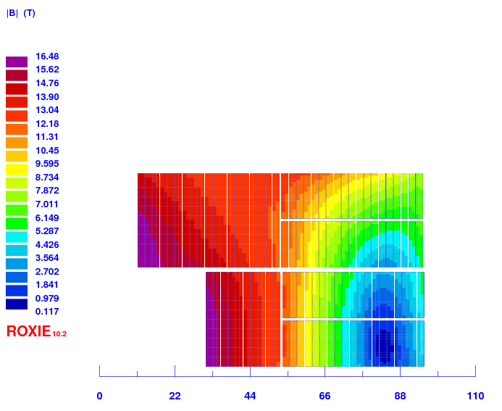
3. Design D
 |  | Design D
 |  | HF | HF
Strand & Cable
Strand diameter | mm | 1 | 1
Cu2SC ratio |  | 1 | 2
# of strands in cable |  | 51 | 25
coil dimensions
number of conductors |  | 28 | 78
coil area (per aperture), including insulation | mm2 | 6819 | 9258
coil area (per coil) ,including insulation | mm2 | 3409 | 4629
conductor area per coil | mm2 | 5306
r | mm | 25
w/r | w_eq | 2.6
Equivalent coil width | mm | 66.1
operation parameters (16T)
Inom | A | 13633 | 13633
Jsc | A/mm2 | 681 | 2083
Jcu | A/mm2 | 681 | 1041
Jeng | A/mm2 | 340 | 694
Joverall | A/mm2 | 224 | 459
Ratio LF/JF Joverall |  | 2.05
Bore field at Inom | T | 16.00
Conductor peak field at Inom | T | 16.48 | 12.72
short sample limits
Short sample current Iss at 4.2 K | A | 15521 | 15111
Coil peak field at 4.2 K Iss | T | 18.46 | 13.91
Margin on the load line at 4.2 K | % | 12 | 10
Short sample current Iss at 1.9 K | A | 17124 | 16650
Coil peak field at 1.9 Iss | T | 20.15 | 16.65
Margin on the load line at 1.9 K | % | 20 | 18
v34
(12450 tons of Nb3Sn)

Slide 22
3. Designs Comparison: Coil size
14.92 mm
27.5 mm
21.32 mm
21.32 mm
 |  | Design A |  | Design B |  | Design C |  | Design D
 |  | HF | LF | HF | LF | HF | LF | HF | HF
Strand diameter | mm | 1.1 | 0.7 | 1.1 | 0.8 | 1 | 1 | 1 | 1
Cu2SC ratio |  | 1 | 1.15 | 1 | 1 | 1 | 2 | 1 | 2
# of strands in cable |  | 26 | 40 | 36 | 50 | 40 | 19 | 51 | 25
number of conductors |  | 20 | 130 | 11 | 101 | 32 | 124 | 28 | 78
conductor area per coil | mm2 | 4991 |  | 5829 |  | 5711 |  | 5306
w/r | w_eq | 2.6 |  | 2.9 |  | 2.8 |  | 2.6
Equivalent coil width | mm | 65.2 |  | 71.4 |  | 69.5 |  | 66.1
Operation Parameters (16T)
Inom | A | 9310 | 9310 | 12790 | 12790 | 9800 | 9800 | 13633 | 13633
Jsc | A/mm2 | 754 | 1300 | 748 | 1018 | 624 | 1970 | 681 | 2083
Jcu | A/mm2 | 754 | 1131 | 748 | 1018 | 624 | 985 | 681 | 1041
Jeng | A/mm2 | 377 | 605 | 374 | 509 | 312 | 657 | 340 | 694
Joverall | A/mm2 | 257 | 378 | 249 | 325 | 207 | 429 | 224 | 459
Ratio LF/JF Joverall |  | 1.47 |  | 1.31 |  | 2.07 |  | 2.05
Bore field at Inom | T | 16.00 |  | 16.00 |  | 16.00 |  | 16.00
Conductor peak field at Inom | T | 16.58 | 14.71 | 16.63 | 15.29 | 16.53 | 12.99 | 16.48 | 12.72
Short sample limit
Short sample current Iss at 4.2 K | A | 10378 | 10382 | 14198 | 14502 | 11263 | 10973 | 15521 | 15111
Coil peak field at 4.2 K Iss | T | 18.20 | 16.20 | 18.25 | 17.07 | 18.80 | 14.30 | 18.46 | 13.91
Margin on the load line at 4.2 K | % | 10 | 10 | 10 | 12 | 13 | 11 | 12 | 10
Short sample current Iss at 1.9 K | A | 11465 | 11456 | 15703 | 16035 | 12456 | 12087 | 17124 | 16650
Coil peak field at 1.9 Iss | T | 19.90 | 17.70 | 19.97 | 18.66 | 20.50 | 15.60 | 20.15 | 16.65
Margin on the load line at 1.9 K | % | 19 | 19 | 19 | 20 | 21 | 19 | 20 | 18

Slide 23
3. Designs comparison: Margin
21.32 mm
27.5 mm
14.92 mm
21.32 mm
Load line margin
[10,90]%
Temperature margin
[2,10] K
Engineering current density margin
[200, 2000] A/mm²
Design A
Design B
Design C
Design D

Slide 24
3. Designs comparison: load lines
Design A
Design B
Design C
Design D

Slide 25
3. Designs Comparison: Protection
21.32 mm
27.5 mm
14.92 mm
21.32 mm
 |  | Design A |  | Design B |  | Design C |  | Design D
 |  | HF | LF | HF | LF | HF | LF | HF | HF
Copper to superconductor ratio |  | 1 | 1.15 | 1 | 1 | 1 | 2 | 1 | 2
Equivalent coil width |  | 65.2 |  | 71.4 |  | 69.5 |  | 66.1
Nominal Current | A | 9310 | 9310 | 12790 | 12790 | 9800 | 9800 | 13633 | 13633
Jsc | A/mm2 | 754 | 1300 | 748 | 1018 | 624 | 1970 | 681 | 2083
Jcu | A/mm2 | 754 | 1131 | 748 | 1018 | 624 | 985 | 681 | 1041
Jeng | A/mm2 | 377 | 605 | 374 | 509 | 312 | 657 | 340 | 694
Joverall | A/mm2 | 257 | 378 | 249 | 325 | 207 | 429 | 224 | 459
Protection with Quench Heaters
MIITs to reach 300 K (conductor+insulation)@ LF | MA2s |  | 14.12 |  | 34.59 |  | 17.59 |  | 30.27
MIITs to reach 300 K (conductor+insulation) @HF | MA2s | 32.30 |  | 62.66 |  | 53.17 |  | 86.21
Stored energy in straight sect. at Inom (per aperture) | kJ/m | 1743.30 |  | 1891.40 |  | 2136.60 |  | 2001.50
Stored energy density | MJ/m3 | 111 |  | 104 |  | 123 |  | 124
Differential inductance at Inom (per aperture) | mH/m | 37.19 |  | 20.99 |  | 41.92 |  | 20.07
MIITs consumed during decay | MA2s | 10.33 | 10.25 | 23.33 | 23.33 | 13.36 | 13.36 | 23.83 | 23.83
time margin | ms | 253 | 45 | 240 | 69 | 415 | 44 | 336 | 35

Slide 26
3. Designs Comparison: Force & Stress
14.92 mm
21.32 mm
21.32 mm
27.5 mm
 |  | Design A |  | Design B |  | Design C |  | Design D
 |  | HF | LF | HF | LF | HF | LF | HF | HF
Equivalent coil width | mm | 65.2 |  | 71.4 |  | 69.5 |  | 66.1
Joverall | A/mm2 | 257 | 378 | 249 | 325 | 207 | 429 | 224 | 459
coil width | mm | 56.30 |  | 64.00 |  | 61.82 |  | 64.00
coil height | mm | 63.28 |  | 66.89 |  | 68.33 |  | 59.60
Fx (per quadrant) at 16 T | kN/m | 9069 |  | 8989 |  | 9468 |  | 9191
Fy (per quadrant) at 16 T | kN/m | -4016 |  | -4109 |  | -4329 |  | -4579
Fx/CoilHeight at 16 T | MPa | 143 |  | 134 |  | 139 |  | 154
Fy/CoilWidth at 16 T | MPa | -71 |  | -64 |  | -70 |  | -72
Fx (per quadrant) at 18 T | kN/m | 11400 |  | 11340 |  | 11010 |  | 11530
Fy (per quadrant) at 18 T | kN/m | -5271 |  | -5430 |  | -5354 |  | -6009
Fx/CoilHeight at 18 T | MPa | 180 |  | 170 |  | 178 |  | 180
Fy/CoilWidth at 18 T | MPa | -94 |  | -85 |  | -78 |  | -101

Slide 27
3. General remarks and conclusions
The most compact, and “easiest” to build is Design A.
Design A
Design B
Design C
Design D
14.92 mm
21.32 mm
21.32 mm
27.5 mm
Coil size is comparable to the achievable coil size for a cos-theta configuration.
To further reduce the coil size, the option of two independently powered layers can be studied.

Slide 28
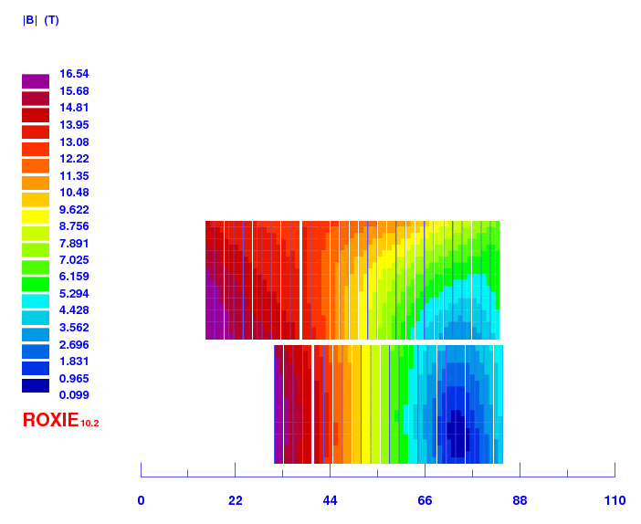
3. General remarks and conclusions
Two power converters and a 50 x 1mm strands cable would lead to the most compact solution.
We will not be able to build this in a flat coil configuration, but it might be possible with flared ends:
  The lead of the high field lower coil can go out of the coil straight → Nb₃Sn-NbTi standard splice
  The lead of the high field upper coil cannot go out of the coil straight!
    If the field is low enough, we could solder a NbTi cable to bring out.
    If the field is too high for NbTi, it will be difficult to set up a robust configuration to bring the lead from the coil to the low field region to solder the NbTi.
NbTi?
Nb3Sn
NbTi
v39

Slide 29
Content
Introduction
Design constrains
Electromagnetic designs overview
Technical challenges and “solutions”
Summary and next steps

Slide 30
4. Technical challenges
Design A
Design B
Design C
Design D
14.92 mm
21.32 mm
21.32 mm
27.5 mm
High inductance
Nb₃Sn internal splice
Min. conductor bending radius
Nb₃Sn internal splice
Cable geometry (50 strands)
High inductance
Nb₃Sn internal splice
Complex coil geometry
Nb₃Sn internal splice
Complex coil geometry
Min. conductor bending radius
Cable geometry (50 strands)

Slide 31
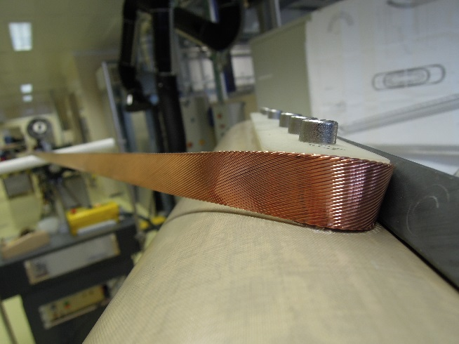
Design A: Minimum bending radius
  In block coils:
    Typically:
  R_{min} = 8-10 x Cable Mid Thickness
    The lowest found in literature: HD1
  R_{min} = 6.5 x Cable Mid Thickness
    In this specific design
  R_{min} = 7 x Cable Mid Thickness
Remark: for the DS-11T dipole, this ratio is ~ 5.5 for the thin edge of the conductor
Proposal: winding test using SMC 11 T, RMC MQXF and FRESCA 2 in order to determine the minimum bending radius of each conductor.
We did similar tests for MQXF. For this specific test we will:
Use RMC winding table
Produce simple pole parts by 3 D printing with different radius (10,15 and 20 mm)
Fast and simple test

Slide 32
Designs A&C: Electrical insulation
  High inductance ( ~ 45 mH/m)
    High inductive voltage in case of a quench → robust electrical insulation needed.
  Mica-Glass insulation successfully implemented on the 11 T project.
    Potential to improve the electrical robustness, but more R&D needed (Developments stopped within the 11 T project for a question of budget and time.)

Slide 33
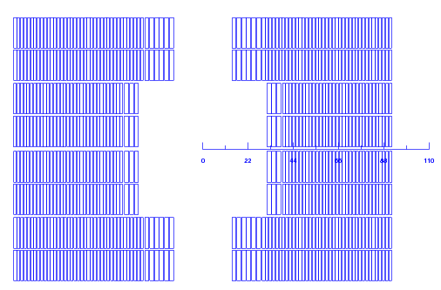
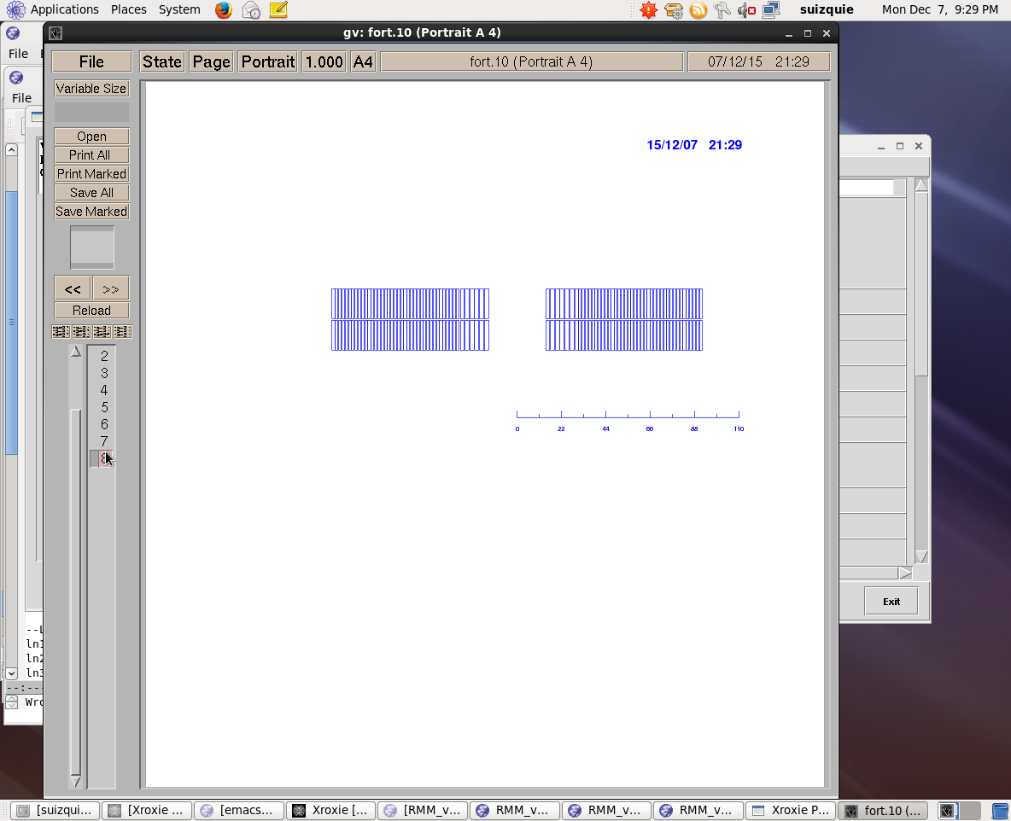
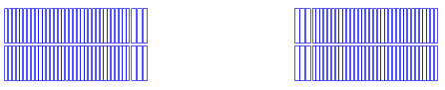
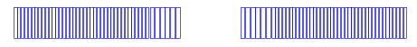
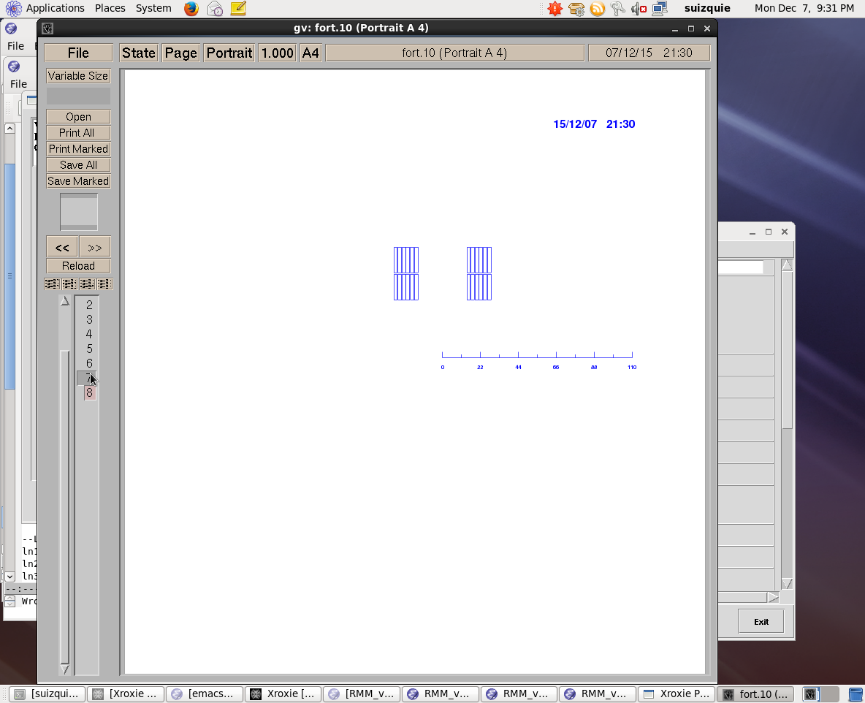
Nb₃Sn High Field Splice
Each aperture is made out of 4 double pancakes
Each pancake can be built with a double pancake for the high field region + 2 single pancakes for the low field
2x
+
2x
+
+

Slide 34
Nb₃Sn High Field Splice
Two possible options:
  Winding + Reaction + Splicing + Impregnation
    High field and low field are wound together and spliced after reaction
  Winding + Reaction + Impregnation + Splicing
    High field and low field are wound, reacted and impregnated independently, and they are spliced after impregnation

Slide 35
Nb₃Sn High Field Splice
Two possible options:
  Winding + Reaction + Splicing + Impregnation
    High field and low field are wound together and spliced after reaction
  Winding + Reaction + Impregnation + Splicing
    High field and low field are wound, reacted and impregnated independently, and they are spliced after impregnation

Slide 36
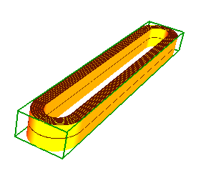
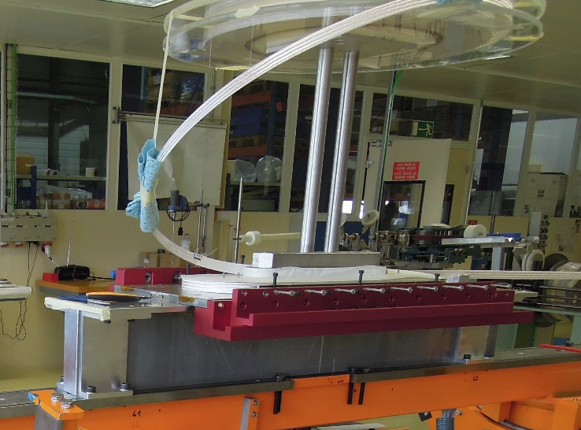
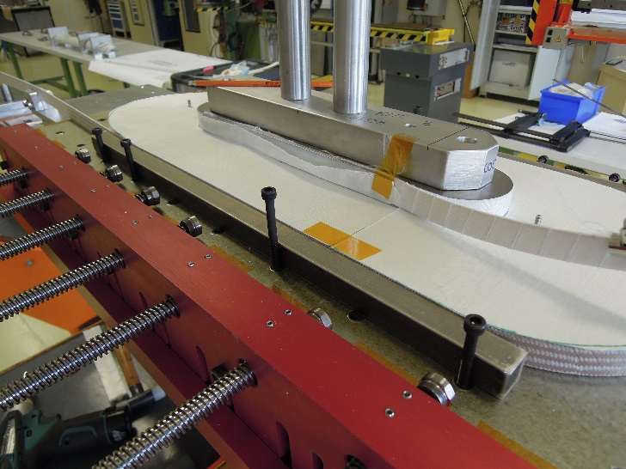
Nb₃Sn High Field Splice
  1.1. Winding of the high field double pancake (standard winding as in RMC&SMC)
Layer jump
Lead 1
Lead 2

Slide 37
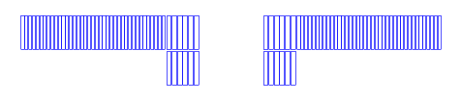
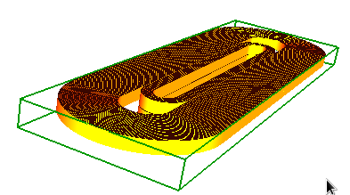
Nb₃Sn High Field Splice
  1.2. Winding of the upper low field layer
Splice HF – LF 1
Lead 1*
Lead 2
Splice 1
Lead 2
Lead 1*

Slide 38
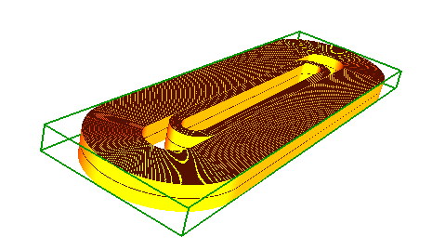
Nb₃Sn High Field Splice
  1.3. Winding of the lower field block
Splice HF – LF 1
Lead 1*
Splice HF – LF 2
Lead 2*
Splice 2
Lead 2*
Splice 1
Lead 1*

Slide 39
Nb₃Sn High Field Splice
1. Winding
Lead 2*
Splice 2
Splice 1
2. Reaction
Lead 1*
Lead 2*
Splice 2
Splice 1
3. Impregnation
Lead 1*
Lead 2*
Splice 2
Splice 1
Lead 1*
Lead 2*
Splice 2
Splice 1
4. Splicing
Lead 1*

Slide 40
Nb₃Sn High Field Splice
Two possible options:
  Winding + Reaction + Splicing + Impregnation
    High field and low field are wound together and spliced after reaction
  Winding + Reaction + Impregnation + Splicing
    High field and low field are wound, reacted and impregnated independently, and they are spliced after impregnation

Slide 41
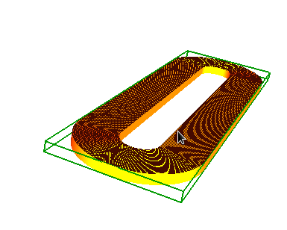
Nb₃Sn High Field Splice
1. Winding
1. Winding
1. Winding
2. Reaction
2. Reaction
2. Reaction
3. Impreg.
3. Impreg.
3. Impreg.
Lead 2*
Splice 2
Splice 1
4. Splice
Lead 1*

Slide 42
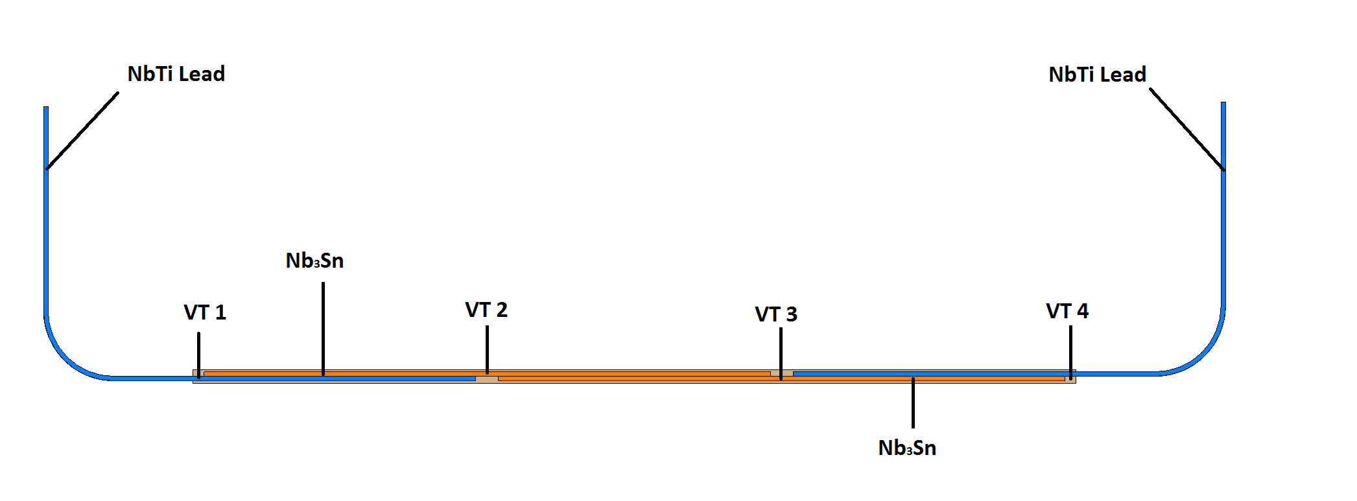
Nb₃Sn High Field Splice
Questions we need to answer:
  Can we reach a good quality splice using the same technology as in the NbTi-Nb3Sn low field splice? (i.e. Sn₉₆Ag₄ and halogen free flux)
  Are there solders more suitable than Sn₉₆Ag₄ or Sn₆₀Pb₄₀?
    We don’t have the same limit in terms of melting temperature than in the case of NbTi splices.
  Can we splice two Nb₃Sn reacted (oxidized) cables without cleaning?
  Is there a way to clean the cable without mechanical contact?
Many of these questions can already be answered with a simple set up, measuring the contact resistance in the Diode Cryostat in SM18:
But…this will tell us what is a bad splice. To know if we have a good splice, we need a background field.
  →“Wound Conductors Test Facilities” [F. Lackner], will provide a full electrical characterization of the splice (long term development)

Slide 43
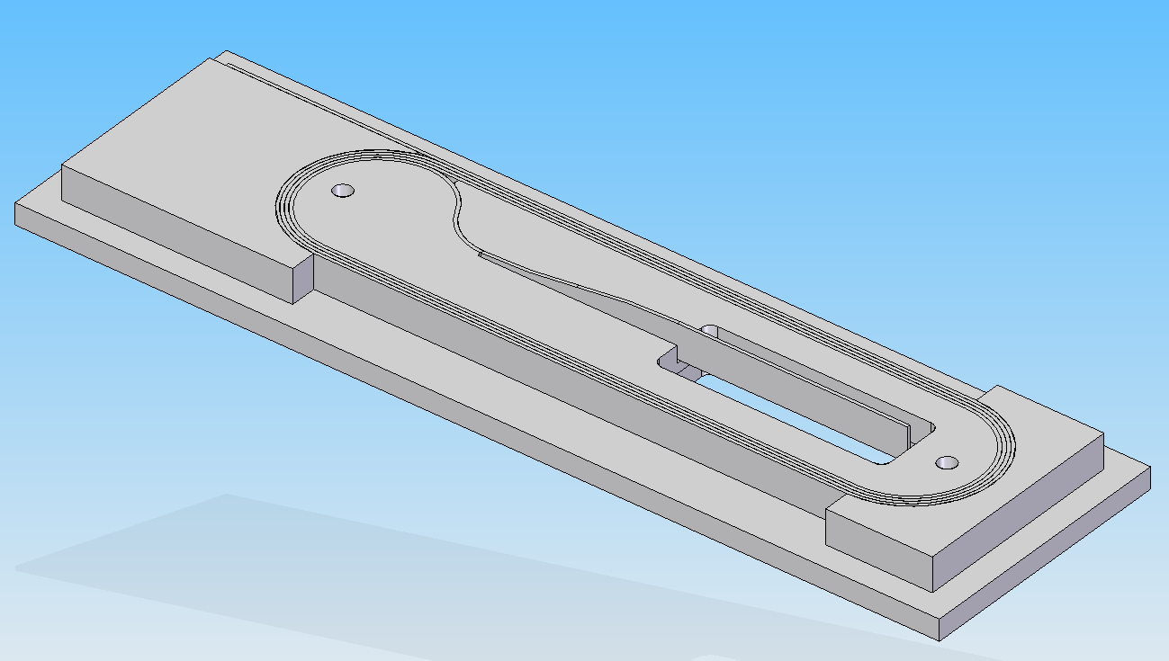
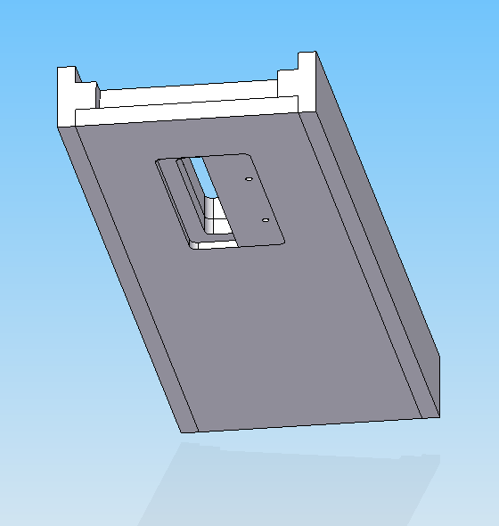
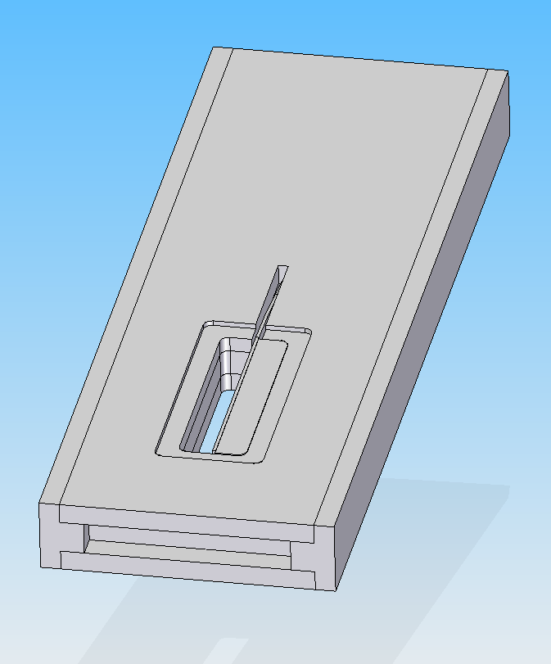
Designs A&B: Nb₃Sn High Field Splice
Our need: Nb₃Sn/Nb₃Sn interlayer splice in coil relevant conditions
On-going activity within a collaboration with STFC (UK) to develop an internal splice using RMC-ILS configuration.

Slide 44
Nb₃Sn High Field Splice
The same concept is applicable for our case, if we perform the splice in the end region.

Slide 45
Nb₃Sn High Field Splice
But this is taken some precious longitudinal space, so there might be better ways to do it!
We could save this room if we make the splice at the level of the coil end spacers
1. Winding (HF+LF)
2. Reaction (HF+LF)
3. Splicing
4. Impregnation

Slide 46
Nb₃Sn High Field Splice
1. Winding (HF) + Reaction (HF) + Impregnation (HF)
2. Winding (LF) + Reaction (LF) + Impregnation (LF)
3. Splicing
4. Impregnation

Slide 47
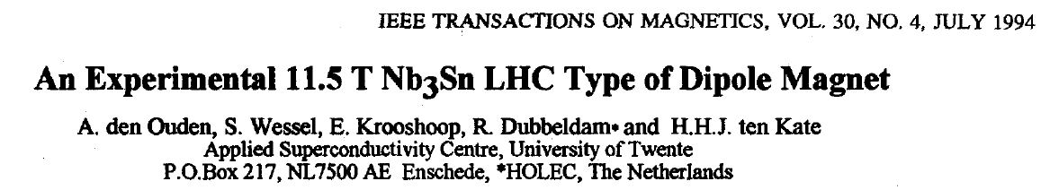
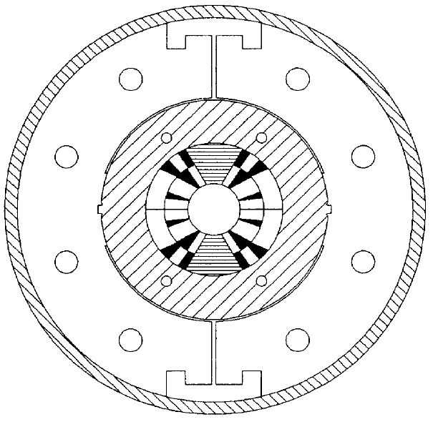
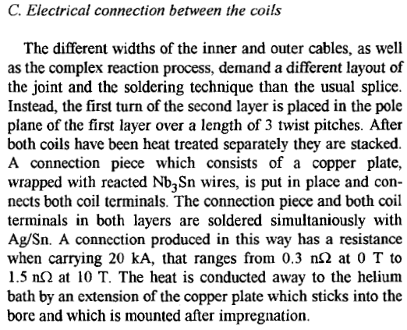
Nb₃Sn High Field Splice
There is some room for creativity here, and we should also take a look to what was done in the past…

Slide 48
Content
Introduction
Design constrains
Electromagnetic designs overview
Technical challenges and “solutions”
Summary and next steps

Slide 49
Summary and next steps
A series of solutions to grade a block coil have been discussed, with a coil equivalent width ranging from 65 to 70 mm (compared to ~85 mm for non-graded solutions).
The most compact solution that can be build with the present constraints is “Design A”.
Conservative design criteria for quench protection (time margin ~45 ms), which is the limiting factor for designs C and D.
If low operating current and high inductance is a showstopper for a magnet operating in the machine, a compact solution with wide cable (50 strands x 1 mm) and two power supplies can be a good option.
In all the cases, the main challenge is the development of the high field Nb₃Sn splice.

Slide 50
Additional slides

Slide 51
Parametric
In general, the smallest coil is achieved when the load line margin is 10 % both in the high field and in the low field.
But solutions can be found where the increase of coil size is not very big when the margin in the low field is increase by a factor 2:
  The operating current can be slightly higher for the same peak field, so at the end the “lost” due to having less coil with high current density is balanced by the slightly higher current density
N2
N4
N1
N3

Slide 52
What if in Design A, we want 20 % margin in the low field?
Margin HF = 10 %
Margin LF = 10 %
Margin HF = 10 %
Margin LF = 20 %
Equivalent coil width: 65.2 MM
Nb₃Sn for FCC: 11710 tons
Equivalent coil width: 66.6 MM
Nb₃Sn for FCC: 12265 tons

Slide 53
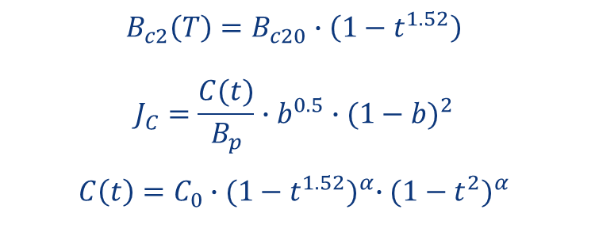
Strand - RMM
Strand diameter: 1 mm
Critical surface parametrization from EuroCircol, without self-field correction
Cu2SC ratio = 1.0
Critical current degradation due to cabling = 5 %
$$B_{c2}\left(T\right)=B_{c20}∙\left(1−t^{1.52}\right)$$
$$J_{C}=\frac{C(t)}{B_{p}}∙b^{0.5}∙{(1−b)}^{2}$$
$$C\left(t\right)=C_{0}∙{(1−t^{1.52})}^{α}∙{(1−t^{2})}^{α}$$
T_{c0} = 16 K, B_{c20} =28.8 T, α = 0.96, C₀ = 255230 A/mm² T

Slide 54
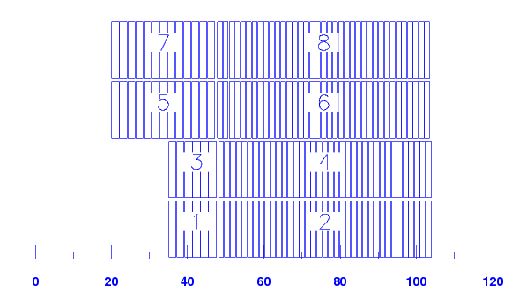
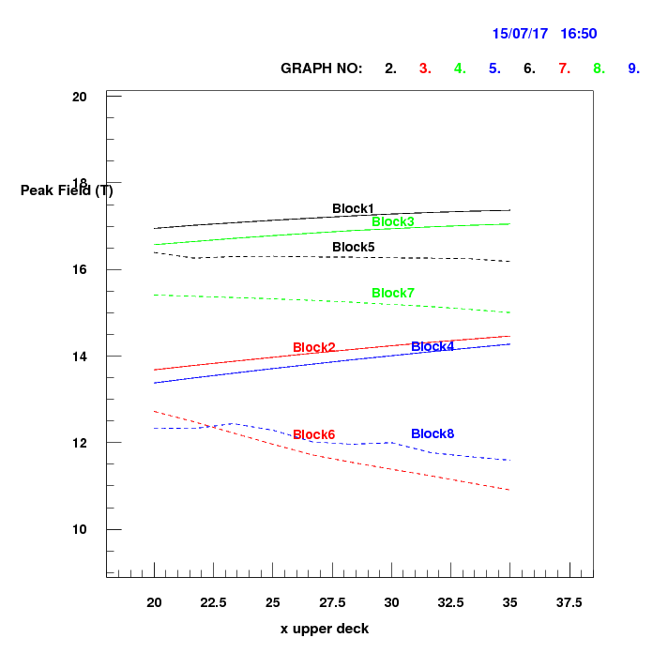
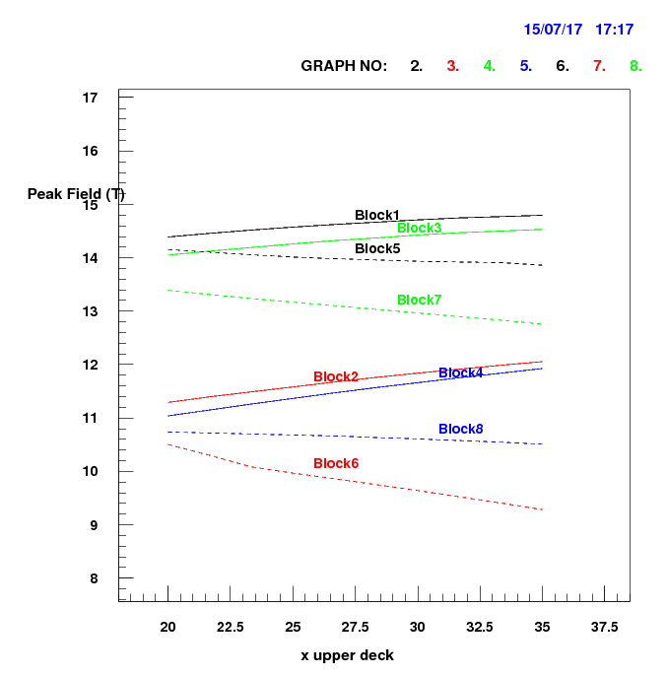
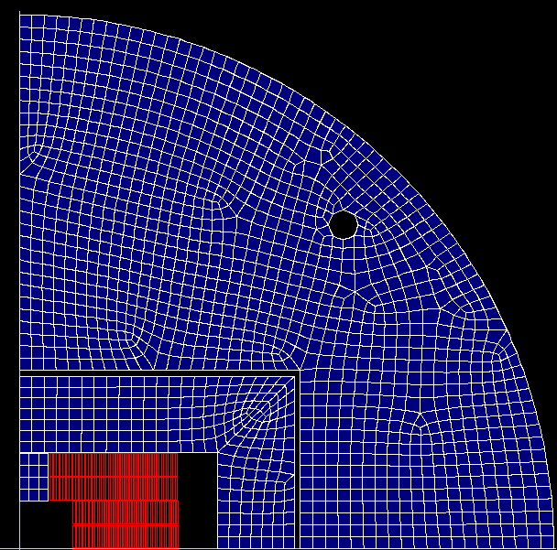
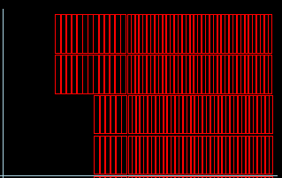
Sensitivity to the longitudinal block position
Bp/Bo=0.997
Bp/Bo=0.957
Bp/Bo=1.03
Bp/Bo=1.09

Slide 55
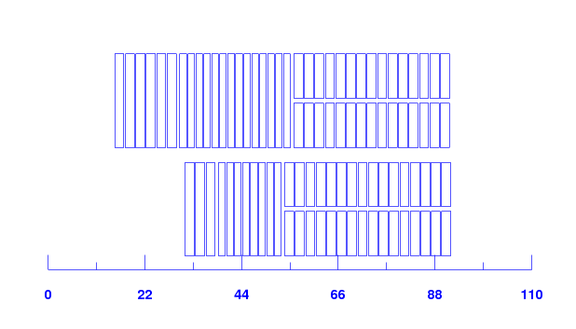
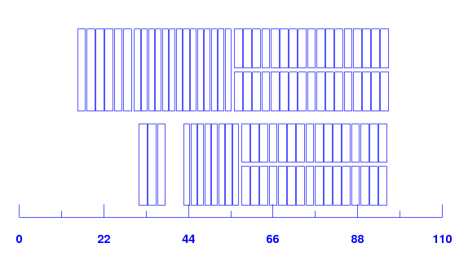
Other lay-outs we looked at

Slide 56
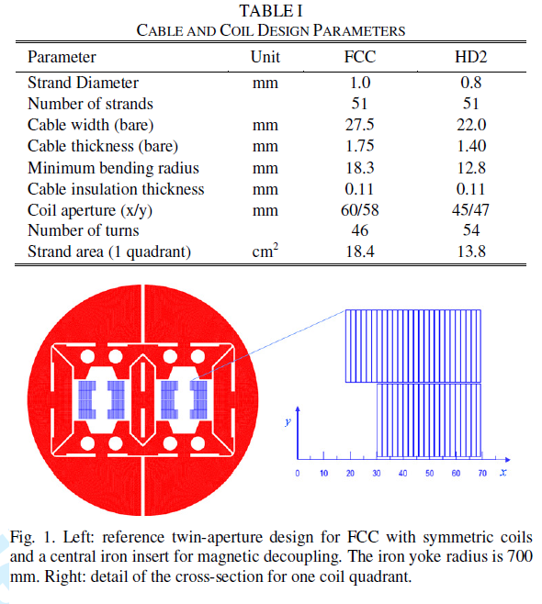
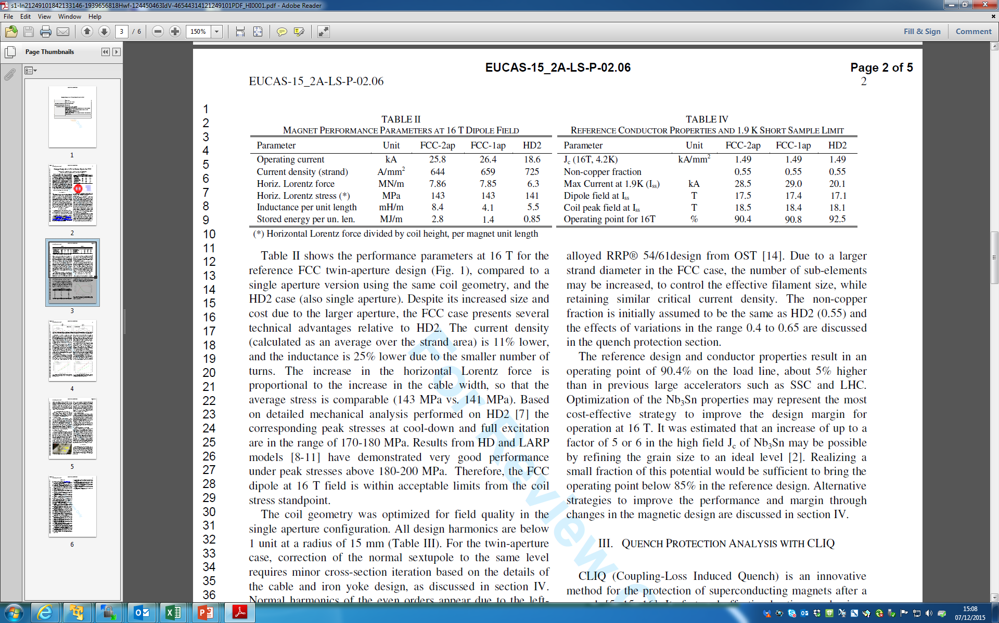
Design from G.S
Sabbi, EUCAS-15_2A-LS-P-02.06
0.15 mm
1.5 kA/mm²
<0.5
80 %

Slide 57
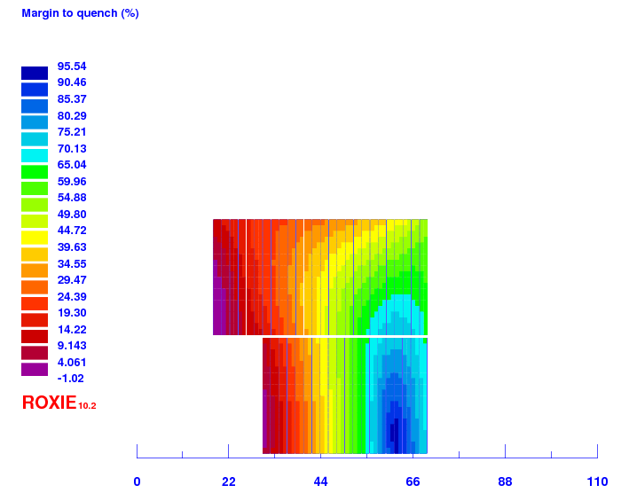

G.S design translated to FCC criteria
 | Sabbi | FCC criteria
I @ 16 T, kA | 25800 | 17400
Insulation thickness, mm | 0.11 | 0.15
Copper to non-copper ratio | 0.82 | 1
Operation point at 4.2K, assuming FCC target Jc | -1 % | 5 % ! Should be >10%
Strand area per quadrant, cm² | 18.4 | 32
Translated to FCC criteria
Sabbi, EUCAS-15_2A-LS-P-02.06

