Slide 1
ECC
Clément Lorin – Maria Durante
Acknowledgements: Fresca2 team

Slide 2
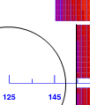
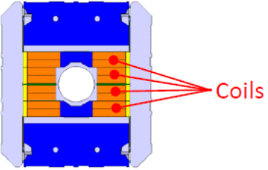
Foundations
Context:
  16 T dipole – 4.5 K – ~10% LL margin – Nb₃Sn – 50 mm aperture
  No-grading leads to too much conductors: >20,000 tons (4800 dip, 15 m, d = 8.7)
  Preliminary graded cos-theta designs: ~12,000 tons (not protectable!)
Grading needed for block (as well!)
  An efficient grading: extremes strand dimensions (1.1 mm – 0.7 mm)
  Number of coils (manufacturing): large current, big cable (40 strands)
  Cables:
    1.1 mm, 26 strands, 15 mm, 2 mm (~125 tons per turn)
    0.7 mm, 40 strands, 15 mm, 1.25 mm (~75 tons per turn)
Mechanical support: 6 mm
  Fresca2 = 8 mm, 15 T @ 1.9 K not optimized
Fresca2

Slide 3
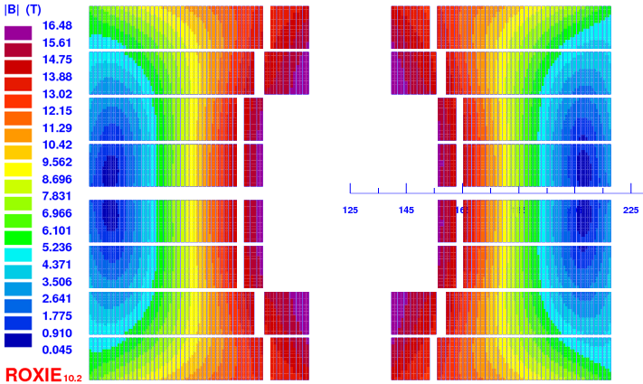
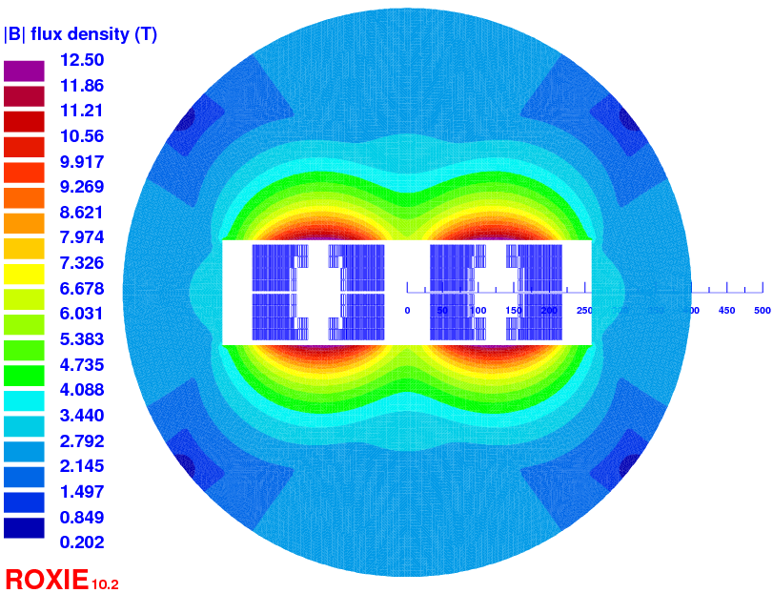
Grading 1 – (reference)
Splice room = Large cable thickness (>2.3 mm)
Cu/nonCu = 1.0 both cable
Protectable (50 ms, hotspot < 300 K)
19/146 turns -> 13,600 tons (217 cm²)
Iop = 8395 A
Gap closed 15/148 turns -> 13,300 tons (212 cm²)
FCC quad remark [Ezio]:
1% less dipole field is 8 outer turns (~quantity of conductors needed for the FCC quad)

Slide 4
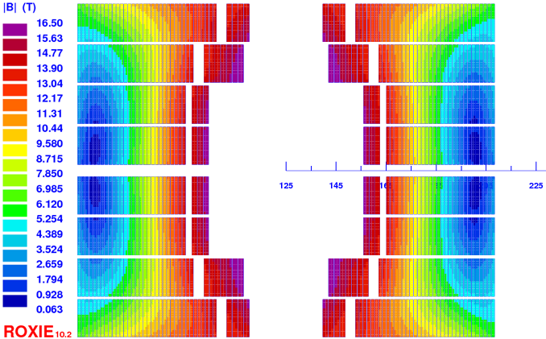
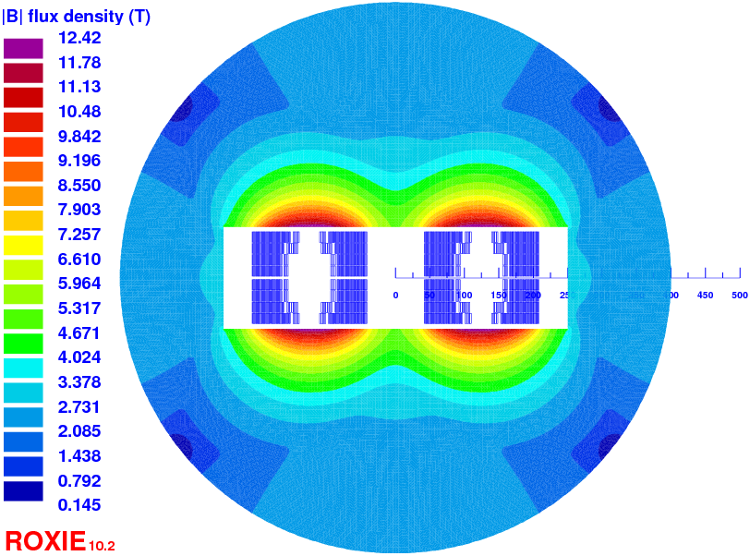
Grading 2 – (Cu/nonCu reduction 0.6)
Splice room = Large cable thickness (>2.3 mm)
Cu/nonCu = 0.6 inner 1.0 outer
Protectable (50 ms, hotspot < 300 K)
17/122 turns -> 11,500 tons (184 cm²)
Iop = 9700 A
Gain ~2000 tons (~3 times the quantity of conductors for the quadrupoles!)

Slide 5
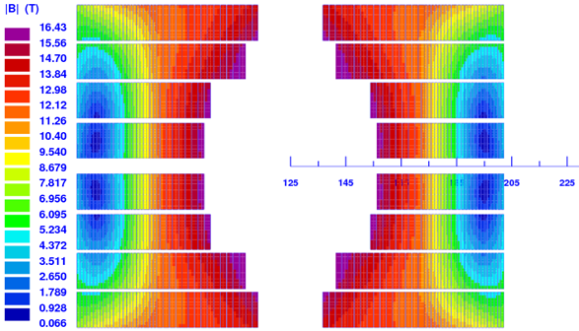
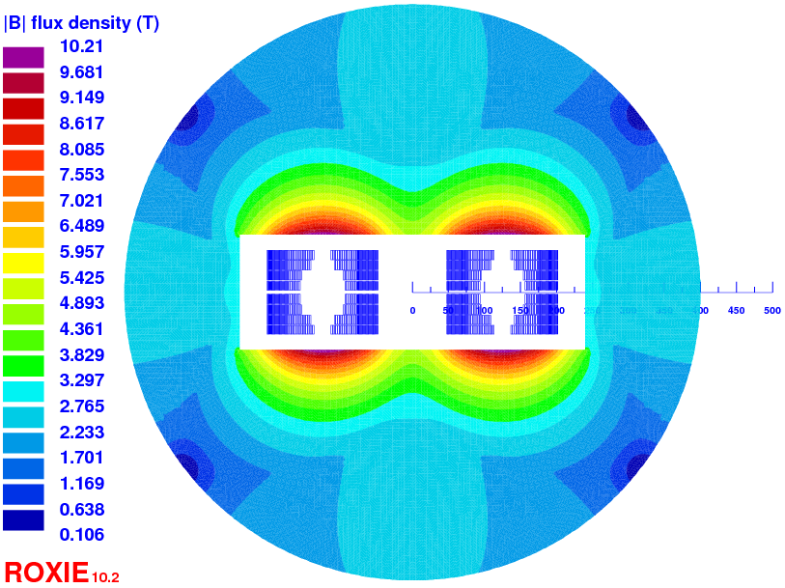
Grading 3 – (Cu/nonCu 0.6 + 48 str. 0.5 mm)
No splice room
Cable
    1.1 mm, 22 strands, 12.7 mm, 2 mm
    0.5 mm, 48 strands, 12.7 mm, 0.9 mm
Cu/nonCu = 0.6 inner 1.4 outer
15 + 10 ms, hotspot ~ 350 K
45/98 turns -> 9,300 tons (149 cm²)
Iop = 8840 A
About the same quantity of conductor as GL Sabbi, same time to react*
*Design study of a 16 T block-dipole for FCC» to be published in IEEE TAS

Slide 6
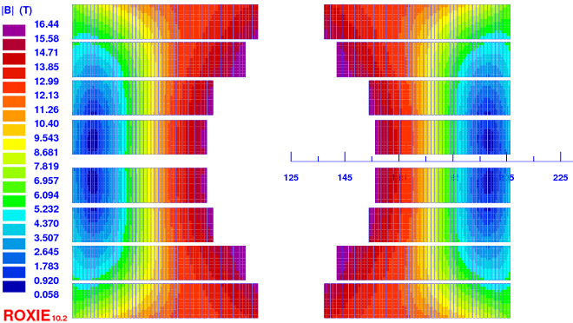
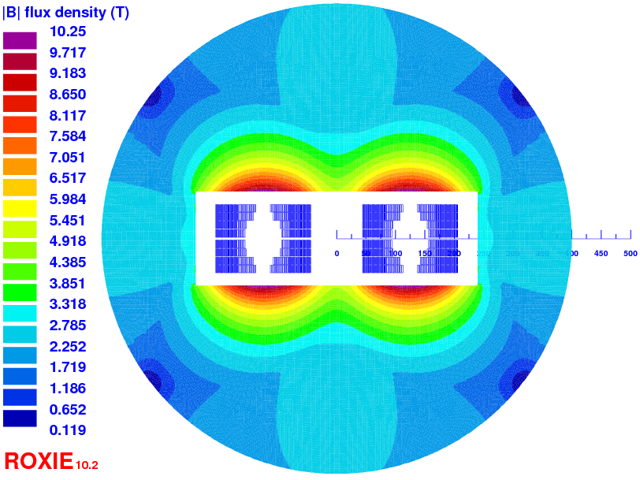
Grading 4 – (Cu/nonCu 0.6 + 40 str. 0.6 mm)
No splice room
Cable
    1.1 mm, 22 strands, 12.7 mm, 2 mm
    0.6 mm, 40 strands, 12.7 mm, 1.1 mm
Cu/nonCu = 0.6 inner 1.5 outer
20 + 20 ms, hotspot ~ 300 K
37/108 turns -> 9,999 tons (159 cm²)
Iop = 8760 A

Slide 7
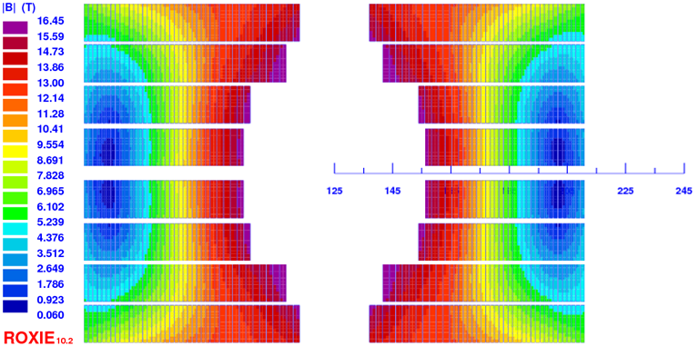
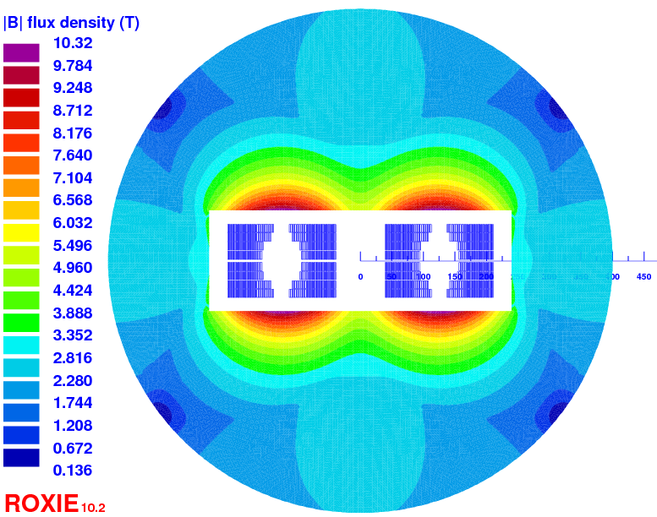
Grading 5 – (Cu/nonCu 0.6 + 34 str. 0.7 mm)
No splice room
Cable
    1.1 mm, 22 strands, 12.7 mm, 2 mm
    0.7 mm, 40 strands, 12.7 mm, 1.25 mm
Cu/nonCu = 0.6 inner 1.5 outer
20 + 30 ms, hotspot < 300 K
33/116 turns -> 11,000 tons (177 cm²)
Iop = 8620 A

Slide 8
Magnet ID | 1 | 2 | 3 | 4 | 5
Cables [mm] | 26x1.1 ; 40x0.7 | 26x1.1 ; 40x0.7 | 22x1.1 ; 48x0.5 | 22x1.1 ; 40x0.6 | 22x1.1 ; 34x0.7
Cu/nonCu [-] | 1 ; 1 | 0.6 ; 1 | 0.6 ; 1.4 | 0.6 ; 1.5 | 0.6 ; 1.5
Turns [-] | 19 ; 146 | 17 ; 122 | 45 ; 98 | 37 ; 108 | 33 ; 116
Iop [A] | 8395 | 9700 | 8840 | 8760 | 8620
Time [ms] | 20+30 | 20+30 | 15+10 | 20+20 | 20+30
HotSpot [K] | < 300 | < 300 | ~350 | ~300 | < 300
Weight [tons] | 13,600 | 11,500 | 9,300 | 9,999 | 11,000
Area 2 ap. [cm²] | 217 | 184 | 149 | 159 | 177
-Is a ‘perfect’ cable the better solution for a ‘perfect’ magnet?
-Why do we operate at 4.5 K instead of 4.2 K?
-Where do we make the splices? And how?

Slide 9
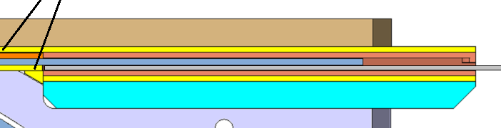
From FRESCA2
No specific feedback about grading from FRESCA2
  Ungraded coils
  No Grading options from the beginning
Feedback on use of 40 strands, 1 mm in diameter :
  no special issues for winding (R min 45 mm)
  to be confirmed by coil/magnet test…
Feedback on coil and tools design:
  Preliminary winding tests with special tools to study/define head configuration (length, angle, …), layer jump -- >
  Cable behavior studies relative to heat treatment : to be done as soon as possible with final cable, bare and insulated
FRESCA2 splices: 2 mm thick copper box (U + wedge)

Slide 10
Splice requirements
Min splice length = cable twist pitch
Need space on each side of cables pair for:
  Copper stabilizer
    U shape + wedge
  Insulation
Need supports to:
  Guide the cables to splice position
  Block the cables ends during winding (and reaction?)
  Support replaced after reaction by copper stabilizer, insulation and soldering tools

Slide 11
Splice options
In the straight section
  Gap between the two conductors blocks (4 x cable thickness?)
  Gap between layers
In the heads
  Experience on bended splices ?
  Small radius → short length → need for longer (flared) heads → bigger outer diameter
External splices/connections

Slide 12

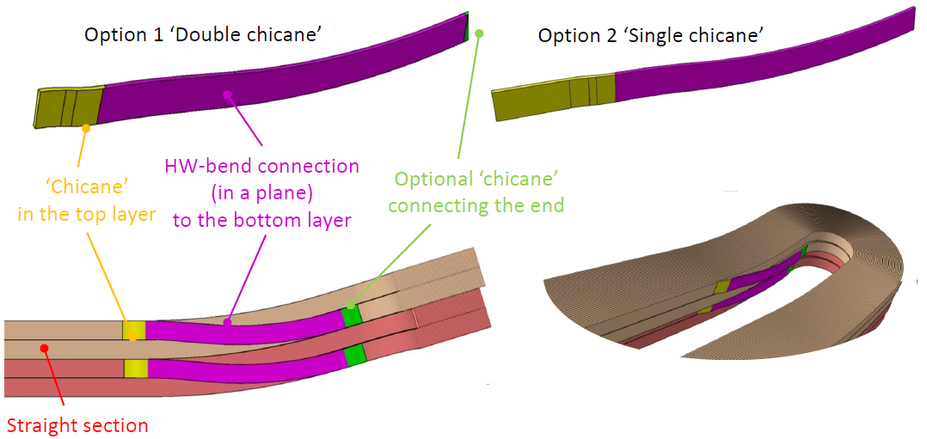
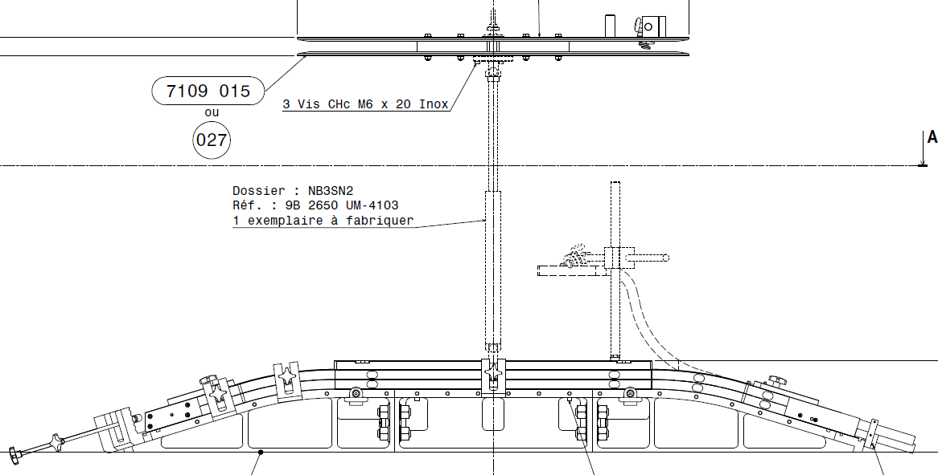
Extra – Fresca2

Slide 13
Extra – D20

Slide 14
Extra – HD2

