Slide 1
IR magnet design: an update
M. Koratzinos
FCC-ee physics meeting,
Monday, 7/12/2015

Slide 2
Purpose
This is an update to my talk given here on 2 November
Please also see my talk on the FCC-ee physics meeting last week (30 November)
I will discuss what is new since 2 November
Then I will discuss future steps
Acknowledgements:
Glyn Kirby and Jeroen Van Nugteren of TE-MSC for fruitful discussions, guidance and the use of very useful tools (Field 2015)
Shlomo Caspi for an introduction to CCT magnets
Katsunobu Oide for helpful discussions

Slide 3
Background information
There was a very nice talk given by E. Paoloni at HF2014 in Beijing.
I will be using some of his transparencies interspersed with mine during this presentation

Slide 4
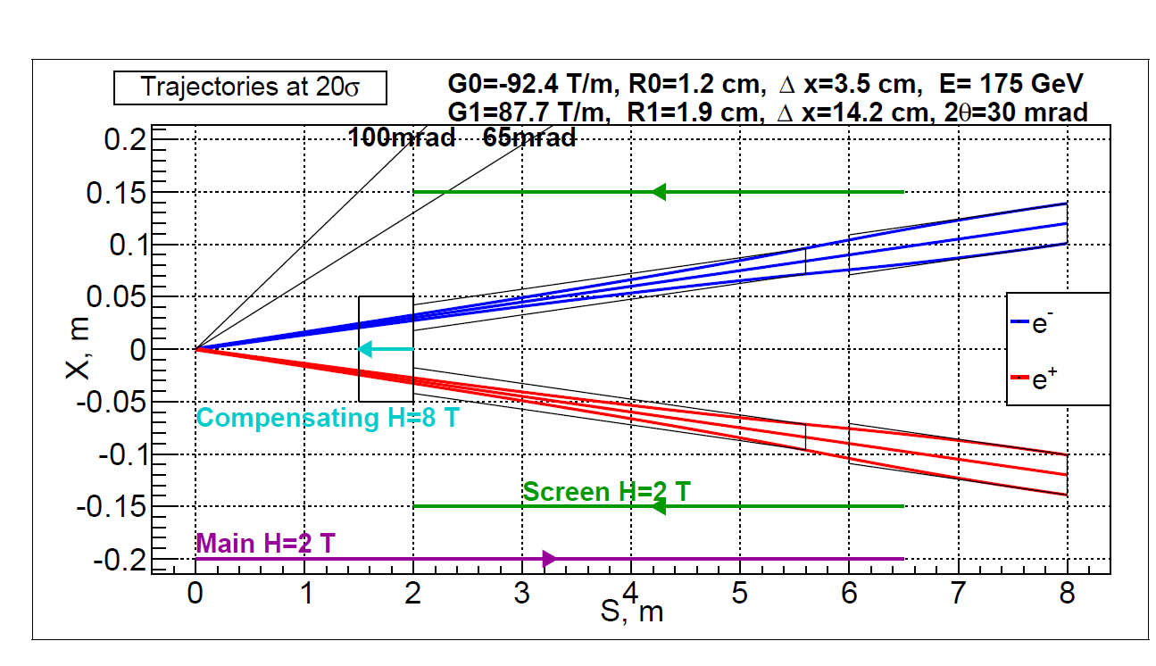
The IR region of a typical FCC-ee experiment
Final quads
Main detector solenoid
Quad screening solenoid
Compensating solenoid
An artist’s impression of the forward region around the IP

Slide 5
Objectives
Objective no. 1: the vertical emittance blow-up should be as small as possible
Objective no.2: the crosstalk between final focus quads should be minimised
Constraints: stick to the 100mrad cone

Slide 7
Emittance blow up
The calculation is given at previous talks
Points to retain: emittance blow up more important at low energies (45GeV)
Total vertical emittance is due to coupling (mainly arcs) and dispersion (mainly IPs)
The aim is to have emittance blow-up at the IPs much smaller than our emittance budget
Vertical emittance budget: ~1pm

Slide 8
The layout
Many different layouts have been tried. Sergei Sinyatkin (BINP) performed some minimization using two solenoids that gave him the optimal position of the solenoids.
Building up on Segei’s work, I tried three solenoids and eventually…
…The best combination that I could find is a two solenoid arrangement with the short solenoid tapered – see next slides

Slide 9
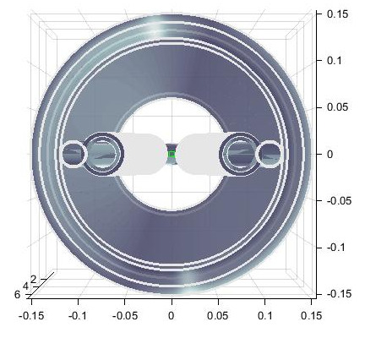
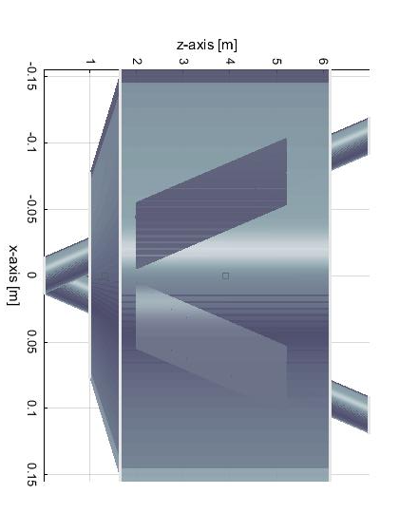
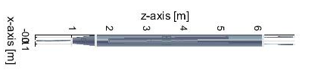
The layout
100mrad
True proportions view

Slide 10
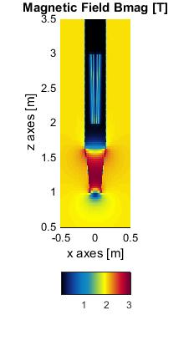
Shielding solenoids
Two screening solenoids are used: a long -2T solenoid, ensuring zero field where the quads are, and a -5T tapered but short (65cm) solenoid, ensuring that the overall field seen by electrons is zero
Other schemes were used, but the one on the left gave the best results: emittance blow up due to two such IPs in the ring of 0.11pm (Katsunobu’s calculation)
The tapered solenoid improves the emittance blow-up by a factor ~2

Slide 11
Note on the layout
Ensuring a minimal emittance blow up is not an easy task: one needs to minimize the edge effects, so the bigger the solenoid, the better. But one needs to respect the 100mrad cone.
Further optimization is possible.
The existence of a stand alone tool (Field2015 + calculations in excel) allowed for fast progress compared to MAD

Slide 12
Final focus quads
We need fields of 100T/m
Beam pipe is at a radius of ~1.2cm (corresponding to 20 sigma horizontal/vertical)
Total quad length: 3.2m (or 2 × 1.6m)
For this application, a CCT approach might be appropriate

Slide 13
CCTs
Canted Cosine Theta magnets are very simple objects:
They comprise two coils on two concentric cylinders
Each coil produces a solenoid field plus an arbitrary multipole field (dipole, quad, sextupole…)
The two solenoid fields from the two coils exactly cancel out (this means that a CCT coil has 30% more conductor than a conventional design for the same field)
Groves are precisely defined for winding the cable on a substrate which could be metal (aluminium) or plastic (bluestone)
Prototypes can be 3D printed – production pieces can be machined in a workshop
This technology is promoted by many people including S. Caspi (LBNL) and G. Kirby (CERN/TE)

Slide 14
Advantages of CCT quads
The novel technique of helical coils (CCTs) has a number of important advantages for this application:
Excellent field quality
Absence of iron
Easy to manufacture
Easy to incorporate additional rings with corrector elements
Possible to “design out” any cross talk by changing pitch and angle of groove
Good synergies with the design of corrector magnets of FCC-ee
Fast prototyping/not labour intensive
(It is a new technique, becoming more fashionable now)

Slide 15
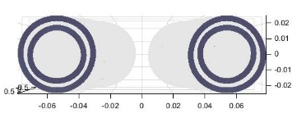
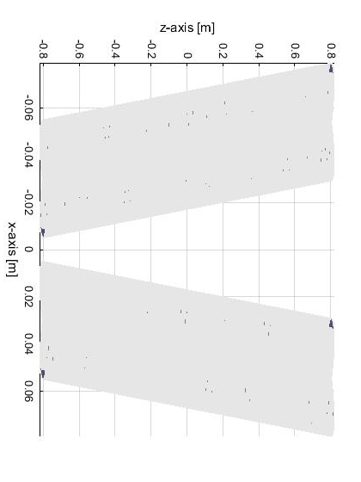
layout
1.6m long, 1.5cm inner bore – would need two of them per side per beam to achieve the 320T integral field

Slide 16
Size of inner bore
We need a study as to what the heat loads would be in the vicinity of the final focus quadrupoles (from SR and impedance)
Paoloni says that one needs to subtract 10mm from the inner coil radius to the beam-stay-clear
The space available at 2m (at the inner tip of the quad) means that the outer radius of the quad cannot exceed 3cm.

Slide 18

How much space is there?
Mechanical support and cooling
B-s-c: 12mm
Inner coil: 20-24mm
Outer coil: 27-31mm
Things are tight, but if we can live with 8mm between b-s-c and inner coil, a L* of 2.2m would be sufficient
L*=2m, 100T/m
Beam stay clear at 12mm
Coil outer radius at 30mm
L*=2.37m, 130T/m
Beam stay clear at 12mm
Coil outer radius at 35mm

Slide 19
Field quality @2/3 aperture (1cm)
With no wire positioning errors, field quality is excellent – the two edges have anti-symmetric fields. Largest component is B1 and A4
Highest component after integration is A1 with a value of 0.1 units
One side of the coil

Slide 20
Harmonics integrals – one quad
B1 [T] | B2 [T] | B3 [T] | B4 [T] | B5 [T] | B6 [T] | B7 [T] | B8 [T] | B9 [T] | B10 [T]
2.19E-08 | -1.54E+00 | -2.31E-09 | -2.86E-07 | -4.00E-09 | -1.24E-06 | 4.22E-09 | 1.09E-08 | 1.70E-09 | 1.83E-06
A1 [T] | A2 [T] | A3 [T] | A4 [T] | A5 [T] | A6 [T] | A7 [T] | A8 [T] | A9 [T] | A10 [T]
1.27E-05 | 2.44E-08 | -1.13E-08 | 9.70E-08 | -8.80E-09 | -7.12E-08 | -5.14E-09 | -7.26E-08 | 3.49E-09 | -1.64E-08
In this work, current leads have been ignored. Current leads will introduce harmonics, so they should be taken into account at a later stage
Highest component is, curiously, A1 with 0.13 units of 10⁻⁴
The aim (K. Oide): all components below 10⁻⁴

Slide 21
Harmonics integrals – both quads
B1 [T] | B2 [T] | B3 [T] | B4 [T] | B5 [T] | B6 [T] | B7 [T] | B8 [T] | B9 [T] | B10 [T]
1.22E-03 | 1.56E+00 | -8.22E-05 | -1.30E-03 | 5.15E-06 | 5.79E-05 | -3.40E-07 | -1.97E-06 | 2.69E-09 | -1.80E-06
A1 [T] | A2 [T] | A3 [T] | A4 [T] | A5 [T] | A6 [T] | A7 [T] | A8 [T] | A9 [T] | A10 [T]
-5.11E-02 | 3.39E-04 | 5.59E-03 | -2.01E-05 | -2.79E-04 | 1.37E-06 | 1.11E-05 | -1.47E-07 | -3.71E-07 | 2.95E-08
Highest components are B4, A3 with ~10 -50 units of 10⁻⁴
Crosstalk should be designed out!

Slide 22
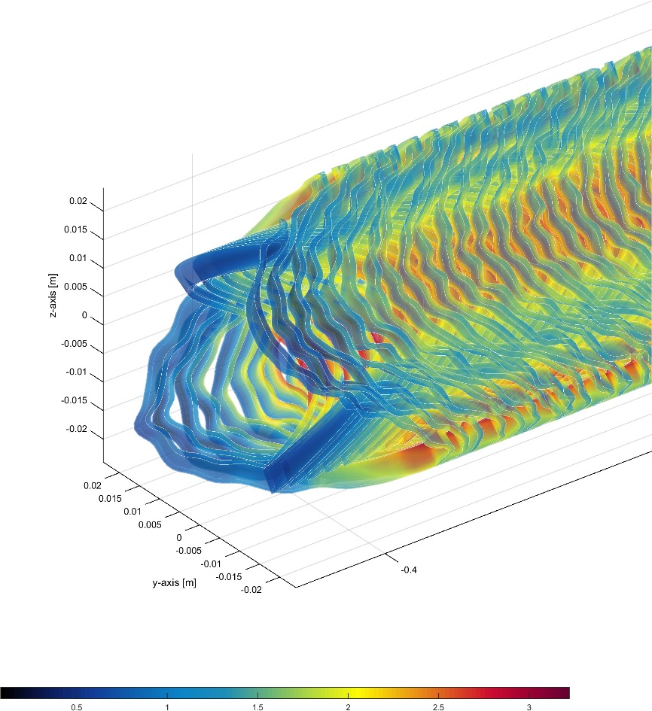
Imperfect coil study
This analysis still to be done – first results show that winding errors need to be larger than 100um to have an effect (16cm long quad)
exaggerated winding errors
Very preliminary; only a single seed

Slide 23
Winding errors
Using a 16cm-long quadrupole
Going through (only) 10 seeds and with a winding error in r of 200um and a winding error in z of 200um (10 points per turn), the maximum field errors were as follows:
B1 [T] | B2 [T] | B3 [T] | B4 [T] | B5 [T] | B6 [T] | B7 [T] | B8 [T] | B9 [T] | B10 [T]
1.75E-04 | --- | 1.11E-04 | 5.83E-05 | 1.90E-05 | 1.69E-05 | 1.14E-05 | 3.02E-06 | 1.66E-07 | 3.80E-07
A1 [T] | A2 [T] | A3 [T] | A4 [T] | A5 [T] | A6 [T] | A7 [T] | A8 [T] | A9 [T] | A10 [T]
1.10E-03 | 1.22E-04 | 5.84E-04 | 9.39E-05 | 7.13E-05 | 1.42E-05 | 1.78E-05 | 2.98E-06 | 3.84E-06 | 2.22E-07
Components B1, B3, A1, A2, A3 are above our limit of 1E-4 but real quad is 10 to 20 times bigger – errors will average out. But I need a bigger computer for this work

Slide 24
Experience from SuperB
The idea of designing the compensation out has been thought about at SuperB

Slide 29
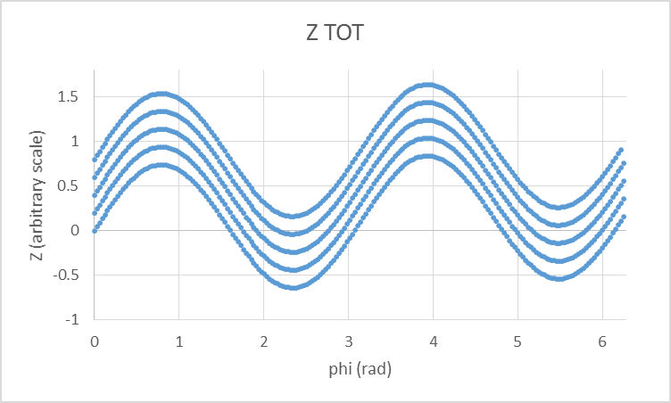
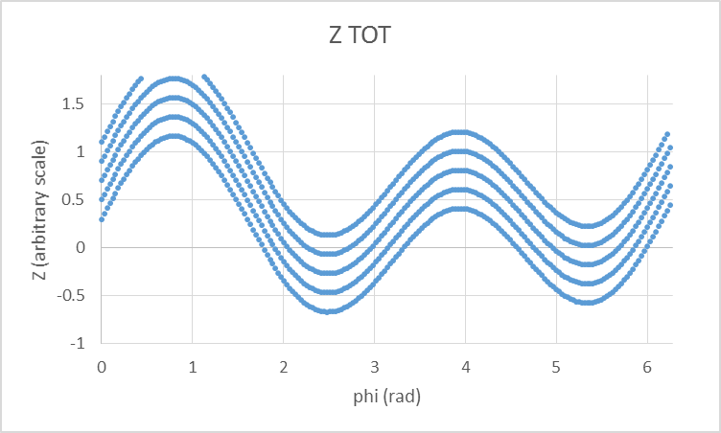
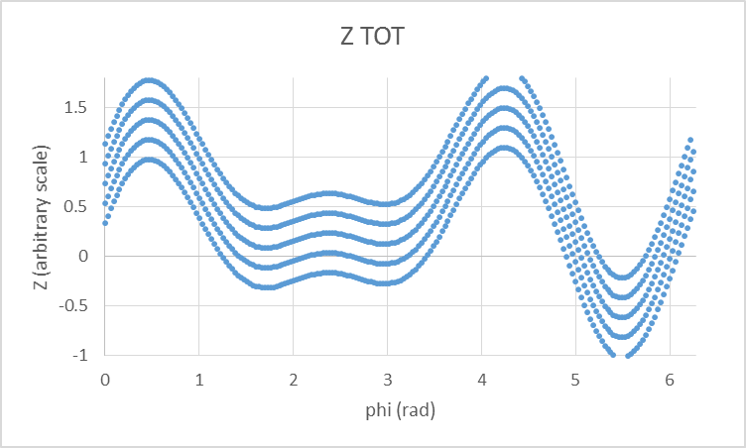
How to design quads with no xtalk
Since we are using no iron, it is very easy to use the principle of field superposition.
It is easy to design helical groves for any superposition of multipoles
Pure quad
Quad strength 1
+
Dipole strength 0.3, phase pi/4
Quad strength 1
+
Sextupole strength 1, phase pi/4

Slide 30
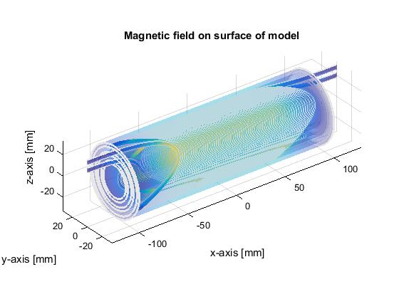
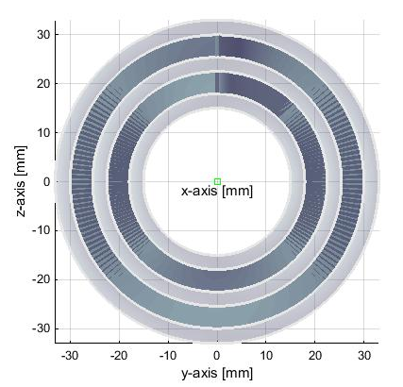
A possible prototype for FCC-ee
A short version of the proposed quad (20cm) with slightly relaxed parameters (thicker walls, less packing

Slide 31
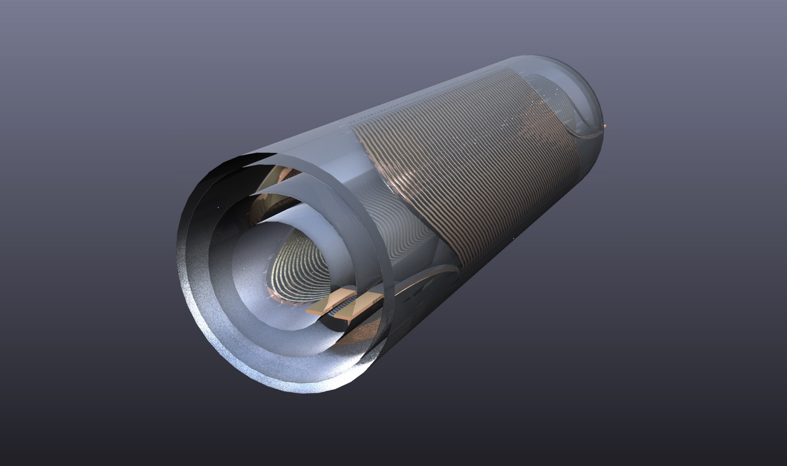
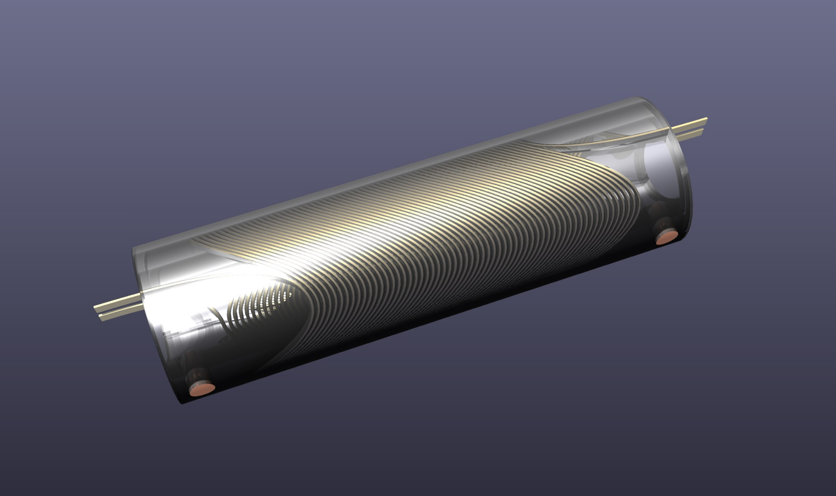
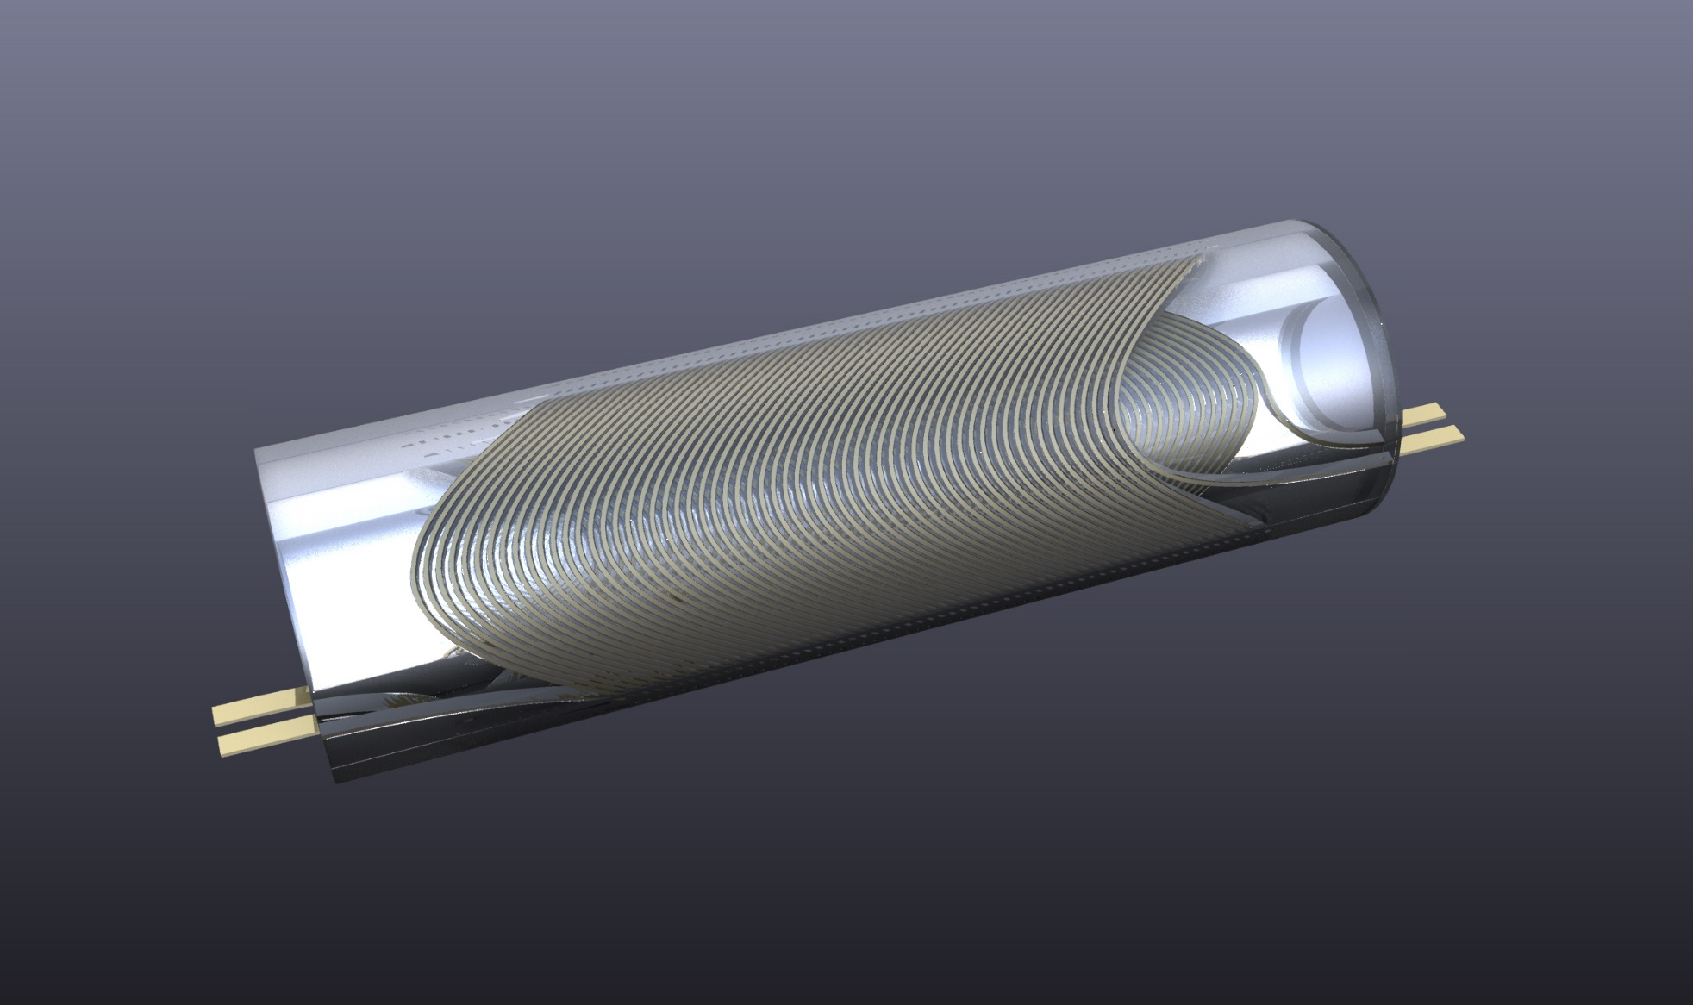
Rapid prototyping
The advantage of this approach is that one can do rapid prototyping. This is a fully engineered CAD drawing with a .STEP file ready

Slide 32
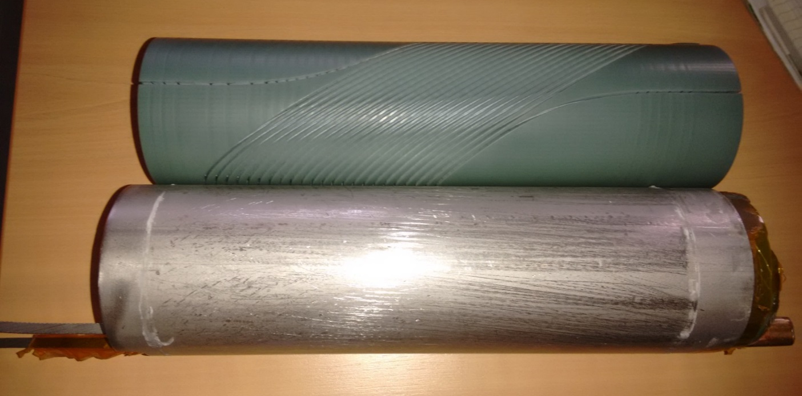
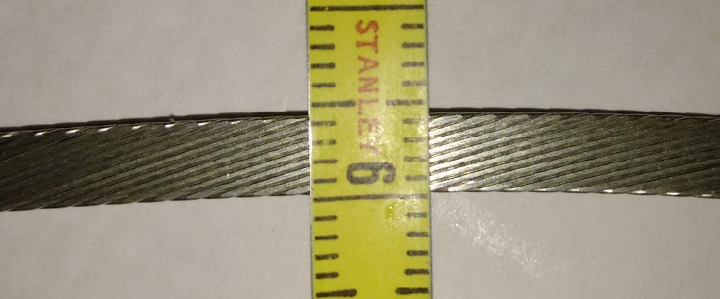
…one they did earlier
In Glyn’s office: a 3D printed version of a CCT dipole printed in bluestone (hard plastic which is cryogenically stable). Wound by hand
Suitable cable: NbTi, already existing, 4.3mm×0.9mm, slightly keystoned

Slide 34
A word on timescales
This work started 15 October 2015
With the right tools and colleagues one can make fast progress
It is possible to have a prototype before Xmas
This will be the first piece of hardware done at CERN for the FCC-ee project

Slide 35
Work plan
Emittance blow up:
already done:
  initial work on emittance blow-up. Target of emittance blow-up reached.
To do:
  Verify, optimise, look into tapered solenoids
  Look into a possible engineering design for the solenoids
CCTs:
Already done:
  Initial design
  Fully engineered prototype
To do:
  Finish prototype
  Test prototype at warm for field quality
  Test prototype at cold, determine gradient limits
  Export to Opera – verify Field2015 calculations
  Design crosstalk elimination
  Design second prototype

Slide 36
Merry Christmas to all!

Slide 37
Extra slides

Slide 38
Bx and Bz components
Emittance is increased by two components of the field:
Bz*sin(theta) and
Bx (due to edge effects)
Out of the two contributions, the second one is more important
e⁻

Slide 39
Magnetic field
Z and X components of the overall field long the path of the electrons
Field components perpendicular to direction of motion of electrons (giving y kick)

Slide 40
α,β,γ, D, D’ close to the IP

Slide 41

Curly H
$$ℋ_{y}\left(s\right)= β{D_{y}^{′}}^{2}+2αD_{y}D_{y}^{′}+ γ{D_{y}}^{2}$$
At ~1m, H is small, maximum at ~1.4m

Slide 42
Components of I5
Edge at ~1m dominates

Slide 43
Emittance blow up
The result is for two IPs. It has been verified by K. Oide and his code who gets a total value of 0.11pm

