Slide 1
TT2 consolidation
EN/EL work package
J.Devine / S.Bertolasi
on behalf of EN/EL 12.01.2016

Slide 2
Agenda
EN-EL work package
Layout and single line diagram
Schedule
Open points

Slide 3
EN-EL work package
Replacement of:
  2 transformers (Oil Filled → Cast Resin)
  2 electrical switchboards (ERD8*25 + ERD9*25)
  Existing electrical containment → realignment with new equipment layout
  Existing LV distribution to suit new equipment

Slide 4
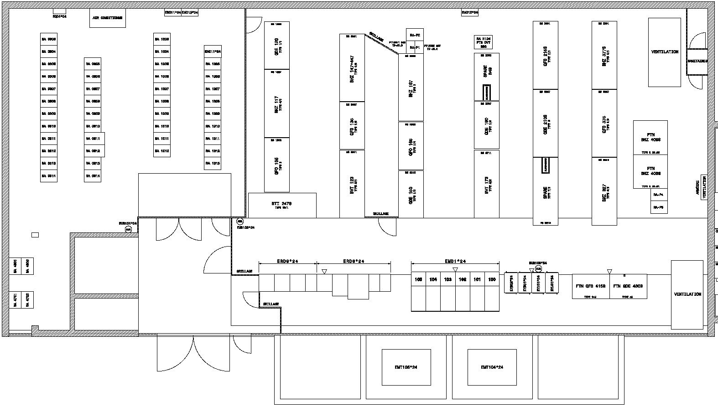
Current layout
LV Switchboards →
Transformers →

Slide 5
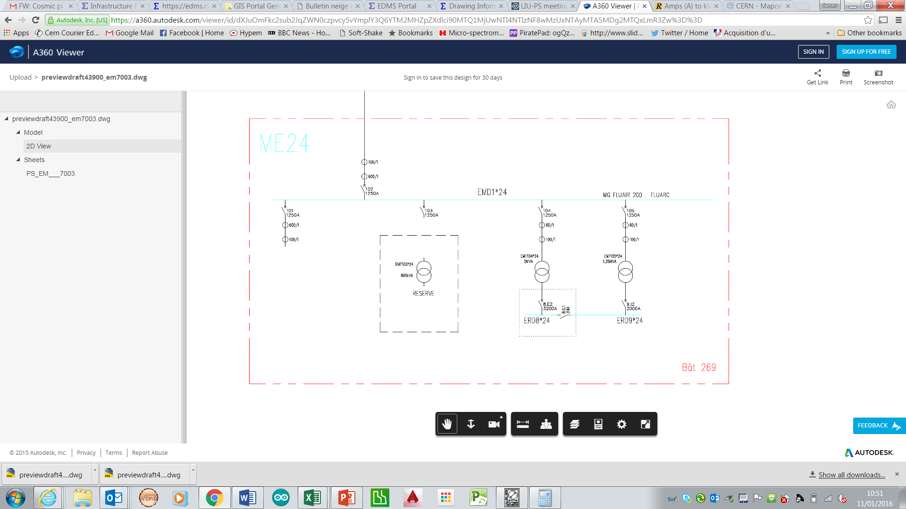
Current single line diagram

Slide 6
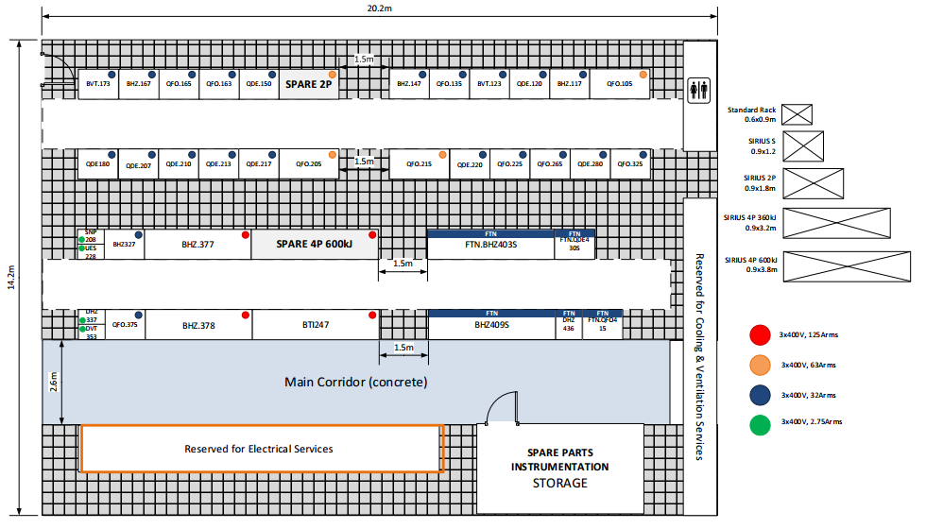
Future layout

Slide 7
Future single line diagram
ERDxx*24
ERDxx+1*24
LOADS

Slide 8
Schedule
Procurement (3 Months)
  2 Transformers, 12 weeks
  2 Electrical switchboards, 12 weeks
  Containment and distribution infrastructure, 6-8 weeks
Installation (2.5 Months)
  Containment 2-3 weeks
  Switchboards 2 weeks
  Transformers 1 week
  Connections (Transformers + Switchboards) 2 weeks
  Cabling & Final equipment distribution 2 weeks (prior) + 2 weeks (post)
Commissioning (0.5 Months)
  Transformers 2 weeks
  Switchboards 2 weeks

Slide 9
Open points
Distribution architecture validation (EL + LIU)
Budget development/estimates → quotations
New Switchboard contract (due March 2016)
Detailed planning coordination:
  Power off date
  Power on date (required)
  Strip out of false floor & re-instatement
  Equipment installation schedule

