Slide 1
Recent rf high-gradient testing results
Jorge Giner Navarro
on behalf of the XBOX team
Mini-MeVArc meeting
22/03/2016 CERN, Geneva

Slide 2
Outline
Introduction
High gradient conditioning
The Xboxes
Xbox-1: Test of TD26CC (Dogleg experiment)
Xbox-2: Test of T24OPEN
Xbox-2: Test of CRAB cavity
Summary

Slide 3
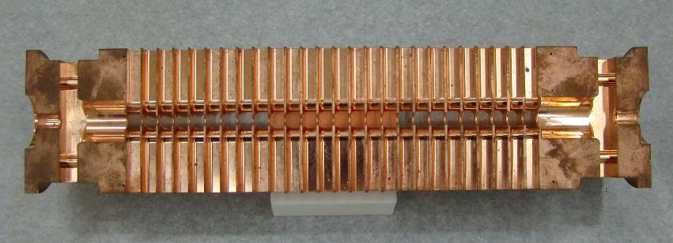
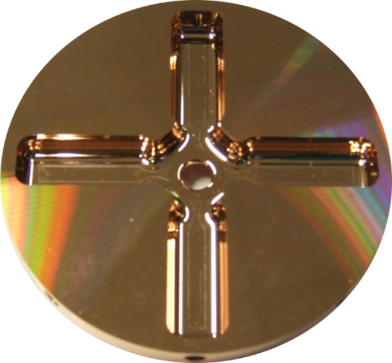
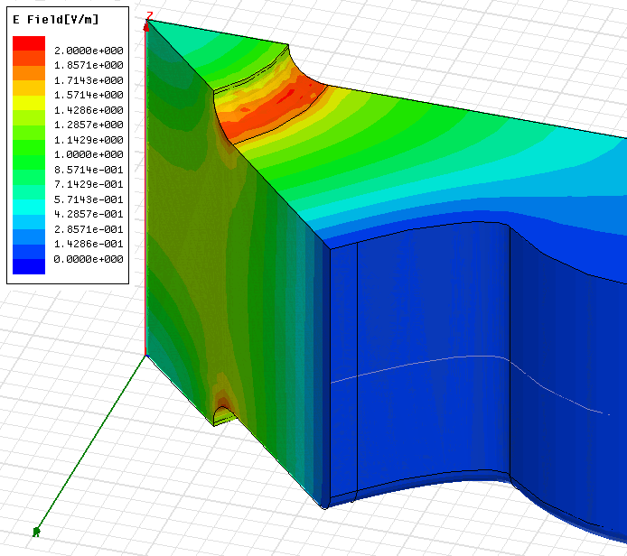
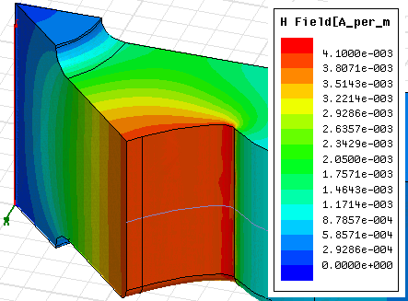
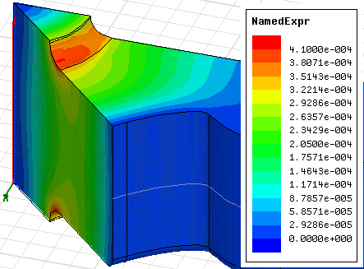
Introduction
CLIC Main Linac accelerating structures
Micron–precision disk
HOM damping
waveguide
25 cm
6 mm diameter beam aperture
Surface electric field E_{s}/E_{a}
Surface magnetic field H_{s}/E_{a}
Modified Poyting vector S_{c}/E_{a}²

Slide 4
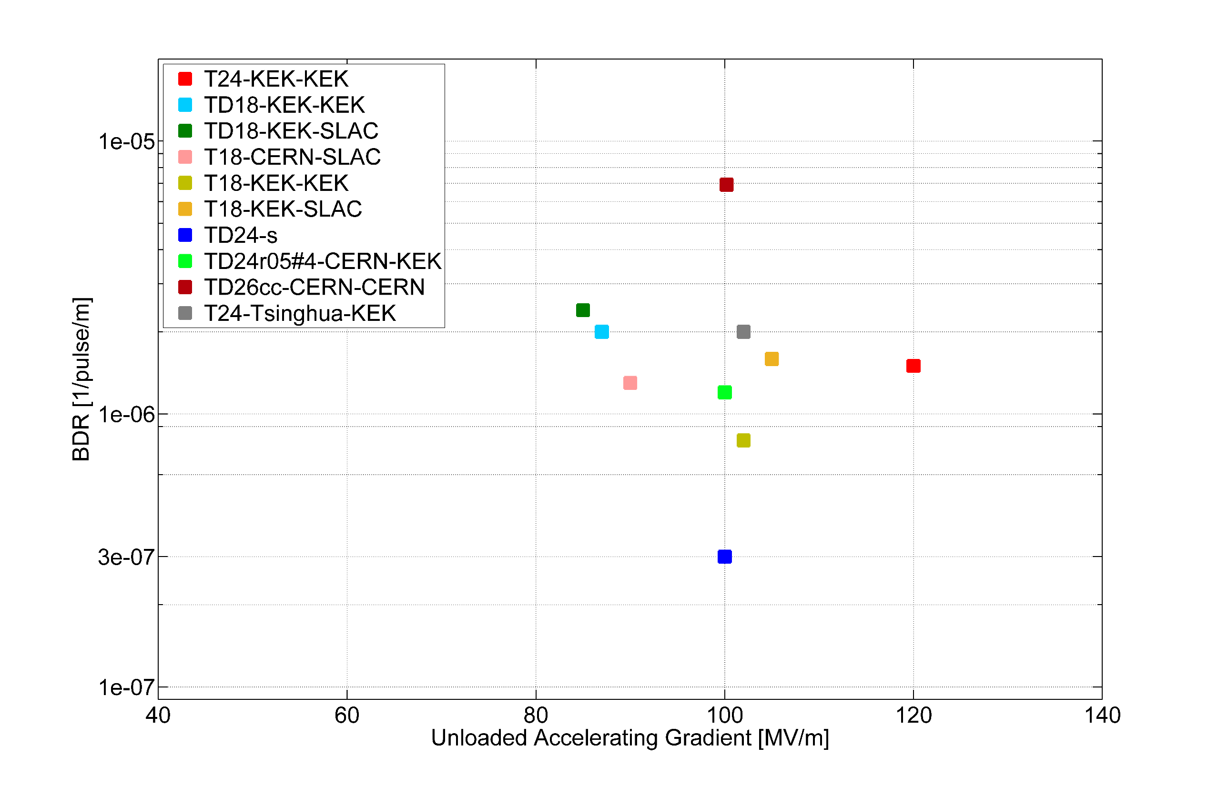

Introduction
Summary of tested CLIC X-band structures
$$BDR∝E_{0}^{30} τ^{5}$$

Slide 5
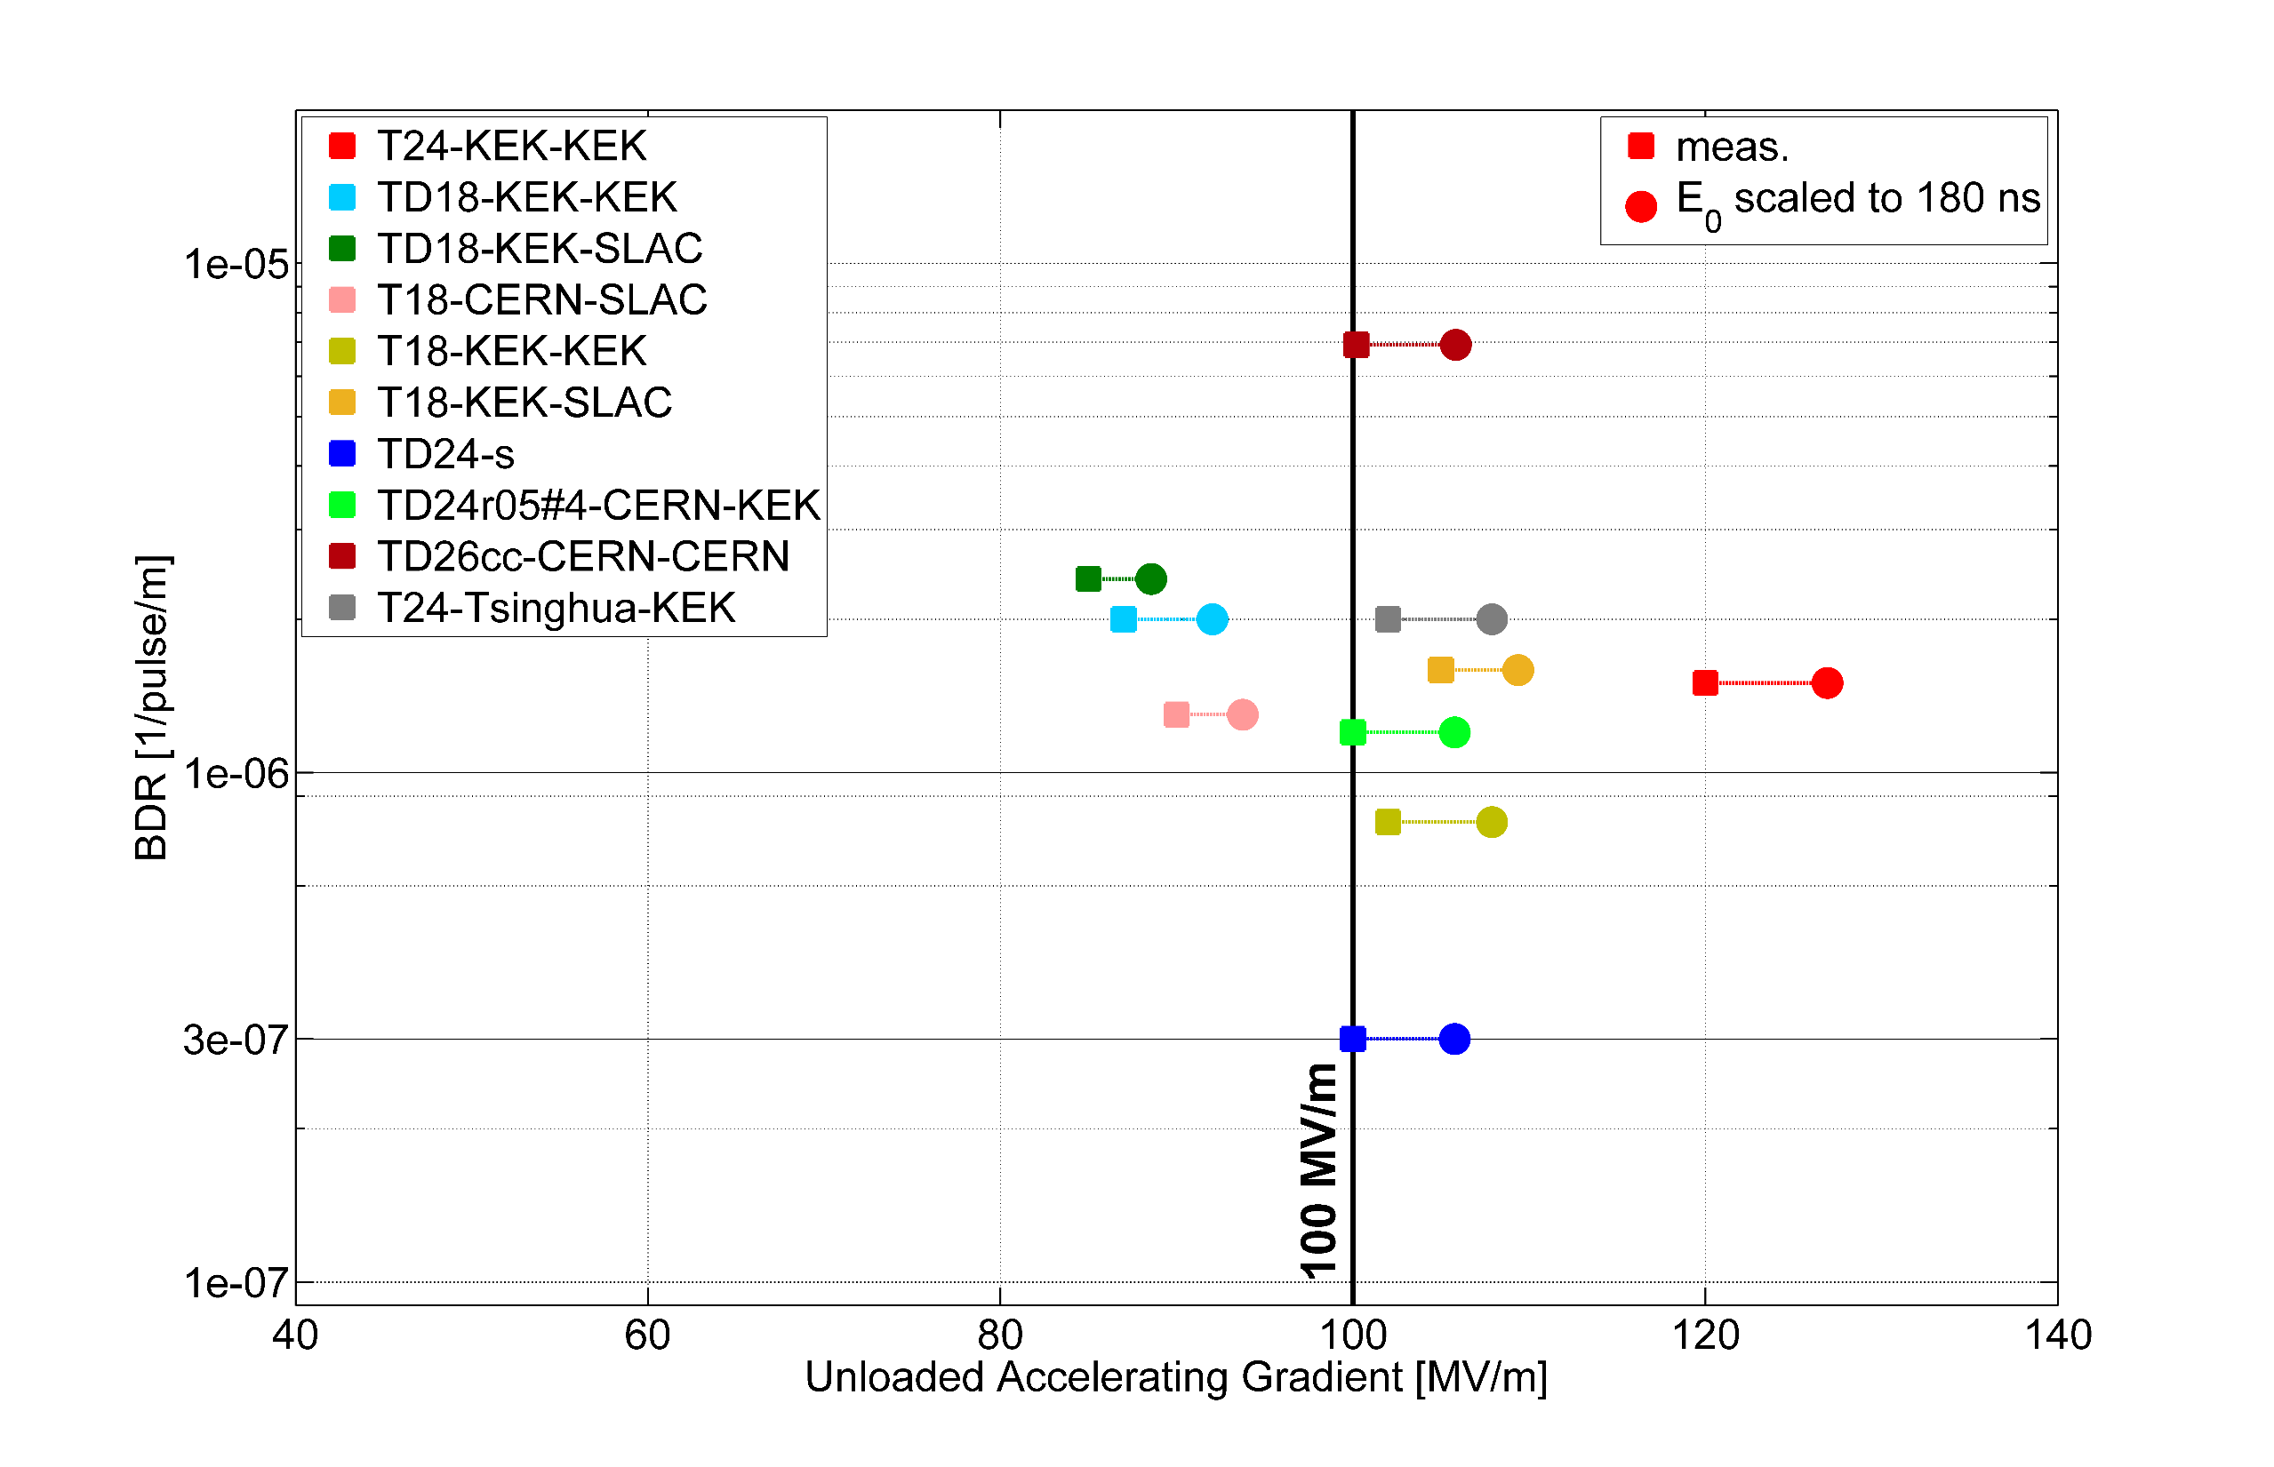

Introduction
Summary of tested CLIC X-band structures
$$BDR∝E_{0}^{30} τ^{5}$$

Slide 6
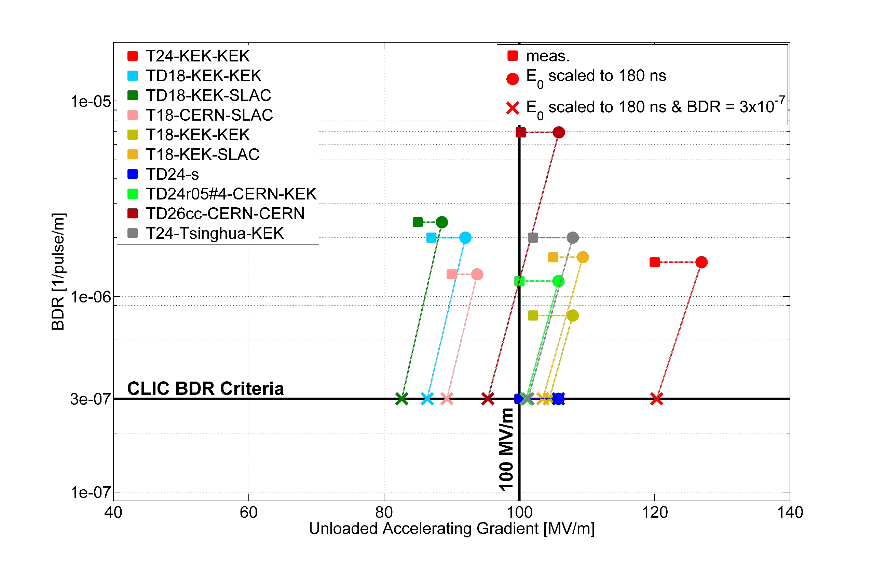

Introduction
Summary of tested CLIC X-band structures
$$BDR∝E_{0}^{30} τ^{5}$$

Slide 7
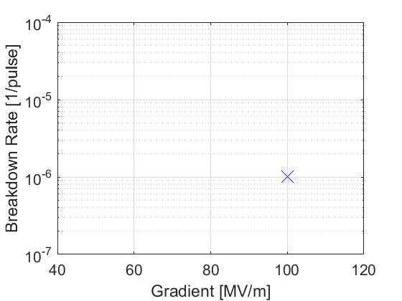
Introduction
What is conditioning?
After accumulating several pulses and breakdowns, the surface better resistance to vacuum arcs at higher electric fields.
Arbitrary algorithm
constant E_{acc}
constant BDR
Why do we study conditioning?
Conditioning is a long process (4-6 months) and therefore the high-power infrastructure implies extra cost. Time consumption needs also to be optimized with the perspective of industrialization of 50km series of accelerating structures.

Slide 8
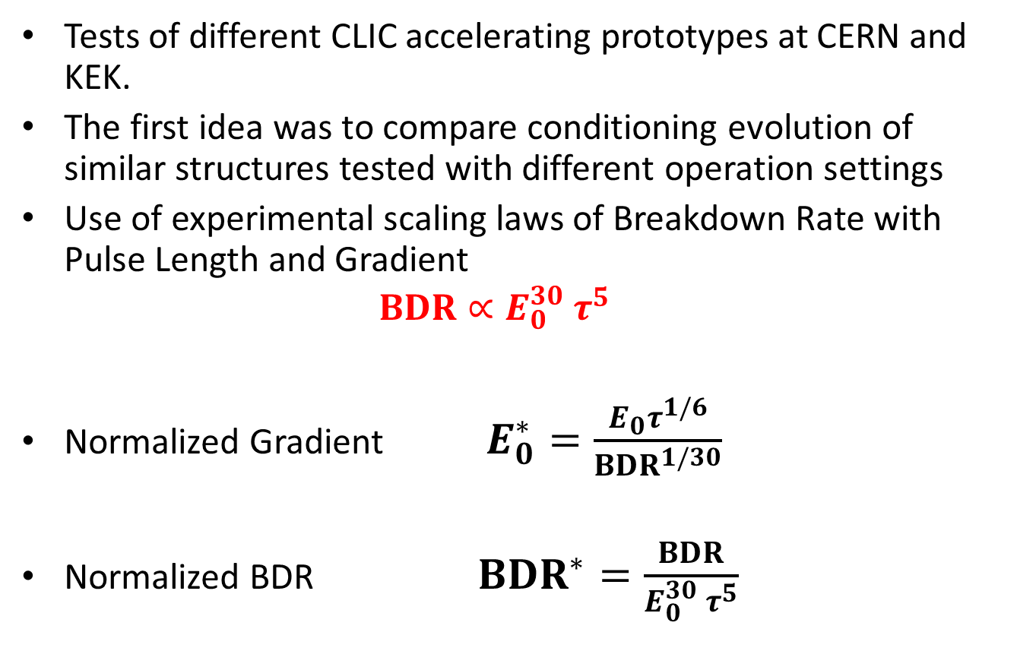
High gradient conditioning
Tests of different CLIC accelerating prototypes at CERN and KEK.
The first idea was to compare conditioning evolution of similar structures tested with different operation settings
Use of experimental scaling laws of Breakdown Rate with Pulse Length and Gradient
  $$BDR∝E_{0}^{30} τ^{5}$$
Normalized Gradient $E_{0}^{∗}=\frac{{E_{0}τ}^{1/6}}{BDR^{1/30}}$
  Normalized BDR $BDR^{∗}=\frac{BDR}{E_{0}^{30} τ^{5}}$

Slide 9
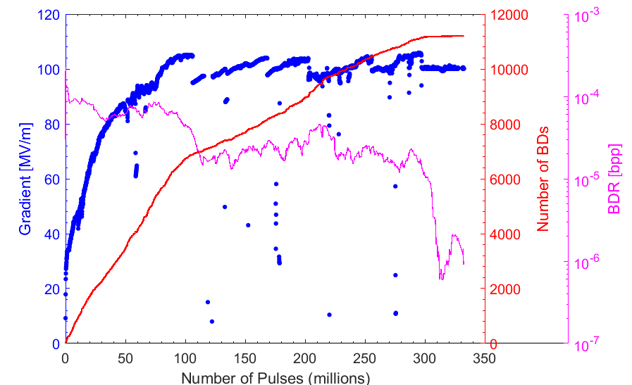

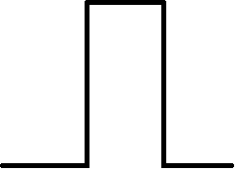



High gradient conditioning
Example of a conditioning history. TD26CC#1 tested in Xbox-1: user-defined pulse length, automated control of gradient at fixed BDR
50ns
100ns
150ns
200ns
250ns

Slide 10
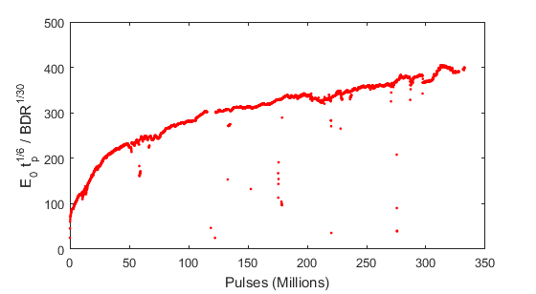
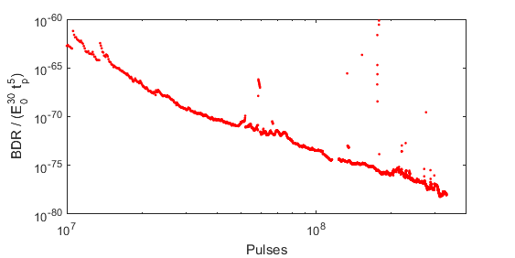
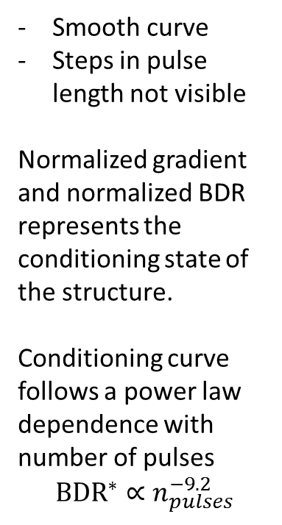
High gradient conditioning
Example of a conditioning history. TD26CC#1 tested in Xbox-1: user-defined pulse length, automated control of gradient at fixed BDR
Normalized Gradient
Smooth curve
Steps in pulse length not visible
Normalized gradient and normalized BDR represents the conditioning state of the structure.
Conditioning curve follows a power law dependence with number of pulses
$${BDR}^{∗}∝n_{pulses}^{−9.2}$$
Normalized BDR

Slide 11
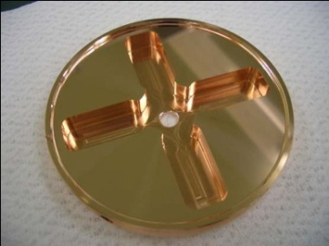
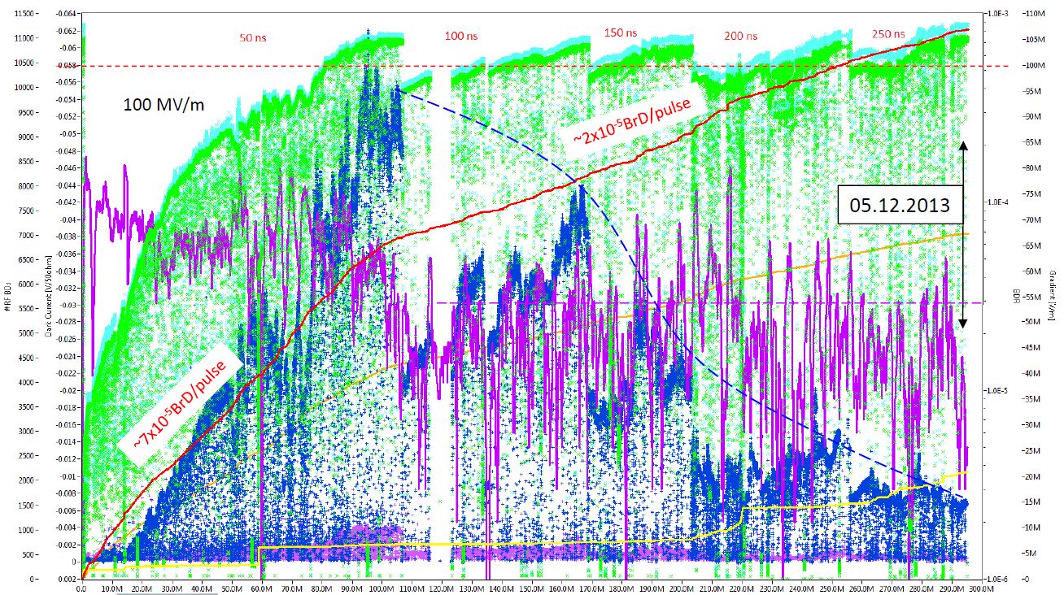
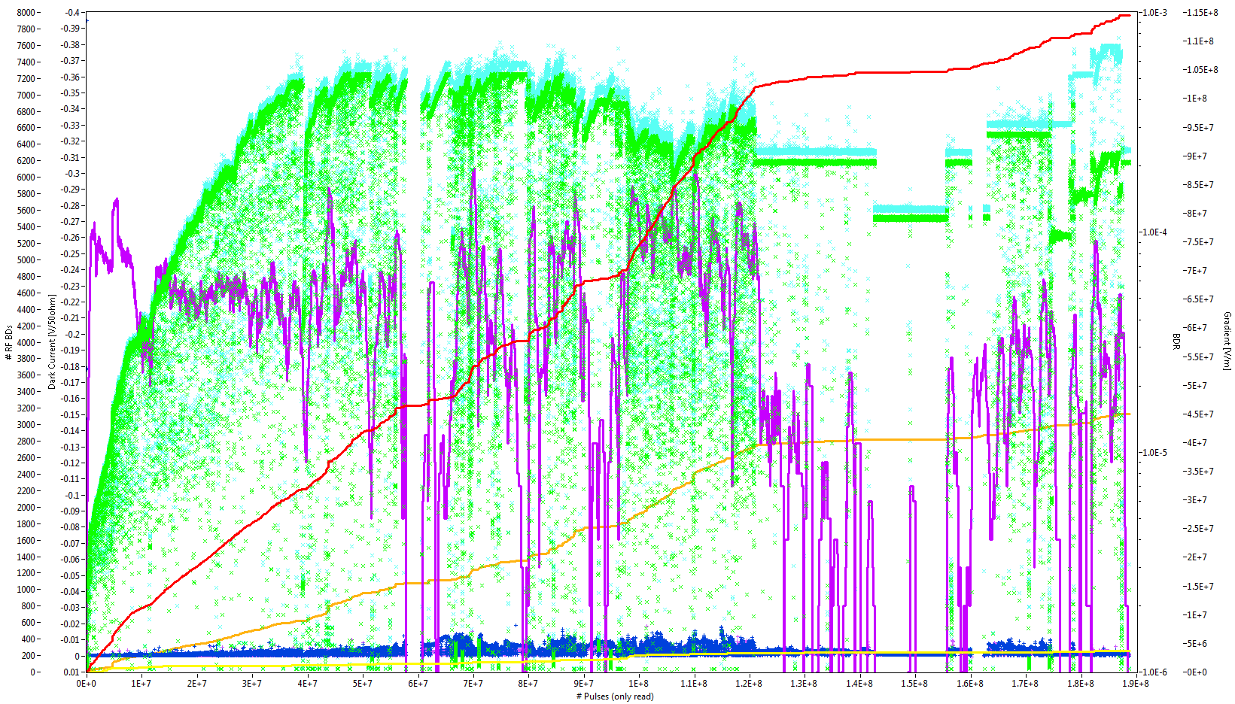
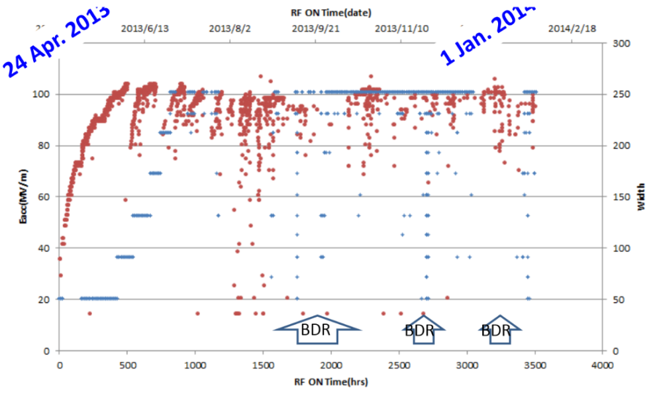
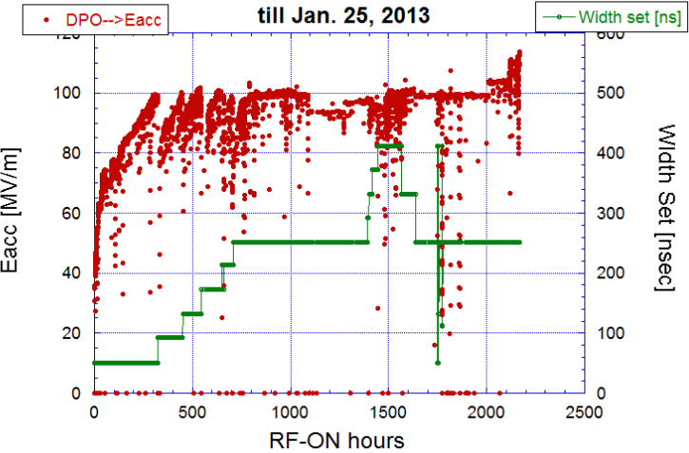
High gradient conditioning
Collection of conditioning histories of CLIC-G prototypes
TD26CC (XBOX-1)
TD24R05 (XBOX-1)
TD24R05#4 (NEXTEF)
TD24R05#2 (NEXTEF)

Slide 12
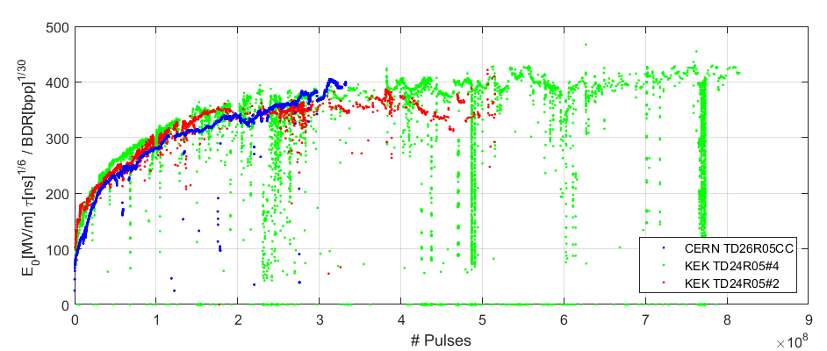
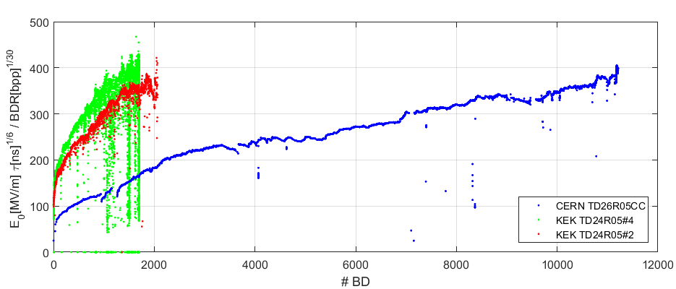


High gradient conditioning
Conditioning to high-gradient is given by the pulses not the breakdowns
$$E_{0}^{∗}$$
RF pulses contribute to surface quality enhancement more than breakdown events (reduction of potential breakdown sites)
Same conditioning speed at different breakdown rates
#Pulses
$$E_{0}^{∗}$$
#BDs
Pub: W. Wuensch et al. Comparison of the conditioning of high gradient accelerating structures. PRAB 19, 032001 (2016)

Slide 13
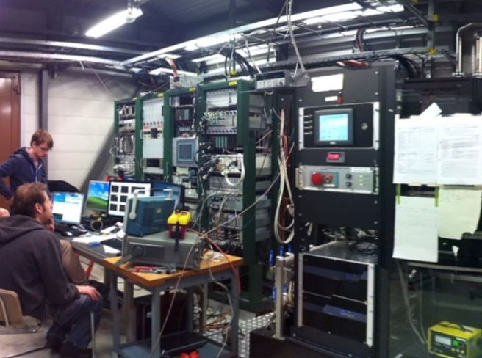
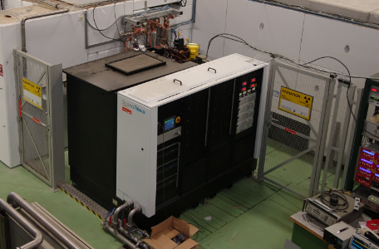
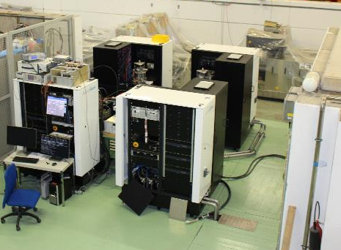
The Xboxes
Xbox-1
Xbox-2
Xbox-3
OPERATIONAL
OPERATIONAL
COMMISSIONING 2016
CPI 50MW 1.5us klystron
Scandinova Modulator
Rep Rate 50Hz
Beam test capabilities
CPI 50MW 1.5us klystron
Scandinova Modulator
Rep Rate 50Hz
4x Toshiba 6MW 5us klystron
4x Scandinova Modulators
Rep Rate 400Hz
Previous tests:
2013 TD24R05 (CTF2)
2013 TD26CC-#1 (CTF2)
2014-15 T24 (Dogleg)
Previous tests:
2014-15 CLIC Crab Cavity
Medium power tests (Xbox-3A):
2015 3D-printed Ti waveguide
2015 X-band RF valve
Ongoing test:
Aug2015- TD26CC-#1 (Dogleg)
Ongoing test:
Sep2015- T24OPEN

Slide 14
1. Test of TD26CC-#1 structure
(Dogleg experiment)

Slide 15
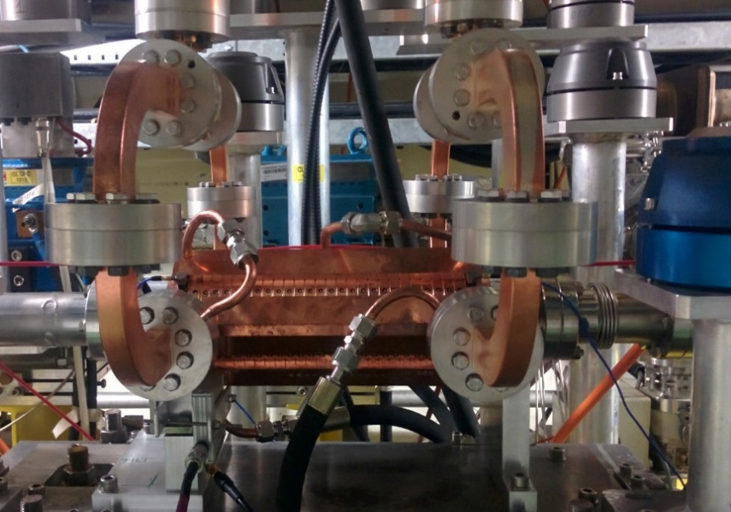
Test of the TD26CC-#1 structure
The structure
The TD26CC-N1 was processed in 2013 by Xbox-1 at CTF2 after a long test of 6 months.
The test at 100 MV/m gradient and 250 ns pulse length showed a breakdown rate of 7e-6 bpp/m.
For CLIC requirements we expected a performance at a maximum gradient of 95 MV/m
TD26CC-N1 installed at the beamline of the CTF3 Linac
This structure was accidentally vented for few weeks at the testing place.
It was re-baken out at 650 deg C and installed again for a new test at the CTF3 Linac for the Dogleg beam-loading experiment.
We found that the structure needed to be reconditioned.

Slide 16
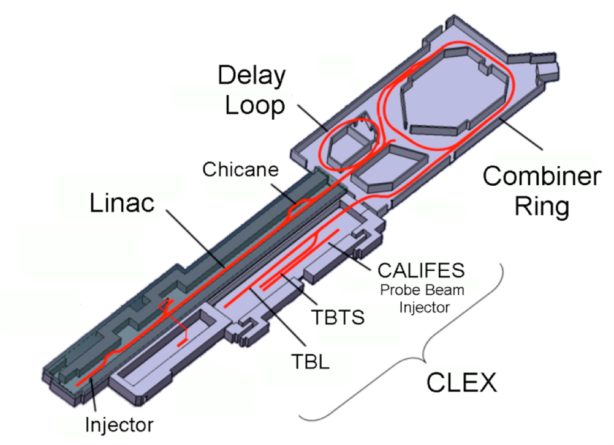
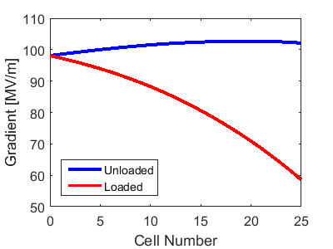
Test of the TD26CC-#1 structure
The Dogleg experiment
Dogleg
12 GHz RF:
90 MW RF power
Up to 50 Hz rep. rate
XBOX1
12 GHz RF
XBox1
CTF3 Injector
Beam:
CTF3 Drive Beam modified
3GHz beam at ~1.2 A
Pulse length up to 250 ns
Energy ~125 MeV at structure
Up to 25 Hz pulse rep. rate
35 m low loss waveguide
MKS02
3 GHz RF
High Gradient Accelerating Structure
MKS03
MKS05
MKS06
MKS07
Gun
Courtesy of Luis Navarro

Slide 17
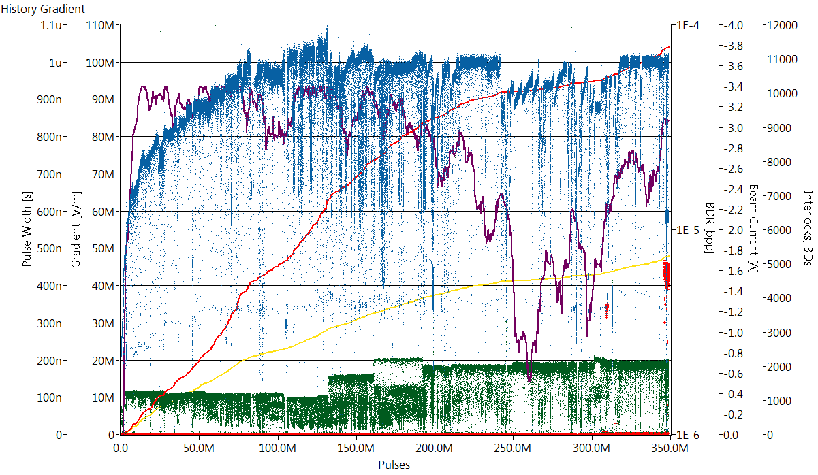
Test of the TD26CC-#1 structure
Full history
348.8 M Pulses
11347 Breakdowns
Pulse length =
100 ns
150 ns
200 ns
180 ns (CLIC pulse shape)
BDR
Gradient
#BDs
Beam Current
#BD-clusters
Pulse length
12/08/2015
07/03/2016

Slide 18
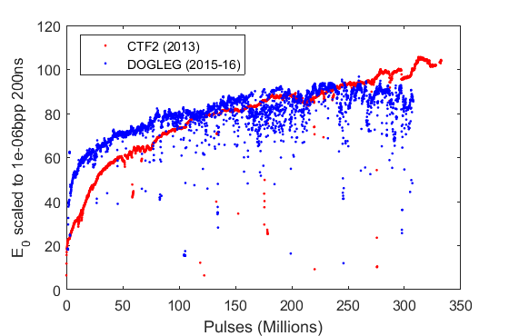
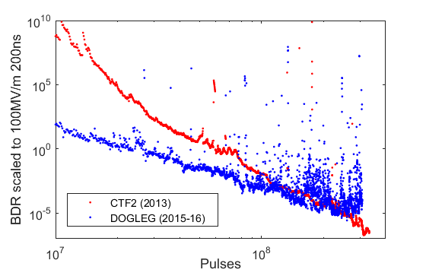
Test of the TD26CC-#1 structure
Current status
Current conditioning (blue) saturating or getting worse, but we do not blame the structure: we have stability problems with the Xbox-1 TWT amplifier which triggers high peak spikes quite often and induces breakdowns in the structure with a high probability.
Comparing to the test at CTF2 in 2013 (red):
After venting and re-bake out the structure started in good conditioning level
The conditioning speed seems much lower and it hasn’t arrived to the best performance despite having triggered the same number of pulses

Slide 19
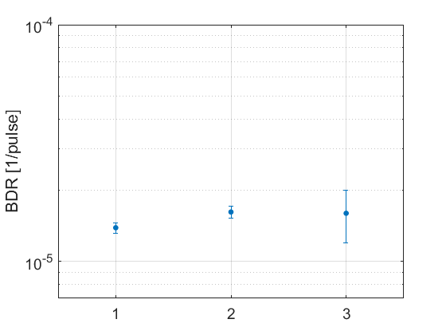



Test of the TD26CC-#1 structure
Beam-loading preliminary results
43.3 MW
100 MV/m
Unloaded
43.3 MW
100 MV/m
Unloaded
43.3 MW
80 MV/m
Loaded
Input Power [MW]
Average Gradient [MV/m]
$$\left(1.6±0.4\right)×{10}^{−5}$$
First Breakdown Rate measurements unloaded and loaded
Still Preliminary! Need of more statistics with beam
$$\left(1.6±0.1\right)×{10}^{−5}$$
$$\left(1.39±0.07\right)×{10}^{−5}$$
Nov´2015
Feb´2016
Mar´2016

Slide 20
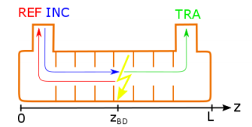
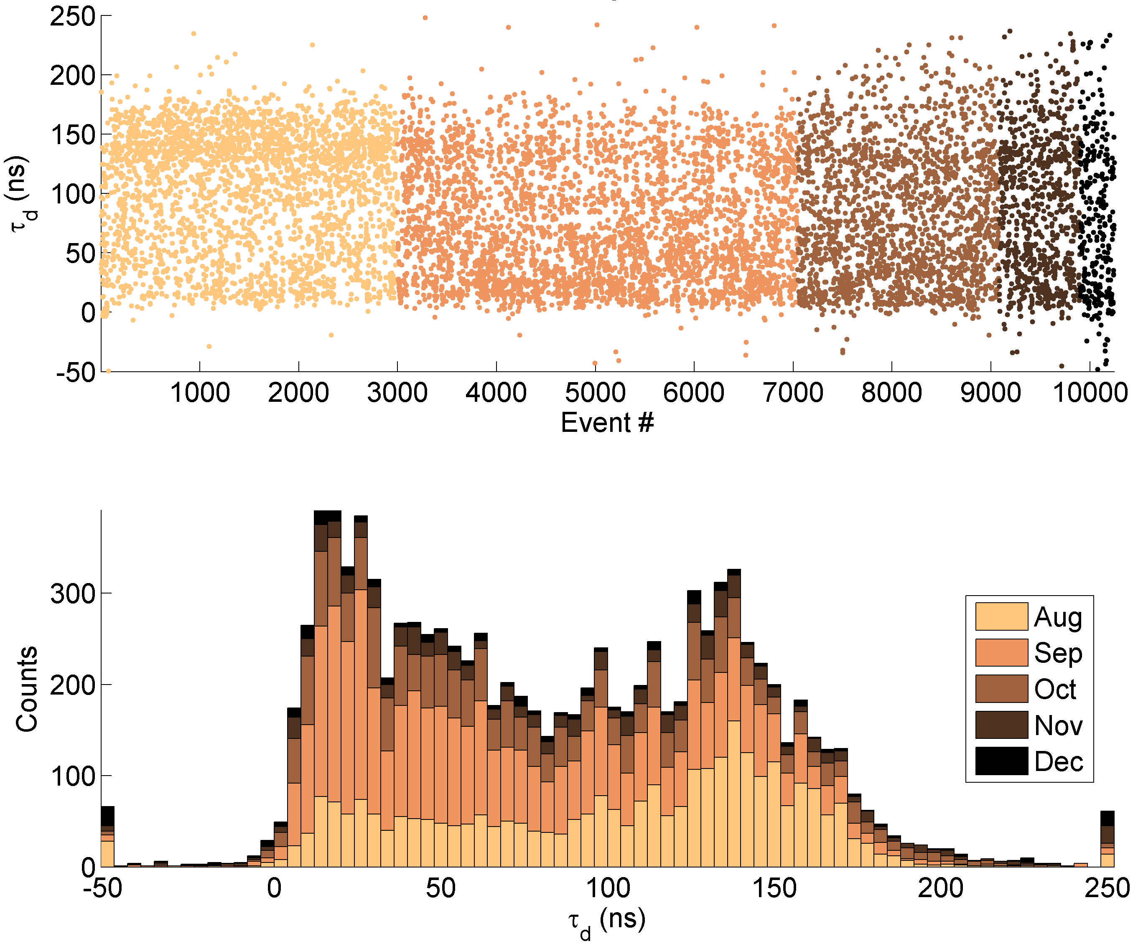
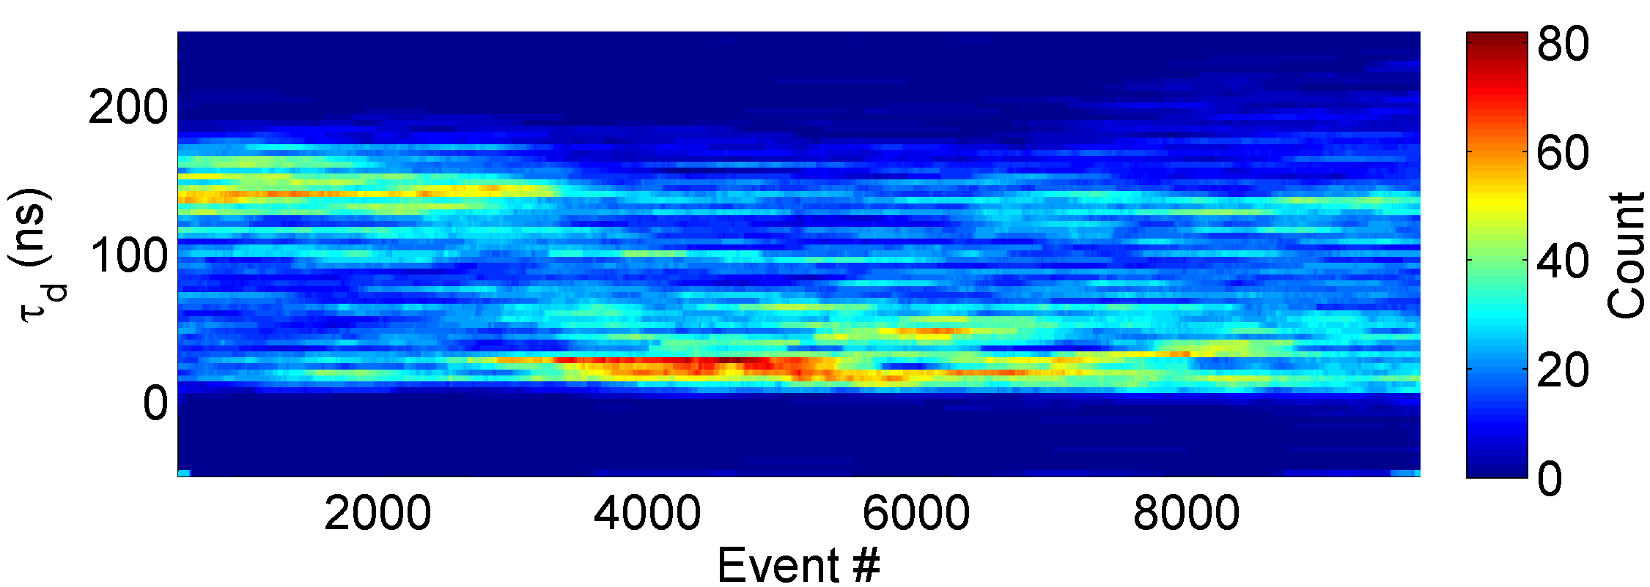
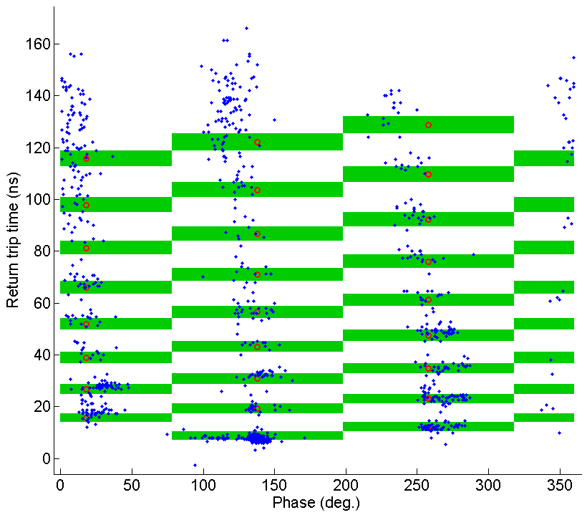
Test of the TD26CC-#1 structure
Breakdown analysis
R. Rajamaki
First we started to see more breakdowns at the end of the structure. Later, they concentrated at the beginning of the structure.
Now they seem to distribute uniformly along the structure.
The combination of timing and phase information provides better accuracy in breakdown localization.
Aug
Sep
Oct
Nov
Dec
In the structure

Slide 21
2. Test of T24OPEN structure

Slide 22
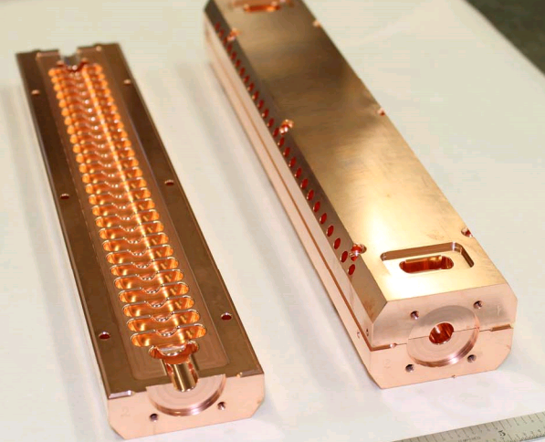
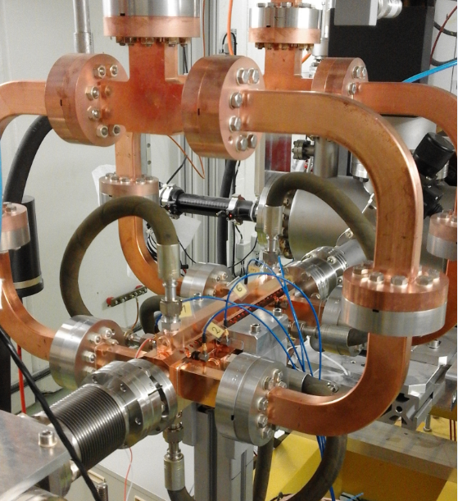
Test of the T24OPEN structure
CLIC-G “open”prototype built in halves and brazed in SLAC:
24 regular cells (20cm-long) and no HOM damping
Milled structures present high interest because of its multiple advantages: costs, materials, treatment…
T24OPEN installed in Xbox-2
A. Grudiev, H. Zha, V. Dolgashev
The T24OPEN structure was installed in Xbox-2 and started running on 04/09/2015

Slide 23
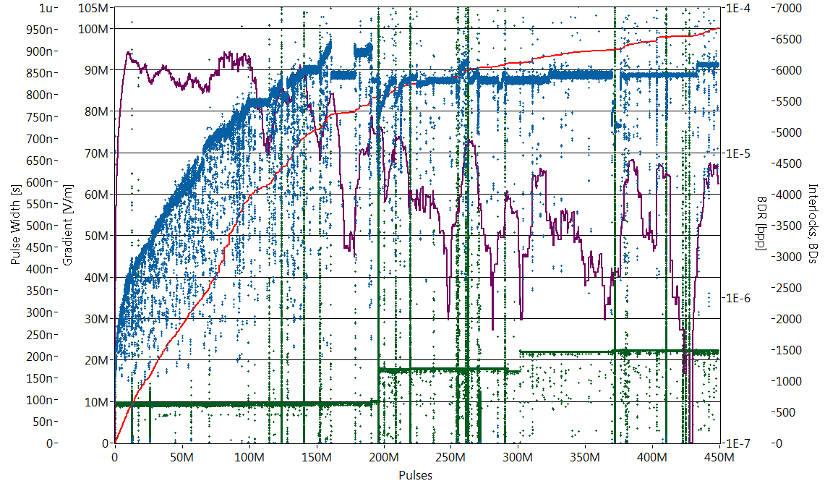
Test of the T24OPEN structure
Full history
75 ns
155 ns
200 ns
200 ns
BDR
Gradient
#BDs
Pulse width
04/09/2015
449M Pulses
6662 Breakdowns
15/03/2016

Slide 24
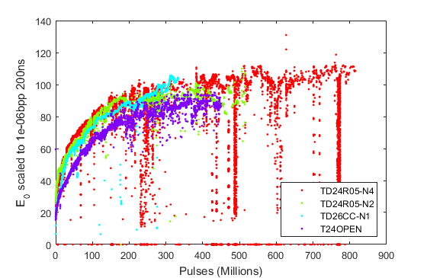
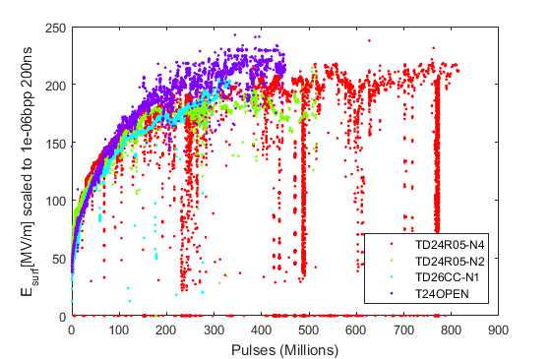
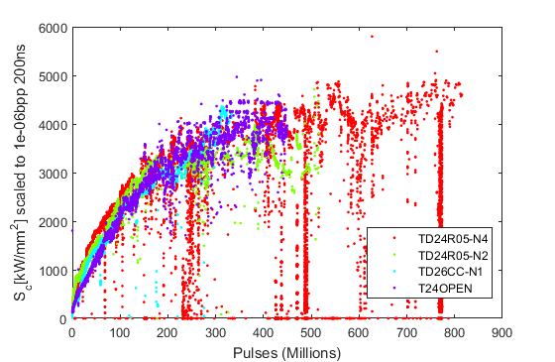
Test of the T24OPEN structure
Conditioning history
Surface electric field E_{surf}~BDR^{1/30} t_{pulse}^{-1/6}
Gradient
Unlike other CLIC designs, the T24OPEN presents 20% higher surface E fields and S_{c} for the same gradient, but lower surface H fields, and this is observed in the conditioning curves.
E_{surf} rises faster in time and S_{c} fits better with conditioning curves of previous tests.
Modified Poynting vector S_{c}~BDR^{1/15} t_{pulse}^{-1/3}

Slide 25
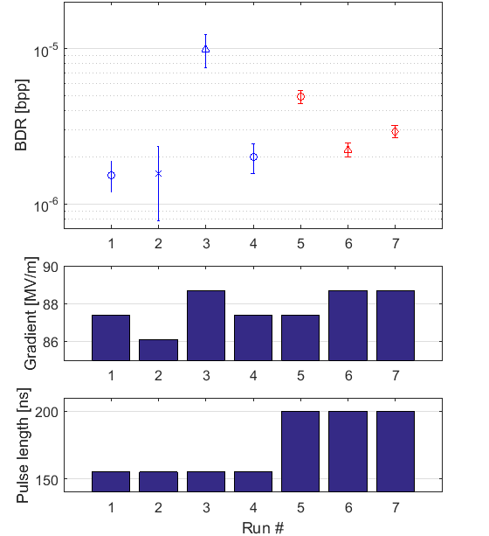
Test of the T24OPEN structure
Current status
We performed BDR measurement at different gradient levels and pulse lengths.
No power laws dependences were found because structure was still conditioning!
88.7
88.7
88.7
87.4
MV/m
87.4
87.4
86.1
155 ns
200 ns

Slide 26
Test of the T24OPEN structure
Current status
Using Pulse Compressor
Using directly Klystron Output power
Question: Breakdown Rate dependence on Pulse shape?
No conclusive results yet

Slide 27
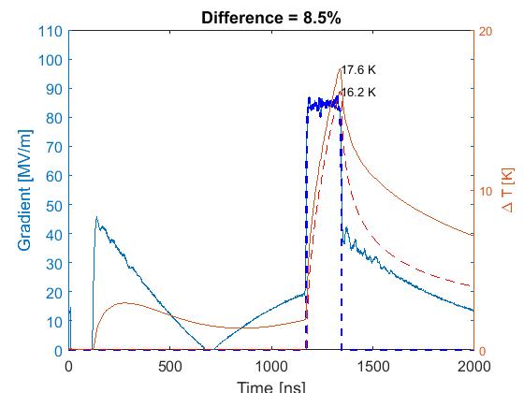
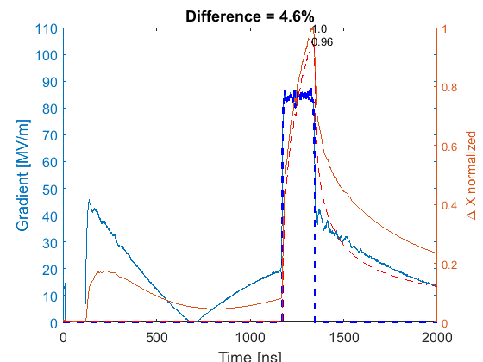
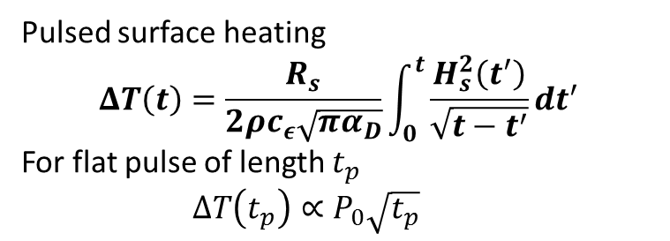
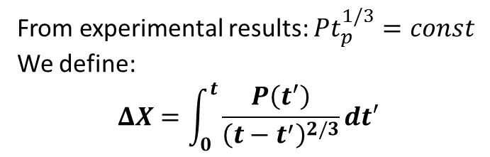
Test of the T24OPEN structure
Breakdown Rate dependence on pulse shape
Pulsed surface heating
$$ΔT\left(t\right)=\frac{R_{s}}{2ρc_{ε}\sqrt{πα_{D}}}\int_{0}^{t}{\frac{H_{s}^{2}\left(t^{′}\right)}{\sqrt{t−t^{′}}}}dt^{′}$$
For flat pulse of length $t_{p}$
  $${ΔT\left(t_{p}\right)∝P}_{0}\sqrt{t_{p}}$$
From experimental results: $Pt_{p}^{1/3}=const$
We define:
$$ΔX=\int_{0}^{t}{\frac{P\left(t^{′}\right)}{{\left(t−t^{′}\right)}^{2/3}}dt′}$$
dX increases +4.6% with
pulse compressor
Solid= with pulse compressor
Dashed= without pulse compressor
Solid= with pulse compressor
Dashed= without pulse compressor
dT increases +8.5% with
pulse compressor
87.5 MV/m → 91 MV/m (+4.2%)
87.5 MV/m → 89.5 MV/m (+2.2%)

Slide 28
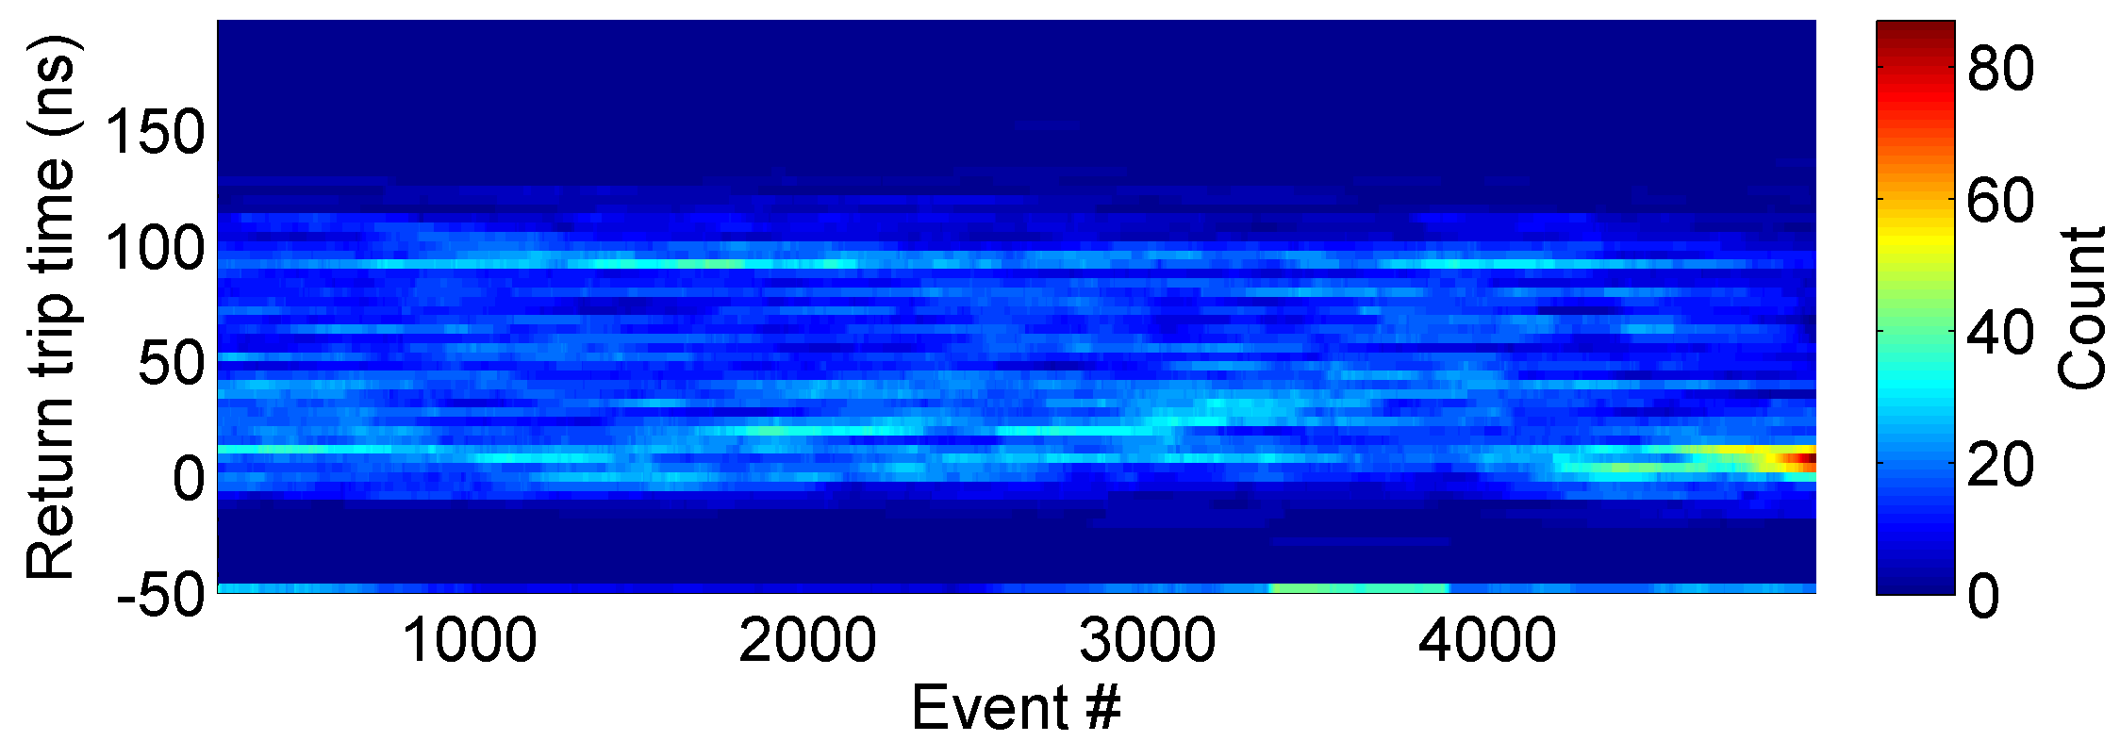
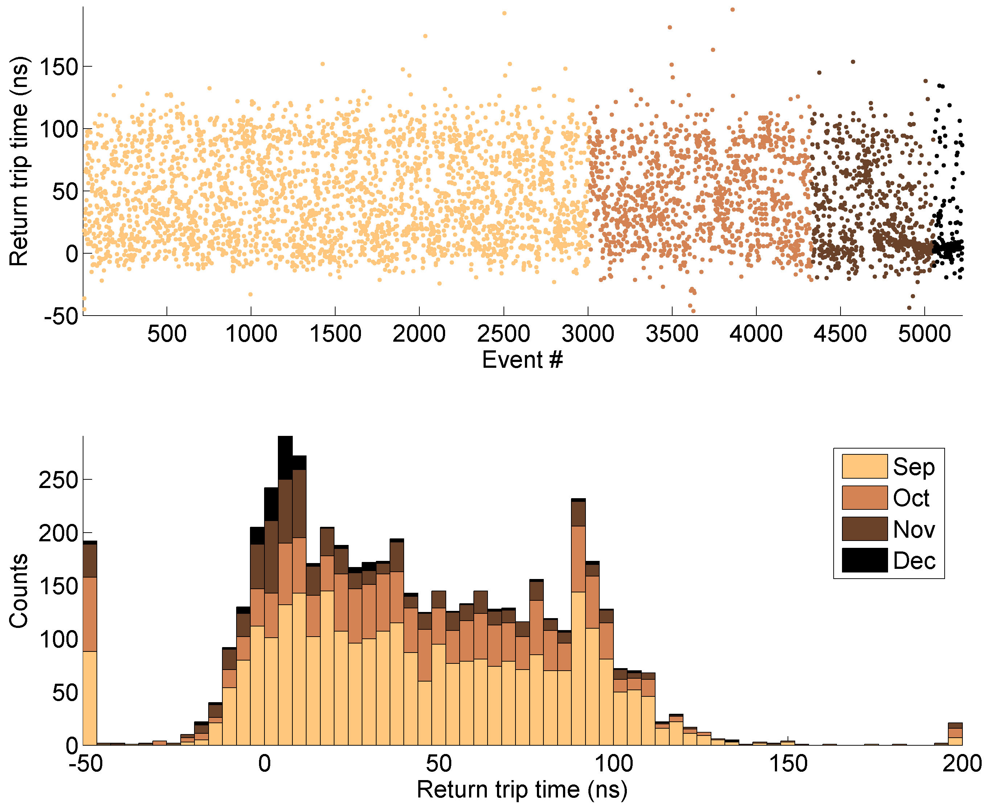
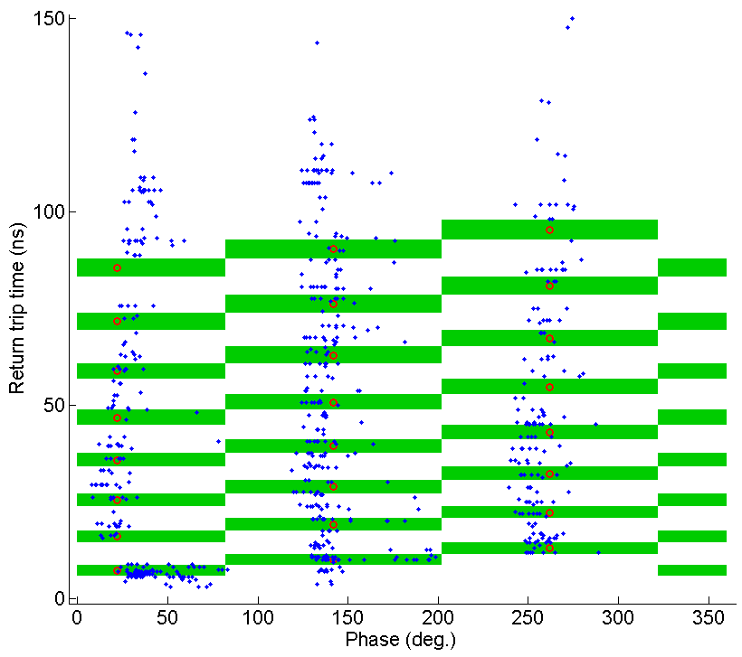
Test of the T24OPEN structure
Breakdown analysis
R. Rajamaki
Good performance of the structure regarding the uniform distribution of breakdowns, until the last month of operation when it started to become hotter in the front.
Sep
Oct
Nov
Dec
In the structure

Slide 29

Test of the T24OPEN structure
Conditioning history
Gradient
Normalized BDR also decreases following a power law at a similar conditioning speed, meaning that follows the same mechanism as seen in disk-based structures

Slide 30

Summary
T24OPEN
(Xbox-2)
TD26CC-N1
(Xbox-1)

Slide 31
3. Test of CRAB cavity

Slide 32


Test of the CRAB cavity
The structure
Property | CLIC T24 (unloaded) | LCLS deflector | CLIC Crab (un-damped)
Input Power | 37.2 MW | 20 MW | 13.35 MW
Transverse Kick | - | 24 MV | 2.55 MV
Peak surf. E-field | 219 MV/m | 115 MV/m | 88.8 MV/m
Peak surf. H-field | 410 kA/m | 405 kA/m | 292 kA/m
Peak Sc | 3.4 MW/mm² | - | 1.83 MW/mm²
Group Velocity | 1.8-0.9%c | -3.2%c | -2.9%c
# Cells | 24 | 117 | 12
Designed to tilt the bunch before the interaction point at in order to improve CLIC luminosity.
Particular interest due to the surface field distribution and possible correlation with breakdowns.
Tested in Xbox-2 from October 2014 to May 2015.

Slide 33

Test of the CRAB cavity
Full history
51 MW
100ns
3E-5bpp
Reference. B. Woolley, Ph.D. Thesis, Lancaster University (2015)
43 MW
200ns
3E-6bpp
Es=154 MV/m
Hs=505 kA/m
Sc=5.48 MW/mm2
Nominal operation
13.35MW 200ns
Esurf=88.8 MV/m

Slide 34



Test of the CRAB cavity
Conditioning histories
Surface electric field E_{surf}~BDR^{1/30} t_{pulse}^{-1/6}
Modified Poynting vector S_{c}~BDR^{1/15} t_{pulse}^{-1/3}
Normalized Breakdown Rate
The structure has reached higher levels of Sc, but surface E field were lower.
Breakdown rate seem to decrease with similar rate than other CLIC accelerating structures.

Slide 35





Test of the CRAB cavity
Breakdown analysis and BDR Scaling laws
B.Woolley, Ph.D. Thesis, Lancaster U. (2015)
BDR$∝P^{14.9±4.9}$
@120 ns FWHM
Surface fields decays exponentially from input to output (constant impedance structure).
Good performance over nominal operation.
BDR measurements consistent with other tests
Post-mortem SEM analysis presented on Wednesday by E.Rodriguez-Castro and B.Woolley
BDR$∝t_{pulse}^{3.6±0.3}$
@43 MW

Slide 36


Summary
CRAB cavity
CRAB cavity
In terms of peak surface E field and peak Modified Poynting vector

Slide 37
Summary
The CERN contribution of the CLIC High-Gradient testing programme is now at the level of two high-power test stands operating at the same time. The third is on commissioning
Re-condition of TD26CC-N1 is ongoing: good performance but still below the status in 2013.
First measurements of BDR with beam-loading. Preliminary results shows similar performance at the same input power.
New prototype T24OPEN is being tested in Xbox-2: good performance so far and still being processed.
Trying to measure BDR dependence on pulse shape (with and without pulse compressor).
Comparison of conditioning histories supports the modified Poynting vector as a limiting quantity.

Slide 38
Thank you for your attention

