Slide 1

Revision of Beam Permit process
Small team: Marc (BE DSO), Marzia (EN-MEF), Joachim (RP), Rende (OP & CSAP), James (SPS), Jose (PS)
+ Karel (OP & CSAP), Stefan (RP)
Mandate: Review BP basic template ←
Define more precisely the limits (for OP)
Define suspension and cancelation procedures
+ New way to manage them (EDMS)

Slide 2
Reminder : Issues
Issues with the template:
Some Groups did not like what they had to sign; did not understand or disagreed about their responsibilities.
Real issues: Some safety aspects might stay in a grey area !
Issue with the paper template:
  Commuting and possible delay in signature
  OP must check the paper every time they want to send beam
→ Do we want to link more solidly the effective possibility to send beam with the BP process ?

Slide 3
Status so far
Agreement about the texts to be signed in the B.P.
Decision to manage the B.P. via EDMS, not on paper. Comments will be entered in EDMS
Decision to introduce a Powering Permit for all machines,
Decoupled → Simplified B.P.

Slide 4
Status so far
Decision to better define the limits of each B.P.
Decision to implement a “solid” way to have these limits respected.
→ The DSO team will check and validate the consignation of the upstream and downstream EIS-b, and approve the de-consignation.
Decision to tag the “safety keys” on the console to better identify the beam facilities where the BP is canceled or suspended.

Slide 5
Decision for this YETS 2015-2016
All Beam Permits will be cancelled as soon as the faculties stop.
EIS-b will be condemned in agreement between OP and the DSO (according to QA procedure EDMS 1211886)
DSO tests will be done in 2016 at the start. (According to the work of the IRWG, the DSO tests will be entered in the planning.)

Slide 6
Still to be done…
Define with the EDMS team how to “suspend” B.P. (Cancellation is easier and clearer.)
Create all B.P. on EDMS (context…)
Develop the Powering Permits for all facilities.
Find a proper and clear way to tag the “safety keys” of SPS and LHC islets.

Slide 7
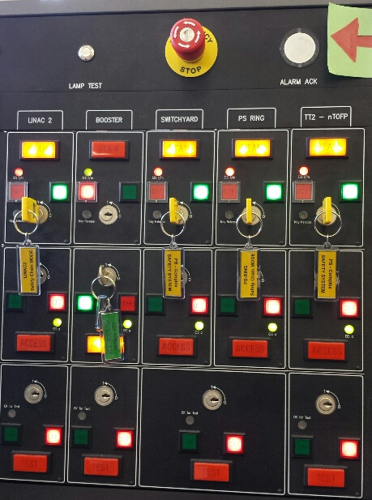
Example of key tag @ the PS islet:

