Slide 1
Final Report – Injector Re-Commissioning Working Group (IRWG)
Working group to find strategy for more efficient start-up of injectors and associated facilities after long stops
V. Kain, B. Mikulec, members of IRWG

Slide 2
Introduction
Chamonix ‘14: rocky injector start-up after LS1
Injector Re-commissioning Working Group was put in place by the IEFC to ensure more efficient start-up after the next long shutdown
Members of each machine/facility (often shifters) and EN/MEF worked together for a year to come up with “new/different” strategy for the re-commissioning after long stops
  2 members per machine/facility
  LINACs, SPS, PS, PSB, ISOLDE, LEIR, AD, experimental areas
  Also had input from the LHC
  EN/MEF: thanks!!!
Meetings in indico: https://indico.cern.ch/category/6174/

Slide 3
Main proposed improvements
Preparation of check lists
  Skeleton prepared by working group
  Each machine fills in check list
    Polarity checks will become obligatory. Convention to be established OP
1 (or 2) person per machine/facility in OP responsible for machine preparation
  Re-commissioning Coordinators
Start testing earlier
  With equipment experts in dry runs: “full” vertical slices with “all” interfaces

Slide 4
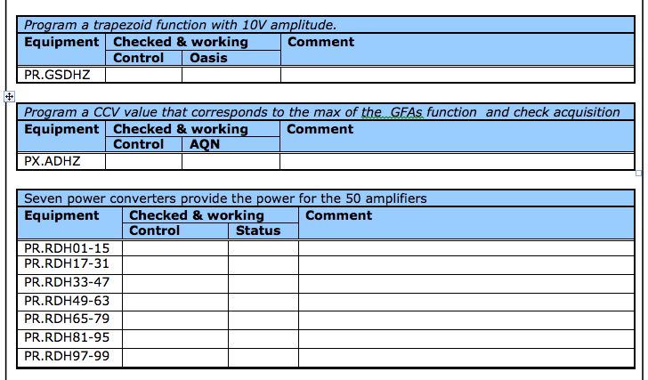
Status of check lists
Work in progress
To be finished with the end of the YETS 2015-16
Example from PS check list

Slide 5
Re-commissioning Coordinator
At the heart of the OP machine preparation: re-commissioning coordinator(s)
    Role definition: EDMS 1540465; distinction from MEF super-intendant defined
    Summary:
Contact person for EN/MEF before and during shutdown
Follow all modifications/activities during shutdown
  And prepare the testing period accordingly
Establish planning of dry runs with equipment experts and EN/MEF
  Dry runs/ machine tests will be part of the MEF planning
During hardware tests: organize daily coordination meetings to plan activities of the day
Check lists: ensure completeness of check list before each machine preparation; track evolution of tests during machine preparation period

Slide 6
Re-commissioning Coordinators
LINACs: D. Kuchler
PSB: A. Akroh & B. Mikulec
ISOLDE: M. Lozano Benito & J. A. Rodriguez Rodriguez
PS: M. Delrieux & O.Hans
AD: B. Lefort
LEIR: J. Axensalva
SPS: S. Cettour-Cave & J. Ridewood

Slide 7
A propos: Start to test earlier
When to re-commission
Machine Preparation: tests, dry runs
Beam
tests from control room with operational interfaces as early as possible
collaboration of experts and OP:
  provide ideal testing environment
extra coordination effort: re-commissioning coordinator
end result:
  big upgrades less risky
  equipment better prepared, better tuned, better integrated
In the schedule
Shutdown
Hardware Tests
Checkout
Beam
Access
Restricted Access
No Access foreseen
Responsible
EN/MEF
OP
time

Slide 8
Feedback from equipment groups
Better testing environment and coordination to guarantee better testing environment:
  Very welcome
Planning will have to be established early enough before shutdown
  Impact on infrastructure readiness can be big

Slide 9
Open issue from last IEFC status report
How to deal with modifications?: upgrades instead of downgrades
  controls interfaces (e.g. FESA classes) for equipment
How to guarantee that all requirements are still fulfilled after “upgrade”?
  Fulfills all hardware specifications
  Fulfills all operational requirements
  Fulfills controls standard
Solution: new proposal from CO3 committee:
  Prepare “controls change request document”
  One part to be written by equipment expert
  One part to be written by controls expert
  One part to be written by OP

Slide 10
Summary and final remarks
The IRWG had a mandate for a year and has used this time to propose a different (better) re-commissioning strategy for the injectors (proposal also for experimental area, but not enforced)
  check lists
  re-commissioning coordinators
  be proactive: OP starts testing earlier and helps equipment teams to have optimum test environments
The challenge now will be to finish check lists, define typical test order per machine and help re-commissioning coordinators to grow into their roles.
The IRWG has come to an end
From next year onwards: regular re-commissioning coordinator meetings

Slide 11


