Slide 1





Solid State Physics and
Perturbed Angular Correlations at ISOLDE new tools, new ideas, new people
Juliana Schell
Universität des Saarlandes -> Universität Duisburg Essen & ISOLDE-CERN

Slide 2
SSP and OF RADIOACTIVE BEAMS
EXOTIC
Presenting a review of today’s offer at:
Nuclear physics and Astrophysics
  Material’s science
    Bio-physics
      Life sciences
    What is WORKING and NEW...
      What is USEFUL and ... USABLE
        Who are the USERS ...
          Where ...
... aiming to work better in 10 – 15 years !

Slide 3
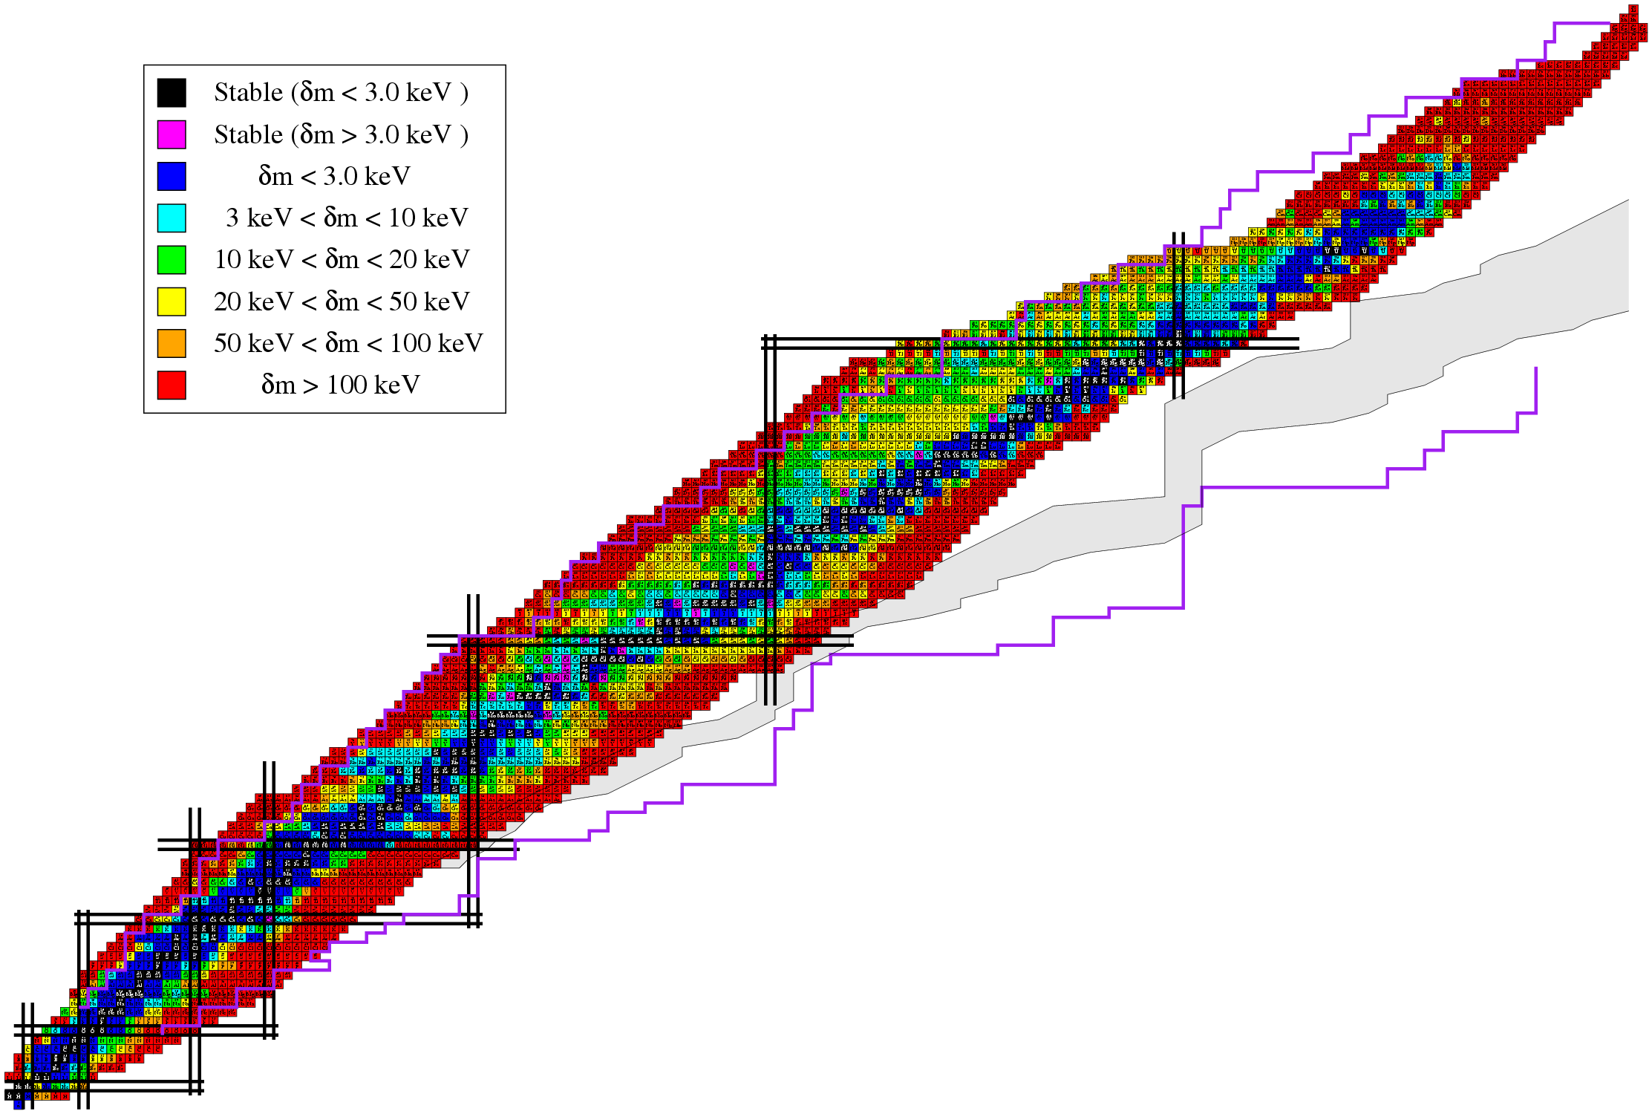
KEY Features for Sustainability of RIB Applications
ADVANTAGES ➔ SENSITIVITY / TRACEABILITY:
Very low concentrations of radioactive impurity atoms in materials, surfaces or interfaces can be detected or followed, e.g., in a body.
SUSTAINABILITY !!!!!!
...Yes but under conditions ...
Originality & Uniqueness of Science output
Large panoply of Elements and isotopes
Variety, Intensity and Purity
! CONCENTRATION OF EFFORTS !
ADVANTAGES ➔ ELEMENT SELECTIVITY:
Element transmutation due to radioactive
decay add chemical selectivity to “classical”
spectroscopy techniques, e.g.,
photoluminescence, resistivity,
deep level transient
spectroscopy...
PRODUCTION / AVAILABILITY
Variety, Intensity and Purity
of elements and isotopes
ADVANTAGES ➔ NANOSCOPIC SCALE INFORMATION:
Hyperfine interactions (ME, PAC, β-NMR)
local information on magnetic and electric neighborhood
e-, β-,β+, α Emission Channeling
direct and precise lattice site location.
pick the right isotope to have TUNEABLE RANGE OF ENERGY DEPOSITION :
Different isotopes and decay particles can adapt to tumor or tumor cell killing.

Slide 4
ISOL (ISOLDE EURISOL)
IN-FLIGHT (FAIR)
Isotope Separator
ON-Line
In-Flight:
Extraction
system
driver-beam
GAS CATCHER
Solid, liquid
Thin target
Thick HOT ISOL target
Isotope Separator ON-LINE – ISOL:
Such an instrument is essentially a target, ion source and an electromagnetic mass analyzer coupled in series. The apparatus is aid to be on-line when the material analyzed is directly the target of a nuclear bombardment, where reaction products of interest formed during the irradiation are slowed down and stopped in the system.
H. Ravn and B.Allardyce, 1989, Treatise on heavy ion science

Slide 5
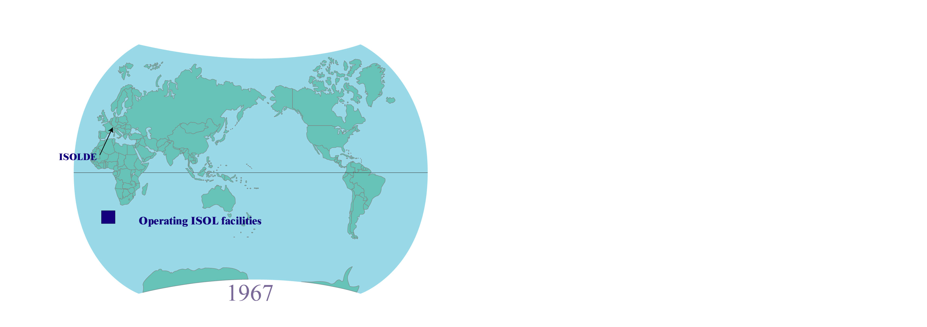
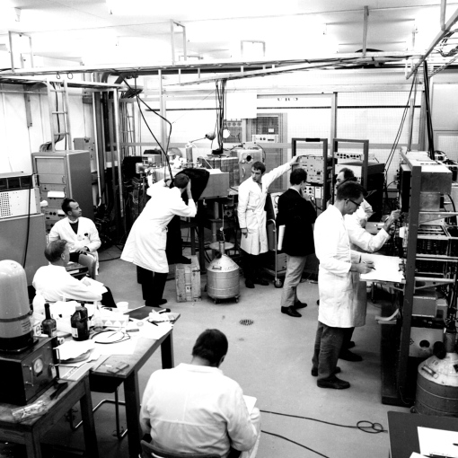
Isotope Separator On-Line
ISOL - facilities 1967

Slide 6
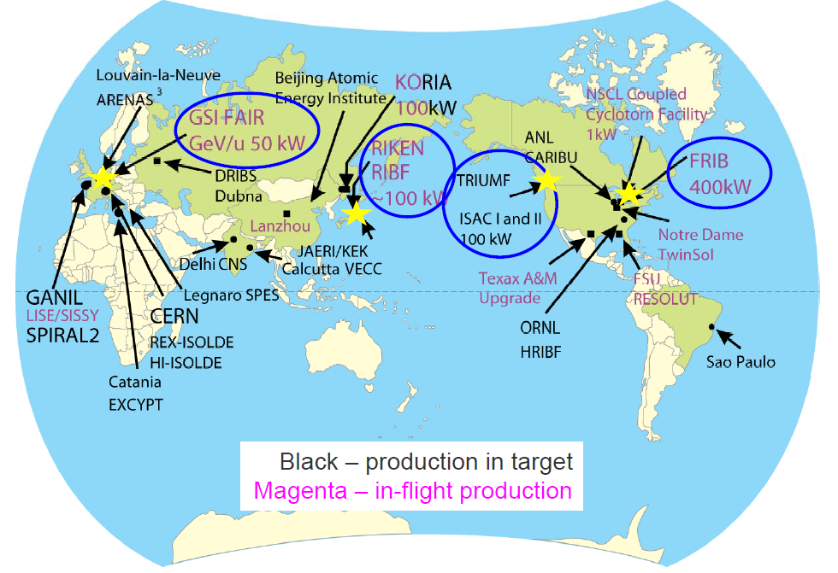

Radioactive Ion Beam – facilities Worldwide
2013
Existing and in preparation
CERN / ISOLDE
REX-ISOLDE
HIE-ISOLDE
ISOL type
In-Flight type
6
ISOLDE: CERN’s longest running facility
After B. Sherill

Slide 7
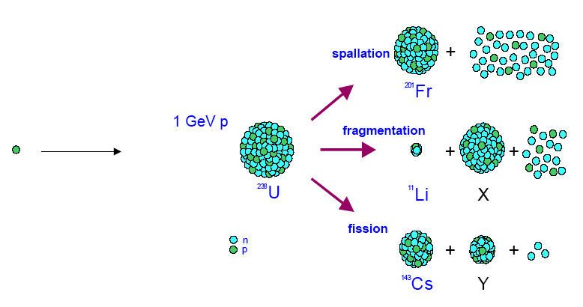
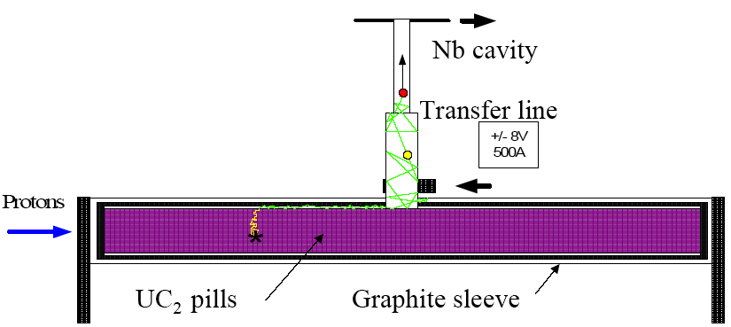
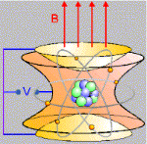
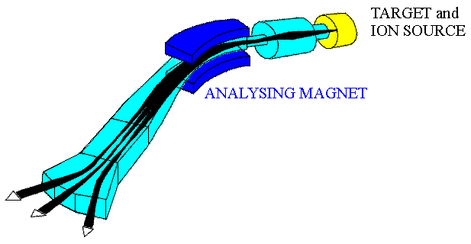

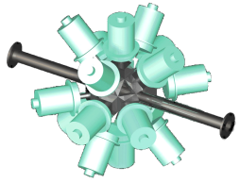
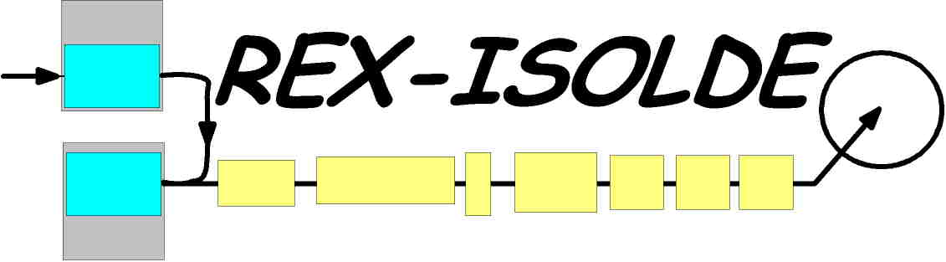
The ISOL Process
Production
Extraction/Ionization
Ionization
Effusion
Isotope Separation
Post acceleration
or Experiment
ISOLTRAP
Q/A
Fast, Efficient, Universal and Selective!

Slide 8
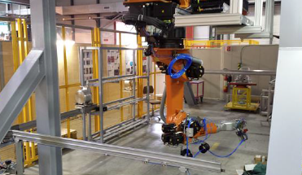
Target handling
Ion energy: 20-60keV
target
Target+ vacuum+ extraction
robots

Slide 9
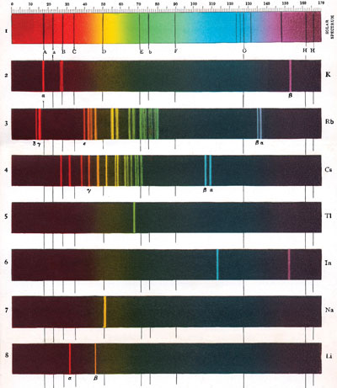
The atomic line spectra are the element’s fingerprint
RILIS (Resonant Ionisation Laser Ion Source)

Slide 10
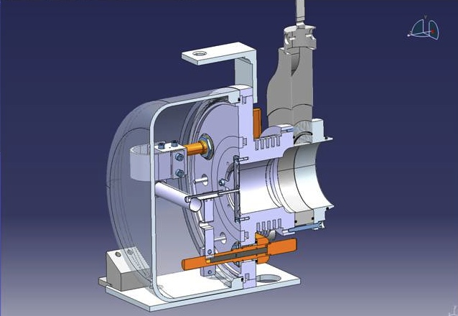
RILIS LASERS
> 20 m optical path
3 mm diameter ion source
Proton beam
from PSB
~10 cm
<author>
6/30/2016

Slide 11
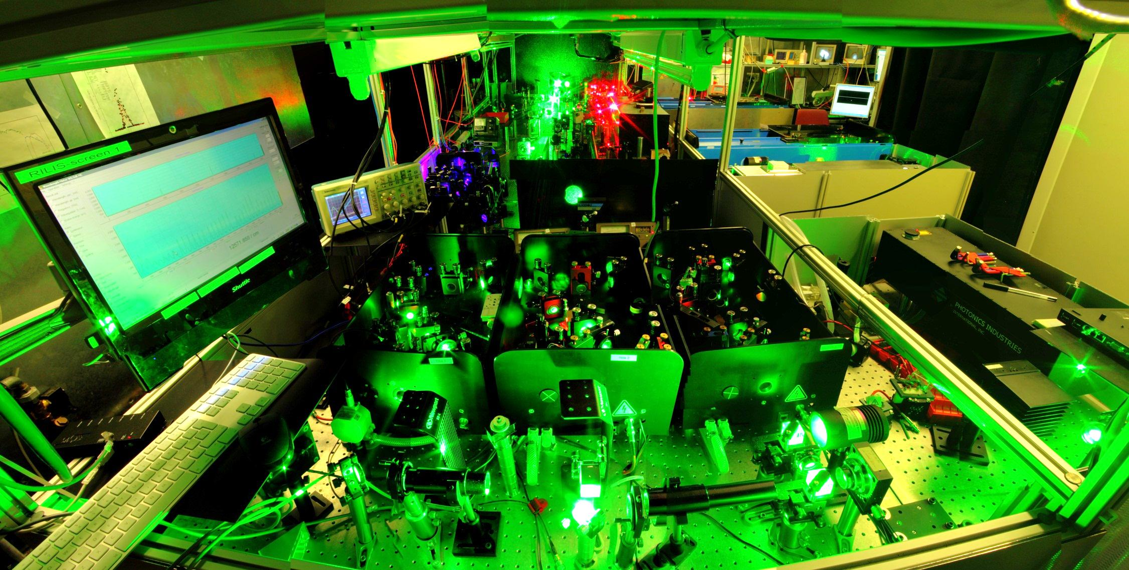
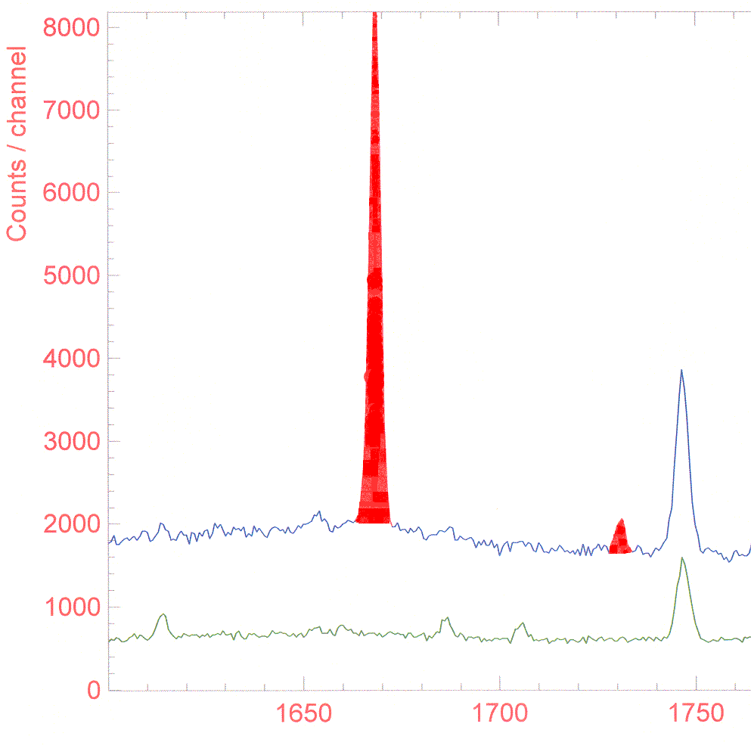
RILIS in action
Laser Cd ionization
Laser ON
¹³⁰Cd (T_{½}=0.2 s)
1669 keV
1732 keV
Gammas singles
¹³⁰Sb
1749keV
T½=39.5 m
¹³⁰Sb
1749 keV
Laser OFF
Energy [keV]
Energy (keV)

Slide 12
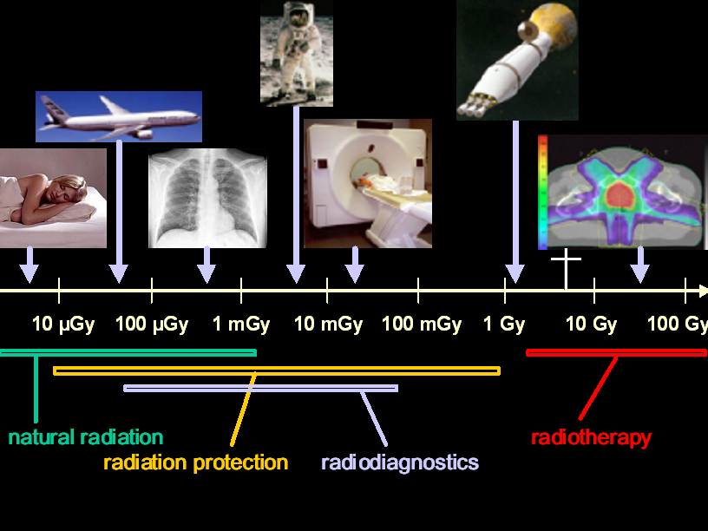
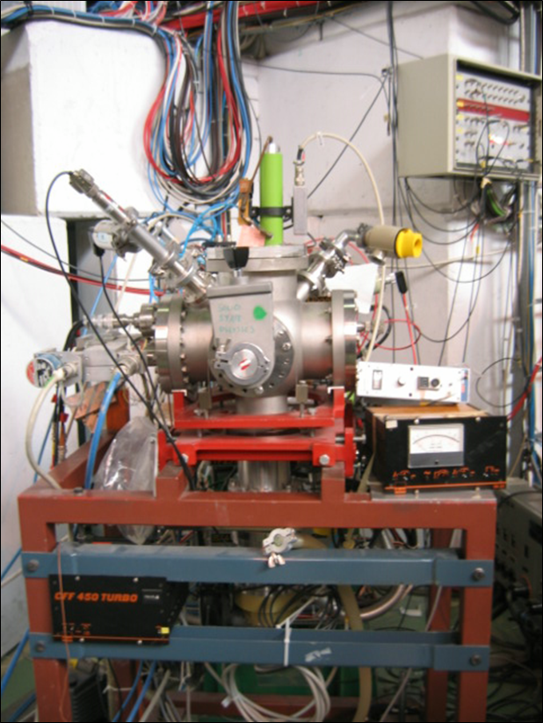
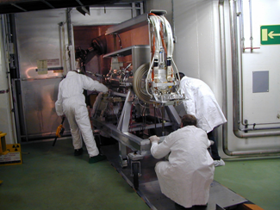
public
6 mSv/y – B workers
20 mSv/y – A workers
ISOLDE USERS
ISOLDE Personnel
μSv
μSv
mSv
mSv
mSv
Sv
Sv
Sv
1 Gy = 1 J/Kg leads to a temperature increase of only 2.4 .10⁻⁴ ºC

Slide 13
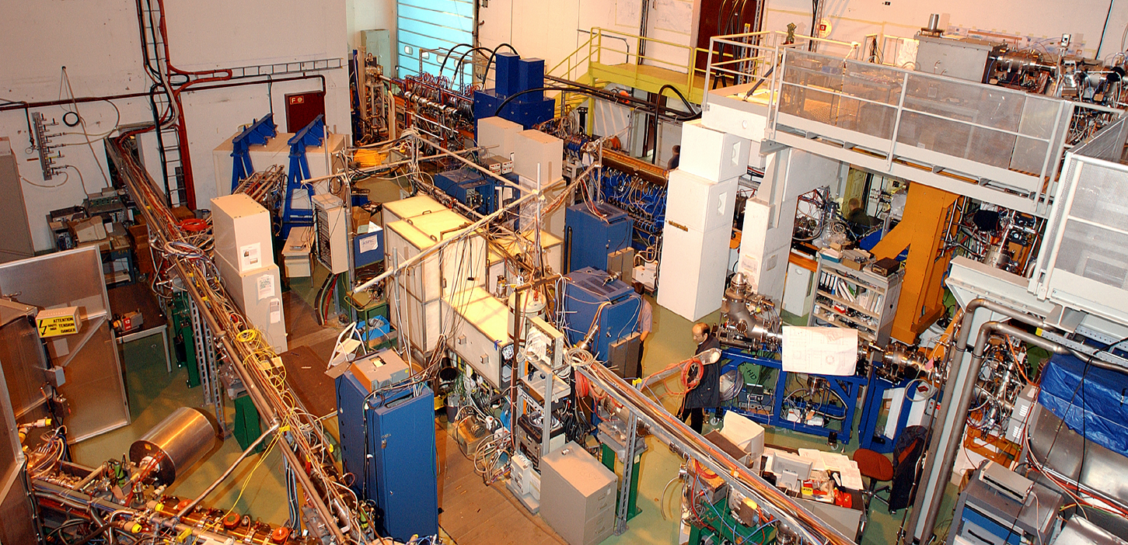
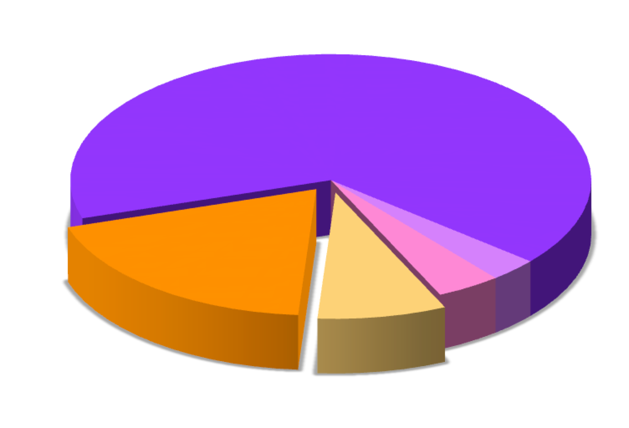
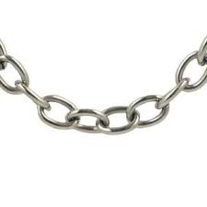
Beam time pie
Beam ti
2015
37 Experiments
300 Users
96 Institutes
22 Countries
235 8h-shifts of radioactive beams
Nuclear physics from
ground state properties
65%
Material’s
Science
19%
Biophysics and
Medicine
8%
3%
4%
Fundamental Interactions
Nuclear Astrophysics 4%
Linked activities
Universities
Research Institutes
Hospitals

Slide 14
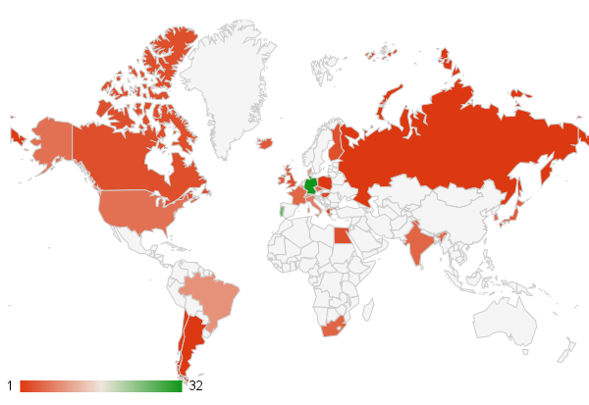
SSP @ ISOLDE: Diverse community
Running experiments/letters of intent | 24
Participating countries | 26
Scientists | 160

Slide 15
Current and PROSPECTIVE Work using EXOTIC Radioactive isotopes
➔ THINKING Materials and Molecular Properties ⬅
dealing with mass, electromagnetism, many body systems and scaling
Atomic-like information is the aim !
➔ Semiconductor Physics (Si, Oxides, organic compounds)
➔ Multi- ferroic- magnetic
➔ Nanomaterials (geometry, downsizing and integration)
➔ Surfaces and interfaces (bulk properties are modified)
➔ Soft matter : graphen,
➔ Bio / Molecular chemistry and physics
➔ THINKING Life Sciences ⬅
optimizing delivering and range of deposition of highly concentration of energy upon radioactive decay into the living body or cell of interest.
Enlarging the choices of radioisotopes is the aim !
➔ NEW isotopes and decay modes for diagnosis and treatments.

Slide 16
RECENT DEVELOPMENTS
Material’s Science Applications
a commitment for the future based on facts !

Slide 17
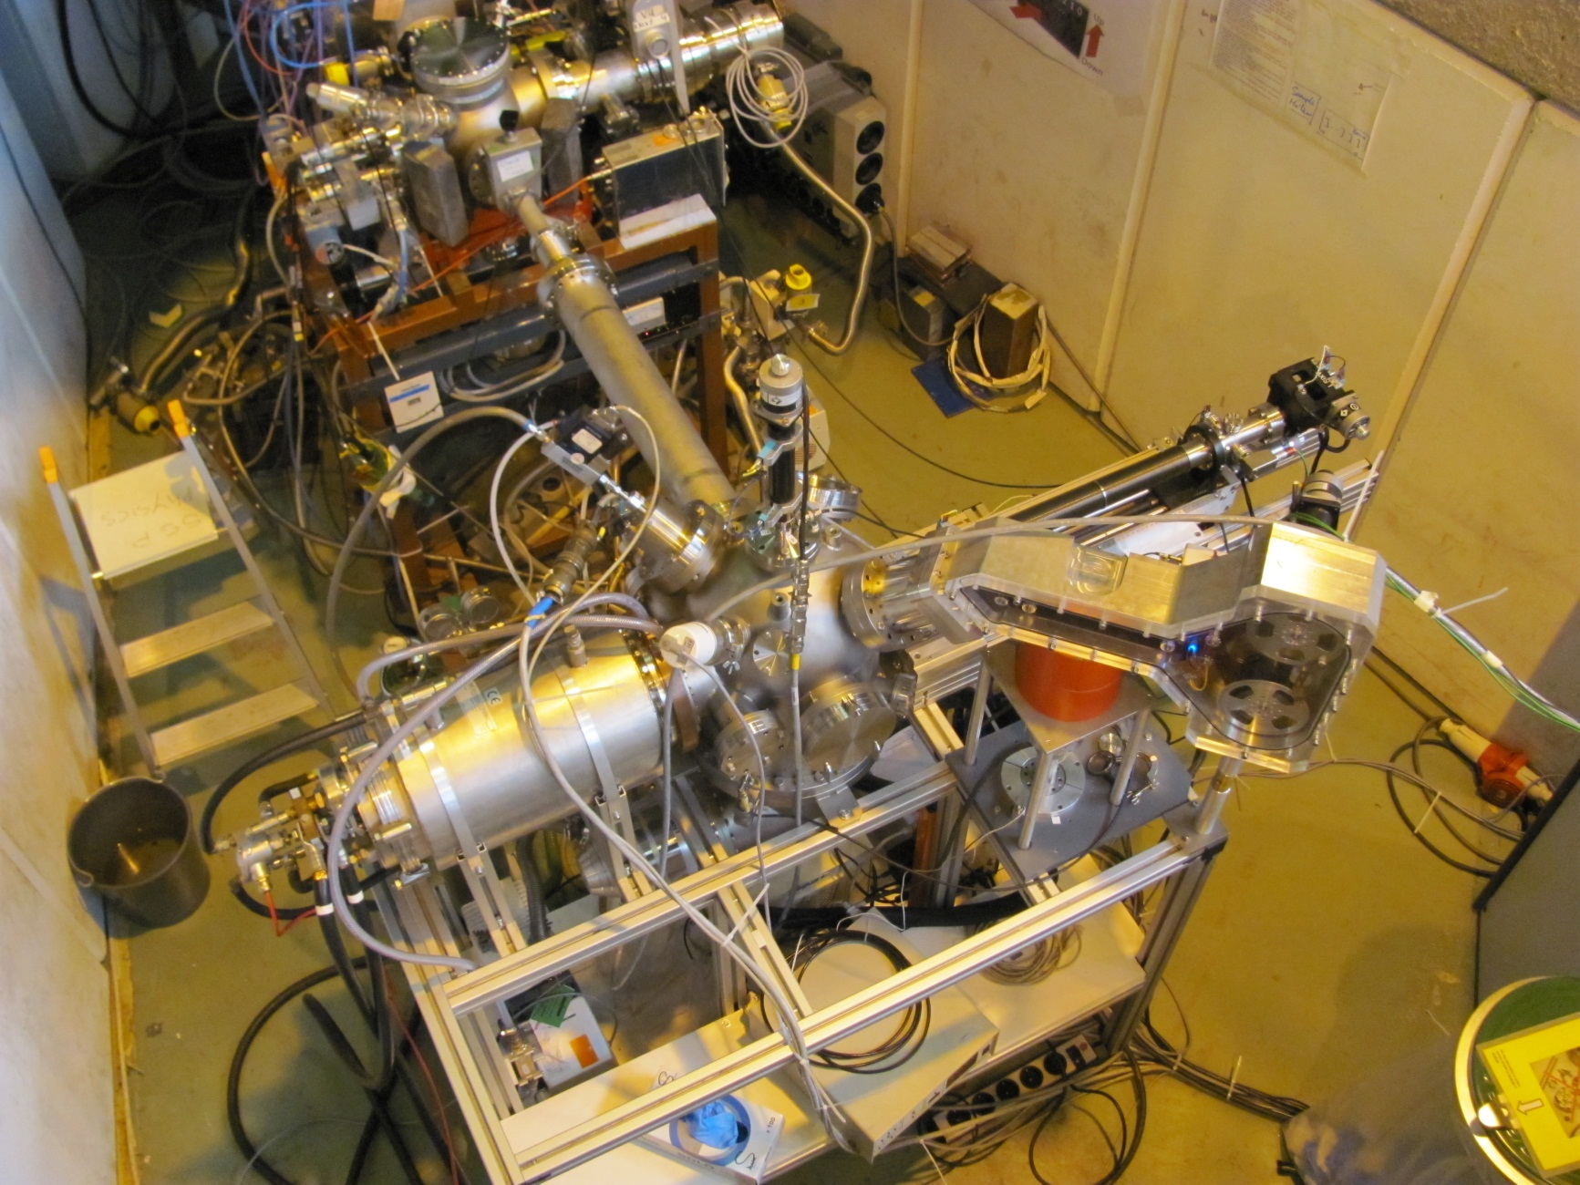
On-line diffusion chamber at ISOLDE
2011
ISOLDE beam
Manipulator
Sputter gun
Tape station
Furnace
Ge detector

Slide 18

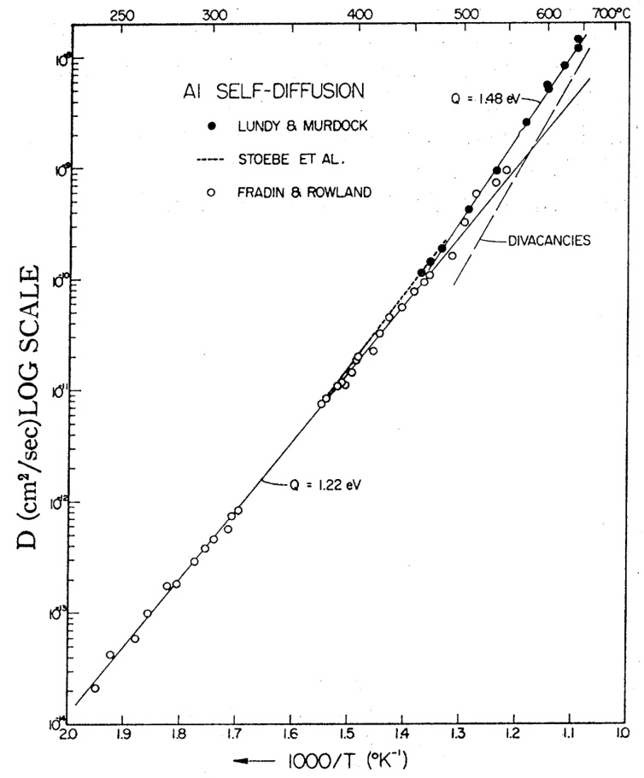
Understanding Diffusion and self diffusion ... On-line !
Aluminum, self-diffusion
⁶¹Cu (3.3h) diffusion in Cd saturated CdTe
Unknown Aluminum self diffusion
T_{diff} = 550 K
t_{diff} = 30 min
D=8.12x10⁻¹³cm²/s
NMR
Indirect
void shrinkage etc.
Isotope | t_{1/2} | Detection
³⁸Cl | 37.3 min | β⁻_{4800keV} ; γ_{2168keV}
¹¹C | 20.38 min | β⁺ ; γ_{511keV}
¹³N | 9.96 min | β⁺ ; γ_{511keV}
(¹⁵O) | 122 s | β⁺ ; γ_{511keV}
²⁹Al | 6.6 min | γ_{1273keV}
(T.G.Stoebe et al., Phys. Rev. 166 (1968) 621)
Single stable Al isotope: no SIMS measurements Unknown activation energy of self diffusion in Al
Unknown role of vacancies, di-vacancies at different temperatures.
Unknown Al diffusion in Al-based compounds

Slide 19
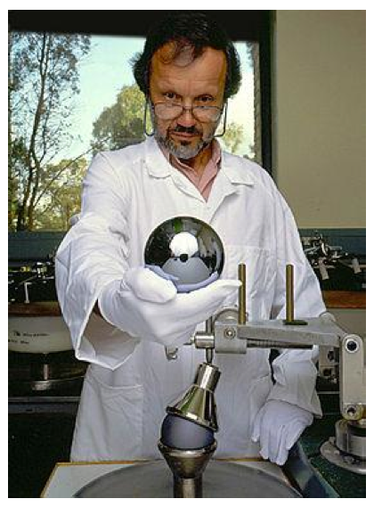
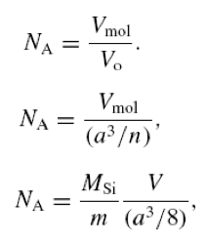
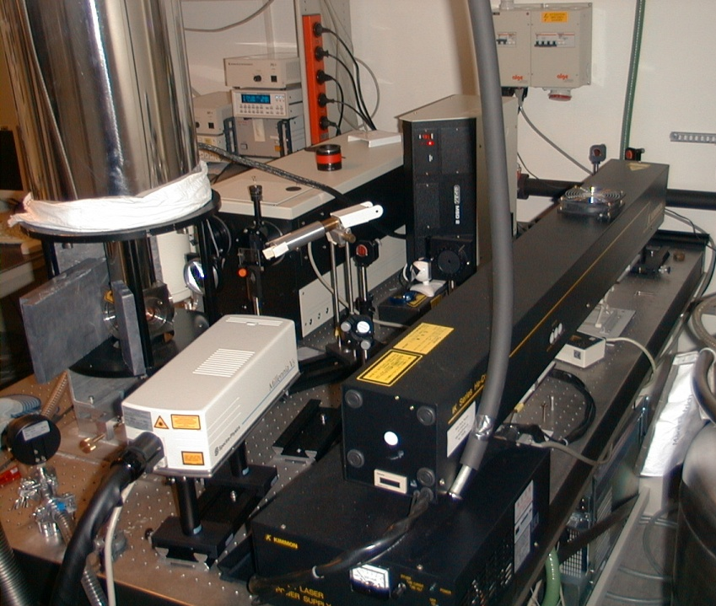

From the Avogadro Project : define Kg in terms of number of Si atoms...
Photo Luminescence – PL
Deep Level Transient
Spectroscopy (DLTS)
... to measure optical properties of mono-isotopic Si!
²⁸Si
Scientific American
295, 102 – 109 (2006)
LASER
HeCd (3,8 eV)
Nd:YAG (2,3 nm)
Diode (1,9 nm)
Cryostat
He-Bathcryostat (1,5 – 300 K) Closed cycle
Monochromator
Focus: 0,75 m
Gratings: 150 – 1800 l/mm
Detectors
CCD-camera (1,1 - 6,2 eV)
Ge-Diode (0,7 - 1,5 eV)
experimental tool for studying electrically active defects and concentration in semiconductors.

Slide 21
Emission Channeling of decay particles, on single crystals
(β⁻, β⁺, c.e., α)
electron emission channeling
@ ISOLDE - CERN
β decay
+
+
+
+
+
+
+
+
+
-
+
+
+
-
-
+
+
+
+
+
-
-
+
+
+
-
+
+
+
-
-
particle yield
angle

Slide 22
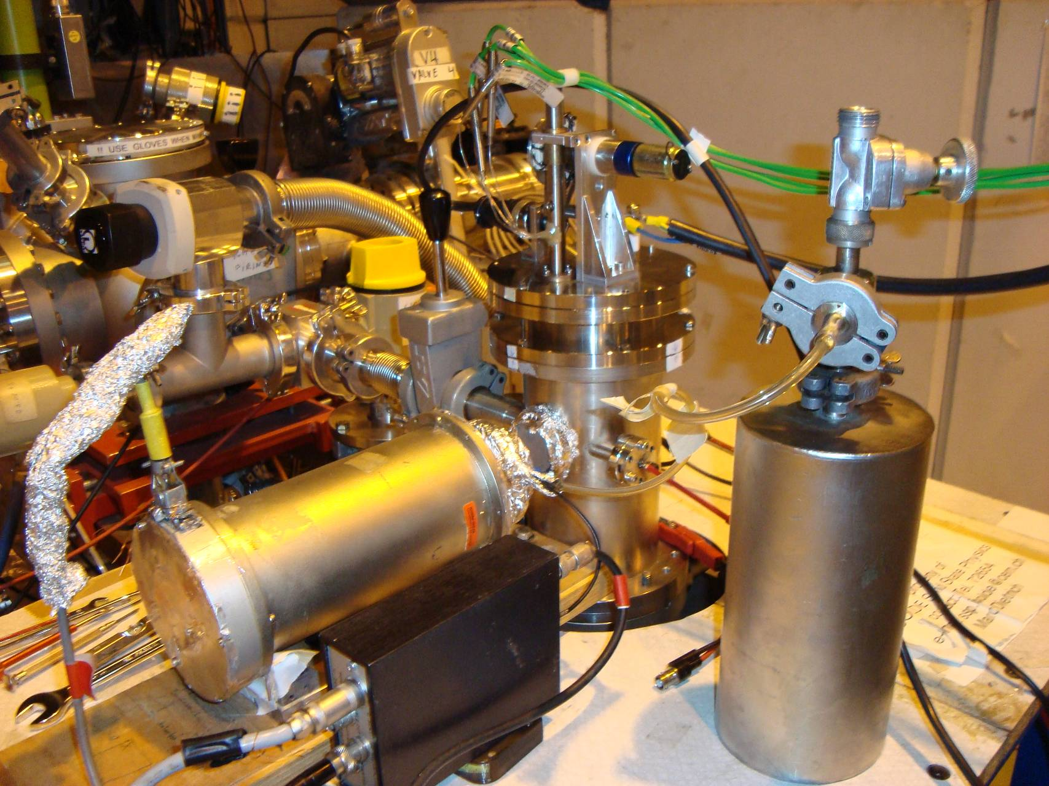
Hyperfine Interactions with Mossbauer spectroscopy
Development of 57Mn beam in late 1990s (with laser ionisation) brought about a new era in Mossbauer experiments at ISOLDE.
Incoming 40-60 keV ⁵⁷Mn⁺ beam
Intensity: ~2×10⁸ ⁵⁷Mn⁺/cm²
Implantation
chamber
Very clean, intense beam of ⁵⁷Mn (>3x10⁸ ions sec⁻¹)
Allows collection of single Mossbauer spectrum in ~ 3 mins.
Able to collect many hundreds over course of a 3 day run.
Allows low concentrations of probe atoms to be used (~10⁻⁴At%)
Sample
Mössbauer drive with
resonance detector

Slide 23

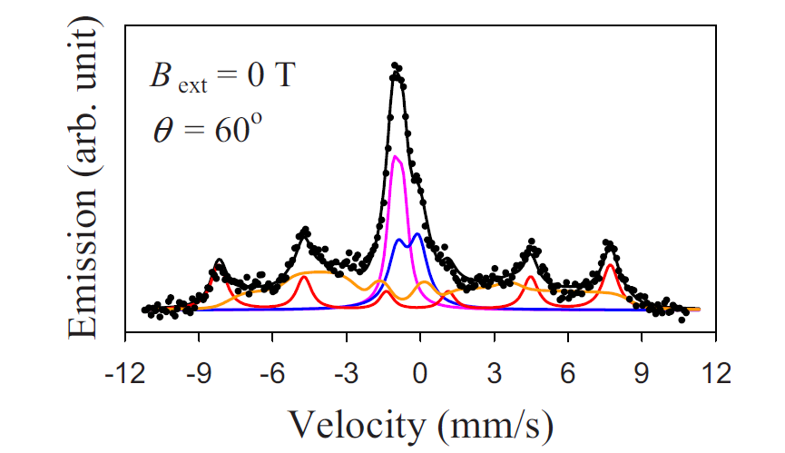
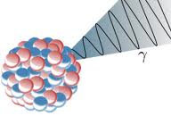
Fe: ZnO a ferromagnetic semiconductor?
(nope!)
ZnO C axis
6 fold spectrum: characteristic of magnetic structure (at room temperature!!!).
Results in an external magnetic field show that the spectrum shown to be a slowly relaxing paramagnetic system .
Gunnlaugsson et al (APL 97 142501 2010)
B
DOGRA, R.; CARBONARI, A. W.; MERCURIO, M. E.; CORDEIRO, M. R.; RAMOS, J. M.; SAXENA, R. N.
Search for Room Temperature Ferromagnetism in Low-Concentration Transition Metal Doped ZnO Nanocrystalline Powders Using a Microscopic Technique.
IEEE Transactions on Magnetics, v. 46, p. 1780-1783, 2010
After high-dose implantations, precipitates of Fe-III are formed. These form clusters yielding misleading information about the nature of magnetism in ZnO (as reported by many groups over the last number of years).
B
Gunnlaugsson et al APL 100 042109 2012

Slide 24
PAC results: no DMS at RT!!!!
SnO₂ PAC Spectra or TiO₂ PAC Spectra
No magnetic interactions observed under the measurements conditions
for intrinsic and doped SnO₂ or TiO₂
PAC reveals the presence of two different EFGs for each case: ^{111m}Cd(¹¹¹Cd), ¹⁸¹Hf(¹⁸¹Ta), ¹¹⁷Cd(¹¹⁷In) and ¹¹¹In(¹¹¹Cd), which are assigned to different local environments.
We stress the particular cases of ¹⁸¹Hf(¹⁸¹Ta) and ¹¹¹In(¹¹¹Cd), where a major fraction, f1 = 55-80 %, of probe atoms was assigned to substitutional Sn/Ti sites in the Sn/TiO₆ octahedral [Schell, J., CERN-THESIS-2015-229].
Universität Duisburg Essen – April -2016 Dr. Juliana Schell

Slide 25
RECENT DEVELOPMENTS
Bio-physics applications
a commitment for the future based on facts !

Slide 26
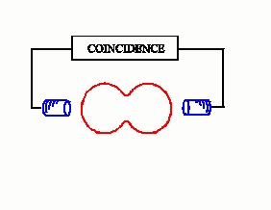
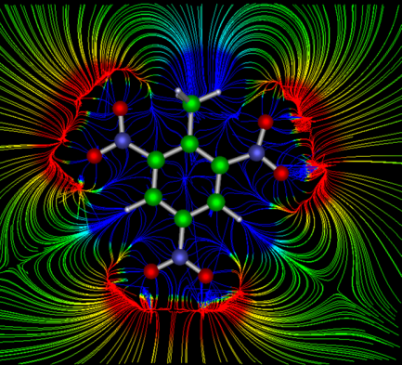
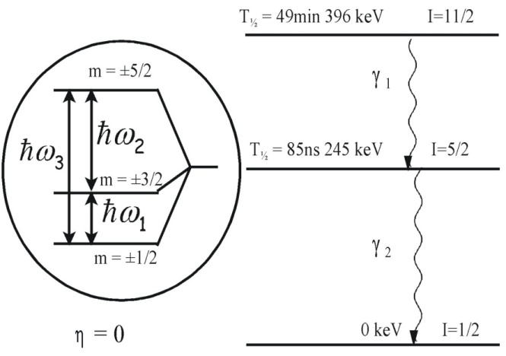
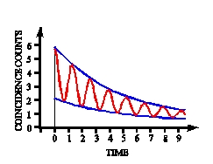

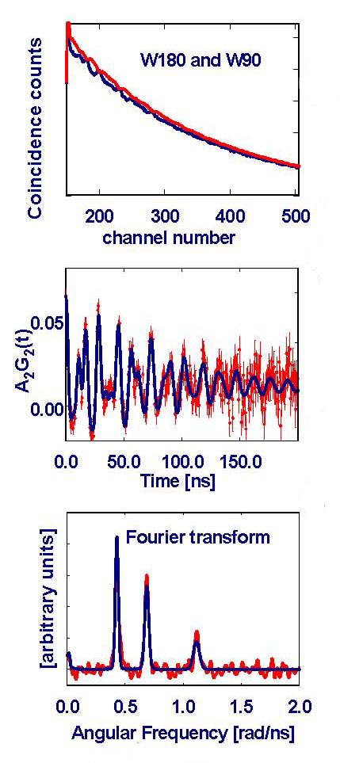
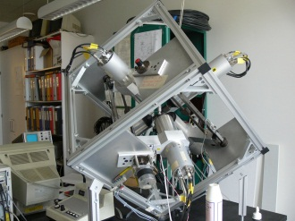
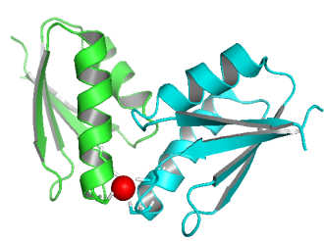
Perturbed angular correlation (PAC) Spectroscopy
applied to BIOPHYSICS
Fourier transform
Least χ² analysis
ω_{Q} and η
+
BASIL model
QM calculations
6·180º spectra and 24·90º spectra
Notes:
26

Slide 27

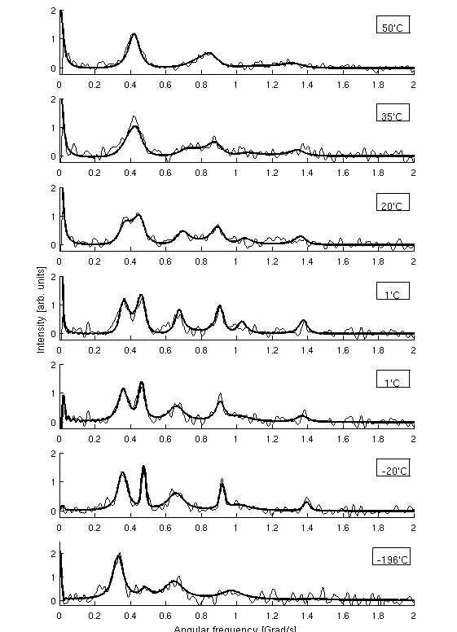
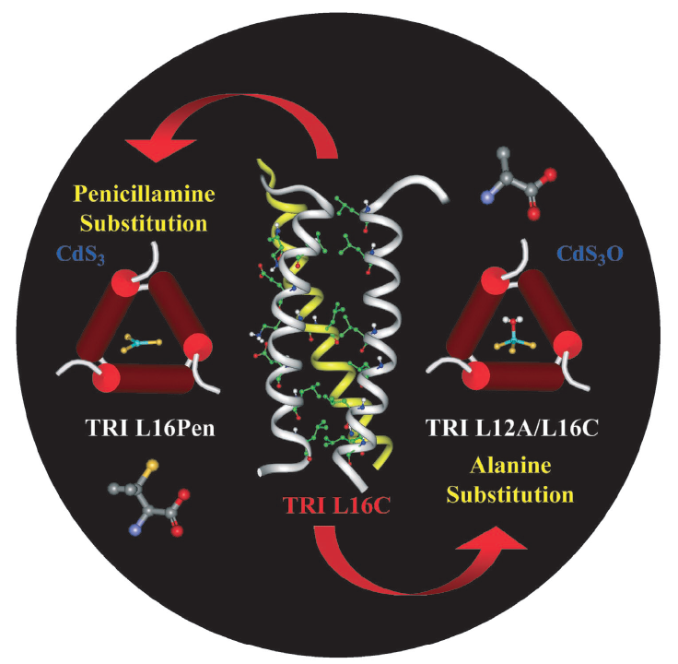
^{111m}Cd PAC (48M) - De novo designed heavy metal
Ion binding proteins: ns dynamics
P(ω)
^{111m}Cd-PAC
50 ºC
35 ºC
20 ºC
1 ºC
1 ºC
-20 ºC
-196 ºC
Temp [ºC] | τ₁ [ns] | τ₋₁ [ns]
1 | 52 | 48
20 | 42 | 36
35 | 28 | 20
50 | 19 | 12
Stachura et al. Manuscript Science in preparation
ω(Grad/s)

Slide 28
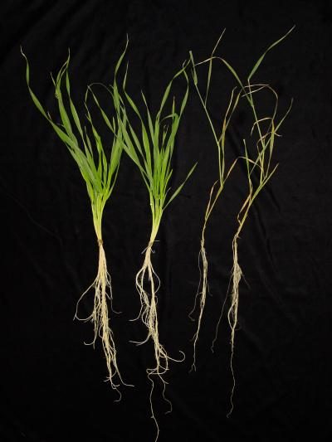
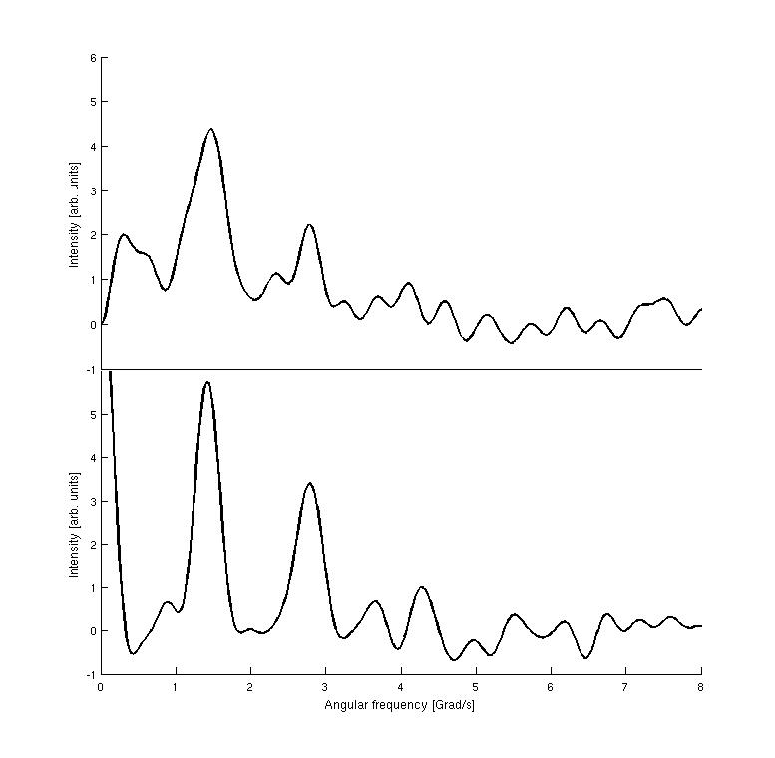
In vivo experiments Hg(II) binding to barley
^{199m}Hg PAC (42M)
Adolph et al. Chem. Eur. J., 2009, 15, 7350 – 7358
P(ω)
Whole barley plant
Homogenised barley leaves
ω(Grad/s)
5-7 days-old plants
Plant inserted into test tube.
Fast uptake of Hg(II) (<1h)
Bound to large molecules, similarities to HgS₂ compounds
Notes:
28

Slide 29
RECENT DEVELOPMENTS
Life Science applications
a commitment for the future based on facts !

Slide 30
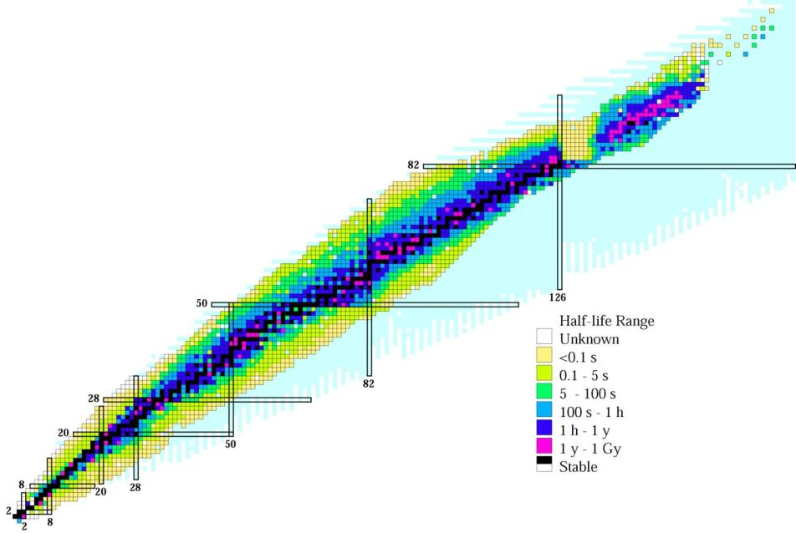

The chart of nuclides – nuclear medicine perspective
Radionuclides for diagnosis and therapy
SPECT
PET
Therapy
²⁰¹Tl
^{186,188}Re
¹⁷⁷Lu
¹⁵³Sm
¹³³Xe
¹²³I
¹³¹I
¹¹¹In
^{99m}Tc
⁶⁸Ga
⁹⁰Y
⁶⁷Ga
⁸⁹Sr
¹⁸F
¹¹C
“exotic” isotopes
Notes:
We know today over 3000 radioisotopes. Thereof over 100 have suitable properties (half-life, decay mode, chemistry) for nuclear medicine applications. However, at present only a small subgroup is actually being used.
While for general purpose diagnostics applications 99mTc (SPECT) and 18F (PET) have indeed close-to-optimum properties, optimization of therapy will require new radioisotopes.

Slide 31
Immunology approach
Target
(antigen)
Antibody
Roelf Valkema, EANM-2008.
Notes:
Cancer cells are often characterized by an overexpression of specific receptors (antigens, peptide receptors, etc.) on their cell surface. If these receptors are not or little present on normal human cells one can use them for a targeted therapy approach. A pure biotech approach would be the injection of the corresponding conjugates (e.g. anti-CD20 antibody to target CD20 antigens or somatostatin analogues to target SSR2 peptide receptors or ….) in the hope these biomolecules can trigger a biological reaction delaying the growth of the cancer cells or even inducing cell death. However, often it is difficult to find such a “special agent” who can find the bad guy and kill him…

Slide 32

Multidisciplinary collaboration to fight cancer
Target
Receptor
Peptide, antibody, etc.
Radionuclide
Linker
Immunology
Structural biology
Coordination chemistry
Nuclear physics and radiochemistry
Roelf Valkema, EANM-2008.
Notes:
… In this case one has to split the function of “find the bad guy” and “kill him”. A biomolecule that is already selective enough for targeting will be combined with a radioisotope. Optimizing the functions of “targeting” and “killing” separately allows a considerable improvement in overall efficacy. However, it is no longer a pure biotech challenge but requires multidisciplinary collaboration, i.e. coordination chemistry to optimize the linker (chelators to hold radiometals in a “cage”) and nuclear physics and radiochemistry to provide the optimum radionuclide in high quality.

Slide 33
Radionuclides for therapy
Radio-nuclide | Half-life | E mean (keV) | Eγ (B.R.) (keV) | Range
Y-90 | 64 h | 934 β | - | 12 mm
I-131 | 8 days | 182 β | 364 (82%) | 3 mm
Lu-177 | 7 days | 134 β | 208 (10%) 113 (6%) | 2 mm
Tb-161 | 7 days | 154 β 5, 17, 40 e⁻ | 75 (10%) | 2 mm 1-30 μm
Tb-149 | 4.1 h | 3967 α | 165,.. | 25 μm
Ge-71 | 11 days | 8 e⁻ | - | 1.7 μm
Er-165 | 10.3 h | 5.3 e⁻ | - | 0.6 μm
Established
isotopes
Emerging isotopes
localized
radiation
Notes:
The historic therapy isotopes 131I and 90Y were first because of specific applications (131I for thyroid) and ease of large-scale production (fission), but their properties are far from ideal: hard gamma rays for 131I require isolation of the patient, long range betas of 90Y make collateral damage outside tumors. Today there is a strong trend towards new therapy isotopes with improved properties and to related diagnostic isotopes for specific applications.

Slide 34
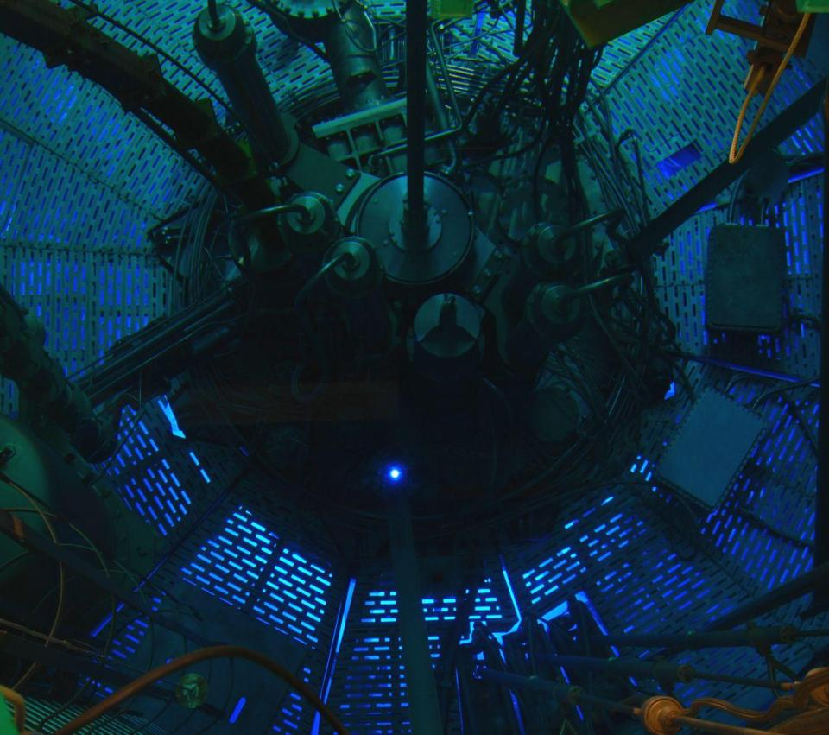
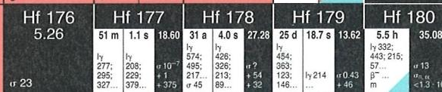
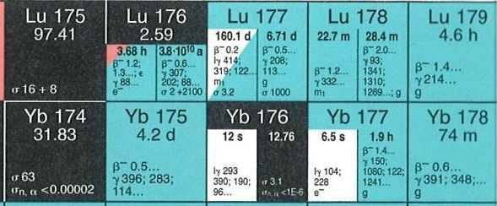

Production of non-carrier-added ¹⁷⁷Lu
Irradiation in high flux reactor (e.g. ILL Grenoble),
then chemical separation of ¹⁷⁷Lu from stable Yb.
Notes:
At present the best commercially available therapy isotope is 177Lu. “quasi-pure” 177Lu (non-carrier added, i.e. nearly without stable isotopes) is obtained by an “indirect production”. Enriched 176Yb is partially transmuted in a high flux reactor to 177Yb that decays quickly to 177Lu. The latter is chemically separated from the target material. The complete chemical separation of microamounts of 177Lu from macroamounts (grams) of 177Yb is very challenging due to the chemical similarity of both neighboring lanthanides. Only recently this radiochemical challenge was solved at large scale and now high activities (TBq per week) are available.

Slide 35
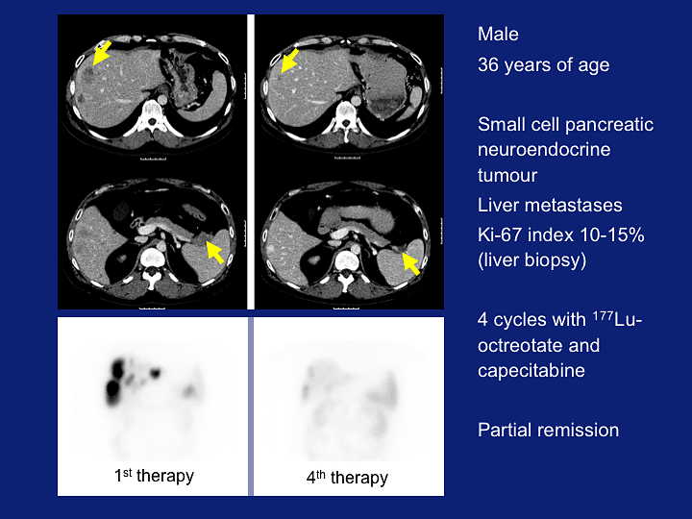
Roelf Valkema, EANM-2008.
Notes:
Dark spots on FDG scan bottom left are from advanced pancreatic cancer and its liver metastases.
After treatment with 177Lu+peptide these are gone (bottom right).

Slide 36
Radionuclides for therapy
Radio-nuclide | Half-life | E mean (keV) | Eγ (B.R.) (keV) | Range
Y-90 | 64 h | 934 β | - | 12 mm
I-131 | 8 days | 182 β | 364 (82%) | 3 mm
Lu-177 | 7 days | 134 β | 208 (10%) 113 (6%) | 2 mm
Tb-161 | 7 days | 154 β 5, 17, 40 e⁻ | 75 (10%) | 2 mm 1-30 μm
Tb-149 | 4.1 h | 3967 α | 165,.. | 25 μm
Ge-71 | 11 days | 8 e⁻ | - | 1.7 μm
Er-165 | 10.3 h | 5.3 e⁻ | - | 0.6 μm
cross-fire
Estab-
lished isotopes
Emerging isotopes
R&D isotopes:
supply-limited!
localized
Modern, better targeted vectors require shorter-range radiation
⇒ need for adequate (R&D) radioisotope supply.
Notes:
While 177Lu has ideal properties to fight small metastases (average range of betas 0.2mm, maximum range 2mm), future treatments targeting individual cancer cells (i.e. circulating cancer cells even before they create metastases and in non-solid cancers such as leukemia) require still shorter-range radiation. This can be achieved with alpha emitters (about 1 cell diameter range, high probability of double strand break by a single alpha) and by Auger emitters.

Slide 37
Radioisotopes for targeted alpha therapy
Radio-nuclide | Half-life (h) | Advantage | Problem
Tb-149 | 4.12 | Known (bio)chemistry | Availability
Pb-212 | 10.6 | Availability (recycled from U-fuel ²²⁸Th) | Release of daughter?
Bi-212 | 1.01 | Known (bio)chemistry Availability | Short half-life
Bi-213 | 0.76 | Known (bio)chemistry | Short half-life Availability
At-211 | 7.22 | Half-life | Challenging (bio)chemistry
Ra-223 | 274 | Half-life Availability | Only for bone metastases (similar chemistry to Ca)
Ac-225 | 240 | Half-life Known (bio)chemistry | Release of daughters? Availability
Notes:
There are only few potential radioisotopes for alpha therapy, each with limitations linked to bio-chemistry, half-life or availability:
1. In-vivo chemistry:
The trivalent metals (Tb, Bi, Ac) behave similar to presently used elements (Ga, Y, In, Lu) and can be labeled to existing vectors (=chelators for peptides and antibodies).
Radium behaves chemically like calcium and will metabolically target bone metastases but cannot be linked stably to vectors.
Astatine has a very difficult biochemistry (sometimes iodine-like, sometimes metal-like) that can only be studied in trace quantities with alpha emitters (no stable At isotope).
2. Half-life:
Bi-212 and Bi-213 are very short-lived, useful for “loco-regional” applications (i.e. direct injection into tumor) but challenging for systemic applications (full body).
Longer-lived Pb-212 produces Bi-212 in the body (“in-vivo generator”) but one has to make sure that Bi-212 stays linked to the vector and is not released and makes collateral damage elsewhere.
Ac-225 decays by a chain of 4 alphas and two betas via 6 different elements. It is challenging to assure that the daughters stay linked to the vector and are not released and make collateral damage elsewhere. Also Ra-223 decays by a chain of alphas and betas but the first two are short-lived and do not diffuse far from the bone metastasis before decaying.
3. Availability:
Ra-223, Pb-212 and Bi-212 are (becoming) available in large-scale.
Only small quantities of Ac-225 and Bi-213 daughter are available today, spallation production with GeV protons is considered to make more (> extraction from used EURISOL direct UCx targets possible!).
At-211 available from few cyclotrons that have 30MeV alpha beams [209Bi(a,2n)], large-scale application would require network of such cyclotrons.
Tb-149 is presently only available at ISOLDE but could be produced in huge quantities at EURISOL.

Slide 38
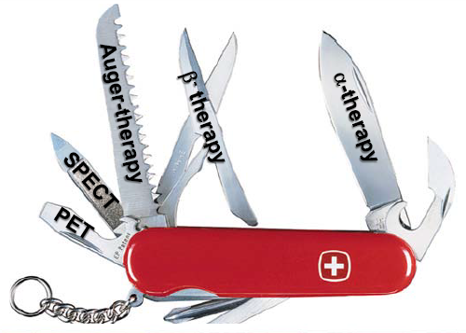
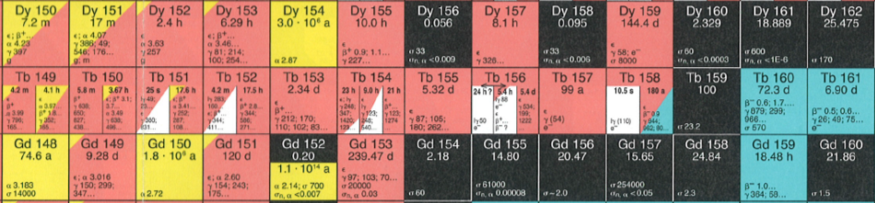
Terbium: a unique element for nuclear medicine
Notes:
In chemotherapy all patients get a prescribed treatment, all patients suffer from side-effects but only few respond to the therapy (reduction/elimination of tumor). These “responders” are only identified after the treatment. In contrast therapy with radioisotopes is a good example of “personalized medicine”. First the vector is marked with a diagnostic isotope (PET/SPECT) to measure if the individual patient will really respond to the treatment (i.e. if the chosen vector is selectively taken up by his cancer cells), only then the same vector labeled with a therapeutic isotope (activity according to the measured uptake) is injected. The high success rate of radioisotope therapy is due to the fact that only those patients are treated that will profit of it! To minimize uncertainties due to different bio-chemical behavior of diagnostic and therapeutic isotope “matched pairs” of diagnostic and therapeutic isotopes of the same element are particularly useful. Terbium is unique since it has suitable isotopes for all nuclear medicine modalities:
155Tb: a SPECT isotope
152Tb: a PET isotope
149Tb: an alpha emitter
161Tb: a beta- and Auger emitter
Thus fundamental R&D can be performed, e.g. to clearly measure in-vivo the relative efficacity of alpha versus beta- versus Auger electrons.
[Note in case of questions: obviously 161Tb emits always both, b- and Auger together but one can either compare an internalizing with a non-internalizing vector or compare 161Tb with 177Lu that behaves bio-chemically identically and has the same half-life and beta- range as 161Tb.]

Slide 39

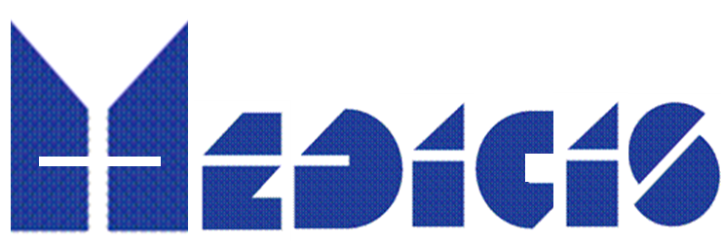
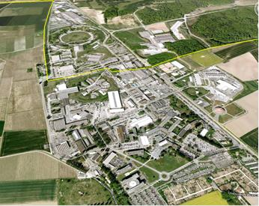

CERN-MEDICIS:
Medical isotopes collected from ISOLDE
R. Catherall, M. Dias, T. Giles, Z. Lawson, S. Marzari, T. Stora (CERN)
Dr. Forni (Clin. Carouge),L. Vouga, Prof. P. Morel, Prof. L. Buehler, Prof. Y. Seimbille, Prof. O. Ratib (HUG, Geneva), Prof. D. Hanahan (ISREC-EPFL, Lausanne), Prof. J. Prior, Dr. F. Buchegger (CHUV, Lausanne), Prof M. Huyse, Prof. P. van Duppen (Univ. Leuven), Prof. S. Lahiri (SINP, Kolkata)
CERN
KT Fund
+ Foundations, FNS,
In prep.
HUG
Foundation
In-kind KULeuven
CERN
152Tb
From
ISOLDE
Prostate
Cancer
cells
Expected to start end 2015

Slide 40





Irradiation station commissioned with beam
Proton Beam
50 60 kV
Cover grounded
Tests with protons:
Done successfully !
Thierry.Stora@cern.ch

Slide 41
The (potential) role of ISOL in nuclear medicine
Samples of R&D isotopes which are not commercially available or easily producible by other means.
Isotopes with ultimate specific activity for R&D, e.g. studies of efficacy versus specific activity.
Isotopes that are best produced by spallation (¹⁴⁹Tb,…).
Existing ISOL beams are sufficiently intense for preclinical studies, in certain cases even for clinical studies.
How to organize R&D with RIBs in nuclear medicine?
Physicists are used to “travel to the isotopes”,
but isotopes must “travel to physicians and patients”.

Slide 42
CONCLUSIONS
“SSP” of EXOCTIC radioactive isotopes
Specific areas are identified:
Life Sciences Materials Nuclear Chemistry...
The methods follow the needs with progressing quality...
Viability and Visibility of “Applications”
depend at the long term from diversifying and optimizing
RIB infrastructures with:
Dedicated BEAM TIME and BEAM LINES
Dedicated LABORATORY SPACE
...the future of “Applications” depend very much on the concept of the next generation of RIB facilities ....

Slide 43




Acknowledgments
To the organizers !
... to colleagues and collaborators!
R. Vianden
D. C. Lupascu
M. Deicher
A. Fenta
H. Gunnlaugsson
T. E. Molholt
K. Johnston
L. B. S. Hemmingsen
U. Köster
M. Kowaslka
A. L. Lopes
J.G.M. Correia
M. Stachura
T. Stora
U. Wahl
and The ISOLDE collaboration

